Slide 1

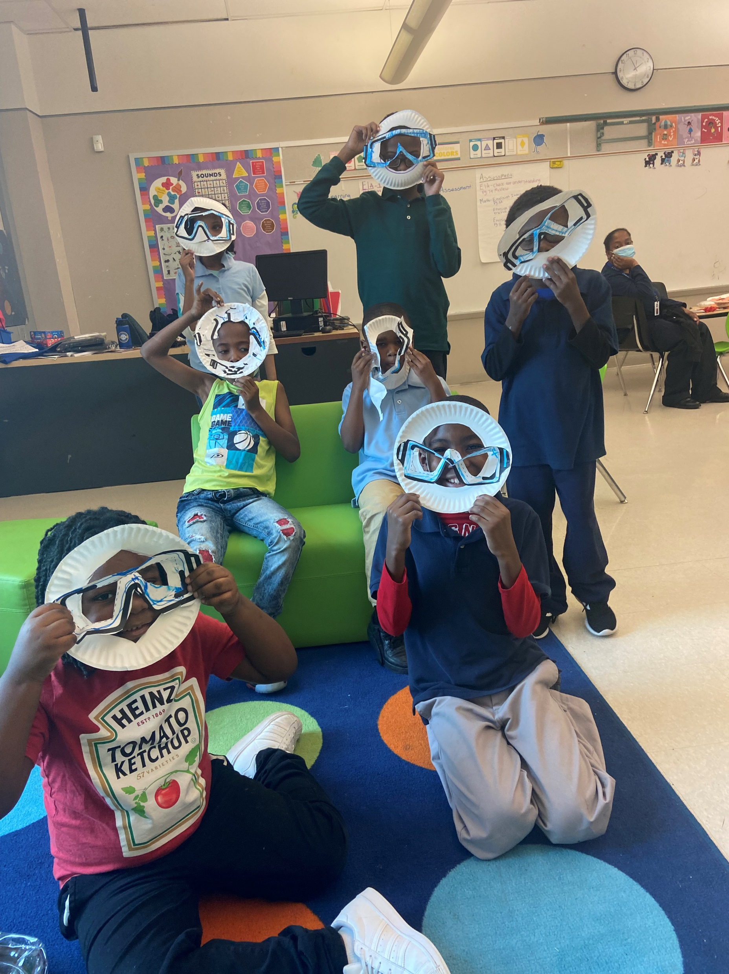
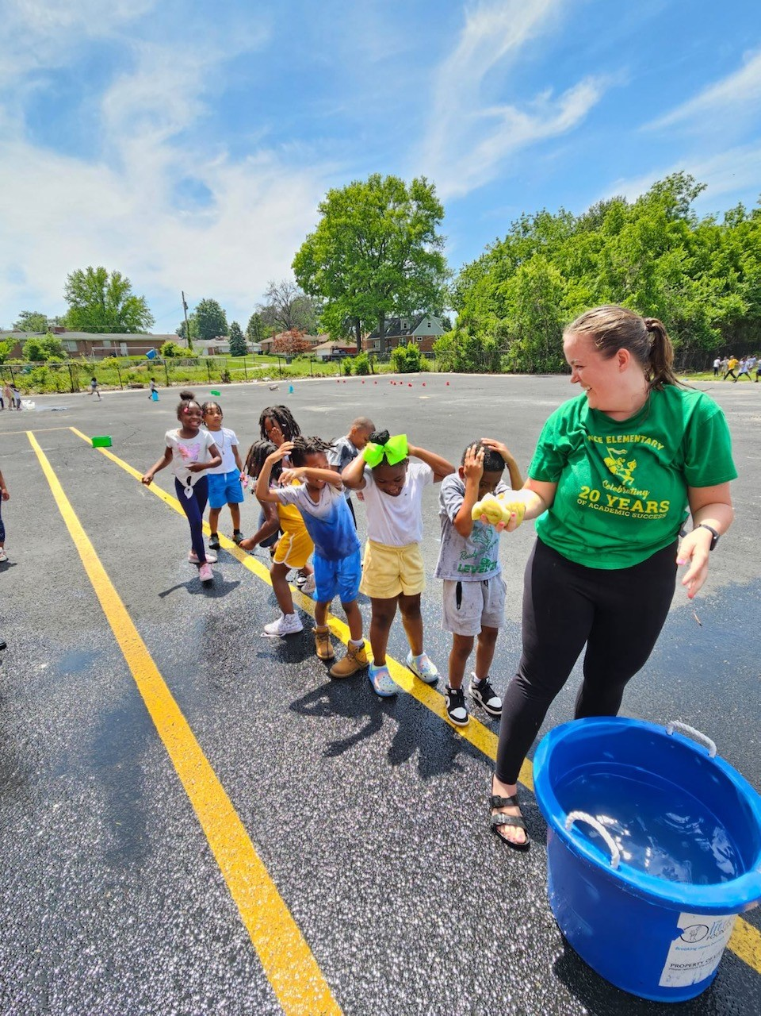


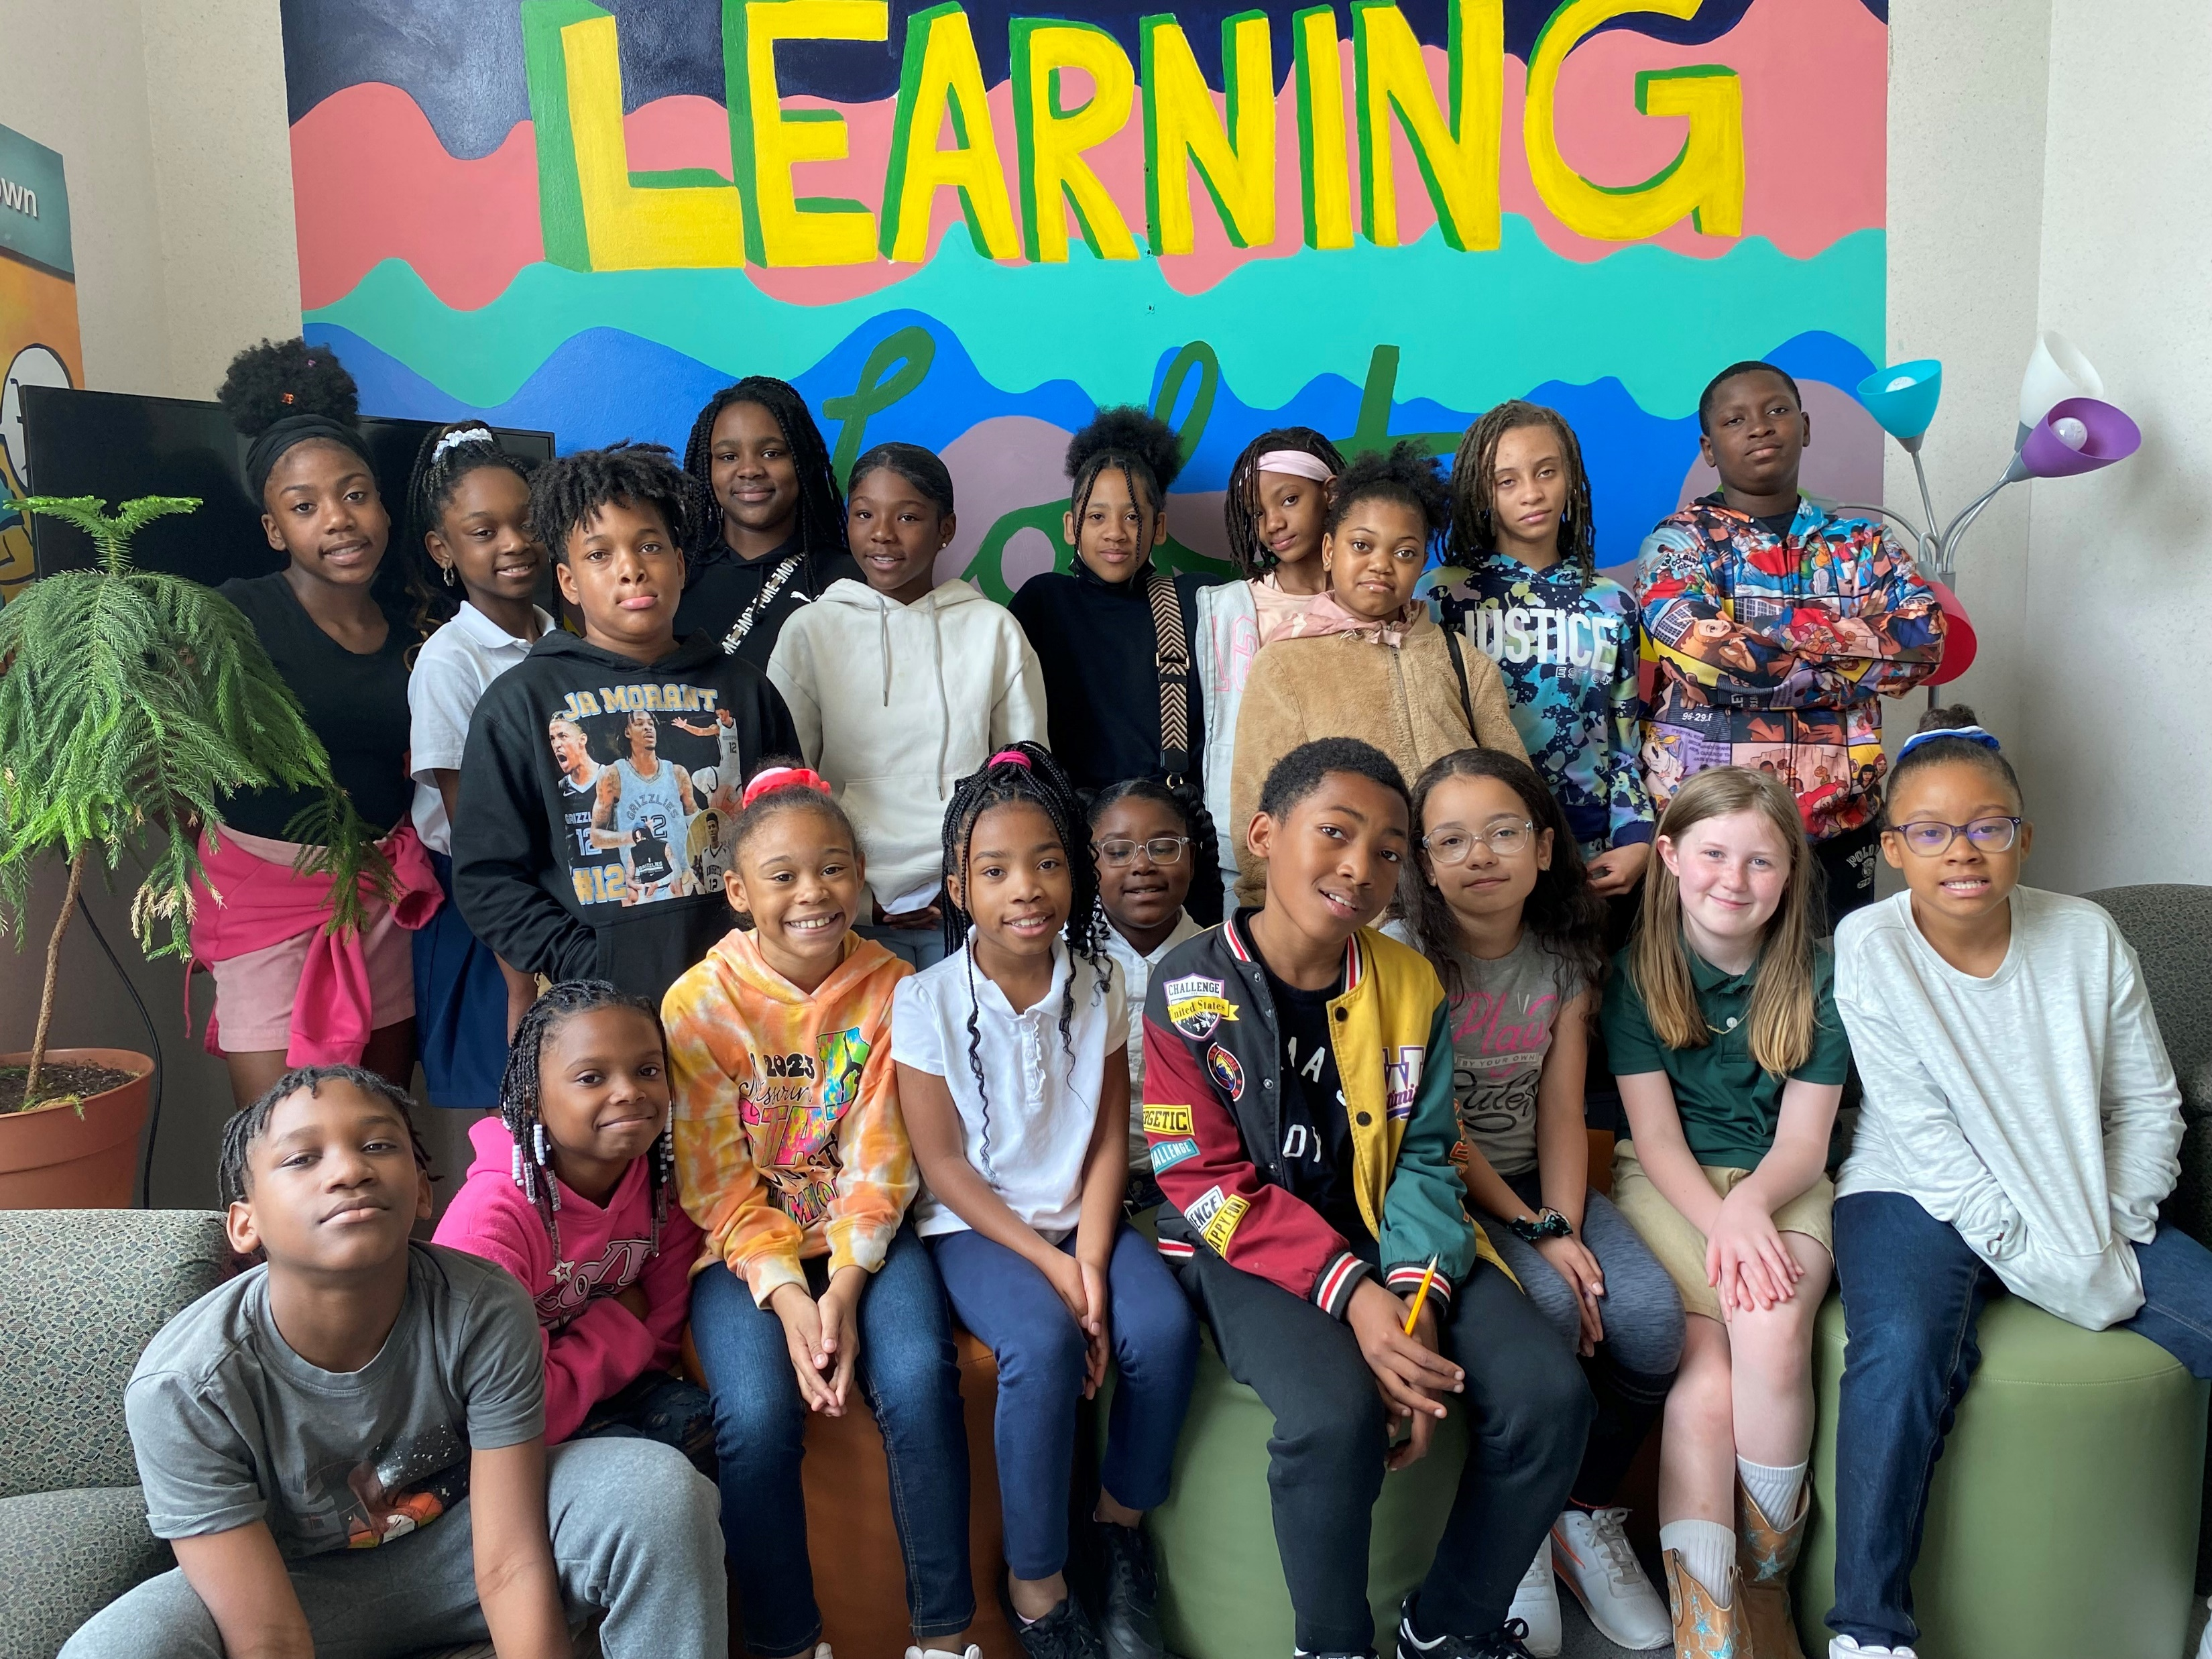
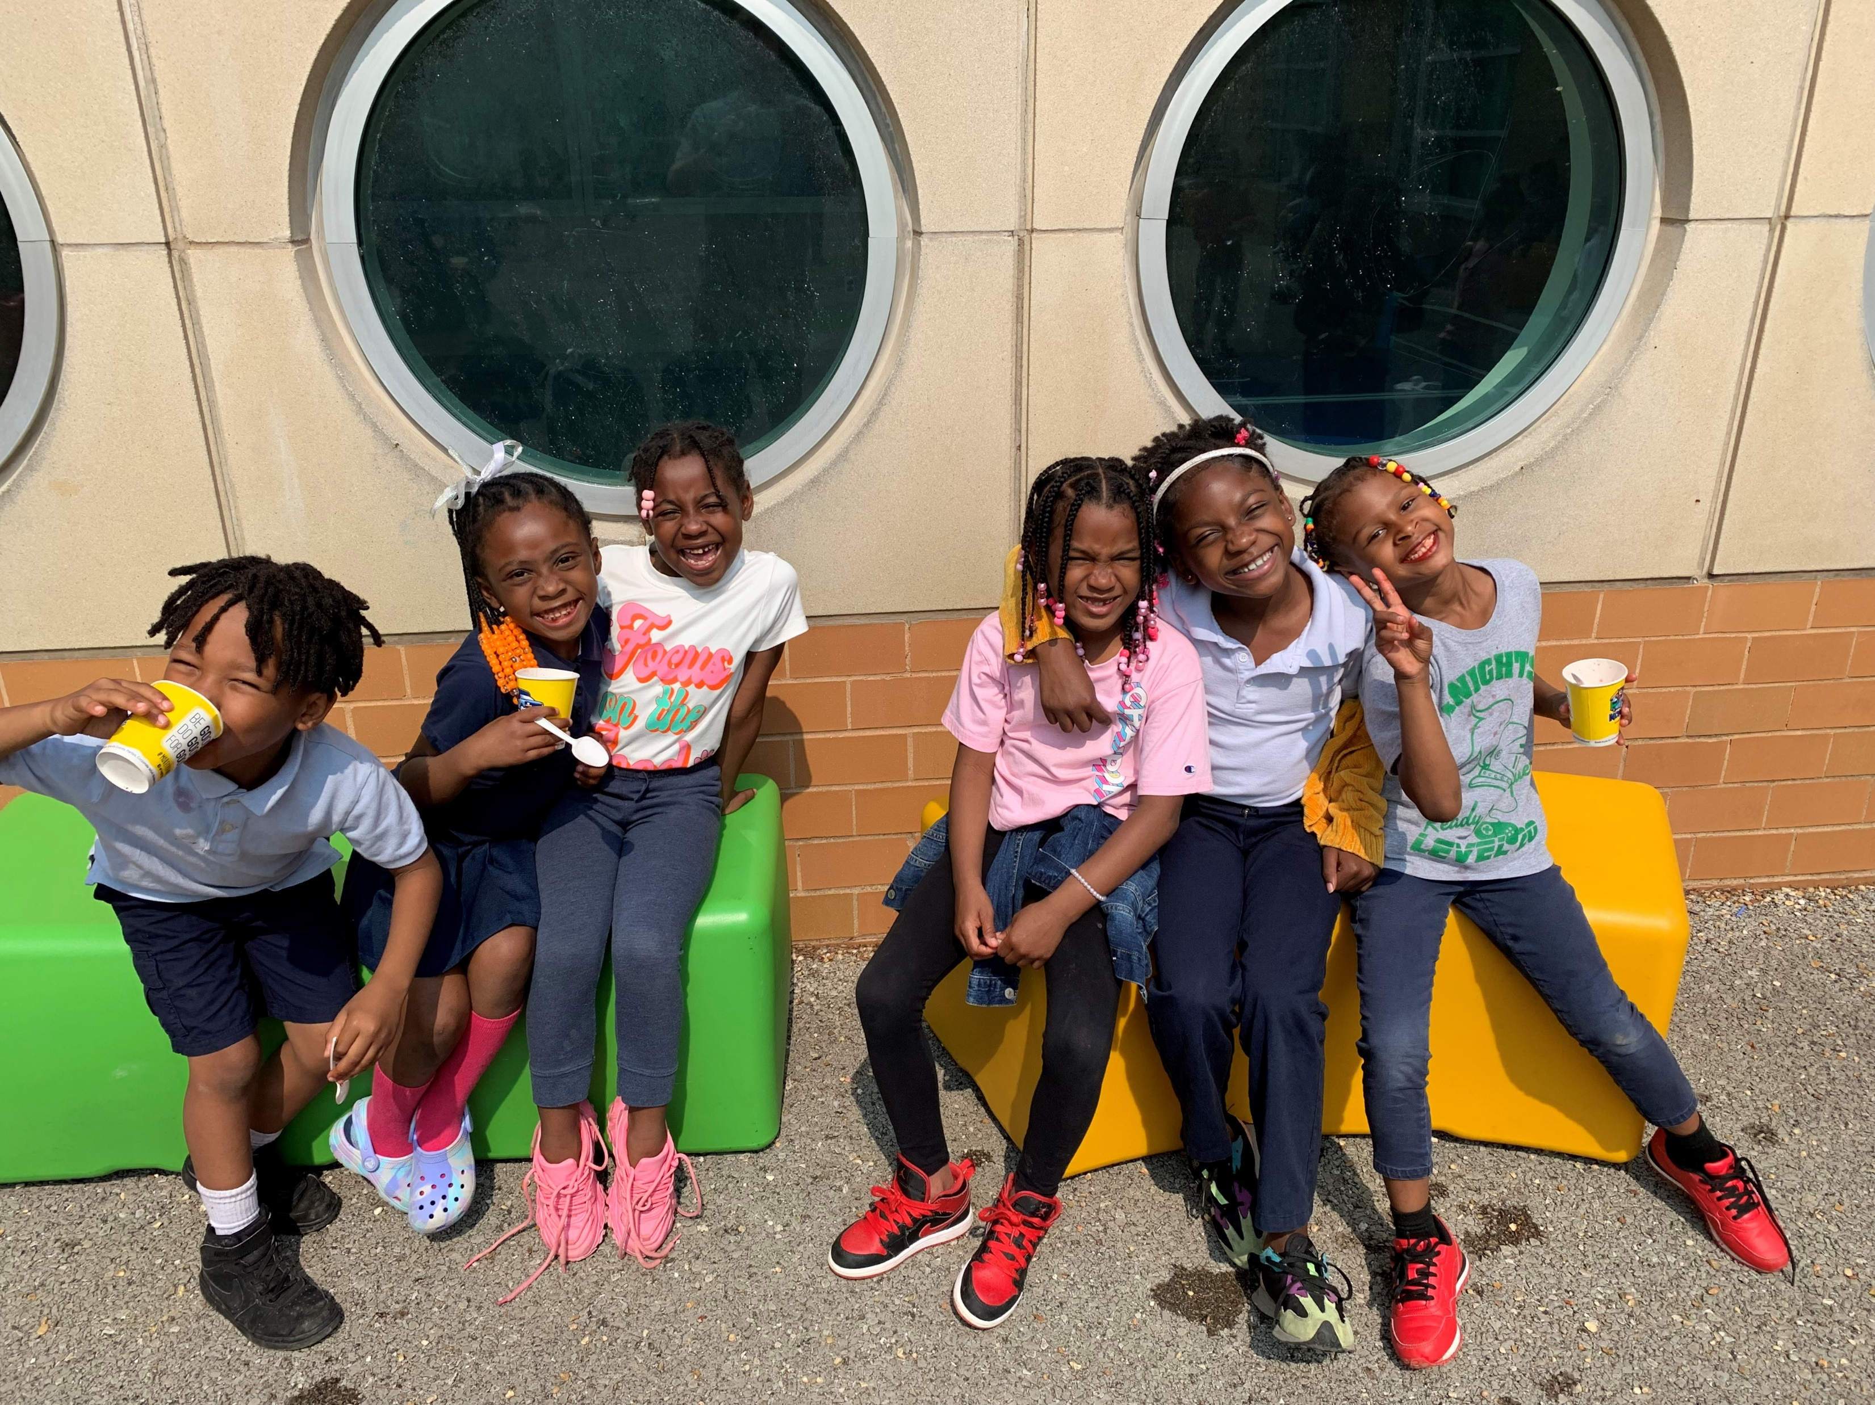
Title 1 Evaluation Meeting Wednesday, March 6th, 2024
Dr. Tyler Archer, Principal

Slide 2

Our Mission, Vision & Core Values
Our Mission:
Our Vision:
The mission of Earl Nance Sr. Elementary School is to empower students to have a voice within their community. All students will achieve success in a school environment that promotes literacy, equity, innovation, social justice, voice, and belonging.
Nance Elementary students will be empowered as change agents to make a positive impact on the world.

Slide 3
Transforming the Future of Our Community
To empower our students as global leaders, we must first prepare our students to transform the future of our community. At Nance Elementary, we will transform the future of our community by:
Creating a positive environment where every child belongs, humanity is valued, and joy is evident.
Providing high-quality, rigorous, culturally responsive instruction to every student, every day.
Supporting students and families by meeting needs that impact their ability to succeed.
Connecting our students to opportunities that prepare them for the future and broaden their horizons.
Challenging systemic racism and inequities by constantly reflecting on policies and practices that disadvantage students of color.
Creating a positive environment
Providing high-quality, rigorous, culturally responsive instruction.
Supporting students and families by meeting needs.
Connecting our students to opportunities
Challenging systemic racism and inequities

Slide 4
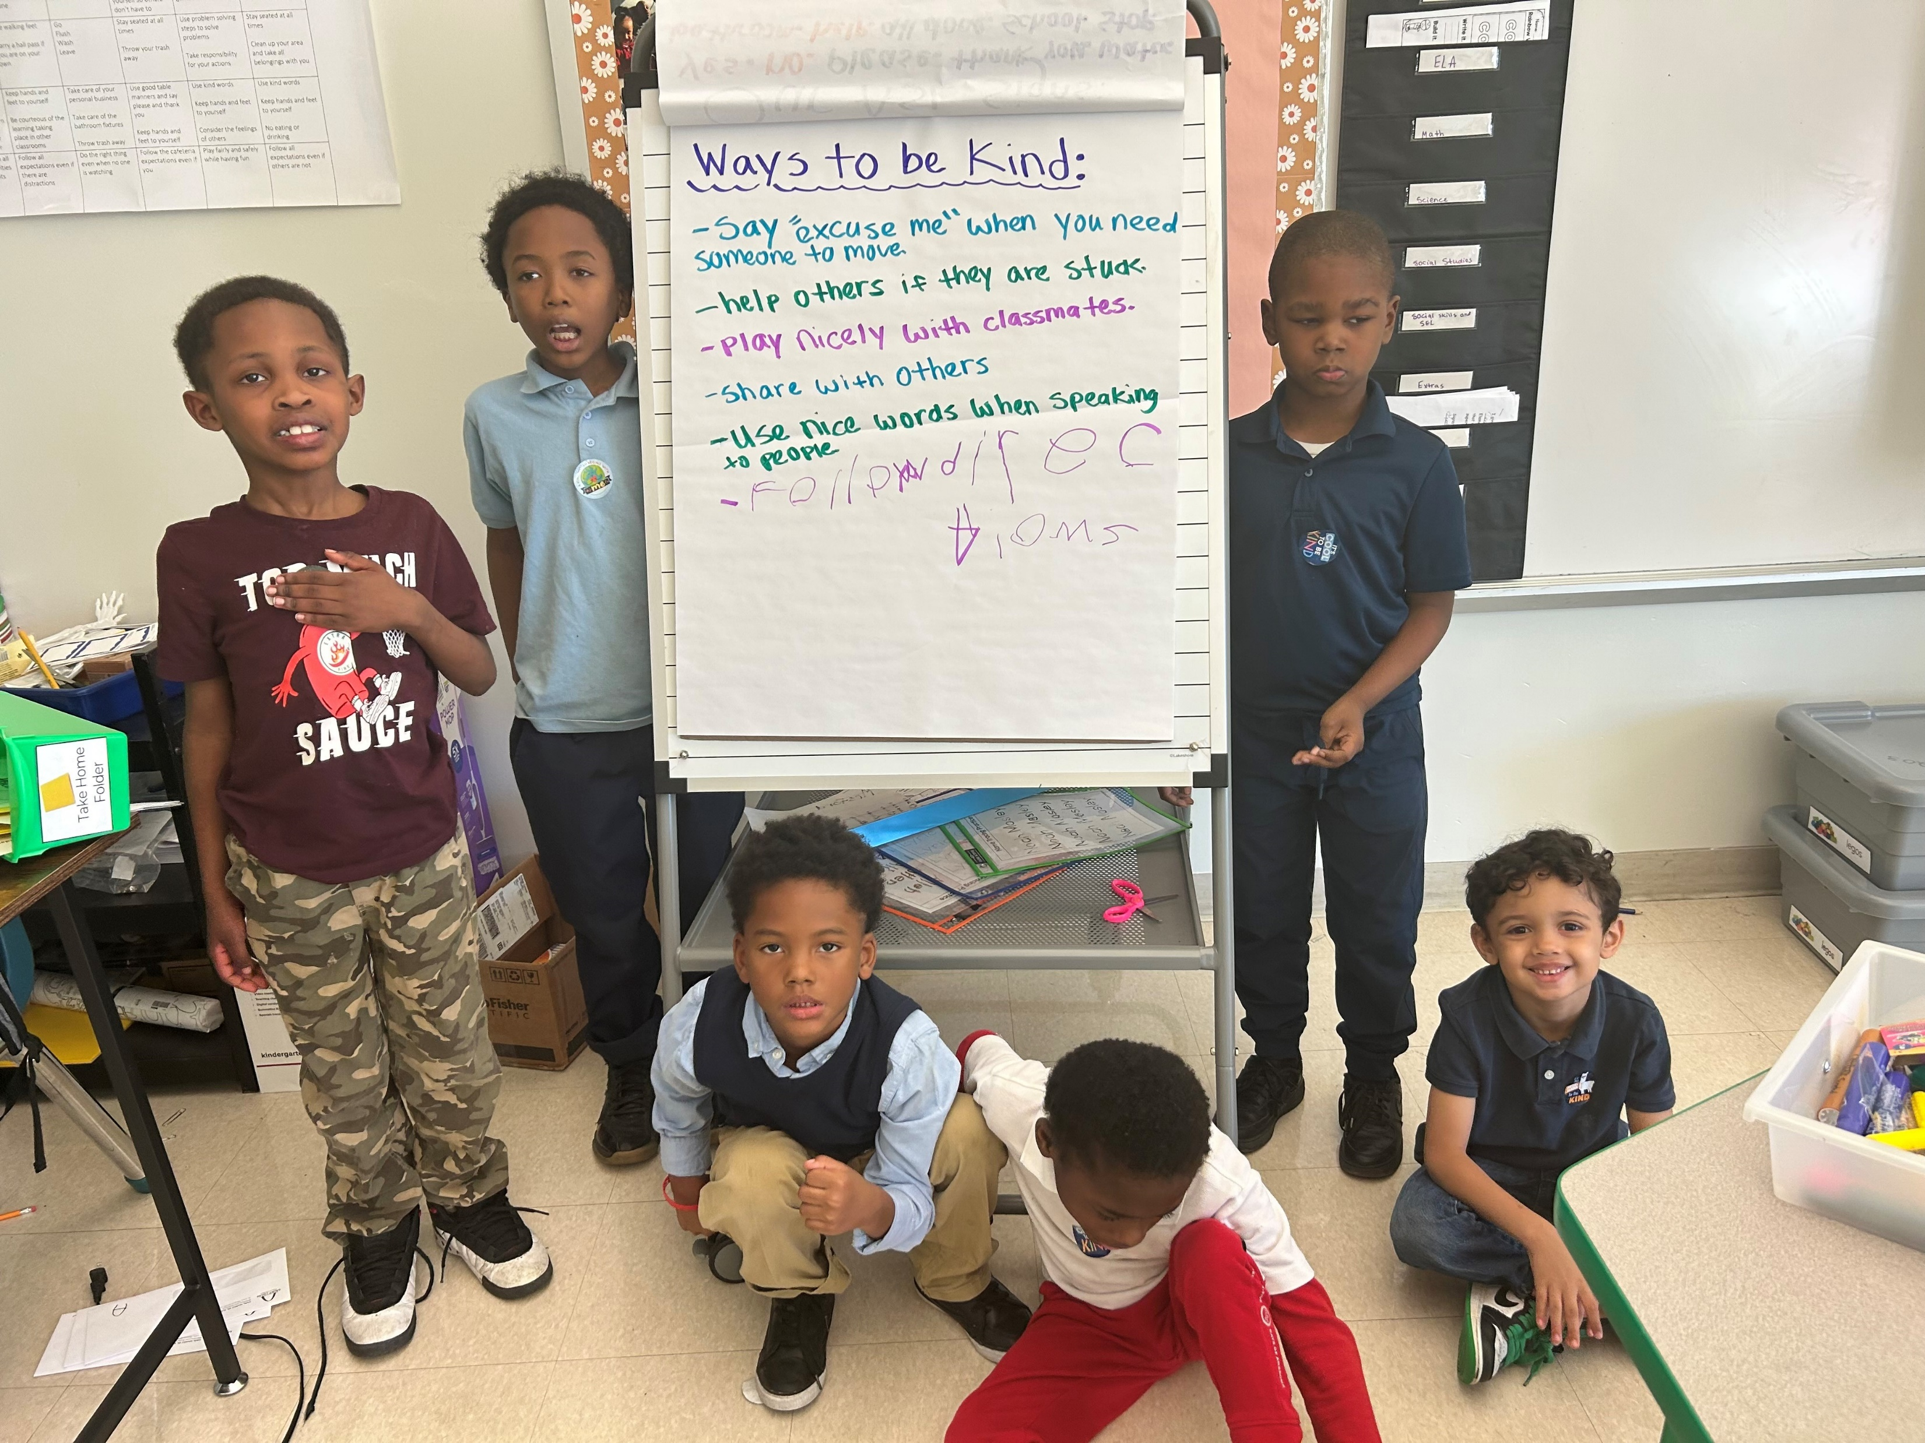
Title I Team Members
Dr. Tyler Archer, Principal
Toccara Montgomery, Assistant Principal
Tifani Allen, Academic Instructional Coach
Shantelle Williams-Green, Family & Community Specialist
Marilyn Jackson, Elementary Counselor

Slide 5
Annual Evaluation Meeting Agenda
Review Student Achievement Data- Dr. Archer
Review Parents' Surveys & Evaluations- Ms. Green
Program Strengths/Weaknesses Need Assessments- Dr. Archer
School Parent Compact- Ms. Green
Recommendations and Revisions of Title I.A Services- Ms. Green & Dr. Archer
School Parent and Family Engagement Policy- Ms. Green & Dr. Archer
Notes:
You may want to change the clip art to a picture from your school

Slide 6
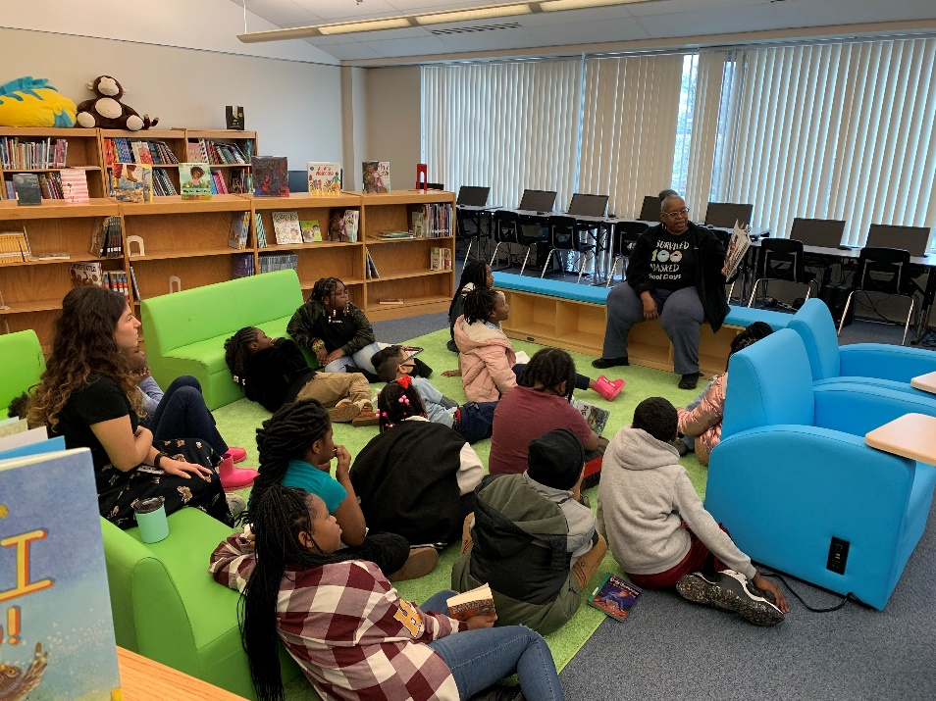
What is Title I?
Title I is a federally funded program that offers additional federal dollars to support schools in areas with high free-reduced lunch percentages. Our breakfast and lunch programs are free to all SLPS students.
Notes:
You may want to have a program eligibility form to show parents.

Slide 7
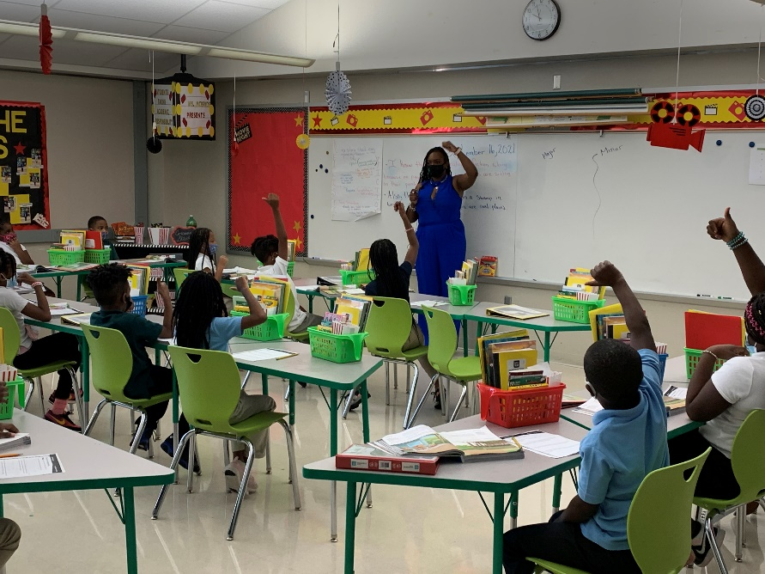
How does our school use Title I funds?
Salaries + benefits
Small equipment
Textbooks
Supplies
Other
Parent Involvement
In addition, Title I district funds pay for our Academic Instructional Coach, and the Family and Community Specialist
Notes:
Please fill in your budget information for Title I dollars only.
Example of budget justification: State testing along with short cycle assessment shows that 3rd grade is having major problems with math. The school Title I plan is designed to provide services to those students in greatest need. An additional 3rd teacher has been hired to lower PTR, and a Bilingual Educational Assistant will offer support to non-English speaking students. Third grade progress will be monitored all year with bi-monthly meetings and review of short cycle testing. Title I funds have also been used to buy additional math kits for students to practice at home. The whole school will benefit from hands on math tutoring after school and monthly meetings with parents using hands-on manipulatives they take home.
If your school is using Waterford, Success Maker, AVID, America’s Choice - District Title I funds may have been used to fund those too.

Slide 8
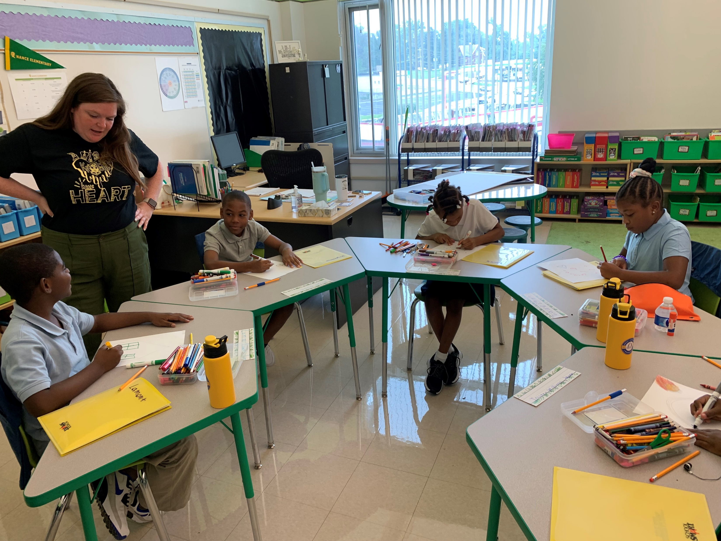
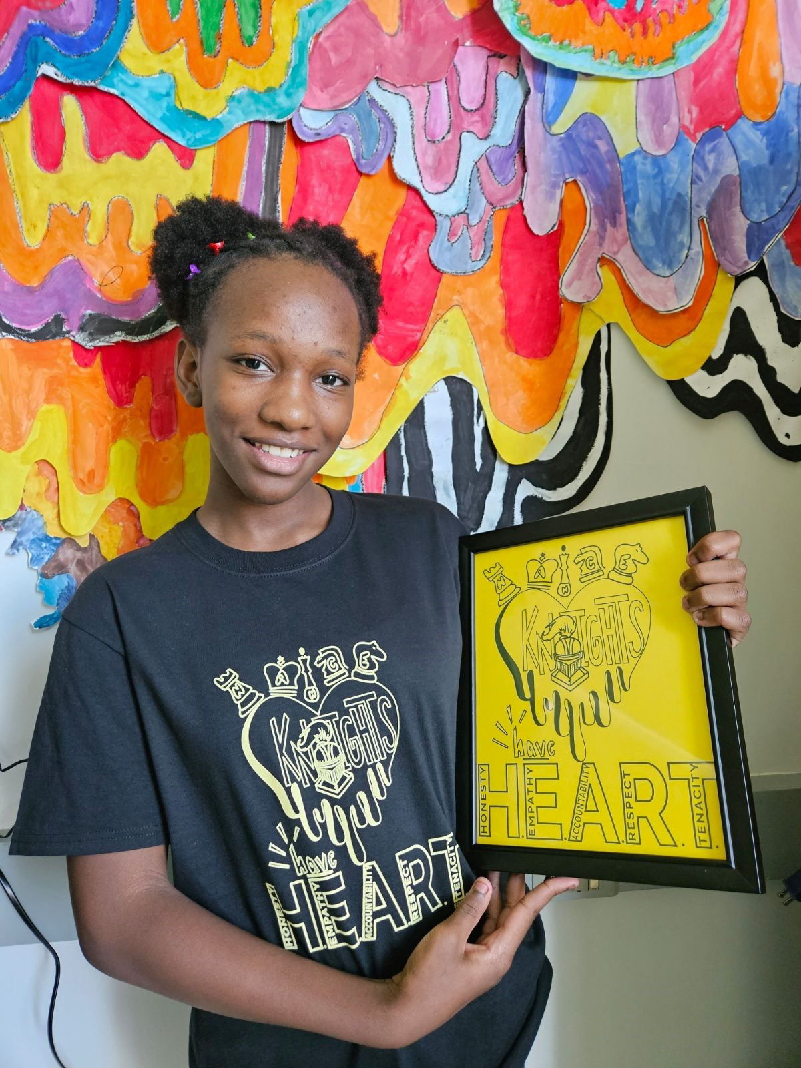
Student Achievement Data Review

Slide 9
Enrollment
 | 19-20 | 20-21 | 21-22 | 22-23 | 23-24
Pre-K | 28 | 17 | 44 | 54 | 58
KG | 56 | 40 | 41 | 44 | 43
1st | 46 | 48 | 42 | 43 | 48
2nd | 51 | 50 | 52 | 41 | 43
3rd | 37 | 51 | 49 | 48 | 31
4th | 34 | 37 | 40 | 40 | 44
5th | 31 | 37 | 34 | 38 | 35
6th | 31 | 28 | 24 | 23 | 25
Total | 309 | 308 (-1) | 326 (+18) | 331 (+5) | 327 (-4)
Students- 327 Total (12/19/23)
Pre-K: 58 students
KG-6th: 269 students
Pre-K currently has highest enrollment
Special Education: 61 students
19%
15% in 2022-2023
ESOL: 1 student

Slide 10
Attendance
90/90: 66.4% (12/19/23)
58% at the end of 22-23
+ 8.4%
Cumulative ADA: 90.9% (12/19/23)
88.9% at the end of 22-23
+ 2%
Students by Attendance Tier
184 students between 90.1%-100%
43 students between 85%-89.9%
4 students are at 89% or higher
50 students < 85%
Dates of Note
Tuesday, October 17th- 94.8% (Highest day of quarter)
Parent conferences, literacy night & multiple field trips
Tuesday, December 19th- 79.9% (Lowest day of quarter)
Last day of semester

Slide 18
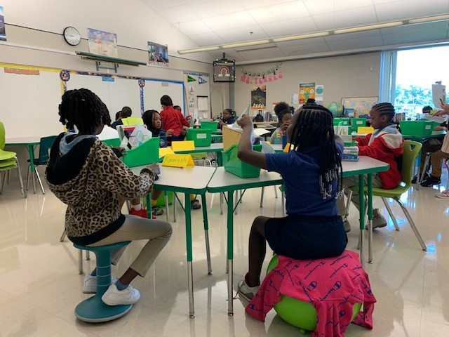
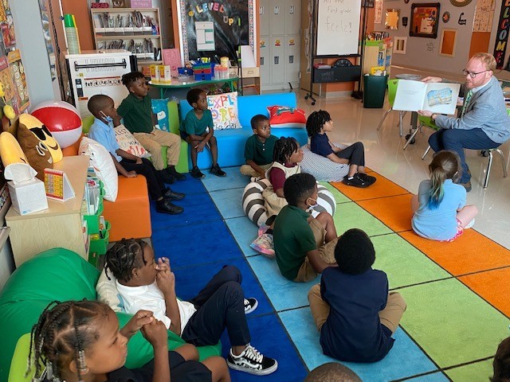
Discussion of Parents’ Surveys & Evaluations

Slide 19
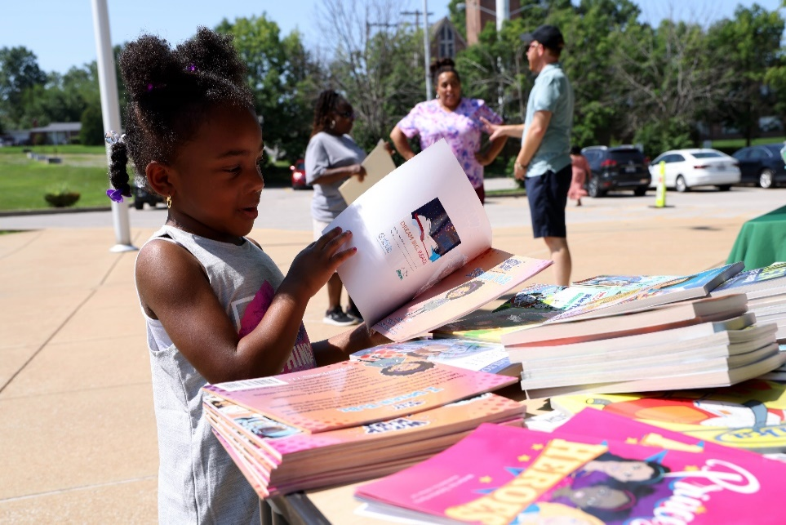
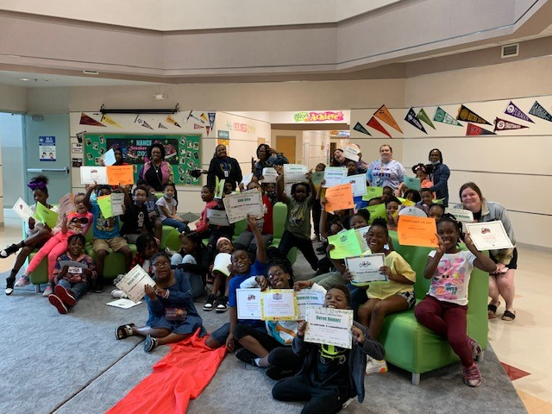
Program Strengths, Weaknesses & Needs Assessment

Slide 20






Priorities and Action Steps
Leadership Development & Coaching
Goal
Action Steps
Goal 1: School Leadership will support and engage in weekly data team meetings with an explicit focus on Student Work, Content Standards, and Data Analysis to impact student outcomes as measured by a minimum of 10% growth from baseline to Spring Panorama Survey Data responses from school-based staff in the category of ‘Data Teams / PLC Work’.
Goal 2: School Leadership will meet or exceed the national percentile score on Panorama Survey Data responses by school-based staff in the category of ‘Feedback & Coaching’.
Effective implementation of Relay coaching protocols: Weekly Data Meetings, Observation & Feedback, and Lesson Plan Internalization aligned to curricular resources.
MyView and Envision instructional modeling and co-teaching by Instructional Leadership Team members for all 1st year and non-proficient ELA and Math teachers.
Initiate small group staff cohort professional development model to promote cross-role collaboration and support belonging.*
Staff participation in professional development led by consultants as well as conferences (Savvas, ASCD, Unbound Ed, Character Plus- i.e. TACE).
Implementation of Grading for Equity, Cultivating Genius, and Morning Meetings and Closing Circles book study for certified staff.

Slide 21

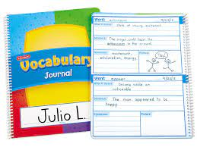




Priorities and Action Steps
Student Achievement
Goal
Action Steps
Goal 1: By the end of May 2024, at least 50% of all students will increase their STAR Reading benchmark scores by an average of 1 year (.10 academic school year).
Goal 2: 50% of students reading 1 or more grade-levels below or more AND receiving intervention supports, will grow by a minimum of 2 years (grade equivalence) as evidenced by STAR Reading.
Goal 3: By the end of May 2024, at least 50% of all students will increase their STAR Math benchmark scores by an average of 1 year (.10 academic school year).
Streamline instructional schedules across grade levels to maximize learning time.
Effective implementation of standards-based ELA curriculum MyView and standards-based math curriculum Envision.
Classroom-based SMART goals for student reading and math growth and quarterly focus standard progress monitoring.
High quality, flexible, small group instruction that supports students with mastering grade level standards.
Enhance academic vocabulary instruction across subject areas in grades 2-6.
STEAM Lab and ongoing STEAM enrichment instruction for students in grade K-6 facilitated by classroom teachers and STEAM PLC.
Emphasize a culture and climate of reading that promotes high engagement in literacy, including Nance Knights Book Club and incentives.
Emphasize a culture and climate of mathematics that promotes high engagement in math including STEAM instruction and incentives.
Enhance after school programming through the implementation of the Twenty First Century grant.
Regular enrichment field trips and learning experiences for all grade levels.

Slide 22




Priorities and Action Steps
School Culture
Goal
Action Steps
Goal 1: By the end of the 2023-2024 school year, proportional attendance data will show that the percentage of students attending school 90% of the time or more will increase by 10% compared to 2022-2023 end of year data.
Goal 2: School Leadership will meet or exceed the national percentile score on Panorama Survey Data responses by grades 3-6 students in the categories of ‘Belonging,’ ‘School Climate,’ and ‘School Safety.’
Goal 3: By the end of the 2023-2024 school year, Nance Elementary will be recognized as a state and national School of Character.
Rollout of “Nance Knights Have HEART!” revised core values (Honesty, Empathy, Accountability, Respect & Tenacity) and expectations matrix.*
Implementation of Second Step & Rethink Ed social emotional learning programs, morning meetings, and SEL instruction in all classrooms.
Complete application for state/national School of Character with assistance from Character Plus.*
Implementation of a comprehensive attendance plan to support daily student attendance and address root causes of attendance concerns.
Staff member participation in student shadowing and empathy interview protocols to deepen understanding of student experiences.*
Implement a new student welcoming protocol for students coming to Nance throughout the year.
Increase regular parent engagement opportunities that incorporate academics including a parent university, STEAM and literacy nights, parent learning walks, and parent workshops.
Continue practice of school-based leadership team, staff committees, and student advisory group.

Slide 23
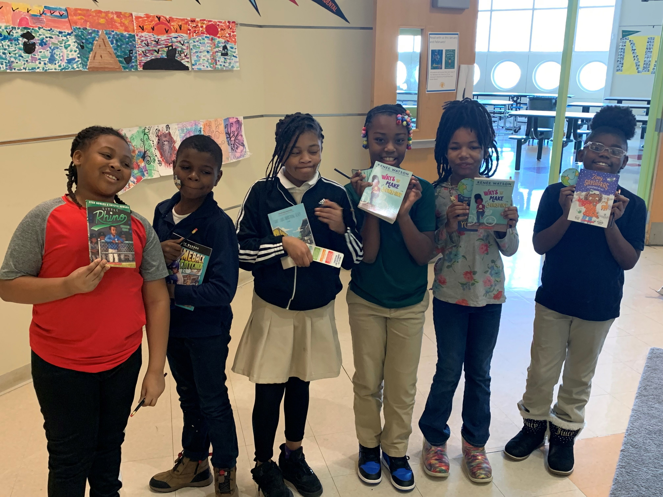
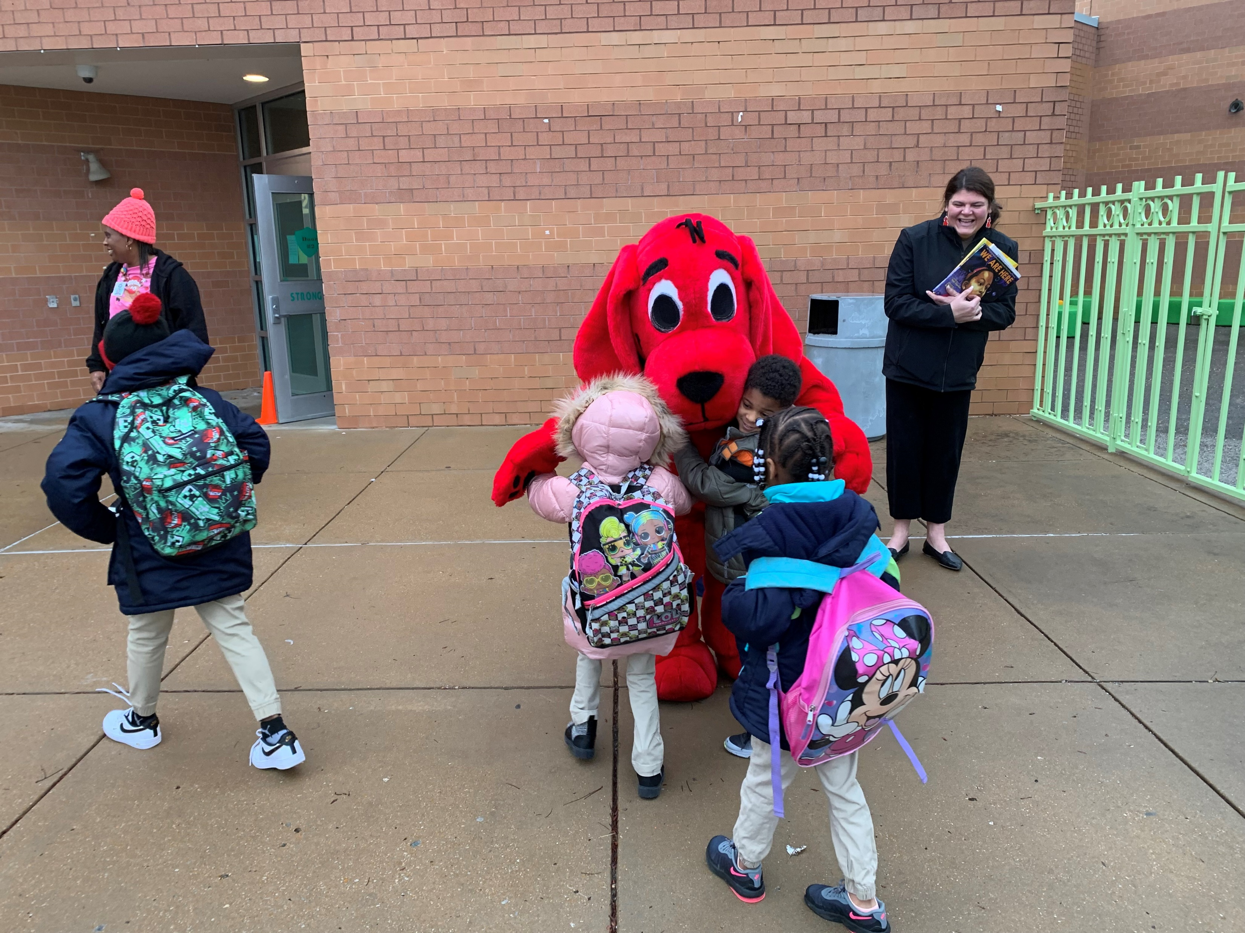
Review of School Parent Compact

Slide 24
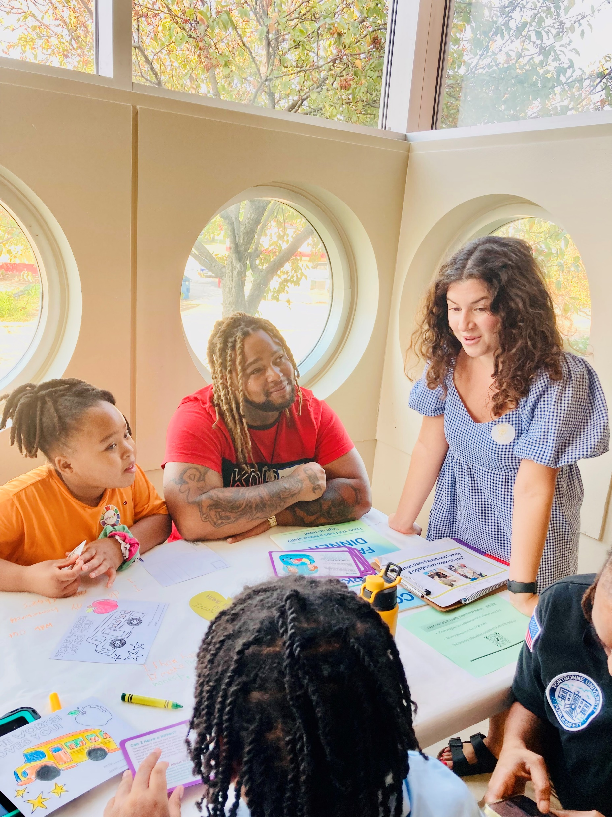
Recommendations & Revisions School Parent and Family Engagement Policy

Slide 25
Who do you contact for more information about your school’s Title I program?
Principal
Dr. Tyler Archer
Tyler.Archer@slps.org
314-867-0634
Family and Community Specialist
Shantelle Williams-Green
Shantelle.Williams@slps.org
314-867-0634
Notes:
Fill in all areas in ( )

