Slide 1
Beaumont Technical Center
Medical Assistant Class
Skills Training

Slide 2

Beaumont Technical Center
Medical Assistant Class
Principal
Dr. Felita Williams

Slide 3
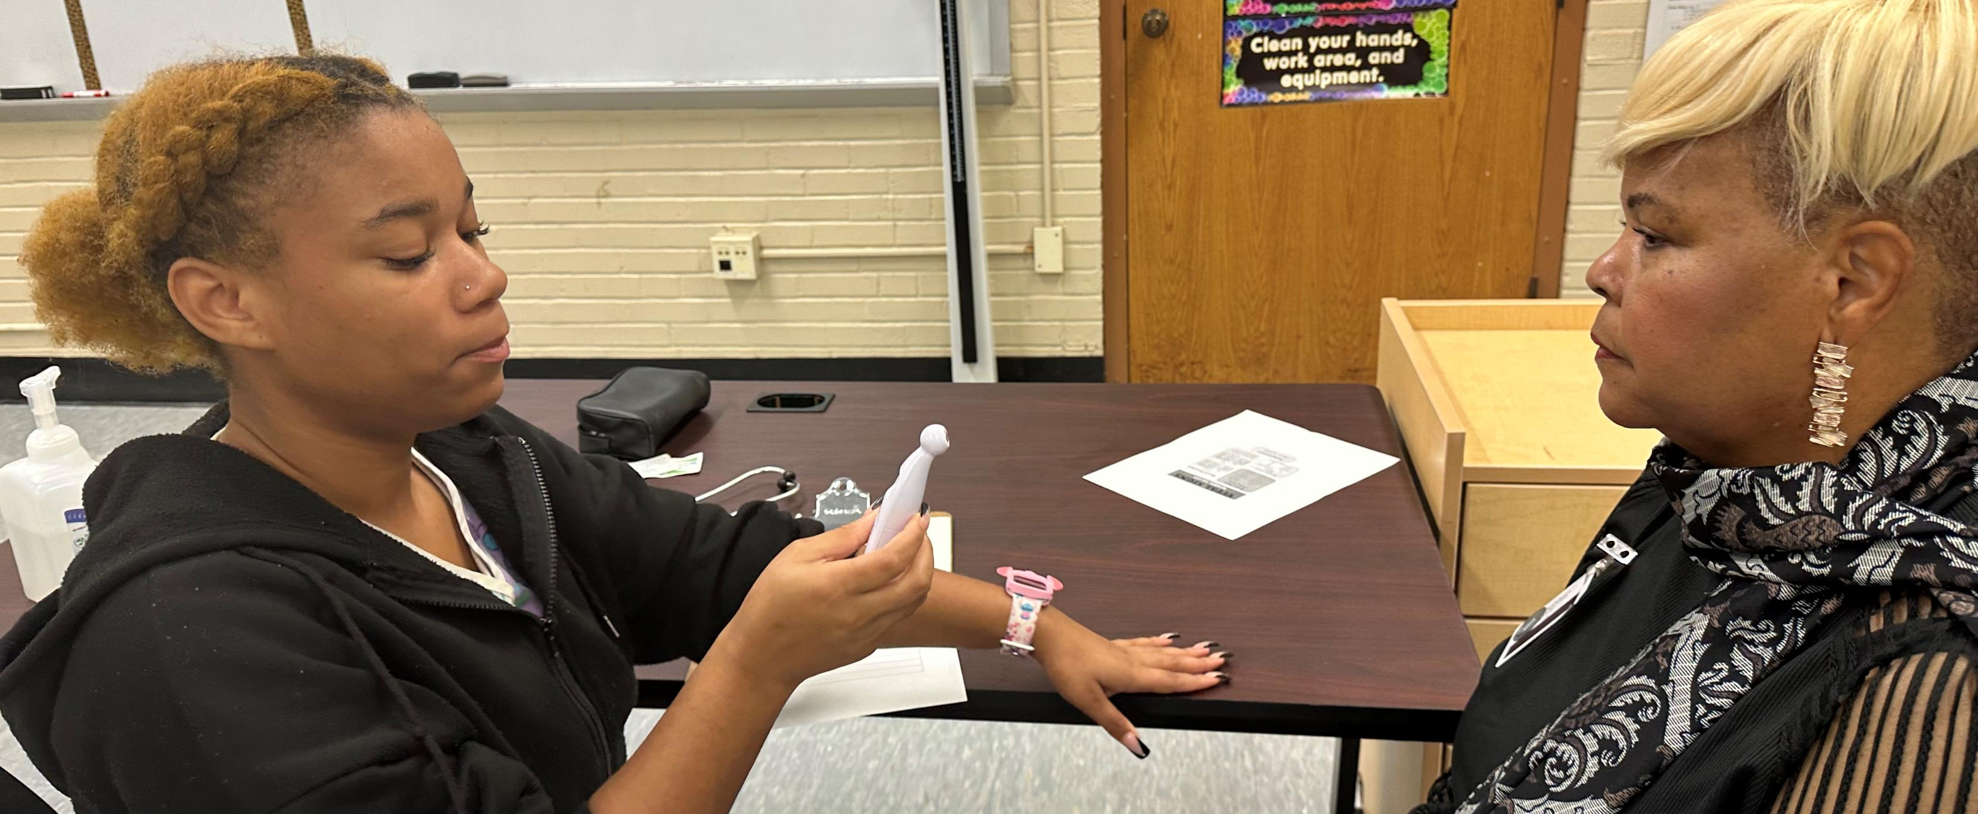
Dr. Felita Williams
Assisting as Medical Assistant Patient

Slide 4
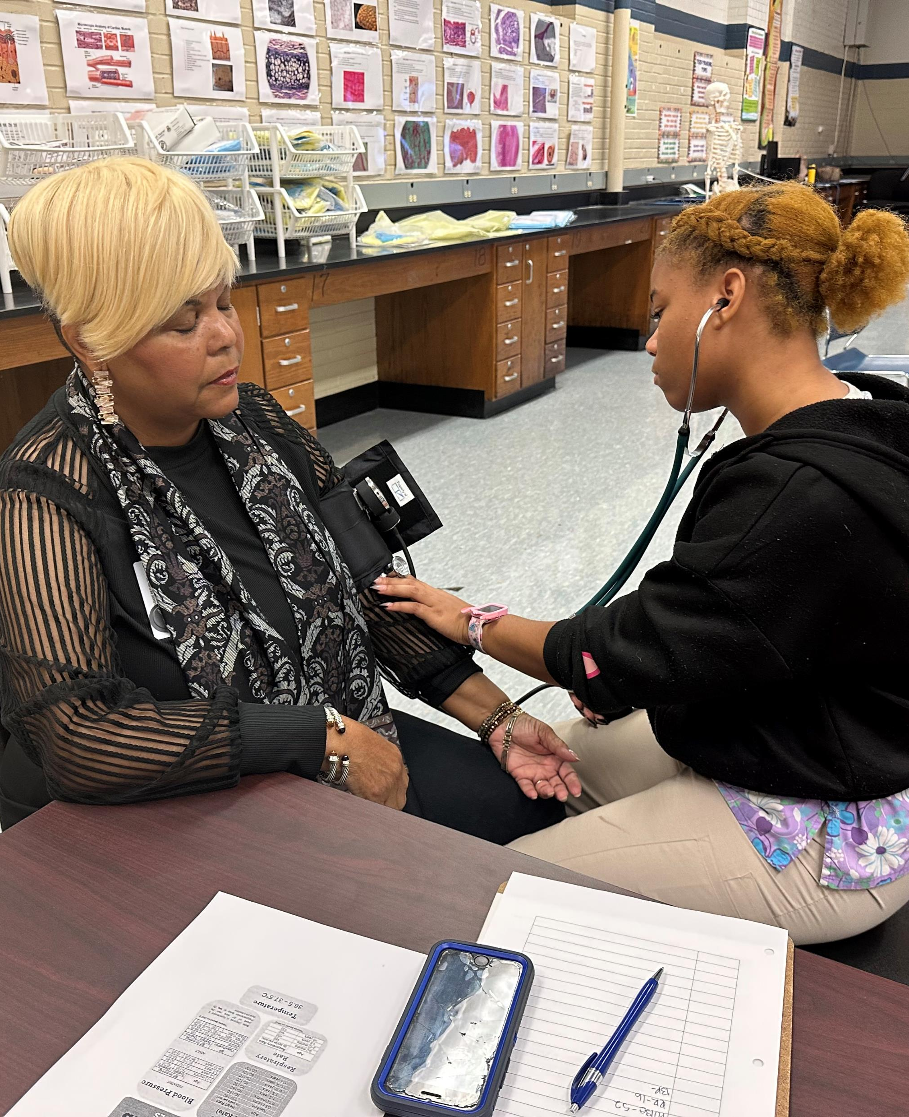
Student Working on
Dr. Felita Williams

Slide 5
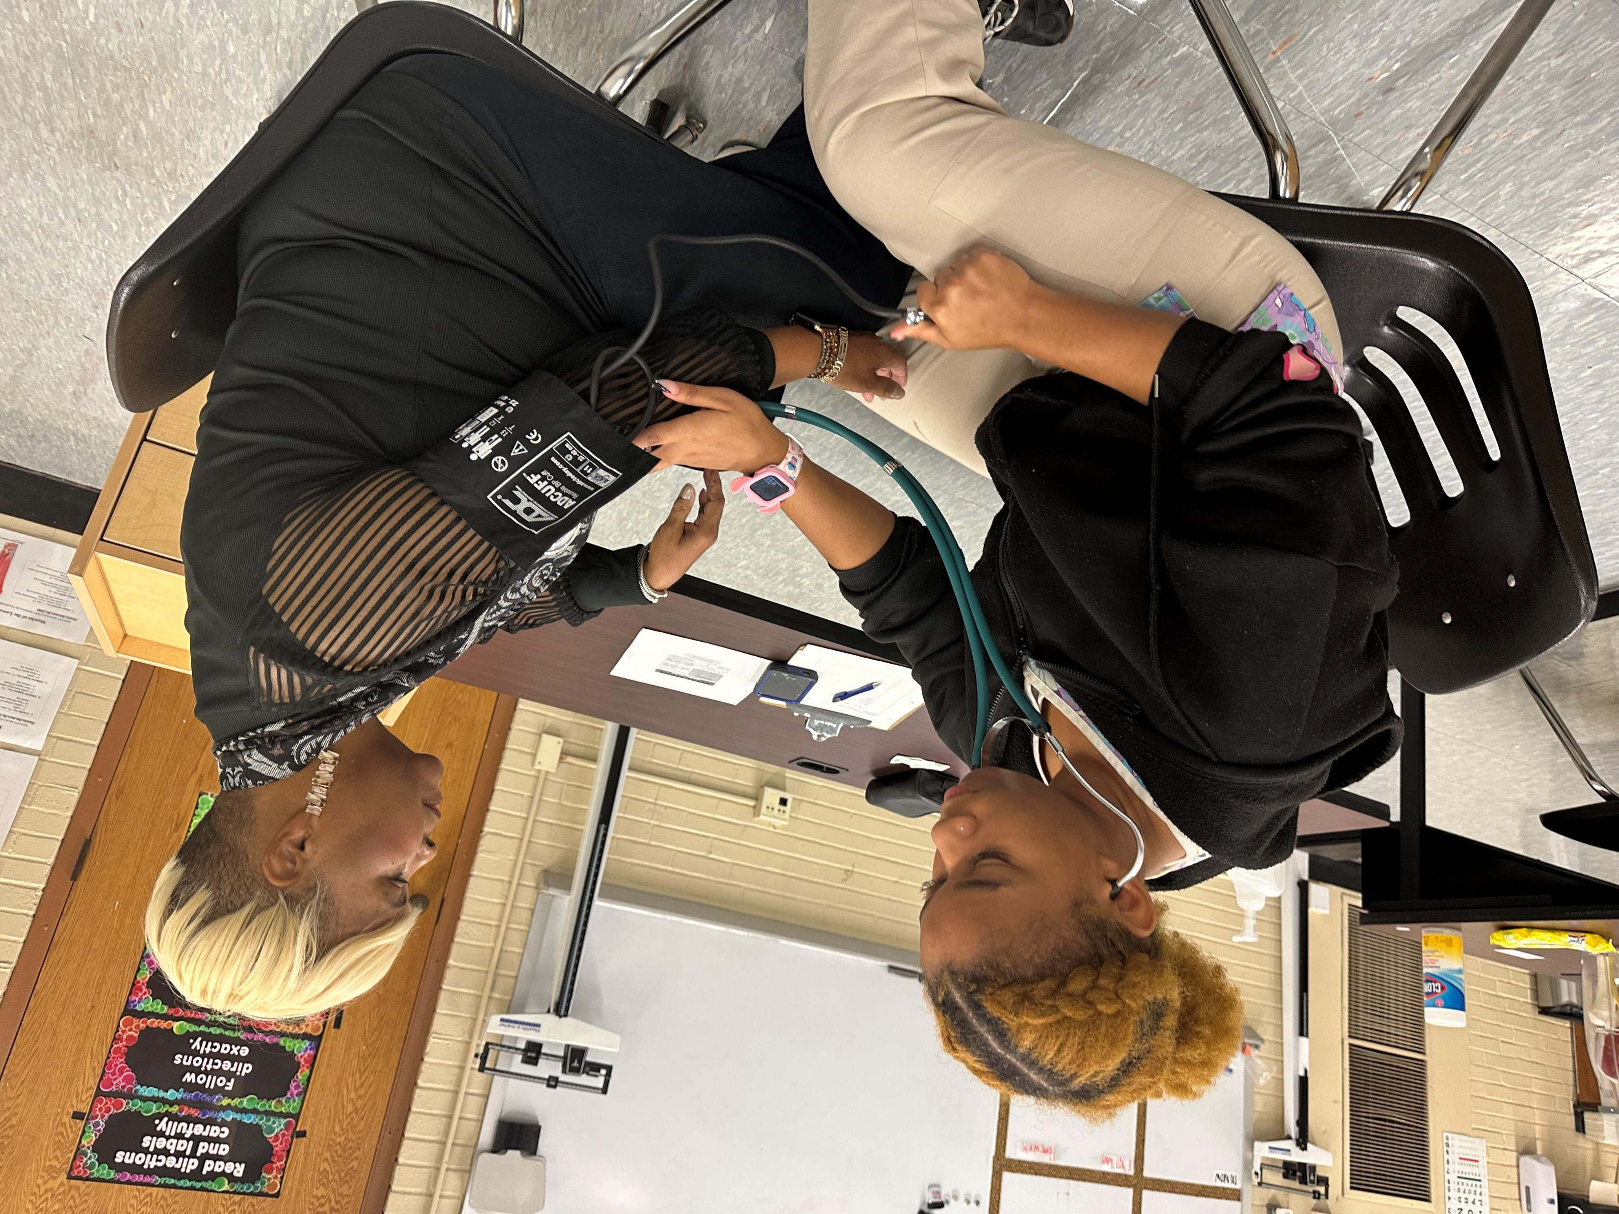
Student Working on
Dr. Felita Williams

Slide 6
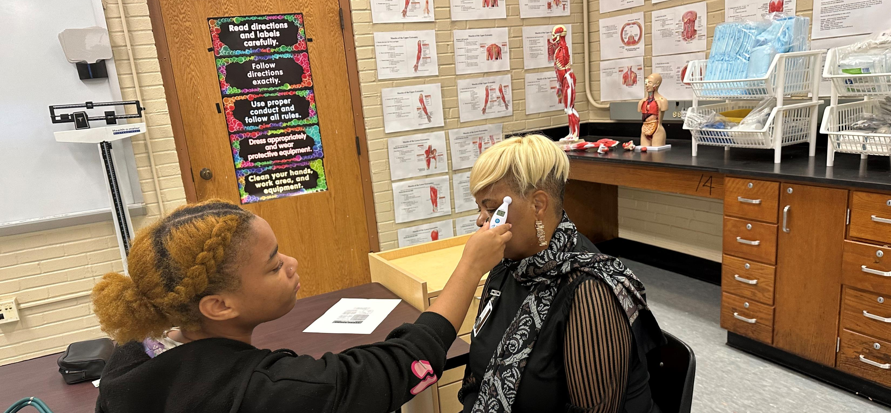
Student Working on
Dr. Felita Williams

Slide 7
We also want to thank our knowledgeable phenomenal CTE specialist Antoinette Williams. We normally see Toni (we call her Toni because that’s the kind of down to earth person she is) in high heels and office wear, but on 10/11/2023 in the absence of our Medical Assistant instructor, Toni kicked off her high heels and put on uniform scrubs to instruct our Medical Assistant students in skills training. This was very heartwarming to our staff and students; it shows the kind of dedication Toni has for our young people and the determination she has for their success.
Enjoy the hands-on skills training slide show BELOW with Antoinette Williams and Beaumont Technical Center Medical Assistant students.

Slide 8
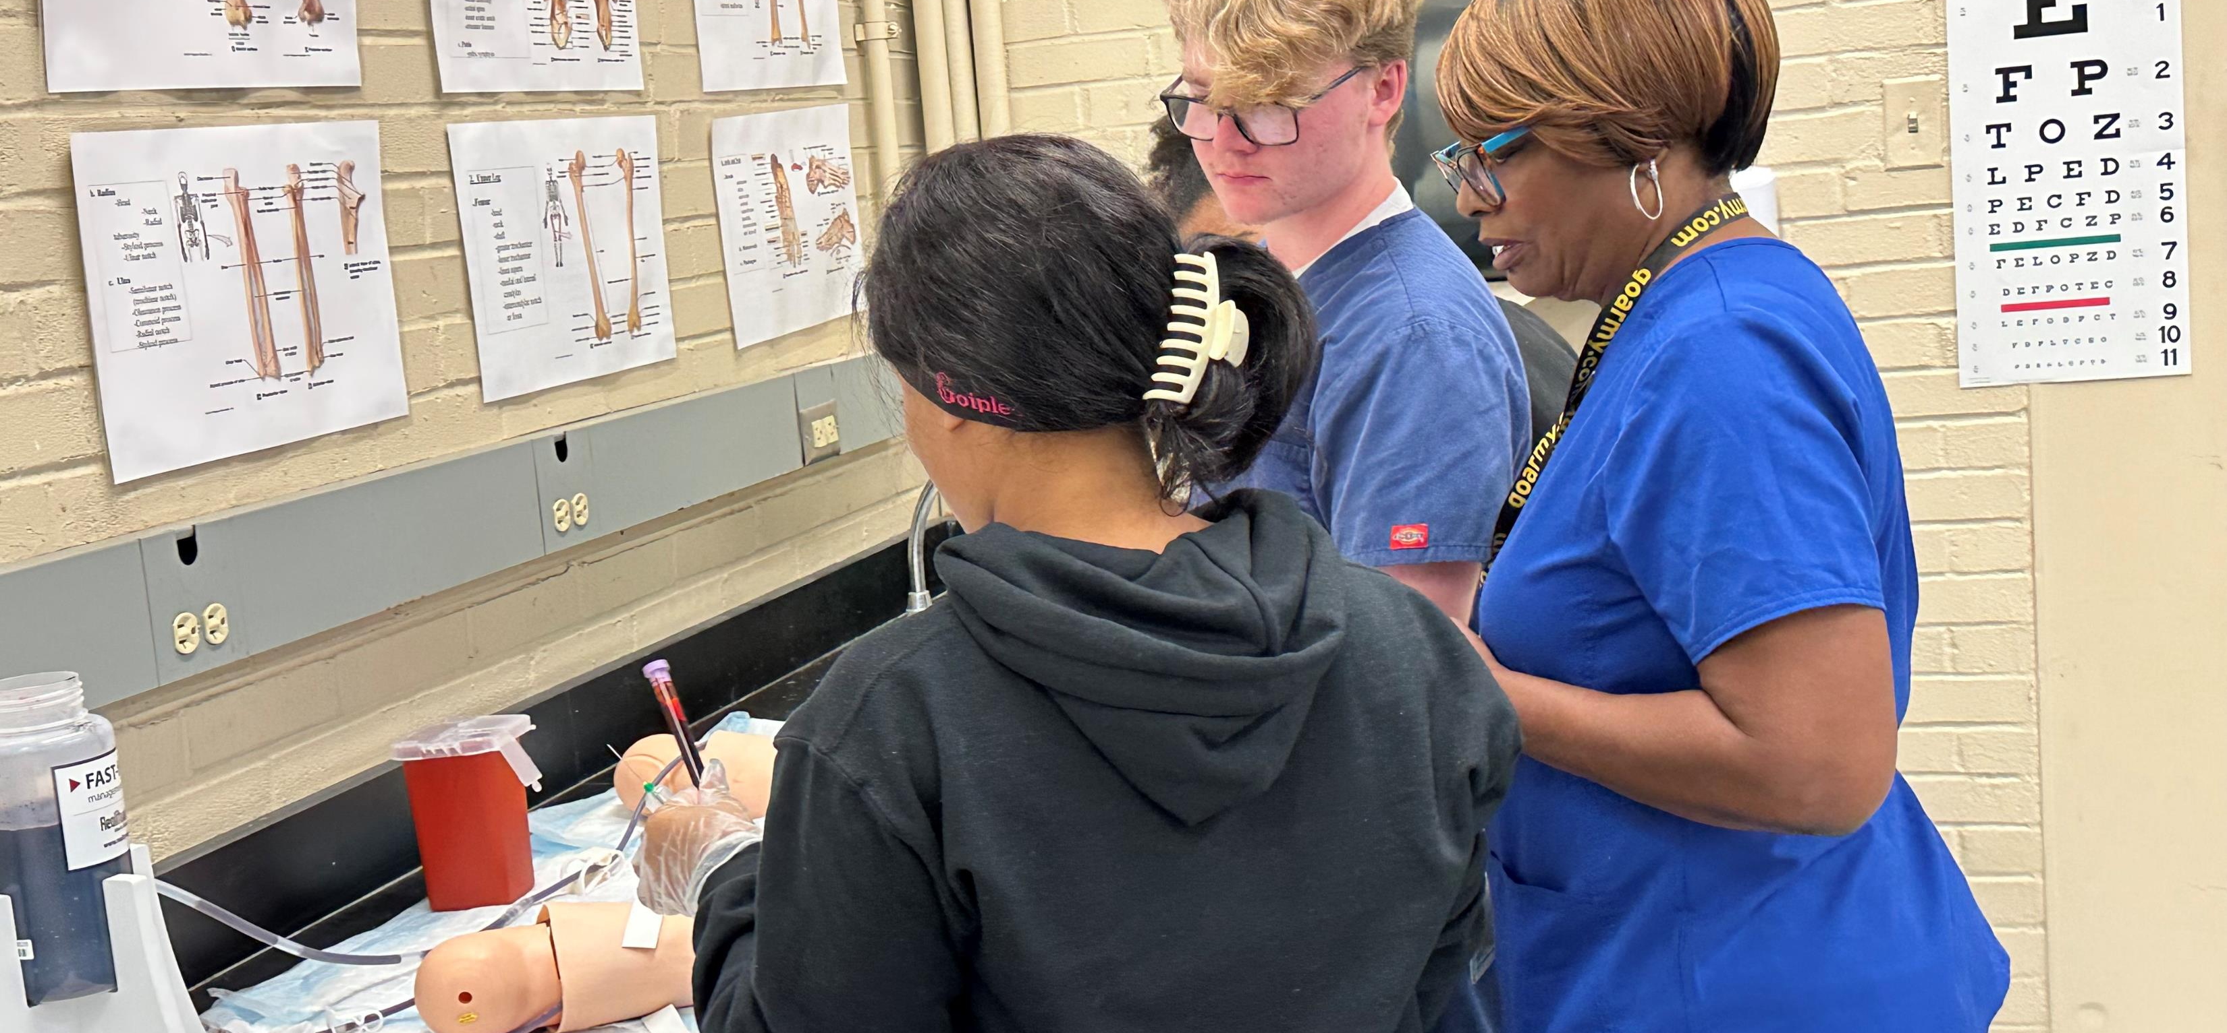
Skills Training with
CTE Specialist Antoinette Williams

Slide 9
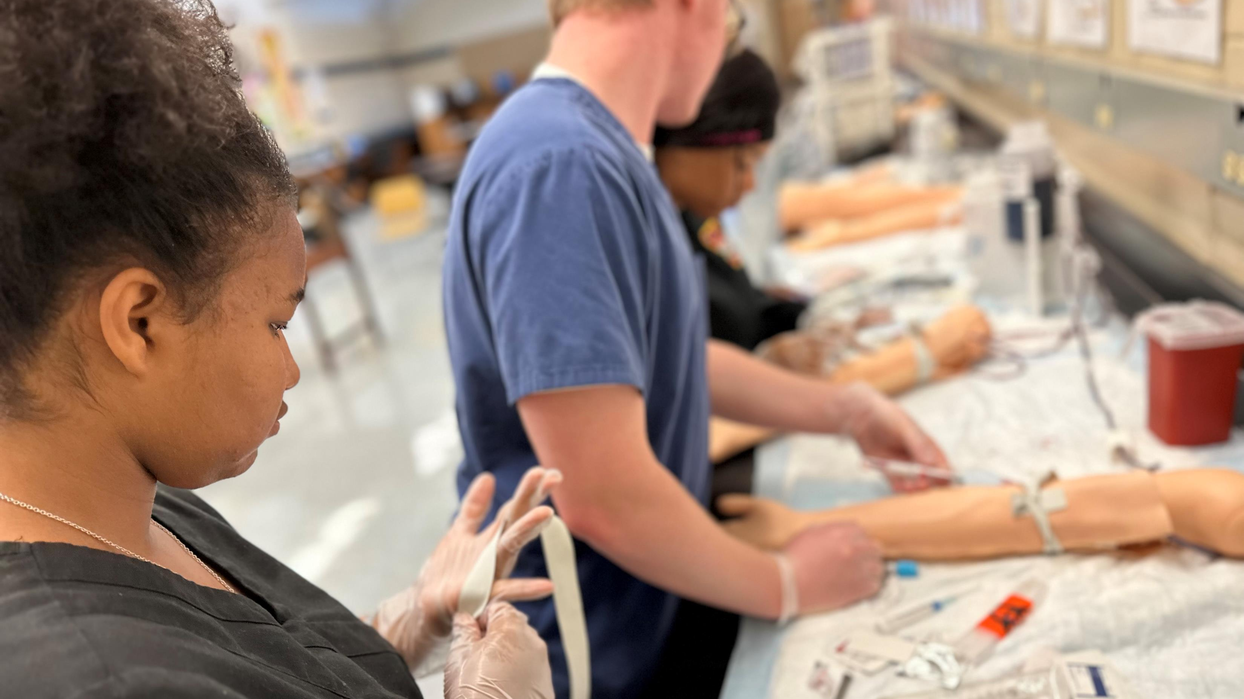

Slide 10
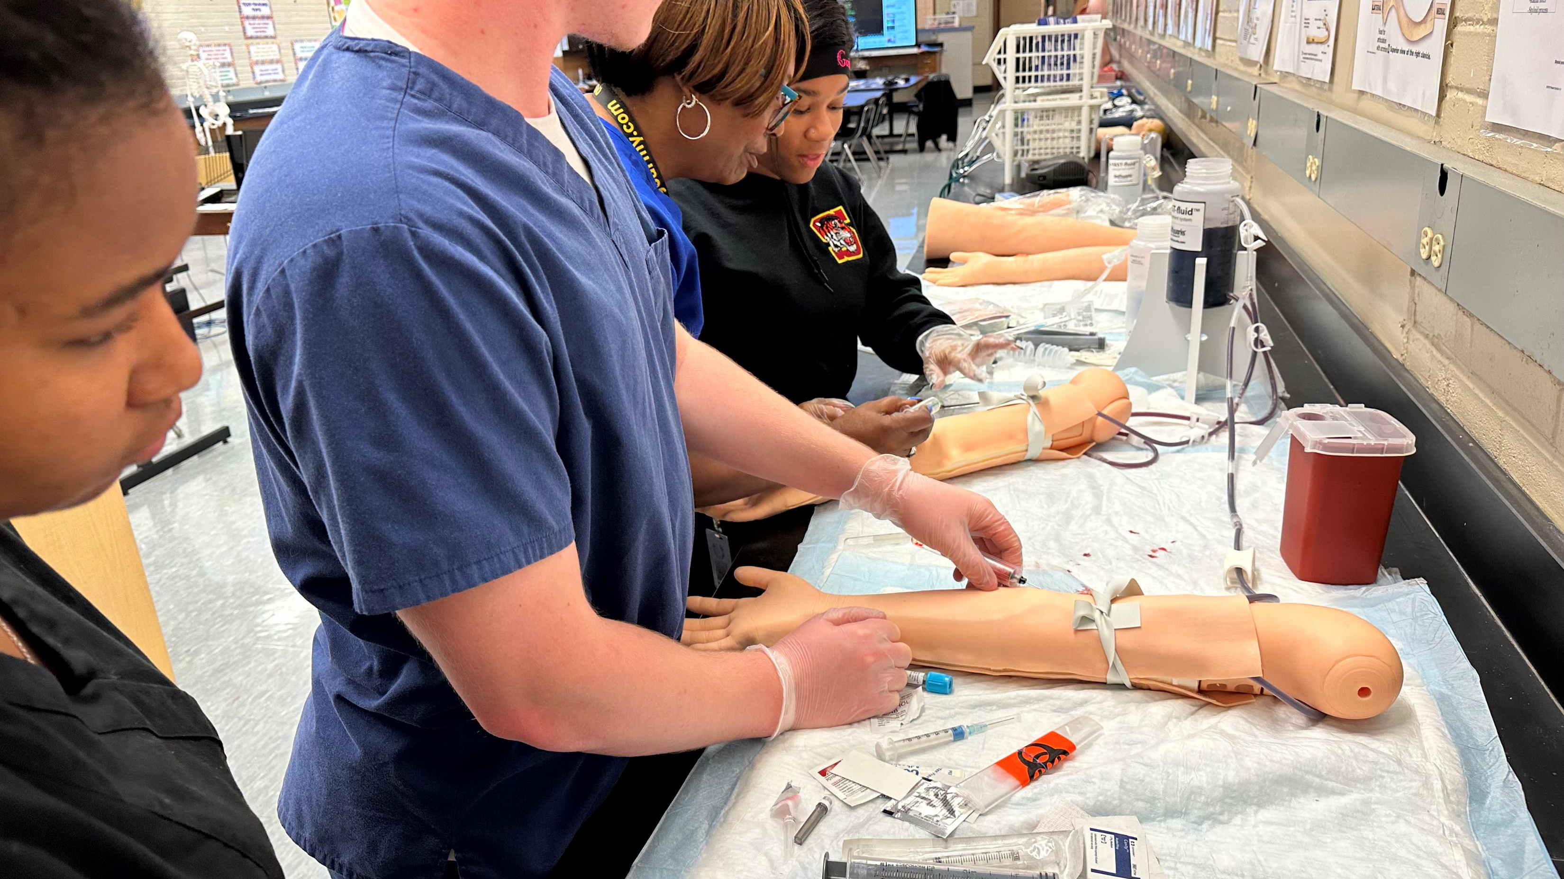

Slide 11
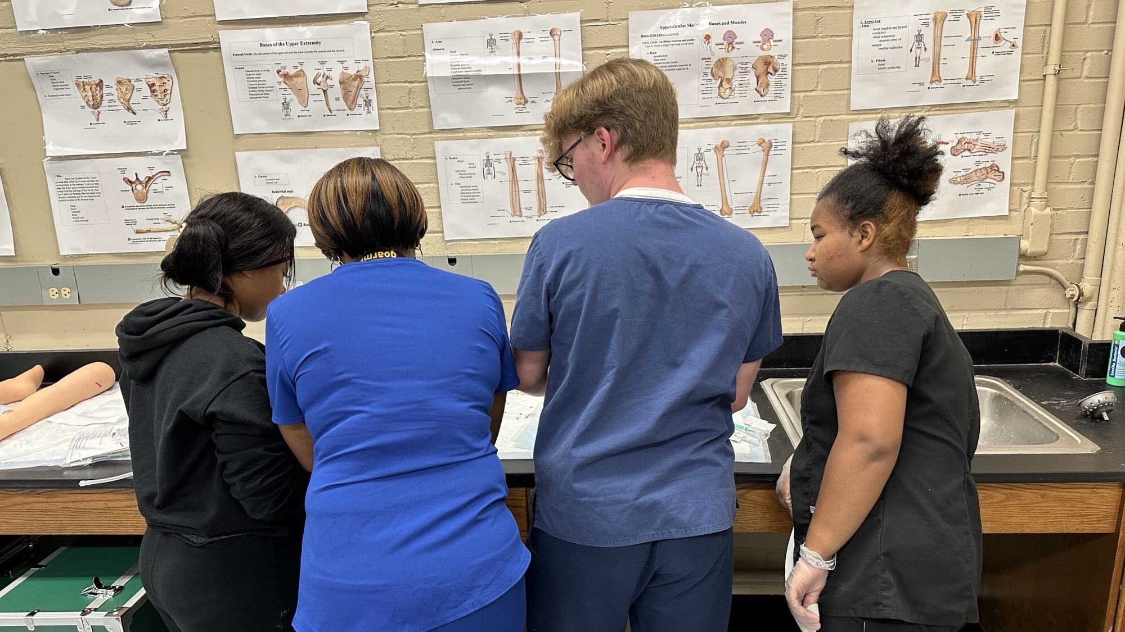

Slide 12
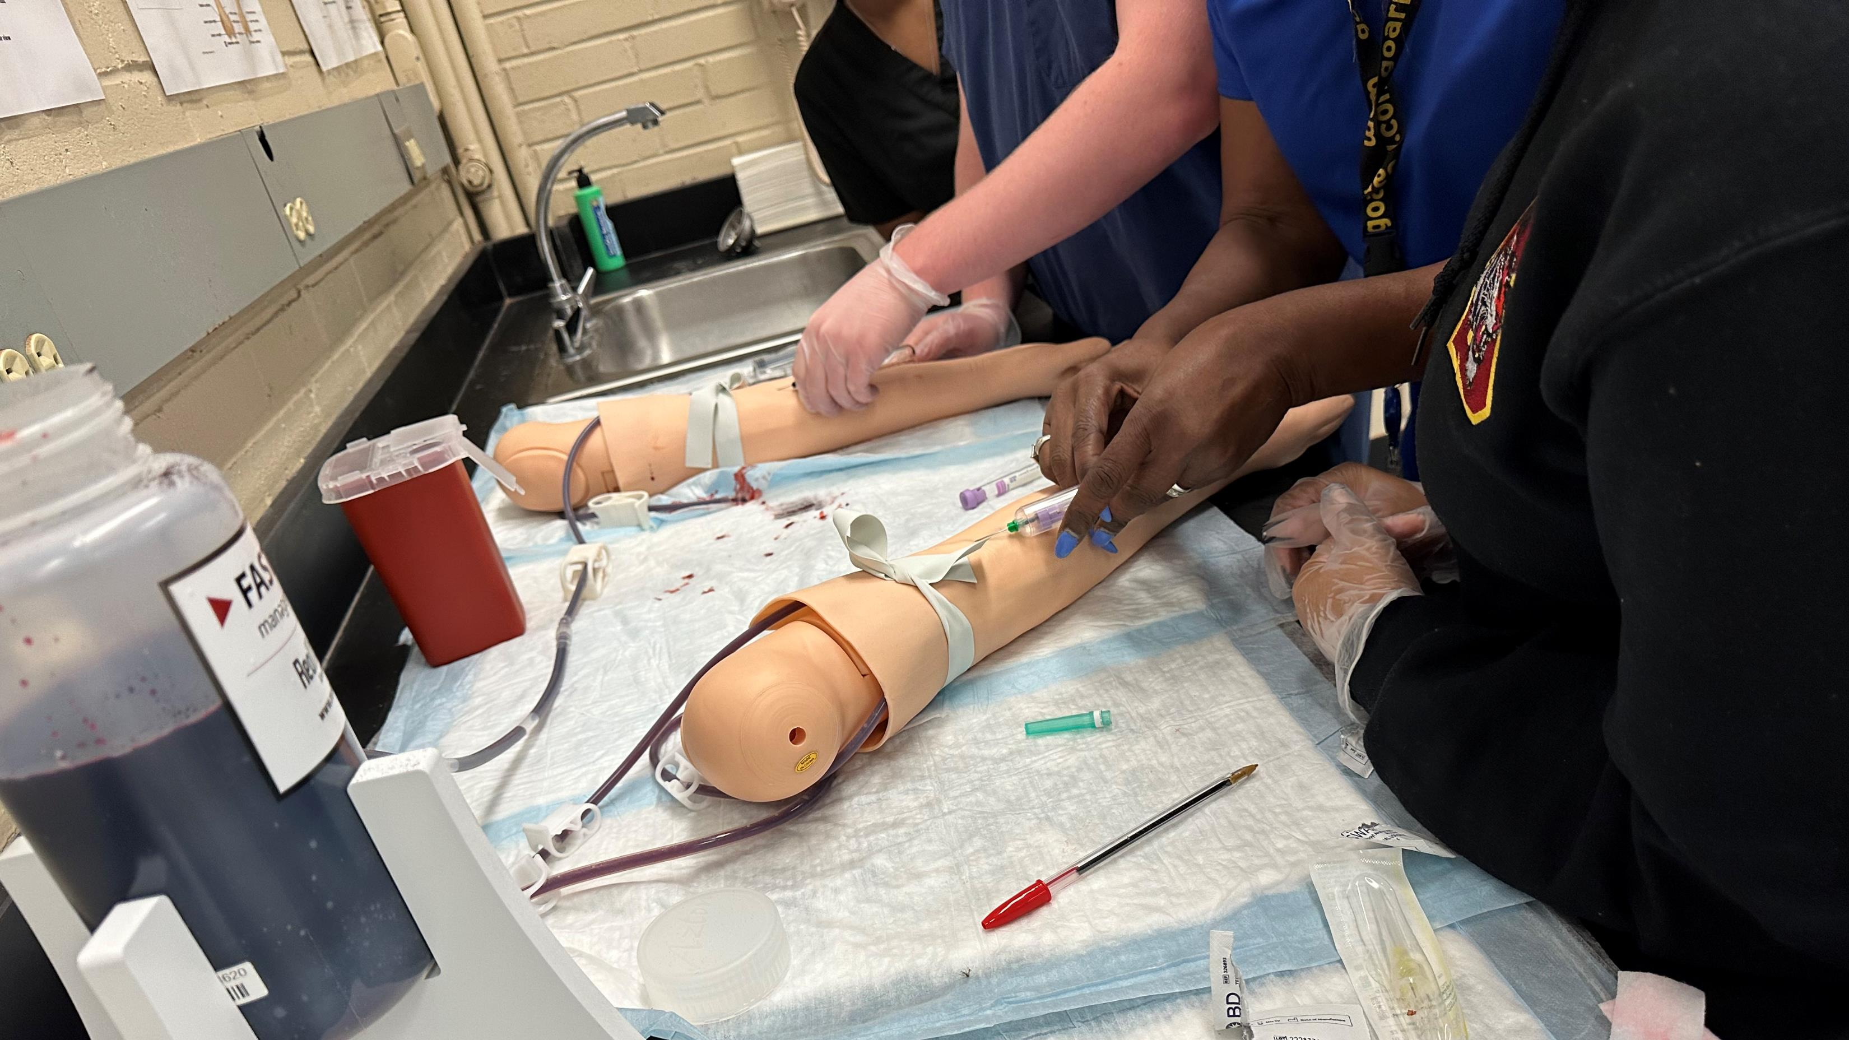

Slide 13
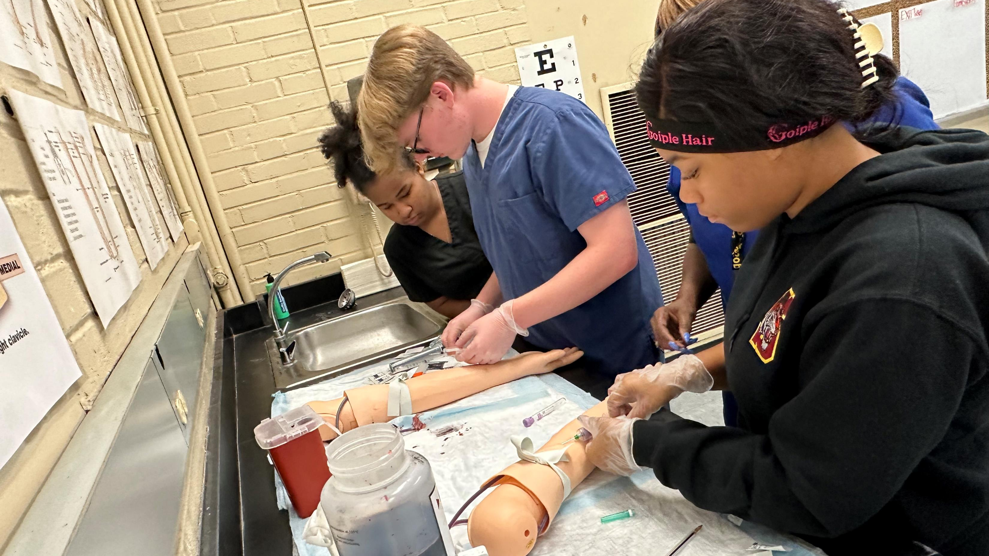

Slide 14
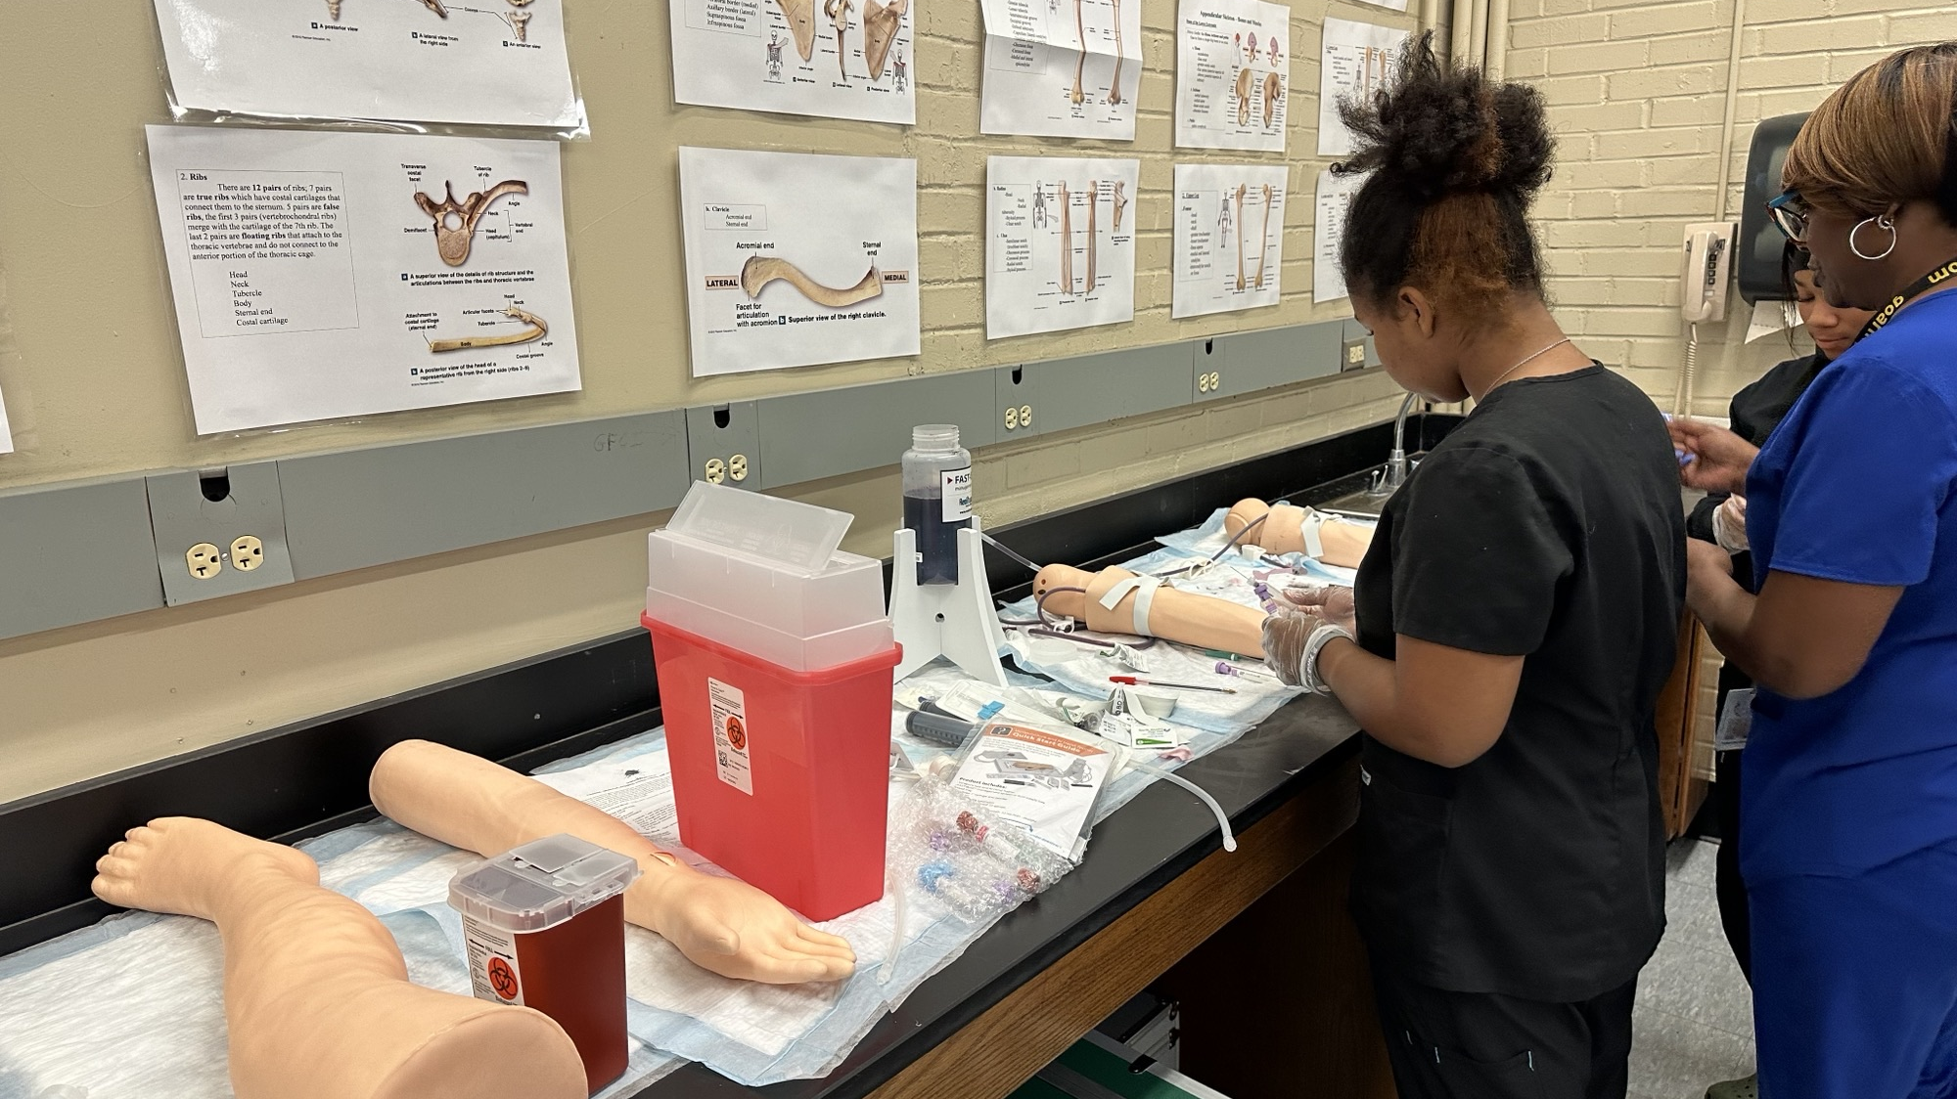

Slide 15
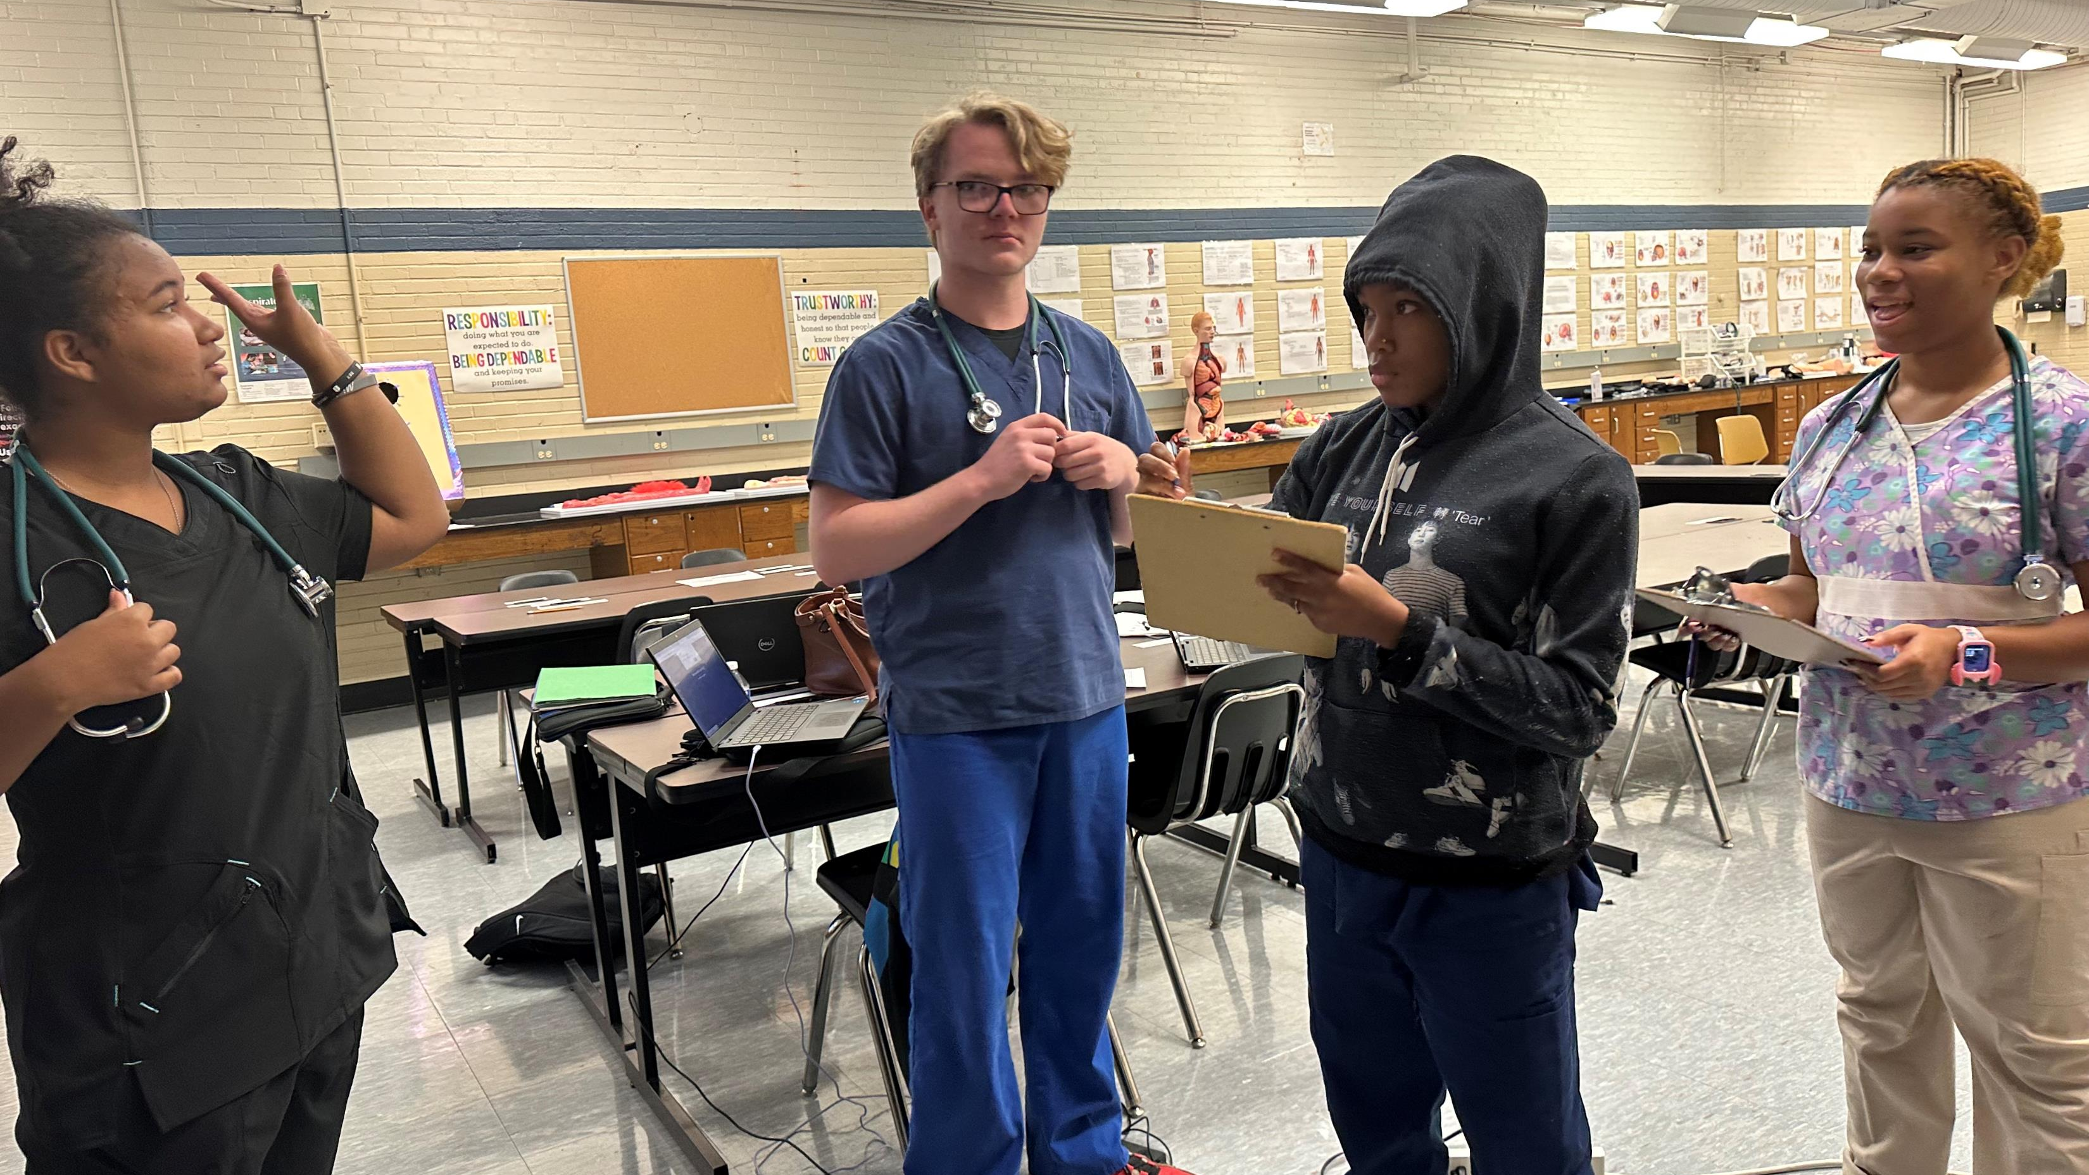

Slide 16
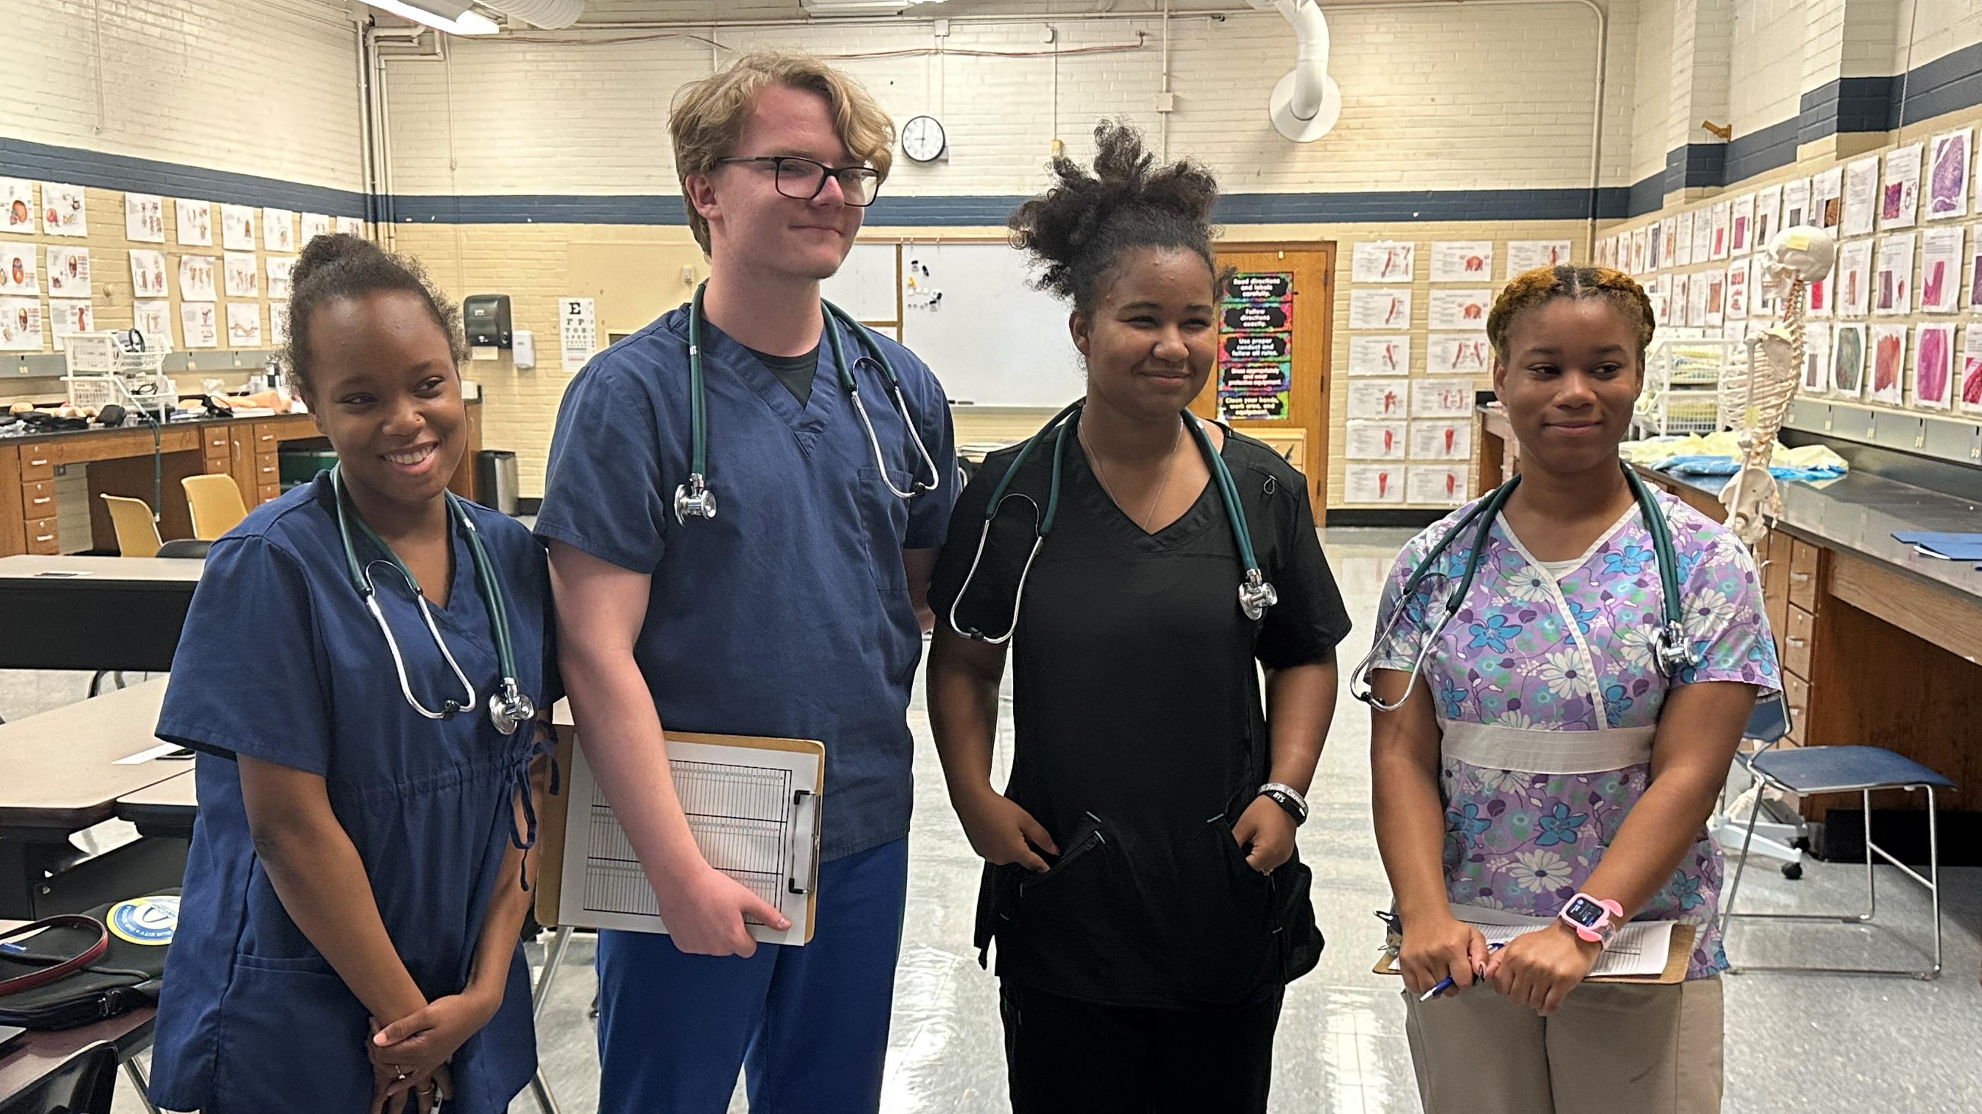

Slide 17
