Slide 1
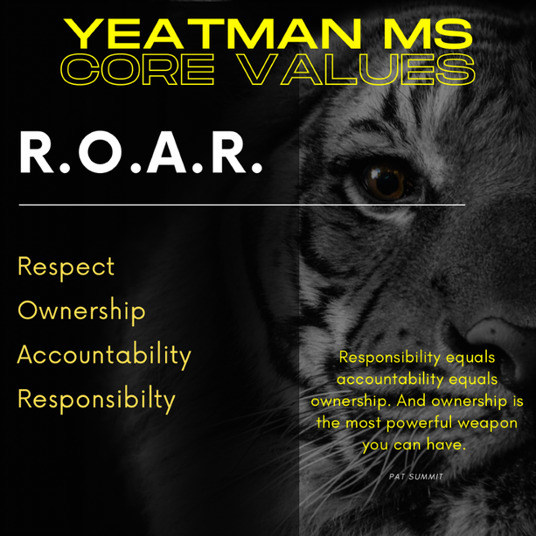
In Everything WE Do!

Slide 2
YLCPMS Core Values (Explained)
R | Respect | We Respect each other as people. We respect each other as professionals. We give each other the courtesy we deserve.
O | Ownership | We take ownership of our roles. We take ownership of our learning/ teaching and development as people/ professionals.
A | Accountability | We hold ourselves accountable for our actions and therefore accept when others hold us accountable for our actions.
R | Responsibility | We are responsible citizens, good people, and we expect others to uphold this same responsibility.

