Slide 1
Medical Assistant
Health Science Career
Beaumont Technical Center
“I am a patient’s greeting, admission-processing, procedures-explaining, physician-conferring, vitals-taking, sutures removing, record keeping, dressing changing, always-caring Medical Assistant.”

Slide 2
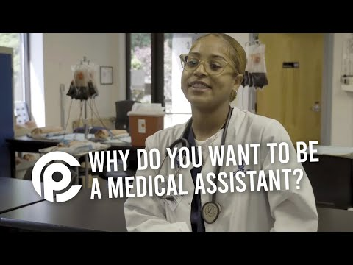
Is Medical Assisting Right for You?

Slide 3
The Role of a Medical Assistant
Medical assistants perform routine administrative and clinical tasks to keep the offices and clinics of healthcare providers running smoothly. The duties of medical assistants vary from office to office, depending on office location, size, and specialty. In small practices, medical assistants are usually “generalists,” handling both administrative and clinical duties and reporting directly to an office manager, physician, or other health practitioner. Those in large practices tend to specialize in a particular area under the supervision of department administrators.

Slide 4
Nature of the Work
Administrative Duties
Using computer applications
Answering telephones
Welcoming patients
Updating and filing patient medical records
Coding and filling out insurance forms
Scheduling appointments
Arranging for hospital admissions and laboratory services
Handling correspondence, billing, and bookkeeping

Slide 5
Nature of the Work
Clinical Duties
Taking medical histories
Explaining treatment procedures to patients
Preparing patients for examinations
Assisting the physician during examinations
Collecting and preparing laboratory specimens
Performing basic laboratory tests
Instructing patients about medication and special diets
Preparing and administering medications, including by intramuscular, intradermal, and subcutaneous injections—including vaccinations/immunizations, as directed by a physician or other licensed provider (e.g., a nurse practitioner or physician assistant)
Phlebotomy
Wound care and changing dressings

Slide 6
Two Year Program
The Medical Assistant program at Beaumont Technical Center is an accredited career training program. The program is offered to Juniors and Seniors. This program consists of clinical lecture and clinical skill practicum. Students will be educated about and demonstrate the administrative and clinical responsibilities of a Medical Assistant. This training prepares students to receive Certification as a Medical Administrative Assistant and Clinical Medical Assistant through the National Health-career Association.
Students will be learning The Role of a Medical Assistant, Administrative Skills and participating in HOSA Junior year. Upon completion students will be able to take their Medical Administrative Assistant examination.
Seniors will be learning Clinical Skills, Employability Skills and competing in HOSA events. Upon completion students will be able to take their Certified Clinical Medical Assistant examination.
Students must enroll in the program Junior year to continue Senior year.

Slide 7
Dual Enrollment Two Year College
You’re set for your next step, so take it. Why wait for the challenge and excitement of being a college student? Enroll in real college courses while taking high school classes with Dual Enrollment.
Types of Dual Enrollment
STLCC
Traditional: Students who want to take 1 or more classes while in high school, who are not part of a special cohort.
Early College: Graduate high school with a high school diploma and an Associate’s Degree by taking classes with STLCC full-time during junior and senior years. Contact your high school counselor to see if your school offers this opportunity!
Make it Count: High school seniors spend their final semester of high school earning a full semester of college credit at STLCC. Contact your high school counselor to see if your school offers this opportunity!

Slide 8
Dual Enrollment Four Year College
Visiting Young Scholars are current high school students who have the aptitude to succeed in 1000/2000 division courses at Saint Louis University. Qualified high school juniors and seniors may sit in SLU courses at the St. Louis campus, Spain campus or online. This dual-enrollment program bridges the gap between the high school and the college experience. Determining if the courses count toward high school graduation is at the discretion of the high school administration and the responsibility of the family to articulate.
Early College Scholars Program, St. Louis area students have the opportunity to enroll in courses for credit and study alongside undergraduates at Washington University. Students may enroll in up to six units of credit per semester. Courses are the undergraduate-level courses in the humanities, social sciences, natural sciences, and mathematics offered by the College of Arts & Sciences. Students commute to campus for courses.

Slide 9
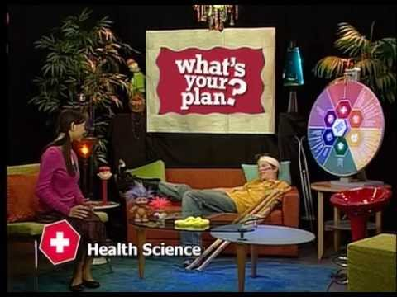
Pathway to Future Healthcare Professions

Slide 10

Medical Assistant Salary
Employment of medical assistants is projected to grow 16 percent from 2021 to 2031, much faster than the average for all occupations.
About 123,000 openings for medical assistants are projected each year, on average, over the decade.

Slide 11

Differences Between Medical Assistant and CNA
What is the difference between a Medical Assistant and a Certified Nursing Assistant?
Nursing assistants have a more physical job than medical assistants, often being asked to help patients with basic tasks like bathing, moving or repositioning patients and monitoring patients' vital signs. Unlike medical assistants, nursing assistants work solely on the clinical side of health care.

Slide 12

Registration for the Medical Assistant Program

