Slide 1
Module 2 – Leadership
Chapter 1 - NJROTC Leadership
Section 1 – NJROTC Leadership

Slide 2
Learn the principles of effective leadership and the importance of discipline

Slide 3
Cite two advantages of unit leadership.
Explain the three things required for leadership positions to exist.
Explain the relationship between good followership and good leadership.
Explain that personal relationships determine a leader’s overall effectiveness.
Describe at least ten essential qualities of an effective leader.

Slide 4
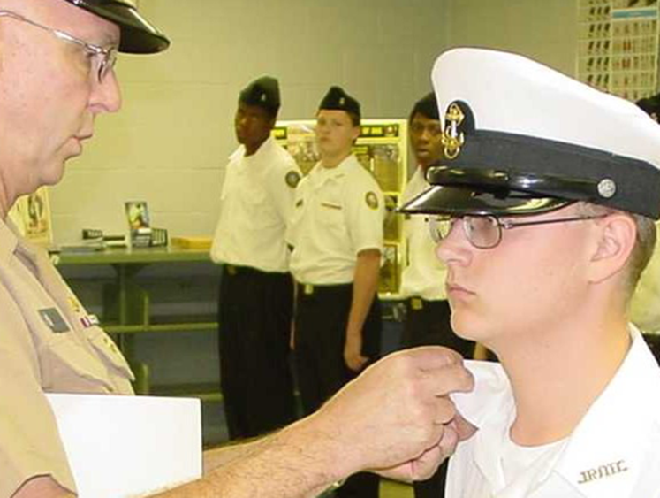
Introduction
Now in your second year of NJROTC, you may have been advanced to petty officer third or second class with leadership duties in a squad or platoon.
Even if you haven’t advanced, be sure to keep trying.
The key to advancement is to be “ready and at the door,” when the opportunity door opens.

Slide 5
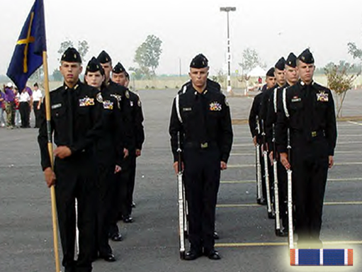
Introduction
You may now be a member of color guard, drill team, rifle team – and you may find leadership opportunities there.

Slide 6
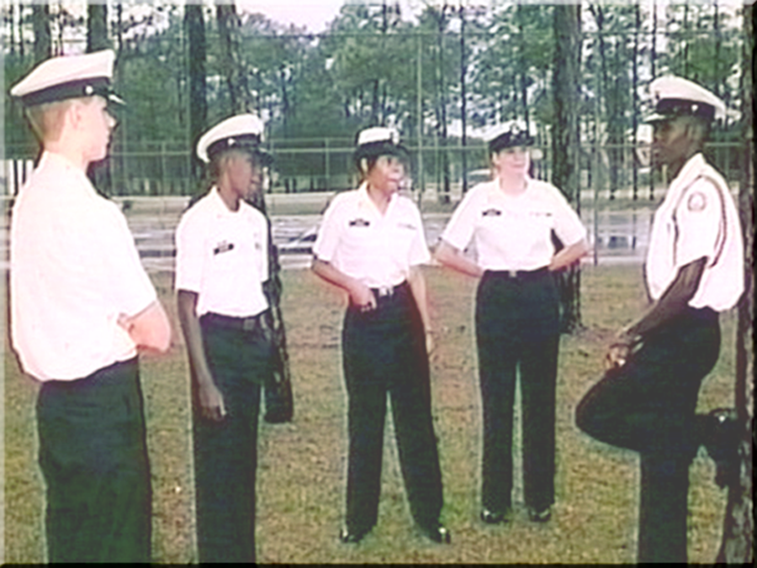
Introduction
Meanwhile, as an experienced cadet, you can and should help cadets in NS1.
If everyone helps, the unit will be a strong team.

Slide 7
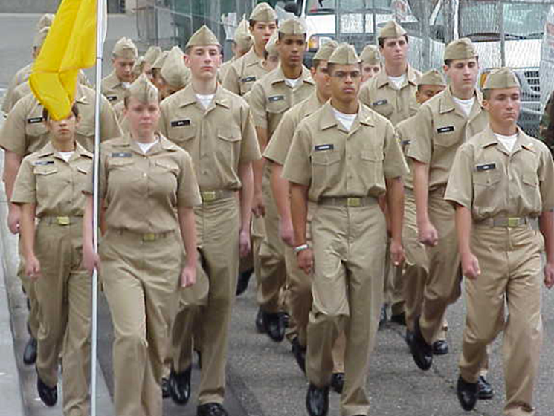
Introduction
Squad leaders, assistant squad leaders and platoon guides all have special responsibilities.
If each person knows their responsibilities, they are in a position to look after, guide and train others.

Slide 8
Introduction
Your first rule must be to set the best example possible, including your appearance.
A Uniform that is:
Clean
Pressed
Neat
Ship-shape
Awards and insignia that are:
Neat
Without loose or dangling threads
________ that are always shined.

Slide 9
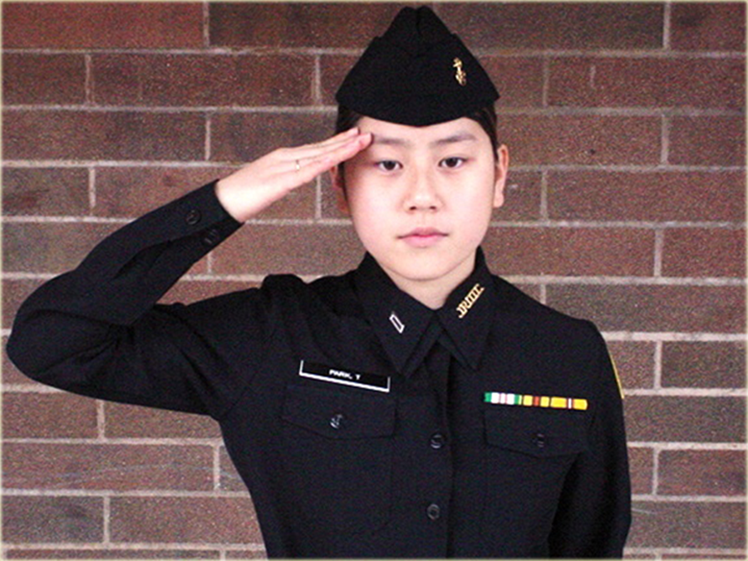
Introduction
You can also set a good example by:
Taking direction
Sharp marching
Snappy salutes

Slide 10
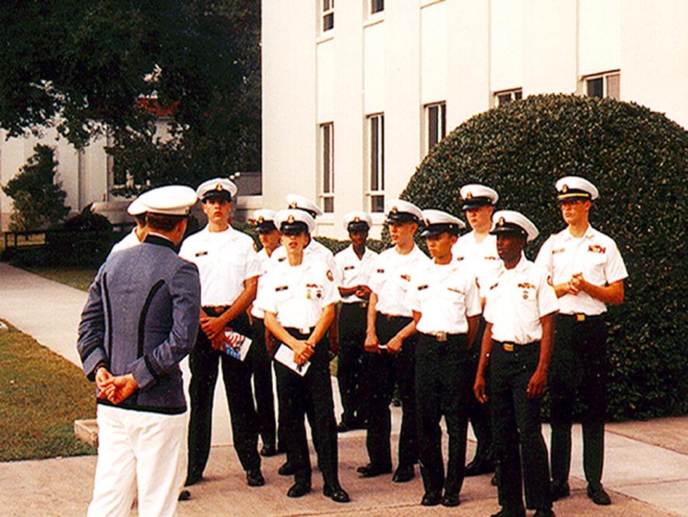
Introduction
Leadership and responsibility begin with setting the example yourself!
Your actions speak louder than words.
Your subordinates learn more by watching and following your example than by what you say to them.

Slide 11
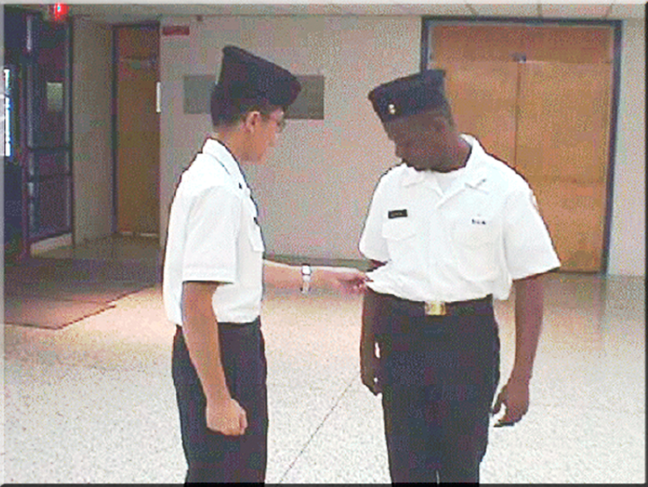
Introduction
When answering a question, it’s better and easier to show an example…in addition to telling.

Slide 12

The Leader
Leadership depends on the three factors shown below:
Leader
Followers
Job to be Done
Each leader may have a different approach yet be equally successful.

Slide 13
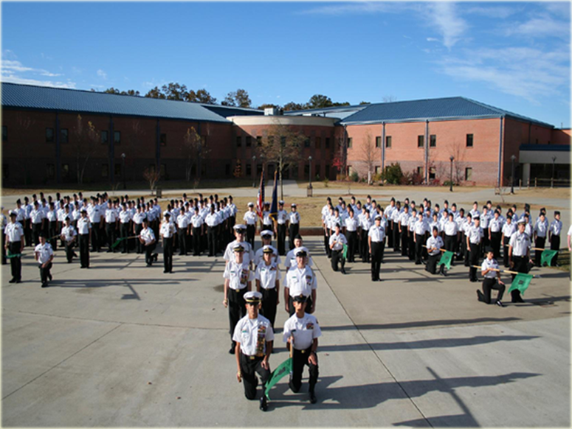
The Leader
During the first year of NJROTC, cadets learn to be good followers, then start working their way up the leadership ladder.
Various leadership opportunities begin to emerge, with teams, color guard and committees.

Slide 14
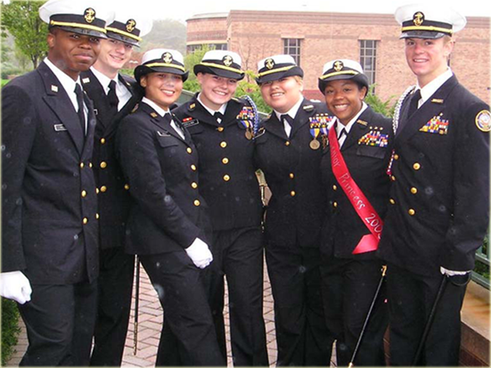
The Leader
Effective leadership at the top is dependent on the effectiveness of leadership at lower levels.
Cadets continue to work their way up as they accumulate experience and improved skills.

Slide 15
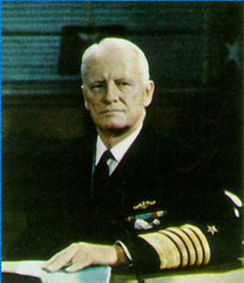
The Leader
There are few “born leaders.”
Most are developed through experiences including successes and failures.
Sometimes those having the most obvious gifts of good looks, outgoing personalities, intelligence and charisma – are not the ones who end up as the best long-term leaders.
Admiral Chester Nimitz

Slide 16
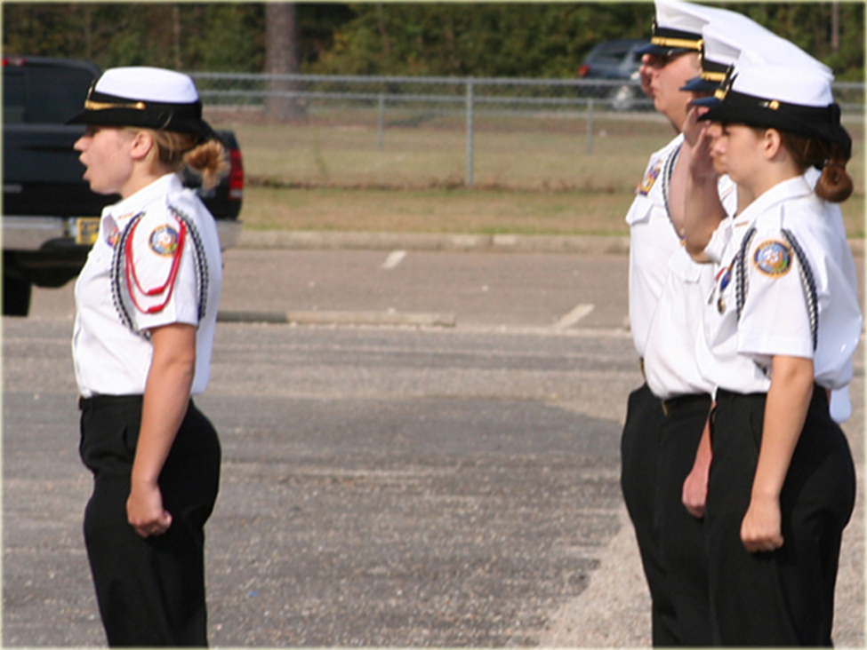
The Leader
NJROTC seeks to help each cadet gain leadership experience that will be useful in almost any situation.

Slide 17
Follow the Leader
School and Program Directives
Naval Science Instructor Staff
Company Commander
Cadet Officers
You
A leader never operates in a vacuum. There is always someone above and below on the chain of command.
Leaders must also be good followers, capable of taking orders as a _____________.

Slide 18
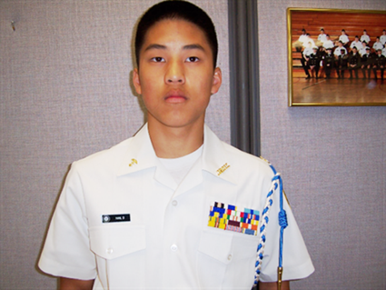
Follow the Leader
As a leader you must be more self-disciplined in your appearance, dress and conduct –
aware that you
are constantly setting an example for your followers.

Slide 19
Follow the Leader
Though cadet officers aren’t called on to make life-dependent decisions, they still make important choices.
Using input from their group, they study pros and cons, then decide how to best get the job done.
With responsibility to seniors, subordinates, job, and unit, this experience leads to learning to
work effectively with others.

Slide 20
Follow the Leader
Key things to remember in developing leadership abilities:
  Know your business
  Know yourself
  Know your personnel

Slide 21
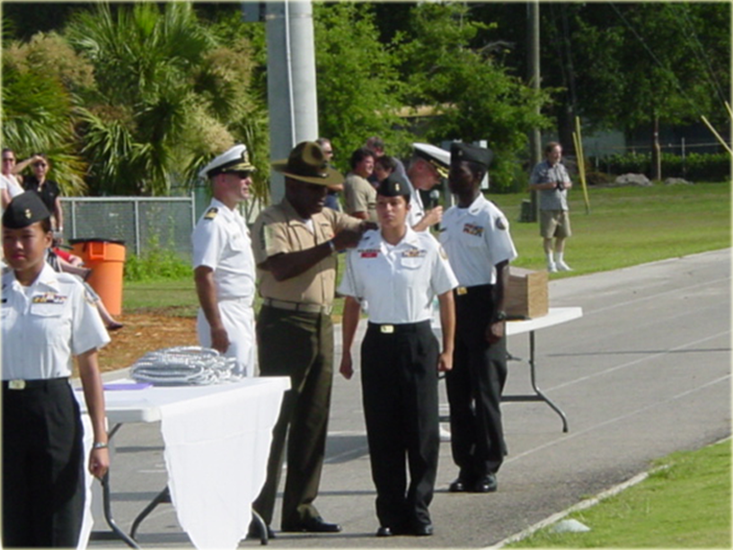
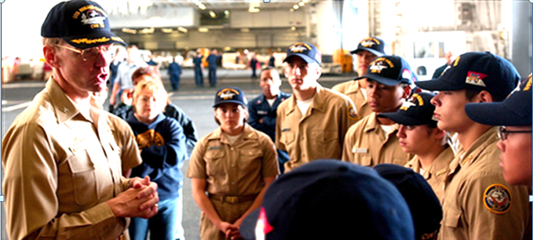
Follow the Leader
NJROTC optional programs and activities are available to develop leadership skills…
Basic Leadership Training
Leadership Academies
Summer Programs
Field trips to Navy bases, ships and air stations

Slide 22
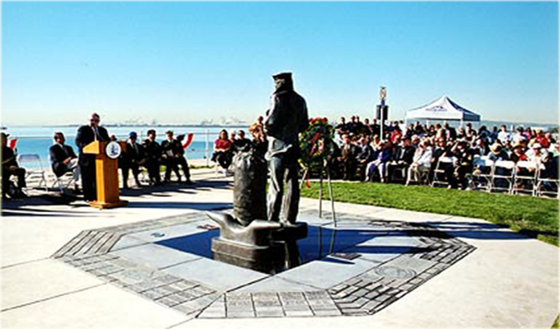
Personal Relationships
A leader’s relationships with his/her seniors, peers, juniors and the public all greatly influence their leadership effectiveness.
It’s great to be able to talk to large groups while making each person feel that he or she is being addressed alone.
Everyone has a desire for __________.

Slide 23
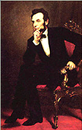
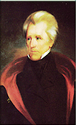
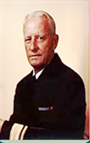
Personal Relationships
These great leaders are noted for their personal and social traits – trademarks of their personalities which made people feel comfortable and welcome in their presence.
President
Abraham Lincoln
President
Andrew Jackson
Admiral
Chester Nimitz

Slide 24
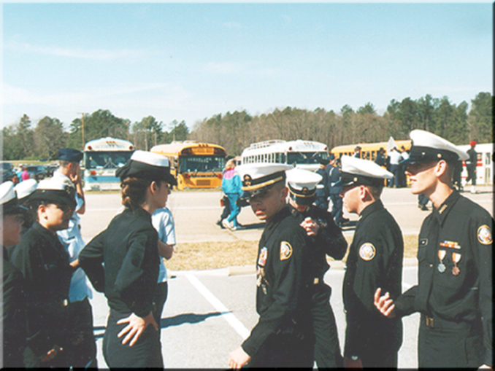
Personal Relationships
This special quality of leadership is just an unselfish, friendly interest in people.
A simple “good morning” or work question can let a subordinate know they are recognized and valued.

Slide 25
Personal Relationships
A feeling of camaraderie, loyalty and connection with the people with whom you are working creates a pride in the organization, also known as ________________.
A leader must have the cooperation of those within their unit – and a warm, friendly personality creates that good working environment.

Slide 26
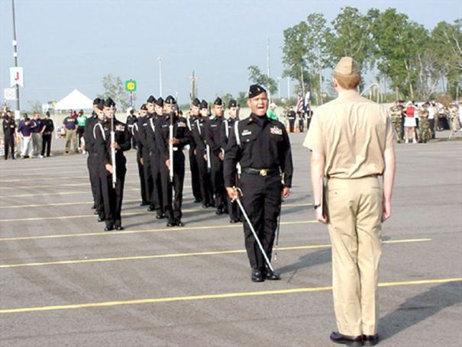
Personal Relationships
Respect from subordinates must be ___________ and cannot be demanded or commanded.
Leaders must counsel and guide subordinates without:
Breaking discipline
Breaking the chain of command
Being a “buddy”

Slide 27
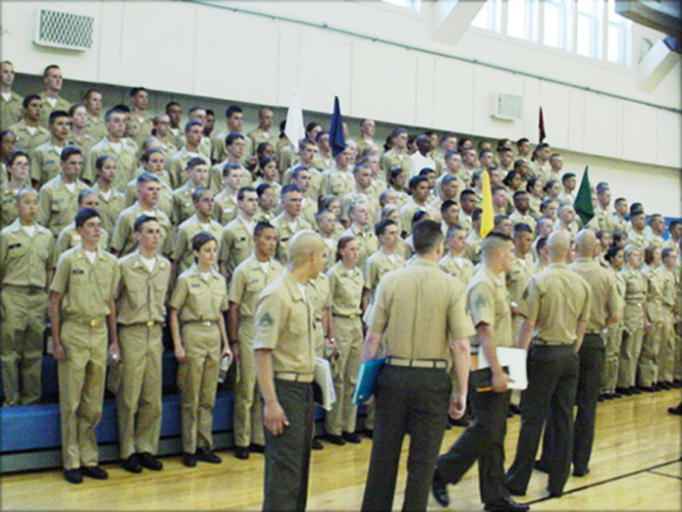
Personal Relationships
If there is one key to successful leadership above all others, it would be ________________.
The leader must be fair in:
Opportunity
Assignment
Work
Recognition

Slide 28
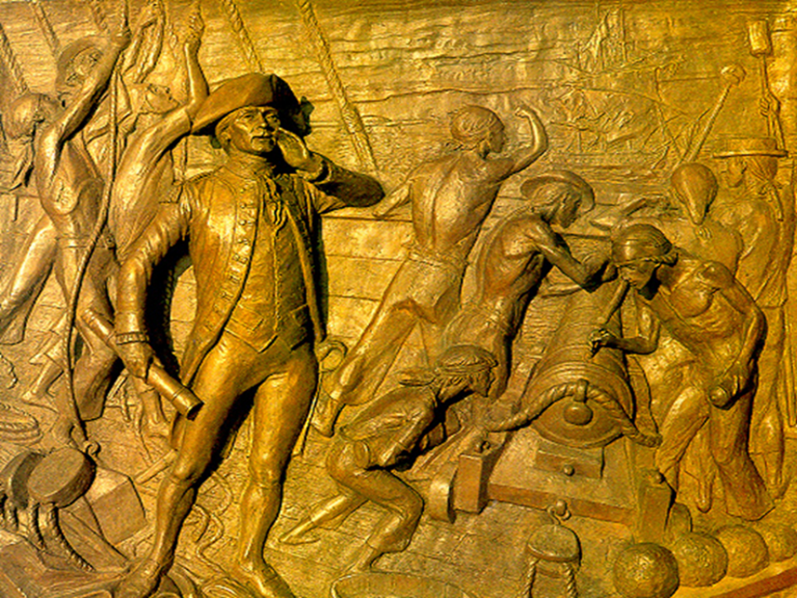
Essential Qualities of Leadership
An effective leader possesses certain personal traits which are absolutely necessary to command respect, confidence and obedience.
Let’s look closer at these traits….
US Navy Memorial - John Paul Jones

Slide 29
Essential Qualities of Leadership
_________________ to:
Country, required for military service
Seniors, to serve reliably and well
Juniors, with consideration for their welfare with “golden rule of loyalty”
Relatives, friends, others
“To thine own self be true, and….thou canst not be false to any man.” - Shakespeare

Slide 30
Essential Qualities of Leadership
___________________:
Implies a willingness to attempt a mission in spite of its danger
Training, education, drill and professional preparation lay the foundation
____________________:
Standing up for one’s beliefs
Calling out a situation honestly
Admitting to a mistake instead of covering up

Slide 31
Essential Qualities of Leadership
______________:
A proper sense of right and wrong
Expected of all, but especially an NJROTC cadet
______________:
Refusal to lie, cheat or steal – no gray area!
Included in honor codes of all service academies
______________:
Telling things the way they truly are without deception

Slide 32

Essential Qualities of Leadership
___________:
Another word for confidence
Examples of types of faith:
  Faith in one’s leaders, subordinates , or in a cause
  Faith in oneself (Self-confidence) builds respect from others

Slide 33
Essential Qualities of Leadership
Consequences associated with __________:
When faith in a leader and/or subordinates is lost, loss of trust and loyalty and reduced morale often follows
Faith in a cause is essential to victory
Leaders who believe in their service, their chain of command and themselves, will see their attitude reflected in those around them

Slide 34
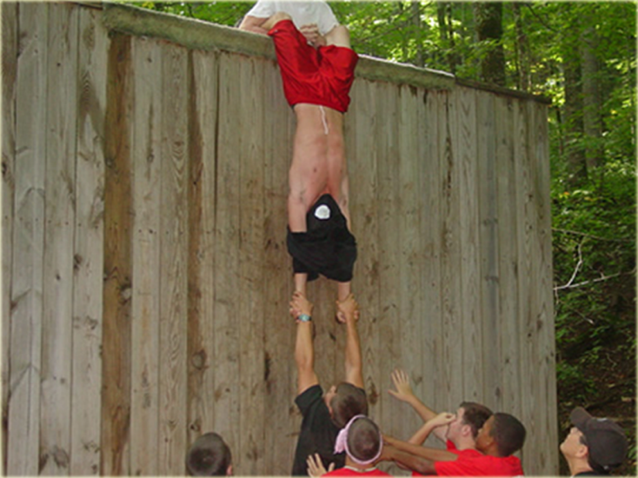
Essential Qualities of Leadership
Sense of Humor:
Finding humor in a situation allows a leader to use laughter to:
- Relax subordinates
- Release tension
- Restore confidence
- Restore positive thinking

Slide 35
Essential Qualities of Leadership
___________________:
Quiet dignity indicates great character and experience
A truly great person lets accomplishments speak louder than words
While maintaining pride in oneself, a leader must not develop an inflated self-image
A great leader doesn’t let self-importance override concern for subordinates

Slide 36
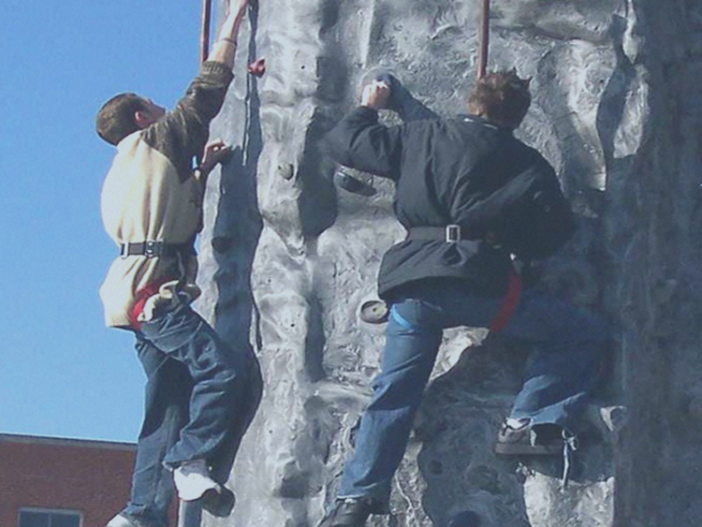
Essential Qualities of Leadership
__________________:
With experience, increased skills, professional knowledge and a positive attitude, a leader gains self-confidence and loses fear of failure
Taking on the tougher jobs may bring an occasional failure, but learning and bouncing back for another marks a leader’s development

Slide 37
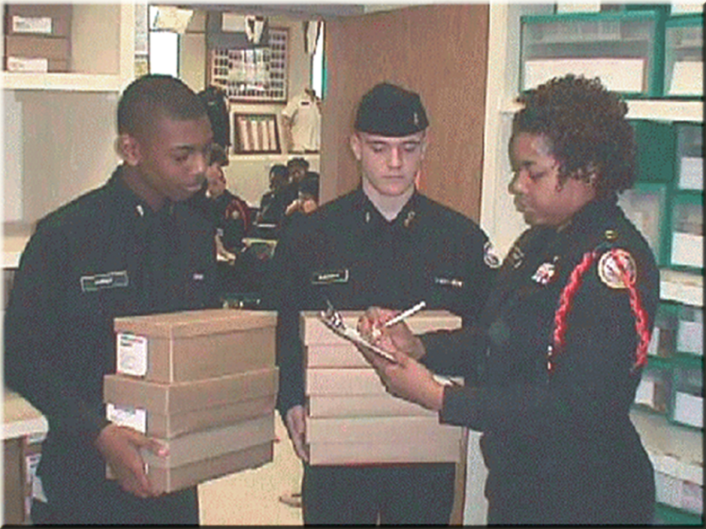
Essential Qualities of Leadership
_______________:
A leader is able to see and react to things as they are
________________:
With training and discipline, a leader gains the ability to analyze and draw correct conclusions
Greater knowledge increases a leader’s qualifications to make good judgments.

Slide 38
Essential Qualities of Leadership
_________:
Using good judgment to speak and act in a diplomatic way, leaders do not offend seniors, peers or juniors
Using common sense, good judgment and tact, a good leader recognizes, appreciates and uses personalities and similar experiences of others to make the best _________.

Slide 39
Essential Qualities of Leadership
__________________:
Without health and personal energy, there is little stamina to withstand the demands of leadership
A leader needs to know when to take a periodic break to remain sharp, and when to delegate work to subordinates.

Slide 40
Essential Qualities of Leadership
__________________:
An effective leader is usually healthy, energetic and optimistic with a “Can Do!” kind of attitude that inspires juniors and seniors alike
An optimist’s opposite is a ________ who is always looking for a reason a job cannot be done
An effective leader is usually an optimistic winner.

Slide 41
Essential Qualities of Leadership
___________________:
Leaders will think independently and take initiative in their jobs
They accept both pleasant and unpleasant tasks, and stay with them until properly completed

Slide 42
Essential Qualities of Leadership
____________________:
Leaders must know their people
NJROTC leaders should know all cadets in their class and most in their unit
Field trips, formations and social events build teamwork, a must for success as a unit and as a leader

Slide 43
Essential Qualities of Leadership
Concern for People:
Successful leaders are known by the people they develop into new leaders
One of a leader’s most important jobs is to recommend subordinates for recognition or promotion – so he/she must know them well enough to fairly and accurately evaluate them.
Subordinates should be kept informed as appropriate, which builds a cohesive team and inspires confidence.

Slide 44
Essential Qualities of Leadership
Concern for People:
The virtue of caring and commitment shines brightest whenever a senior follows through with promises made to subordinates.
Leaders should _______________________________
_________________________________________
A leader should be careful to avoid neglecting commitments for reasons of expedience, laziness or personal gain.

Slide 45
In Summary
Leaders must:
Know the capabilities of each member of their group and how to coordinate them to do their assigned jobs well
Be self-confident, with ability to:
  Keep a winning attitude
  Keep on track to accomplish goal
  Know when it’s better to stress the job or the individual

Slide 46
In Summary
Leaders must:
Be willing to take increased responsibility while:
  Carrying out orders cheerfully with imagination
  Completing their work in an ordered fashion
  Looking ahead to the next job after current task is done

