Slide 1
Shakespeare: innovator of drama and language for all time
Stan Misler
World Literature IB-3
Fall 2016
latrotox@gmail.com

Slide 2
Motivation: Approaches to study of Shakespeare plays
1. Structural and character analysis: psychological analysis; new hypotheses for meaning of play
2. Intellectual history: how society affects the dramatist and how the dramatist affects contemporaries and later society.
3. Linguistics: Shakespeare’s language
4.”Archeology”: finding manuscripts and reconciling them with prior ones
5. Staging and direction: past and contemporary

Slide 3
A. Elizabethan London: A brave new world crossing from Medieval to modern:
1. “the best of times”
Relatively peaceful period of compromise in religion and politics with advancement of learning and flourishing English language and theater; adventurous travel including circumnavigation of globe; pursuit of pleasure and luxury
Society dominated by Queen Elizabeth (Gloriana or Virgin Queen) who operates via “divide and conquer”, and “patronage”. Rare convocation of Parliament; local self-government. Considered very wise widely loved by populace for devotion of life to England. Central paradox of reign: woman with absolute power in country where women had no vote, few legal rights including property and only limited chance at education
Religious tightrope between extremes: legal suppression of (a) “ foreign” Roman Catholics and (b) strict Protestants (Puritans). Individuals of both groups were tolerated if they remained loyal and attended Anglican services

Slide 4
……… and 2. the worst of times
(a) Filthy medical nightmare after 5-fold population explosion in London and ignorance about hygiene and diet: bubonic plague; malaria; waste contaminated water supplies and “airmailing of garbage”; small pox and influenza kill young; tuberculosis kills adolescents; early hypertension, heart disease and liver disease -> early aging and death of adults. Poor personal hygiene covered up by herbal scents.
(b) Queen keeps nobility broke by touring around country and having her hosts entertain up to 2000 people per evening and supply her with new wardrobes
(c ) New poorly regulated capitalism:
mines and looms bring treacherous working condition
Abolition of fiefdoms -> many displaced persons (vagrants)
Boom / bust cycles and famines
Growing gap between rich and poor
Licenses for privateering (piracy) against Spain
(d) Strict spy network in prisons and outside of country

Slide 5
…….And what kept it all together: age of great change is also age of conservatism to fend off chaos
Belief in hierarchy. Each person, as each planet and star, has a fixed place in rigid columns of social order. Reinforced by clothing law where each person must wear clothing recognizable for class.
Idea of correspondence across creation Ex. As King is ruler of nobles and lion is King of beasts, so husband as king of household
Obedience to laws, traditions and the Queen
Superstition. Terrors of night (ghosts); witches as scapegoats

Slide 6
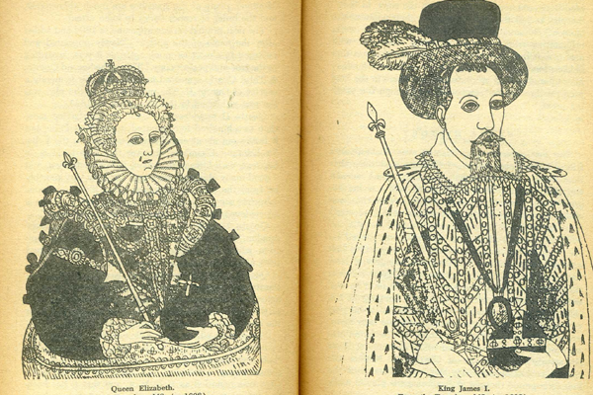

Slide 7
B. The birth of the English Theater
1576: construction of “The Theatre” for professional dramatic presentations in English. Prior to this there were itinerant, Bible-based or morality play presentations with pageantry and spectacles.
Beginning in late 1580’s three competing theaters running simultaneously and needing a new play every 2 weeks.
Actors need to sing, dance, fence, be witty, project strong emotions and have own costumes. Boys whose voices have not yet changed play women’s parts
No copyright and little chance of publication except in comic book type form (Quartos). Receive about $200 per play.
Up to 10 plays done in repertory so good prompter needed or ability of actor to improvise

Slide 8
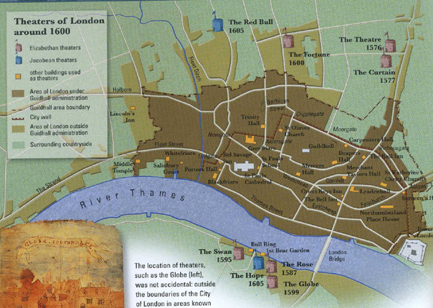
Theaters: South Bank of Thames = outside of central London

Slide 9
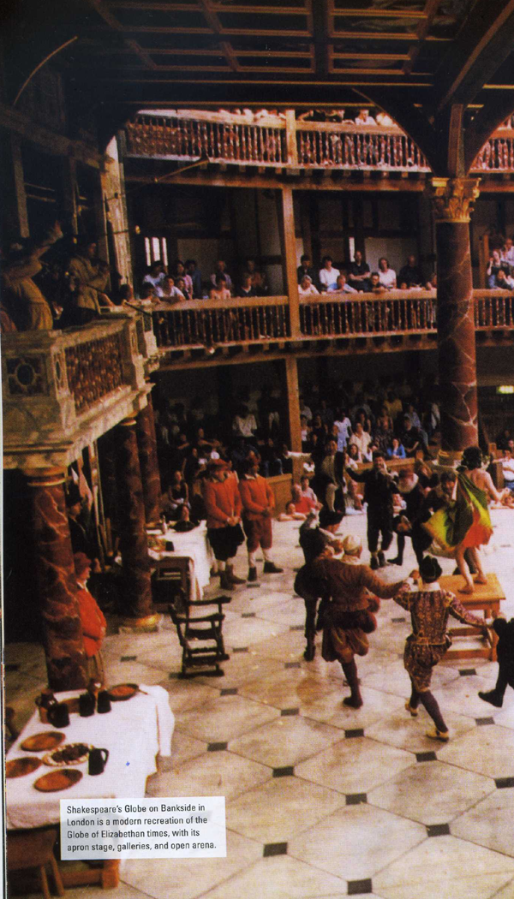
Details of theater in the time of Shakespeare
Octagonal wooden structure with thrust stage and open roof for daylight so performances begin at 2pm and must end by 5pm
Accommodates up to 2000 people = 1/4 standing on ground in pit (“groundlings”) and ¾ in seats. Wide range of theater goers (15-20% of London population from day laborers to nobility) with price of “groundling” admission + beer and nuts is 1.5 % of laborers’ weekly salary
Varying stage action (dialogue + soliloquies = verbalizing inner thoughts +/- asides to audience) to maintain audience attendance
Few props = table, chairs, swords; painted cloth as scenery + priming lines to paint location of scene; elaborate costuming
Music and dance: trumpet flourishes to sound call to attention; alarum = battle music with fife and drums; lute songs for dance accompaniment

Slide 10
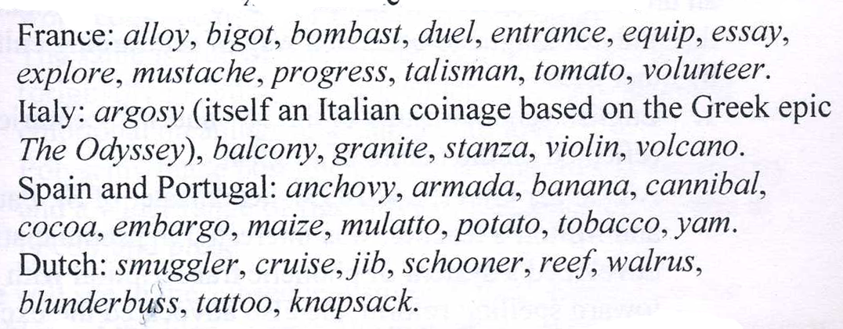
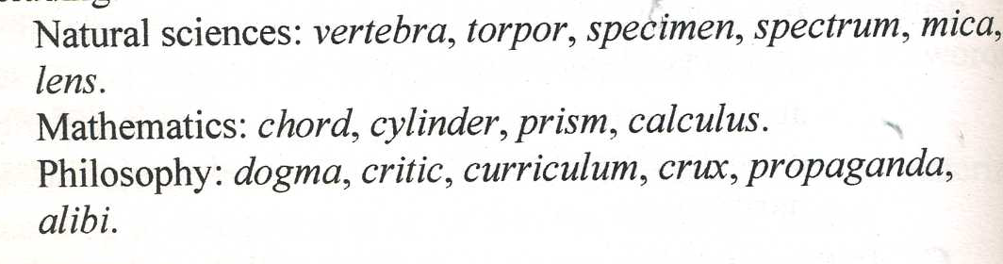
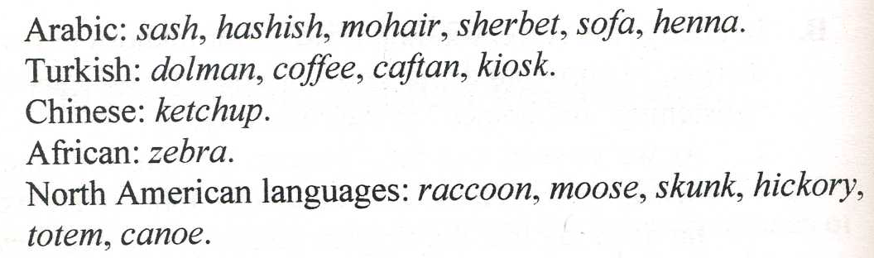
C. Shakespeare and Elizabethan era as central to development of modern English and dramatic speech
1. Words borrowed from wide spectrum of world-wide languages through trade, wars, exploration, diplomacy, colonization, science (see below) as well as specialty terms from science
2. Grammar: introduction of subjunctive: shall/should; will/would

Slide 11
D. What makes Shakespeare special among English Renaissance playwriters
Creator of a cohesive body of work, with common themes (e.g., the nature of love and kingship), that is central to the canon of Western literature and
Inventor of modern English
In single plays portrayal of wide range of contemporary man (from nobility to household servants and clowns in complex situations) with inner discussions and debate on nature of man “Holding a mirror up to nature”: “the inventor of the human psyche ” H. Bloom; “His works may be considered a map of life” S. Johnson;
Equal master of (a) comedy (festive romantic, pastoral, farce); (b) histories of English kings; (c) tragedies (fate and free will) and (d) romances (folk tales with incredible plots (wrongdoing -> penance -> reconciliation or grace

Slide 12
5. Dramatic invention: Used popular plots but enhanced them with great character portrayals; plays written with eye towards ability to edit and cut
6. Stylistic invention: Convincing writing in wide range of styles: flights of poetry interspersed with humor of taverns.
Verse in iambic pentameter = 10 syllable line with 5 feet; without rhyme: (but SOFT what LIGHT through YONder WINdow BREAKS) vs (ii) prose for dramatic impact

Slide 13
7. Philosopher of theater of the imagination: (a) Prologue to Henry V
O for a Muse of fire, that would ascend
The brightest heaven of invention,
A kingdom for a stage, princes to act
And monarchs to behold the swelling scene!
Suppose within the girdle of these walls
Are now confined two mighty monarchies…
Think when we talk of horses, that you see them
Printing their proud hoofs i' the receiving earth;
For 'tis your thoughts that now must deck our kings,
Carry them here and there; jumping o'er times,
Turning the accomplishment of many years
Into an hour-glass: for the which supply,
Admit me Chorus to this history;
Who prologue-like your humble patience pray,
Gently to hear, kindly to judge, our play.

Slide 14
(b) A Midsummer Night’s Dream
The lunatic, the lover, and the poet
Are of imagination all compact.
One sees more devils than vast hell can hold—
That is the madman. The lover, all as frantic,
Sees Helen’s beauty in a brow of Egypt.
The poet’s eye, in fine frenzy rolling,
Doth glance from heaven to Earth, from Earth to heaven.
And as imagination bodies forth
The forms of things unknown, the poet’s pen
Turns them to shapes and gives to airy nothing
A local habitation and a name.
Such tricks hath strong imagination,
That if it would but apprehend some joy,
It comprehends some bringer of that joy.
Or in the night, imagining some fear,
How easy is a bush supposed a bear!

Slide 15
8. Shakespeare’s Theatrical devices
Dreams
Eavesdropping scenes
Play within a play
Double plot (parallels)
Block to young love
Punishment of “killjoy”
Green world
Drama of ideas
Arc of character development: ignorance to knowledge
Embedded stage directions
Tests of “character”
Pageants, spectacles and entertainment
Music and songs

Slide 16
E. Hamlet Backgrounds
1. Plot outline
Hamlet, Prince of Denmark and university student, is despondent over death of father and hasty remarriage of mother Gertrude to lesser person, his uncle Claudius. Denmark is in a state of confusion about possible invasion by Norwegian Prince Fortinbras who wishes to recover lands captures by Hamlet senior.
Hamlet confronted by ghost who tells him Claudius is his murderer and prods Hamlet to revenge.
Hamlet hesitant about killing uncle (is ghost real?) and assumes madness to figure things out; girlfriend Orphelia is unfortunate chief target. Claudius seeks to find out reason for madness by engaging Rosencrantz and Guildenstern (R&G, fellow students) as spies
Hamlet engages troop of players to present work that mimics father’s death; catches conscience of king
Hamlet oversees Claudius attempting confession and confronts mother about he sexual relationship with Claudius; Polonius (king’s secretary of state) overhears conversation and Hamlet, mistaking him for Claudius, kills Polonius.
Claudius sends Hamlet into exile in England with R &G with idea that English will kill him; Orphelia goes mad and drowns herself on hearing news of her father Polonius death
Polonius son Laertes returns from abroad to avenge his father’s murder. Hamlet returns to Denmark to find Orphelia dead and being buried and mourns her
Claudius conspires with Laertes to arrange dueling match between Hamlet and Laertes in which Laertes will use pointed and poisoned sword and Claudius will offer Hamlet poisoned drink
Play ends with duel with deaths of both Hamlet, Laertes and Gertrude; Hamlet kills Claudius. Hamlet designated Fortinbras as new King and Hamlet’s confidant Horatio is left to tell story and clear Hamlet’s name

Slide 17
2. What type of play is Hamlet?
Revenge and purgation (state cleansing) tragedy driven by disclosure of a ghost but inhibited by doubt: Hamlet as “hero of hesitation” who can still act impulsively
Tragedy:
a. Recall from Greek tragedy: “A man’s character is his fate” (oracle prediction based on character but not determined by gods) and learning through suffering. Tragic hero is noble man who rose to heights of success only to be plummeted to defeat by tragic flaw (harmartia).
b. Renaissance tragedy types: revenge vs blood bath vs. man built to suffer and die (Does Hamlet forfeit life for justice?) against background of man with a soul that can be fought for
Protagonist as a Renaissance humanist: individualist, deep thinking intellect with courage, generosity, wit, courtly bearing who in Hamlet is a limitless, constantly self-revealing theatrical character.
“man is the measure of all things”; “excellent dignity of man” (Pico della Mirandola Oration on the Dignity of Man);

Slide 18
3. Sources and Novelties
Old Danish tale of son (heir apparent) deprived of throne because the widow Queen rapidly marries her brother-in-law and son’s uncle. Hamlet pretends to be feeble-minded to hatch revenge
Kyd’s A Spanish Tragedy (1587) includes revenge, ghost, madness (real or pretended?), horror of multiple deaths, play within a play and
Early Hamlet play by Shakespeare (Ur-Hamlet) might have been written in collaboration with Kyd (1590)
Shakespeare’s “Revenge of Hamlet, Prince of Denmark” registered in 1602 and then published in 1603 as “Tragical history of Hamlet , prince of Denmark” by Wm. Shakespeare.
a. Creation of mysterious character of consummate intellect presented through “indecision” soliloquies :
Act 1: O that this too too solid flesh would melt
Act 2: Oh what a rogue and peasant slave am I!
Act 3: To be or not to be (contemplation of suicide)
Act 4: How all occasions do inform against me and spur my dull rage
(b) Is longest of Shakespeare plays in which Hamlet, most charismatic of characters, speaks more lines, has greater command of language and expresses wider range of thoughts and feelings than almost any other character in Shakespeare or other dramas. Subject to wide range of interpretation

Slide 19
4. Critical themes
Revenge and Hamlet’s inability to perform it
Contemplation vs. action (Fortinbras as foil)
Appearance vs. reality: what is the nature of certainty?; “plucking out heart of mystery”
Duality of man: savagery vs. sensitivity; careful vs. rash
Decay and corruption in the state
Sanity vs. insanity: Hamlet = melancholia (longing for death in Act 1) -> play acting and real mania with strong sense of irony (Acts2-4) -> equanimity (Act 5) ; Orphelia = real psychosis
Play acting in the theatre and life (“holding mirror up to nature”) : Hamlet as actor, director and author; The Mousetrap = play within a play (“the play’s the thing wherein I’ll catch the conscience of the king”); emphasis throughout on elocution; comic relief and restraint (not overstepping modesty of nature) throughout play
Misogyny: woman as liar and cheater (Hamlet “frailty thy name is woman” “get thee to a nunnery”) whom world wishes to control (Orphelia “I don’t know what to think”; “I shall obey”)
Mystery of death and afterlife: ghost is true soul in purgatory or an evil spirit?; afterlife as “undiscovered territory from whose bourn no traveler returns”
Religion: humanist vs. atheist (belief in damnation, confession, and Christian burial vs. Hamlet’s leaving “harsh world” with only concern for “wounded name”). Claudius confrontation of self guilt: appearance of repentance but knows he can’t have this as he wishes to enjoy fruits of crime

Slide 20
5. Everlasting Expressions from Hamlet
A document in madness
What a piece of work is man
The play’s the thing (wherein I’ll catch the conscience of the King)
There is method in his madness
To be or not to be
Brevity is the soul of wit
To thine own self be true
Something rotten in the state of Denmark
Alas poor Yorrick I knew him well
The time is out of joint
There is more twixt heaven and earth than is dreamt of in your philosophy
The mind’s eyes
There is nothing either good or bad but thinking makes it so
The glass of fortune and the mold of form
To play the fool
Good night sweet prince and flights of angels sing thee to thy rest
Now is the very witching time of night
I will speak daggers but use none
Though this be madness yet there is method in it
To hold a mirror up to nature
By indirection find direction out

