Slide 1

Pacifica School District Online Enrollment

Slide 2
To Access Your Existing ParentVUE Account with Pacifica School District
Use This Link
ParentVUE Account Access

Slide 3
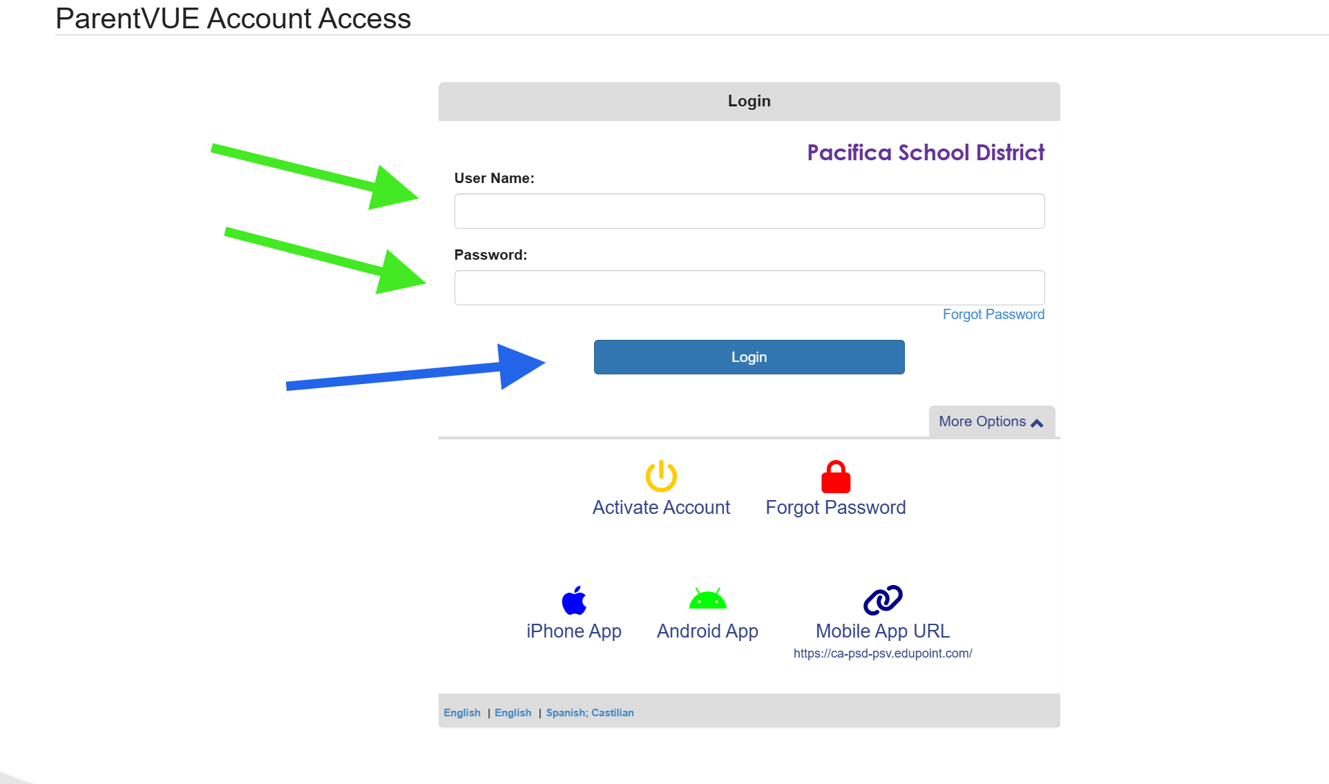

Log In to Your Account
Steps to Log In:
Type your Username
Type your Password
Click on "Login"

Slide 4
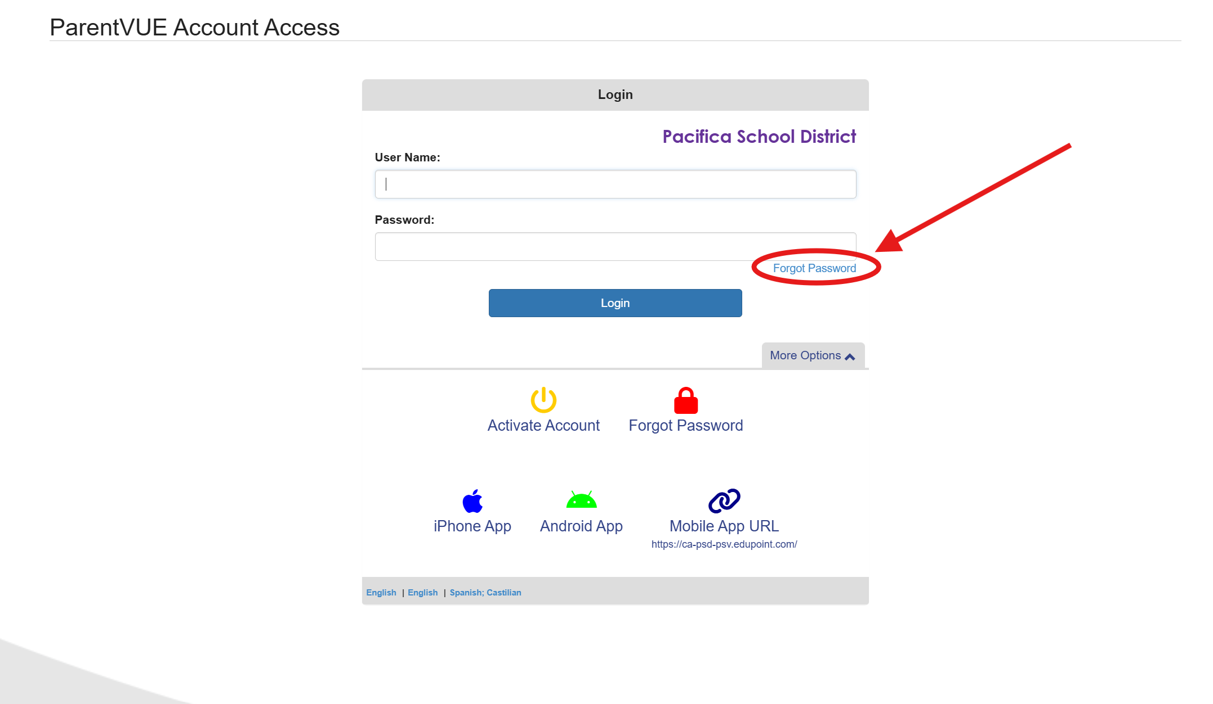
What to Do If You Don’t Remember Your Username or Password
1. Click on 'Forgot Password

Slide 5
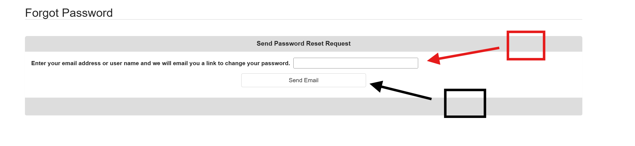



How to Reset Your ParentVUE Password After Clicking 'Forgot Password
Type your district email address in Field.
Click on the "Send Email" button.
Check your district email inbox and follow the instructions to create a new password.

Slide 6
I Have Never Had a ParentVUE Account with Pacifica School District
Use This Link
Online Registration Account Access

Slide 7
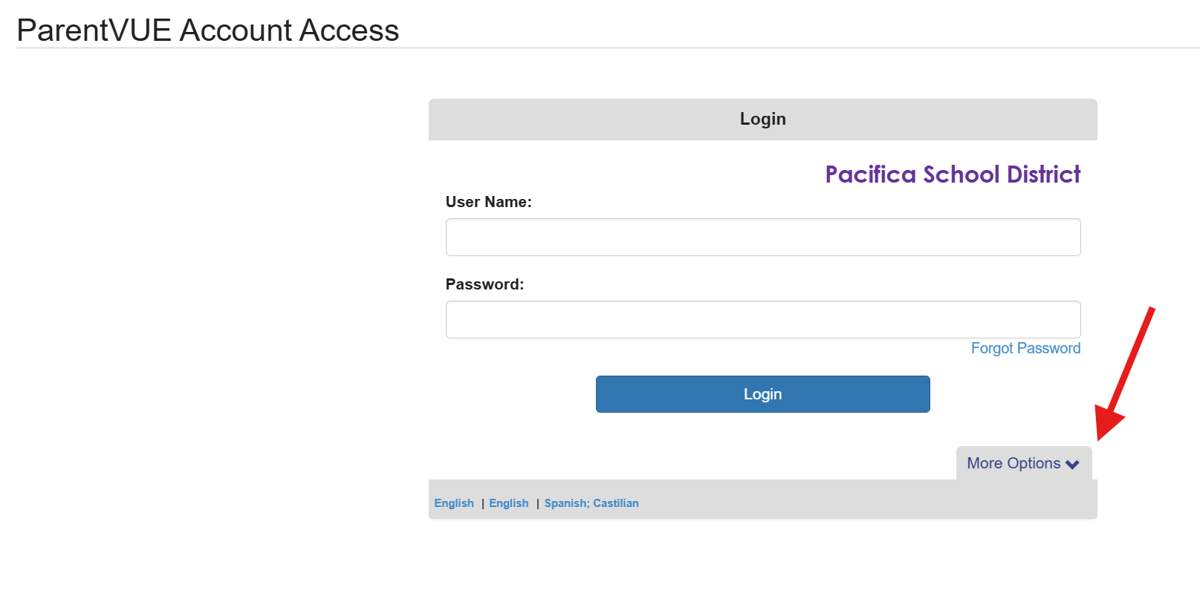
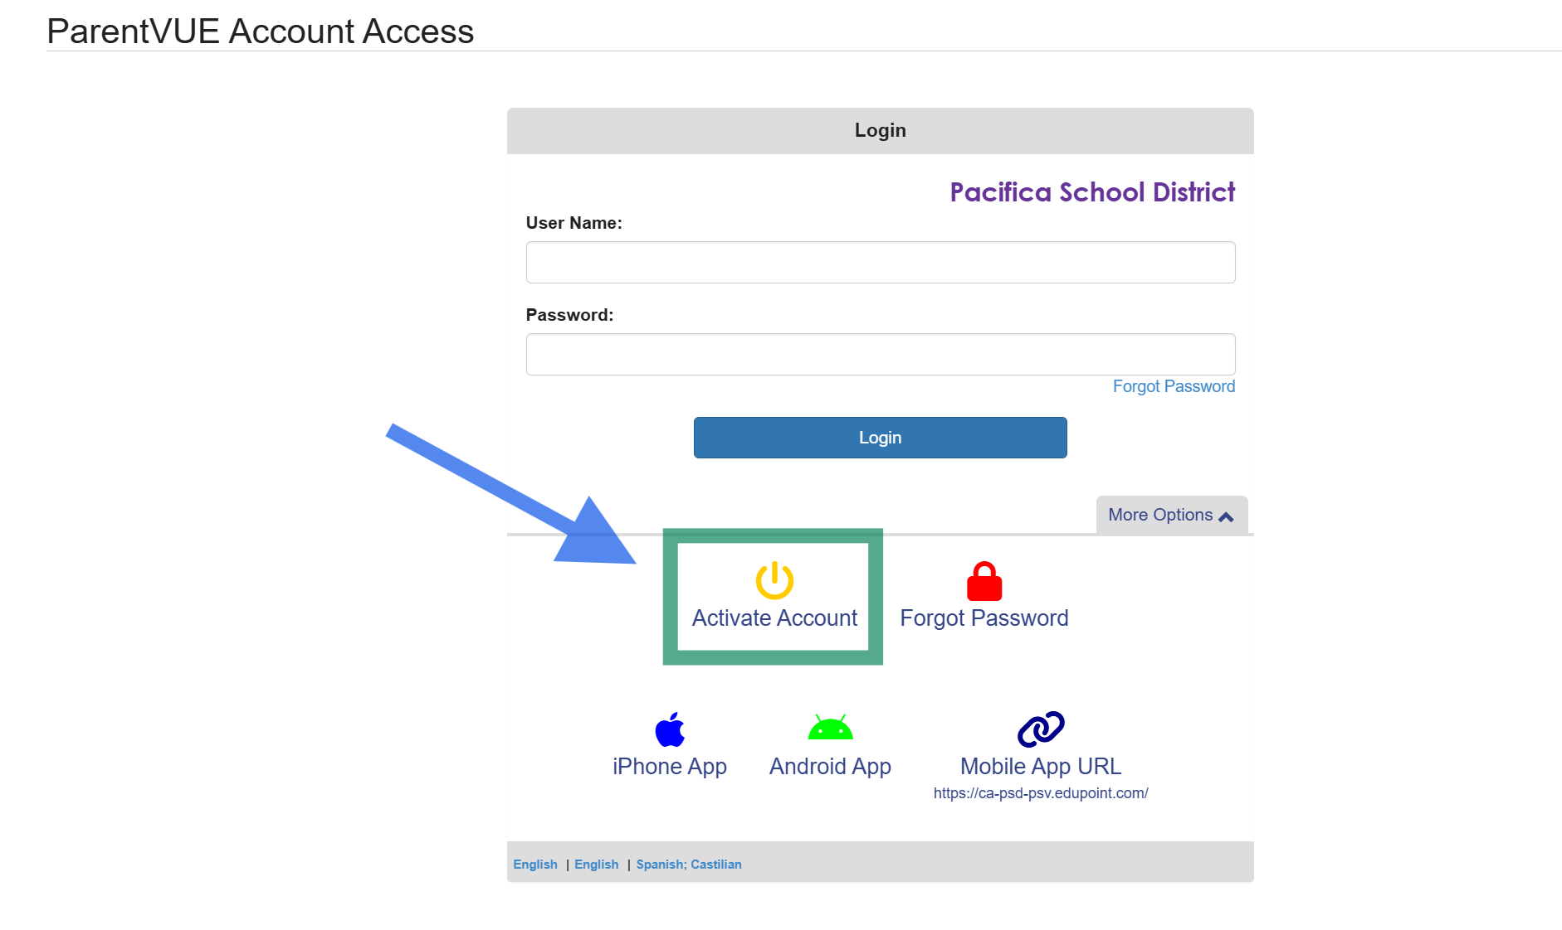
To Create a ParentVUE Account with Pacifica School District
1. Click on “More Options”
2. Click on “Activate Account”

Slide 8
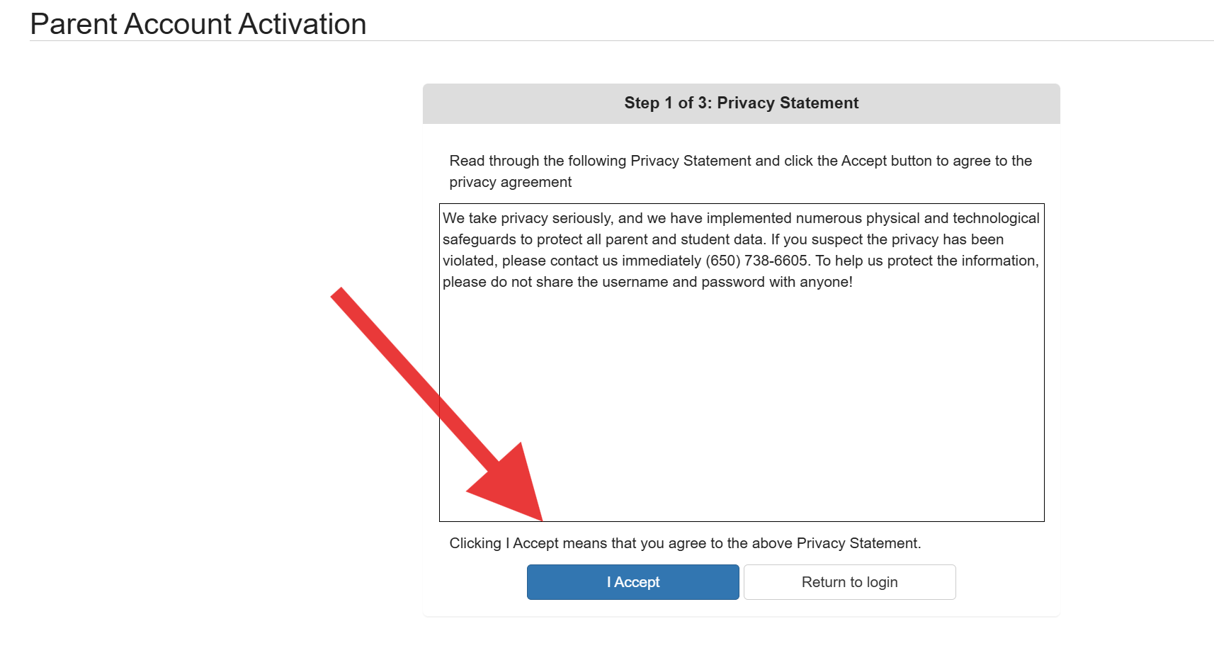
To Create a New Account, Follow These Three Steps
1. Read the Privacy Statement (You must accept it to proceed. If you have any questions, please contact us.)

Slide 9
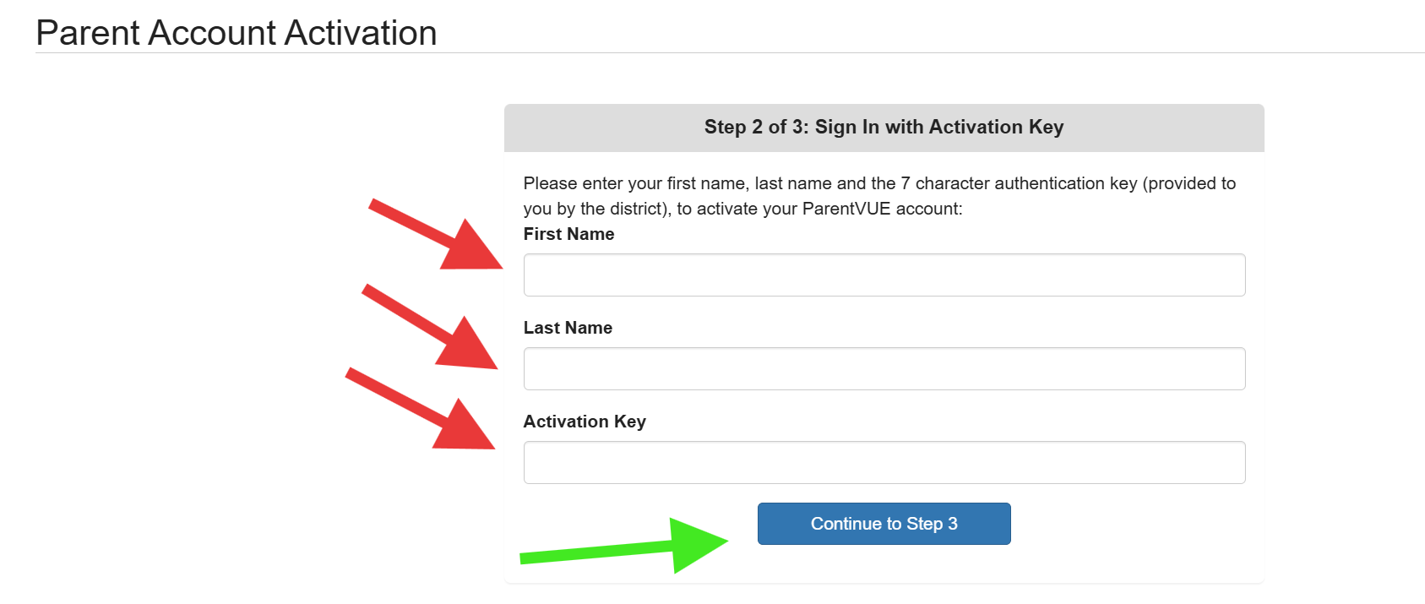

To Create a New Account, Follow These Three Steps
2. Please enter your first name, last name and the 7 character authentication key (provided to you by the district), to activate your ParentVUE account:

