Slide 1

Merrimack School District Summer and ESY Programs
Coming June 2021-August 2021

Slide 2

Summer Reading Program Grades K-7
Format of Instruction:
Remote Monday
Large Group SEL Lesson
Tuesday-Thursday
30-minute Zoom lessons working on targeted skills
Remote
In-Person
Monday-Thursday
Literacy Activities and targeted lessons
Large and small group instruction

Slide 3
Summer Reading Program Grades K-7
Program Facilitator: Debbie Fournier
Location: MMS/Remote
Dates: July 6, 2021- July 29, 2021
Frequency of Instruction:
In-Person – Tuesday-Thursday 8:30-11:20 AM
Remote: - Monday –Thursday
I day whole group
3 days of 1-to-1 or small group instruction
Targeted Students:
Students who are reading below grade-level including regular education
Students enrolled in special education, and Title I are included if the team decides this is the best program for the student.

Slide 4

Title I Digital Reading and Math Academy
Grades K-7
Instructional Model:
  Customized reading and math lessons and skill work using online instructional programs
  Weekly one-to-one Zoom tutoring sessions for follow-up skill-based work, corrective instruction, and feedback.

Slide 5

Title I Digital Reading and Math Academy
Grades K-7
Program Facilitator: Susan Luhrs
Location: Remote
Dates of Program: July 6, 2021 – August 13, 2021
Frequency of Instruction:
  1-2 Scheduled Zoom tutoring sessions per week
  Weekly Online practice using Lexia and/or DreamBox
  Parent/Instructor collaboration regarding scheduled sessions and monitoring of online practice
Targeted Students:
  Students who are currently enrolled in the 2020-2021 Title I program plus an expanded list of newly selected Title I students based on Spring assessment data.
  Students must be invited in rank order, neediest first, based on multiple-educational criteria.

Slide 6
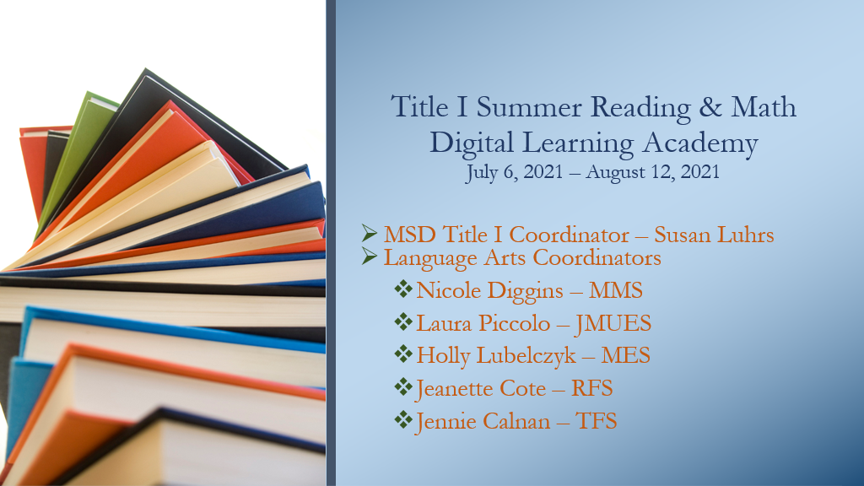

Slide 7
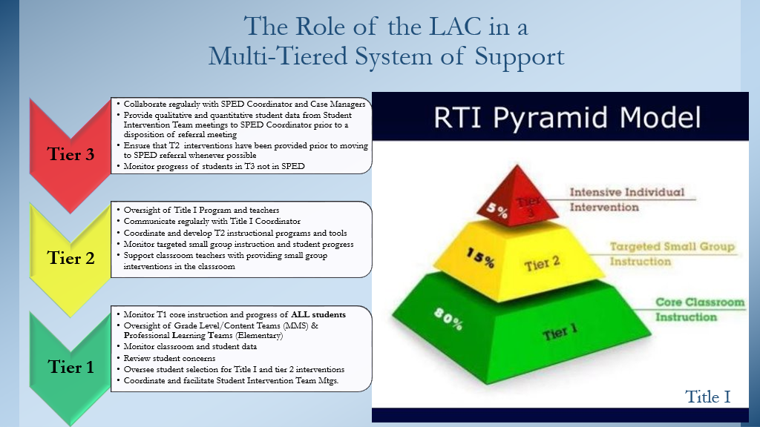

Slide 8
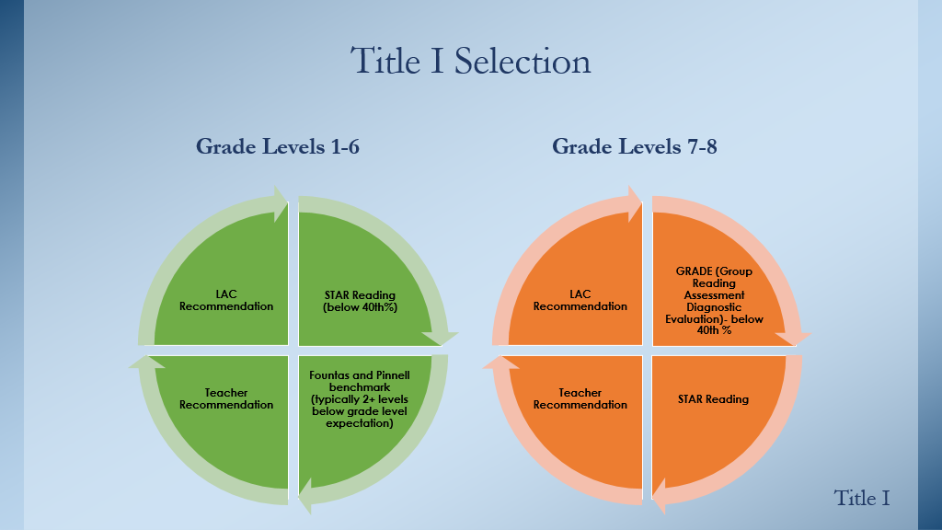

Slide 9
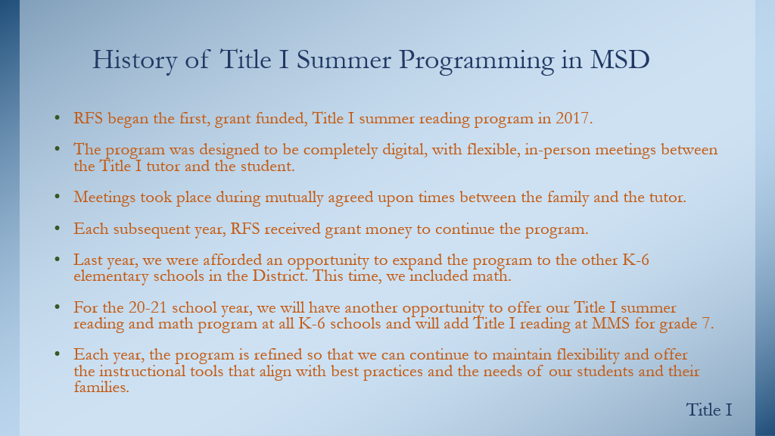

Slide 10
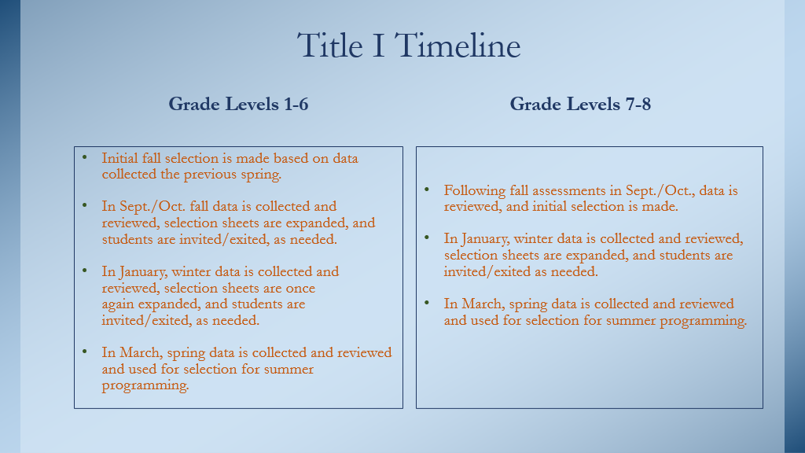

Slide 11
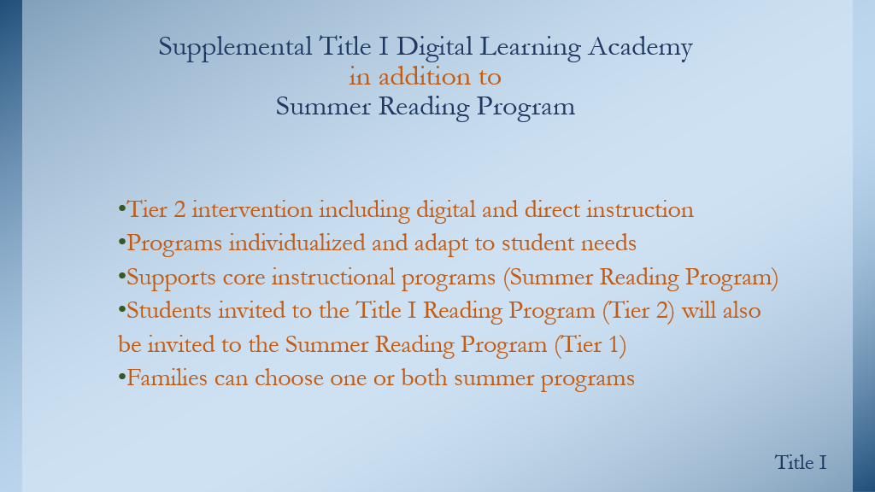

Slide 12


Slide 13

Middle School Pre-Algebra Program
Instructional Model:
Zoom instruction in order to allow incoming 7th grade students prepare to be enrolled in Pre-Algebra at the start of the school year.
Zoom instruction in order to allow current 7th grade students prepare to be enrolled in Pre-Algebra at the start of the school year.

Slide 14

Middle School Pre-Algebra Program
Program Facilitator: Cheryl Smith
Location: Remote
Dates of Program: Quarter 4 at MMS and July 2021 (84 student currently enrolled)
Frequency of Instruction: 2X week for 90 minutes over 8 sessions during Quarter 4
Targeted Students:
  Incoming 7th grade students who would like to be able to enroll in Pre-Algebra in the fall.
  Current 7th grade students who would like to participate in Algebra I in grade 8

Slide 15

High School 8.5 Program
Instructional Model:
  The 8.5 program helps struggling students who need more support during their transition into the high school.
  Provides enrichment for incoming ninth graders of all academic abilities.
  The program’s goal is to prepare all students for their time at the high school.
  Our students go on to classes of all levels, foundations to honors.

Slide 16

High School 8.5 Program
Program Facilitator: Ron Delude
Location: MHS In-Person/ Remote
Dates of Program: June 28, 2021 – August 5, 2021
Frequency of Instruction:
  Monday –Thursday: 4 days a week
  Six-week program
Targeted Students:
  Struggling students who need more support during their transition into the high school, and enrichment for incoming ninth graders of all academic abilities.

Slide 17

High School Credit Recovery Program
Instructional Model:
  Serves the same role as the traditional summer school program
  Allows students to earn credit in courses they previously failed
  There are two, 130-minute classes each day.

Slide 18

High School Credit Recovery Program
Program Facilitator: Ron Delude
Location: MHS In-Person/Remote
Dates of Program: June 28, 2021 – August 5, 2021
Frequency of Instruction: 4 days a week for 6 weeks
Targeted of Instruction:
  Students to earn credit in courses they have previously failed.

Slide 19

Gifted and Talented Program
Instructional Format: Offering fully In-Person and fully Remote programs

Slide 20

Gifted and Talented Program
Program Facilitator: Meg Fowler, Sally Agel, and TBA
Location: In-Person and Remote
Dates of Program: July 5, 2021 – August 5, 2021
Frequency of Instruction:3 days a week
Targeted Students:
  Previously Identified Gifted and Talented Students grade 5-10

Slide 21

ESY Programs – Special Education
Director of Student Services: Heather Barker
Special Education Coordinators Nancy Romero and Christine Reinert

Slide 22

ESY Instructional Model
As part of their Individualized Education Program (IEP), in order for a student to receive ESY services, the student must have evidenced substantial regression and recoupment issues during the previous IEP year
And/or there is evidence of emerging skills which are often referred to as "breakthrough" skills
The focus of the services provided to the student as part of an ESY program are generally not upon learning new skills or "catching up" to grade level, but rather to provide practice to maintain previously acquired or learned skills.
Specialized instruction and related services are identified in ESY section of the IEP
Some students may require additional instruction and/or related services beyond the five- or six-week program. Those services are available in June and August, and determined by the IEP team

Slide 23

Special Education ESY Program Grades Pre-K-6
Program Coordinator: Nancy Romero
Location: MMS/Remote
Dates of Program: K-6: Main Program
  July 5 to August 5
  5 weeks, no Fridays
  Additional extended summer instruction and related services determined by special education IEP team available in June and July
Frequency of Instruction:
  4 days a week,
  Pre-K-6: One on one and group instruction in the morning and afternoon therapies
Targeted Students:
  Students with Disabilities that qualify
  Services are individualized and driven by ESY specified in IEP

Slide 24

Special Education ESY Programs Grades 7-12
Program Coordinator: Christine Reinert
Location: MHS/Remote
Dates of Program: June 28, 2021 – August 5, 2021
Frequency of Instruction:
  4 days a week
  One on one and group instruction in the morning and afternoon therapies.
  No Friday field trips this year due to Covid related issues.
Targeted Students:
  Students with Disabilities that qualify.
  Services are individualized and driven by ESY specified in IEP

