Slide 2
Gender Development
Based on genetic makeup,
males and females are alike,
since the majority of our inherited genes
(45 chromosomes are unisex) are similar.
Males and females differ biologically in
body fat, muscle, height, onset of puberty,
and life expectancy.
Notes:
OBJECTIVE 25| List one way males and females are similar, and other ways they differ.

Slide 3
Gender Differences in Aggression
Men express themselves and behave
in more aggressive ways than do women.
This aggression gender gap appears
in many cultures and at various ages.
In males, the nature of this aggression
is physical.
Notes:
OBJECTIVE 26| Summarize gender gap in aggression.

Slide 4
Gender and Social Power
In most societies, men are socially dominant and are perceived as such.
Only 22.8 per cent of all national parliamentarians were women as of June 2016, a slow increase from 11.3 per cent in 1995.
As of October 2017, 11 women are serving as Head of State and 12 are serving as Head of Government.
Rwanda had the highest number of women parliamentarians worldwide. Women there have won 63.8 per cent of seats in the lower house.
Globally, there are 38 States in which women account for less than 10 per cent of parliamentarians in single or lower houses, as of June 2016, including 4 chambers with no women at all
Notes:
OBJECTIVE 27| Describe some gender differences in social power.

Slide 5
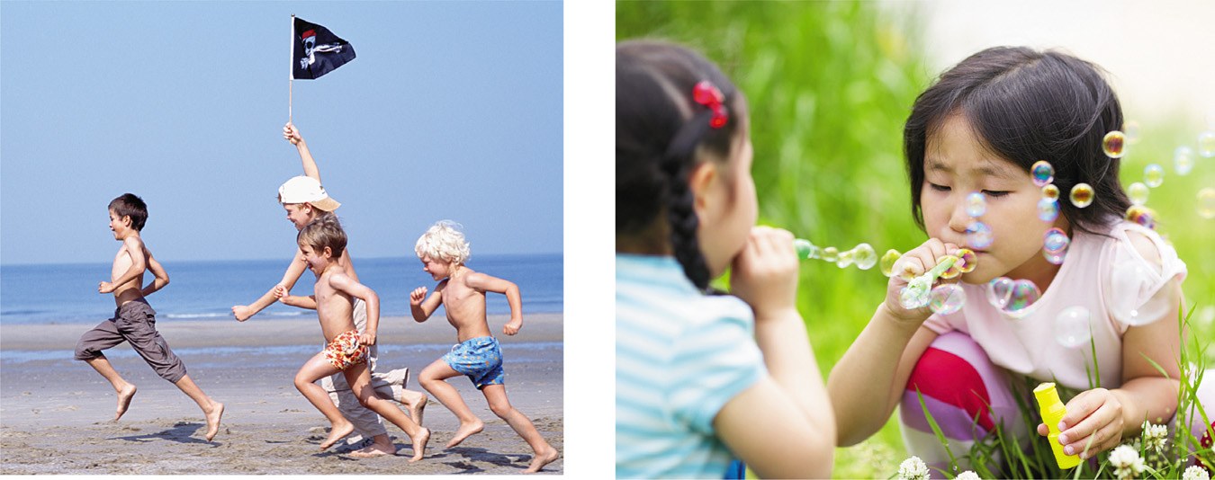
Gender Differences and Connectedness
Young and old, women form more connections (friendships) with people than do men. Men emphasize freedom and self-reliance.
Oliver Eltinger/ Zefa/ Corbis
Dex Image/ Getty Images
Notes:
OBJECTIVE 28| Discuss gender differences in connectedness, or the ability to “tend and befriend.”

Slide 6
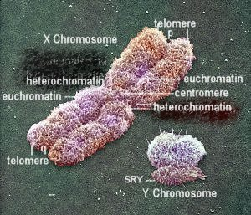
Biology of Sex
Biological sex is determined by the twenty-third pair of chromosomes. If the pair is XX, a female is produced. If the pair is XY, a male child is produced.
Notes:
OBJECTIVE 29| Explain how biological sex is determined, and describe the role of sex hormones in biological development and gender differences.

Slide 7
Sexual Differentiation
In the mother’s womb, the male fetus is exposed to testosterone (because of the Y chromosome), which leads to the development of male genitalia.
If low levels of testosterone are released
in the uterus, the result is a female.

Slide 8
The Nature and Nurture of Gender
Testosterone
  the most important of the male sex hormones
  both males and females have it
  additional testosterone in males stimulates
    growth of male sex organs in the fetus
    development of male sex characteristics during puberty

Slide 9
Sexual Differentiation
Sexual differentiation is not only biological,
but also psychological and social.
However, genes and hormones play a very important role in defining gender,
especially in altering the brain and
influencing gender differences as a result.

Slide 10
Gender Roles
Our culture shapes our gender roles — expectations of how men and women are supposed to behave.
Gender Identity — means how a person views himself or herself in terms of gender.
Gender-typing-- the acquisition of a traditional masculine or feminine role
Notes:
OBJECTIVE 29| Discuss the relative importance of heredity and environment on gender development, and describe two theories of gender-typing.

Slide 11
The Nature and Nurture of Gender
Social Learning Theory
  theory that we learn social behavior by observing and imitating and by being rewarded or punished
Gender Schema Theory
  suggests that we learn a cultural “recipe” of how to be a male or a female, which influences our gender- based perceptions and behaviors.

Slide 12
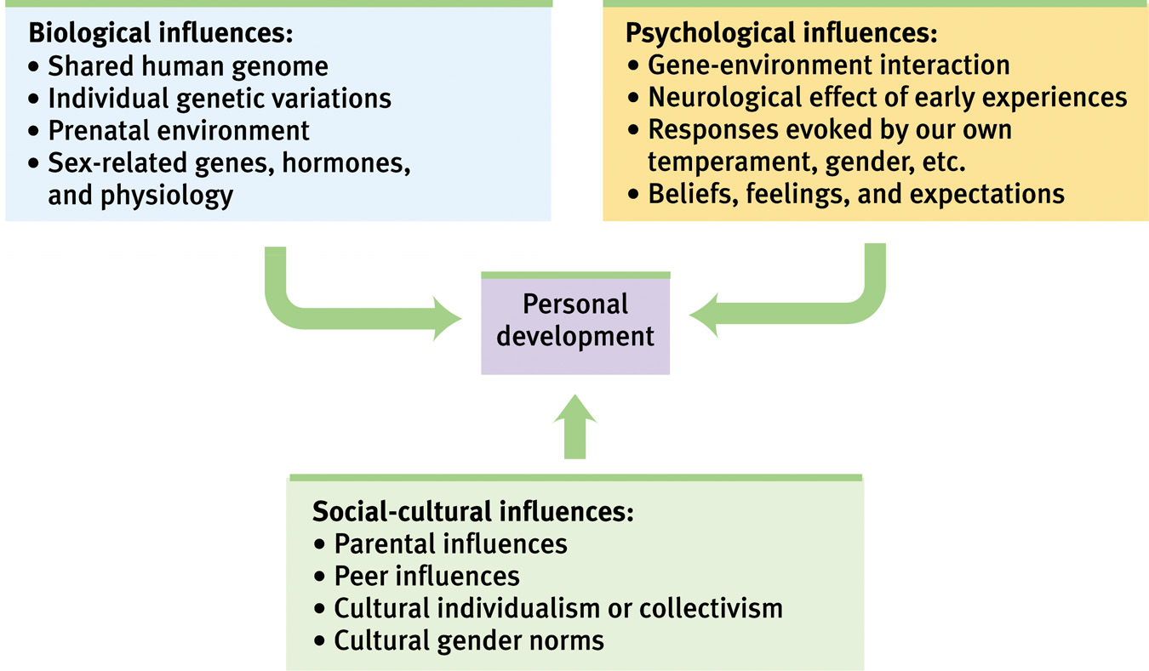
Reflections on Nature and Nurture
Notes:
OBJECTIVE 30| Describe the biopsychosocial perspective on development.

Slide 13
Gender Schema Theory
Gender-role development is influenced by the formation of schemas, or mental representations, of masculinity and femininity
An example of how a child forms a schema associated with gender. A girl is offered a choice of 4 toys to play with.
Boys
Not for me
Toy car
Avoid/Forget
Approach object
Doll
Who for?
Is it relevant to me?
I am a girl
Orange
Assign to category and remember/
Approach
Artichoke
For me
Girls

Slide 14
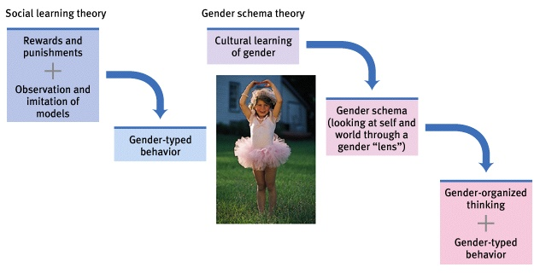
The Nature and Nurture of Gender
Two theories of gender typing

Slide 15
The Role of Hormones
Hormones are chemicals that control bodily responses such as emotions, growth, and sexuality.
The sex hormones are estrogen and androgen.
Males have more androgen.
Females have more estrogen.
Hormones play a lesser role in human development and behavior than they do in animals.

Slide 16
Male/Female Differences
The only activity that is clearly defined along gender lines is reproduction. All other activities are shared by both sexes to different degrees. So… Note… The remaining slides are generalizations based upon common ‘Midwestern Stereotypes’ they are intended for discussion…
Nurturance: Women generally show more empathy, but males can also be nurturing. No one has proven the existence of strong maternal instinct in humans.

Slide 17
Aggression: Males are aggressive in more situations than females. Females do show aggression in some situations, however.
Physical activity: Boys start out more physically active. By adulthood, differences in activity levels between genders have disappeared.

Slide 18
Intelligence
Males and females are very close in overall intellectual abilities.
Spatial Skills
Skills involving the ability to imagine how objects would look when moved about in space. Males generally do better though social role, social class, ethnic background, and the type of test given also play roles.

Slide 19
Mathematical Ability
Studies are not clear and have not as yet conclusively shown that males are innately better at math.
2+ 2
Males do better than females on the SAT math section, but study findings have not been consistent.
Teachers and parents have higher expectations for males.
Females may avoid difficult areas such as math.
368 x 42

Slide 20
Verbal Ability
Includes not just speaking but also word problems, reading and writing. Generally, girls do better than males until early adolescence.

Slide 21
Social Factors
Self-Confidence
In adolescence, females’ confidence often declines (concerned with how boys will react to them?).
The loss of confidence is highest in whites and Hispanics and lowest in African Americans.
Overall, studies have not found major differences in self-confidence levels between males and females.
#1

Slide 22
Friendships
Boys’ groups usually have a leader, girls have more equal status in groups.
Boys usually issue orders and demands while girls make more suggestions.
Adult females tend to have a best friend of the same sex while males do not.
Adult females have a few close friends while males have a larger number of male acquaintances.
Females initiate most breakups.

Slide 23
Communication
Men
Women
Talk more and interrupt more
Talk less and interrupt less
Touch more
Are the ones being touched
Disclose less about self
Disclose more about themselves
Boys sit next to one another
Girls sit facing one another
Males offer solutions to problems
Girls share similar stories

Slide 24
Gender Role Behavior
Gender role behaviors reflect what society says are appropriate actions for males and females.
Through identification with a parent of the same sex, people learn how to behave appropriately.
Which jobs are appropriate for males? for females?

Slide 25
Gender studies have shown
Fathers who are very warm toward daughters tend to produce mild tomboyishness in girls.
Boys whose fathers were absent during preschool years tend to be less aggressive and not as active in sports.
People who are considered mentally healthy tend not to have excessive masculine or feminine qualities.
Children tend to identify with the dominant parent in the household, even across sex lines.

Slide 26
Fathers are more determined that appropriate activities are given to young male children.
People handle babies differently depending on whether they are identified as male or female.
People will assign different characteristics to babies when they are identified as male or female.

Slide 27
Mixing Gender Roles
Rigid extremes for gender roles for males and females restrict the full range of human behaviors and emotions.
Androgynous people are high in male and female characteristics.
Androgynous behavior can lead to more flexibility and willingness to share characteristics of members of the opposite sex.

Slide 28
Gender-Busting Communication Hints (for Males)
1. Do you frequently interrupt females while they are speaking? Try to break the habit.
2. Avoid answering questions with “Nope”and “Yep.” Try to explain more and give some details why you did something.
Can you tell me
how to get to . . .?
3. Try to open up on personal issues.
4. Ask for help if you need it.

Slide 29
Gender-Busting Communication Hints (for Females)
1. Look people directly in the eye.
2. If men interrupt conversations, assertively direct the conversation back.
3. Do not over-apologize for your behaviors.
4. Talk more often about current events, less about people.

