Slide 1
Researching in the Census
Martha Grenzeback
Omaha Public Library
June 2024

Slide 2
What is a census?
“An official count or survey of a population, typically recording various details of individuals.”
U.S. Federal census overview
State and territorial censuses
How the census was (is) carried out
What will you find?
Locating people
Tools for searching
Notes:
Countries all over the world have taken censuses: In 3800 BCE The Babylonian Empire took the first known census, counting livestock and quantities of butter, honey, milk, wool, and vegetables. A census might have a lot of details, or hardly any. We will look at the U.S., and especially Nebraska.

Slide 3
Facts about the U.S. federal census
Almost the first provision of the Constitution (Article 1, Section 2)
Establishes proportional representation of states in the House of Representatives
Statistical basis for determining federal funding needs
Taken every 10 years, beginning in 1790; different questions each year
Most of 1890 census destroyed by fire
Individual census data is kept confidential for 72 years.
Notes:
Besides federal program funding, local authorities also use these counts to plan for local service needs. In 1960 the Census Bureau began mailing the census questionnaires (more cost-efficient). Because of the 72-year rule, the most recent census we can look up individual people in (maybe your grandparents or great-grandparents) is 1950. The information from 1960 will be released in 1932.

Slide 4
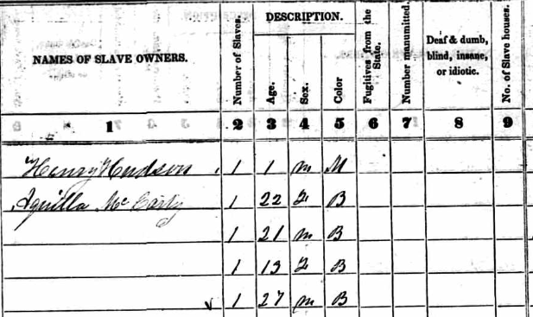
More about the U.S. federal census
From 1850 on separate censuses were taken for agriculture, industry/manufacturers, and social statistics.
Separate censuses for Native Americans living on reservations (1885-1940).
In 1850 and 1860 censuses were taken of enslaved people in slaveholding states (not Nebraska Territory, which was nominally a “free” state).
Notes:
Talk about slave censuses—Those censuses listed enslaved people under the name of the enslaver and by age and gender (no names).

Slide 5
How did they do it?
The population to be counted was divided into districts.
In each district a census taker (enumerator) was appointed to count the people in that district.
The enumerator visited every house and institution in their district.
Some censuses also counted farm crops, animals, industrial products, or other things, including (before 1865) enslaved people.
Notes:
From 1790–1870, U.S. marshals in each state, aided by appointed assistants, were the census-takers (enumerators). They went to every house and institution to ask questions about the people residing there, compiled the information, and sent it to Washington, DC. From 1880 on, supervisors were specially appointed, and enumerators had to pass a test. The 1950 was the last “door-to-door” census.

Slide 6
State and territorial censuses
U.S. states and territories also carried out censuses for various purposes:
  --military
  --taxation
  --local government representation
  --school-age children
Usually taken in different years from the federal census
Different questions, depending on the purpose of the census
Notes:
Many states had their own censuses besides the federal ones; Nebraska had one in 1885. But we’re going to specifically talk about the censuses that Nebraska took before March 1, 1867, when it became a state—the Nebraska territorial censuses. In 1854 Nebraska Territory was created by the Kansas-Nebraska Act. That was the impetus for the first territorial census: Acting Gov. Thomas Cuming ordered a census so the could create legislative districts in the settled part of the territory. Why was this important? To determine how many representatives each county would have in the new Territorial Legislature. The Legislature (like today!) would be making all the important decisions about new laws, where the capitol would be, etc. The first federal census in Nebraska was 1860, while it was still a territory.

Slide 7
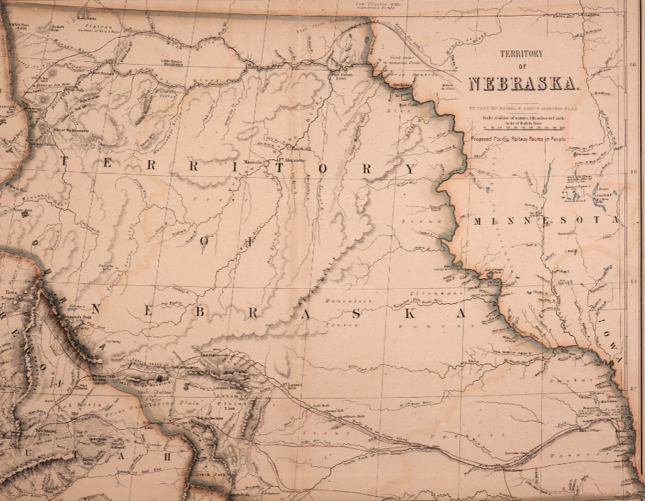

Nebraska in the 1850s
Notes:
In the early 1850s Nebraska was one big expanse of wildness, without many settlers—mostly hunters, Native Americans, people passing through; there were a few forts and trading posts. Just imagine trying to locate and count all the people living there. This is 1857.

Slide 8
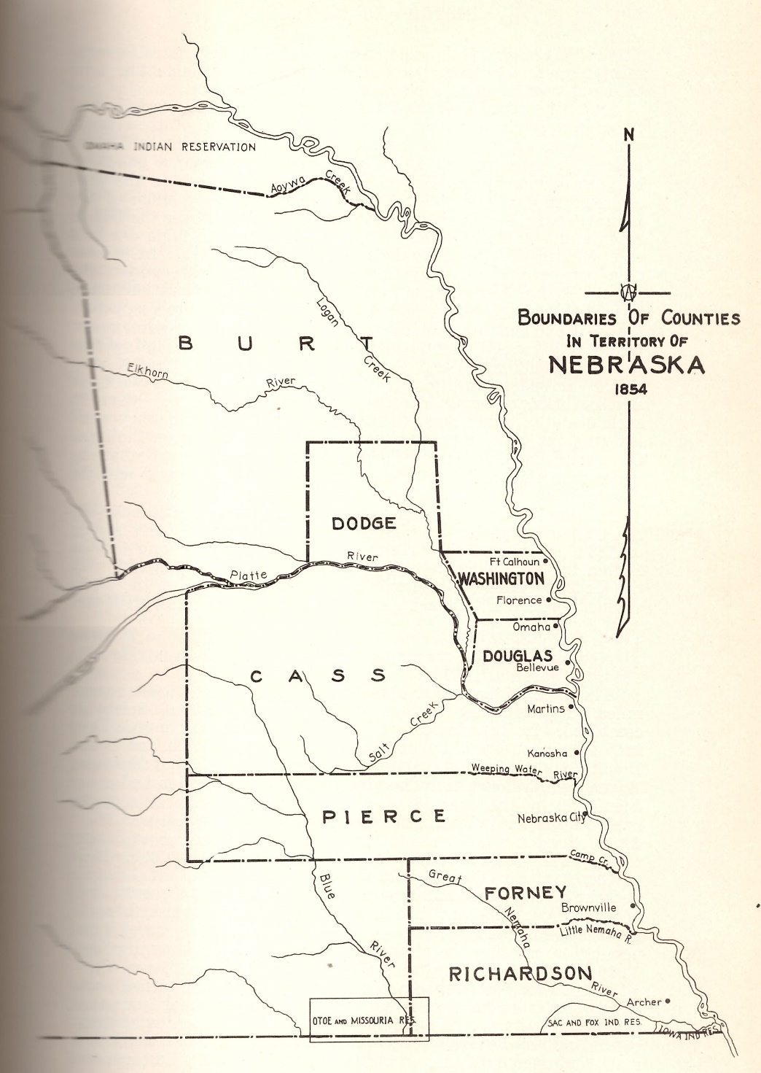
Only 8 original counties in 1854
Fluid boundaries
“These officers were enjoined to be strict in the enrollment of names, and to require an oath of residence whenever they deemed it best; especially in the region bordering on the Missouri. They were instructed to designate suitable points for the establishment of voting precincts, and also to name proper persons to act as Judges and Clerks of Election. The census was to be completed by November 20, and returns sent to Acting Gov. Cuming, at the Mission House, Bellevue, or to the care of Mr. Lindley, Postmaster at Omaha.”
Notes:
It could have been worse. The territory those 7 deputy marshals and their assistants would have to cover was only the part along the Missouri River, where most of the settlements were, since that was where there was boat transport and better land—plus agreements with the Native populations to allow white settlers. But they still had to visit every home and settlement, and many of the people living there were not permanent residents. And there were no exact boundaries between Nebraska and Kansas, so some of the people counted were actually Kansas residents.

Slide 9
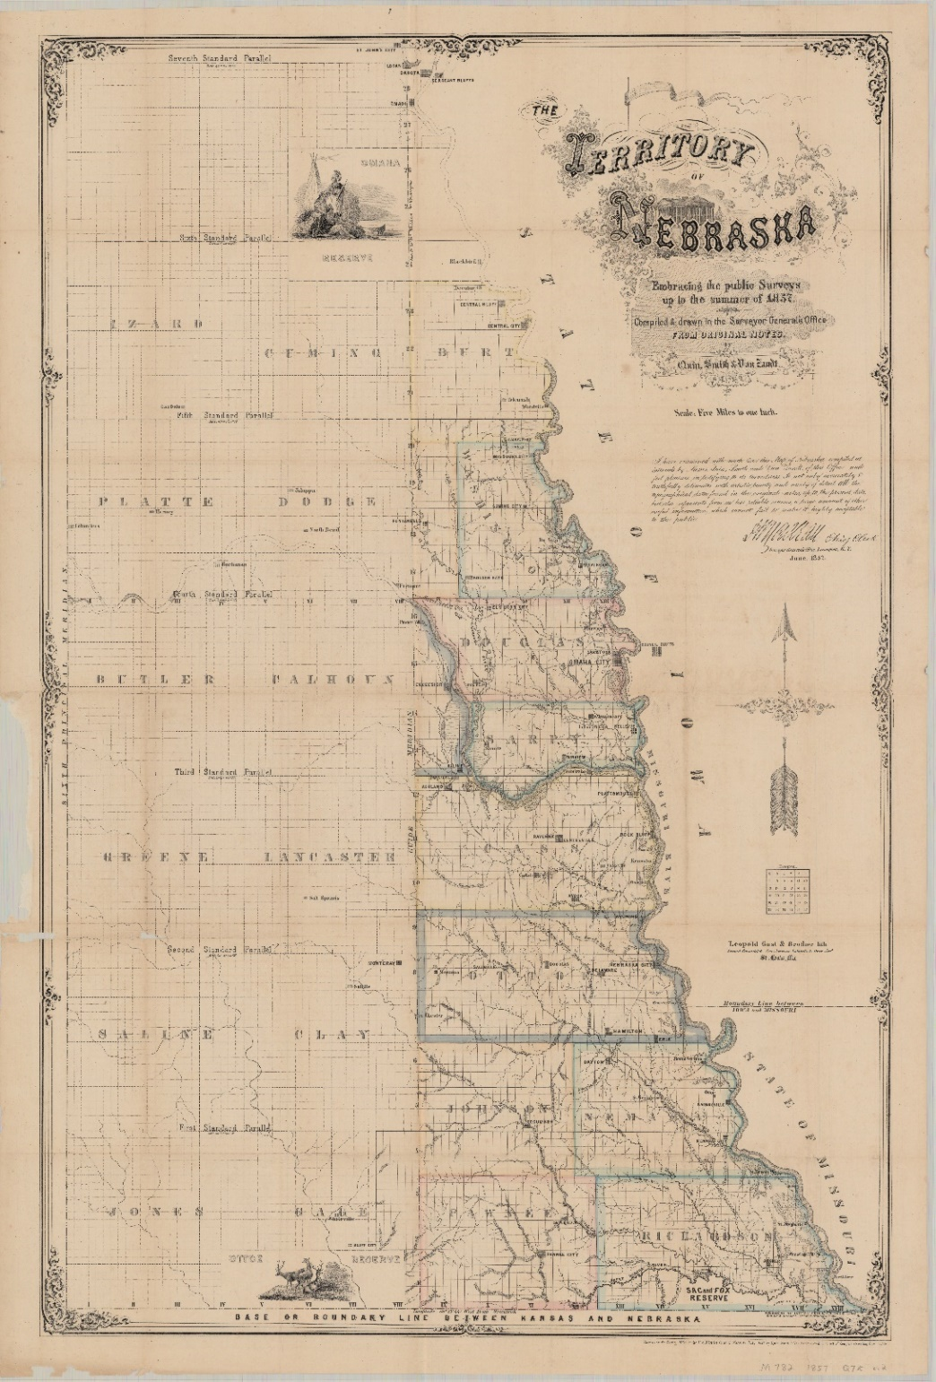
By the time of the 1860 census
Notes:
Just because I like this map.

Slide 10
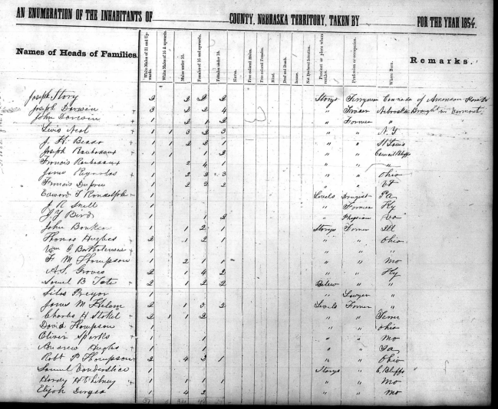
What will the census tell you?
1854
Name of head of household
Residence
Birthplace
Occupation
Number of household members classed by age range, gender, color, and free or enslaved status
Blind, deaf, or insane
Notes:
The territorial censuses actually provide quite a bit of info, more than the first federal censuses, anyway. This is 1854.

Slide 11
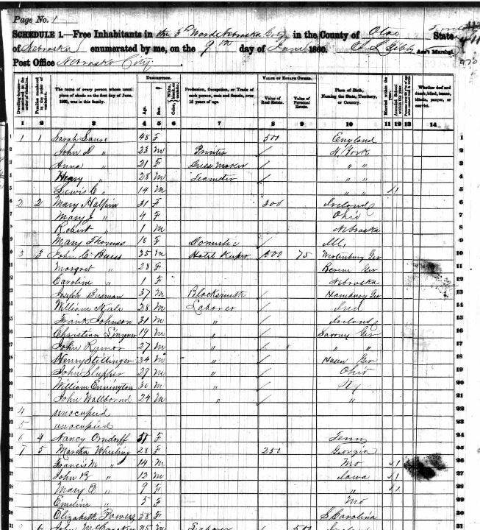
1860
Name of everyone in household
Age
Gender
Color
Residence
Birthplace
Occupation
Value of property owned
Married within last year?
Attended school?
Literate?
Deaf, “dumb,” blind, “idiot,” pauper, convict?

Slide 12
Kinds of census research
Specific historical research:
How many enslaved people in 1860?
Flour mills in Nebraska
Migration history
Development of different industries
Family history
Statistics about things like birth rate, home ownership, education, etc.

Slide 13
How to search
All the federal censuses and most state censuses have been digitized AND indexed:
FamilySearch.org
Ancestry Library Edition
MyHeritage Library Edition
(some of them also on other sites)
Nebraska’s territorial censuses (1854, 1855, 1856) are available only on microfilm (OPL Genealogy Room or History Nebraska) or as transcriptions in Nebraska & Midwest Genealogical Record: https://usgennet.org/usa/ne/topic/resources/OLLibrary/Journals/NMGR/censindx.html

Slide 14
A few search tips
Names often misspelled (spelling was not standard in any case)
Many abbreviations were used; for example, Jas for James, Jno for John
Information was recorded AS OF the census date (June 1, 1860), even if the census taker only arrived a month later
Information not necessarily accurate; just what people reported
Notes:
Some people didn’t know their exact age or birth place for example. Or didn’t want to tell the truth about something.

Slide 15
Questions?
Martha Grenzeback
mgrenzeback@omahalibrary.org

Slide 16
Activity
Territorial census:
https://usgennet.org/usa/ne/topic/resources/OLLibrary/Journals/NMGR/censindx.html
1860 census:
https://archive.org/details/populationschedu665unit/
https://archive.org/details/populationschedu665unit/page/n469/mode/2up
https://www.familysearch.org/search/collection/1473181

