Slide 1

Researching Individuals in Nebraska’s Territory
1854-1860

Slide 2
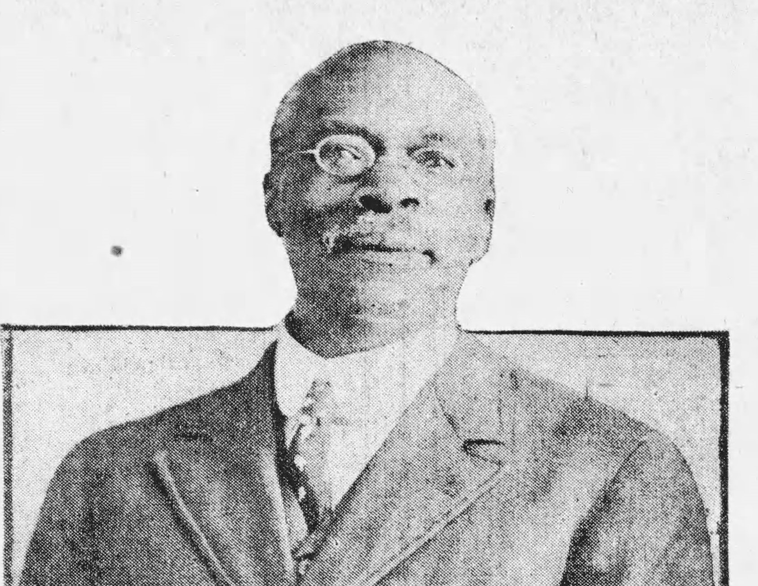
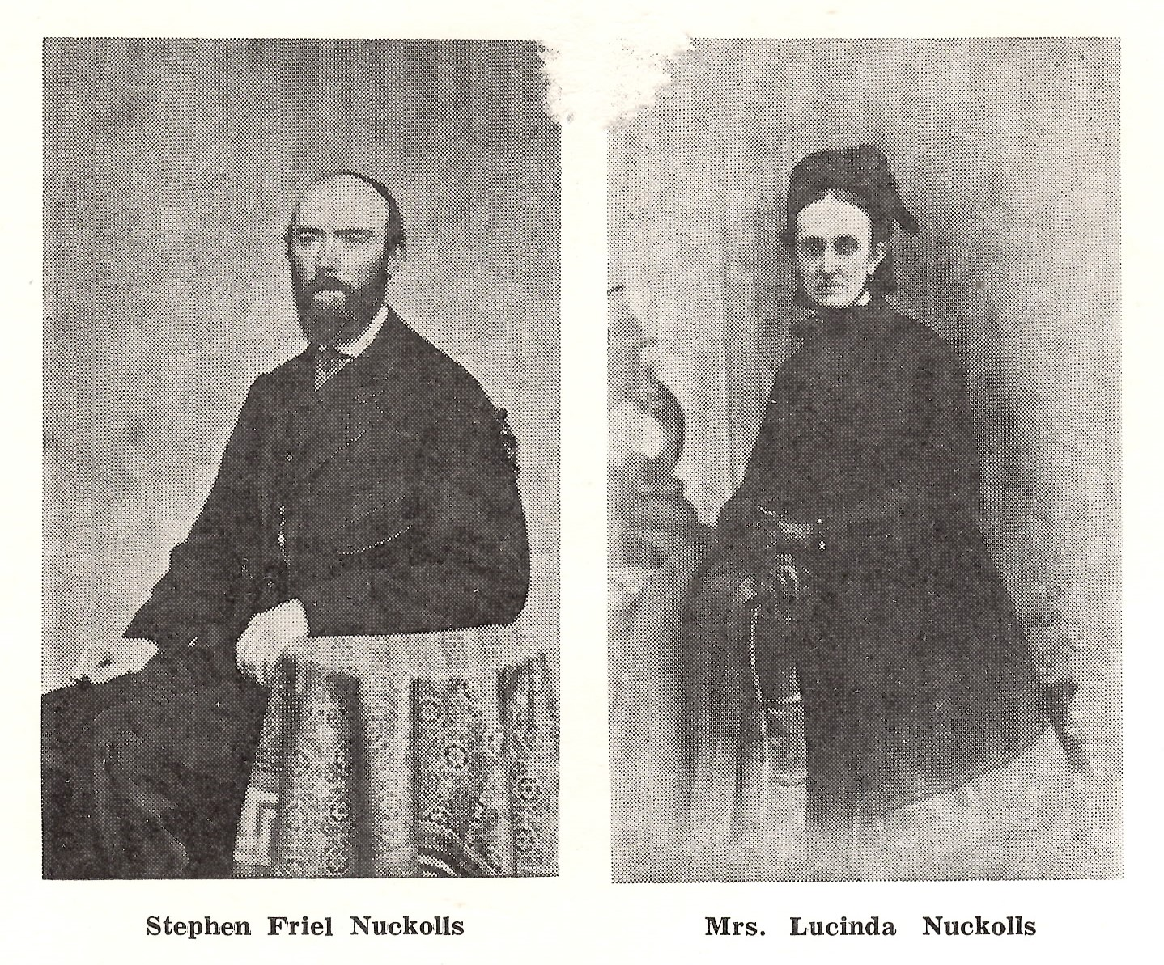

Nebraska’s first residents all had stories.
Uncovering those stories can help you understand and appreciate Nebraska’s early history.

Slide 3
MIHV Underground Railroad Project
Person’s Name. Abolitionist, Enslaver or Freedom Seeker.
When were they born and where? When did they die?
Find 2 to 3 Primary or Secondary Resources about your Person or Site. Photograph. Newspaper Article. Book or Scholarly Journal article. Sanborn Map.
Write down the source, date, and writer/photographer (if known) of your research. For photographs, explain what it is showing. If needed, to jpeg images to be uploaded to your final project.
Select an address associated with your person or site. Does this site still exist today? Find or take a picture of this site.
How was the site or person tied to the Underground Railroad or slavery?

Slide 4

Where to Begin

Slide 5
Robert M. Kirkham
Lived in Nebraska City
B. Indiana in 1819.
2 slaves listed in 1860 Census.
1 slave listed in tax valuation article Peoples Press (Nebraska City) dated June 21, 1860

Slide 6
Omaha Public Library
OmahaLibrary.org > Resources
Digital Historic & Current Omaha World-Herald, 1878-Present
Digital Omaha Star 1938-2011
Newspapers.com
Nebraska Territorial Newspapers
Fold3
Military Records
Heritage Library Addition or Family Search – Census, Marriage Records, Birth Records.
Special Collections
Early photographs, postcards, albums, stereo views and maps

Slide 7
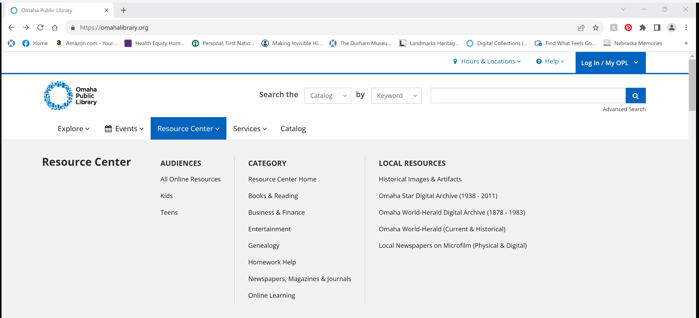
www.OmahaLibrary.org

Slide 8
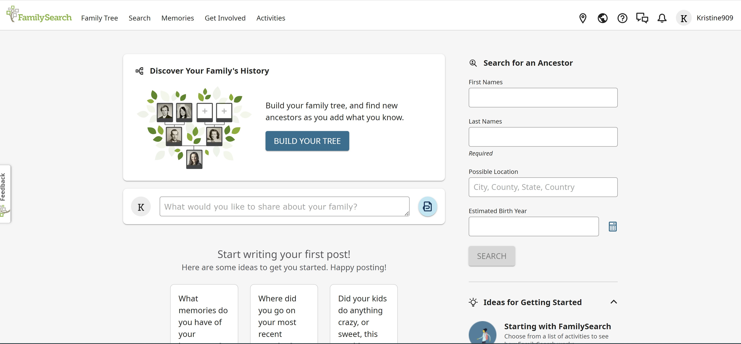
Family Search

Slide 9
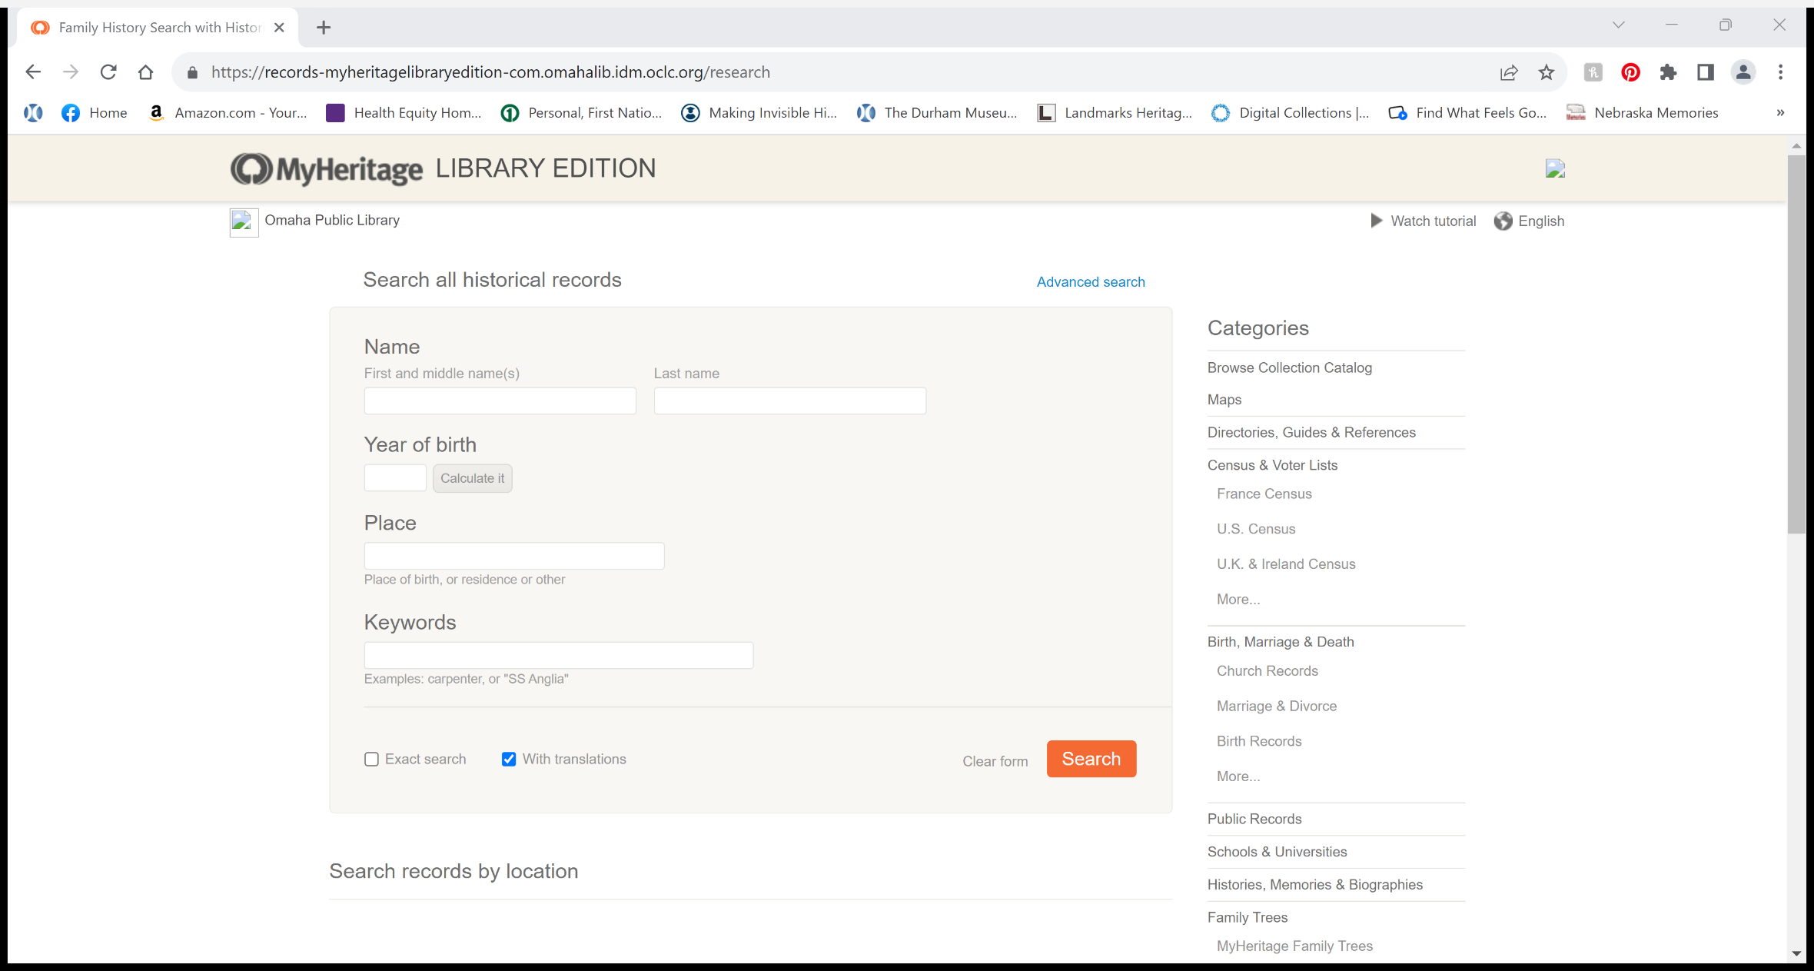
My Heritage Library Edition
Census Data, Birth, Marriage, Death Records and More

Slide 10
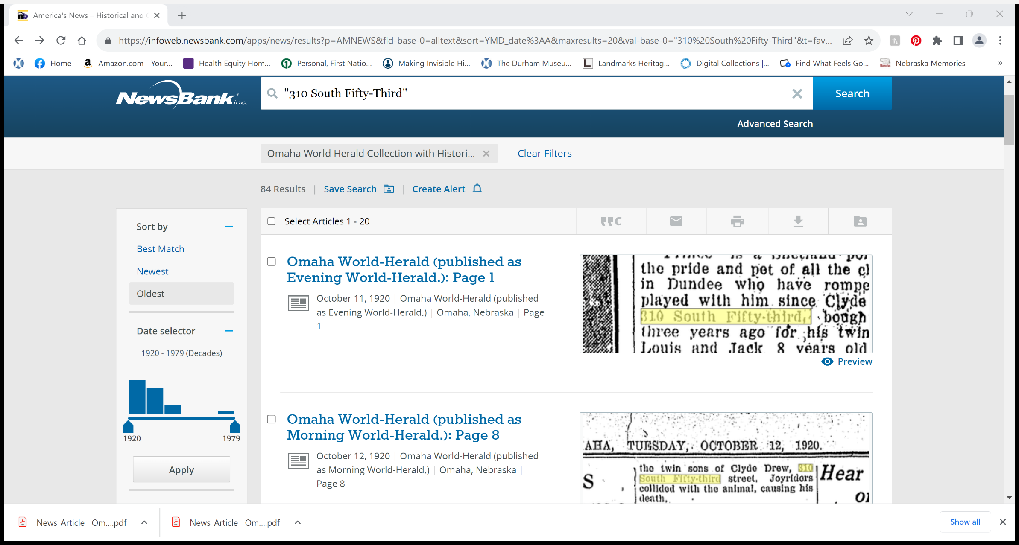

Slide 11
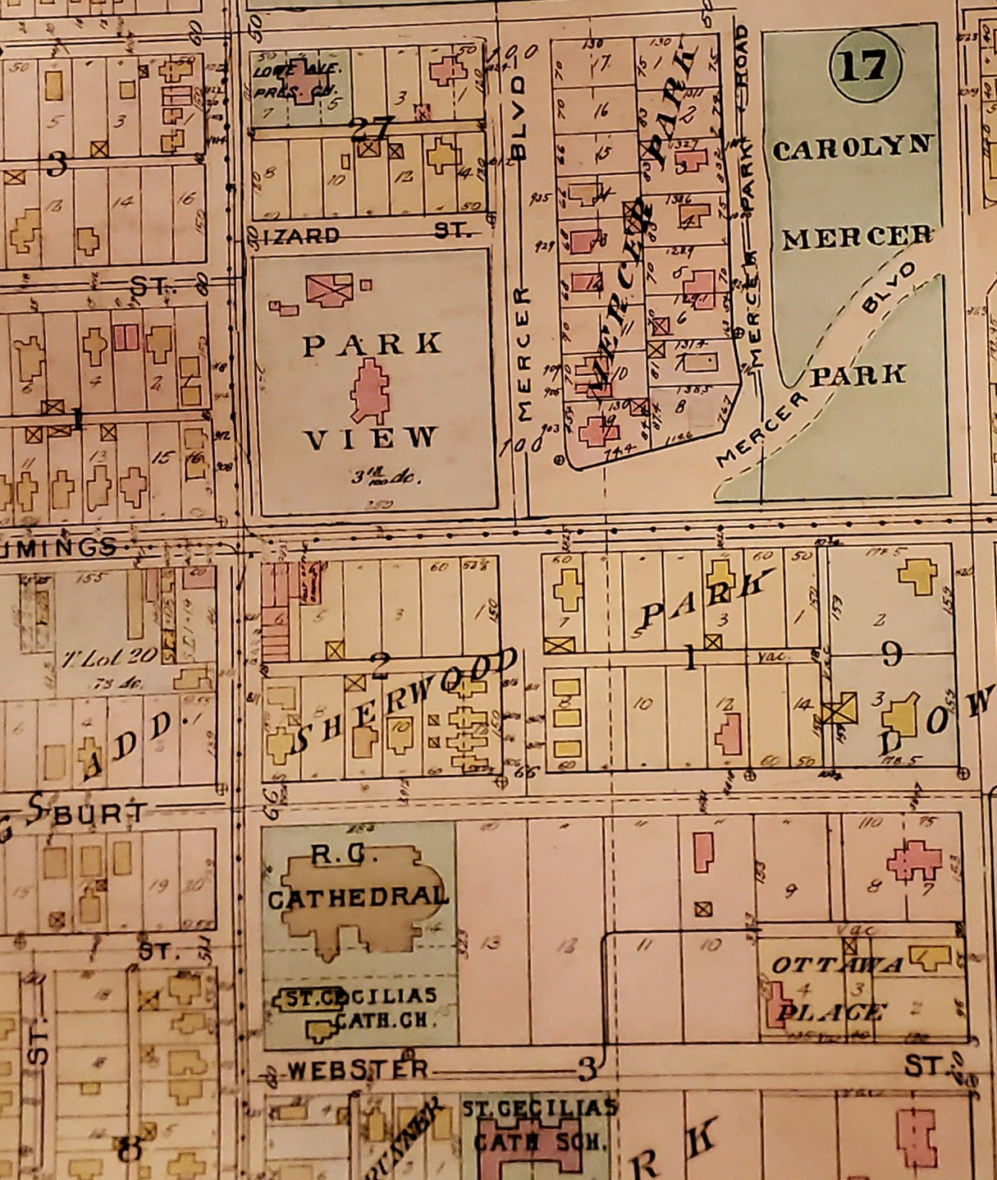
Digital Sanborn Maps
Produced by a Fire Insurance Company to determine insurance rates for properties.
Digital and printed copy versions available at the Omaha Public Library or in City Planning.
For Omaha maps start in 1880’s and go through 1962.

Slide 12
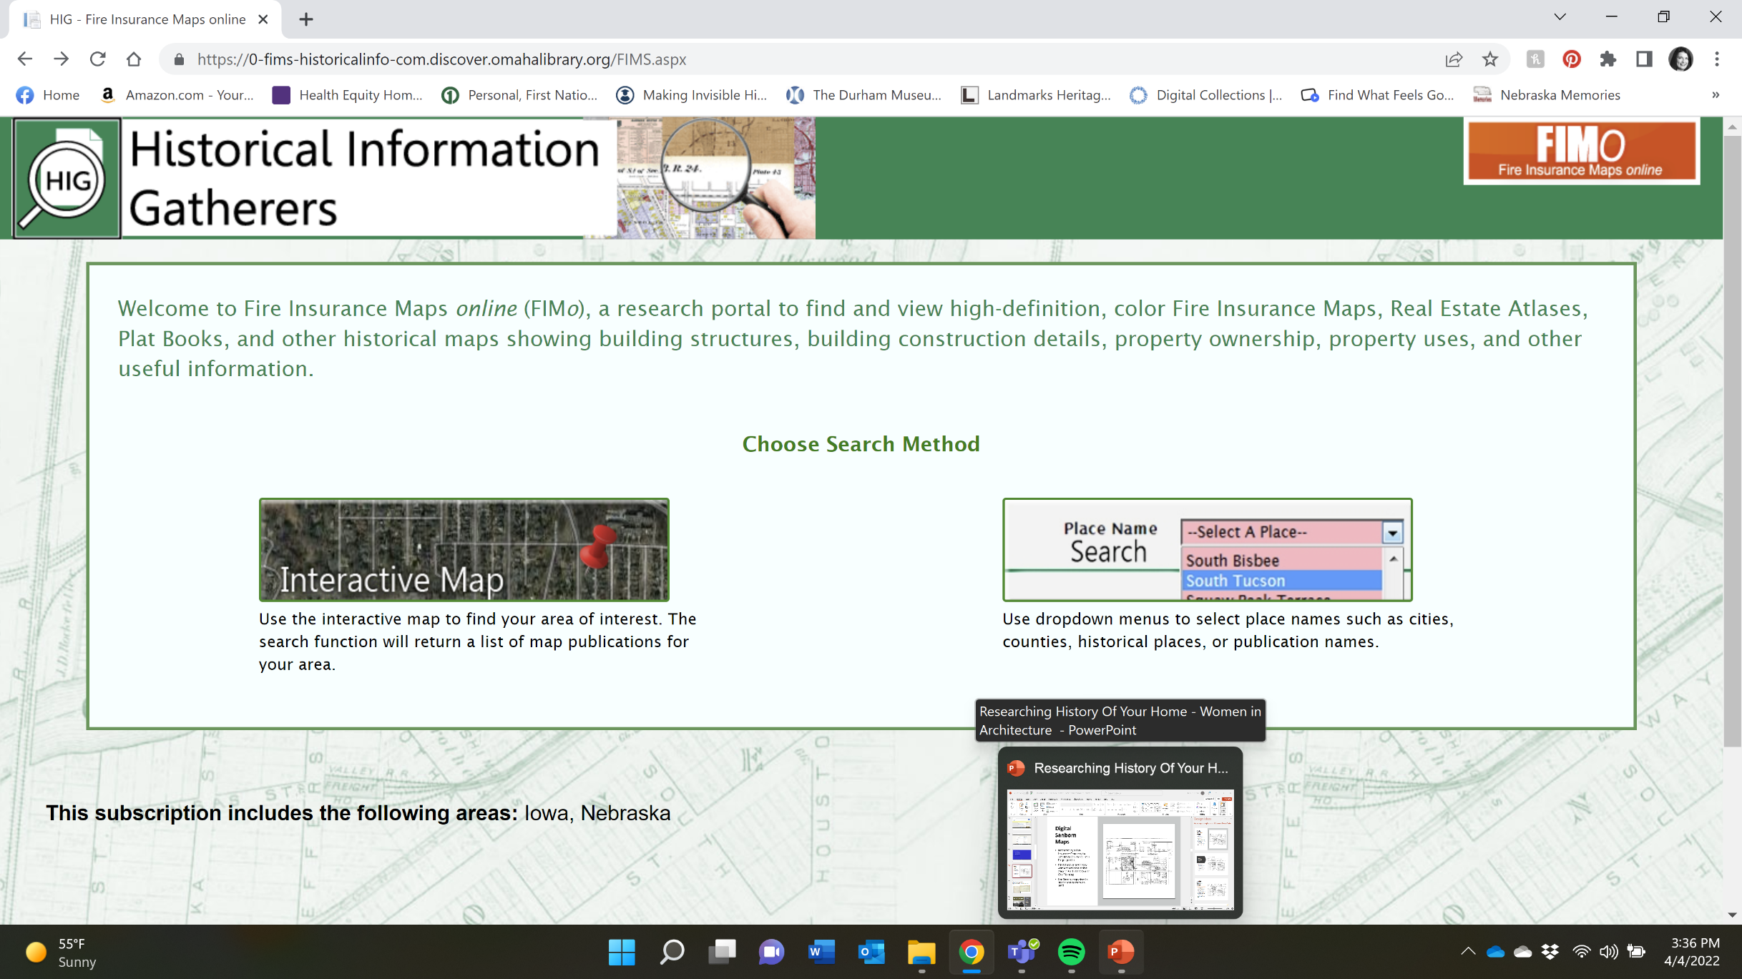

Slide 13
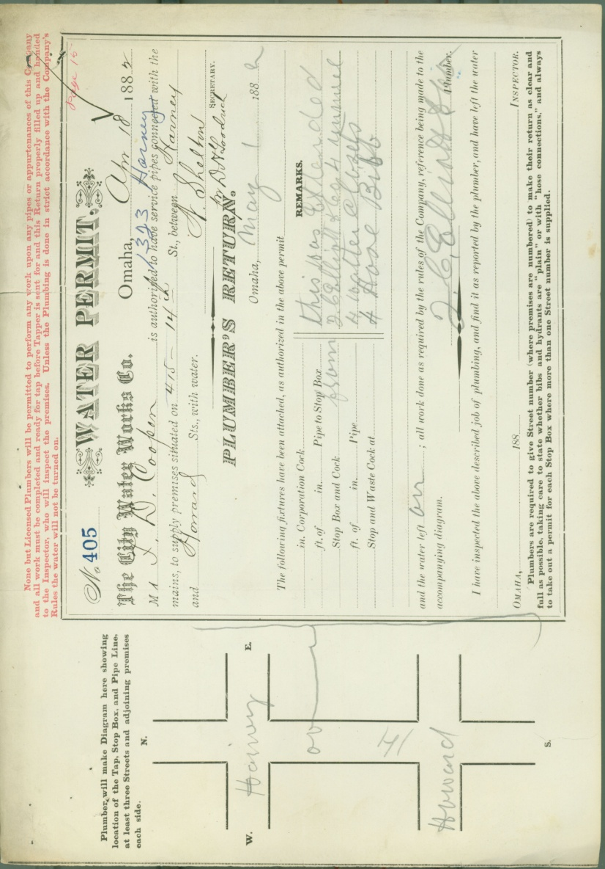
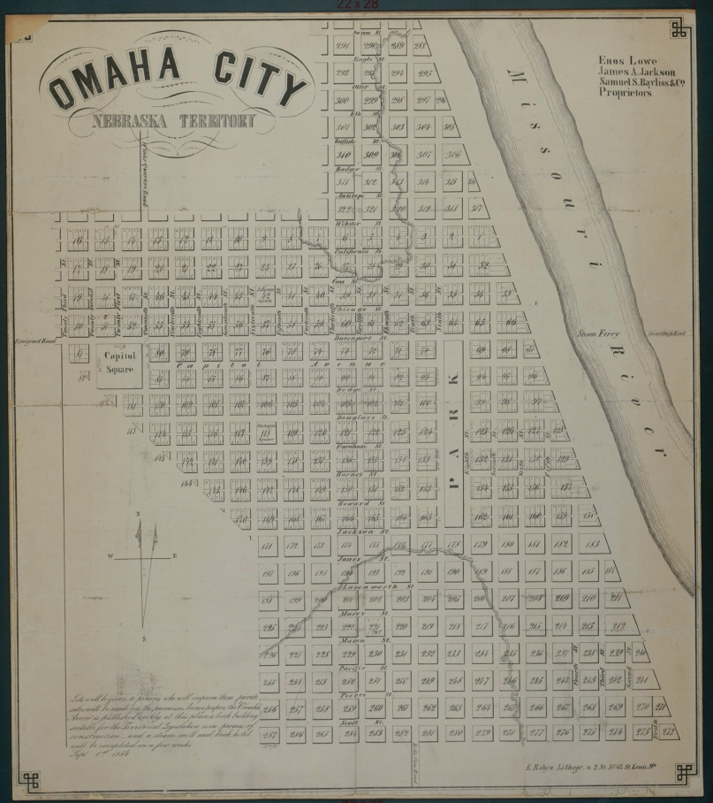
Early Maps and Plat Books
Card Index to People, Places, and Events
Institutional Records e.g. early Omaha Water Permits

Slide 14
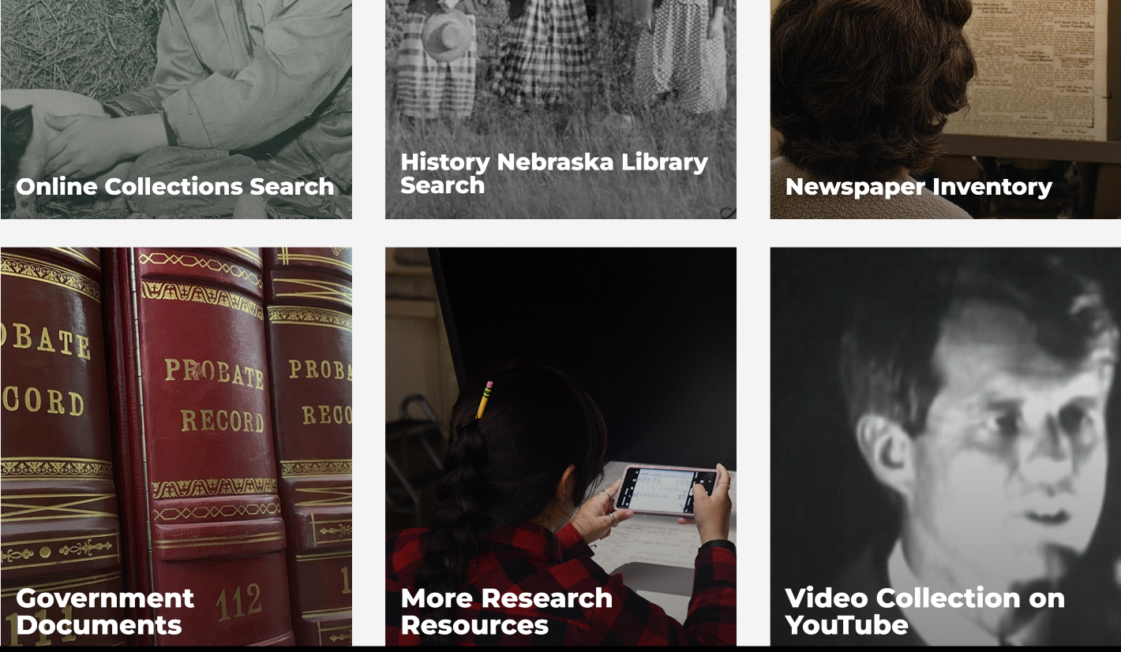
History Nebraska
HistoryNebraska.org
Online Collections Search
Newspaper Inventory
History Nebraska Library Search
Video Collection on YouTube
Government Documents
Architects and Their Work
E-nebraskahistory.org

Slide 15
Other Photo Resources
National Archives Catalog
https://www.archives.gov/research/catalog
Library of Congress
https://www.loc.gov/photos/

Slide 16
U.S. Census Data
Available for free through Ancestry.com (1940 and 1950), FamilySearch or National Archives. I like Ancestry.com best.
Can gather property owners name, others living in the home, ethnic group/race, where born, education level, where they work.
Reports are easy to download.
Available every 10 years up to 1950.

Slide 17
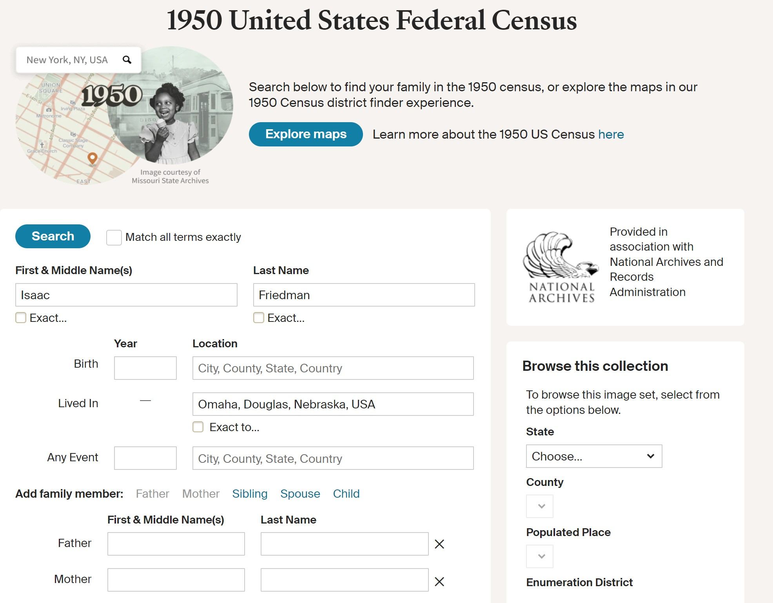

Slide 18
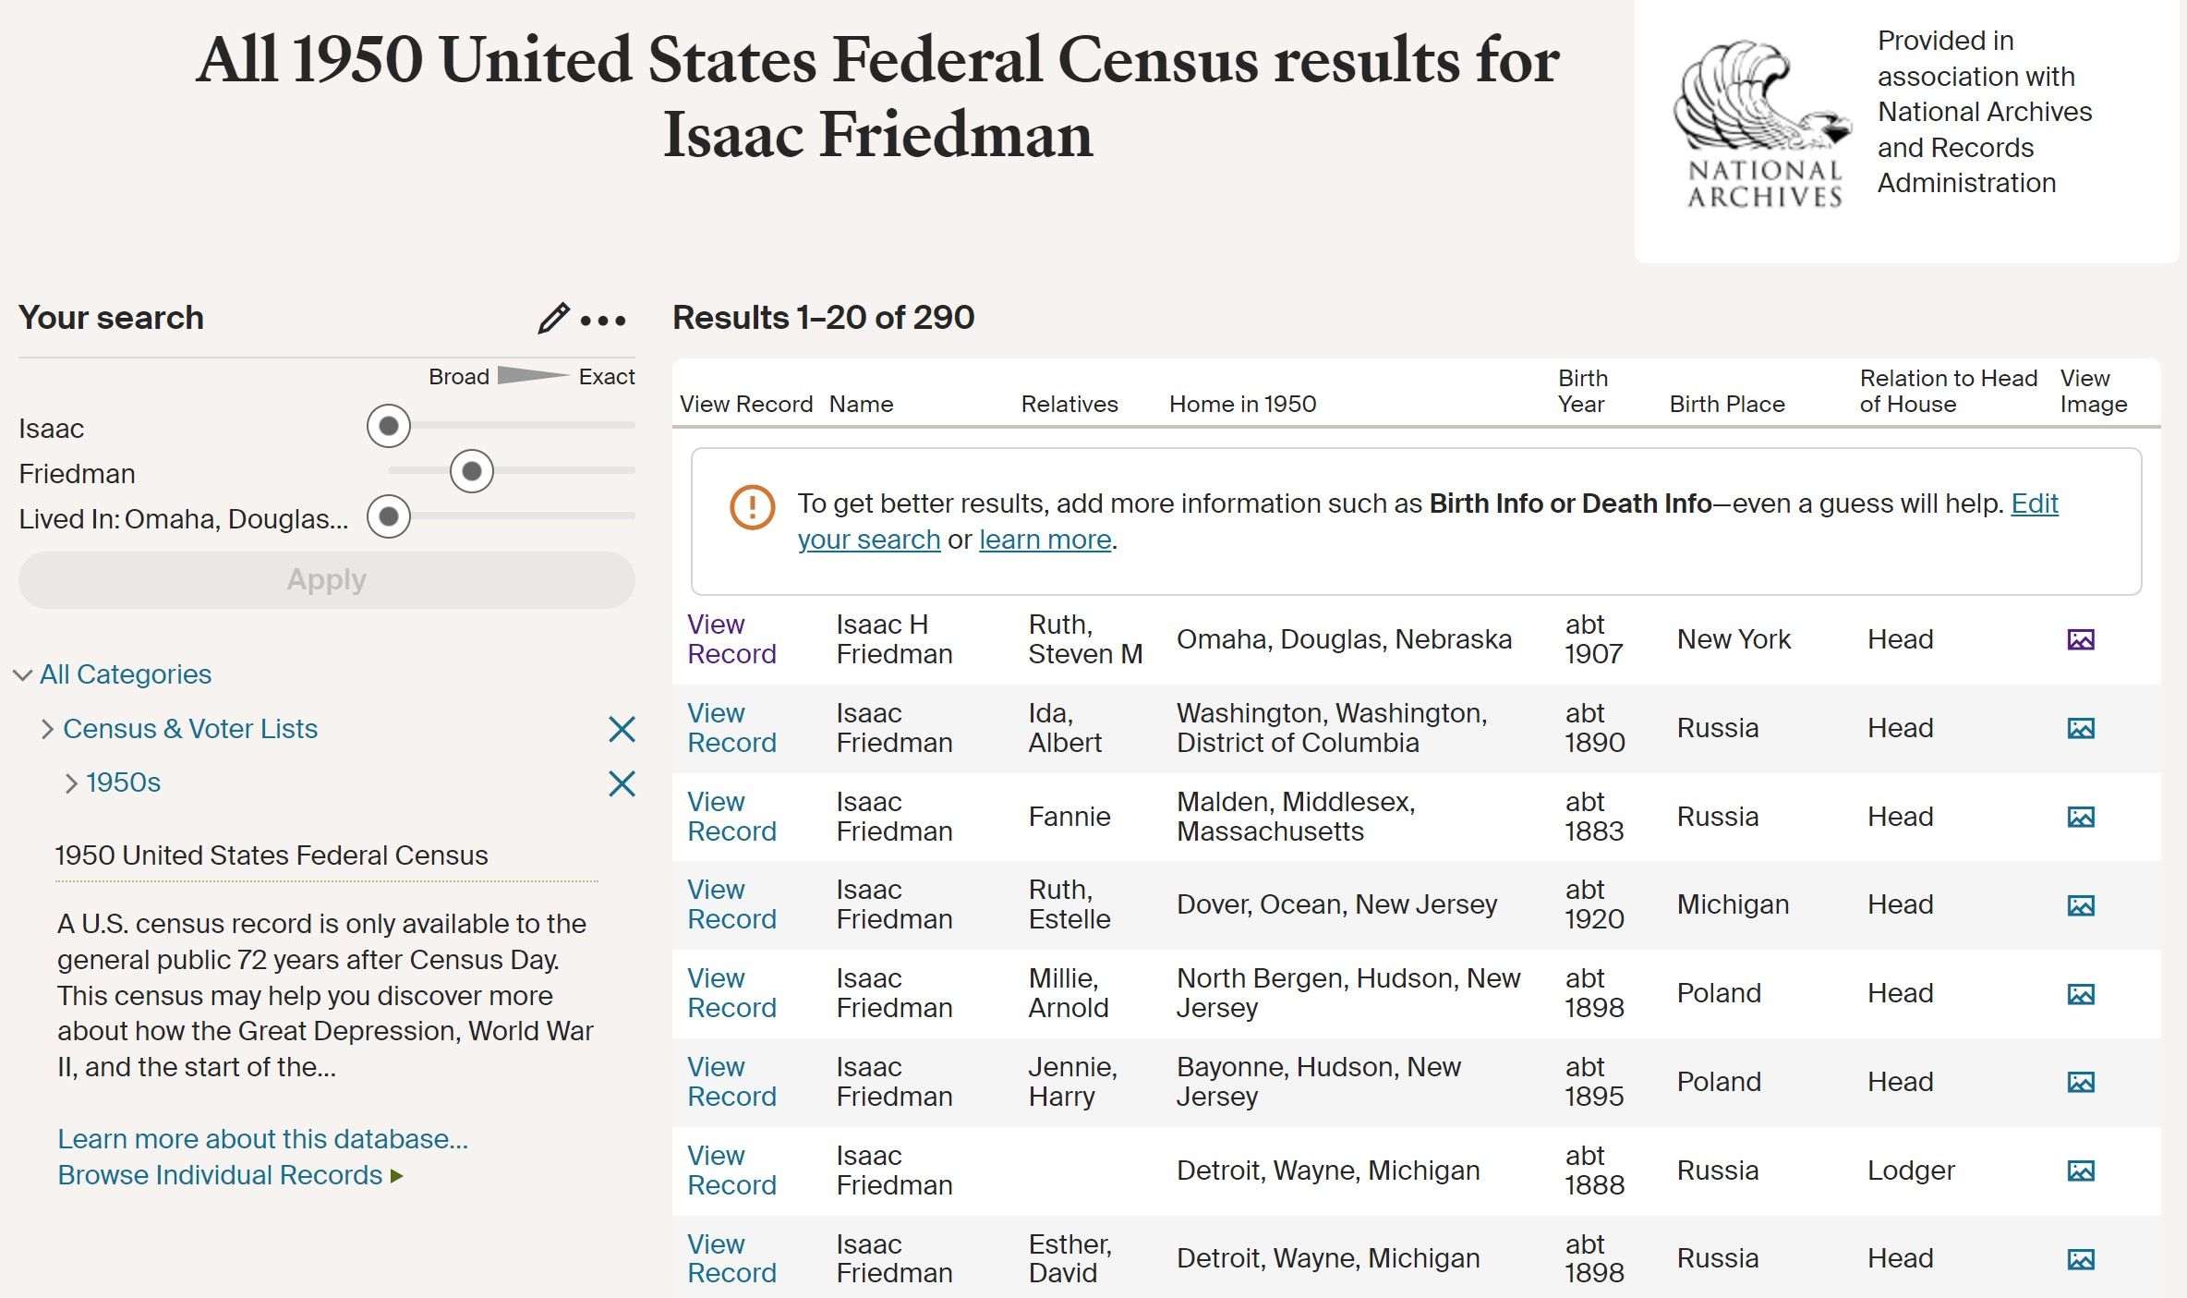

Slide 19
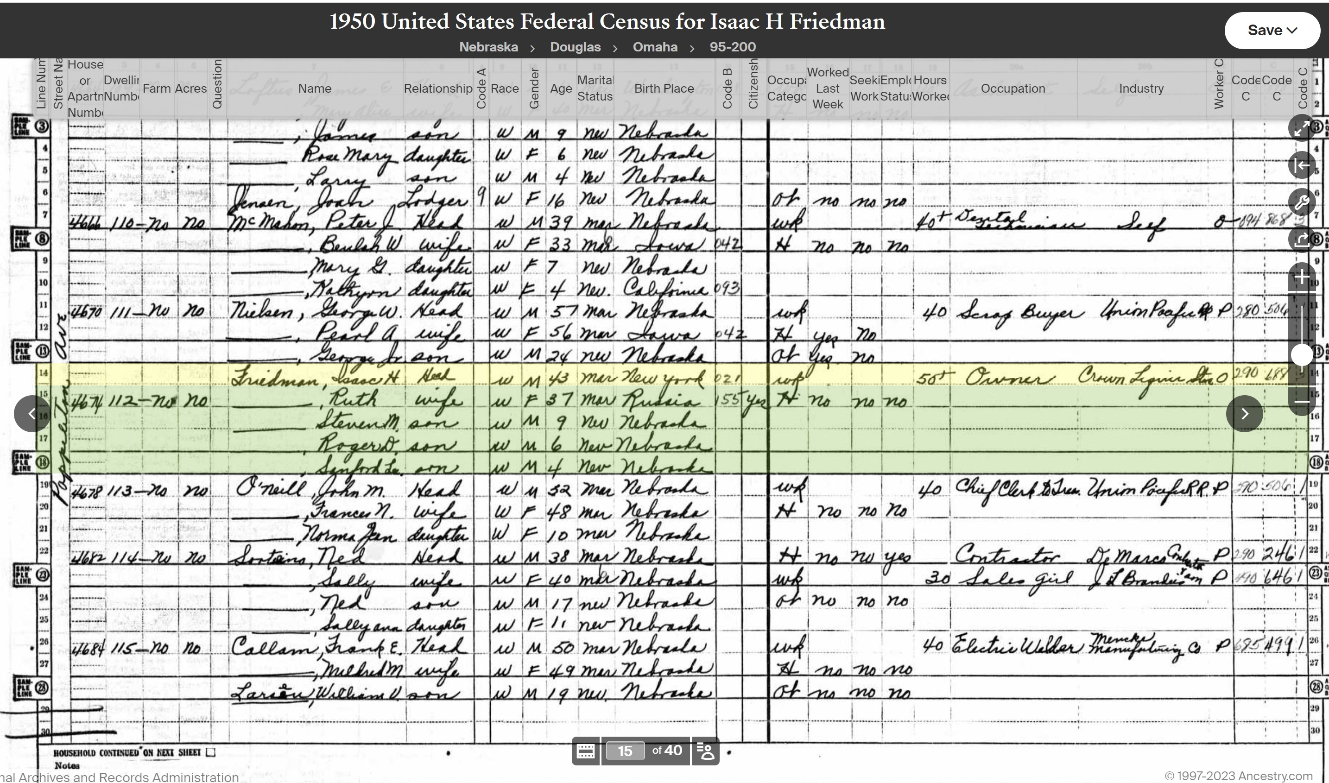

Slide 20
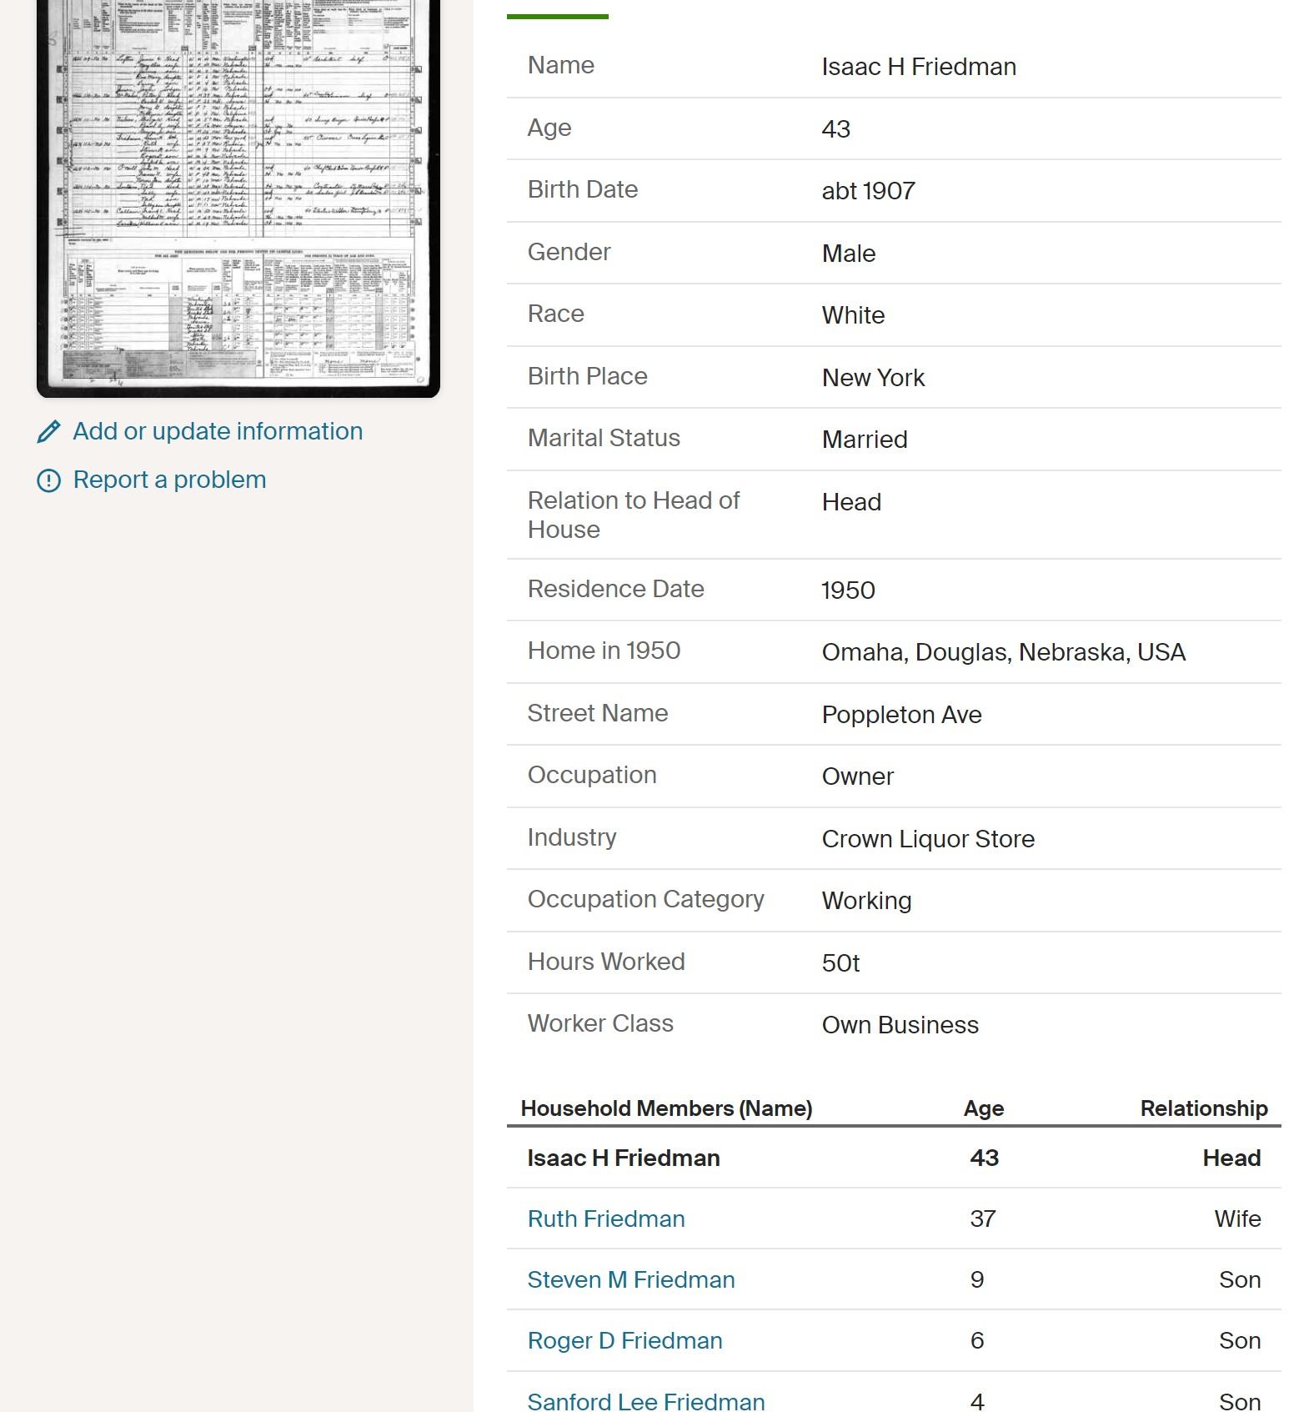

Slide 21
Other Sources
Google Books books.google.com
Hathitrust.org – Digital library. Western Architect, Improvement Bulletin.
Internet Archive - https://archive.org/ Includes Nebraska State Historical Society Journals from 1880s on.
Bureau of Land Management Glorecords.blm.gov Access to more than five million Federal land title records issued between 1788 and the present. Includes images of land patents, survey plats and field notes and land status records.

Slide 22
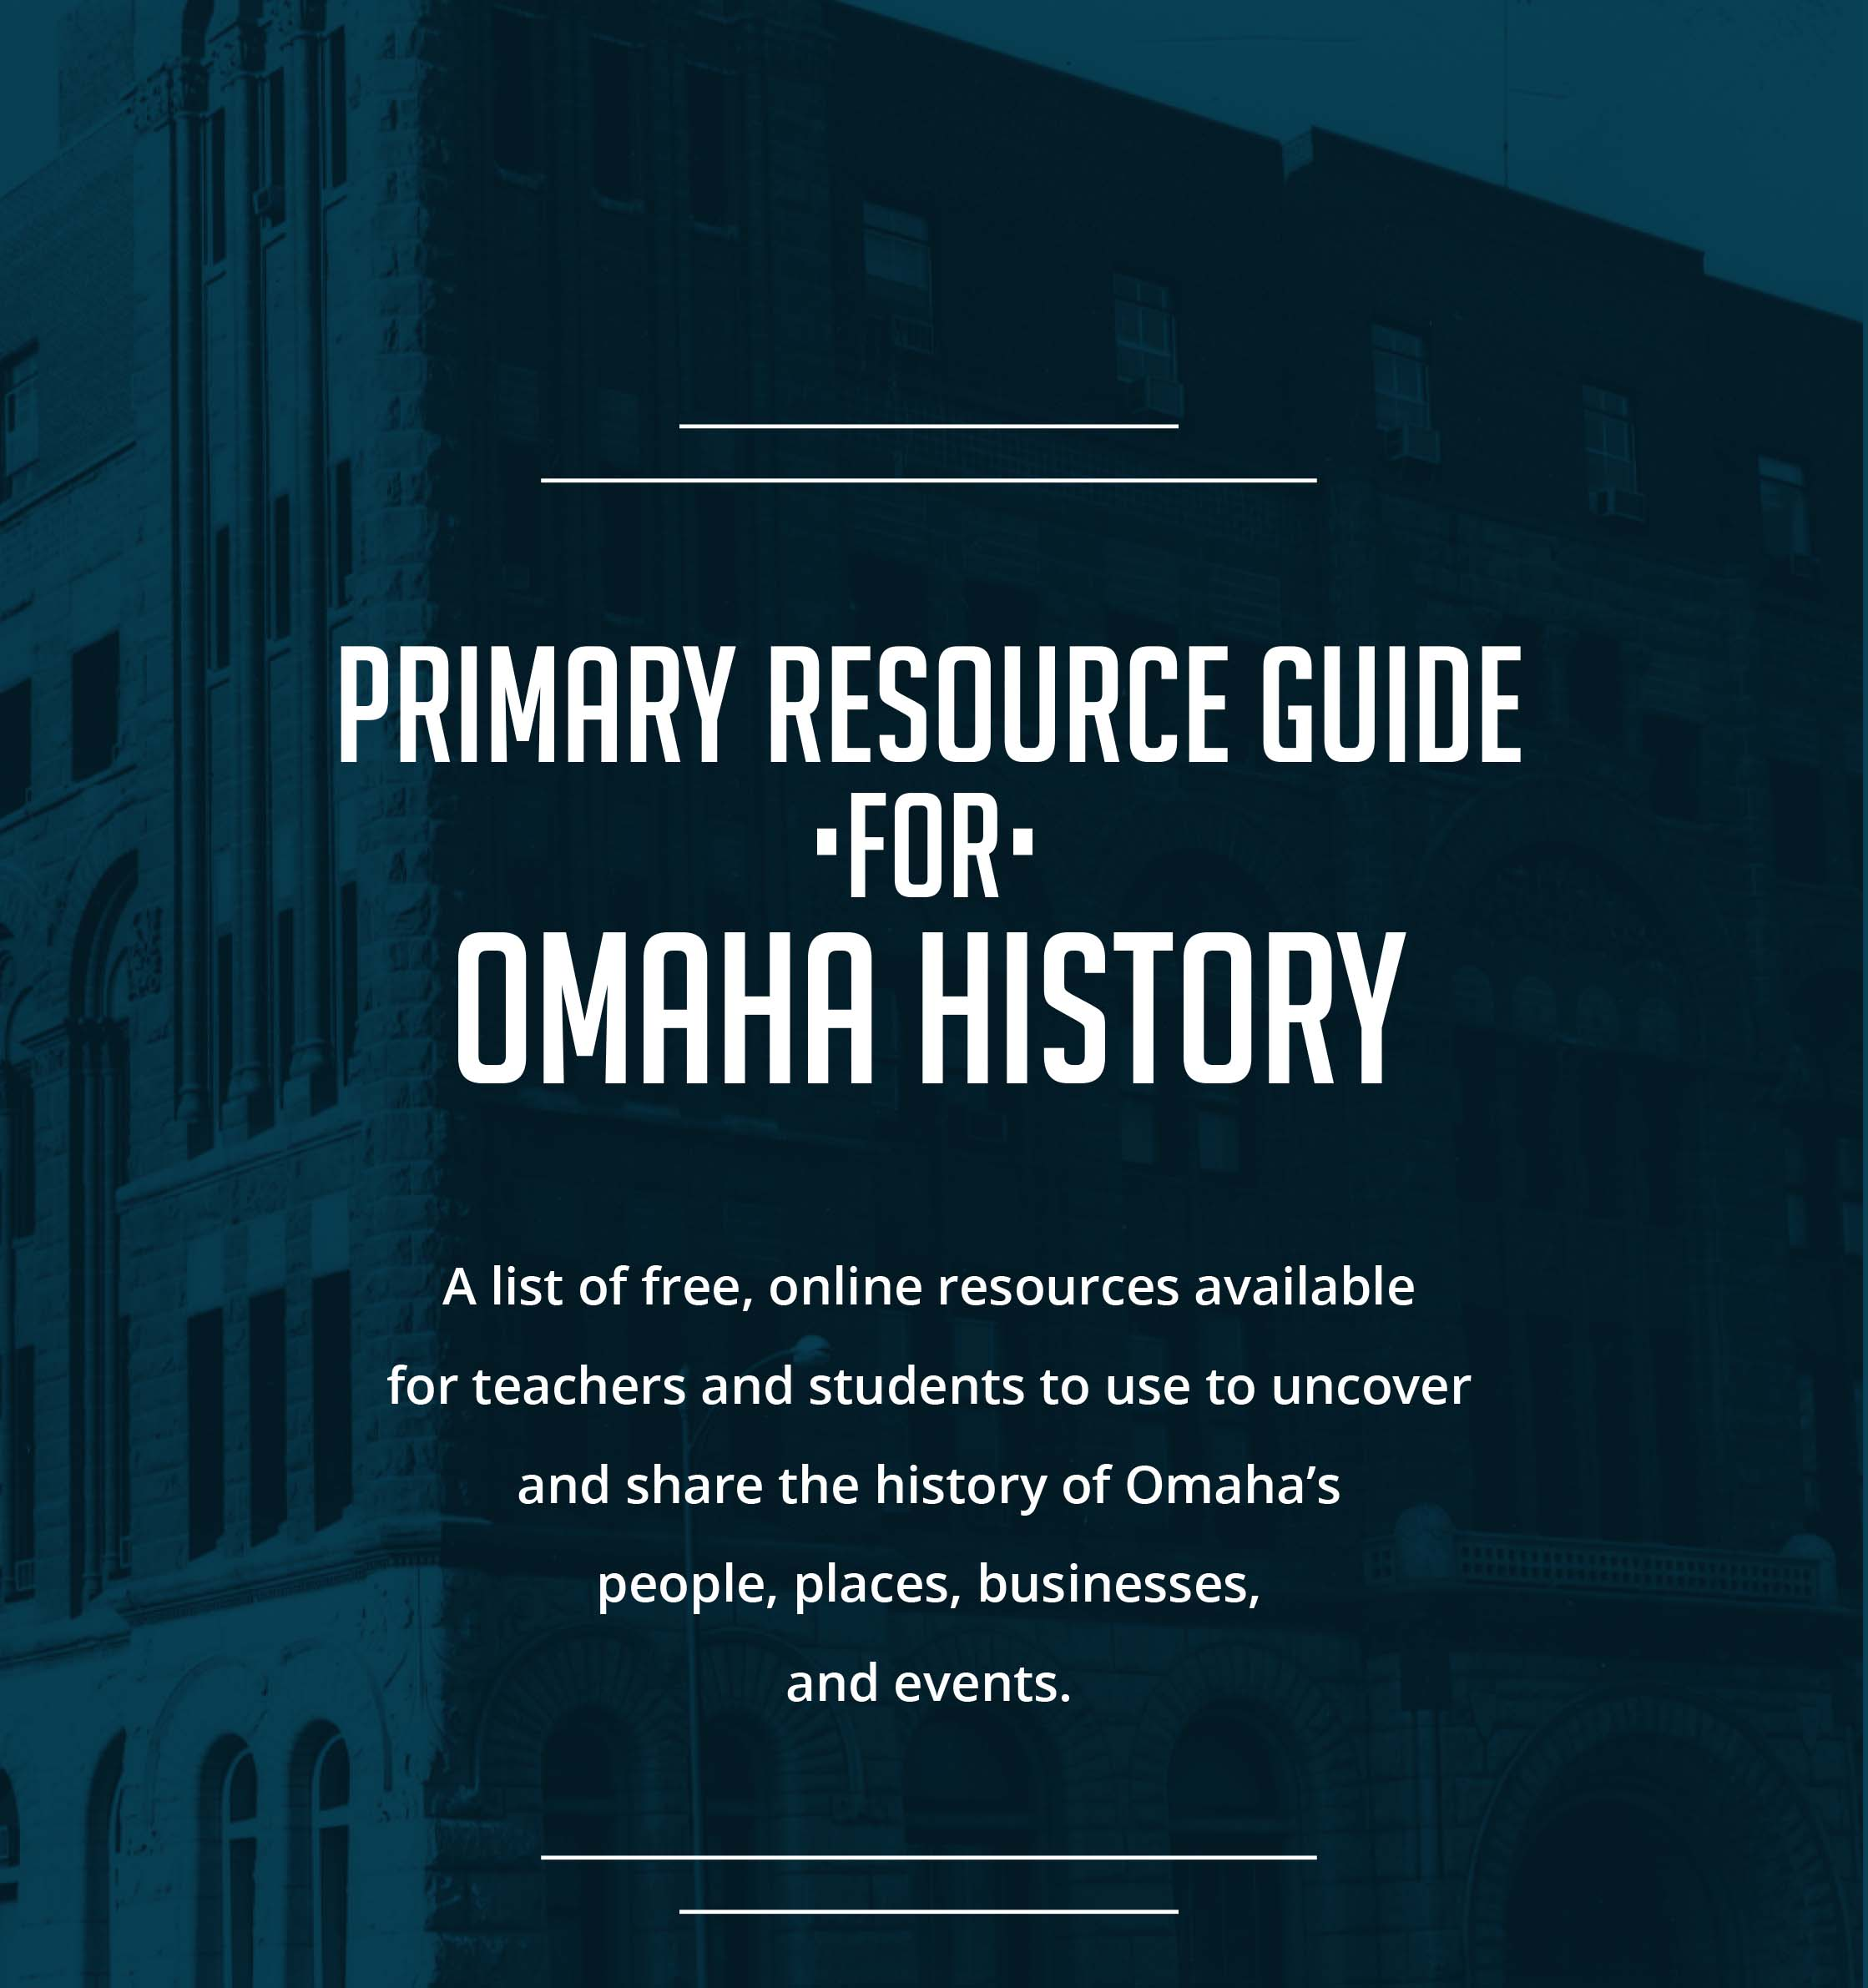
www.ops.org/InvisibleHistory
Curriculum Tab

