Slide 1
Day 4:
Lane Trail
Thursday, June 6

Slide 2
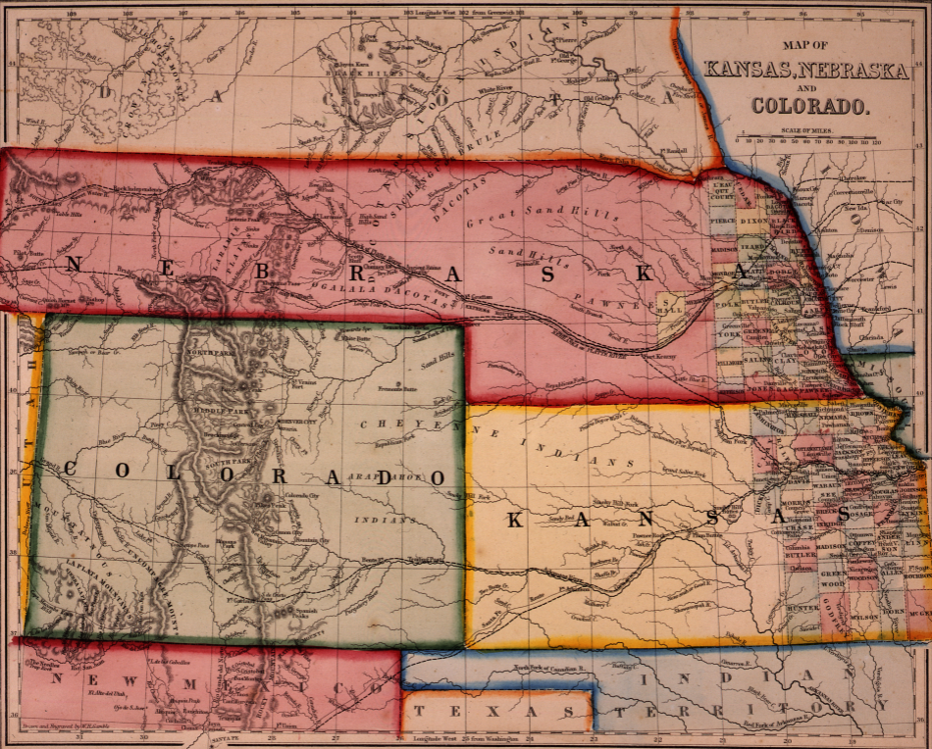
Notes:
See-Think-Wonder in their notebooks first, then on the board. Give them 5 mins to do alone, then together.

Slide 3
Band-Aid Solutions to Slavery
GOAL: Discover the “band-aid” solutions to slavery the U.S. tried to use to avoid war and how they actually worked.
Together, we will watch a video (about 7 minutes long)
The video will show 4 different “band-aid” solutions to the issue of slavery. These “band-aids” were trying to fix the huge wound of slavery so the U.S. could avoid a Civil War (yeah…right)
Answer the 1-2 questions about each “band-aid.” They will go in order like the video. The title will also pop up on the screen.

Slide 4
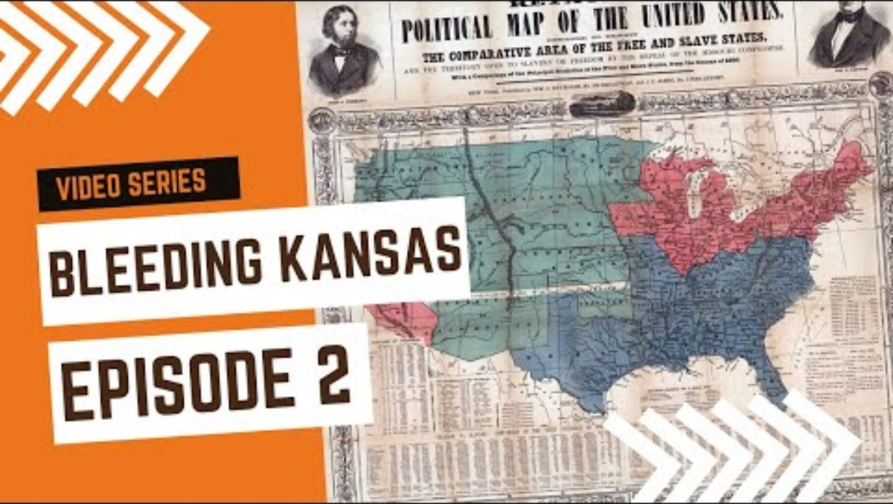

Slide 5

The Lane Trail: 5Ws
GOAL: Record 5 Ws about the Lane Trail, an important part of the UGRR through Nebraska!
On Teams, go to MIHV-Summer Bridge 2024
Click on Northwest High School
Click on Files —> Lane Trail Reading
BEFORE READING: Preview the questions for each of the 5Ws. Looking at the questions first = reading smarter
Read the Lane Trail Reading alone or with a partner. Answer the 5 Ws as you read.
Stuck? Try making the question into an answer. EXAMPLE: The goals of abolitionists and freedom seekers on the Lane Trail were…

Slide 6
Exit Ticket
In your notebook, write:
Today’s date
SUMMARIZE: The Lane Trail was ___________________________ _______________________________________________________.
Something I want to ask the expert about the Lane Trail tomorrow is ____________________________________________.

