Slide 1
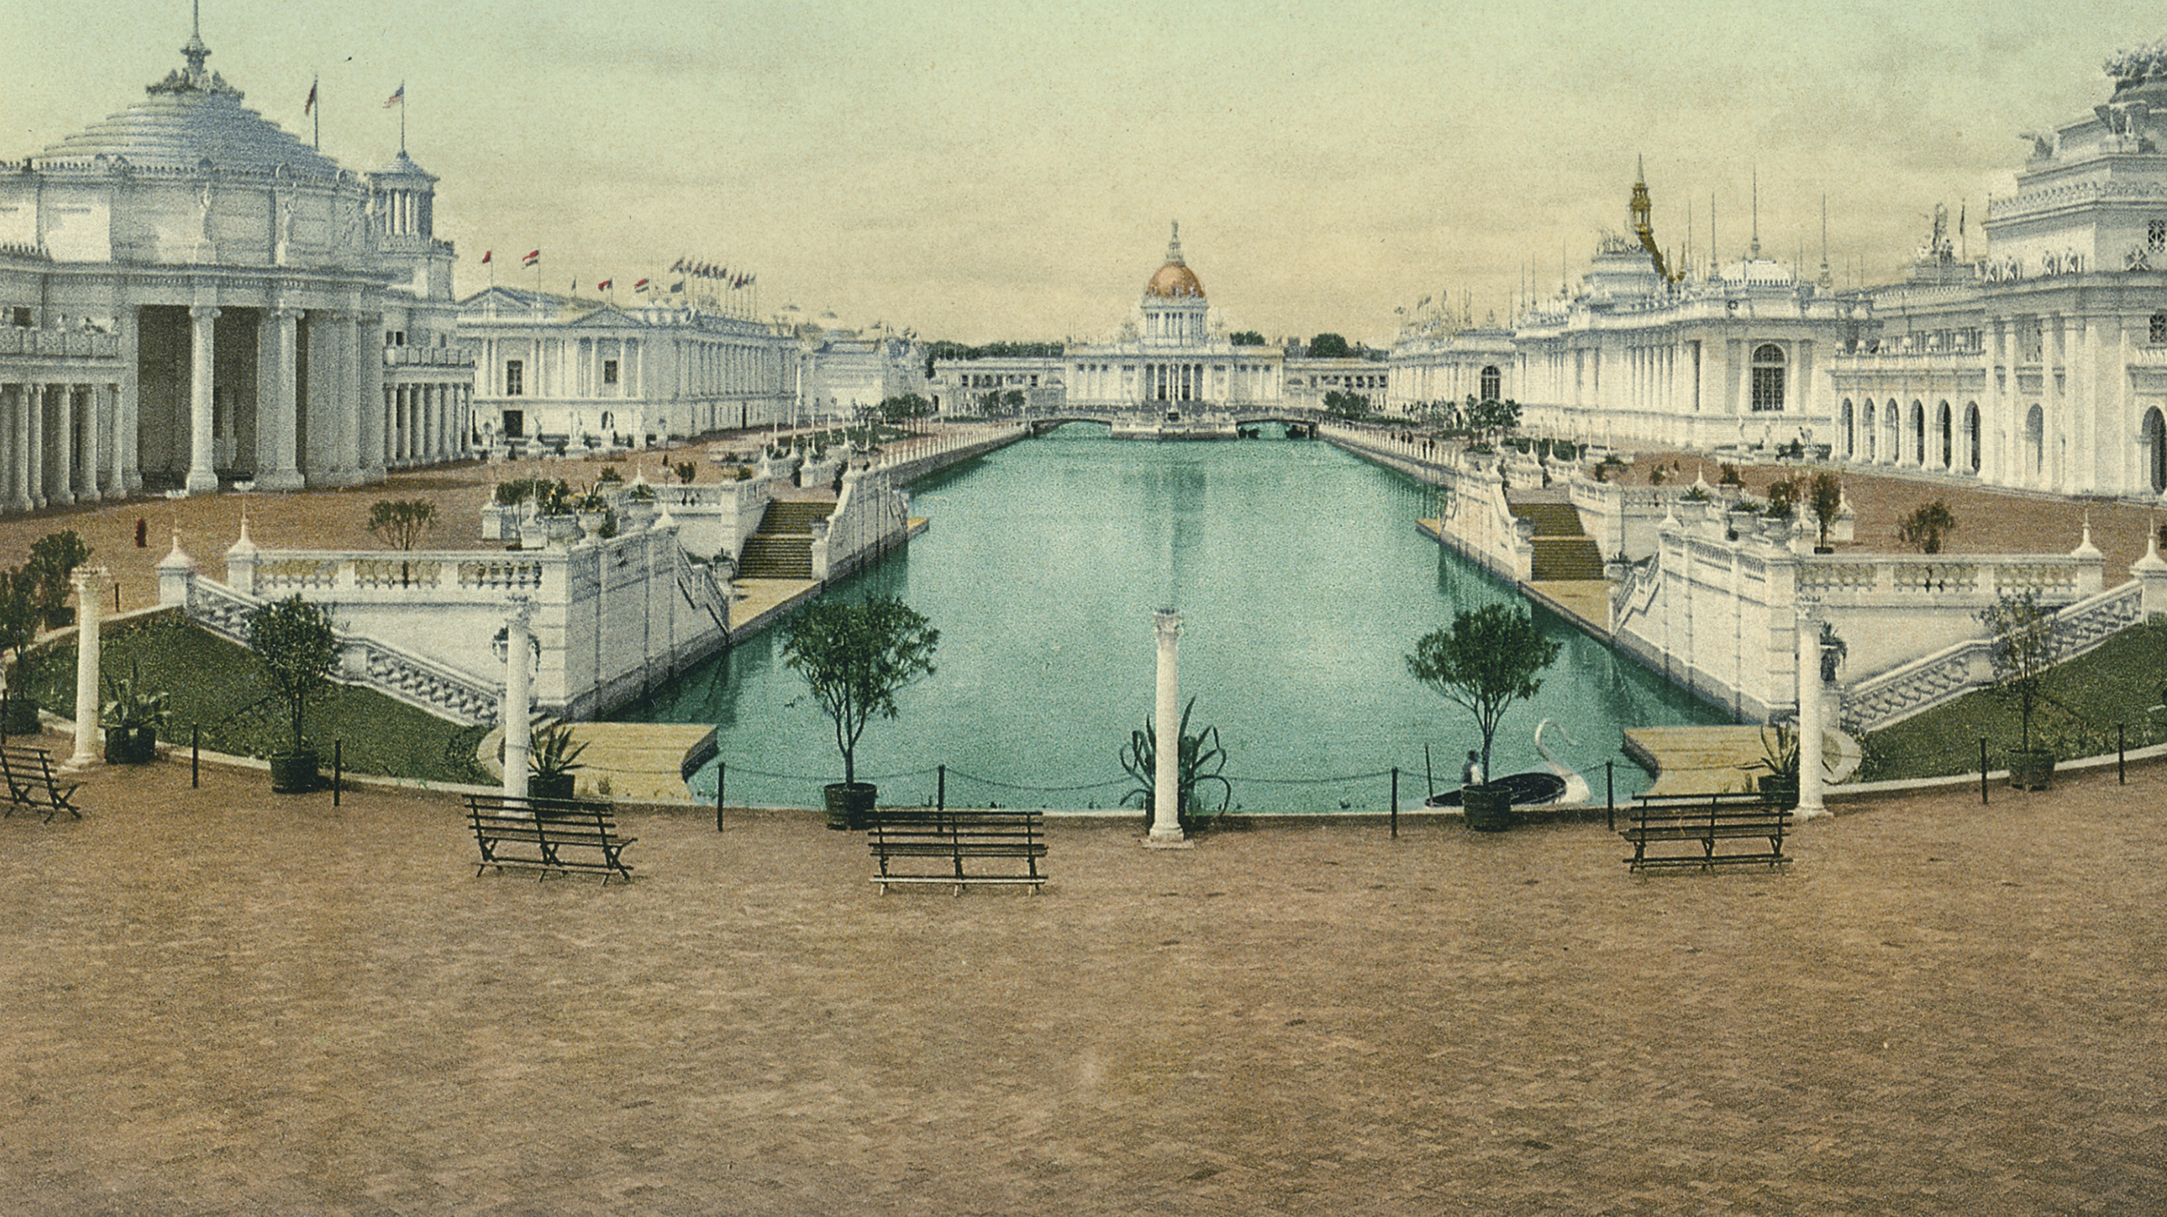
Leo Baroch and the 1898 Trans-Mississippi Exposition A Journey Through Artifacts and Stories

Slide 2
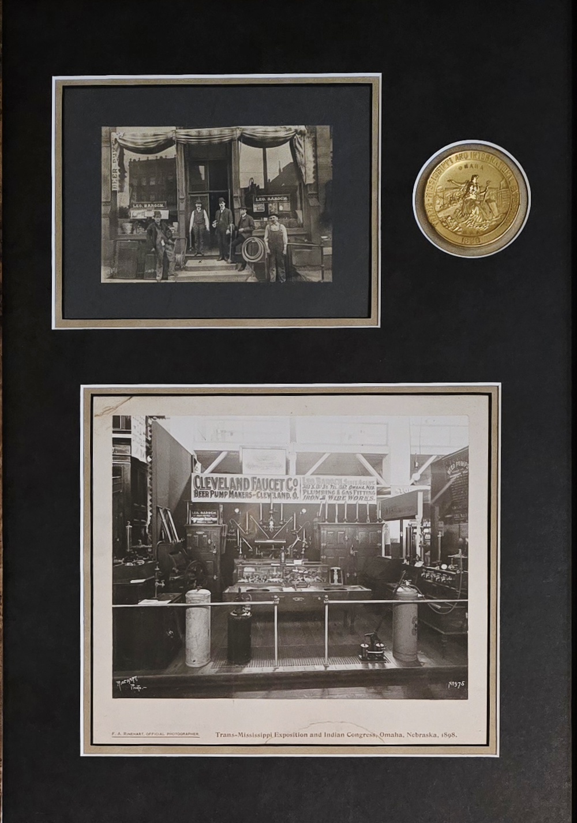
Leo Baroch Trans-Mississippi Exhibitor
Leo Baroch was a Czech immigrant. He came to Omaha in 1893 and started working as a plumber.
He had a booth at the Exposition. He promoted and sold pumps used to dispense beer in taverns.
His exhibit won a Gold Medal.
In 1904 he moved his plumbing business to 1217 Howard Street. He worked as a plumber until 1947.

Slide 3
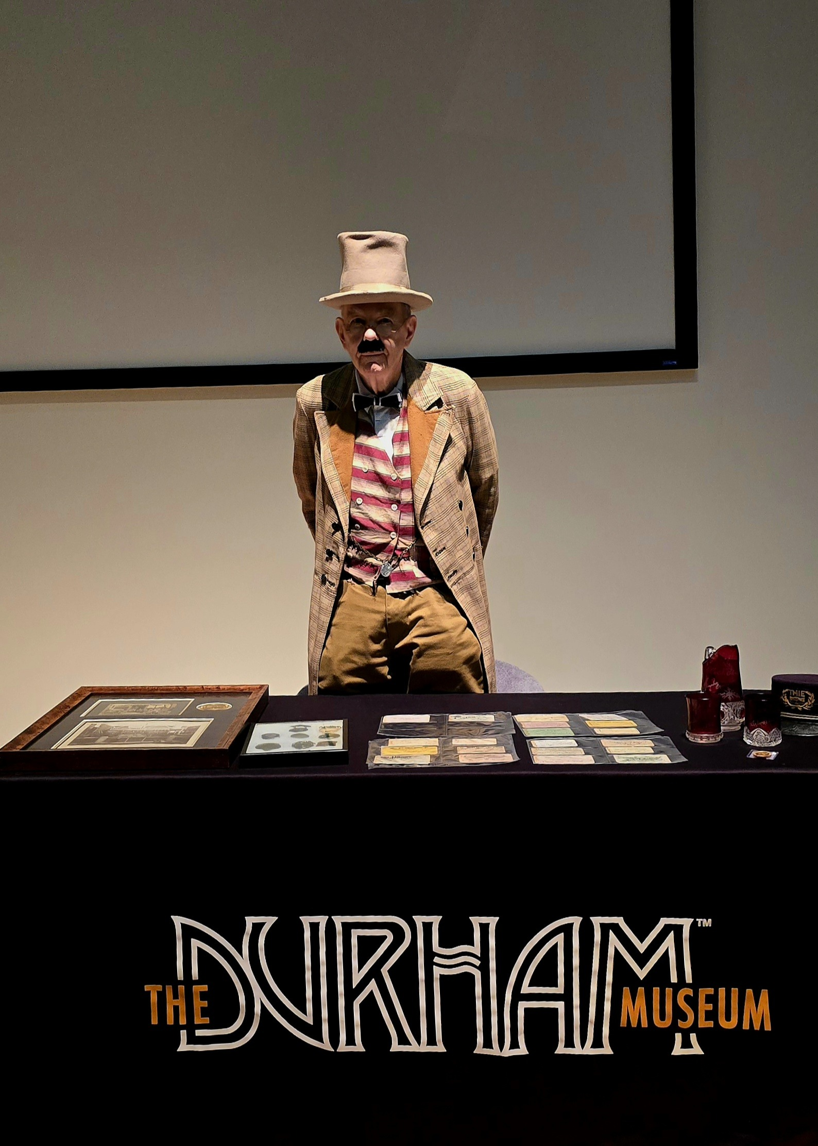
John Krecek Trans-Mississippi Collector
John Krecek is the grandson of Leo Baroch
He has the largest collection of Trans-Missississippi items in the world.
He started collecting after learning of his grandfathers involvement in the Exposition.
The following are some items in his collection.

Slide 4
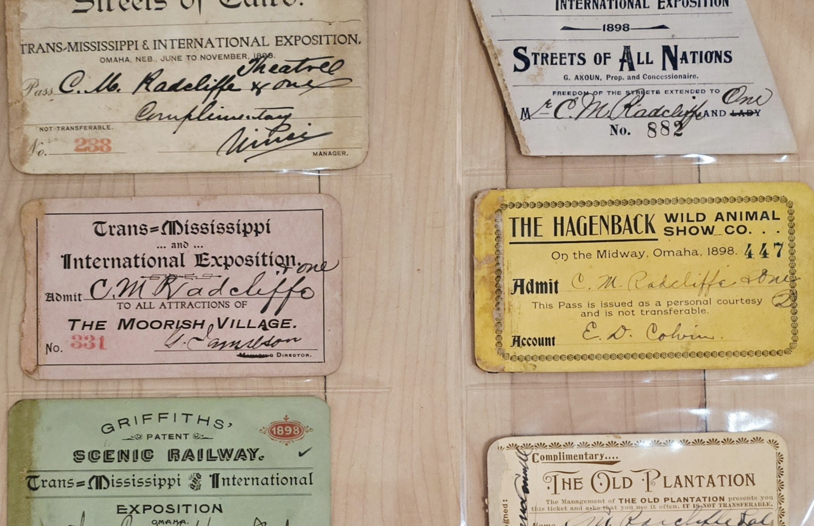
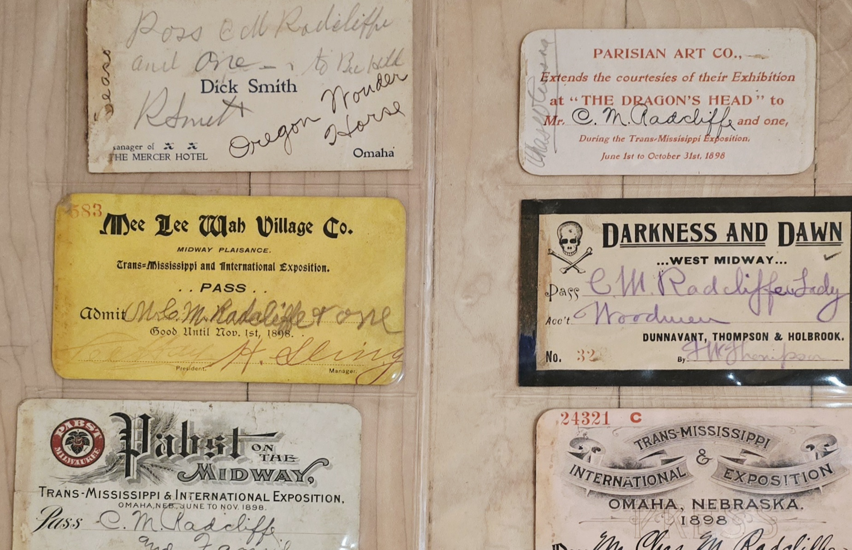
Advertisement Cards
Used to promote attractions like the Streets of Cairo, The Moorish Village, and the Hagenback Wild Animal Show.
Each card is a window into the marketing and entertainment of the time.

Slide 5
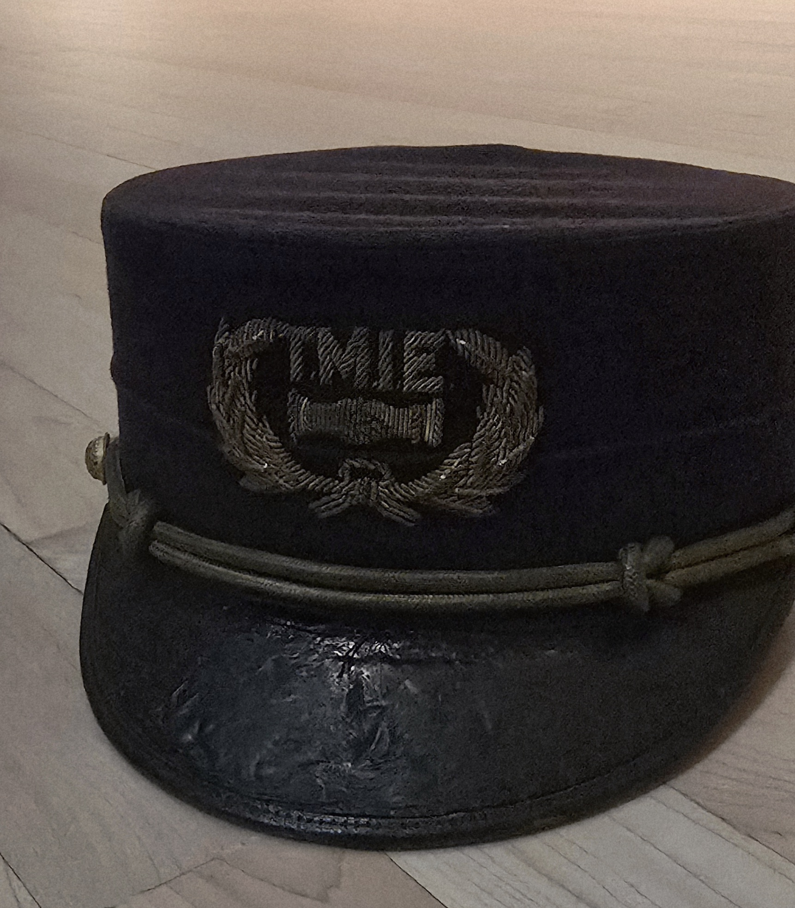
Worker’s Hat
The Trans-Mississippi Exposition uniform hat with “TME” insignia.
Part of the official uniform worn by exposition staff.
Symbolized professionalism and unity among workers.

Slide 6
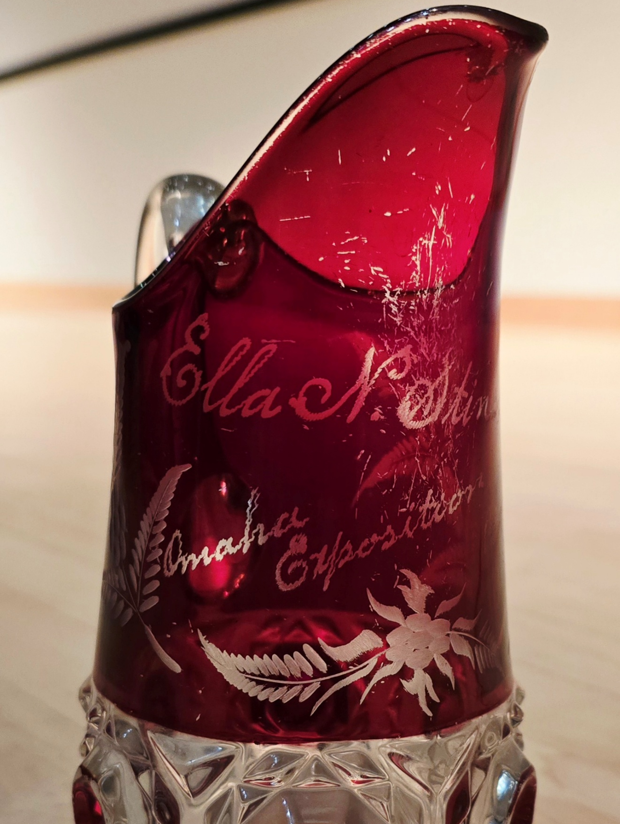
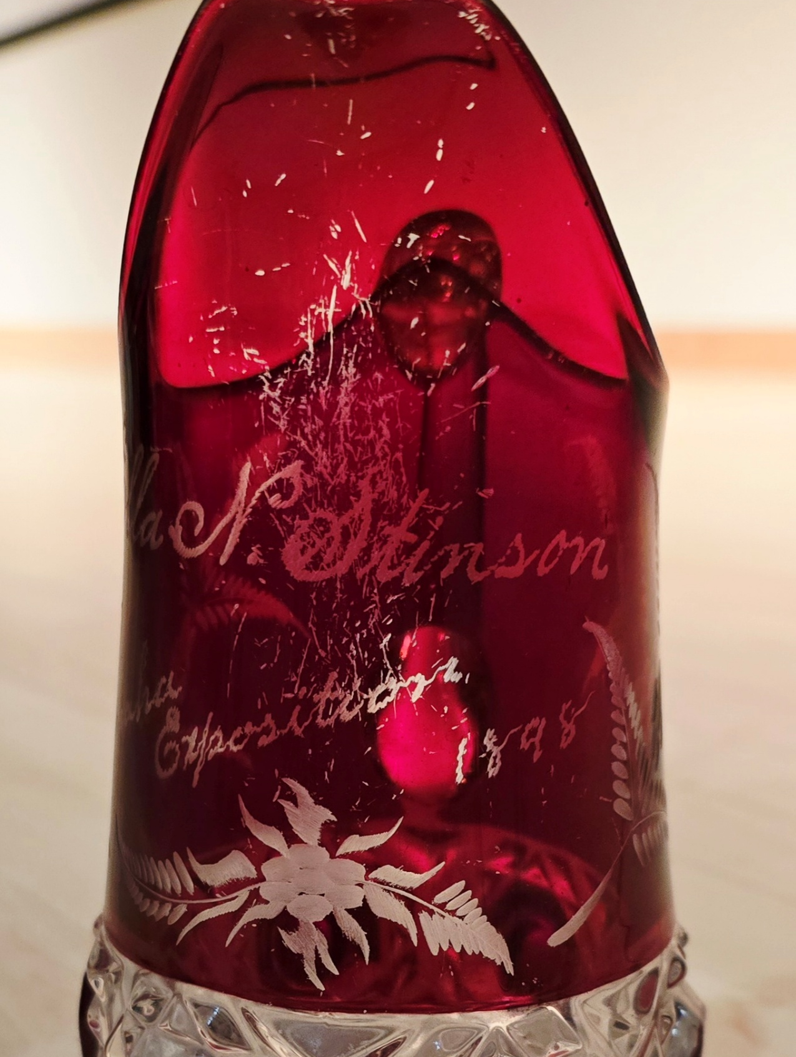
Engraved Ruby Pitcher and Glasses
The ruby red cut glass pitcher is engraved with “Ella N. Stinson, Omaha Exposition 1898” and detailed floral patterns.
Popular souvenir glassware at the Exposition.
Personalized and often given as gifts or keepsakes.

Slide 7
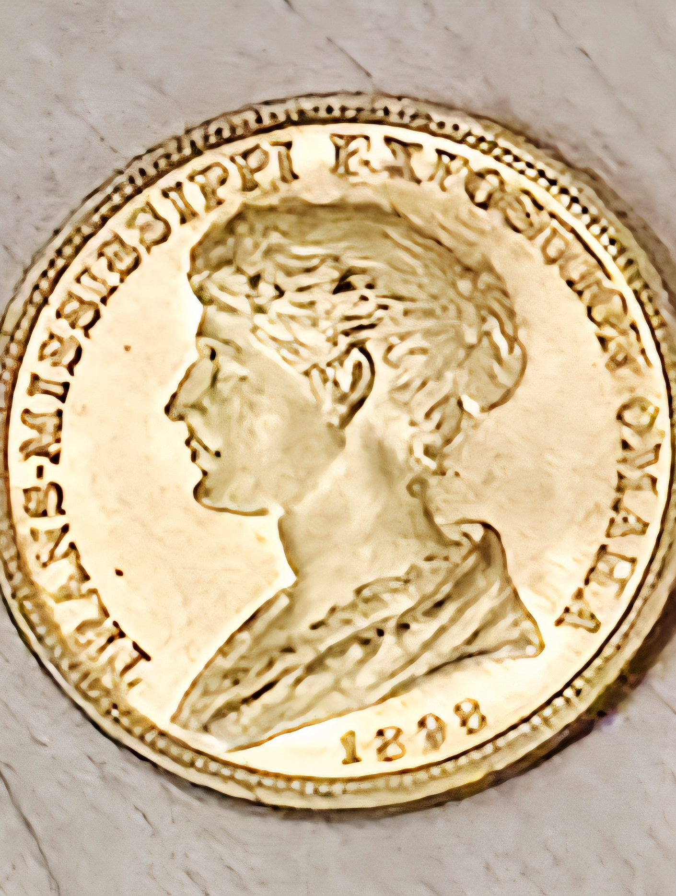
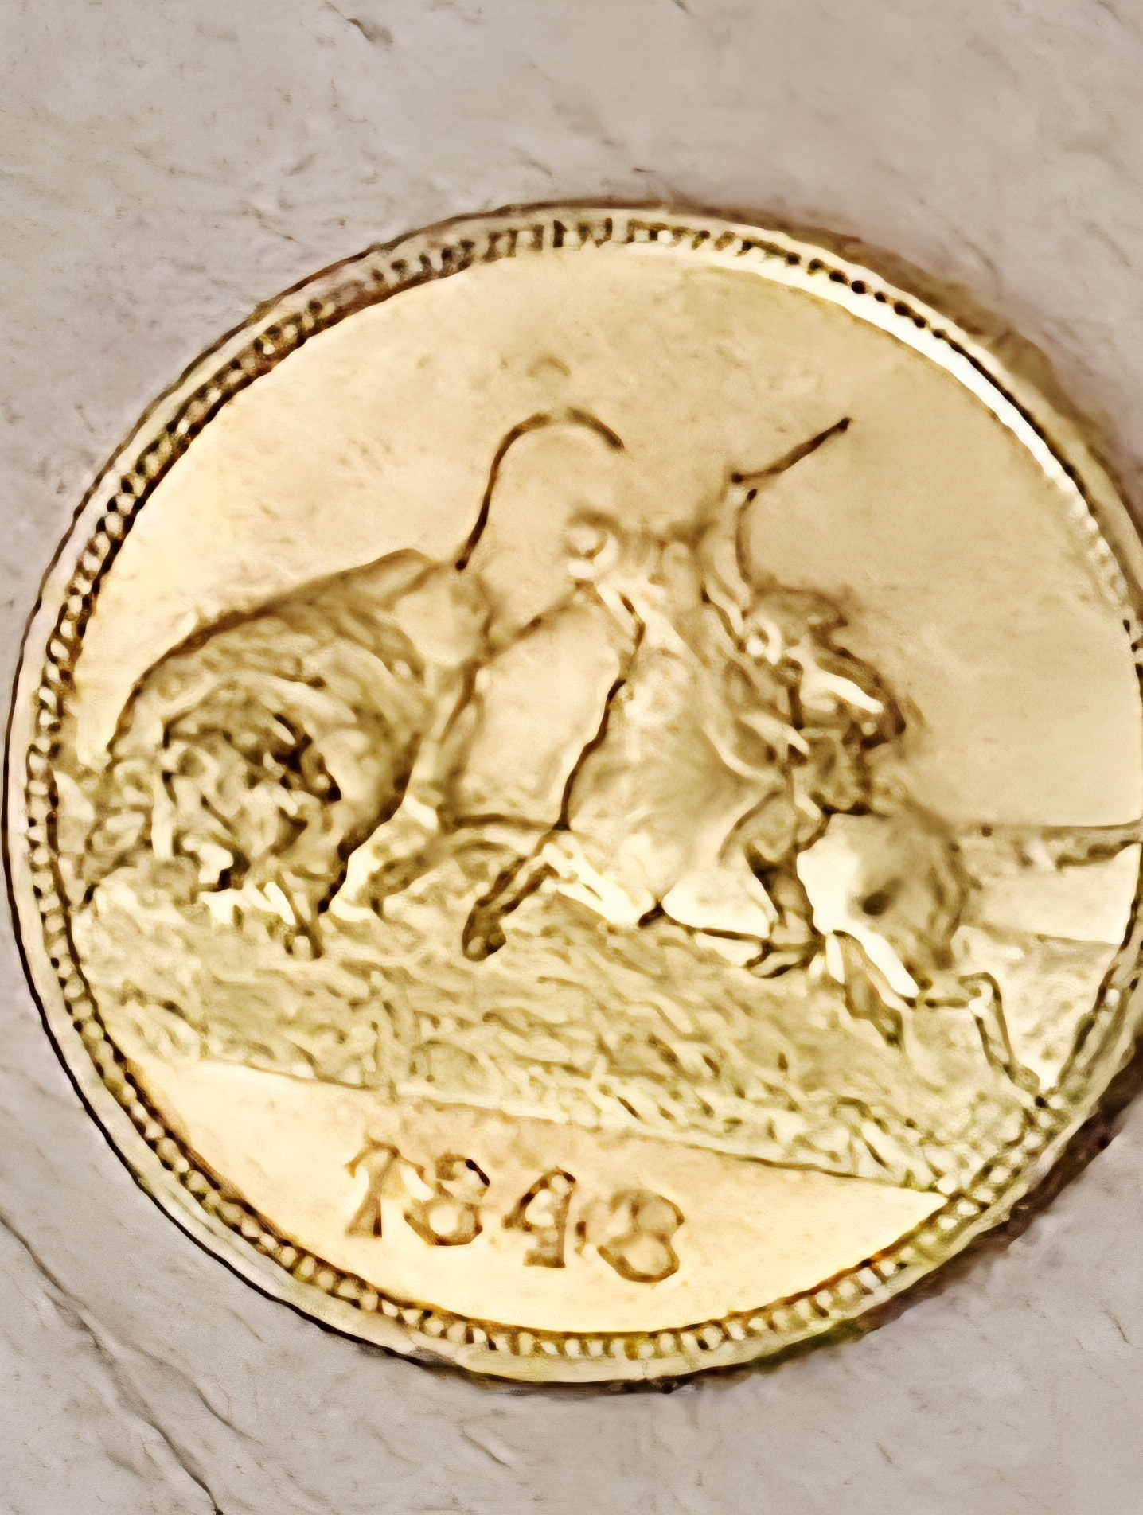
Souvenir Coin
Front and back of the gold souvenir coin.
Obverse: “Trans-Mississippi Exposition Omaha 1898” with the “Most Beautiful Women of the Trans-Mississippi States.”
Reverse: “1898” with bison and Native American imagery.
Minted at the Exposition by the U.S. Treasury in the U.S. Government Building

Slide 8
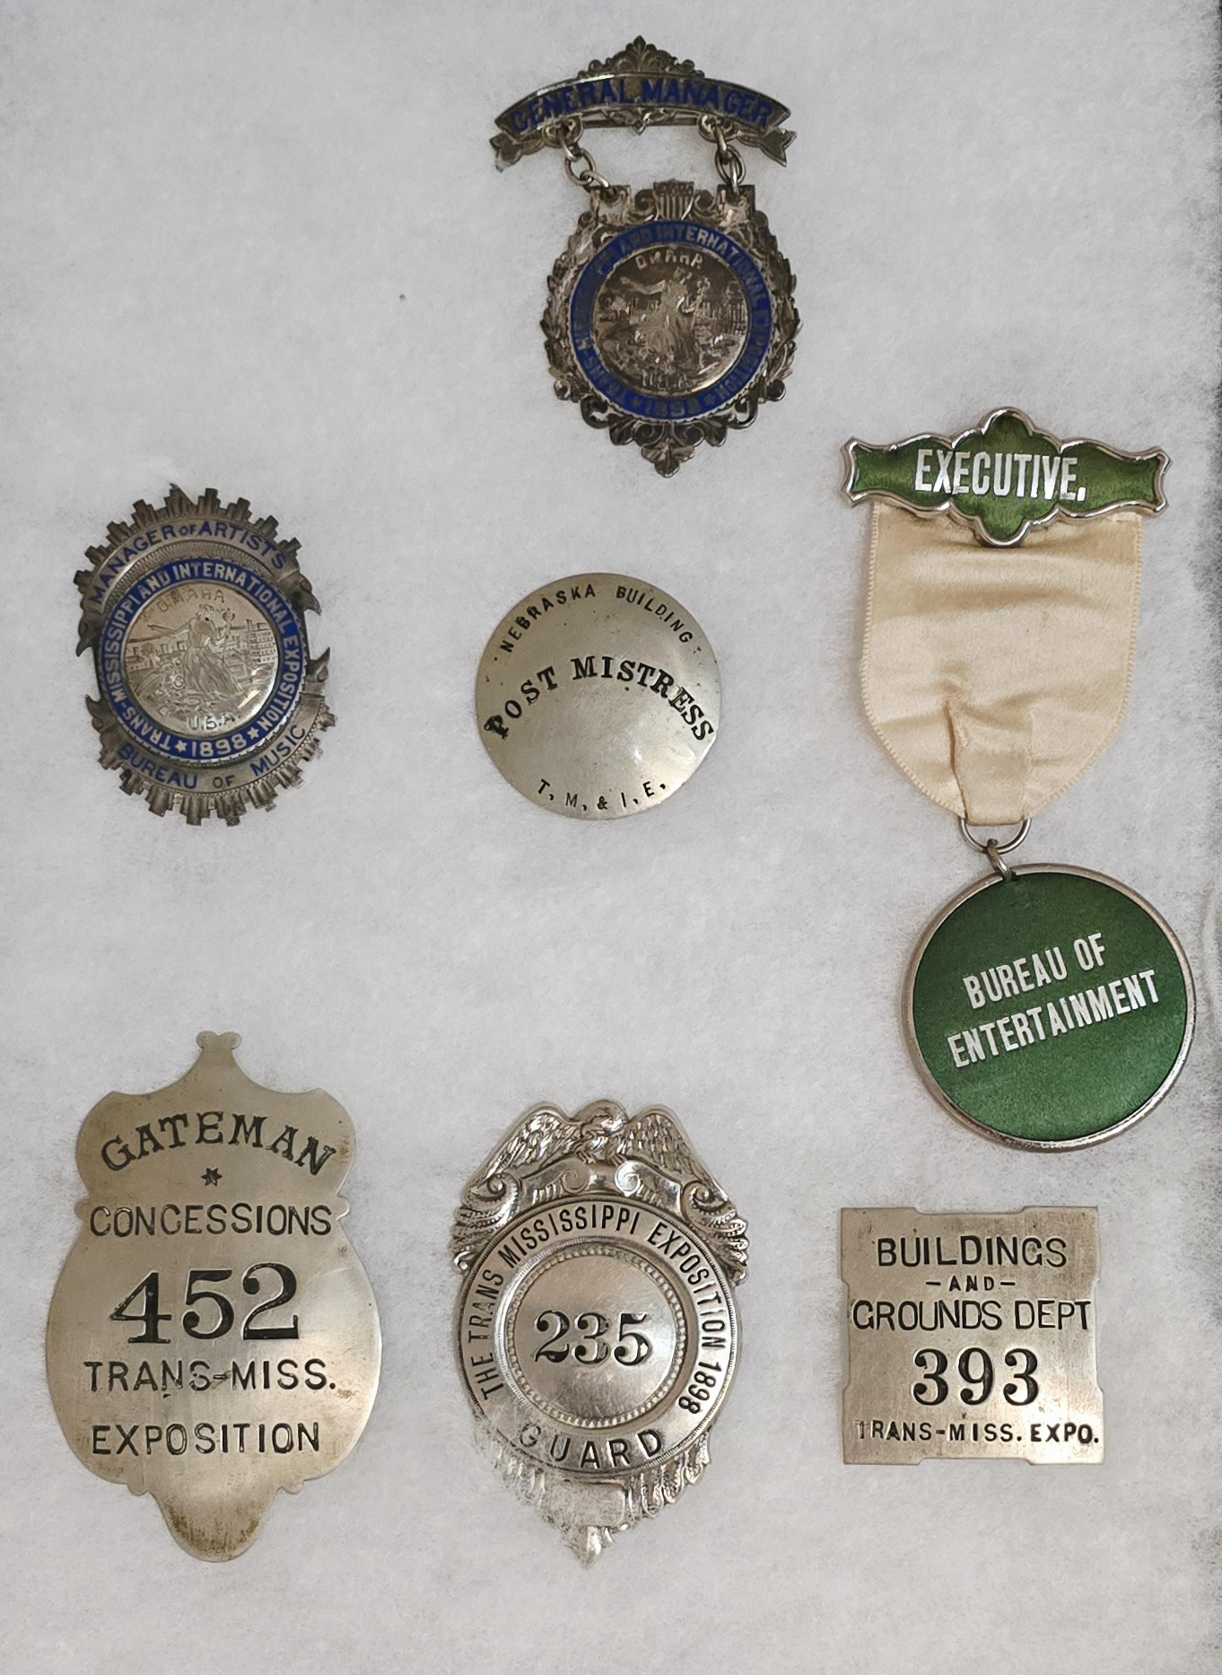
Badges
Various badges such as “General Manager,” “Post Mistress,” “Executive,” and “Gateman.”
Identified roles of workers and officials.
Reflect the organization and scale of the event.

Slide 9
