Slide 1
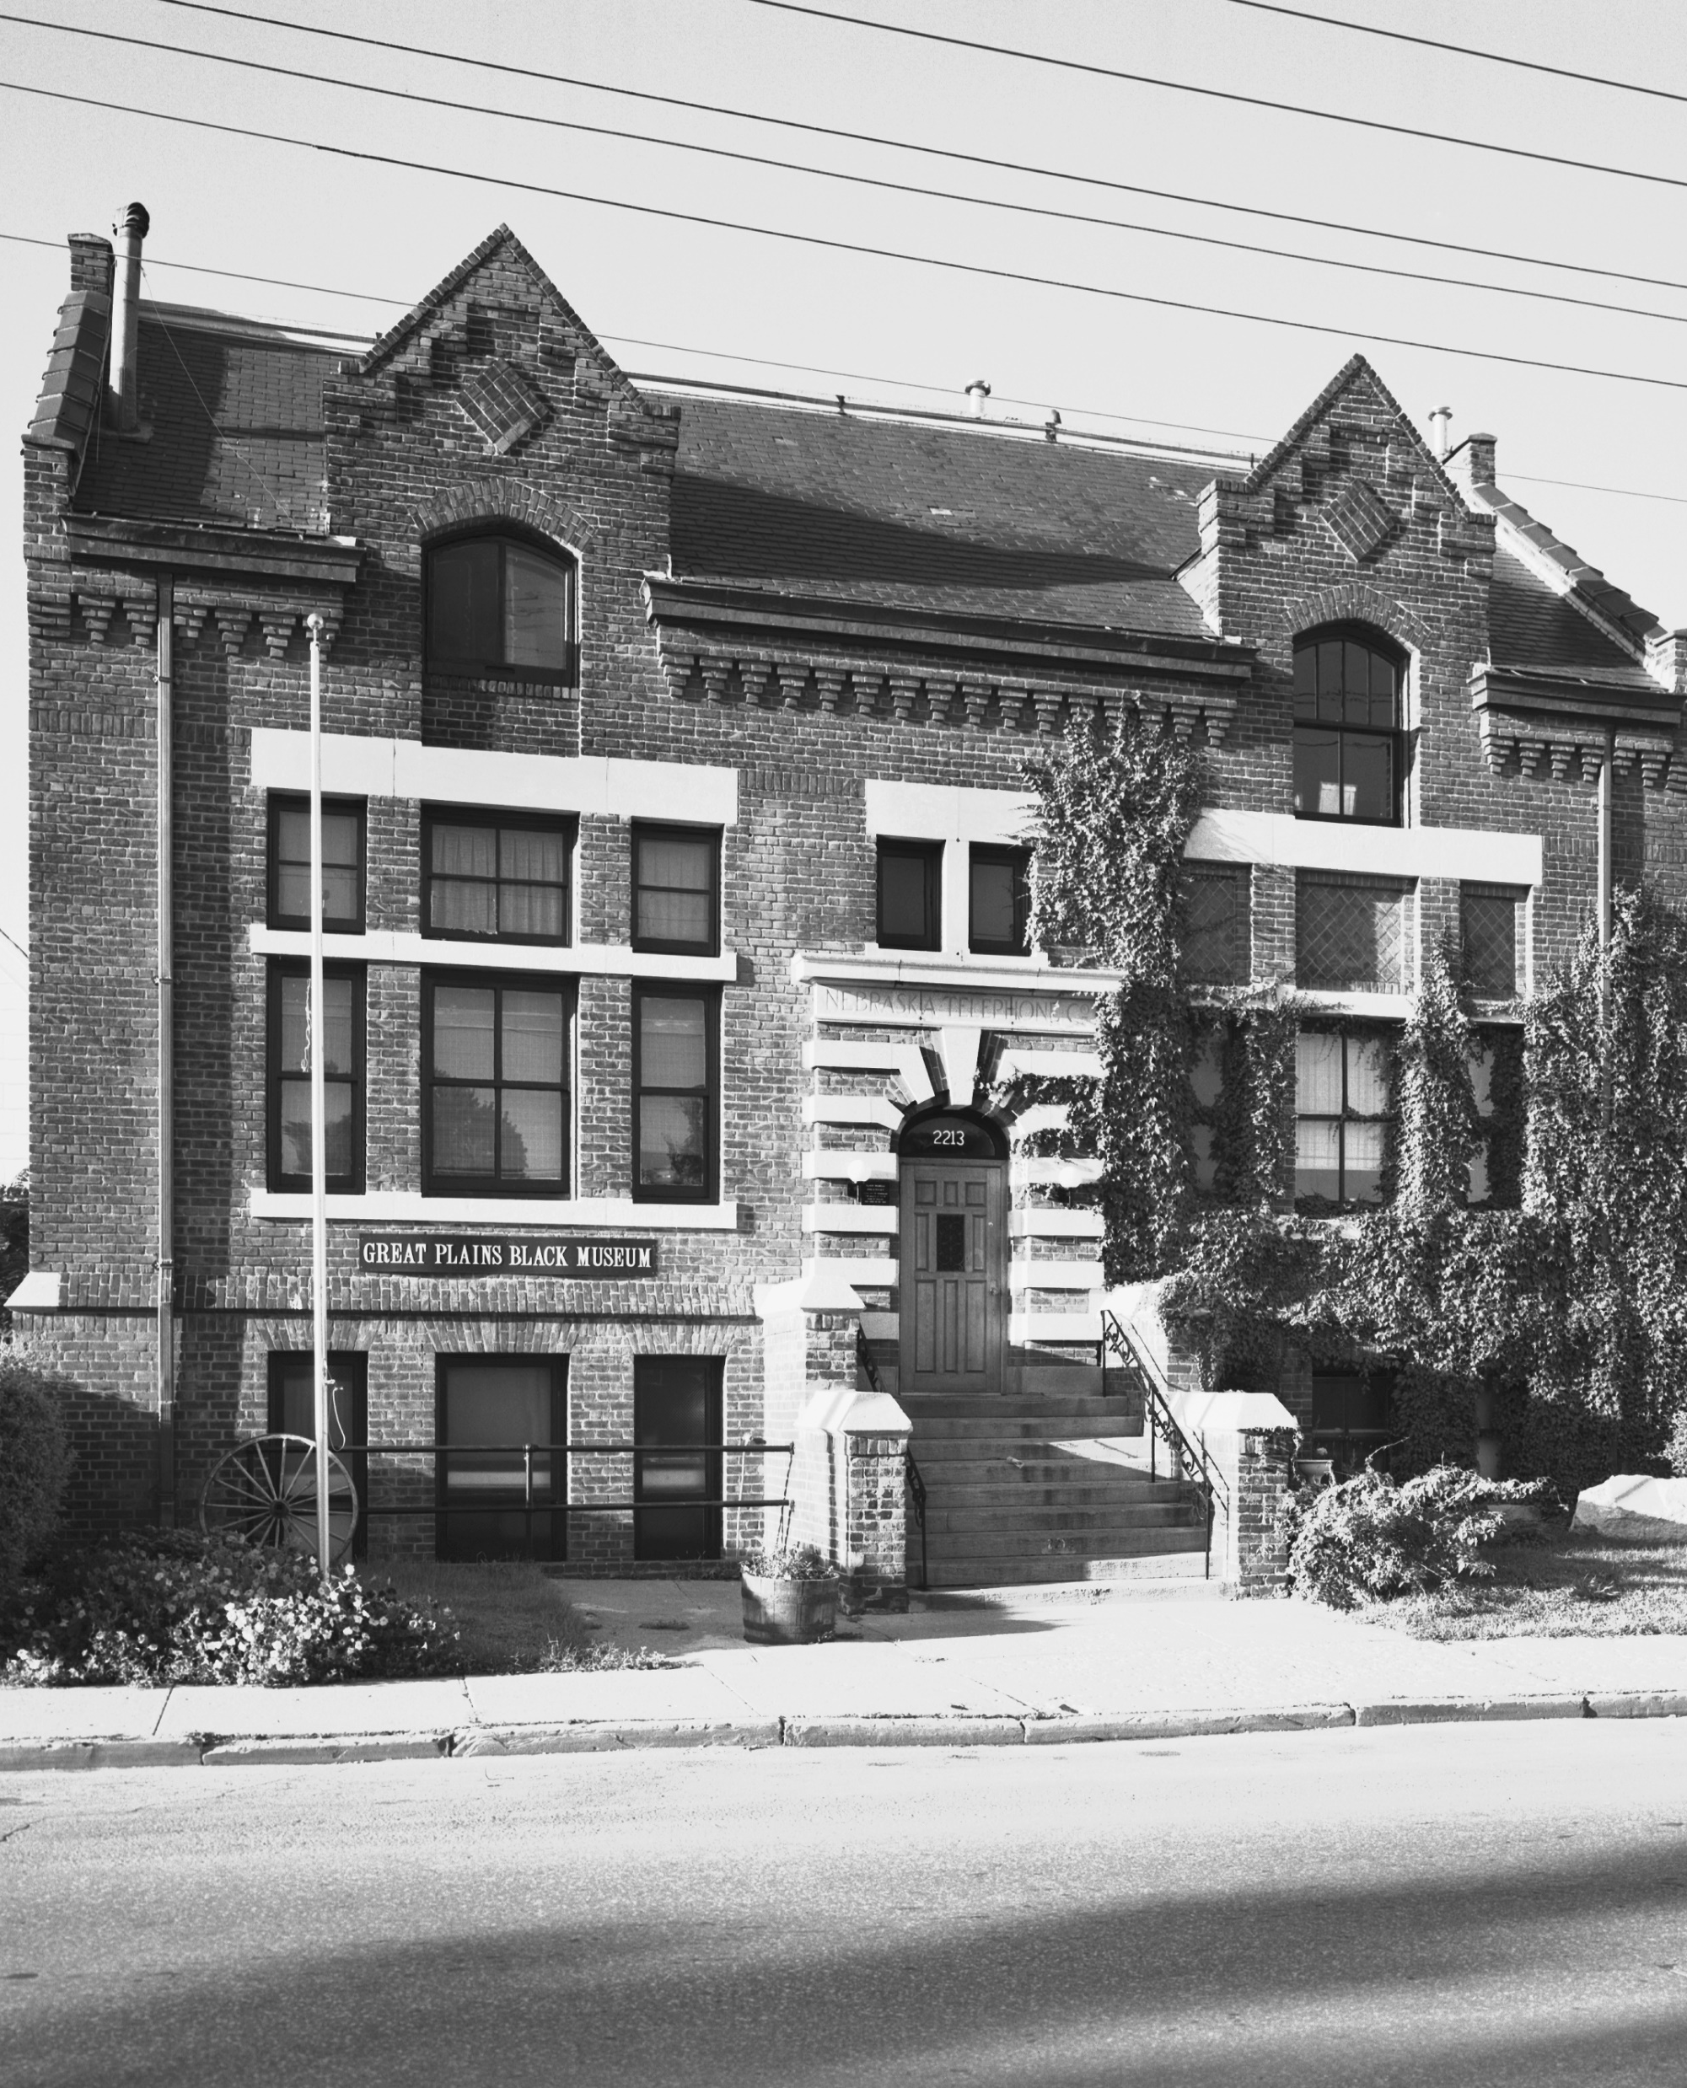
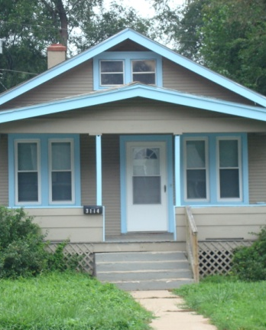
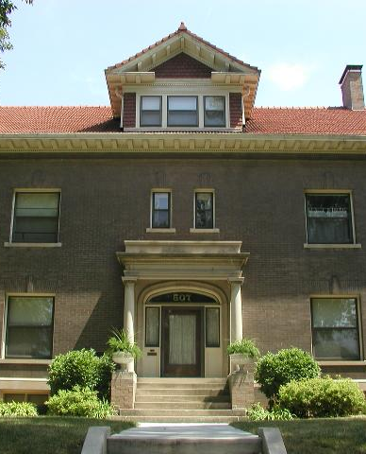
Researching the History of a Home, Building and Neighborhood

Slide 2
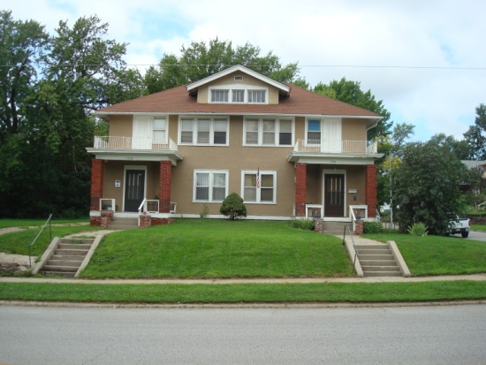
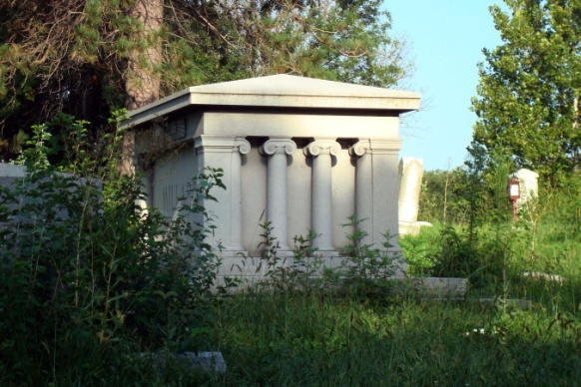
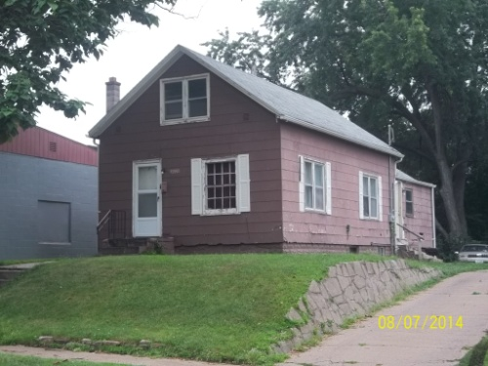
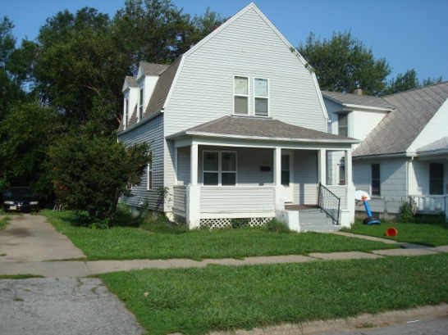
Why Is Researching
the History of Properties Important?

Slide 3
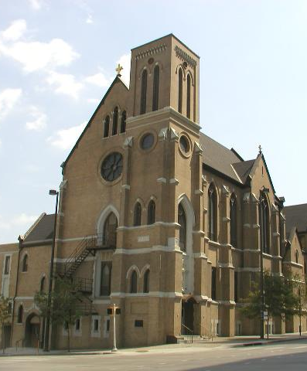
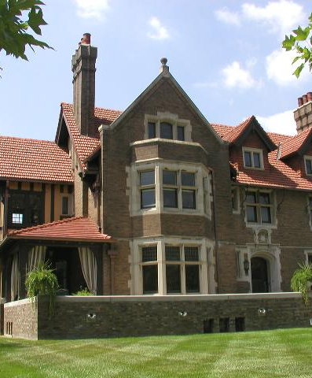
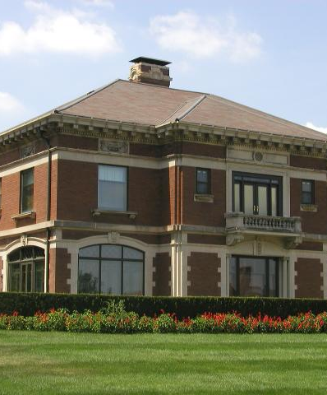
Every property has a story.
Knowing that story can help you appreciate and promote
what makes it unique.

Slide 4
Where to Begin

Slide 5
Douglas County GIS Site www.dogis.com
Approximate Year Property Built
Addition Name, Lot and Block
Section, Township and Range
Materials Property Made Out Of
Historic Pictures

Slide 6
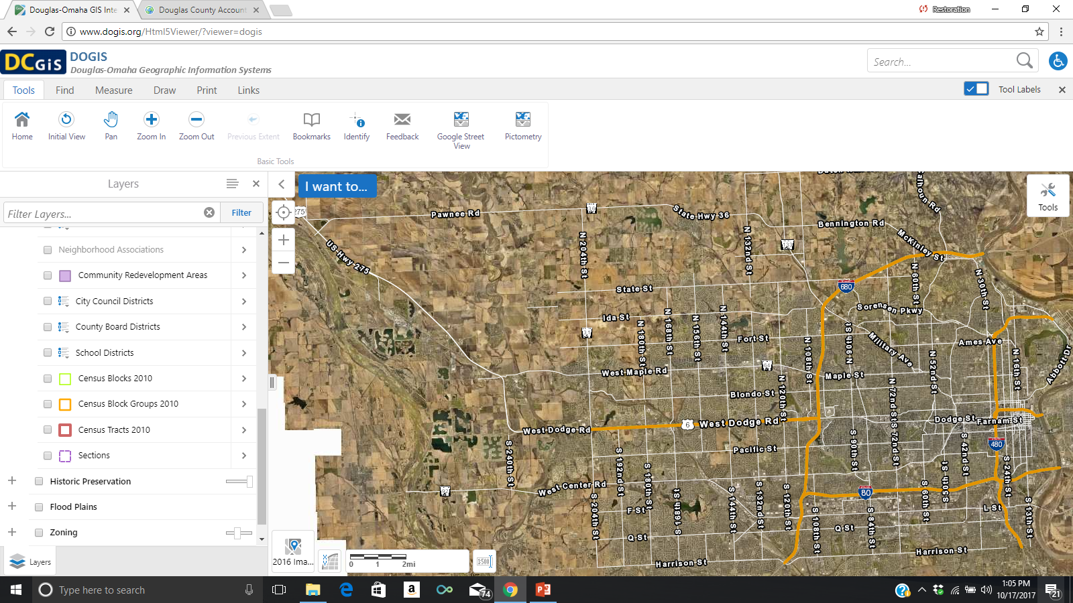

Slide 7
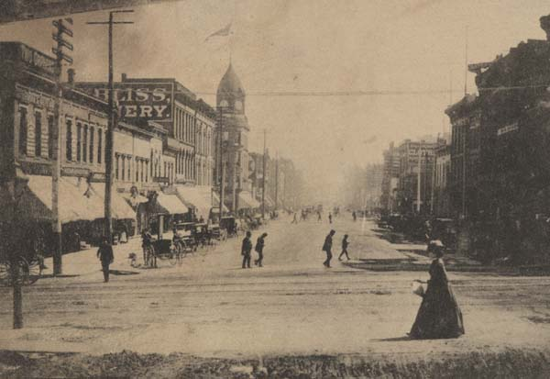
Omaha Public Library
Digital Historic & Current Omaha World-Herald, 1878-Present
Digital Omaha Star 1938-2011
City Directories
Ancestry.com Library Edition
Special Collections
Early photographs, postcards, albums, stereo views and maps
Sanborn Maps 1887-1962

Slide 8
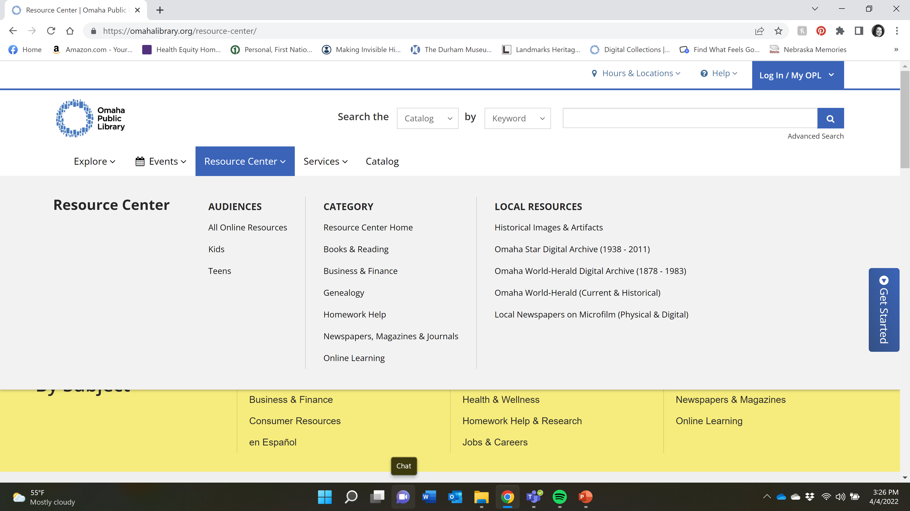
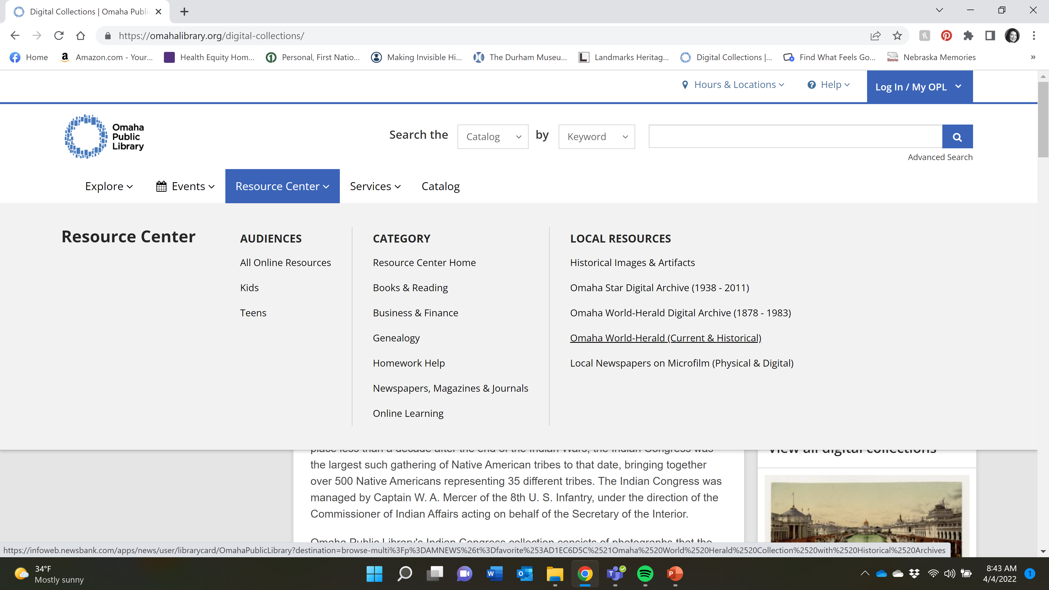

Slide 9
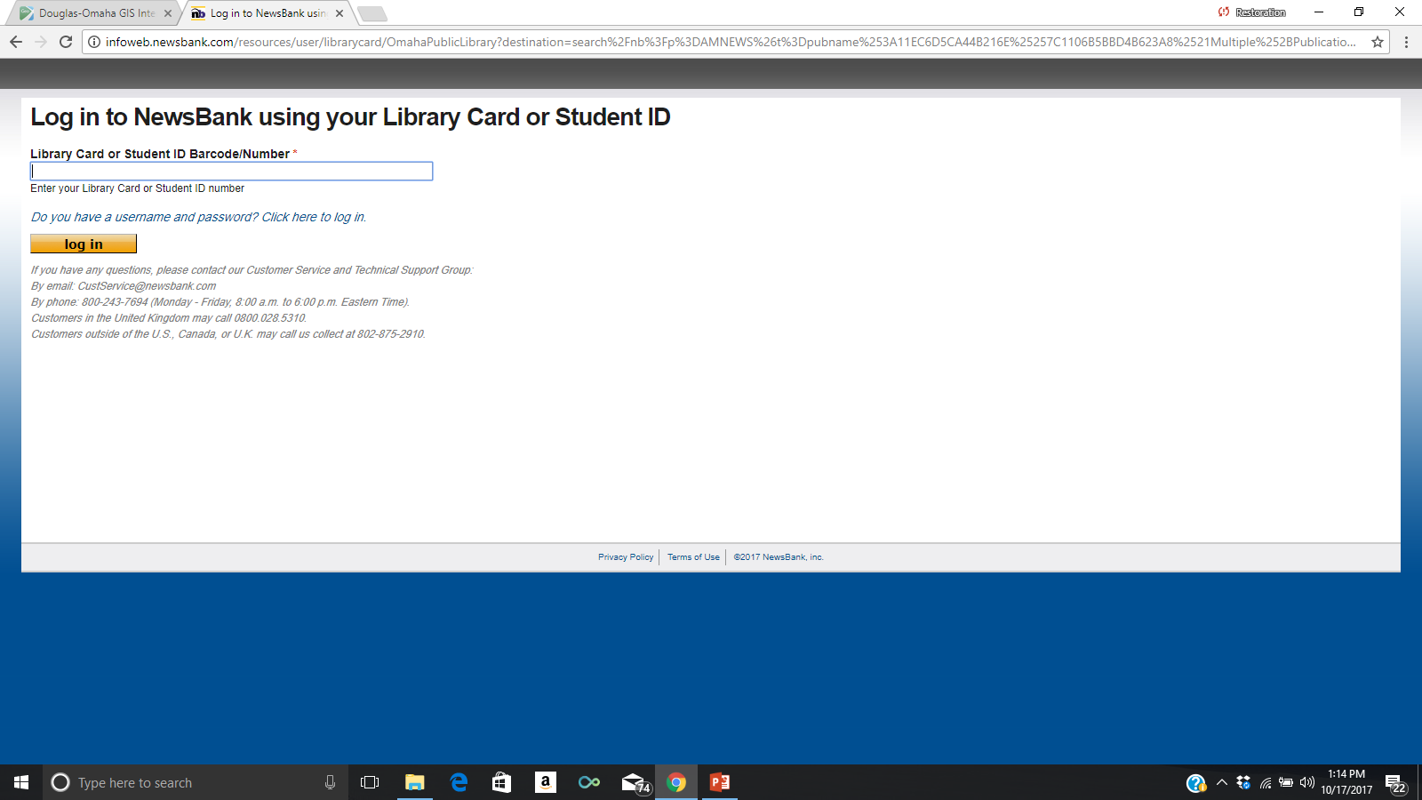

Slide 10
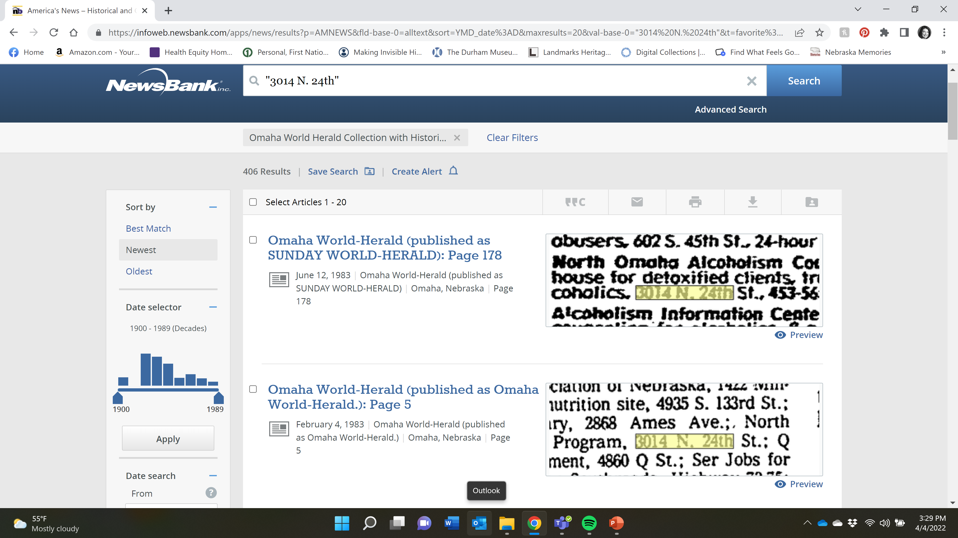
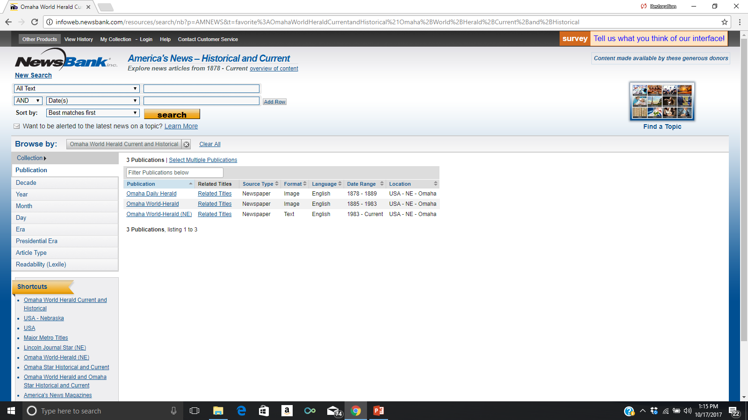

Slide 11
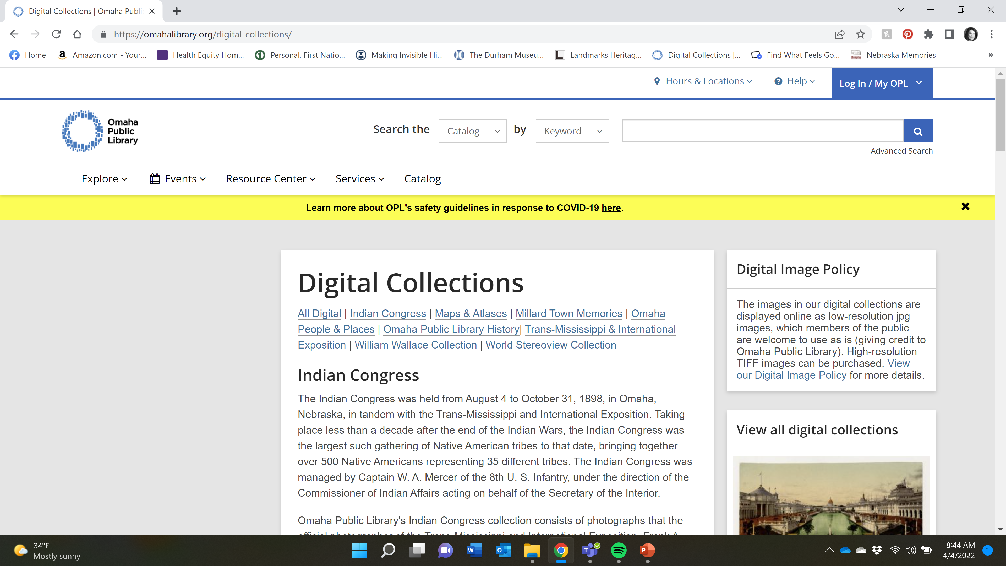

Slide 12
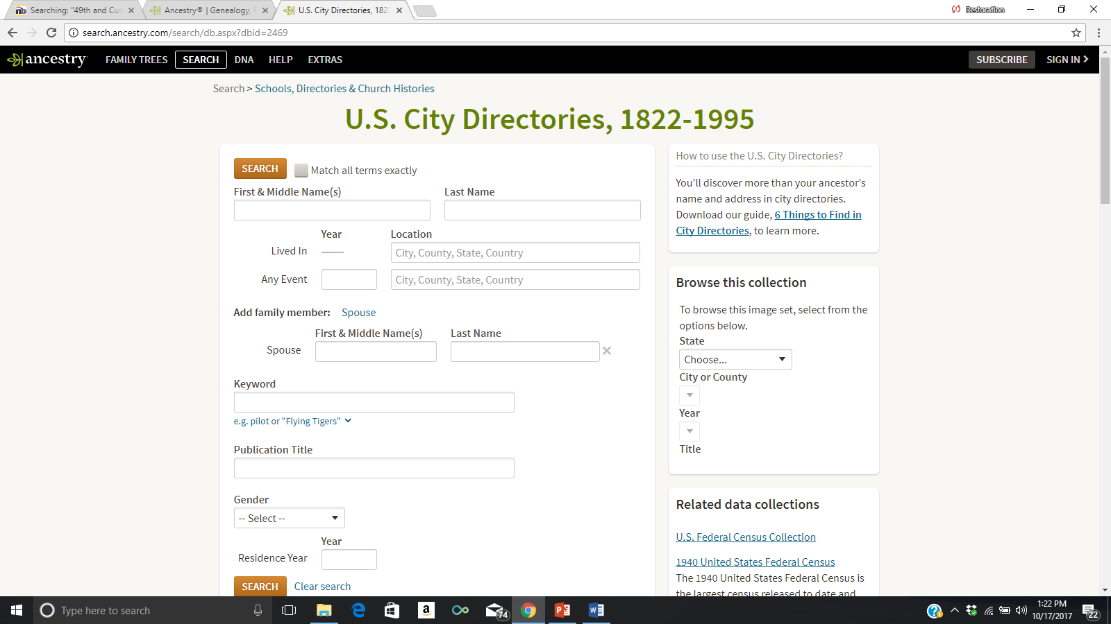

Slide 13
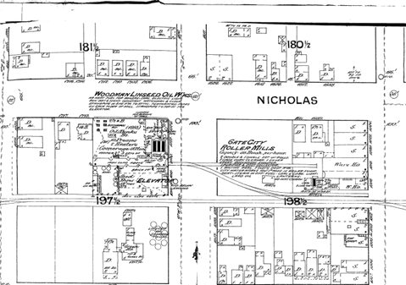
Digital Sanborn Maps
Produced by a Fire Insurance Company to determine insurance rates for properties.
Digital and printed copy versions available at the Omaha Public Library or in City Planning.
For Omaha maps start in 1880’s and go through 1962.

Slide 14
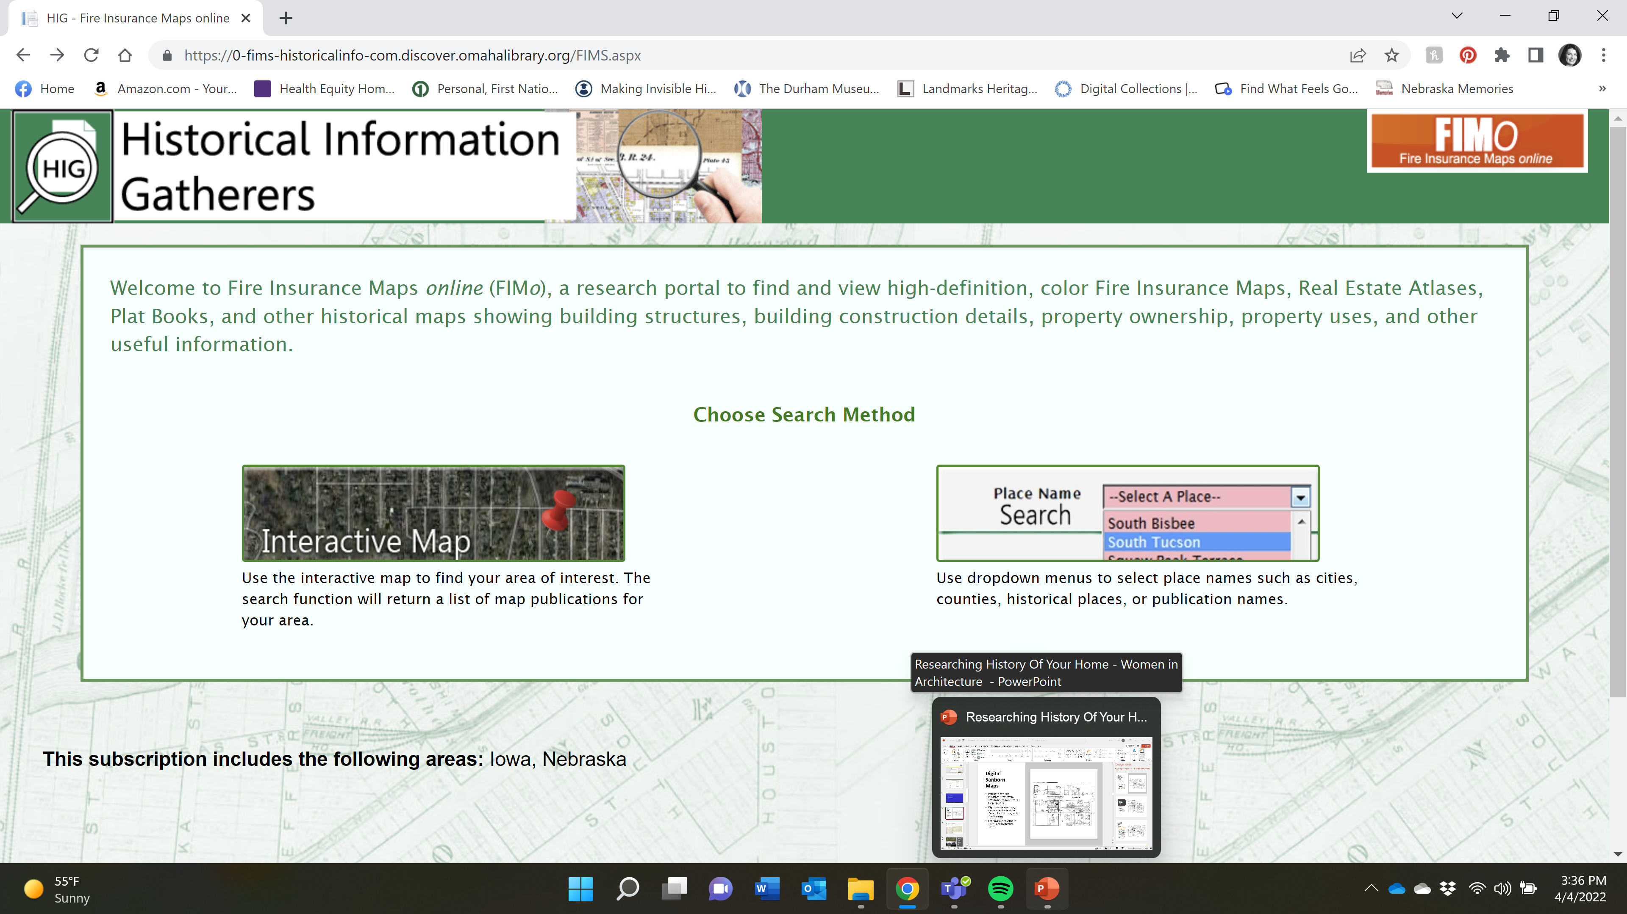

Slide 15
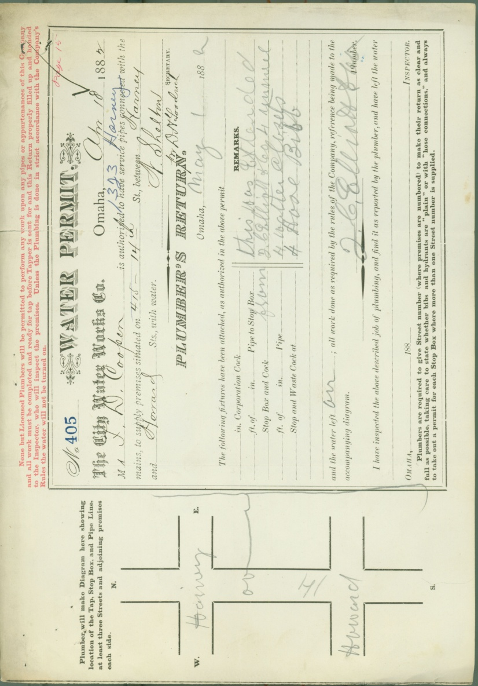
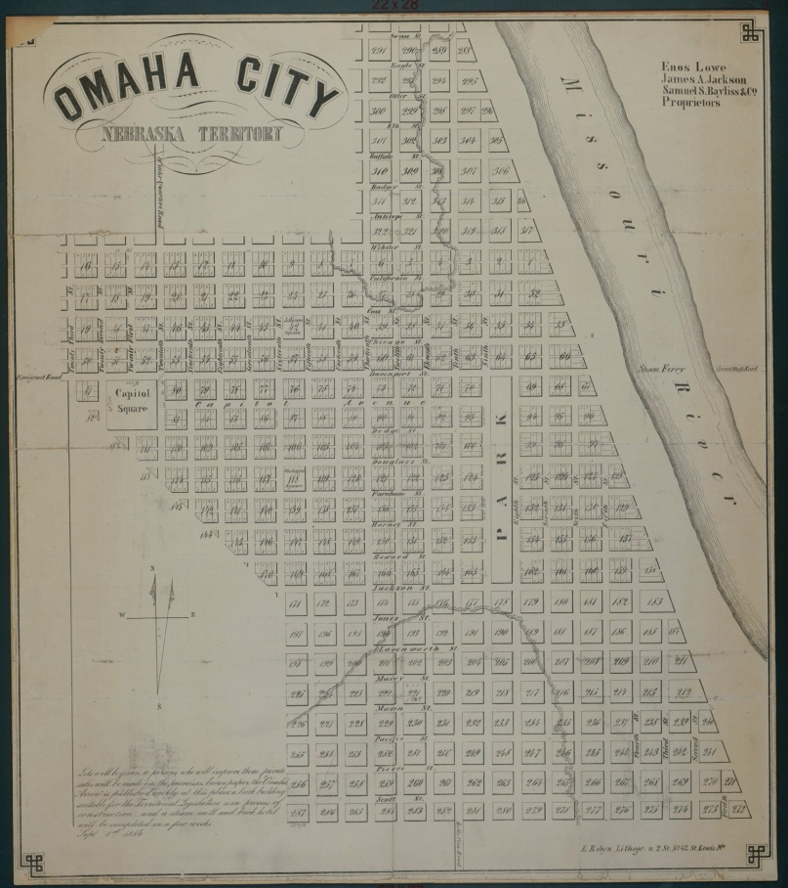
Early maps, plat books, and gazetteers
Card index to people, places, and events
Institutional records e.g. early Omaha water permits, 1882-1955

Slide 16
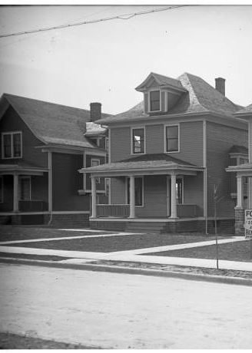
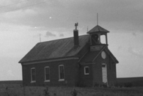

The Durham Museum
Archive contains over 800,000 images spanning from the 1860s to the 1990s.
Search Online first
Or open by appointment - Tuesday-Friday 10:30-3:30, or the first Saturday of the month.
Policies
Notes:
People – primarily in the 1930s-1960s, images from OWH photographers. Maybe mention AkSarBen collection?
Houses – Some, but* stress that it’s spotty and really depends on the area, we’ll come back to this later. This particular photo is: 902 South 38th Street house belongs to Dr. C.C. Criss. This house has a for sale sign in front of it. 906 south 38 ST belongs to Dr. Neil Criss. The 38th Street homes were built by Carl Berg. Dated to 1912. We have this because Photographer Homer Frohardt lived at 920 S 38th street – they were neighbors.
Businesses and Buildings – our strongest section! This photo is: West on Douglas Street from 17th Street, Omaha, Nebraska. Parked cars line the street, cars drive down the street, people walk along the sidewalks. Notable buildings include: Athletic Club, Strand Theater, Fontenelle Hotel, Masonic Temple, and Northwest Bell Telephone Building. Dated 1922.
Bostwick – commercial photographer, downtown shots, good growth of Omaha.

Slide 17
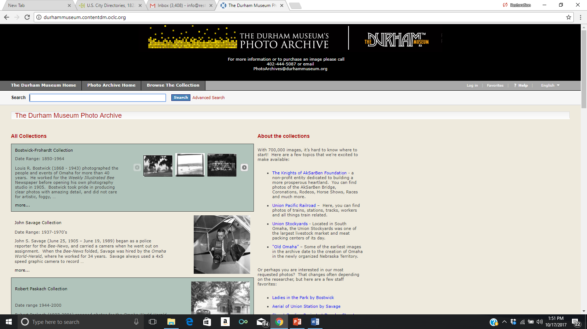

Slide 18

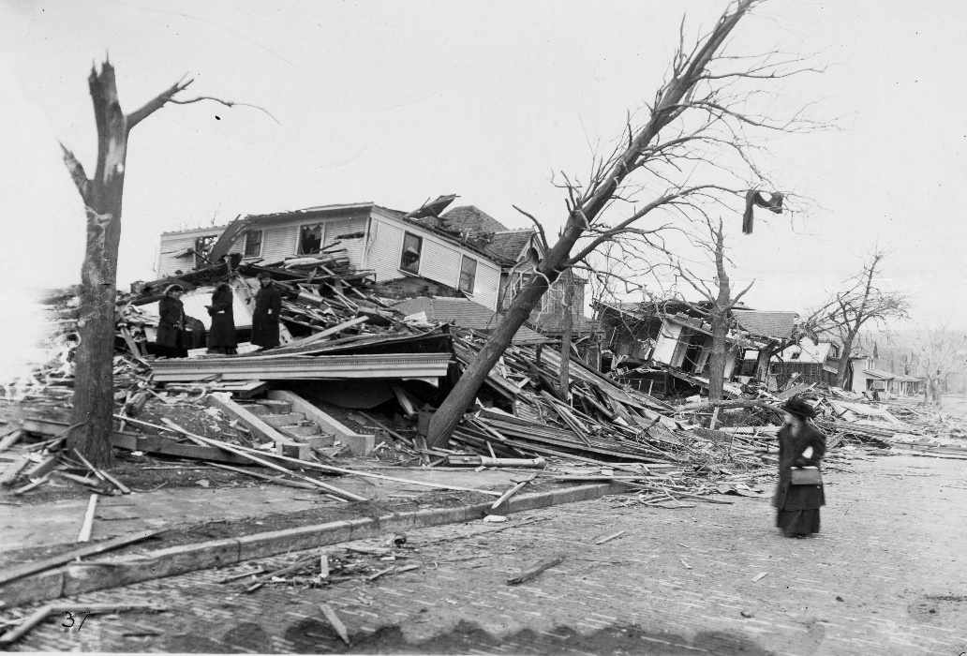
More than 500,000 photos housed in the
World-Herald Library (1900 - 1997)
Negatives from May 1991 - December 1997
Digital Archive 1997 – present
Photographs before 1997 filed by name or subject
March 23, 1913 Easter Sunday Tornado.
42nd & Farnam, South Side of Street

Slide 19
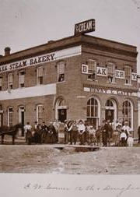
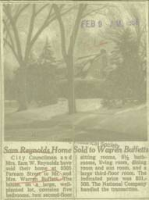
Douglas County Historical Society
Bound Newspapers
Clipping Files
City Directories
County Records – Birth, Death, Marriage, Naturalization
Images – 30,000
William Wentworth Collection
William Henry Jackson
Benson Historical Society

Slide 20
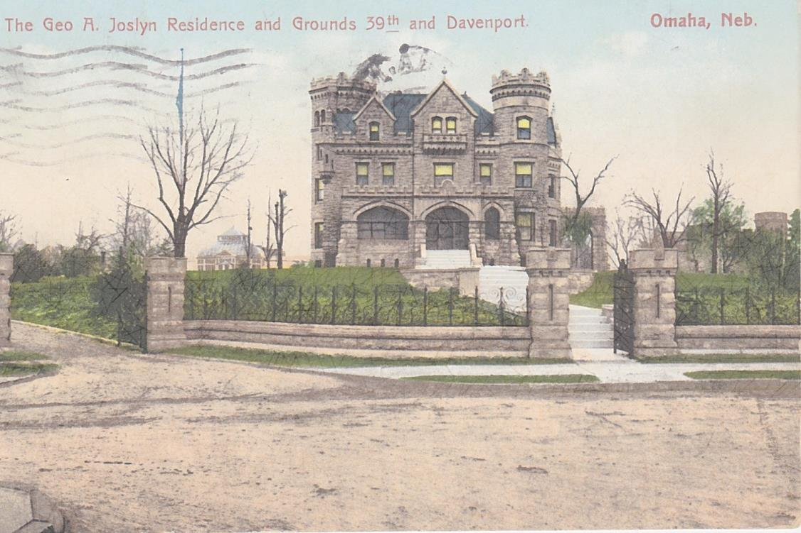
Postcards
Postcards of past and present, local and distant sites.
Classic postcards of businesses, residences, parks, schools and city street scenes from a century ago. 1890s to 1960s.
David Edwards, Postcard and Paper Show, paperetc@aol.com
March and August shows in Omaha.

Slide 21
Other Nebraska Newspapers
Library of Congress Site - http://chroniclingamerica.loc.gov
Omaha Bee from 1871 to 1927
Omaha Monitor
Omaha Guide
UNL Site – Digitized all of History Nebraska’s Holdings
https://nebnewspapers.unl.edu/
Omaha Daily Record on Newspapers.com. Listed when people moved to town or left town.

Slide 22
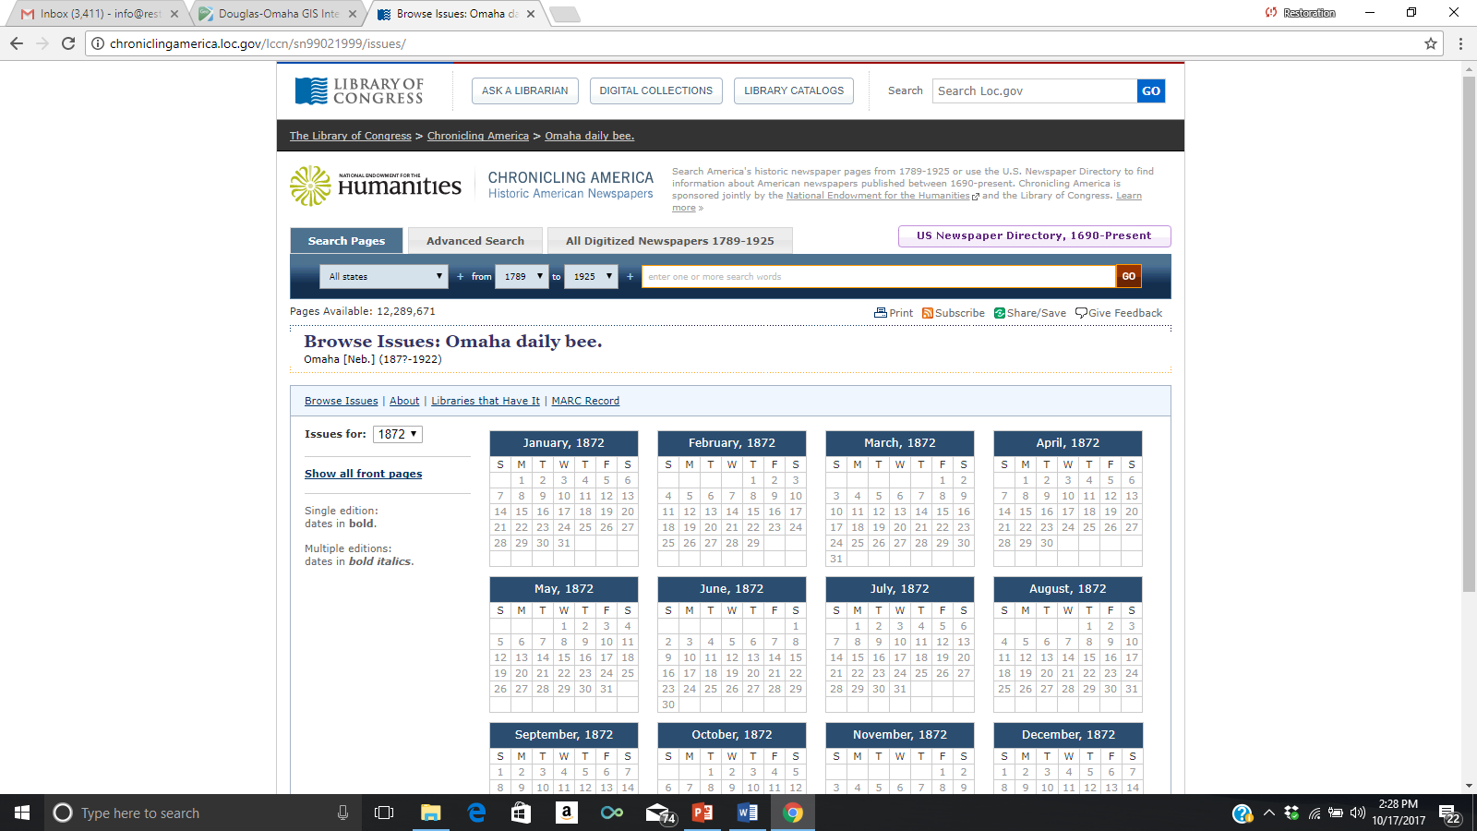

Slide 23
City of Omaha Landmarks Office
City of Omaha Planning Department – Preservation Office
Reconnaissance Surveys
Local and Nationally Registered properties in Douglas County.
Image Collection
Architectural plans
http://landmark.cityofomaha.org/

Slide 24
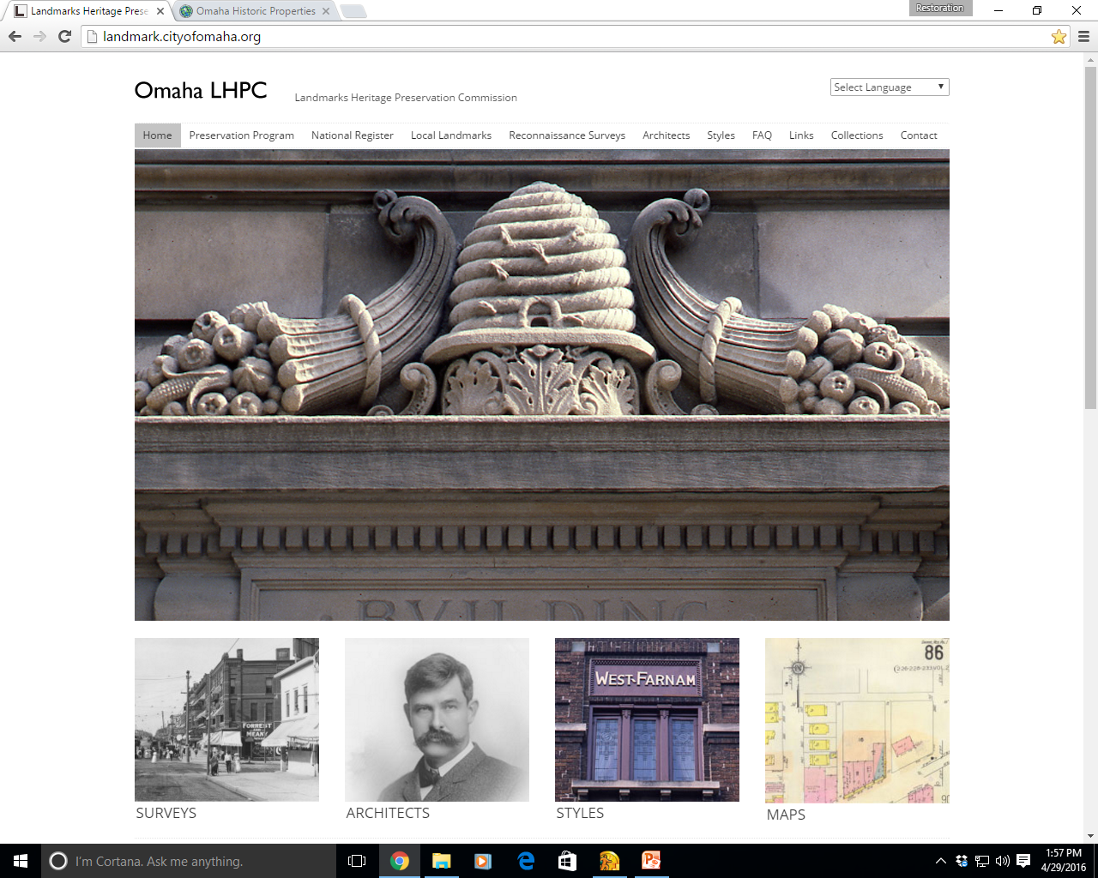

Slide 25
Nebraska State Historical Society
Photo Archives
Newspapers Across State on Microfilm
Architects and their work
NebraskaHistory.org
E-nebraskahistory.org

Slide 26
Other Image Sources
Library of Congress Site - http://chroniclingamerica.loc.gov
Great Plains Black History Museum at 24th and Lake
Nebraska Jewish Historical Society – Near North Side
Omaha History Books – Omaha Times Remembered

Slide 27
U.S. Census Data
Available for free through Ancestry.com, FamilySearch or National Archives. I like Ancestry.com best.
Can gather property owners name, others living in the home, ethnic group/race, where born, education level, where they work.
Reports are easy to download.
Available every 10 years up to 1950.

Slide 28
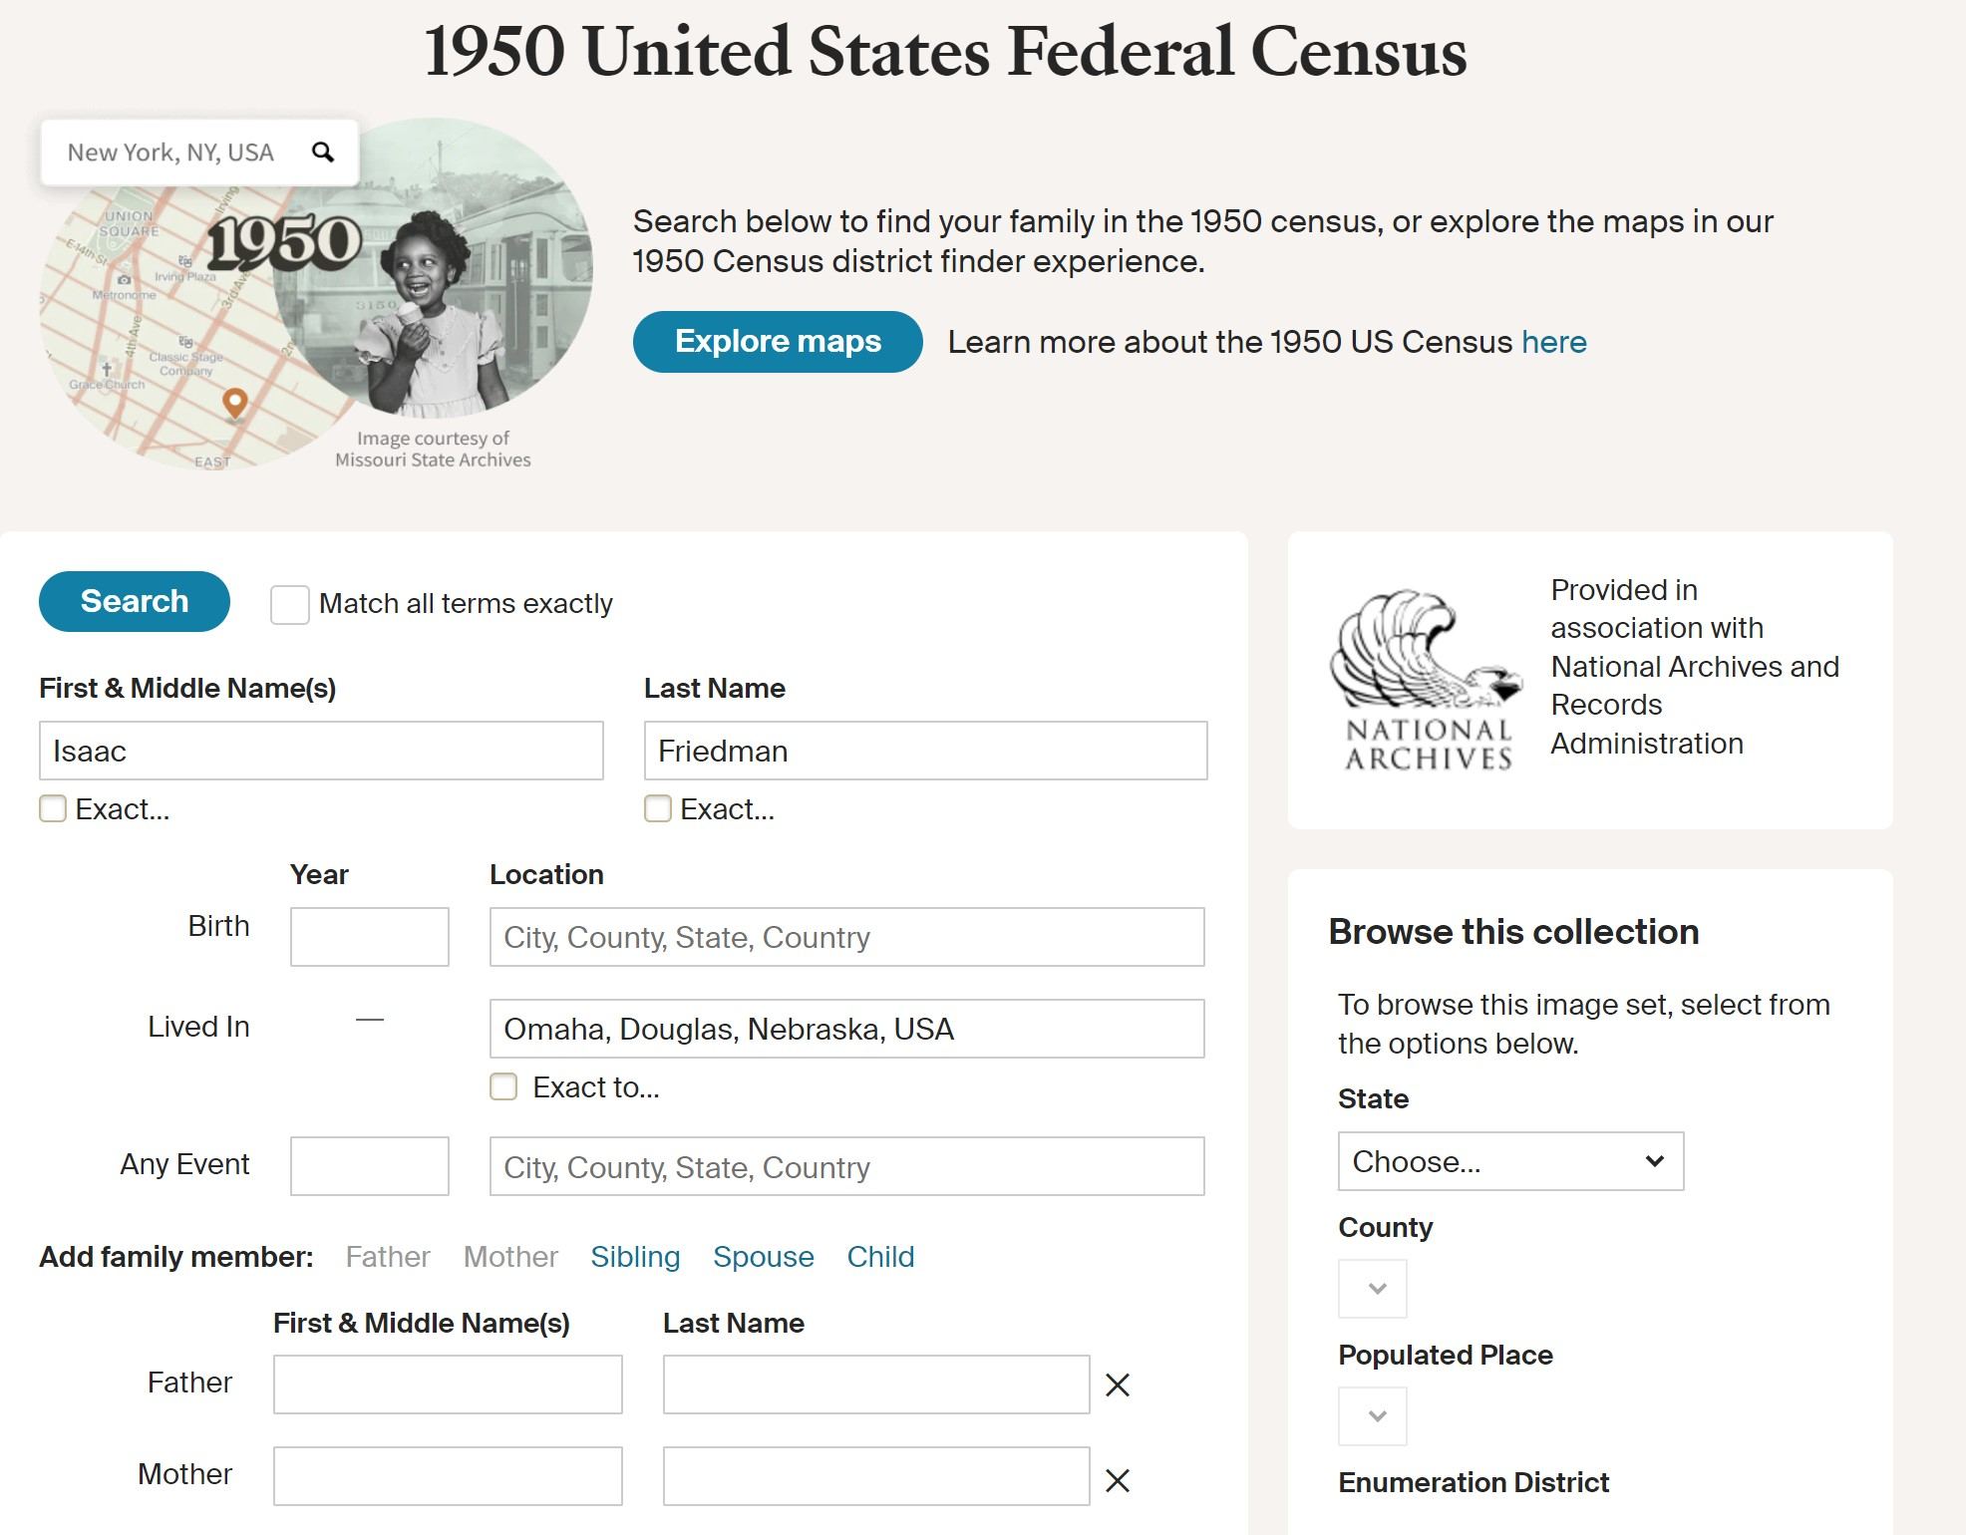

Slide 29
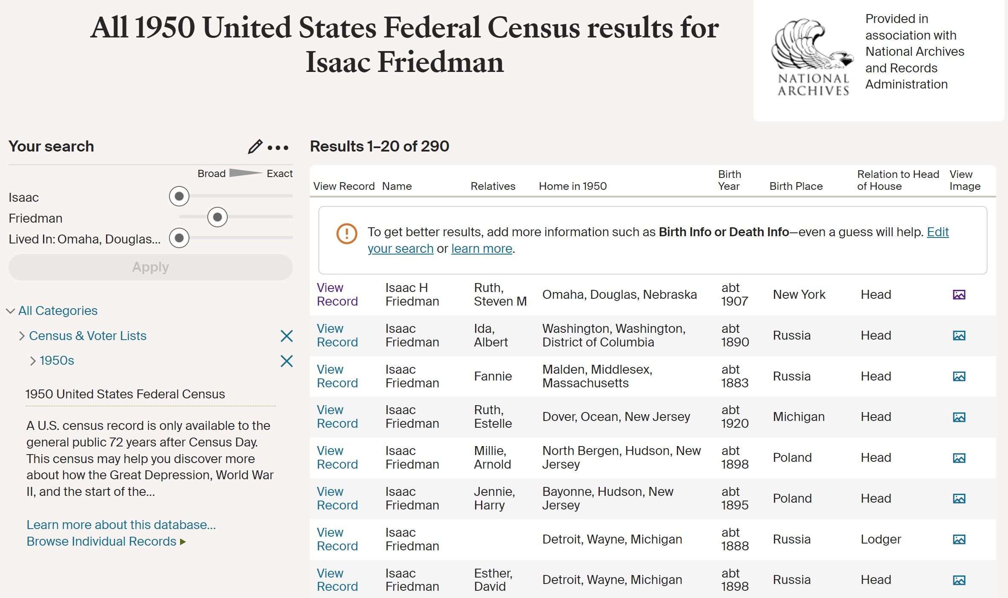

Slide 30
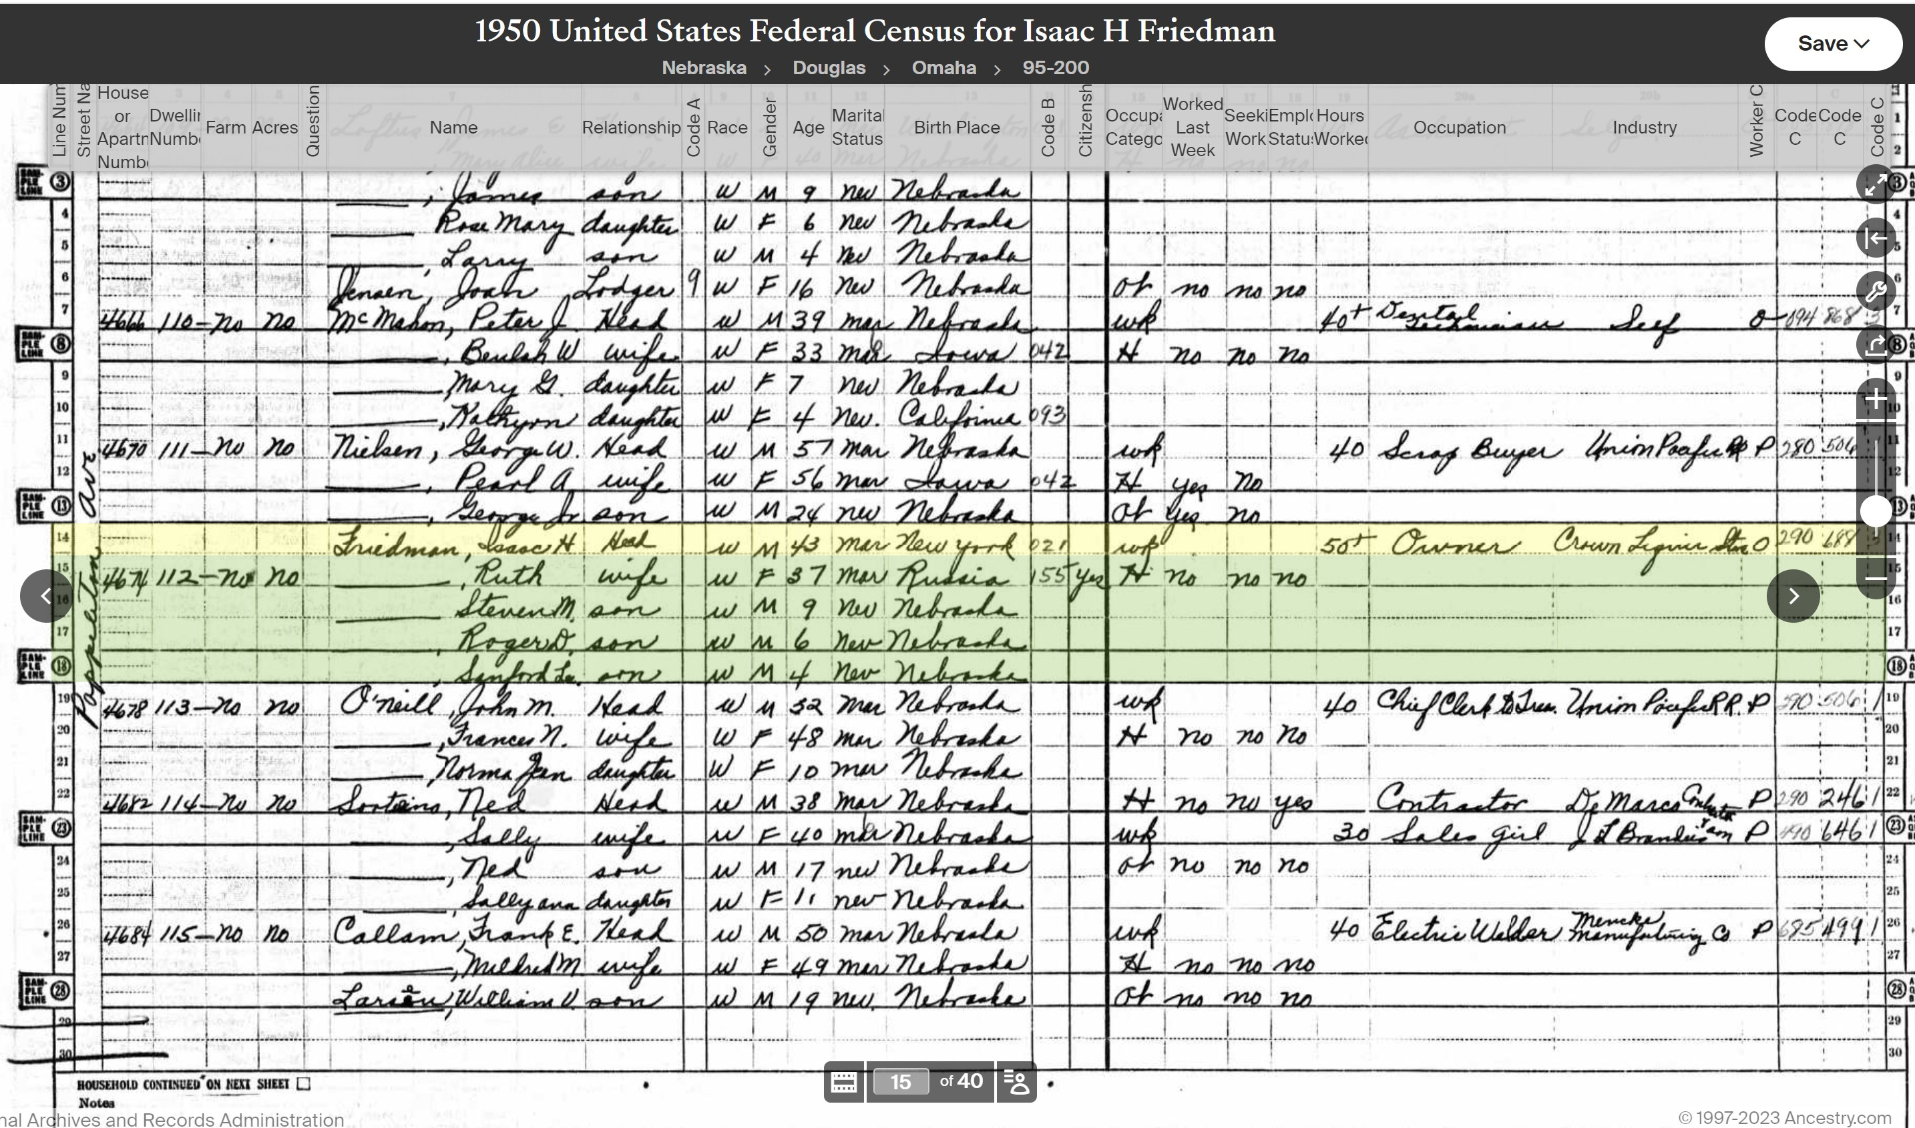

Slide 31
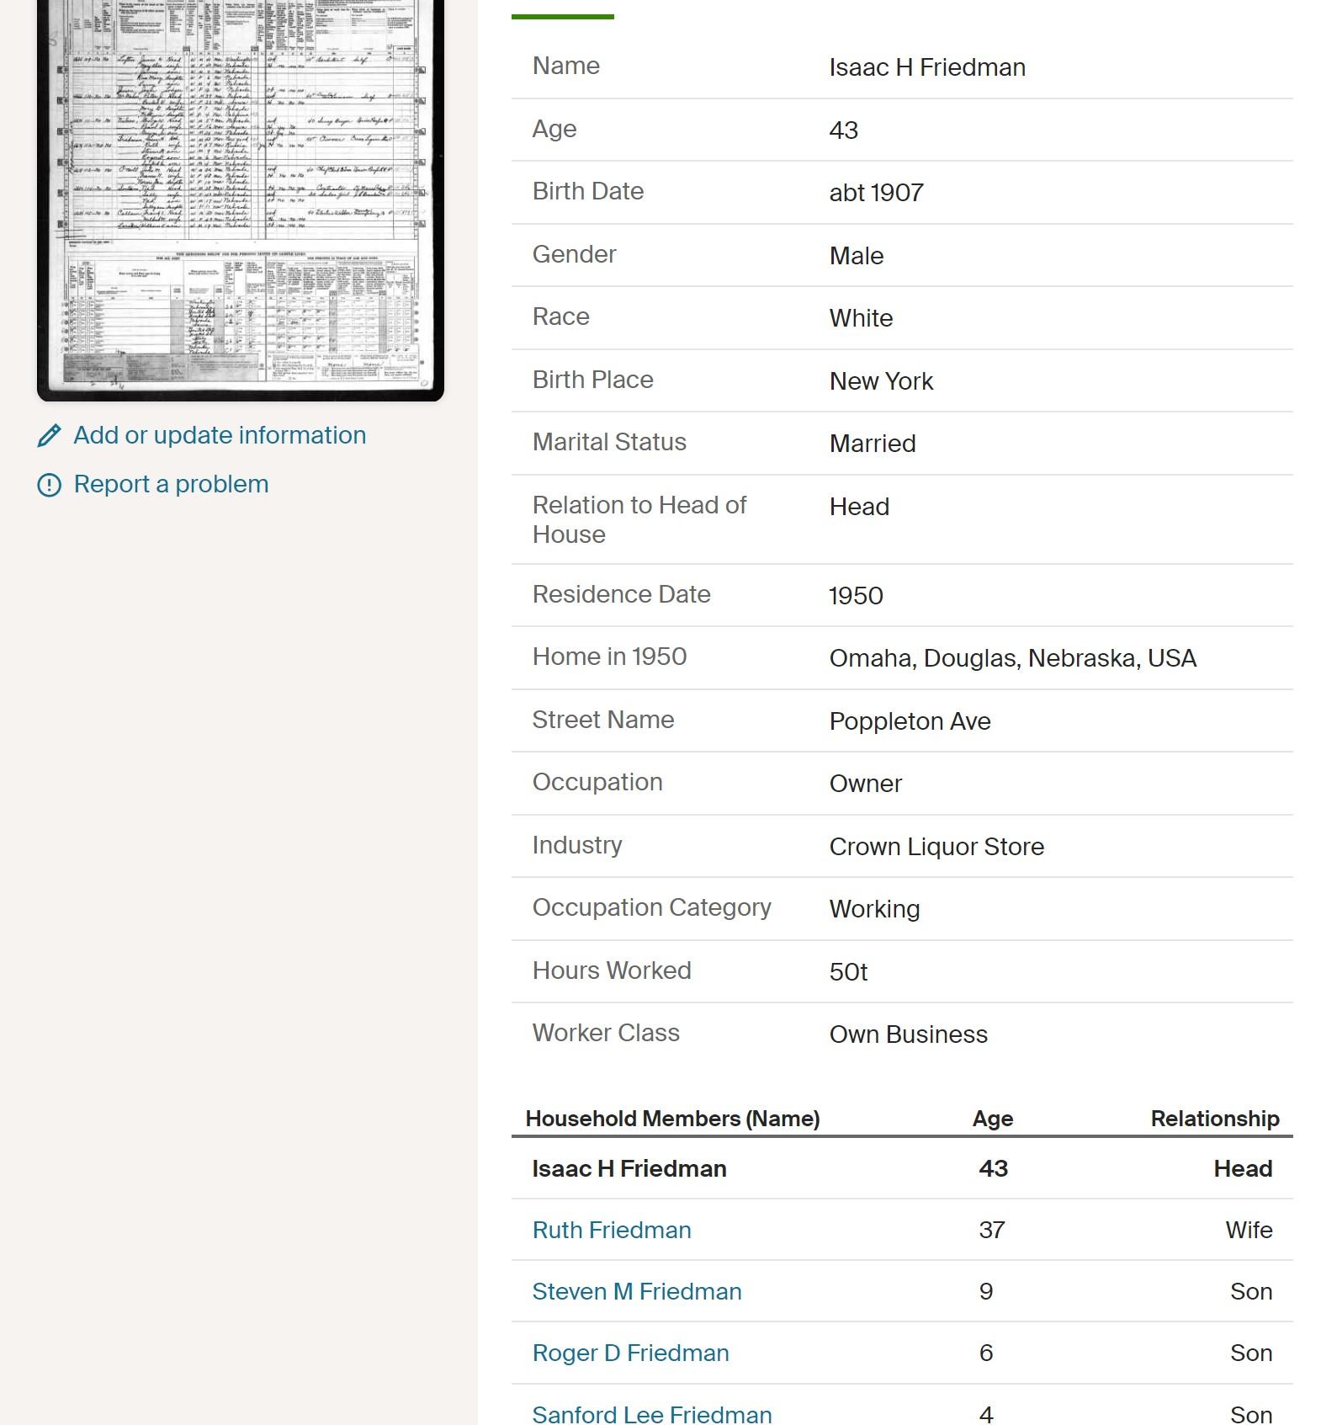

Slide 32
Other Sources
Facebook Sites - Forgotten Omaha, Omaha History Club and North Omaha History Blog, My Omaha Obsession
Google Books books.google.com
Hathitrust.org – Digital library. Western Architect, Improvement Bulletin.
Douglas County Engineer dcengineer.org/land-survey-records Using the properties section, township and range, look up survey records, original deeds and abstracts.
Bureau of Land Management Glorecords.blm.gov Access to more than five million Federal land title records issued between 1788 and the present. Includes images of land patents, survey plats and field notes and land status records.

Slide 33
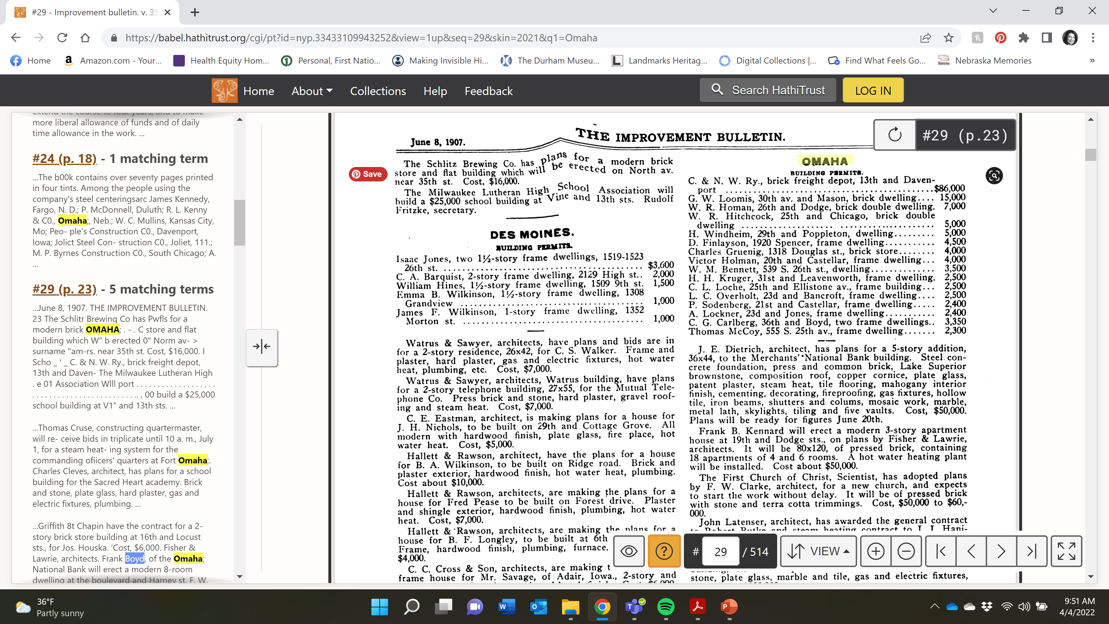

Slide 34
Examples

Slide 35
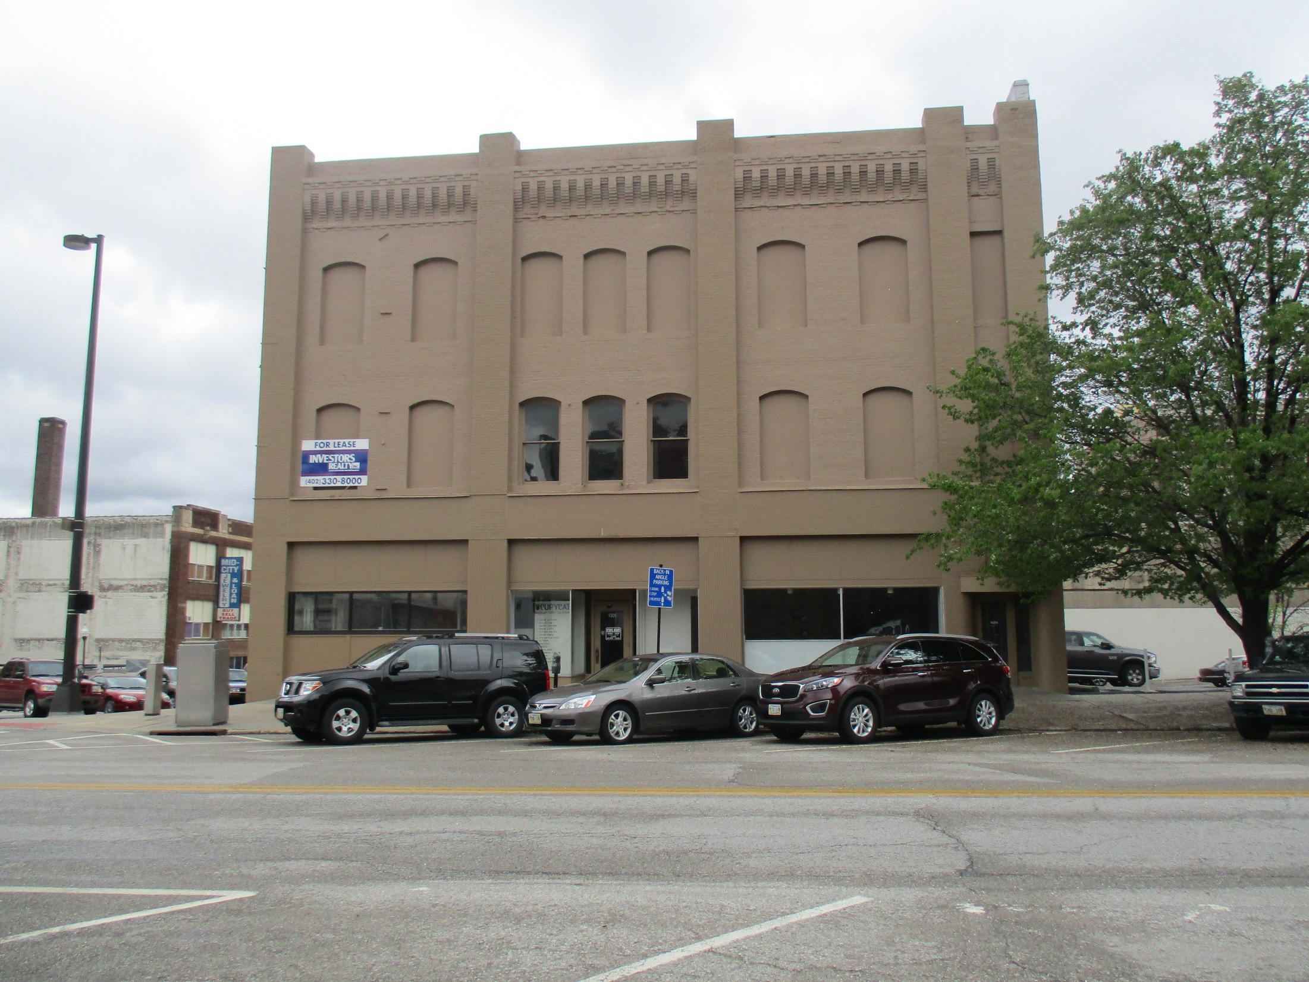

Slide 36
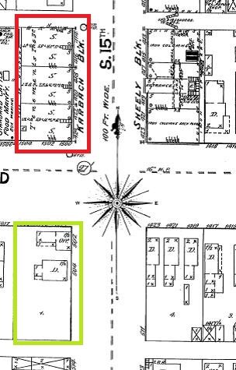
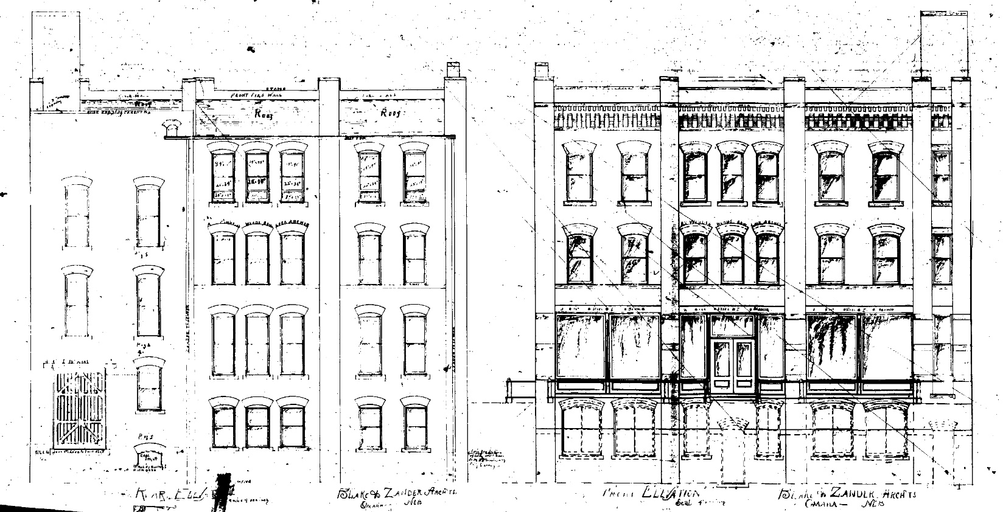
1501 Howard Street

Slide 37
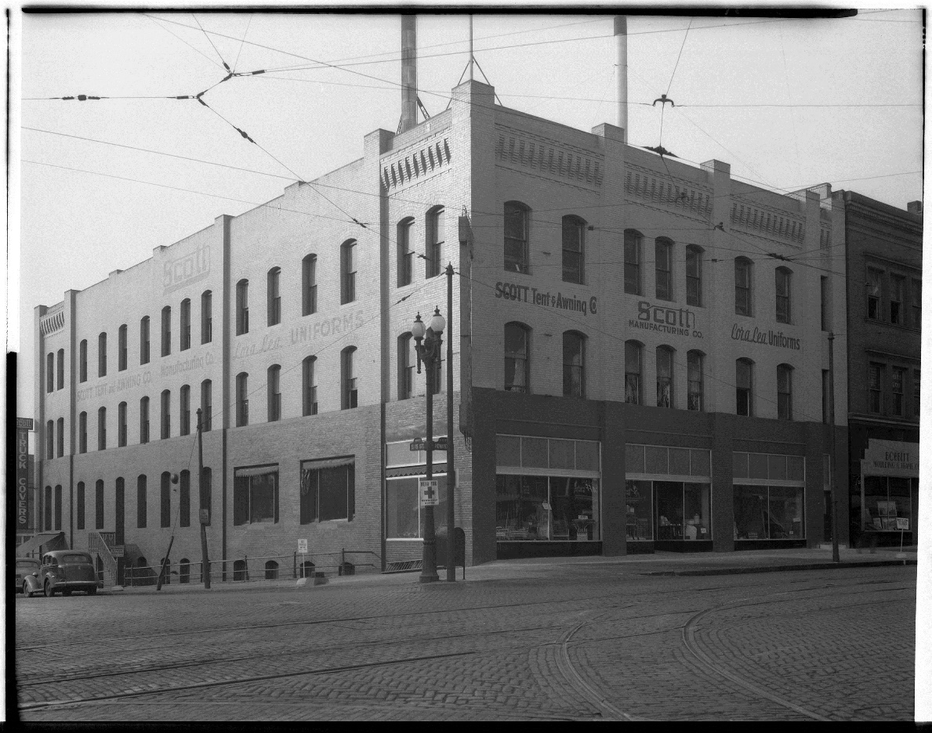
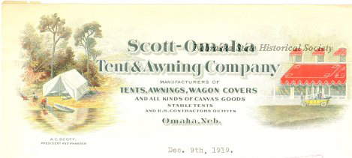

Slide 38
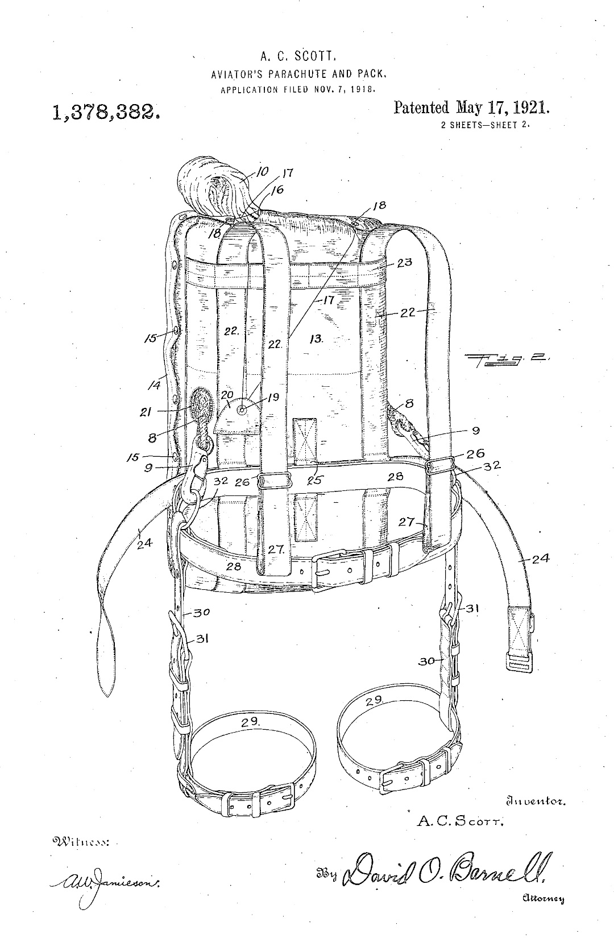
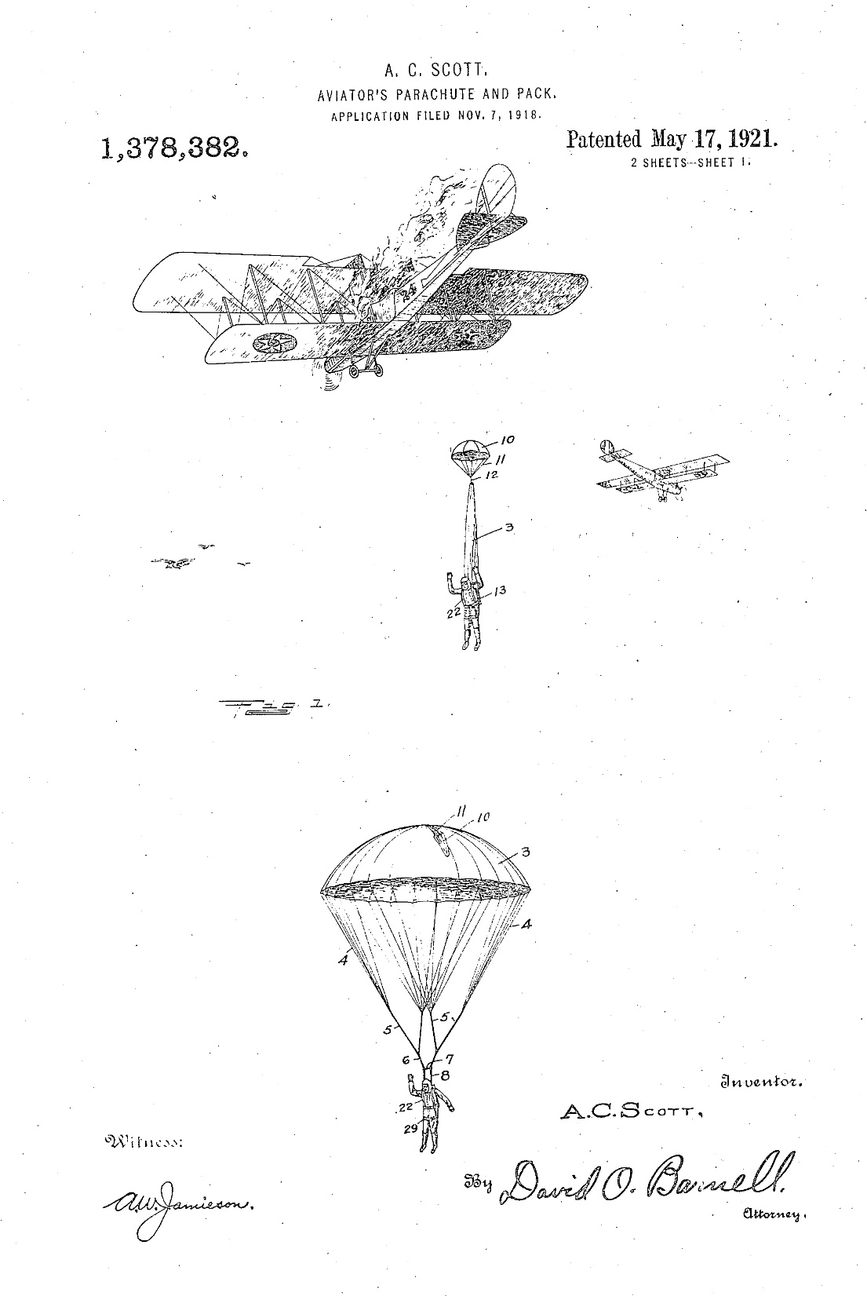

Slide 39

www.ops.org/InvisibleHistory
Curriculum Tab

