Slide 1
Refugees in OPS
There were 2,772 refugee students in the district during the 2017-2018 school year.
They came from 15 different countries and made up 5.5% of the K-12 population.
The number of refugees is up 125% over the last eight years with the largest growth coming from Southeast Asian countries.
Omaha Public Schools District English Language Learner and Refugee Report (2017-2018)

Slide 2
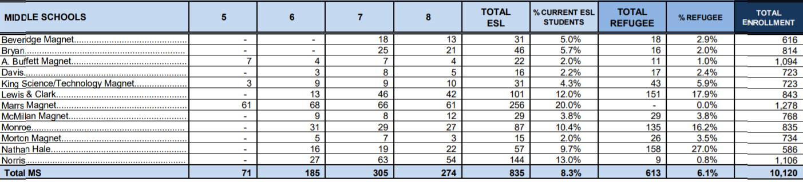
What was the population of refugees at your
middle school during the 2017-2018 school year?

Slide 3
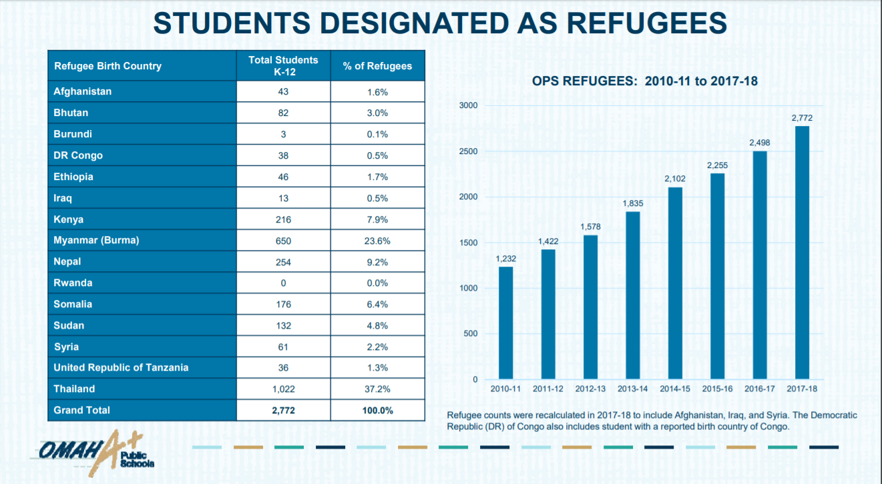

Slide 4
Refugees from Africa made up 22.7% of the refugee population in OPS during the
2017-2018 school year.

Slide 5
