Slide 1

ANNOUNCEMENTS
June 2021

Slide 2
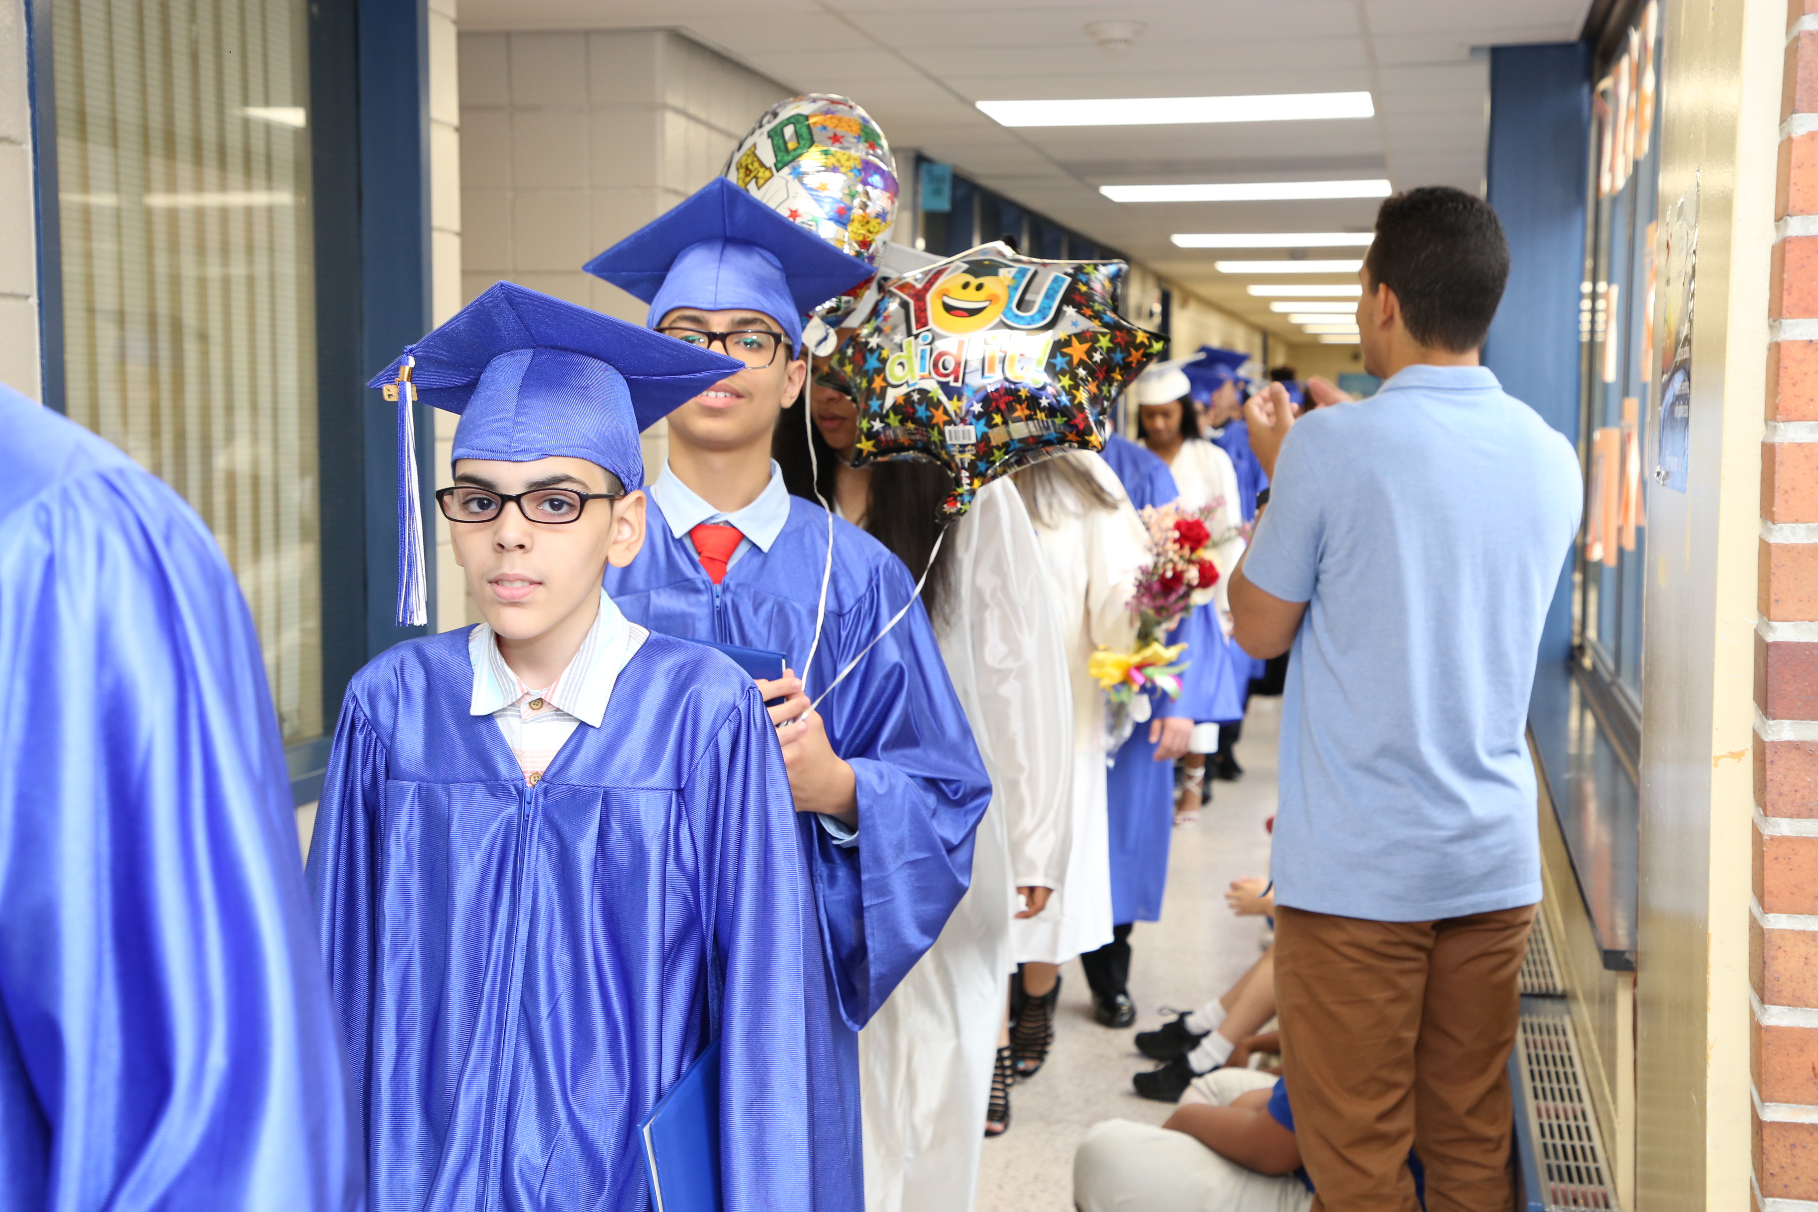
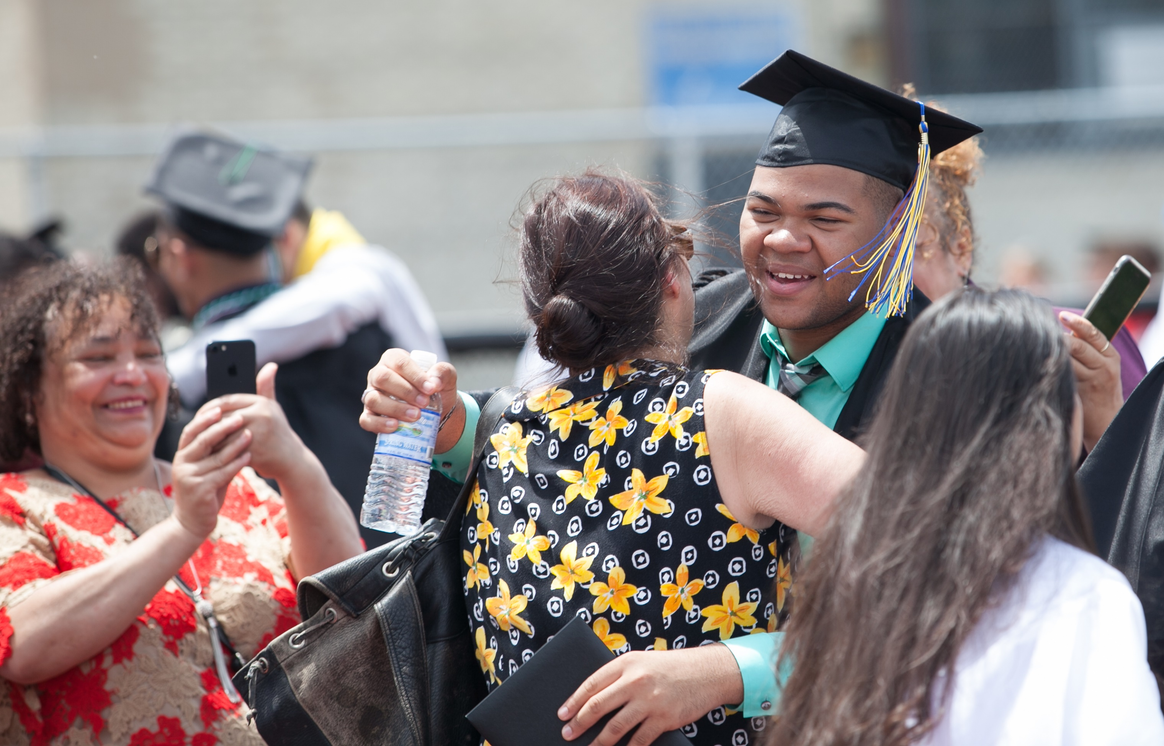
8th Grade Promotion &
High School Graduation/ Class Award
Ceremonies Schedule

Slide 3
8th Grade Promotion Ceremonies
Tuesday, June 22, 2021 – 9:00 am
School
Toussaint L’Ouverture – Marquis de Lafayette School No. 6
Benjamin Franklin School No. 13
Christopher Columbus School No. 15
Dr. Antonia Pantoja School No.27
Juan Pablo Duarte – José Julián Martí School No. 28
Dr. Albert Einstein Academy School No. 29
Chessie Dentley Roberts Academy School No. 30

Slide 4
8th Grade Promotion Ceremonies
Wednesday, June 23, 2021 – 9:00 am
School
George Washington Academy School No. 1
Abraham Lincoln School No. 14
Madison – Monroe School No. 16
Robert Morris School No. 18
Woodrow Wilson School No. 19
Victor Mravlag School 21
Dr. Orlando Edreira Academy School No. 26

Slide 5
8th Grade Promotion Ceremonies
Wednesday, June 23, 2021 – 1:00 pm
School
Nicholas S. LaCorte – Peterstown School No. 3
Joseph Battin School No. 4
Terence C. Reilly School No. 7
iPrep Academy School No. 8
John Marshall School No. 20
Sonia Sotomayor School No. 25

Slide 6
8th Grade Promotion Ceremonies
Thursday, June 24, 2021 – 9:00 am
School
Winfield Scott School No. 2
Mabel G. Holmes School No. 5
Jerome Dunn Academy School No. 9
Elmora School No. 12
William F. Halloran School No. 22
Nicholas Murray Butler School No. 23

Slide 7
High School Graduation/ Class Award Ceremonies
Dunn Sports Center
High School | *Date | Time | Arrival
John E. Dwyer Technology Academy | June 25 | 9:00am | 8:00am
Elizabeth High School – Frank J. Cicarell Academy | June 25 | 1:00pm | 12:00pm
J. Christian Bollwage Finance Academy | June 25 | 5:00pm | 4:00pm
Alexander Hamilton Preparatory Academy | June 28 | 9:00 am | 8:00am
Thomas Jefferson Arts Academy | June 28 | 1:00pm | 12:00pm
Admiral William F. Halsey, Jr. Health & Public Safety Academy | June 29 | 9:00am | 8:00am
Thomas A. Edison Career and Technical Academy | June 29 | 1:00pm | 12:00pm

Slide 8


Slide 9
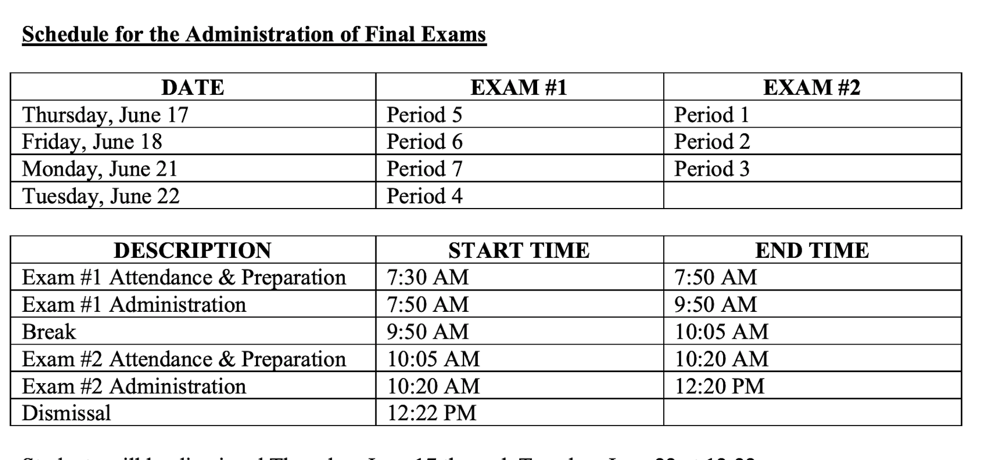

Slide 10
SY 2019-2020 Final Exams were canceled as a result of the acute severity of the pandemic
SY 2020-2021 District organized itself around the goal of returning to normalcy
  Teachers and School Administrators notified students in September and throughout the school year that Final Exams would be administered
  Final Exams and other high school activities, such as Prom, Graduation, etc., are part of returning to normalcy
  To address the extraordinary circumstances caused by the pandemic, we have set a minimum grade for Final Exams for this school year, in order to avoid harming a student’s opportunity to pass a course
Final exams address knowledge and skills that may not have been mastered when benchmarks, unit tests and other assessments were administered, may be mastered by the end of the school year
Final exams provide students an opportunity to bring up 20% of their final grade for the school year
Final exams provide an additional component of a course final grade to give new entrant students the opportunity to gain course credit
Final exams provide educators and students in grades 9-11 with instructional and curricular feedback for the following school year
Importance of High School Final Exams
Notes:
At a minimum, 2380 students would lose the opportunity to pass one course or more by not taking the Final Exam. With the minimum grade that has been set, 2380 students would not be harmed.
The potential harm to students with an “A” average is much less severe than the potential harm to 2380 students.

Slide 11
FILE CODE: 6147.1
EVALUATION OF INDIVIDUAL STUDENT PERFORMANCE
M. Exam Exemption Policy
Seniors qualify for exemption from final exams in any class in which they meet the following criteria:
1. Advanced Placement:
Maintain a B or above and maintain an average of B or above in all other courses; Take the AP exam for that course;
Shall have no major cheating violations or plagiarism;
Shall have no more than four (4) unexcused absences by April 30th (excluding school related activities and religious holidays);
Shall have no more than five (5) tardies in that AP class;
No major infractions resulting in ISS, GRIP, or out-of-school suspension;
Must have no outstanding fines, fees, or debts for school property or other services;
2. General Courses
Maintain a B+ or above in identified course and maintain an average of B- or above in all other courses;
Shall have no major cheating violations or plagiarism;
Shall have no more than four (4) unexcused absences by April 30th (excluding school- related activities and religious holidays;
Shall have no more than five (5) tardies in that class;
No major infractions resulting in ISS, GRIP, or out-of-school suspension;
Must have no outstanding fines, fees, or debts for school property or other services.

Slide 12
Executive Order 230
Indoor Gatherings
In a press conference on Monday, June 4th, Governor Murphy spoke about indoor gatherings and noted in his presentation:
“Removing the general indoor gathering limit, which is currently at 50 people. Removing the indoor gathering limit for political gatherings, weddings, funerals, memorial services, performances, and other catered and commercial events, which is currently at 250 people and;
Removing 30 percent capacity limitation for indoor large venues with a fixed-seating capacity over 1,000.
In consultation with Dr. Guillermo Munoz and City of Elizabeth Health Officer, it has been determined that district schools can hold eighth grade promotion and graduation ceremonies indoors without issues pertaining to capacity.
The district has determined that capacity for any of the ceremonies, given the guidelines of two adults per student, will fall well below the capacity of any of the respective designated venues.

Slide 13
Executive Order 241
Use of Face Coverings
In a press conference on Monday, June 7th, Governor Murphy spoke about the heat as related to schools and noted in his presentation:
“In-school masking requirements include exceptions for extreme heat. School officials are empowered to make the best decisions for their buildings and communities.”
In consultation with Dr. Guillermo Munoz and City of Elizabeth Health Officer, it has been determined that in cases of extreme heat, students and staff will have the option to remove their masks to protect each individual’s health while inside the school building. The same should also apply when people are outdoors.

Slide 14

All programs will be held at air-conditioned facilities.
Programs will be offered from July 6th through August 5th.
Transportation will be provided to students that reside 2.0 miles and beyond for K-8. (for eligible programs).
Online registration will be required.
Summer Brochure will be made available online on June 15, 2021.

Slide 16
ANNOUNCEMENTS
June 2021

