Slide 1

Reopening Together Plan
Update
October 1, 2020

Slide 2
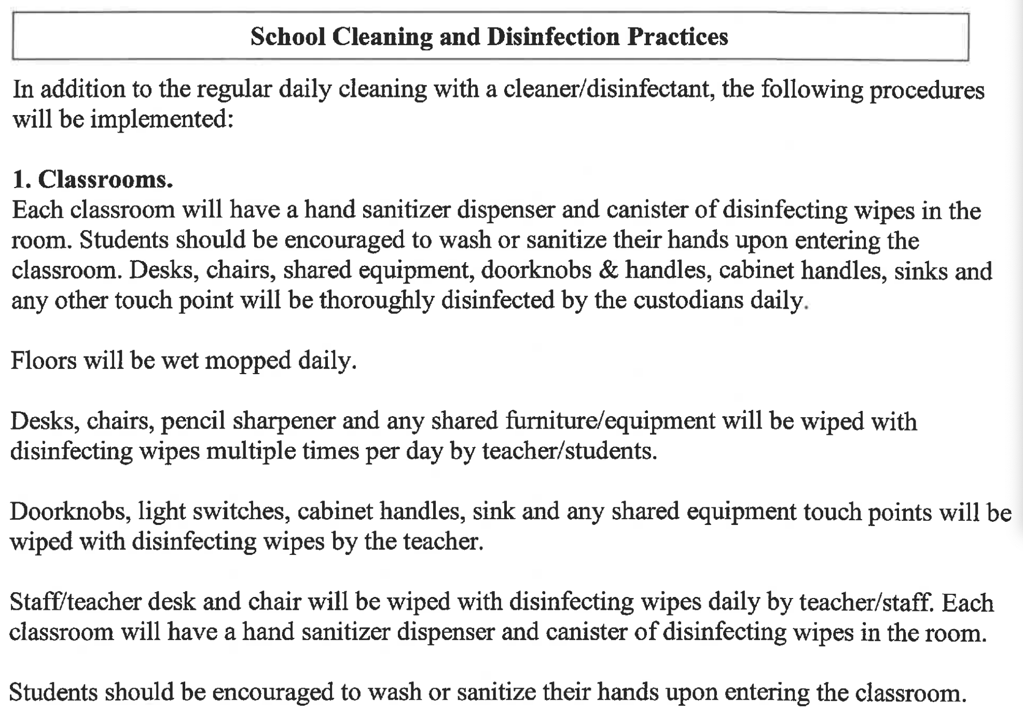
Reopening Together Plan 2020
(p.44-47)

Slide 3
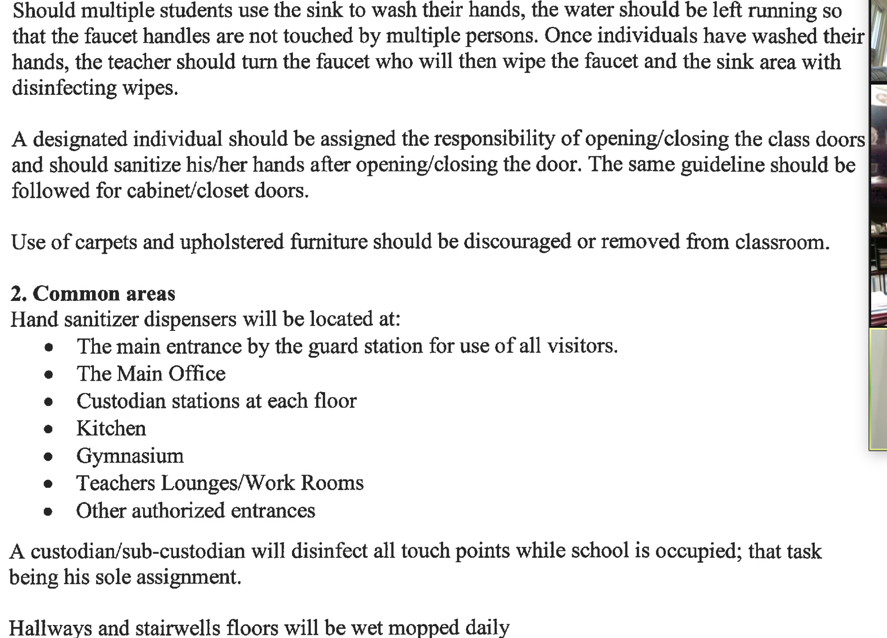
Reopening Together Plan 2020

Slide 4
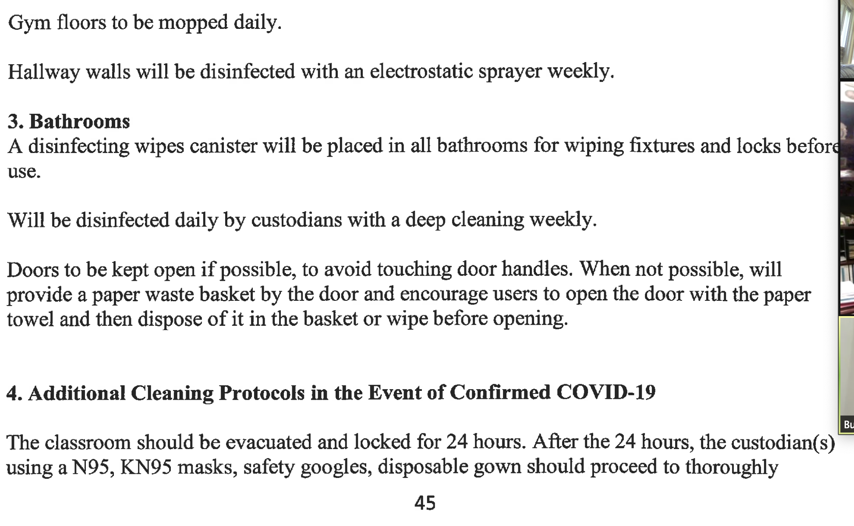
Reopening Together Plan 2020

Slide 5
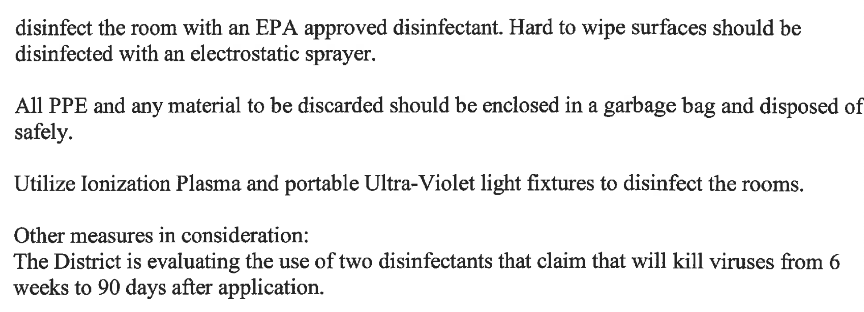
Reopening Together Plan 2020

Slide 6
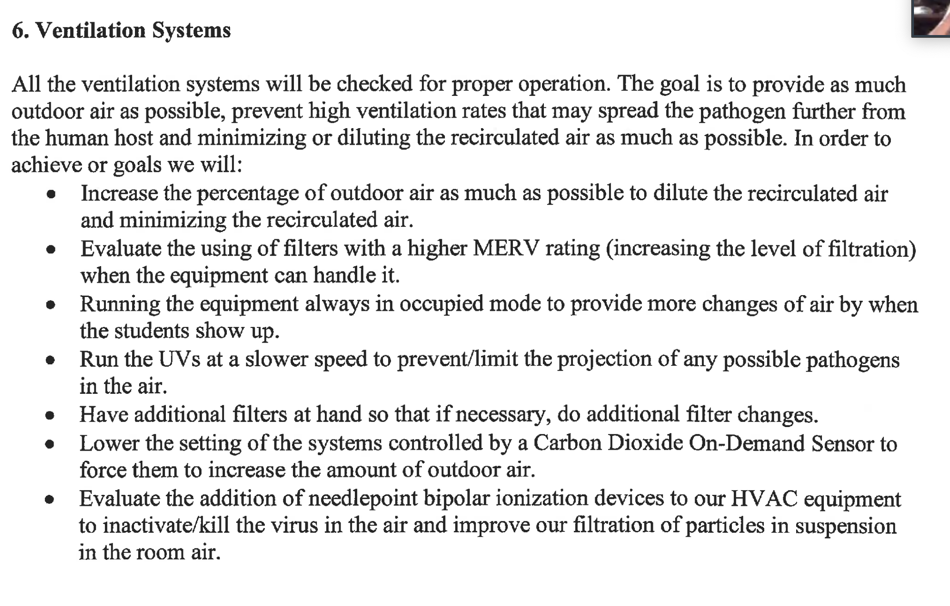
Reopening Together Plan 2020

Slide 7
CARES ACT Funding July 2020
1500 KN95 masks
50 cases Brutabs 3.34 grams bleach alternative effervescent tabs
50 cases Brutabs 13.1 grams bleach alternative effervescent tabs
600 AAA batteries for Thermostats
830 boxes 3 Layer Ear Loop Disp. Masks 50 per box
15 Cases Latex small gloves 10 boxes of 100 per case
95 Cases Latex medium gloves 10 boxes of 100 per case
130 Cases Latex large gloves 10 boxes of 100 per case
58 Cases Latex X-large gloves 10 boxes of 100 per case
145 Cases Nitrile medium gloves 10 boxes of 100 per case for nurses
120 Cases Nitrile Large gloves 10 boxes of 100 per case for nurses
28 Cases Nitrile X-large gloves 10 boxes of 100 per case for nurses
100 ¼” clear acrylic sneeze guard 48 x 24
25 Cases Vinyl small gloves 10 boxes of 100 per case
55 Cases Vinyl medium gloves 10 boxes of 100 per case
90 Cases Vinyl large gloves 10 boxes of 100 per case
70 Cases Vinyl X-large gloves 10 boxes of 100 per case

Slide 8
CARES ACT Funding July 2020
4000 Buckets antiseptic wipes 900 per bucket
600 Protective Eye Goggles
3130 cases Gallons of Gel Hand sanitizer
910 Containers antiseptic wipes 160 per container
250 One Gallon handheld sprayers
800 Isolation Gowns for Nurses
1500 AA Batteries for Thermometers
25,000 Cotton reusable masks with Logo Adult size
10,500 Cotton Reusable masks with Logo Children size
2,750 Reusable Full-Face Shield
626 Non-Contact forehead thermometer
200 Disposable full-face shields

Slide 9
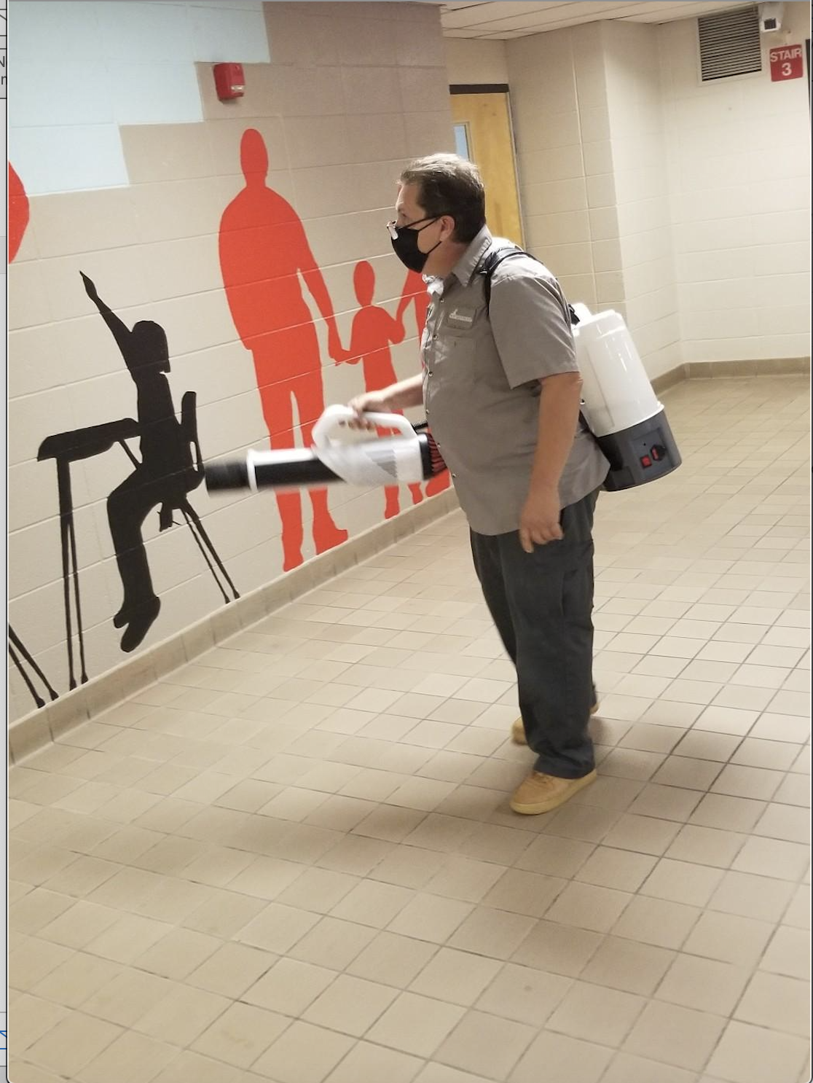
100 Electrostatic backpack sprayers

Slide 10
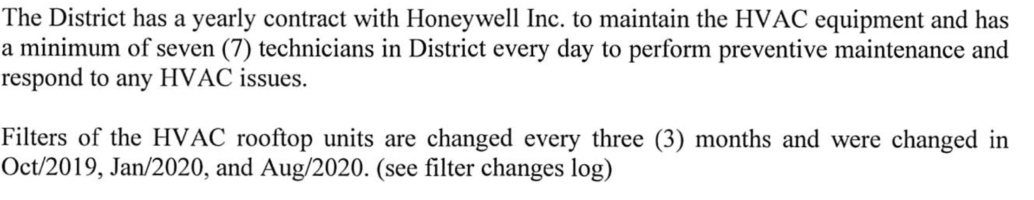
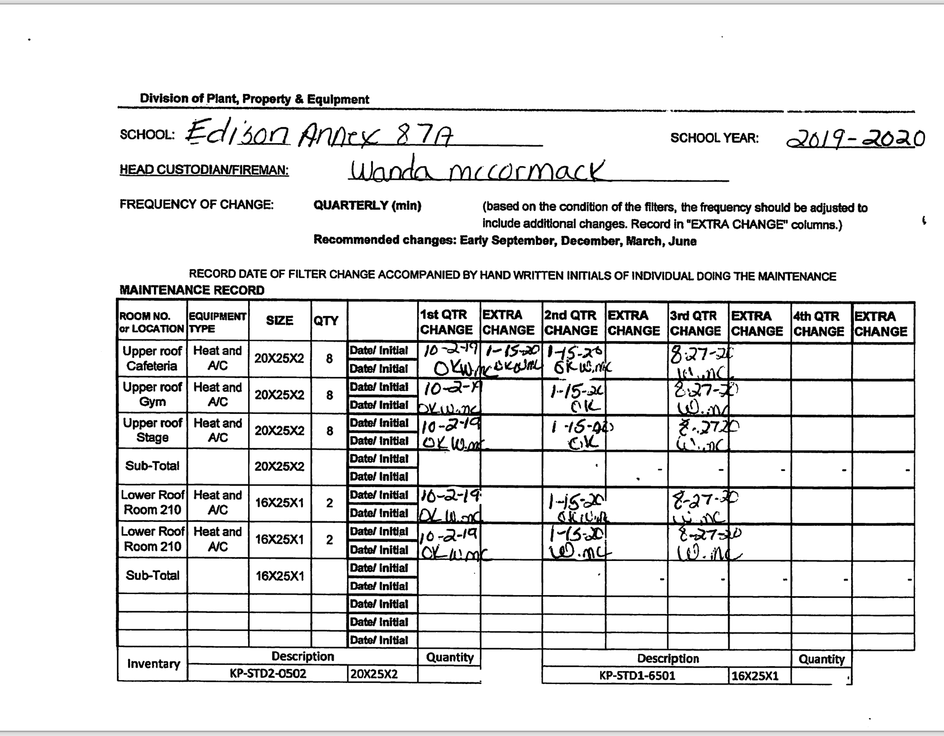
HVAC Maintenance

Slide 11
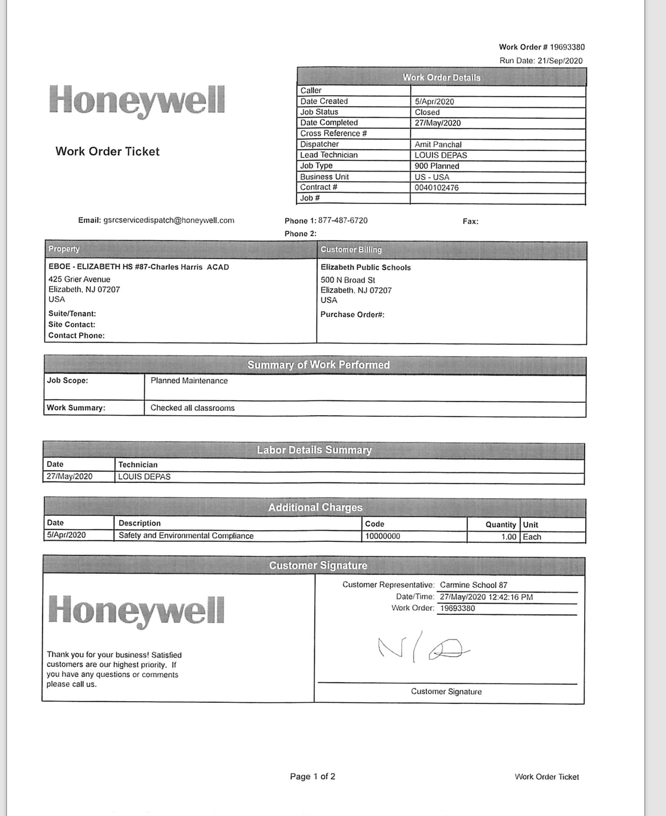
HVAC Maintenance

Slide 12
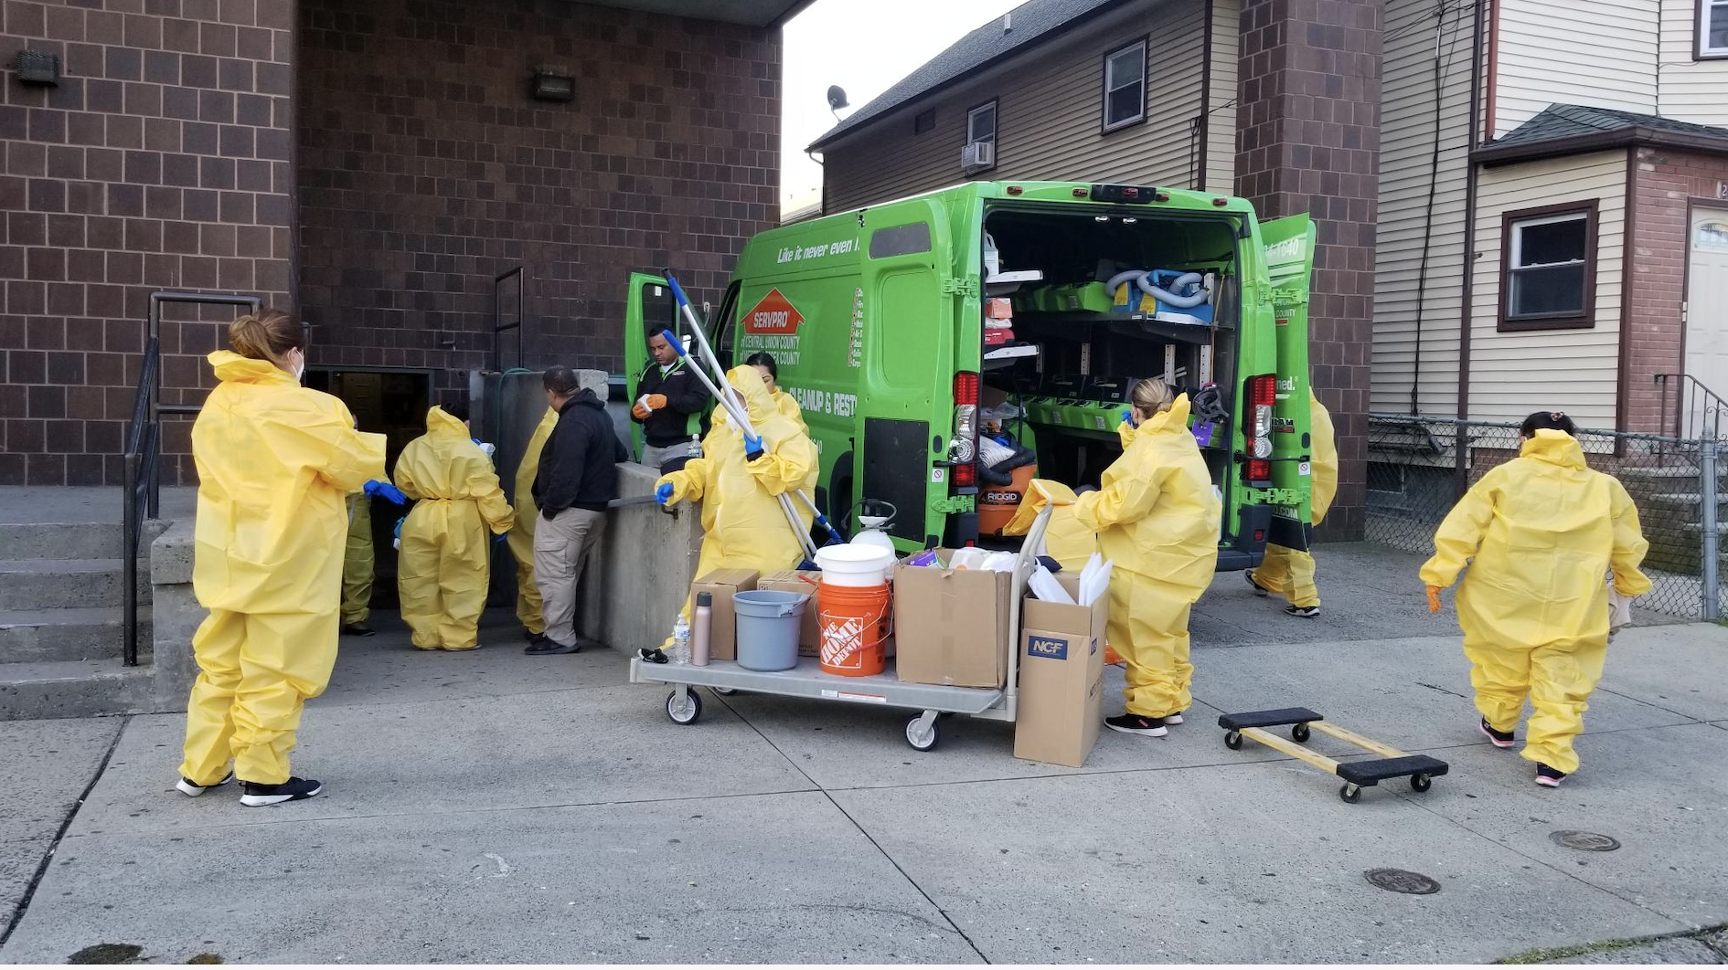
Sanitizing and disinfecting schools

Slide 13
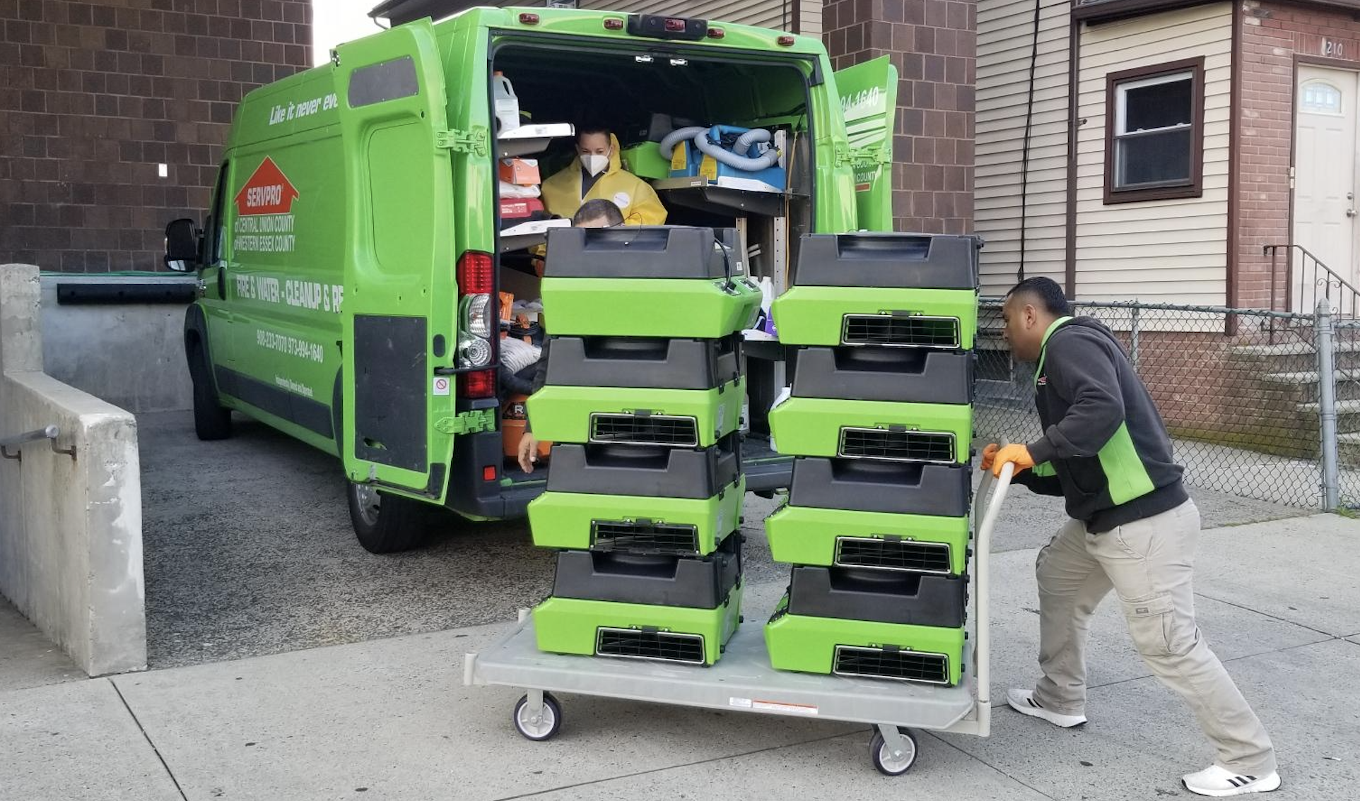
Sanitizing and disinfecting schools

Slide 14
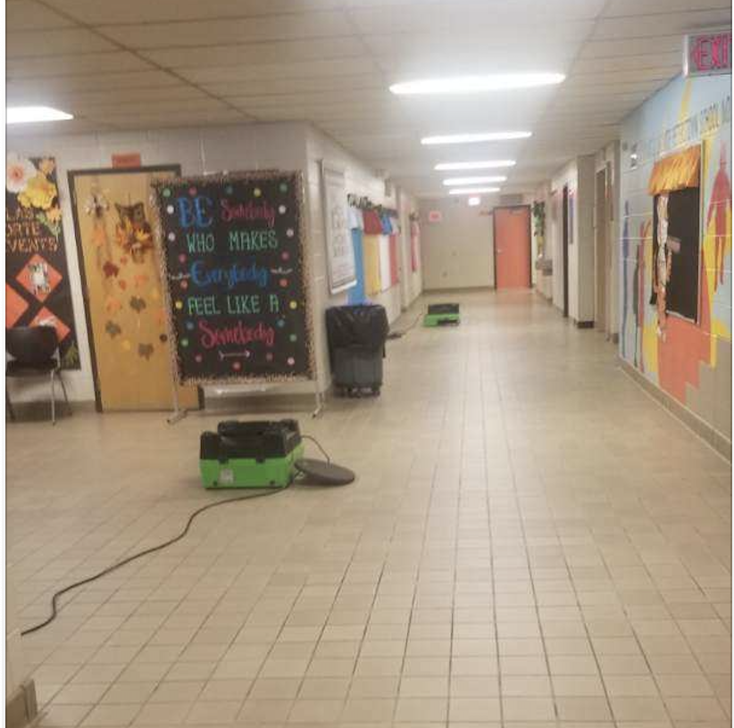
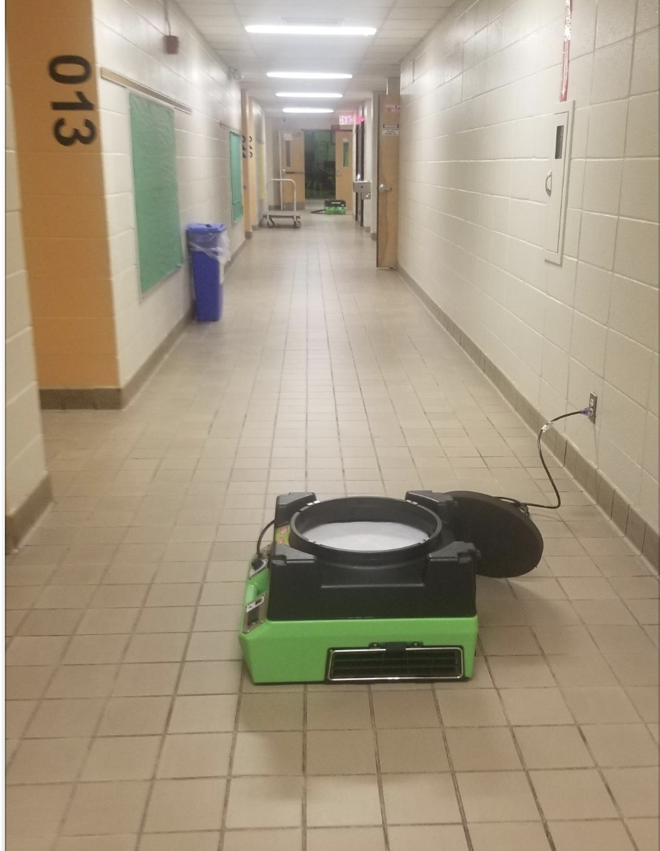
Sanitizing and disinfecting schools

Slide 15
Q&A
Plant & Property

Slide 16
Outcome of two-week closure
9/21 /20– 10/2/20
Summary of COVID Positive Cases:
School 87 – All Direct Contacts were Negative
School 28 – All Direct Contacts were Negative
School 5 – All Direct Contacts were Negative
School 18 – Presumed COVID Positive Case was negative and all presumed direct contacts were negative
Hardware Department - Presumed COVID Positive Case was negative and all presumed Direct Contacts were Negative
School 3 – All Direct Contacts were Negative
School 7 – The Direct Contact was Negative
Dwyer - Direct Contact was Negative
School 22 – Test Results pending

Slide 17
Discussion with Health Experts
Recommendation for Monday, October 5, 2020

Slide 18
Proposed update to the Reopening Together Plan
Rolling Reopening Dates:
Monday, November 9: In-person special education services can resume as a hybrid model at pilot schools.
Monday, December 7: In-person special education services can resume as a hybrid model at additional pilot schools.

Slide 19
Proposed update to the Reopening Together Plan
The updated plan, will include a phased-in approach:
Students that receive special education services
On November 9, in-person special education services can resume as a hybrid model.
We will share which special education services are in the November 9 reopening group as soon as possible with our team members and families.
Please note, that a fully virtual option will continue to be available for all families who chose this option.

Slide 20
Autism Hybrid Model
The Autism Hybrid Program would allow students with an IEP the opportunity to be in school every other day for approximately 4 hours.
This would allow the teacher the opportunity to address each student’s individual needs to the greatest extend possible.
Sample Biweekly Schedule
*Students electing hybrid instructional model
In person Instruction
The teacher will teach in person on A day and virtually on B day)
A Day
Sample Biweekly Schedule
*Students electing to get virtual instructional model
Teacher: Ms. Brady will teach the students who choose virtual instruction every day
Students will remain virtual
Monday | Tuesday | Wednesday | Thursday | Friday | Monday | Tuesday | Wednesday | Thursday | Friday
A | B | A | B | A | B | A | B | A | B

Slide 21
Autism Hybrid Model
Pros | Cons
Provide students with direct instruction, allows levels of prompting and support that cannot be done via virtual instruction | Parents electing in-person OR virtual could possibly have a change in teacher for their child. This could potentially disrupt students who elect to come to school or stay home. Change in teacher during the school year is challenging for students with Autism.
In-person instruction allows related services to be in-person | Potential for additional teachers to request leave.
In-person instruction allows teachers and related service providers to address student regression and address IEP goals | Safety – student programming includes bathroom goals and changing students in bathroom, sometimes dealing with bodily fluids
 | Safety – students in Autism program sometimes become aggressive and bite staff, students also sometimes need to be physically restrained using Handle with Care.
 | Teacher/Staff to Student ratio per IEP (classroom size and social distancing)
 | Accountability of teacher to address IEP and Programming Goals to ensure student progress

Slide 23
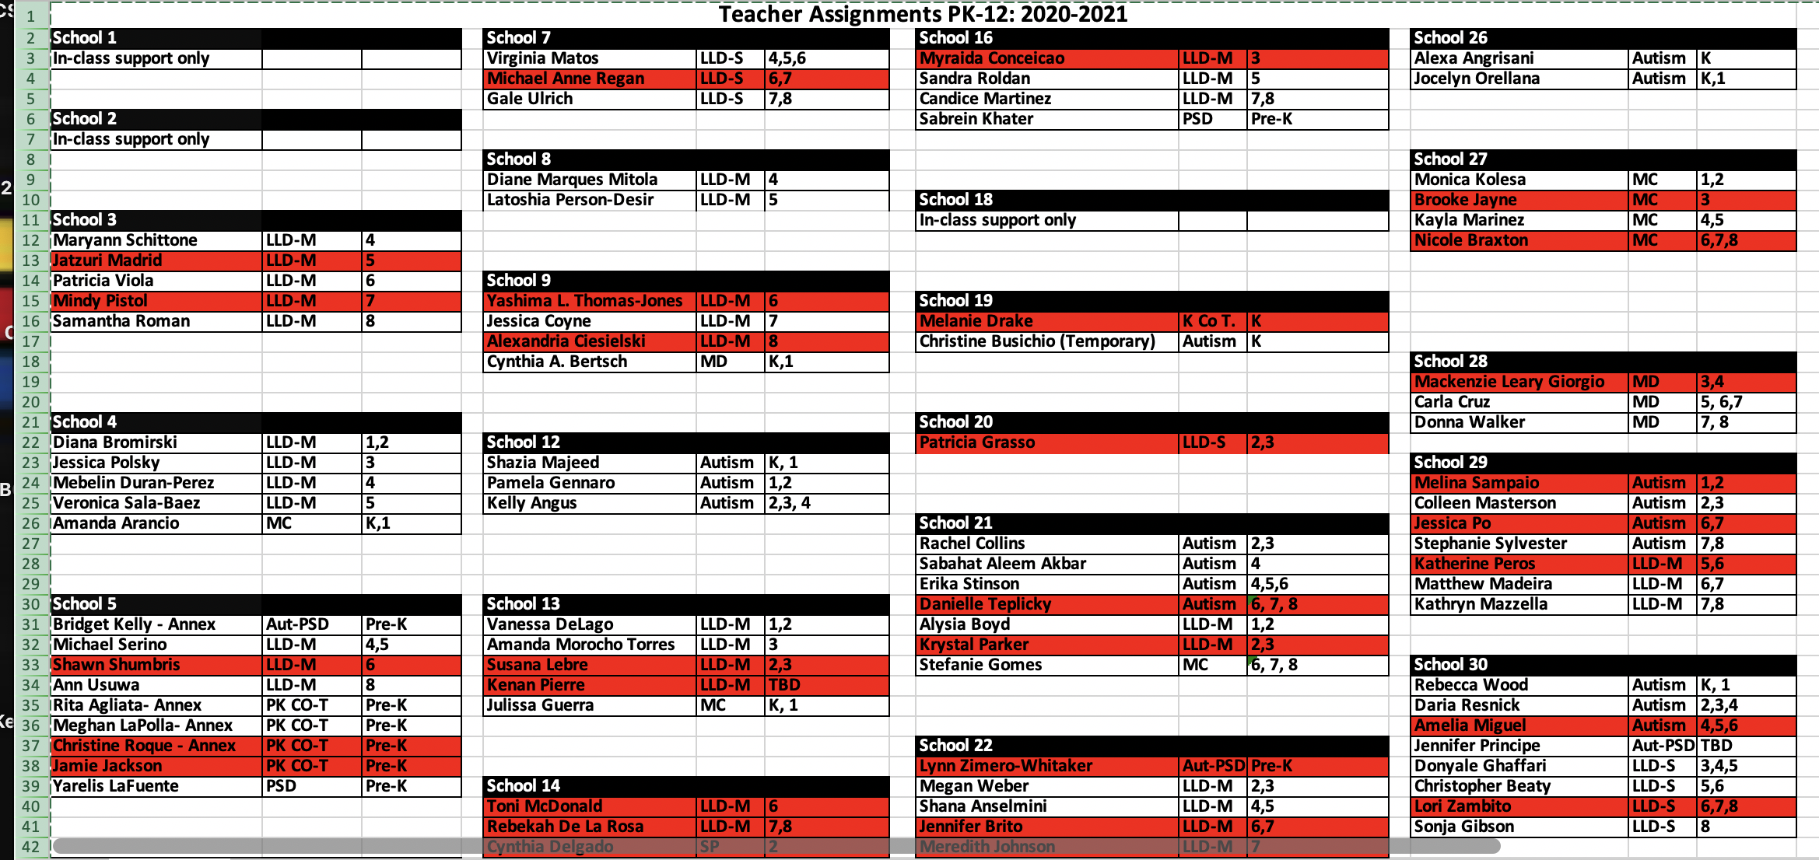

Slide 24
Autism Hybrid Model
Next Steps:
Speak to teachers to present the Hybrid Model
Pole students/parents
Rework rosters of students based on choice
Order all materials needed so that students can each have their own materials
Meet with teachers/PAs/CDAs

Slide 25
Proposed update to the Reopening Together Plan
On December 7 in-person special education services can resume as a hybrid model.
We will share which special education services are in the December 1 reopening group as soon as possible with our team members and families.
Please note, that a fully virtual option will continue to be available for all families who chose this option.
In-person special education services can resume as a hybrid model at additional pilot schools.
Multiple Disabilities Program -74 students
Moderate Cognitive Program – 142 students
Learning Language Disabilities – Severe -132 students

Slide 26
Q&A
Special Services

