Slide 1
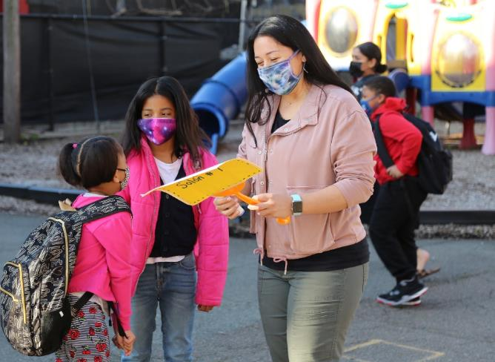

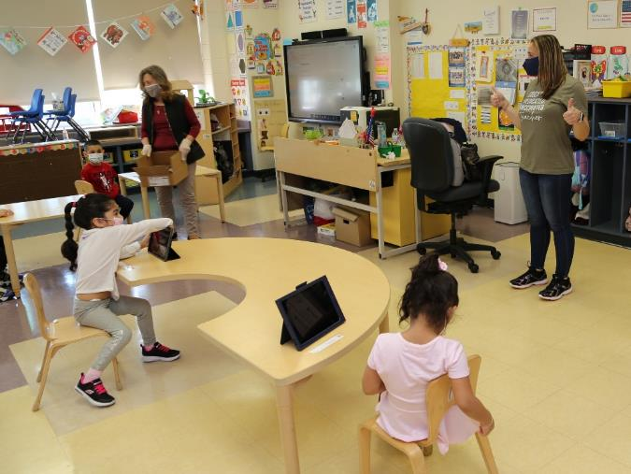
2021-2022
Budget
Presentation
presented by
Olga Hugelmeyer
Superintendent of Schools
May 6, 2021
Notes:
This evening we will present to you the 2014-2015 budget of the Elizabeth Board of Education. A budget that has allowed us to maintain the educational improvement efforts we have put in place in recent budgets, and sustain the strong academic progress our students are making.
Providing an equal educational opportunity for all students requires funding public schools at levels sufficient to provide a rigorous curriculum, in a broad range of subject areas, delivered by well trained teachers, and supported by effective school and district leaders. This also requires sufficient funds for schools serving our
high numbers of low-income students, English-language learners, and students with special needs. We have worked diligently to craft a budget that prioritizes and protects school-based instructional positions, and closely aligns our resources with our ambitious educational aspirations.
Over the past several years, we have seen both tremendous change and strong academic progress at Elizabeth Public Schools. By most academic measures we continue to see impressive gains in student learning and success. This budget recommendation firmly supports our instructional priorities and continues to tightly align our resources to our district promise and goals. With this proposed budget, we will be able to sustain the great work happening in our classrooms to ensure that every child can achieve excellence.

Slide 2
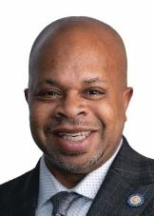
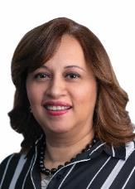
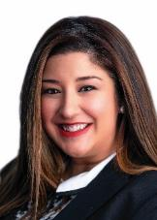
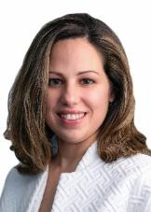
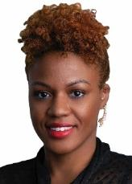
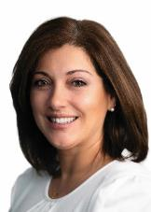
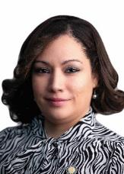
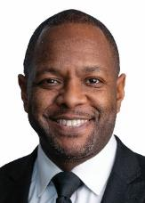
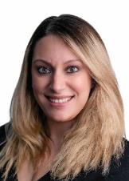
ELIZABETH BOARD OF EDUCATION
Jerry D. Jacobs
President
Rosa Moreno-Ortega
Vice President
Nathalie Alcaide-Hernandez
Diane Barbosa
Charlene Bathelus
Maria Z. Carvalho
Iliana Chevres
Stanley Neron
Stephanie G. Pestana

Slide 3








OUR SCHOOL SYSTEM
28,148
STUDENTS
37 SCHOOLS
3
20
NEIGHBORHOOD
SCHOOLS
MAGNET
SCHOOLS
HIGH
SCHOOLS
EARLY CHILDHOOD
CENTERS
6
8
2nd Largest District in the State of New Jersey
+ 4,757 Students
Student
Demographic
ENROLLMENT
IN PAST 10 YEARS
2011-2012 School Year – 23,391 students
2020-2021 School Year – 28,148 students
GRADUATION RATE – 81.6%
Male
50.70%
EPS record 1,622 students graduated as members of the Class of 2020
Female
49.30%
79.8% FREE/REDUCED LUNCH
Student Profile
68.0%
20.0%
10.06%
1.15%
.79%
WORKFORCE
General
Education
ELL
Special
Education
Special Ed
& ELL
Homeless
2020-2021 School Year
4,074 team members

Slide 4
Enrollment Trends
3% decrease in past year due to COVID-19
20% increase over 10 years

Slide 5

How do we define
Every Child
Achieving
Excellence?
5

Slide 6

We Believe…
… ALL students can learn and achieve at high levels regardless of race, ethnicity, culture, neighborhood, household income or home language.
… Teachers make a positive difference in student achievement. Teachers will prepare ALL students for success in college, career, and our technological global society.
… Effective leaders demonstrate unwavering commitment to high levels of achievement for ALL students.
… Parents and caregivers are both valued partners and active participants in their children’s learning. A shared sense of mutual responsibility for learning is the foundation for family involvement to ensure student success.
…Every member of the Elizabeth Public Schools team has a responsibility in producing and supporting high levels of achievement for ALL students.
6

Slide 7
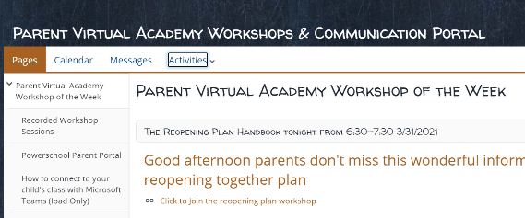
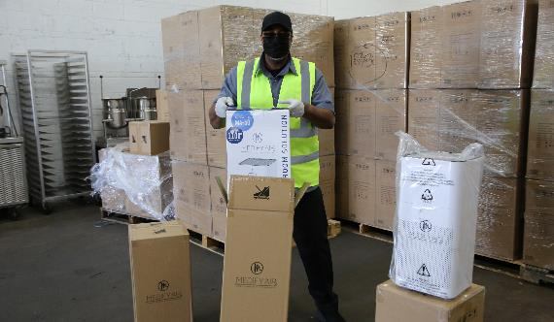
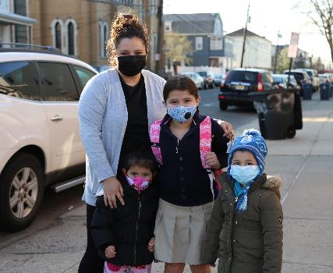
2020-2021 Budget Highlights
Implemented E-Remote Learning virtual instruction platform
Hosted Parent Virtual Academy Workshops
Served more than 2.5M meals to families through Grab & Go Breakfast/Lunch program
Provided laptops for all students and instructional staff
Provided free internet connectivity to students in need
Provided PPE for students and employees
Purchased 4,000 air purifiers for classrooms and offices
EPS employees provided access to COVID-19 vaccine

Slide 8
Goals for the 2021-2022 Budget
Nurture
Nurture students’ social/emotional development and overall well-being
Strengthen
Strengthen educational access and opportunities for all students in our diverse community
Empower
Empower students to become lifelong contributors of our community

Slide 9
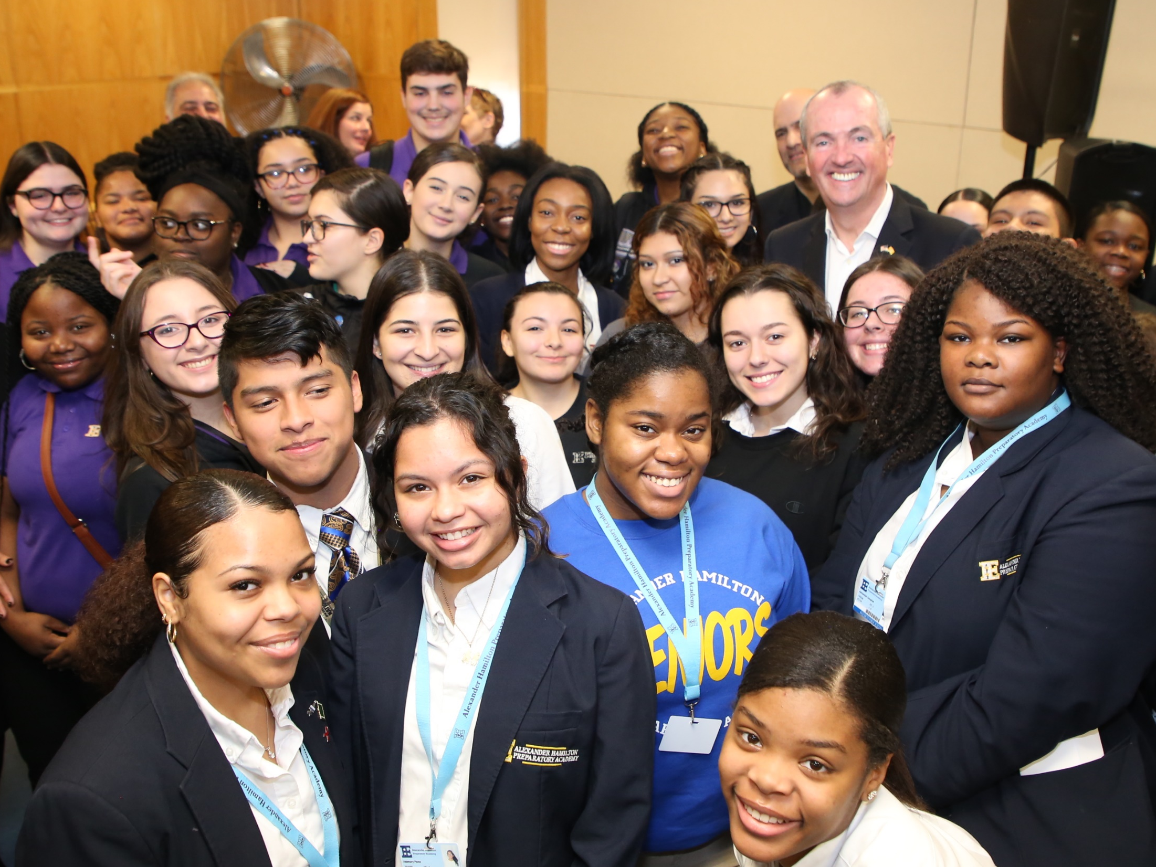
Thank you Governor Murphy
Elizabeth Public Schools Receives Increase in State Aid
Pre-Pandemic
December 2018

Slide 10
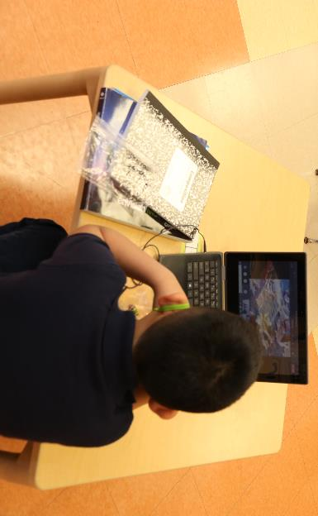
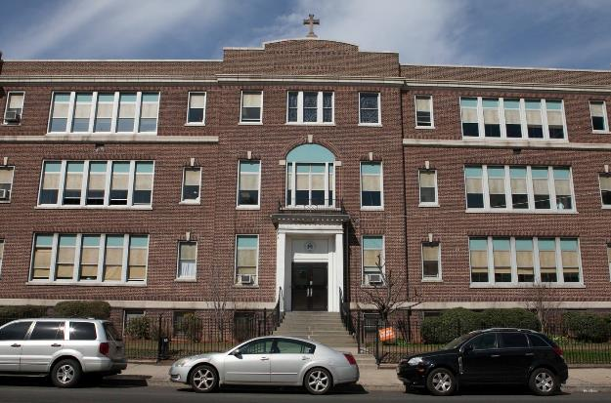
2021-2022 Budget Highlights
Opening of district’s eighth high school for 9th & 10th grades – additional 288 seats in 2021-2022. - $2,900,000.
Acquisition of Our Lady of Fatima – School Annex - additional 14 classrooms for Grades 2 & 3 to assist School 15 and 25 in 2021-2022. - $3,400,000
87 New Certified and Non-Certified Positions - $7,305,000.
Acquisition of property adjacent to Hamilton Preparatory Academy – additional 200 seats in 2022-2023. - $500,000.

Slide 11
2021-2022
Budget
Presentation
OUR FINANCIALS
OUR DRIVERS
OUR PROGRAMS AND SERVICES
Notes:
This evening we will present to you the 2014-2015 budget of the Elizabeth Board of Education. A budget that has allowed us to maintain the educational improvement efforts we have put in place in recent budgets, and sustain the strong academic progress our students are making.
Providing an equal educational opportunity for all students requires funding public schools at levels sufficient to provide a rigorous curriculum, in a broad range of subject areas, delivered by well trained teachers, and supported by effective school and district leaders. This also requires sufficient funds for schools serving our
high numbers of low-income students, English-language learners, and students with special needs. We have worked diligently to craft a budget that prioritizes and protects school-based instructional positions, and closely aligns our resources with our ambitious educational aspirations.
Over the past several years, we have seen both tremendous change and strong academic progress at Elizabeth Public Schools. By most academic measures we continue to see impressive gains in student learning and success. This budget recommendation firmly supports our instructional priorities and continues to tightly align our resources to our district promise and goals. With this proposed budget, we will be able to sustain the great work happening in our classrooms to ensure that every child can achieve excellence.

Slide 12

2021-2022
Budget
Presentation
OUR FINANCIALS

Slide 13

OUR FINANCIAL
DATA
Harold E. Kennedy, Jr.
School Business Administrator/Board Secretary

Slide 14



Development of an Equity Centered Budget
Phase IV
Budget Review Process
Line by line department budget review
Allocation of funds within the school-based budgets based on enrollment, programs and equitable need
Review by Financial Consultant
Collaboration with and review by the
EBOE Finance Committee
Phase II
Determine needs
based on October 15th enrollment
Class size analysis
Phase I
Gather input
from
stakeholders
Phase III
Determine priorities, adjust budget
Face to Face meetings with all Principals
Review of all curricular inventories and requests
Face to Face with all Instructional and Operations Directors
Comparative Analysis of Expenditures for 2019-2020 vs. Proposed Budgets
Phase V
Budget Hearing

Slide 15
Elizabeth Board of Education
2021 - 2022 Budget
Revenue

Slide 16
Elizabeth Board of Education
2021 - 2022 Budget Expenditures

Slide 17
Where does the money go?
2020-2021 Budget Expenditures
OPERATION AND
MAINTENANCE OF PLANT
INSTRUCTION
OTHER
ADMINISTRATION
76.9%
9.5%
10.2%
3.4%

Slide 18
Elizabeth Board of Education
2021 – 2022 Per Pupil Costs

Slide 19

How do we compare on a state level
Administrative Cost Per Student
$1,536 COST PER STUDENT
$2,252 REGIONAL COST PER STUDENT
Elizabeth Public Schools is spending less this year per pupil on administrative cost when compared to the New Jersey regional cost!

Slide 20
The 2021-2022 Budget and tax levy proposed is in accordance with the rules and regulations as promulgated by the New Jersey Department of Education.
EPS prepares its budget following instructions incorporated into the Budget Guidelines and Electronic Data Collection Manual published by the NJDOE Office of School Finance.
The instructions ensure that budgets and information submitted for approval to the Executive County Superintendent and Business Administrator are complete and correct.
20

Slide 21
2021-2022
Budget
Presentation
OUR PROGRAMS
AND SERVICES
Maintaining Our
School System

Slide 22
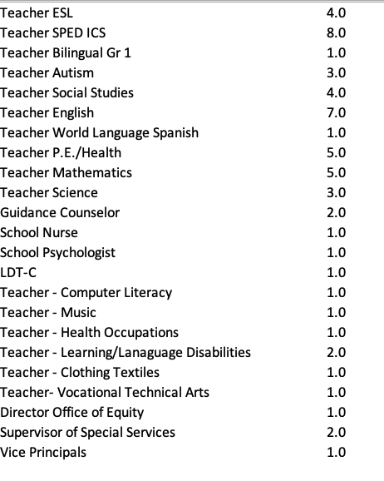

Maintaining
Our School
System
Adequate staffing for instruction
Teacher to pupil ratio
K – Gr 5 = 1:19
    Gr 6 – Gr 8 = 1:22
    Gr 9 – Gr 12 = 1:20
Certified Positions
22

Slide 23
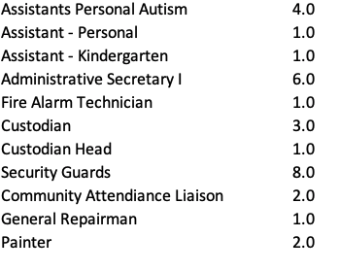
Maintaining
Our School
System
Adequate staffing for instruction
Non-Certified Certified Positions
23

Slide 24
Maintaining
Our School
System
Safe and Caring Initiatives:
Contracted services:
  Nursing
  Speech
  Occupational therapy & Physical therapy
  Chief Medical Inspector
  Behavioral services
  Student drug screenings
Substance Abuse Coordinator (SAC) services
Investigators & School Security Guards services
School Guidance Counselor services
Social Worker services
School Nursing services
Child study Team (CST) services
American Red Cross CPR training
Before-school breakfast programs
High School Saturday programs
Positive Behavior Supports in Schools (PBSIS) supports
Recovery High School tuition and transportation
Alternative education programs for at-risk learners
24

Slide 25
Maintaining
Our School
System
Transportation
Impact of CDC Guidelines – 6 feet social distance on busses
Transportation Eligibility
  2.0 miles and beyond for PK-8 students
  2.5 miles and beyond for 9-12 students
  students with transportation in their IEP,
Increase from $19.8 million to $29.7 million
25

Slide 26
Maintaining
Our School
System
Home and School Relationships
Community Services
Welcome Centers – Centralized Registration
High School Registration (After School/Saturday/Summer)
Community Attendance Liaisons
Student Handbooks and Parent Handbooks
Communication materials and brochures designed to promote school and district programs available in multiple languages
High School Information Sessions
Community Education Program
Free Application for Federal Student Aid (FAFSA) Seminars
School Events:
  National Honor Society
  Back to School Nights
  Math/Science/Literacy Nights
  Awards Ceremonies
26

Slide 27
Maintaining
Our School
System
Academic Safety Nets
Summer Academics
Promotion/Retention program for grades K-8
Summer Literacy Interventions Program
Summer Remediation and Advanced Credit for grades 9-12
Marine Corps Junior Reserve Officers Training Corps (JROTC)
Home Instruction Services
Reading is Essential to Adolescent Development (READ) for grades K-3
Algebraic Thinking for grades 6-8
Developing Mathematical Understanding for grades 4-5
Recreation Program for Special Education
Extended School Year (ESY) for students with disabilities PreK to age 21)
Summer Arts Enrichment for grades K-11
27

Slide 28
Maintaining
Our School
System
Academic Safety Nets
Programs for students with disabilities
Opening of two new self-contained autism classrooms.
TouchMath for grades K-8
Edmark for Autism/MC/MD
504 Plan Related Services
Extended School Year (ESY) for students with disabilities PreK to
age 21)
Contracted services:
    Nursing
    Speech
    Occupational therapy
    Physical therapy
    Behavioral Services
Applied Behavior Analysis (ABA) Services
Rethink
Union County Educational Services Commission (UCESC) Transition Partnership
28

Slide 29
Maintaining
Our School
System
Academic Safety Nets
Before-school and after-school basic skills and enrichment programs
After school enrichment program for grades K-8
Saturday Recreation Program for students with disabilities
After School Clubs for high school students
Attendance Recovery Program for high school students (Saturday)G
Graduation Rate Improvement Program (GRIP) for high school students (Saturday)
Academic Interventions
Agile Minds: Mathematics for grades 8
Response to Intervention (RTI)
Hispanics Inspiring Students Performance and Achievement (HISPA) – role model program for grades 6-8
SONDAY multisensory interventions
Orton Gillingham
Leveled Literacy Interventions
29
Notes:
AVID – K-8 Total of 19 schools and 6 high schools including Bollwage as our new site

Slide 30
Maintaining
Our School
System
    Academic Interventions
    Khan Academy – supplemental resource for mathematics (no cost)
    ST Math for grades K-5 for all students
    SuccessMaker for Reading and Mathematics for Grades K-8 for General Education, Bilingual ICS, Bilingual Math SC, and Special Education
    Achieve 3000 for ELA for Grades K-8 in Self-Contained Bilingual classrooms
    Programs for bilingual students
      Self-contained Bilingual and ESL services
      Native language materials
      Transition services
      Bilingual Magnet Program for grades 4-8 (Spanish)
      Point of Entry for grades 9-12
      Esperanza Literacy Intervention
    Home Instruction
      Contracted providers
      Hospital Home Instruction
      After school Home Instruction
30

Slide 31
Maintaining
Our School
System
  Athletic and Co-Curricular Activities
  Complete array of clubs and activities
  Athletic Summer Camps
  Intermural Sports for grades 6-8
  Athletic Programs for grades 9-12
  Summer Band Camp for grades 9-12
  New Jersey State Police Top Physical Challenge
  Young Men’s Christian Association (YMCA) Health Bee
  Special Olympics
  Saturday and Summer Recreation Program for students with disabilities
  T. Bowles Play 60
31

Slide 32
Maintaining
Our School
System
  Student Assessments
    High School Graduation Appeals Portfolios
    State Testing Program for NJ Student Learning Assessment (NJ SLA),
    Dynamic Learning Maps (DLM),
    Developmental Reading Assessment (DRA) and Evaluacion del Desarrollo (EDL)
    College Board Assessments:
      Preliminary Scholastic Aptitude Test (PSAT)
      Scholastic Aptitude Test (SAT)
      Advanced Placement (AP)
      PreK IDEA Proficiency Test (Pre-IPT)
    New Entrant Testing for English Language Learners
    Translation services for student assessments
    Verbal Behavior Milestones Assessment and Placement Program (VB-MAPP) for students with Disabilities
32

Slide 33
Maintaining
Our School
System
Academic Programs & Partnerships
Refurbishment of instructional materials in grades K-12 (including general education, bilingual education, and special education)
Technology
Information Technology (IT) Technicians
Internal and External Communications
  E-mail system
  Phone system
  Robo-call system (Blackboard APP Connect)
Technology Training
Continued Maintenance of Technology Resources at the district and school level
    Microsoft Translator
    Computer Literacy Teachers
    Computer Literacy Curricula Writing
      Digital Literacy (grades 3 and 4)
      Introduction to Coding (grade 5)
33

Slide 34
2021-2022
Budget
Presentation
OUR PROGRAMS
AND SERVICES
Raising Standards and
Expanding Opportunities

Slide 35
Raising Standards and Expanding Opportunities
Resources for Closing the Achievement Gap
Office of Equity
Guidance Counselor to track and monitor Out of District students
Leveled curricular materials
SchoolNet data system
Data Analyst to identify strengths and weaknesses minority populations
Culturally relevant supplement curricular materials
Consultants to examine Curriculum of Inclusion
15-hour Sheltered Instruction Module for all instructors
Summer transition program before 9th grade
Children’s Literacy Initiative (CLI) Partnership
Partnership with Harvard University – Reimagining Integration: Diverse and Equitable Schools (RIDES) Growth Mindset
35

Slide 36
Raising Standards and Expanding Opportunities
Resources to Enhance Technology Standards for Students and Teachers
Partnerships for grades 9-12:
      National Academy Foundation (NAF)
      Global Logistics/Federal Express
Industry certifications
      Certification Exams for Engineering
      Global Logistics Exams
National Academy Foundation (NAF)
      Be Future Ready: Academy of Information Technology & Project Lead the Way
Structured Learning Experiences (SLE) – Advisors & Internships
      United Way of Greater Union County
      ShipCo
      Automotive Technology
      Print Services
      Health Sciences
      Cosmetology/Barbering
      Commercial Foods
      Fashion/Marketing
36

Slide 37
Raising Standards and Expanding Opportunities
Career and College Readiness
International Baccalaureate for grades K-8
Naviance for College and Career Readiness for grades 9-12
Dual Enrollment Partnerships:
  Kean University
  New Jersey Institute of Technology (NJIT)
  New Jersey City University
  Middlesex County Community College (MCCC)
  New Jersey Institute of Technology for grades 9-12
Transition program for students with disabilities
College visits
Advancement Via Individual Determination (AVID) for grades 6-12. Adding J. Christian Bollwage Finance Academy in 2021-2022.
37

Slide 38
Raising Standards and Expanding Opportunities
  Visual and Performing Arts
    Teen Arts Program
    Summer Arts Institute
    Music Theater Orchestra
    High School performing arts program after school
    Disney Musicals in Schools
    HBO partnership
    Visual Arts Center of New Jersey
38

Slide 39
2021-2022
Budget
Presentation
OUR PROGRAMS
AND SERVICES
Building Professionalism-Resources

Slide 40
Building Professionalism- Resources
Resources for Professional Development
Mentoring first-year teachers
New teacher training
New teacher Network Induction Programs
Montclair State University Network for Educational Renewal
Content Area Trainings (including Bilingual and Special Education)
Harassment Intimidation and Bullying (HIB)
Language Arts Literacy Training: K-3 On-site Coaching
Mathematics Training for Grades K-8 & HS Algebra I Advanced, Algebra II: On-site Coaching
Training for Librarians on Literacy Instruction
Safety and Security of our Schools
Personalized Learning Environments and Differentiating Instruction
Handle with Care
Global Compliance Network Professional Development System
Administrators’ Institute
District PD days
40

Slide 41
2021-2022
Budget
Presentation
Protecting Our Investments
Capital and Maintenance Projects

Slide 42
Capital and Maintenance
  Projects
  Asphalt replacement (2 schools)
  Repoint brick on main building (1 school)
  Add bathrooms in kindergarten classrooms (2 schools)
  Replace gym ceiling (1 school)
  Replace cold water main (1 school)
  Convert nursing room to conference room (1 school)
  Convert classrooms (3 schools)
  Replace and or install new doors (3 schools)
  Replace gym floors (3 schools)
  Replace greenhouse glass room (1 school)
  Additional heat in the weight room (1 school)
  HVAC installation (3 schools)
  Paint entire building (2 schools)
  Paint classrooms (3 schools)
  Roof replacement (9 schools)
  Shoprite/backing room (1 school)
  Replace hot and cold-water lines in tunnel (1 school)
  Exterior wall weatherproofing (1 school)
  Build black box theater space (1 school)
42

Slide 43
2021-2022
Budget
Presentation
OUR ACCOMPLISHMENTS

Slide 44
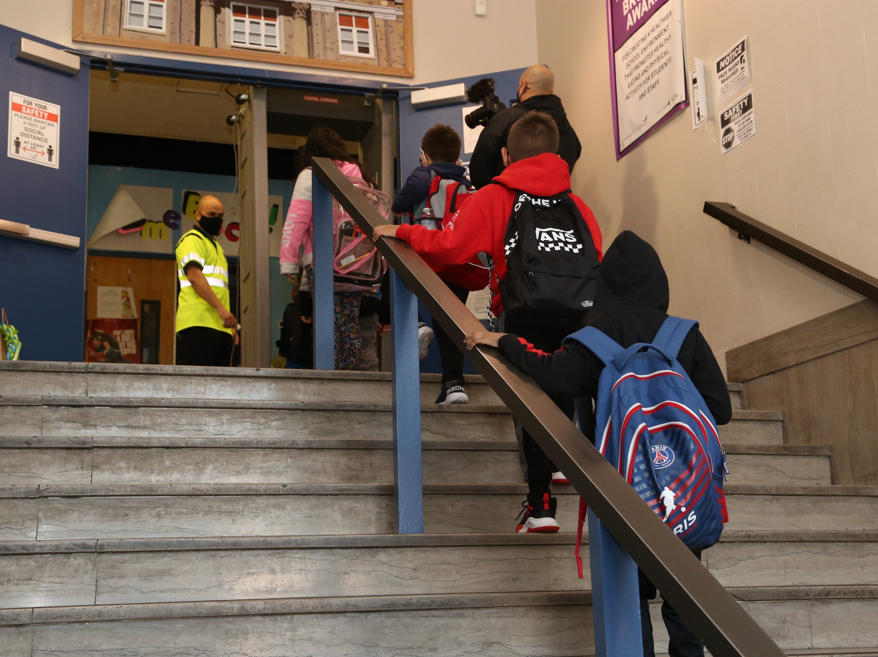
Reopened All Schools for In-Person Learning
for Students in All Grade Levels
44

Slide 45

EPS Recognized as a 2021 Best Community for Music Education by NAMM Foundation
45

Slide 46

2 EPS Schools Named 2021 NJ School of Character
Donald Stewart Early Childhood Center School No. 52
Alexander Hamilton Preparatory Academy
46

Slide 47

U.S. News and World Report
2021 Best U.S. High Schools Rankings
No. 204 in US
No. 13 in NJ
No. 1,143 in US
No. 49 in NJ
Elizabeth High School – Frank J. Cicarell Academy
Alexander Hamilton Preparatory Academy
47
Notes:
College readiness 30% - college curriculum 10% (AP EXAMS – multiple exams – qualifying scores) Math and Reading proficiency & performance 20% underserved student performance 10% Graduation rate 10%

Slide 48

EPS, Kean University’s Be The Change Partner
to Help Families in Need During the Pandemic
Provide 70 community families with meals in accordance with CDC guidelines
delivered toys, clothes, and essential items
provided turkeys to the community for Thanksgiving
48

Slide 49



EPS Students Participate in
Virtual Environmental Day
49

Slide 50


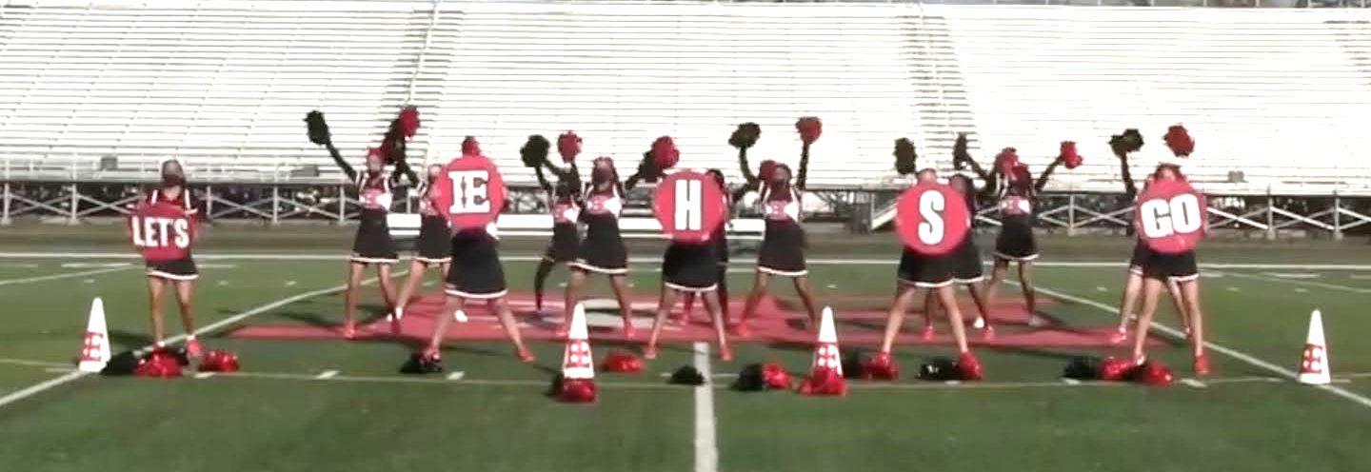
Elizabeth High School Varsity Cheerleaders Earn 1st Place in ImpAct Cheer & Dance Competition
50

Slide 51

TJAA’s Twelfth Night/Merchant of Venice
Receives 11 MSU Theater Night Awards Nominations
Production Nominations
Outstanding Achievement in Virtual Background Design
Outstanding Achievement in Editing
Outstanding Achievement in New Media / Special Effects
Outstanding Achievement in Live or Original Music
Outstanding Production of a Virtual Play with Cinematic Editing
Outstanding Achievement by an Acting Ensemble of a Virtual Play with Cinematic Editing
Individual Nominations
Lucas Luchsinger (Malvolio- Twelfth Night; Bassanio- Merchant of Venice) – Outstanding Performance by an Actor in a Virtual Play with Cinematic Editing
Josiah Perez (Antonio- Merchant of Venice) – Outstanding Performance by an Actor in a Virtual Play with Cinematic Editing
Diana Benenaula (The Clown- Twelfth Night) – Outstanding Performance by an Actress in a Virtual Play with Cinematic Editing
Zoe Rivera (Portia- Merchant of Venice) – Outstanding Performance by an Actress in a Virtual Play with Cinematic Editing
51

Slide 52
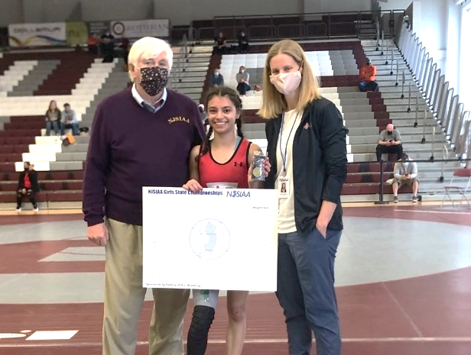
Isabella Santos Becomes First Ever
Elizabeth Wrestling State Champion
52

Slide 53
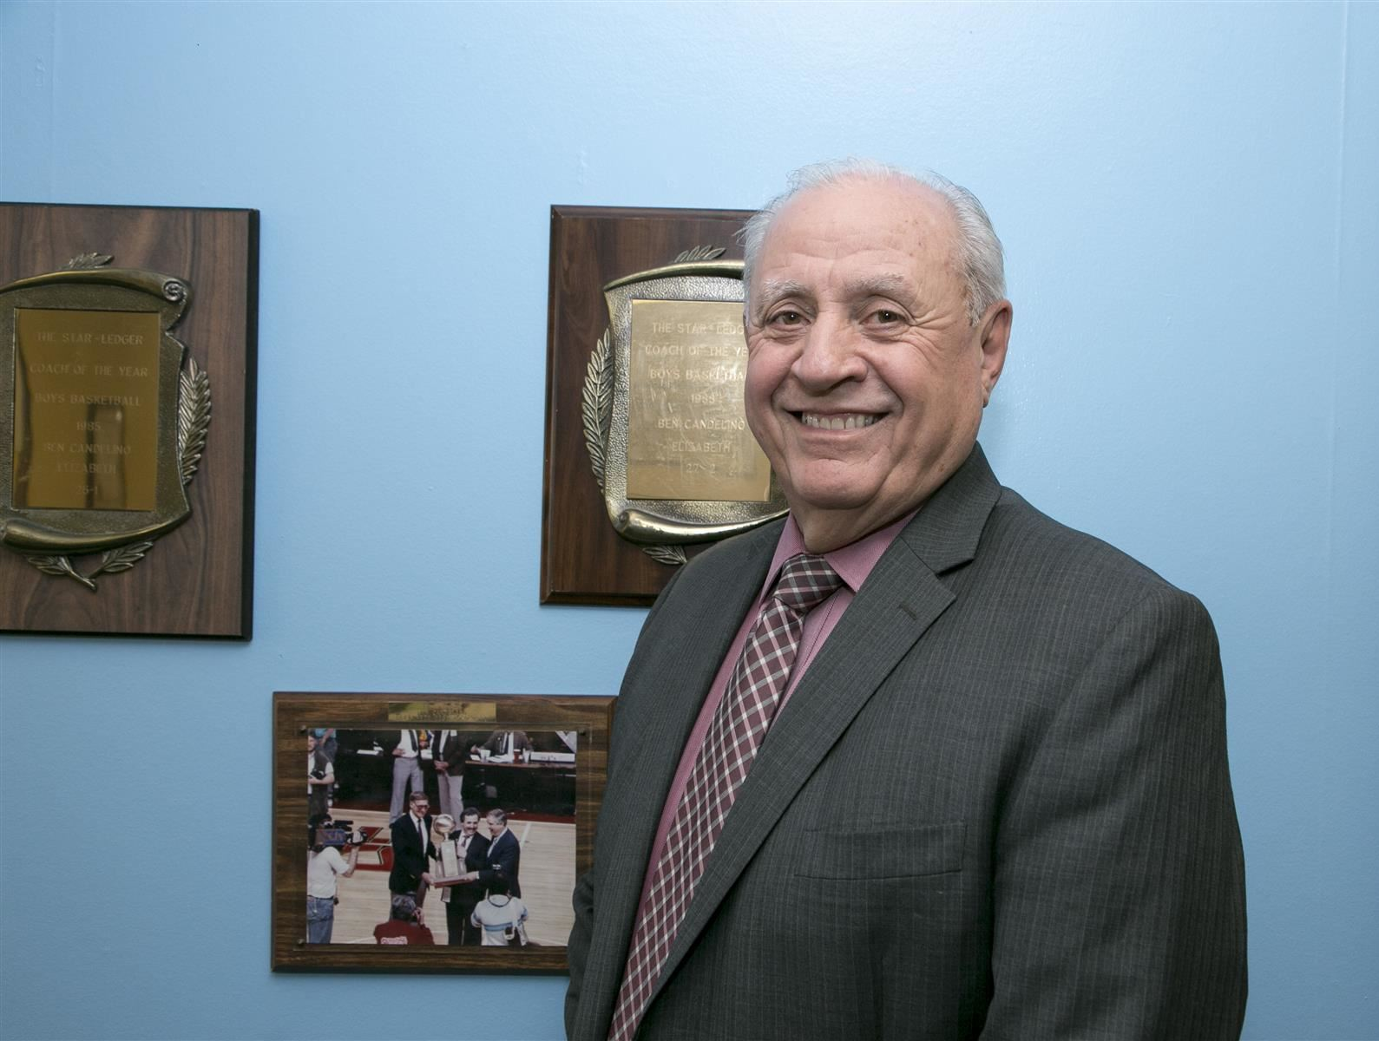
Elizabeth Athletic Director Ben Candelino Inducted to NJSCA Coaches Hall of Fame
53
Notes:
New Jersey Scholastic Coaches Association

Slide 54
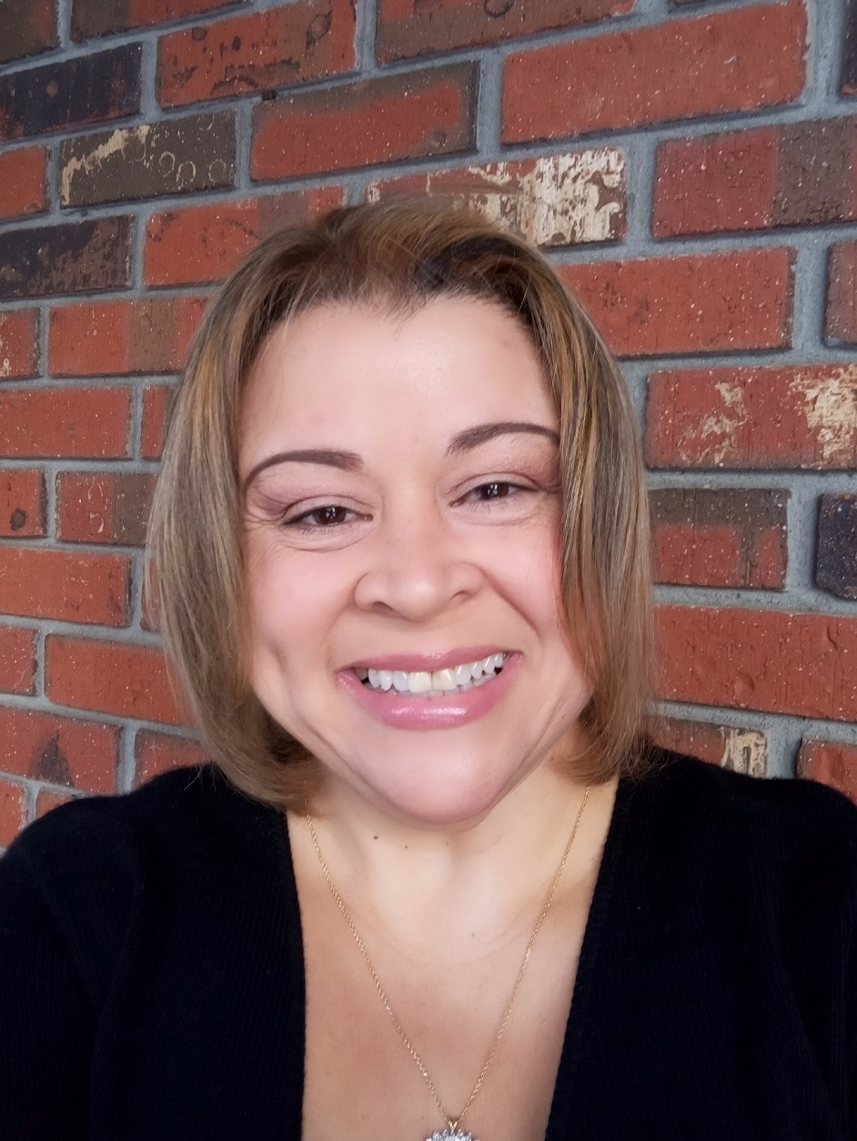

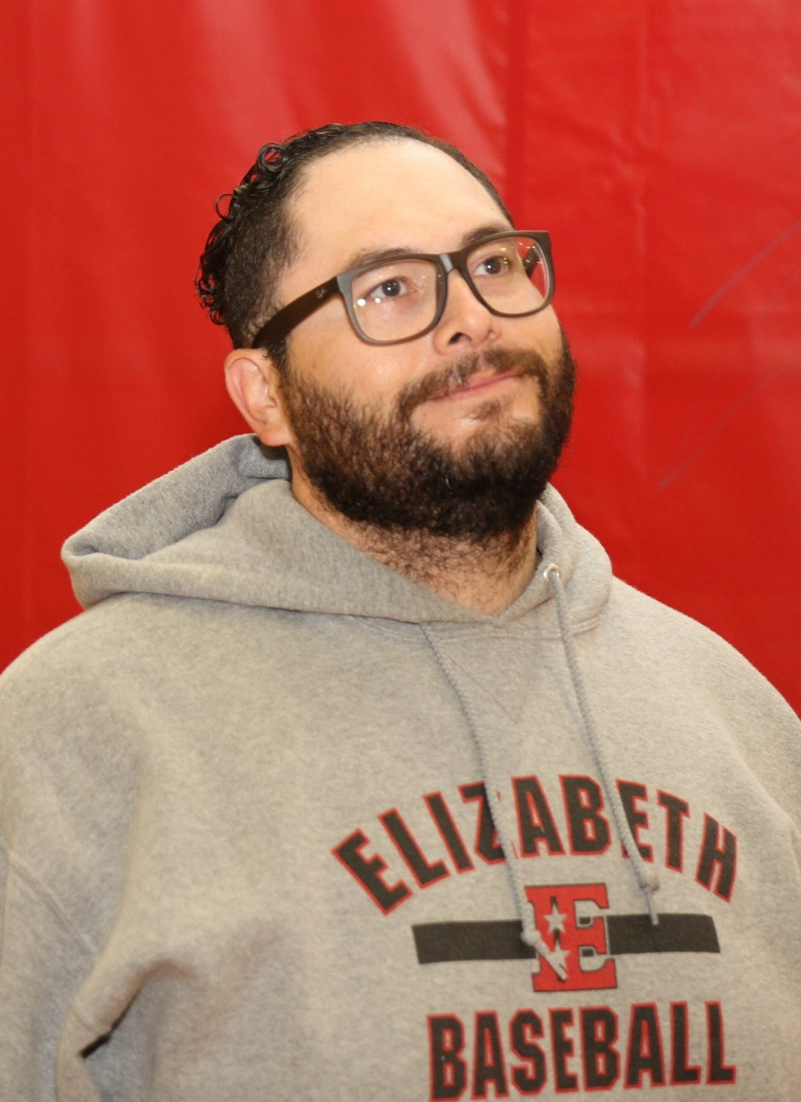
EPS Teachers Earn Middle School Phys. Ed. Teacher of the Year, Physical Activity Champion Awards from NJAHPERD
Jairo Labrador
Belinda Jimenez
54

Slide 55
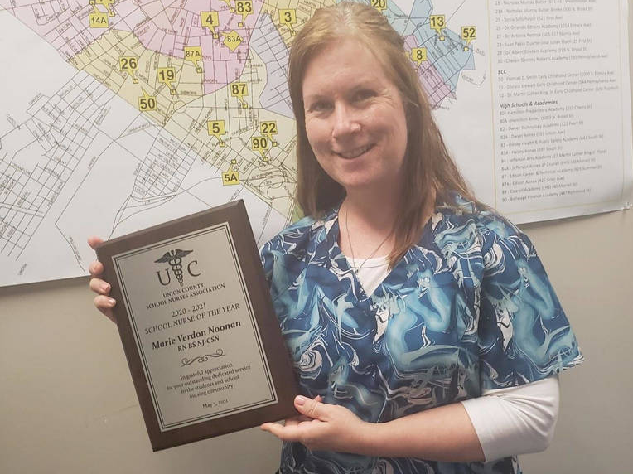
Marie Verdon Noonan Named School Nurse of the Year by Union County School Nurses Association
55

Slide 56


Jahari Jacobs Named 2021 New Jersey Agriculture in the Classroom (NJAITC) Teacher of the Year
56

Slide 57

Thomas Jefferson Arts Academy students Lucy Gomez and Nick Mayancela Shine at NJSEE
57

Slide 58
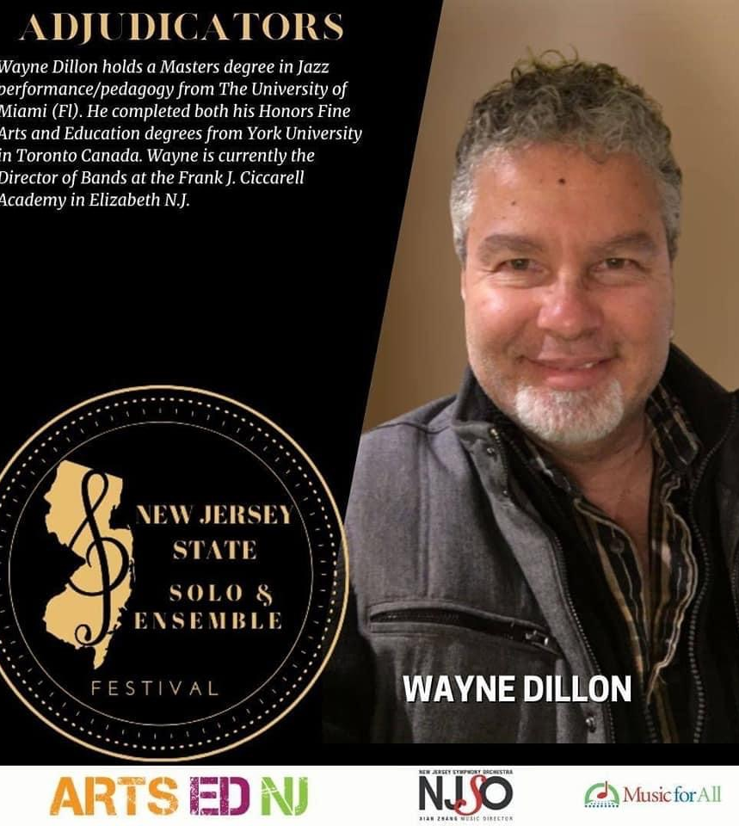
EHS – FJC Director of Bands Selected as Adjudicator
of Inaugural
New Jersey State
Solo and Ensemble
Festival
58

Slide 59

EHS – FJC Student Wilmary Figuereo
Named a Coca-Cola Scholar Semifinalist
59

Slide 60


EPS Responds to Global Pandemic
with Global Instruction
EPS provided instruction on its virtual learning platform to students staying in 14 different countries spanning four continents
60

Slide 61
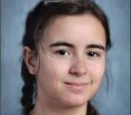

Thomas Jefferson Arts Academy’s Lucielle O’Donnell Earns Honorable Mention in
19th Young Playwright’s Competition
61

Slide 62
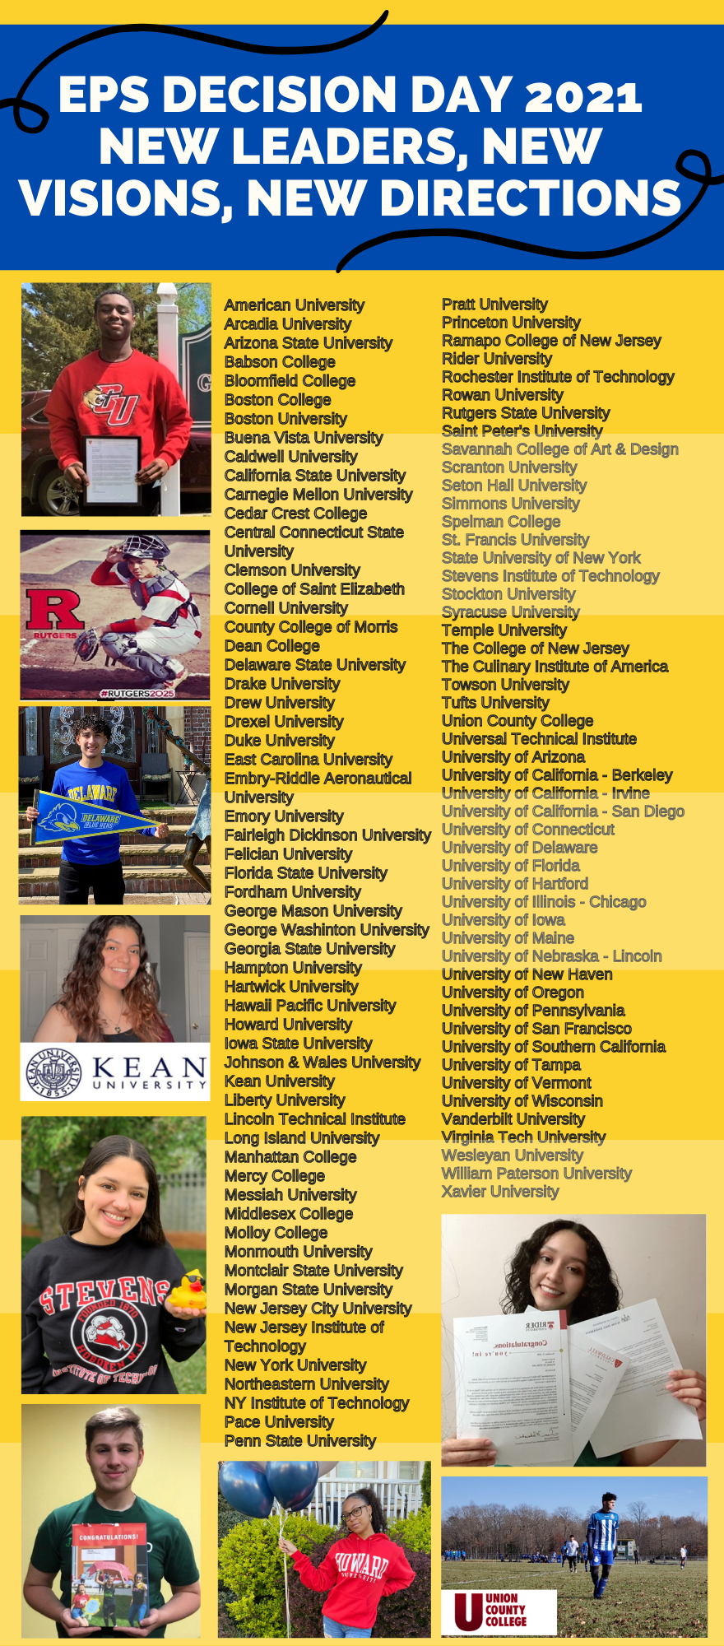



Slide 63
2021-2022
Budget
Presentation
The Board of Education and Central Office believe in an open and transparent budget process. All Board of Education meetings are open to the public, and agendas and meeting minutes are available at www.epsnj.org
Copies of the 2020-2021 budget are on file at the
Elizabeth Board of Education – Mitchell Building (500 N. Broad St.)
A copy of the proposed budget is posted online at the district’s web site: www.epsnj.org
63

Slide 64
ELIZABETH BOARD OF EDUCATION
Jerry D. Jacobs
President
Rosa Moreno-Ortega
Vice President
Nathalie Alcaide-Hernandez
Diane Barbosa
Charlene Bathelus
Maria Z. Carvalho
Iliana Chevres
Stanley Neron
Stephanie G. Pestana

Slide 65
2021-2022
Budget
Presentation
Thank You!
Olga Hugelmeyer
Superintendent of Schools
Notes:
This evening we will present to you the 2014-2015 budget of the Elizabeth Board of Education. A budget that has allowed us to maintain the educational improvement efforts we have put in place in recent budgets, and sustain the strong academic progress our students are making.
Providing an equal educational opportunity for all students requires funding public schools at levels sufficient to provide a rigorous curriculum, in a broad range of subject areas, delivered by well trained teachers, and supported by effective school and district leaders. This also requires sufficient funds for schools serving our
high numbers of low-income students, English-language learners, and students with special needs. We have worked diligently to craft a budget that prioritizes and protects school-based instructional positions, and closely aligns our resources with our ambitious educational aspirations.
Over the past several years, we have seen both tremendous change and strong academic progress at Elizabeth Public Schools. By most academic measures we continue to see impressive gains in student learning and success. This budget recommendation firmly supports our instructional priorities and continues to tightly align our resources to our district promise and goals. With this proposed budget, we will be able to sustain the great work happening in our classrooms to ensure that every child can achieve excellence.

