Slide 1

Coronavirus Panel with Medical and Health Experts
JULY 16, 2020

Slide 2
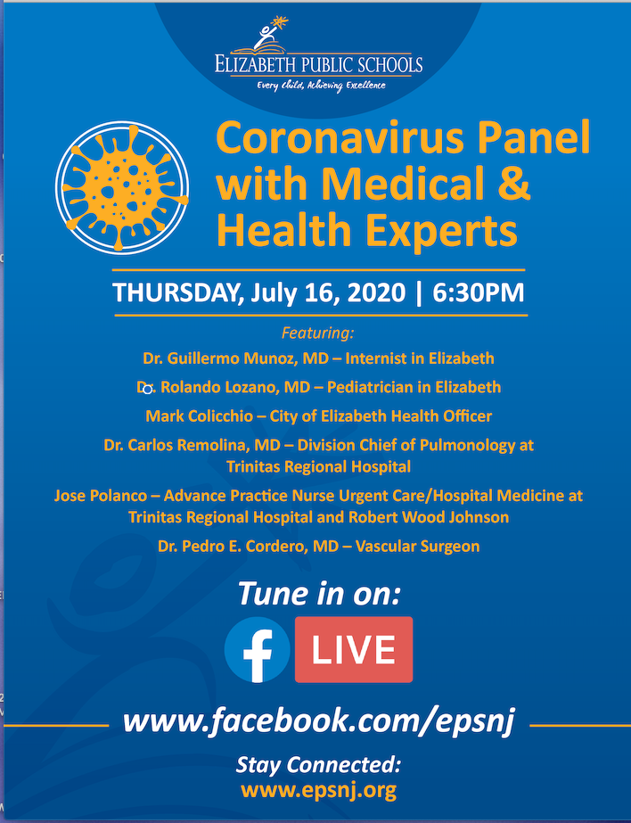

Slide 3
Question
Are our students going to be safe returning to school?
Will opening schools lead to a second wave and lockdown?

Slide 4
Question
How will immune-compromised staff or students be accommodated? If people have conditions on the CDC's list of higher risk factors are districts required to provide further accommodations?

Slide 5
Question
Many schools are not air-conditioned, and scientists have brought up concerns about heat exhaustion brought on by masks.
How can the district mitigate this risk?

Slide 6
Question
What health concerns will allow students to not wear a mask?
There are students with sensory disorders and medically-treated anxiety who are unable to wear masks at this time.

Slide 7
Question
Can in-school transmission occur?
Has any consideration been given to the viral load teachers may be exposed to?
Special area teachers and content area specialists (secondary) are often exposed to hundreds of students.

Slide 8
Question
The use of nebulizers for administration of asthma medications could aerosolize COVID-19.
Will the use of nebulizers be prohibited in the health office?

Slide 9
Question
What do you do with an asymptomatic person?

Slide 10
Question
If a student or staff is to quarantine at home due to a family exposure, as identified by the Health Department, for either positive or due to being a close contact to a case, will the school be notified promptly with the quarantine effective dates?

Slide 11
Question
Will students that are sent home or report possible Covid-19 symptoms be required to return with a medical note?
If a family does not have insurance, will they be allowed to return without a medical note after isolation for 7-10 days, or need to be symptom-free or have a negative Covid-19 test?

Slide 12
Question
Can you explain the process for contact tracing?
If one student exhibits COVID-19 symptoms, does that mean the teacher and the rest of the class have to quarantine for 14 days?
Are the siblings of the student that exhibits COVID-19 symptoms also excluded from school and quarantined for 14 days?

Slide 13
Question
Are students usually asymptomatic? If so, should daily temperature screening be done at the school and before boarding a bus?

Slide 14
Question
Are there enough tests available for our schools to have school-based testing?

Slide 15
Question
Are schools with no air-conditioning safe for our students and staff?

Slide 16
Question
Can students carry COVID-19 back to their home and expose their family?

Slide 17
Question
Should students and staff be tested prior to the reopening of schools?

Slide 18
Question
With the focus being on sanitizing on a frequent basis, how can parents be assured that the chemicals being used will not affect asthmatic students and staff?

Slide 19
Question
How often should classrooms be sanitized throughout the day?

Slide 20
Reopening Together
September 2020
JULY 6, 2020

