Slide 1

ANNOUNCEMENTS
March 2021

Slide 2
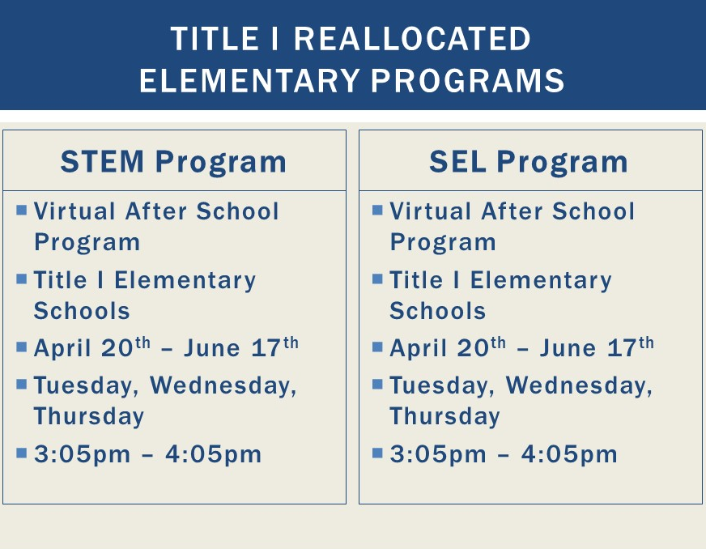
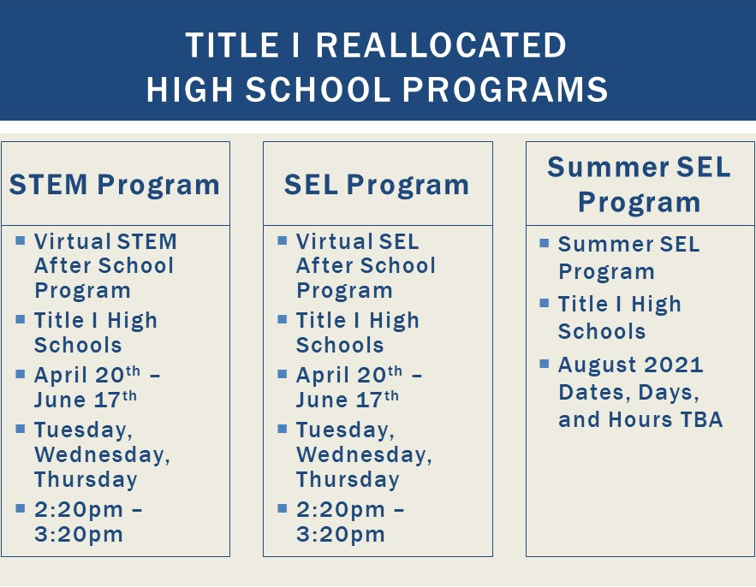
Supplemental Virtual Programs

Slide 3

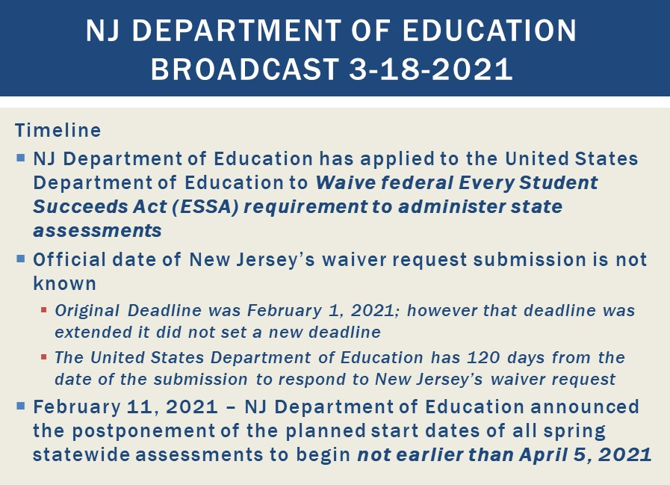

State Assessments Update

Slide 4
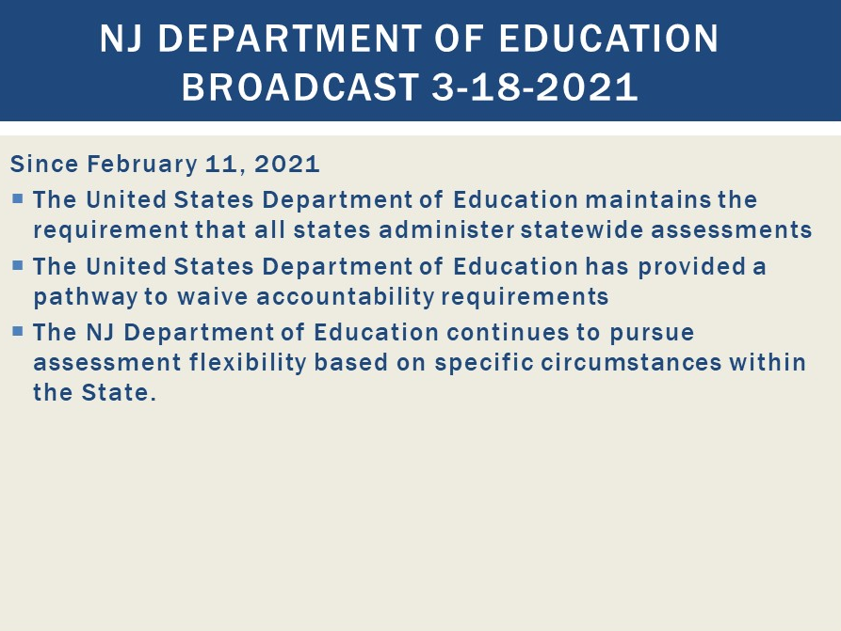
State Assessments Update

Slide 5
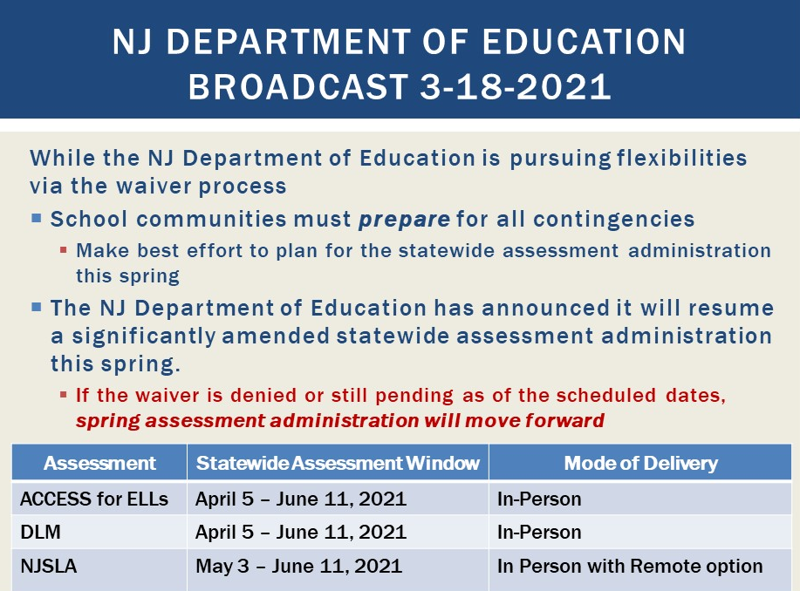
State Assessments Update

Slide 6
ANNOUNCEMENTS
March 2021

