Slide 1

September 2020

Slide 2
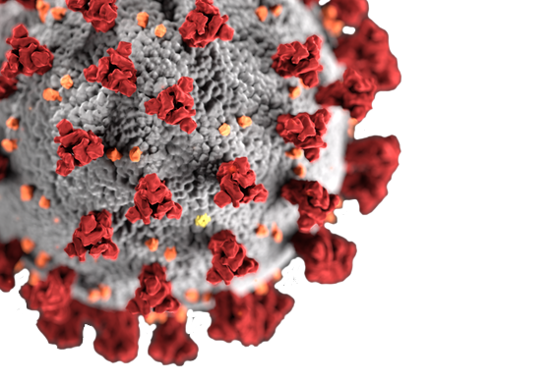
COVID-19 Protocols
Elizabeth Public Schools
has exceeded requirements of NJ Dept. of Education and NJ Department of Health

Slide 3

COVID-19 Protocols
NJDOE/NJDOH Guidelines
EPS Protocol
Custodian sanitizes
after 24 hours
EPS contracted sanitizing company ServPro to clean entire building

Slide 4
COVID-19 Protocols
NJDOE/NJDOH Guidelines
EPS Protocol
Sanitizing classroom
Sanitizing entire building

Slide 5
COVID-19 Protocols
NJDOE/NJDOH Guidelines
EPS Protocol
Student/Staff Member Tests Positive for COVID-19- Shut down classroom for 24 hours
Student/Staff Member Tests Positive for COVID-19-
Shut down school for 48 hours

Slide 6
COVID-19 Protocols
NJDOE/NJDOH Guidelines
EPS Protocol
COVID-19 Contact Tracing- identify and inform
primary contacts
COVID-19 Contact Tracing- Informing all team members in building and supporting whether or not to be tested

Slide 7
COVID-19 Protocols
Additional EPS Protocols
Zoom meeting with all staff from the building along with Elizabeth health officer and EPS Director of Plant and Property
Shut down and sanitize entire building for safety even for suspected cases

Slide 8
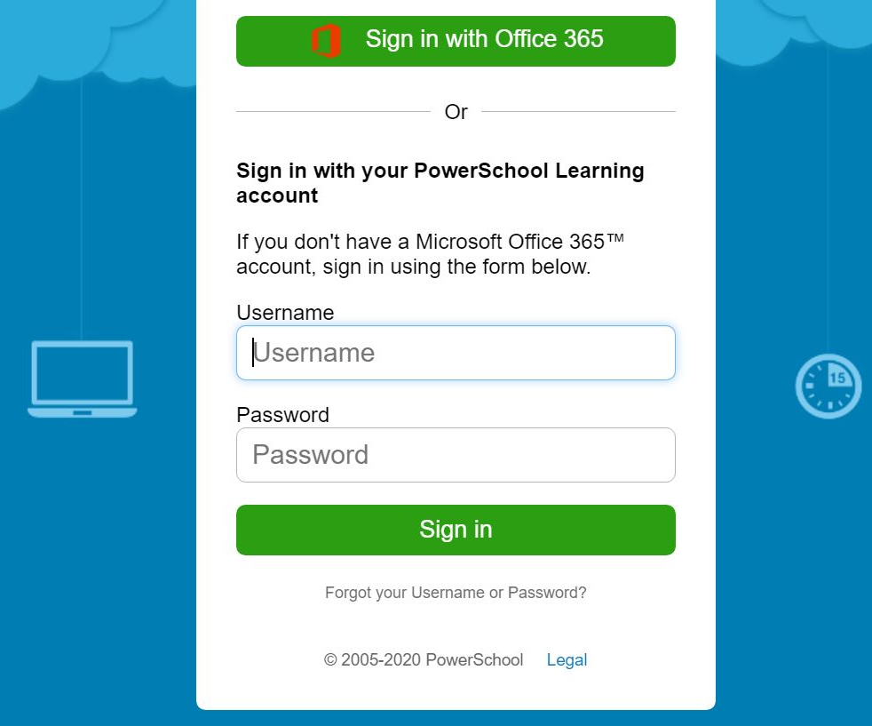
Attendance
EPS Attendance
First Week of School - 2020-2021
9/11 | 9/14 | 9/15 | 9/16 | 9/17
92.10% | 91.60% | 92.15% | 93.17% | 93.60%

Slide 9
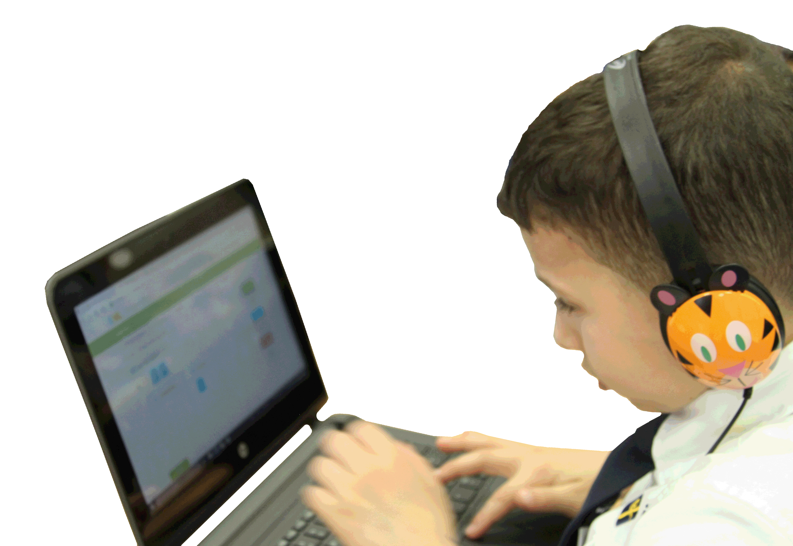
Technology
Addressing Challenges
School based personnel receiving training on how to change password to help address issues with password changes
There will be a two-step process for which personnel will be trained on how to install the proper software. A second training will then be scheduled to instruct on how to change passwords.
Laptops (K-12) and iPads (PK) for New Entrants & New Teachers
New Entrant and New Teacher laptops (K-12) are available for pick up at Elizabeth High School and iPads (PK) are available for pick up at School No. 52 from 8:00 a.m. to 4:00 p.m. daily. Please note that the registration process has to be fully completed and also the school has to have a schedule created prior to the parent being notified of laptop/iPad pick-up.

Slide 10
Technology
Addressing Challenges
Help Desk Support
Currently the help desk has 20 phone lines. Once at capacity, there is a busy tone.
Device Repair
All device repairs are taking place at the IT Hardware department located at Gold Administration 600 Pearl Street (Welcome Center – HS). Parents can drop off their device and receive a working laptop immediately with technical assistance.

Slide 11
Technology
Addressing Challenges
Parent Virtual Academy- Microsoft Teams in Classroom
Elizabeth Public Schools launched its Parent Virtual Academy to provide families with valuable training and information to support their child’s learning during remote instruction and beyond. Workshops will take place daily Monday through Friday from 6:00-7:00 p.m. through September 30.
Weekly Team Member Training
Pre-K- Preschool Team Training
K-8- Virtual Support Training

Slide 12

Grab and Go Breakfast/ Lunch Program
Meal Distribution
Monday, September 14
9,000 families picked up meals
Wednesday, September 16
16,375 families picked up meals

Slide 13

Grab and Go Breakfast/ Lunch Program
Monday, September 21, 2020 - Grab & Go will include 2 Breakfast and 2 Lunches:
• Lunch for Monday, September 21, 2020
• Breakfast & Lunch for Tuesday, September 22, 2020
• Breakfast for Wednesday, September 23, 2020
Wednesday, September 23, 2020 – Grab & Go will include 2 Breakfast and 2 Lunches:
• Lunch for Wednesday, September 23, 2020
• Breakfast & Lunch for Thursday, September 24, 2020
• Breakfast for Friday, September 25, 2020
Friday, September 25, 2020 – Grab & Go will include 2 Breakfast and 2 Lunches:
• Lunch for Friday, September 25, 2020
• Breakfast & Lunch for Tuesday, September 29, 2020
• Breakfast for Wednesday, September 30, 2020

