Slide 1

2020-2021 Observation Protocols January 28, 2021
Taken from the NJDOE: Educator Evaluation Guidance for School Year 2020-21

Slide 2
2020-2021 teacher evaluation process during remote learning
The teacher evaluation process for 2020-2021 will focus on classroom observations:
Definition and Purpose
Background
Key Themes
Portfolio Protocols
Next Steps

Slide 3

NJDOE Educator evaluation guidance
This presentation is based on NJDOE Educator Evaluation Guidance for School Year 2020-21.
Released on
September 21, 2020
Educator Evaluation Guidance for School Year 2020-21 (nj.gov)

Slide 4
Definition and purpose
Definition:
Observations are “a method of collecting data on the performance of a teaching staff member's assigned duties and responsibilities.” (N.J.A.C. 6A:10-1.2)
Purpose:
Effective evaluation systems are designed to support teachers and school leaders in improving their practices and building upon their strengths.
Teachers and school leaders must engage in reflective conversations and work together to implement procedures that will continue to improve teaching and learning.

Slide 5
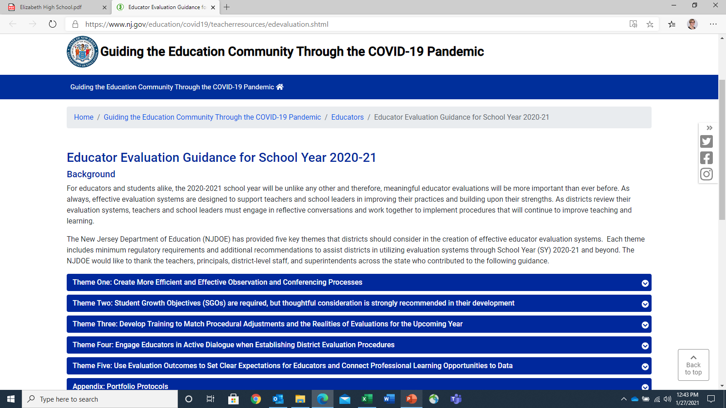
Background
2020-2021 school year is unlike any other; therefore, in these extraordinary times, it is important that we come together as a team to support teaching and learning.
Our teachers have tackled this sudden shift to online teaching and learning with determination and dedication.
The observation process is meant to provide teachers with support needed, especially during virtual environment.

Slide 6
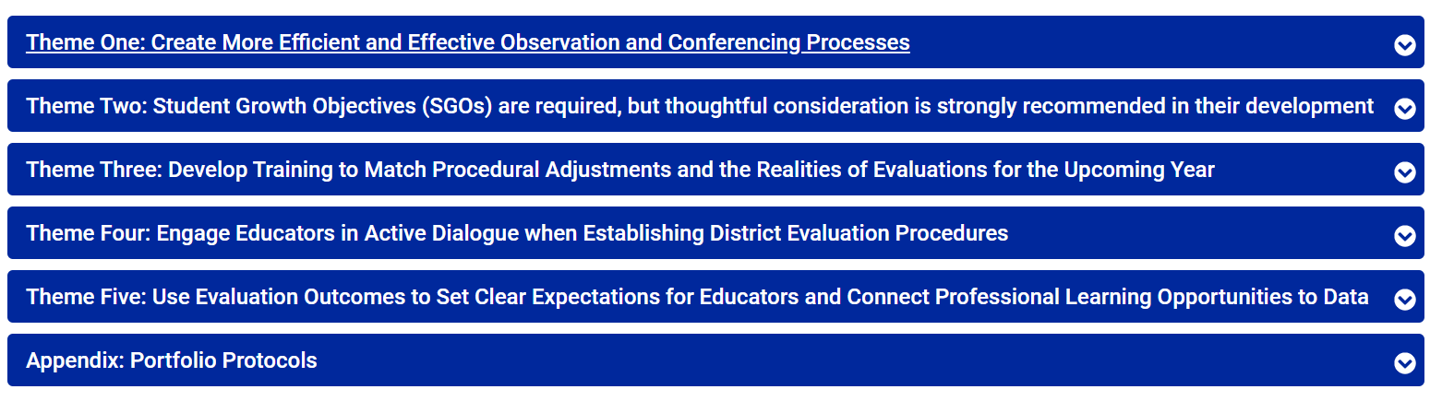
Key Themes
The New Jersey Department of Education (NJDOE) has provided key themes in the creation of effective educator evaluation systems:

Slide 7
observation and conferencing processes
All staff must receive the number of observations required by regulations (N.J.A.C. 6A:10:4.1 and 5.1):
Tenured Certified Staff a minimum of two observations.
Nontenured Certified Staff a minimum of three observations.
Types of Observations for 2020-2021:
In-Person Learning: Traditional in-class observations
Traditional in-class observations remain the required method for evaluating in-class, in-person instruction.
This includes hybrid models in which teachers are teaching in-class, in-person with students.
Remote Learning: The Portfolio Process
New process due to Pandemic and remote learning environment.
If instruction is not occurring in-class or in-person, the portfolio process may be utilized for teachers.
Notes:
The state has not relaxed observation regulations, but have provided guidance on how districts can still meet the regulations within virtual, hybrid, and traditional environments.

Slide 8
observation and conferencing processes
NJDOE | EPS
Districts should make every effort to ensure that at least one observation is a traditional in-person observation. | EPS in-person instruction is based on district decisions related to the health and safety of our school community.
Districts are also strongly encouraged to take advantage of the local flexibility in the use of their observation instruments. | EPS worked with the NJDOE to develop protocols. EPS worked with observation instrument experts to develop guidance. EPS has reduced the number of components for virtual observations (from 9 components in a traditional observation to 5 components in a virtual observation).

Slide 9
observation and conferencing processes
NJDOE | EPS
Districts can and should make adjustments to leverage the benefits of professional learning facets of the evaluation system. | EPS provided training and guidance to staff members in September 2020 and January 2021. EPS streamlined the observation and portfolio process by reducing the number of components, eliminating the written post-conference component for virtual observations, and providing sample artifacts.

Slide 10
Portfolio Protocols
NJDOE | EPS
The Portfolio process replaces the traditional twenty-minute single classroom observation. | The Portfolio process in place for observations during 2020-2021 school year while students remain remote.
The Portfolio process allows educators to showcase their professional practice with a set of artifacts. | New EPS observation protocols reflect teachers providing one to five documents in support of their lessons.
If the Portfolio observation includes a preconference, this must occur within seven working days prior to opening the observation window. | EPS observation protocols include the required timelines for announced observations.
All post conferences must occur within 15 working days of the close of the observation window. | EPS observation protocols reflect required timelines for post conferences.

Slide 11
Portfolio Protocols
NJDOE | EPS
Included should be evidence of direct observation of synchronous or the indirect observation of asynchronous remote learning. | EPS protocols follow NJDOE guidelines of a direct observation of synchronous remote learning. EPS protocols provide evidence from teacher uploaded artifacts and direct observation of synchronous remote learning to ensure the observation process fulfills its goal to support teachers in improving their practices and building upon their strengths.

Slide 12
Synchronous and asynchronous learning
Synchronous Learning | Asynchronous Learning
Communication is in real time Same time, teacher and students in different places | Communication is not in real time Different time, different place
Learners view content at the same time | Learners view information and respond at different times and from different places
Responses are immediate | Responses may not be immediate
Not flexible Learners must meet at the same time (whether in person or virtual); follows a schedule Sessions include attendance at scheduled meetings or lectures | Flexible Learners are not required to meet at the same time
Instruction delivered by a “live” teacher | Instruction is not delivered by a “live” teacher
 | www.edglossary.org/synchronous-learning/

Slide 13
NEXT STEPS
We believe teachers make a positive difference in student achievement. Teachers will prepare ALL students for success in college, career, and our technological global society. We believe that teachers are central in a child’s life. Having an effective teacher is the single most important factor in student success.
EPS will continue to monitor NJDOE broadcasts and updates and make changes in current guidance and recommendations as needed.
EPS has been and will continue to dialogue with state officials regarding the guidance and our processes.
EPS continues to value and leverage the observation process to provide an innovative and personalized learning environment that ensures every child achieves excellence.

