Slide 1

Reopening Together September 2020
JULY 6, 2020

Slide 2
Our Pledge
Reopening Our Schools Responsibly

Slide 3
Our Guiding Principles
Exceed minimum expectations to place health and safety first for our students and Team Members
Provide High-quality instruction to all students
Ensure families have flexibility and choice in the instructional models
Deliver accurate and timely communication to team members and families as needed and keep all stakeholders informed throughout the school year.

Slide 4
Our Sources of Information
Internal and external stakeholder groups
Parent, Team Member, and Student surveys
Mayor’s office
Local Department of Public Health
Elizabeth Police Department
Governor’s office
New Jersey Department of Education
New Jersey Department of Health
New Jersey Office of Emergency Management
Centers for Disease Control and Prevention (CDC)
American Academy of Pediatrics

Slide 5
Our Reopening Task Force
Parent Reopening Schools Committee
Cabinet
Elizabeth Parent Teacher Organization
Elizabeth Special Education Parent Advocacy Committee
Elizabeth Bilingual Parent Advocacy Committee
Culture and Wellness Committee
Cabinet
Division of Human Resources
Department of Public Health Elizabeth Chief Medical Inspector & Elizabeth City of Elizabeth Health Officer
Trinitas Hospital

Slide 6
Our Reopening Task Force
Education Recovery Committee
Cabinet
Elizabeth Education Association
Elizabeth Administrators and Supervisors Association
Teaching and Learning Committee
Cabinet
Division of Early Childhood
Division of Elementary & Secondary Instruction
Division of Special Services
Division of Curriculum and Instruction
Division of Special Projects
Division of Staff Development and Innovative Programs
Division of Human Resources
Principals

Slide 7
Our Reopening Task Force
Operations Committee
Cabinet
Division of Plant & Property
Division of Financial Services
Division of Human Resources
Equity and Community Engagement Committee
YMCA
Elizabeth – NAACP
Elizabeth -Early Childhood Providers
NJ PTA

Slide 8
Education Continuity for Learning Committee
Technology Sub-Committee (Technology Instructional Coaches)
Devices
Access to internet
Students Sub-Committee (High School Student Government)
School Nutrition
Physical and Mental Health
Social Emotional & Instructional Supports

Slide 9
Education Continuity for Learning Committee
Families Sub-Committee (PTO Presidents)
School Nutrition
Physical and Mental Health
Social Emotional Supports
Instructional Supports
Professional Development – Distance Learning Pedagogy
Health & Safety Considerations
Teachers Sub-Committee (PK/Elementary/High School/Bilingual and Special Education Teachers)
School Nutrition
Physical and Mental Health
Social Emotional Supports & Instructional Supports
Professional Development – Distance Learning Pedagogy
Health & Safety Considerations

Slide 10
The Reopening Together Plan Timeline
Initial Community Input – July (July 1 – July 10, 2020)
Initial Planning for Reopening Plan – Mid-July
(July 15, 2020)
Continued Stakeholder Engagement – July-August (July 13-August 5, 2020)
Final Decisions on Reopening – Mid-August (August 11, 2020)
Final Preparations for Reopening – August (August 16 – September 4, 2020)

Slide 11
The Reopening Together PlaN Stakeholder Engagement
We invite parents, Team Members and 6-12 grade students to complete the Reopening Plan Survey specific to your group.
Parent surveys will be available until July 10.
Team Member surveys will be available until July 10
Student Survey will be available until July 13
Results will be shared on our website at a later date. You can click on the links below to access the appropriate survey. The student survey links will also be emailed to epsnj.org email addresses.

Slide 12
The Reopening Together Plan
Planning and Preparation

Slide 13
How do we decide which scenario is best for the Elizabeth Public Schools?
We need you to know that guidance and orders from Federal, State and Local agencies change weekly, sometimes daily.
We are closely monitoring these changes and are conferencing regularly with other Districts to make sure that we are using the most current information available in making our decisions.

Slide 14
What is the Current Key Guidance from the CDC?
“New Normal” - The phased reopening is not a return to pre-pandemic normal. We all must all consistently take five core actions to reduce the spread of COVID-19.
Physical distancing
Wearing cloth face coverings
Handwashing
Cleaning surfaces
Staying home if you are sick
The guidance from the CDC includes social and physical distancing in classrooms, buses, and shared spaces. These are important COVID-19 prevention strategies. Physical distancing limits the number of students and staff who can be inside a school at any one time.

Slide 15
what are the Options for Reopening Elizabeth Public Schools during COVID-19? ?
Modified In-Person Model - All students return to school with 6’ physical distancing
Maximum number of students per classroom while maintaining 6’ feet of distancing
Students in rows facing forward
Students return to full-time school

Slide 16
What are the Variables Driving the District’s Reopening Decision?
Physical Distancing Requirements
Number of Students
School Building Capacity

Slide 17
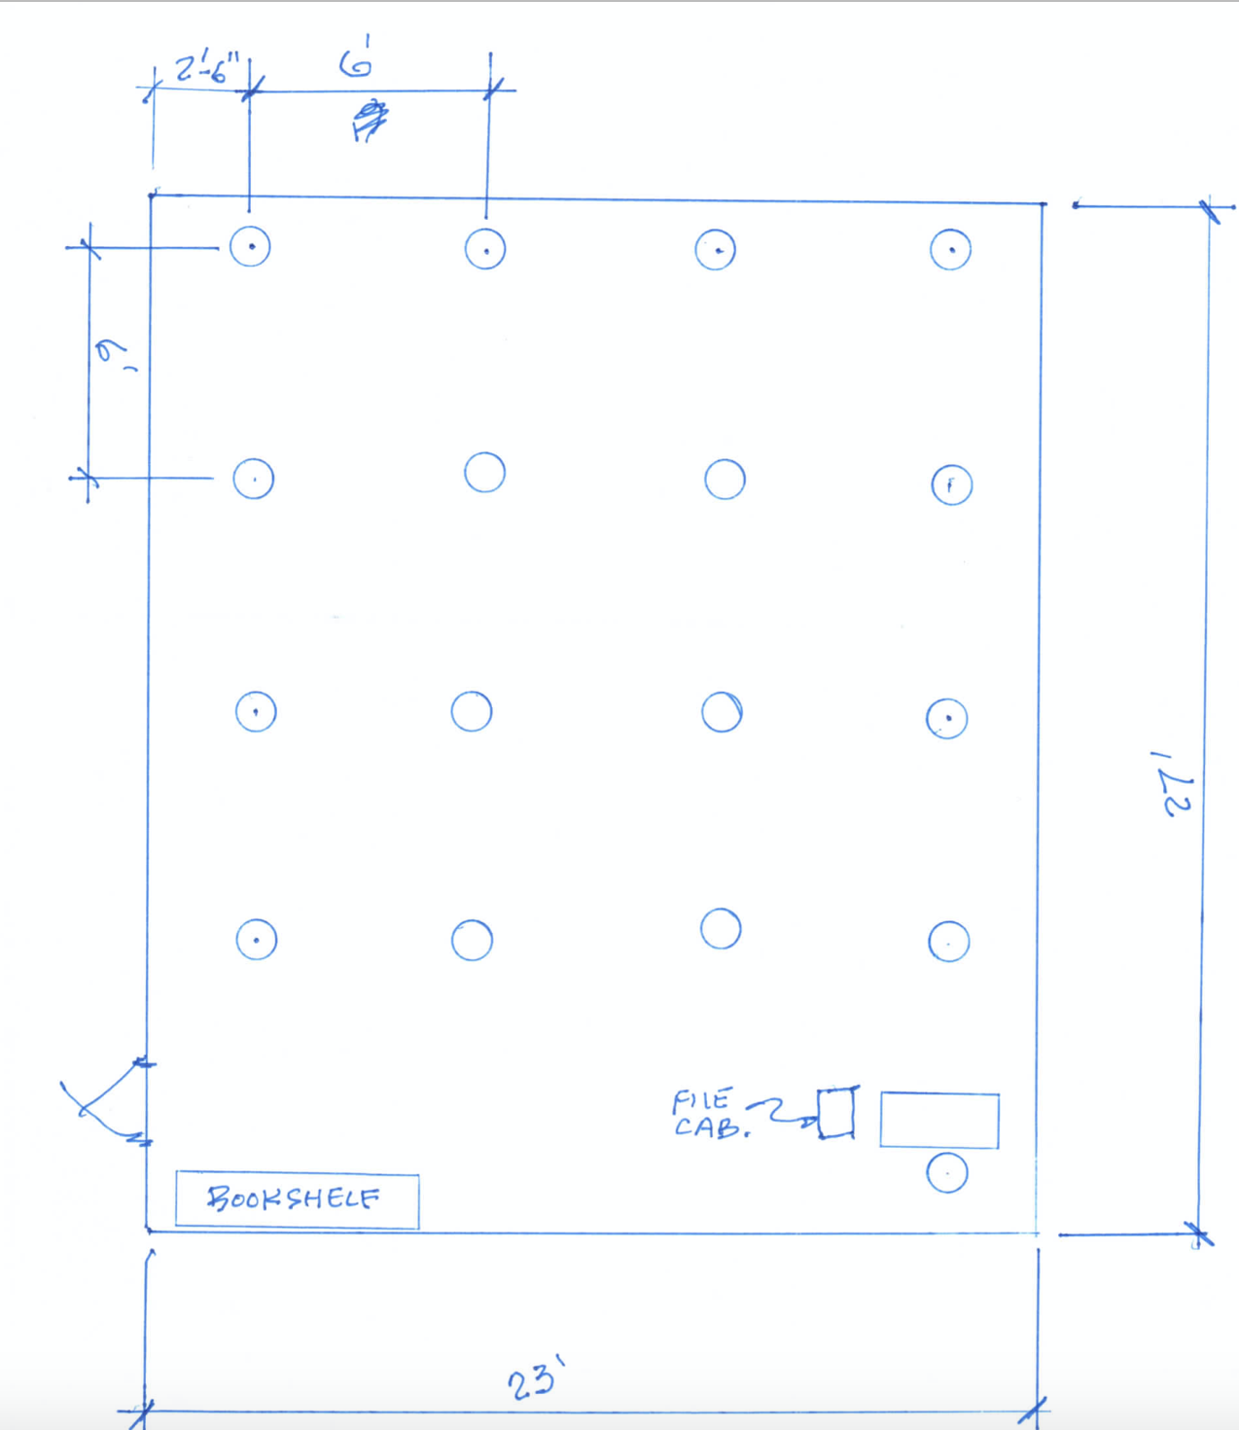
Physical distancing requirements

Slide 18
Option 1
Option 1. Hybrid In-Person & Remote Learning: Students will engage in some in-person learning coupled with remote learning.
Part-Time in School, part-time E-remote learning for all students
Daily virtual instruction will be connected to each classroom daily as an improved structure for the E-remote learning program.
Groups of Students | Monday | Tuesday | Wednesday | Thursday | Friday
Group A | In-Person | Remote | In-Person | Remote | In-Person
Group B | Remote | In-Person | Remote | In-Person | Remote

Slide 19
Option 2
Option 2. Hybrid In-Person & Remote Learning: Students will engage in some in-person learning coupled with remote learning.
Part-Time in School for one week and the following week in E-Remote learning.
Daily virtual instruction will be connected to each classroom daily as an improved structure for the E-remote learning program.
Groups of Students | Week 1 |  |  |  |  | Week 2
 | Monday | Tuesday | Wednesday | Thursday | Friday | Monday | Tuesday | Wednesday | Thursday | Friday
Group A | In-Person | In-Person | In-Person | In-Person | In-Person | Remote | Remote | Remote | Remote | Remote
Group B | Remote | Remote | Remote | Remote | Remote | In-Person | In-Person | In-Person | In-Person | In-Person

Slide 20
Option 3
Option 3. Full-Time Remote Learning – All students learn remotely
Reasonable accommodations should be provided for individuals that the Centers for Disease Control identifies as having a higher risk for severe illness from COVID-19, including older adults (aged 65 years and older) and individuals with disabilities or serious underlying medical conditions, which may include:
Chronic lung disease or
Asthma (moderate to severe) }
Serious heart conditions
Immunocompromised
Severe obesity (body mass index, or BMI, of 40 or higher)
Diabetes
Chronic kidney disease undergoing dialysis
Liver disease
Medically fragile students with Individualized Education Programs (IEPs)
Students with complex disabilities with Individualized Education Programs (IEPs) }
Students who require accommodations under a Plan in accordance with the Section 504 of the Rehabilitation Act of 1973 (504 Plan).

Slide 21
Special Education
Providing 2 to 3 days of instruction per week
Remote Learning option will be offered if that is what the family desires
Daily virtual instruction will be connected to each classroom daily as an improved structure for the E-remote learning program.
Special needs students attending Out of District Schools may have a different plan compared to the district’s plan.

Slide 22
Safety Precautions for All School Environments
Require vendors to follow EPS recommendations when working in or entering facilities.
Discontinue use of water fountains.
Provide a cleaning frequency chart that addresses COVID-19 concerns.
Request building staff to help with personal space disinfecting procedures

Slide 23
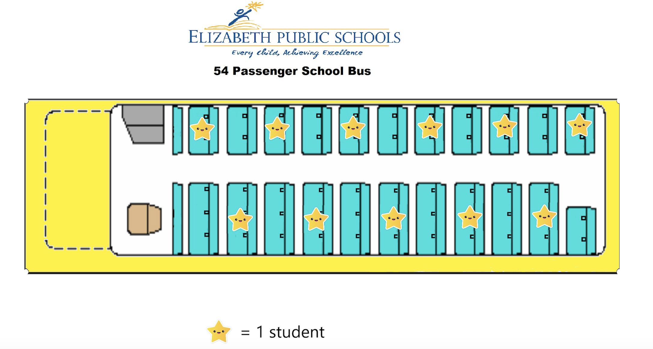
Safety Precautions for Transportation Services
Implement 6 feet distancing on all buses.
Masks must be worn by students and adults
Parents must declare whether students will be virtual or in-person
Require vendors to follow EPS recommendations when operating buses.
Hand Sanitizer installed on buses with addition of routine bus sanitization

Slide 24
Social-Emotional Supports for Students
Social-Emotional Learning needs to be a top priority in all of our EPS classrooms Pk-12.
Identify the students that require additional socio-emotional supports
Make resources available for students, staff and team members
School Counseling and Social Work services (In-Person or in a virtual format)

Slide 25
Future Topics to be discussed
Transportation
Education for at-risk students
Athletics – Phase 2 Guidelines will be issued on July 26, 2020
Recess and Passing Periods
Lunch – Grab and Go
Physical Education
Visitor Management
Extra-curricular Activities

Slide 26
Parent or Guardian Responsibility
Families are asked to communicate their intent to participate in this model by July 15. Parents must declare whether students will be virtual or in-person.
By responding by this date, our district can plan and schedule both the in-person and remote learning.
Teachers will also be surveyed about both in-person and remote learning.

Slide 27
Reopening Together September 2020
JULY 6, 2020

