Slide 1
Title I Annual Meeting for Parents & Families 2025 - 2026 SY
Highland Renaissance Academy
Date: 9/18/2025

Slide 2


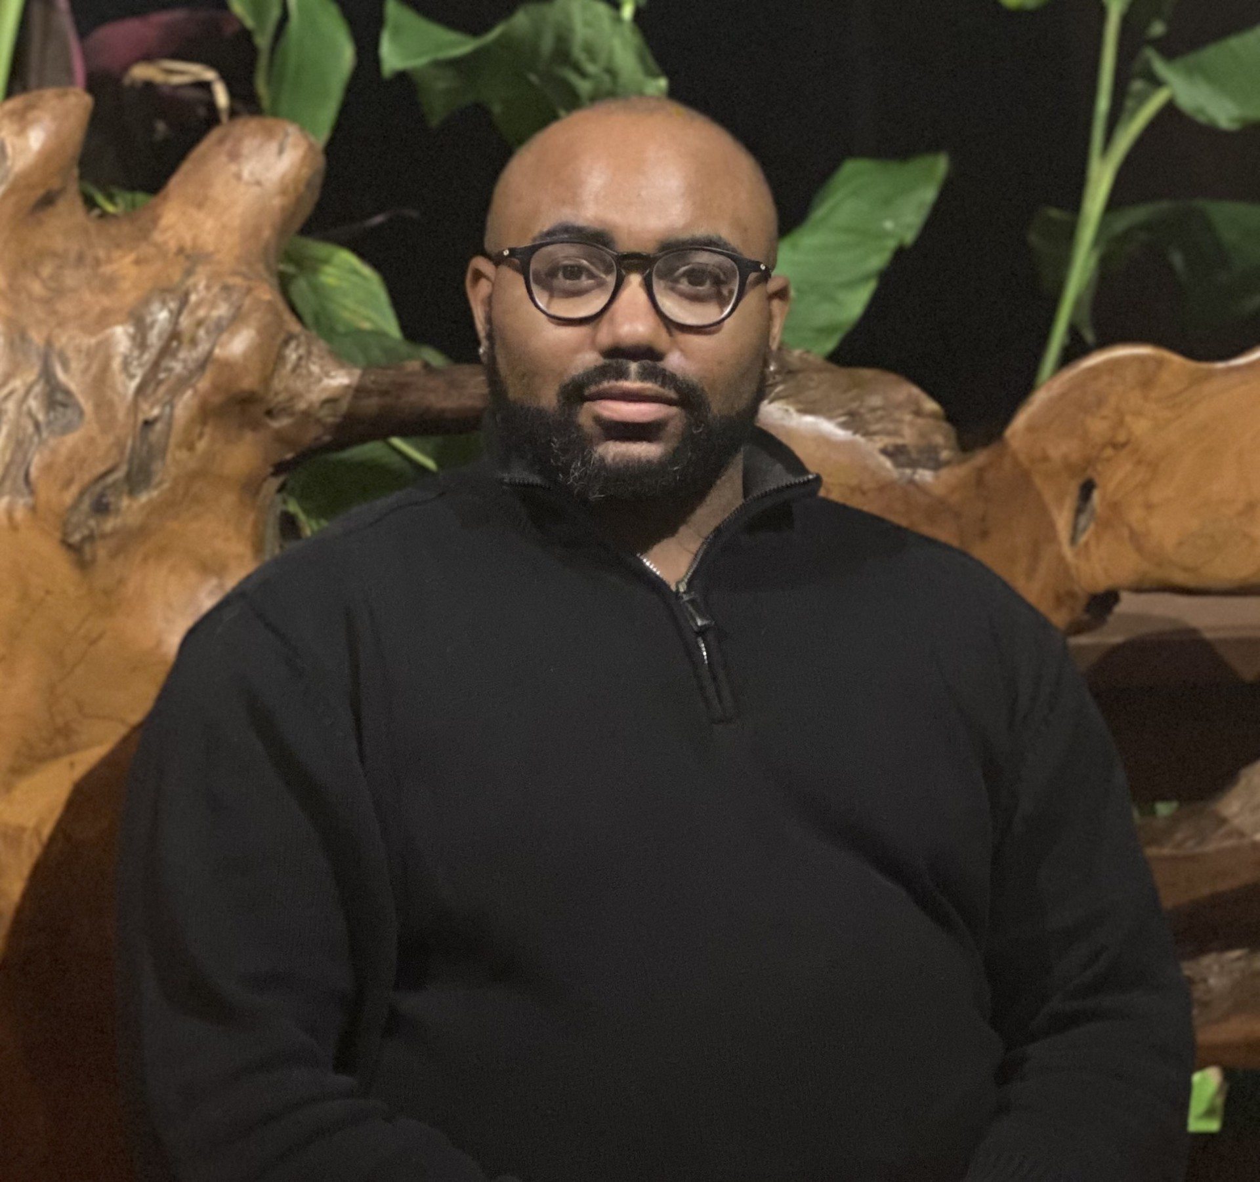
Welcome: 25-26 Admin Team
Imani Harper Principal
Layla Williams Assistant Principal
Michael Jones
Dean of Students

Slide 3
Why are we here?
The Elementary and Secondary Education Act (ESEA), as amended by the Every Student Succeeds Act (ESSA) of 2015, requires that each Title I School hold an Annual Meeting for parents/families/community members for the purpose of:
Informing you of your school’s participation in Title I services
Explaining the requirements of Title I, Part A
Explaining your rights as parents to be engaged

Slide 4
Meeting Overview
What is a Title I school and what it means to be a Title I school
Required Set-Aside for parent and family engagement
The CMS Parent and Family Engagement Policy
How the annual evaluation of the CMS Parent and Family Engagement Policy is conducted
School Parent and Family Engagement Policy
School Improvement Plan (SIP) in NCStar
School-Parent Compact
How to request the qualifications of my child’s teacher(s)
How parents will be notified if my child is taught by a teacher who is not deemed to be qualified by teacher licensing standards in the North Carolina ESSA Accountability Plan

Slide 5
What is a Title I school?
Title I is the largest federally funded educational program. A Title I school is a school receiving federal funds for students. The basic principle of Title I is that schools with large concentrations of low-income students receive supplemental funds to meet students’ educational goals.

Slide 6
What does it mean to be a Title I School?
Being a Title I school means receiving federal funding (Title I dollars) to supplement the school’s existing programs. These dollars are used for the following:
Identifying students experiencing academic difficulties and providing timely assistance to help students meet the state’s challenging content standards.
Purchasing supplemental staff/programs/materials/supplies
Conducting parent and family engagement meetings/trainings/activities
Recruiting/Hiring/Retaining Highly-Qualified Teachers
Being a Title I school also means encouraging ongoing parent and family engagement and advocating for parents’ rights

Slide 7
How are Title I funds used in our school?
Please edit based on your school’s allocation of funds
Teacher Leader Pathway - use of EIT’s and MCL2
Parent Involvement
Professional Development for staff
Substitutes for staff professional development
Supplies and materials (books, technology)
Positions: BMT & Interpreter

Slide 8
What is the 1% set-aside and how are parents involved?
Any Local Education Agency (LEA) or school district with a Title I Allocation exceeding $500,000 is required by law to set aside 1% of the Title I allocation for parent and family engagement.
Of that 1%, 10% may be reserved at the LEA/district level for system-wide initiatives related to parent and family engagement. The remaining 90% must be allocated to all Title I schools in the district. In CMS, each Title I school receives its portion of the 90% to implement school-level parent and family engagement activities and events
Title I parents have the right to provide input into decisions regarding how this money is spent. This process is completed through the School Improvement Team (SIT)

Slide 9
Parent and Family Engagement Allocation
How we are spending our Title I funds:
Examples
1 Title I Night & Celebration
2 EOG Night

Slide 10
What is the CMS Parent and Family Engagement Policy?
This policy addresses how the district or LEA will implement the parent and family engagement requirements of the Every Student Succeeds Act (ESSA). It includes the following:
The district’s expectations for parents
How CMS will engage parents in decision-making
How the district will work to build the schools’ and parents’ capacities in the implementation of effective parent and family engagement activities to improve student academic achievement
Parents and families in Title I schools have the right to be engaged in the review/evaluation of this annual policy

Slide 11
What is the School Improvement Plan/NCStar Plan?
The School Improvement Plan (SIP) is created in an online platform called NCStar and includes:
A Comprehensive Needs Assessment
Goals and Strategies to Address Academic Needs of Students
Professional Development Needs
Coordination of Resources and Comprehensive Budget
The School’s Parent and Family Engagement Goals
Parents of students at Title I schools have the right to be engaged in the development of this plan
Access the SIP on our website: https://highlandrenaissancees.cmsk12.org/our-school/school-improvement
User Name: guest7101
Password: guests7101

Slide 12
What is included in the School’s Parent and Family Engagement Policy?
This policy addresses how the school will implement the parent and family engagement requirements of the Every Student Succeeds Act (ESSA). Components include the following:
How parents can be engaged in decision-making and activities
How parent and family engagement funds are being used
How information and training will be provided to parents
How the school will build capacity in parents and staff for strong parent and family engagement
Parents of students at Title I schools have the right to be engaged in the development of the school’s Parent and Family Engagement Policy

Slide 13
What is the School Compact?
The compact is a commitment from the school, the parent/family, and the student, to share in the responsibility for improved academic achievement
Parents and families of students in Title I schools have the right to be involved in the revision/review of the School Compact

Slide 14
Who are the parent leaders at my school?
Name Email address
Raine Gordon rainegordon21@gmail.com
Ardine Harley III ardineharleyiii@gmail.com
Rosibel Jarquin merlinjarquin2009@gmail.com
Laterria Lassiter laterria.ece.professional@gmail.com
Victoria Nelson vcbarksdale29@gmail.com
Interpreter: Hector Munguia
School’s Title I Compliance Contact: Layla Williams

Slide 15
Volunteer Opportunities
Join parent leadership groups such as PTA, PTSA, PTSA, booster clubs, etc.
Become a member of the School Improvement Team and/or attend meetings
Volunteer to contact other parents/families regarding important school information
Attend academic events occurring at your child’s school
Participate in opportunities that support school activities
Support Teacher appreciation activities
Assist with class parties
Attend parent conferences
Tutor students
Please call Sharon Clifton or email sharond.clifton@cms.k12.nc.us to- learn about volunteer opportunities

Slide 16
How do I request the qualifications of my child’s teachers?
Title I parents and families have the right to request the qualifications of their child’s teachers. The “Parent Right to Know” letter is linked to the school’s website and contains the form to request the teacher’s qualifications
School Website: https://highlandrenaissancees.cmsk12.org/
Requests should be completed by the school within 30 days.

Slide 17
How will I be notified if my child is taught by a teacher who is not Highly-Qualified?
Being Highly Qualified in NC means you have successfully passed the licensure exams required or received alternate licensure in a way set out by NC law.
Parents and families are notified if teachers do not meet ESSA’s requirements for Highly-Qualified
Parents may request information on teacher qualifications in writing

Slide 18

Parent Concerns or Questions?
Questions: Call office at 980-343-5511
Concerns: Contact office, share your child’s name, grade and request a time to speak with your child’s grade level administrator.
Principal Harper: EC PK, PK, 1st
AP Williams: 2nd, 3rd, 4th
Dean Jones: Kindergarten, 5th, K-5 Extensions

Slide 19
North Carolina Standard Course of Study
The full North Carolina Standard Course of Study (NCSCOS) can be viewed using the link below:
http://www.dpi.state.nc.us/curriculum/
For more information about the NCSCOS and professional development at your school site, please reach out to Principal Harper.

Slide 20
Some Schools Have an Additional Designation
NCDPI will notify schools as to whether they have a special designation of ATSI or CSI in November of each year. You can skip this slide and the next two until notification from NCDPI or if not relevant to your school.
The Every School Succeeds Act (ESSA) requires each state to have a plan to measure student achievement annually
The plan outlines how each state is being held accountable
Title I schools can receive an additional designation based upon state End-of-Grade or End-of-Course assessments
Link to the North Carolina State Plan under ESSA:
http://www.ncpublicschools.org/succeeds/

Slide 21
Additional School Designations
Additional Targeted Support and Improvement (ATSI)- subgroup gap (if applicable)
Comprehensive Support and Improvement (CSI)-lowest performing 5% of schools or low graduation rate (if applicable)
Schools with these designations remain in this status for 3 years

Slide 22
Proud Points
Examples:
____________ School consistently builds a culture of caring, support, and focus on academic growth.
_________ School has strong community partnerships with ___ community and faith-based organization. They provide ____________ support for our students and staff!

Slide 23
Thank you for being here!
Charlotte
-
Mecklenburg Schools
Time and Effort Certification Report
(YEAR)
Requirement under the federal Office of Management and Budget (OMB)2 CFR Part 225
-
Cost Principles for State, Local, and Indian Tribal Government (Uniform Grant Guidance)
Title I
(PRC 0
50
)
This certification is to be completed semi
-
annually, in
January and July, by employees
Questions? Email laylao.williams@cms.k12.nc.us or call at 980-343-5511
who spend 100% of their time and effort working on one federal program or cost
Objective and whose salary is funded by that federal program. The certification report
periods for 20XX-20XX
are as follows:
January Report
–
Covers July 1, XXXX(
YEAR) through
December 31, XXXX (YEAR)
Jul
y Report
–
Covers January 1, XXXX (YEAR) through June 30, XXXX (YEAR)
I certify that
{Staff Name}
,
worked solely on Title I program activities for the period of
J
uly
1
,
XXXX (
YEAR) to
December 31, XXXX (YEAR)
.
EMP ID
Job Code
Position
Last Name
First Name
Signature of
Staff
: _________________
______________________
Date: _
________________
Signature of
Supervisor
/Director
: _________________
_____
Date:
_______
__________
At the end of each report period, January and July, the original of the completed certification
form must be sent to the
Title I
Executive
Directo
r’s office where it will be maintained on file
for a period of five years. The principal and/or supervisor should
s
a signed copy of this
document
into the school or department’s
compliance folder on Google Drive
. It is not
necessary to send a copy of
this form to the Finance Department.

