Slide 1

Charles County
Public Schools
School Improvement Plan
Cycle 1
Gale-Bailey
Elementary School

Slide 2
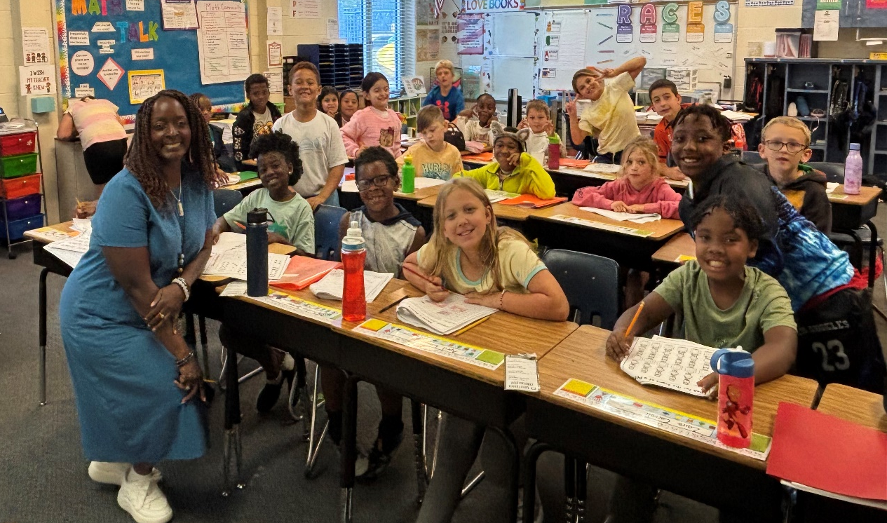
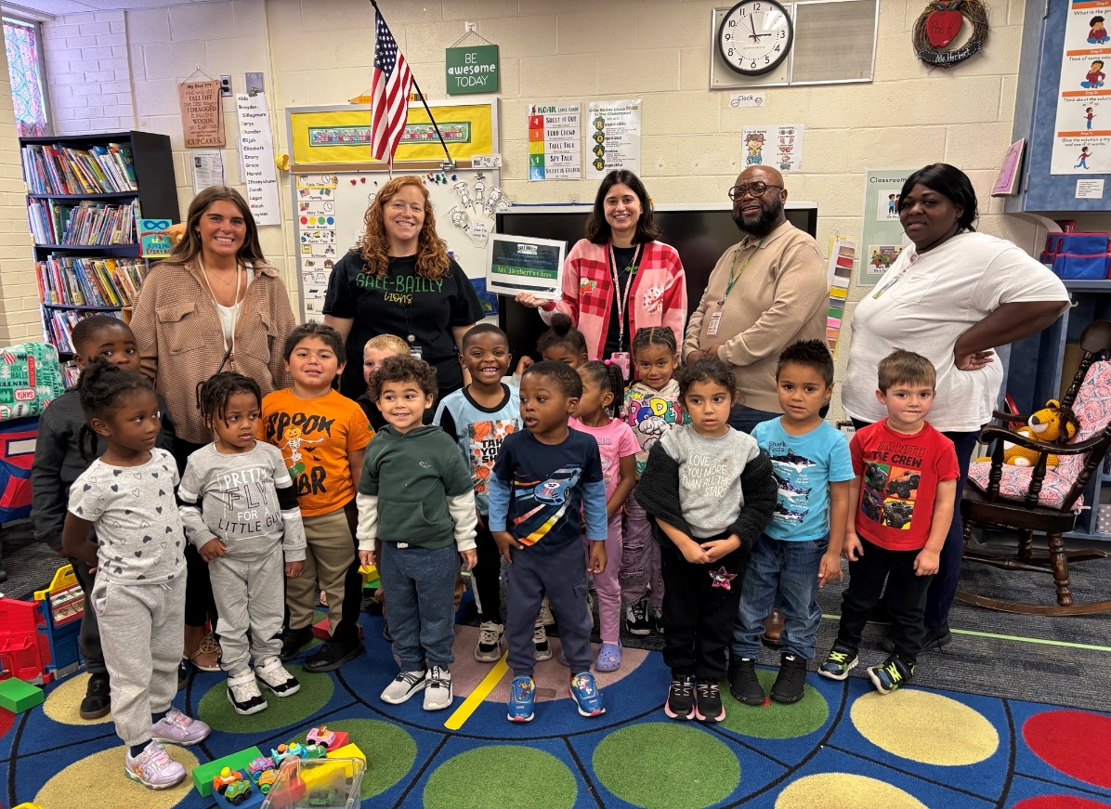
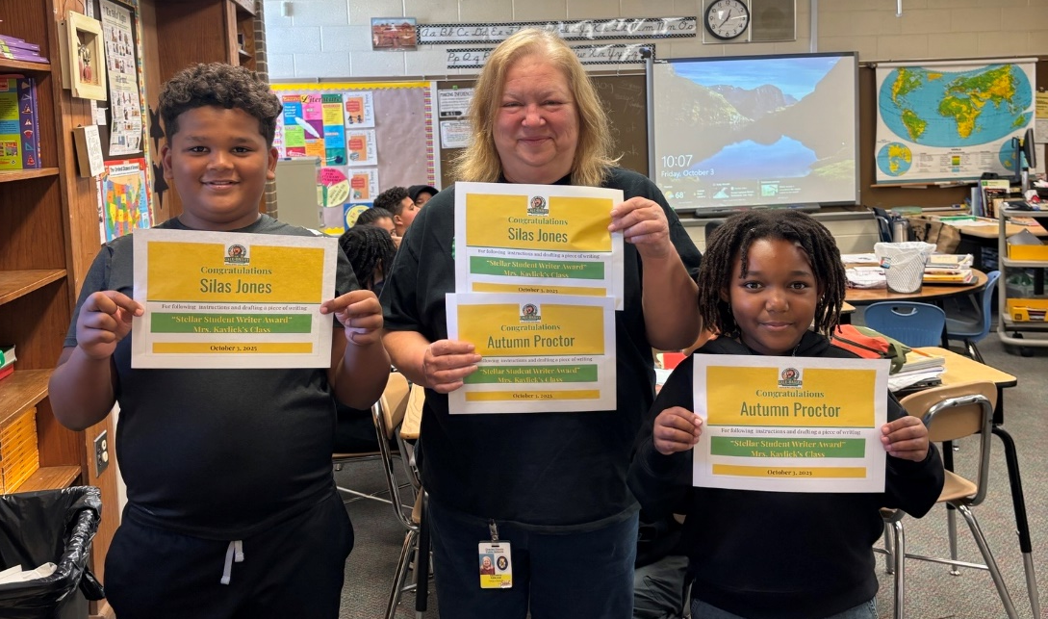

Gale-Bailey ES
GBES Morning Mantra.
“I AM SOMEBODY”
by Rita F. Pierson
I am SOMEBODY.
I was somebody when I came.
I'll be a better somebody when I leave.
I am powerful, and I am strong.
I DESERVE the education that I get here.
I have things to do, people to impress, and places to go."
At Gale-Bailey we have… "Strong Minds. Brave Hearts. & Lion Pride". Hear Us Roar.

Slide 3

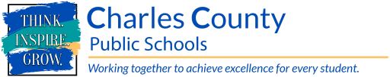
Why Continuous School Improvement
School Improvement is the blueprint schools use to guide decision – making to impact important markers of successful schools - student achievement, absenteeism, teacher retention and development, school climate and culture, parental involvement, resource allocations, and systems and structures (Grissom, Egalite, & Lindsay, 2021).
Each school develops a School Improvement Plan (SIP). The SIP identifies priority goals, instructional and culture strategies, and supports schools will implement to raise student achievement and prepare students for college and career pathways.
This work starts at the elementary school and continues through high school.

Slide 4
Why Continuous School Improvement
Continuous improvement is based upon three core principles:
Change takes time and involves collective effort (Bryk et al., 2015; Katz, Earl, & Jaafar, 2009).
Change is context-specific and therefore requires constant adaptation, data collection, and learning (Bryk et al., 2015).
Focusing on a series of small changes, combined with ongoing evidence collection and review, can lead to large-scale change (Derrick-Mills, Sandstrom, Pettijohn, Fyffe, & Koulish, 2014; Hawley, 2006; Park, Hironaka, Carver, & Nordstrum, 2013; Snow, Dismuke, Zenkert, & Loffer, 2017).

Slide 5
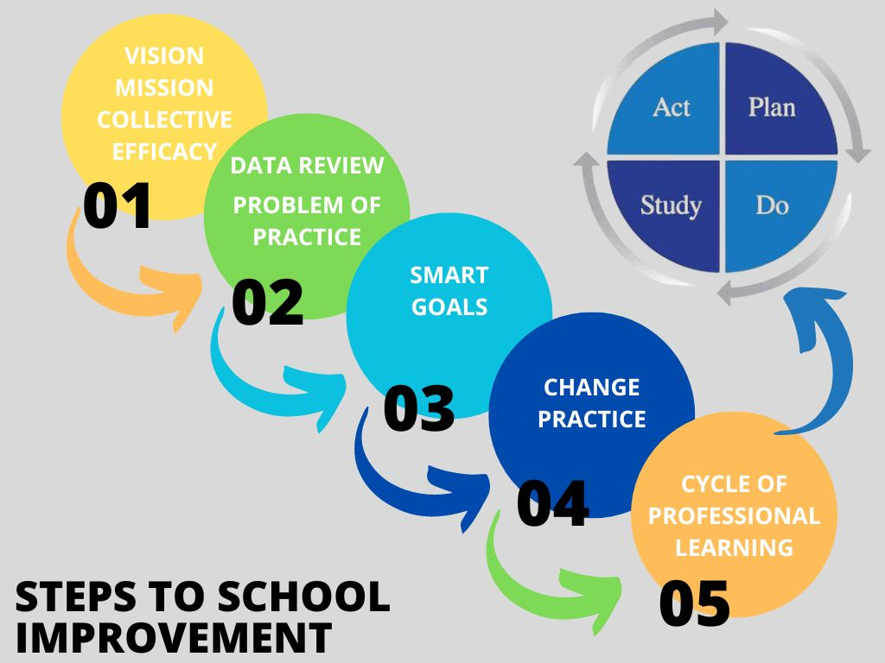

Slide 6
Gale-Bailey’s
Vision, Misson, Collective Efficacy Statements
Vision: Our vision is “To create an inclusive twenty-first century caring community of unique learners through clear communication, creativity, and critical thinking.”
Mission: The mission of Gale-Bailey is to prepare every student to become effective leaders in a global society. We will make an impact on students by operating in integrity, motivation, positivity, accountability, collaboration, and transparency. We will be equitable, student-centered, celebrating diversity, promoting teamwork, and using all the tools and strategies needed to be 21 Century leaders.

Slide 7
Gale-Bailey’s
Collective Efficacy Statements
Collective Efficacy Statement:
Through the continuous school improvement process, Gale-Bailey will create a positive, collaborative environment that has a clear, concise focus. Collaboratively, we will demonstrate quality implementation of high expectations of our students. Through shared leadership, we will work together to implement quality teaching and learning within our school to best support our students.

Slide 8
Area of Focus
Area of Focus Statement: At Gale-Bailey Elementary, we are committed to strengthening teaching and learning in both reading and mathematics to ensure that every student reaches their full potential. Our focus is on providing well-designed lessons, differentiated instruction, and high-quality learning experiences that meet the needs of all learners. By setting clear expectations and increasing students’ exposure to a variety of problem types and test-taking strategies, we aim to build confidence, deepen understanding, and promote academic success for every child.
Dear Parents and Guardians,
We are excited to share our continued commitment to strengthening teaching and learning in both Reading and Mathematics at Gale-Bailey Elementary. Our goal is to ensure that every student reaches their full potential and develops the skills needed to succeed as confident, lifelong learners. To achieve this, our school is focusing on the following key areas:
Well-designed lessons that actively engage and challenge students.
Differentiated instruction that meets the diverse needs of all learners.
High-quality instructional programs that support consistent, standards-aligned teaching and learning.
Increased exposure to problem types and test-taking strategies to build student confidence and deepen understanding.
By prioritizing these areas, we are creating a learning environment where every child can thrive academically and socially. With your continued partnership, we can work together to help our students grow, achieve, and shine.
Thank you for your ongoing support in making Gale-Bailey Elementary a place where excellence and care go hand in hand.
Sincerely,
Gale-Bailey Elementary School

Slide 9
Data Summary
In the chart, please include five concise data points that identify the areas of need.
English Language Arts Data Overview | Mathematics Data Overview
4th Grade went from 39% proficient to 47% proficient | 4th Grade went from 33% proficient to 25% proficient
5th Grade went from 51% proficient to 41% proficient | 5th Grade went from 32% proficient to 19% proficient
3rd grade is outperforming 4th and 5th grade | 3rd grade is outperforming 4th and 5th grade
50% of our students were proficient on writing | 3rd graders achieved in “exceeding” in math for the first time
Students at GBES are doing better in reading than in Math. Target in Reading was originally 49 % | Students at GBES are doing worse in Math than in reading. Target in Math was originally 28 %

Slide 10
School Problem of Practice & Smart Goals
ELA Smart Goal
By June 2026, Gale-Bailey Elementary will increase the percentage of 4th and 5th grade students meeting or exceeding proficiency in ELA on the MCAP Reading Assessment from 49% to 53%, by providing consistent standards-aligned instruction, clear expectations, and regular exposure to test-taking strategies and problem types.
This goal equates to a 4% increase above SY 24/25’s targeted goal.
Mathematics Smart Goal
By June 2026, Gale-Bailey Elementary will increase the percentage of 4th and 5th grade students meeting or exceeding proficiency in MATH on the MCAP Assessment from 28% to 32%, by providing consistent standards-aligned instruction, clear expectations, and regular exposure to test-taking strategies and problem types.
This goal equates to a 4% increase above SY 24/25’s targeted goal

Slide 11
Cycle 1: Change Practice & Cycle of Professional Learning
Change in Practice Statement: To increase the percentage of 4th and 5th grade students meeting or exceeding proficiency on the MCAP Math Assessment from 28% to 32% by June 2026, Gale-Bailey Elementary will implement consistent, standards-aligned instruction, establish clear learning and performance expectations, and provide students with regular opportunities to practice a variety of test-taking strategies and problem types.
This approach will ensure targeted support for all students and drive a 4% increase above the SY 24/25 goal. Staff will focus on maintaining clear instructional expectations, using formative assessments and data-driven discussions to adjust instruction in real time. Through these intentional practices, Gale-Bailey will foster greater consistency across classrooms and increase student confidence, leading to measurable gains in Math proficiency by June 2026.

Slide 12
Cycle 1: Change Practice & Cycle of Professional Learning
Cycle of Professional Learning # 1 Overview (Math)
This cycle of professional learning is designed to equip teachers with the strategies and tools needed to improve student achievement in 4th and 5th grade math. The focus is on increasing the percentage of students meeting or exceeding proficiency on the MCAP Math Assessment from 28% to 32% by June 2026.
During this cycle, teachers will:
Implement consistent, standards-aligned instruction across all classrooms to ensure every student has access to high-quality math learning experiences.
Establish and communicate clear learning and performance expectations so students understand the goals and criteria for success.
Integrate formative assessments to monitor student understanding and inform instructional decisions in real time.
Engage in data-driven discussions to identify trends, address gaps, and adjust instruction to meet students’ individual needs.
Provide regular opportunities to practice test-taking strategies and a variety of problem types, building student confidence and familiarity with the MCAP format.
Collaborate and reflect regularly to maintain instructional consistency, share effective practices, and continuously refine teaching strategies.
Through these steps, Gale-Bailey Elementary will create a culture of high expectations and continuous improvement, leading to measurable gains in math proficiency and student confidence by June 2026.

Slide 13
Cycle 1: Change Practice & Cycle of Professional Learning
Change Practice: To achieve our ELA proficiency goal, Gale-Bailey Elementary will strengthen instructional practices by:
Ensuring that all teachers consistently deliver standards-aligned, high-quality instruction that promotes reading comprehension and critical thinking. Teachers will engage in collaborative planning to design well-structured lessons, implement differentiated strategies to meet the diverse needs of learners, and provide students with regular opportunities to engage with rigorous texts and varied question types that mirror the MCAP assessment. Staff will focus on maintaining clear instructional expectations, using formative assessments and data-driven discussions to adjust instruction in real time. Through these intentional practices, Gale-Bailey will foster greater consistency across classrooms and increase student confidence, leading to measurable gains in ELA proficiency by June 2026.

Slide 14
Cycle 1: Change Practice & Cycle of Professional Learning
Cycle of Professional Learning # 1 Overview (Reading)
This cycle of professional learning is designed to equip teachers with the strategies and tools needed to improve student achievement in 4th and 5th grade ELA. The focus is on increasing the percentage of students meeting or exceeding proficiency on the MCAP Reading Assessment from 49% to 53% by June 2026.
During this cycle, teachers will:
Implement consistent, standards-aligned instruction across all classrooms to ensure every student has access to high-quality math learning experiences.
Establish and communicate clear learning and performance expectations so students understand the goals and criteria for success.
Integrate formative assessments to monitor student understanding and inform instructional decisions in real time.
Engage in data-driven discussions to identify trends, address gaps, and adjust instruction to meet students’ individual needs.
Provide regular opportunities to practice test-taking strategies and a variety of problem types, building student confidence and familiarity with the MCAP format.
Collaborate and reflect regularly to maintain instructional consistency, share effective practices, and continuously refine teaching strategies.
Through these steps, Gale-Bailey Elementary will create a culture of high expectations and continuous improvement, leading to measurable gains in reading proficiency and student confidence by June 2026.

Slide 15
Cycle 1: Anticipated Outcomes
Anticipated Outcomes (Educators) | Anticipated Outcomes (Students)
Improved Instructional Consistency: Teachers will consistently deliver standards-aligned instruction across all 4th and 5th grade classrooms. | Increased Reading & Math Proficiency: Students will demonstrate growth in reading skills, reflected in a rise from 49% to 53% meeting or exceeding proficiency on the MCAP Reading Assessment by June 2026. Students will demonstrate growth in Math skills, reflected in a rise from 28% to 32% meeting or exceeding proficiency on the MCAP Math Assessment by June 2026.
Clarity in Learning Goals: Teachers will effectively communicate learning and performance expectations, ensuring students understand what success looks like. | Clear Understanding of Expectations: Students will understand the learning goals and performance criteria, leading to greater engagement and ownership of their learning.
Data-Informed Decision Making: Teachers will use formative assessment data to identify learning gaps, adjust instruction in real time, and differentiate support for individual student needs. | Improved Academic Confidence: Regular practice with a variety of reading problems and test-taking strategies will increase students’ confidence and reduce anxiety around assessments.
Enhanced Collaboration: Teachers will actively engage in data-driven discussions and reflective practices to share strategies, monitor progress, and continuously refine teaching methods. | Enhanced Learning Opportunities: Students will experience consistent, high-quality instruction and targeted support to address individual learning needs.
Confidence in Test Preparation: Teachers will be equipped with strategies to prepare students for the MCAP Reading & Math Assessment, including targeted practice on problem types and test-taking skills. | Active Participation in Learning: Students will engage in meaningful classroom discussions and activities, applying reading strategies and critical thinking skills in authentic contexts.

Slide 16
Cycle 1: Outcomes
Cycle Areas of Growth | Cycle Celebrations
TBD by end of cycle 1. | TBD by end of cycle 1.
Next Steps
TBD

Slide 17
Charles County
Public Schools
Culture & Climate Cycle 1
Gale-Bailey ES

Slide 18
Culture & Climate Overview
Data Overview | Gale-Bailey had 78 total referrals last school year. 52 minor and 26 major.​ Of those referrals, the most happened in the month of September (25).​ Of the total referrals, the majority were related to student to student conflict​ Student to student conflict is considered physical attacks, fighting, and/or bulling and harassment​ There were a total of 29 student conflict referrals out of 78. That totals 37% of our referrals were student to student conflict related.​
Culture & Climate Area of Focus | At Gale-Bailey Elementary, we are committed to creating a safe and supportive school environment where all students feel respected and valued. Currently, a significant number of behavior referrals (29 out of 78) are related to student-to-student conflicts. This indicates a need to strengthen students’ social skills, conflict resolution strategies, and positive interactions with their peers. Our focus is to improve relationships among students (Student-Student Relationships), reduce conflicts, and foster a culture of respect, collaboration, and kindness throughout the school.

Slide 19
Culture & Climate Overview
Smart Goal | By the end of the 2025–2026 school year, Gale-Bailey Elementary will improve school culture and climate by identifying the root causes of negative behaviors using a fishbone diagram and implementing targeted interventions to address them.​ ​ Measurable: Success will be measured by a 15% reduction in behavior referrals and a 10% increase in positive behavior recognition points logged in our PBIS system.​ ​ Achievable: PBIS leaders, Ms. Thomas and Ms. Luskey, will lead staff in creating fishbone diagrams for the top three behavioral challenges, then develop action plans for each.​ ​ Relevant: Addressing the root causes of behavior aligns with our PBIS framework and promotes a safe, positive, and inclusive school environment for all students.​ ​ Time-Bound: Fishbone diagrams will be completed and shared with staff by December 2025, and interventions will be fully implemented by May 2026, with data reviewed monthly.​

Slide 20
Action Steps
1 | New implementation of PBIS/MTSS strategies to promote positive behavior for our school community​ addressing student conflict and mediating conflict resolution techniques​
2 | Refer students to external service providers to help support the mental health needs of our students​
3 | Implement tier II behavioral interventions to support social emotional and behavioral regulation​.
4 | Identify and meet with weekly boy’s club (3-5)​ Counselor check-ins and referrals to mental health services

Slide 21
Culture & Climate Cycle 1: Outcomes
Cycle Areas of Growth | Cycle Celebrations
TBD in Nov. Cycle 2 (Jan 5– March 6) | TBD in Nov. Cycle 2 (Jan 5– March 6)
Next Steps
TBD by end of cycle 1.
Cycle 2 (Jan 5– March 6)

Slide 22

Thank
You For Reviewing our plan!
Working Together To Achieve Excellence For Every Student . . .
We Appreciate Your Partnership!

