Slide 1

Senior SEMINAR
Class of 2026
Notes:
Are your classroom colors different than what you see in this template? That’s OK! Click on Design -> Variants (the down arrow) -> Pick the color scheme that works for you!
Feel free to change any “You will…” and “I will…” statements to ensure they align with your classroom procedures and rules!

Slide 2
Graduation Requirements
Language Arts Math Science Social Studies Fine Arts Physical Education (HOPE) Total Credits GPA *World Language | 4 Credits 4 Credits (Algebra 1 and Geometry Required) 3 Credits (Biology Required) 3 Credits (US Govt, Econ, US History, World History) 1 Credit 1 Credit 24 Credits 2.0+ Unweighted 2 Credits for Bright Futures and 4 year Colleges/Universities

Slide 3
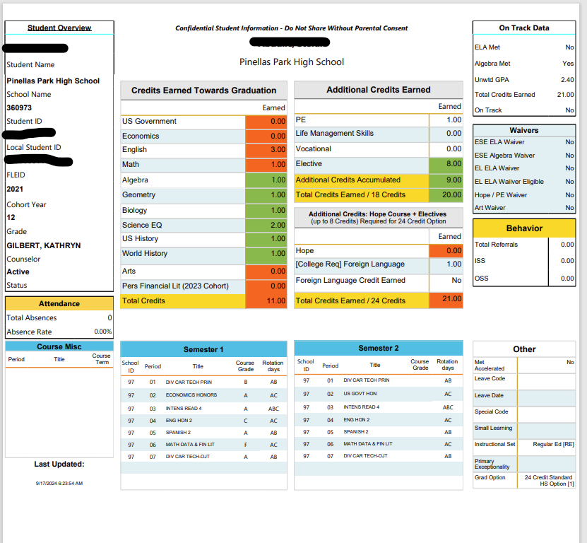
GPA 2.0 UNweighted

Slide 4
Graduation Requirements
Statewide Assessments (**c/o 2026 only)
Students MUST Pass: | Students MUST Participate In:
Grade 10 FSA ELA Or earn one of the following concordant scores: 480 SAT Reading and Writing** 18 ACT English and Reading Subtests Average 36 CLT Verbal and Grammar section sum** Algebra 1 EOC-30% of the final course grade Or earn one of the following concordant scores: 430 on the PSAT math 420 on the SAT math 16 on the ACT math 11 on CLT qualitative math** | Geometry EOC 30% of the final course grade Biology 1 30% of the final course grade US History 30% of the final course grade

Slide 5
Upcoming testing opportunities
in-school testing DATES:
SEPTEMBER 18th – CLT (ALL STUDENTS WHO NEED A CONCORDANT SCORE FOR GRADUATION)
October 1ST - SAT for all seniors (college-REPORTABLE)
October 14th – 15th - in school ACT (all students who need a concordant score for GRADUATION non-college reportable score)
OCTOBER 22nd – CLT (ALL STUDENTS WHO NEED A CONCORDANT SCORE FOR GRADUATION)
November 8TH – CLT (ALL STUDENTS WHO NEED A CONCORDANT SCORE FOR GRADUATION)
ADDITIONAL SATURDAY testing opportunities:
October 18th Saturday ACT (register at www.act.org)
November 8th Saturday SAT (register at www.collegereadiness.collegeboard.org/sat)
December 6th Saturday SAT (register at www.collegereadiness.collegeboard.org/sat)
December 13th Saturday ACT (register at www.act.org)

Slide 6

Post-Secondary planning
Testing
ACT
SAT
SAT and ACT fee waivers are available for students on Free or Reduced Lunch.
Please see your counselor to obtain a waiver.

Slide 7

Post-Secondary planning
Test Prep
SAT: https://www.khanacademy.org/
ACT: https://academy.act.org/

Slide 8


Post-secondary planning
College and Career Fair
Monday, October 6th
6-7:30pm
Countryside High School

Slide 9

Post-secondary planning
Military
If you plan to enter a branch of the military, reach out to Mr. Hennessy to connect with a recruiter.
The ASVAB will be offered at PPHS on November 4th.

Slide 10

Post-Secondary planning
College APPLICATIONS
Students are using Xello (accessible through Clever) to begin their college application process. They must link Xello with CommonApp to ensure all required school documents are submitted.
College and Career Center – 10/9 - Common App Help from 2-5.

Slide 11
Debt Free SPC Nights
The sessions will cover:
  FAFSA completion support
  Scholarship opportunities
  Community-based funding resources
  Free application assistance for SPC
Dates and Locations:
  Tuesday, November 4th at our St. Petersburg Gibbs Campus
  Thursday, November 6th at our Tarpon Springs Campus
  Wednesday, November 12th at our Clearwater Campus

Slide 12

CLASS OF 2026 INFORMATION
Important Dates
September 26 – Deadline to order Senior Shirt
October 18 - Homecoming Dance
January 30 – Cap and Gown Fee Increases
April 25 – Prom
May 1 – Busch Gardens Grad Nite
Graduation Date and locationto be determined
* Make sure to get your senior portrait with Cady Photography.
*Jostens will be our cap and gown provider.
*More details are on the website and will be announced regularly.
October 17 – Yearbook Price Increase
October 17 – Senior Sunrise Breakfast & Senior Assembly
December 4 – Senior Movie Night
May 1 – Senior Breakfast and Senior Assembly
JOIN SENIOR REMIND Text 81010
LAST NAMES A-G text: @26sena-g
LAST NAMES H-P text: @26senh-p
LAST NAMES Q-Z text: @26senq-z
OVERFLOW (if last name is full) text: @classor26
Also, check the class of 2026 teams page regularly
Senior year is an exciting time and the costs can add, so please think about saving for the things that are most important to you and your family.
See Ms. V in G2 during lunch or after school if you need anything or email verdenskyk@pcsb.org

Slide 13


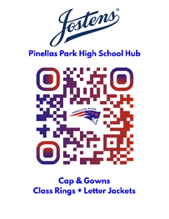
  Cap and Gowns through Jostens
Please order your gown through Jostens, as they are made especially for Pinellas Park with embroidery on both cuffs.
Order your announcements and Senior Apparel by October 3, and they will be distributed to students during lunch on October 27. The cost of gowns increases as we near the big day, so please order early.
The current cost for the basic set is $62.62
Jostens will be on campus for on-site purchases or questions.
Friday, September 26
October 3
October 10

Slide 14






2025-26
Pinellas Park High School
Financial Aid Overview
FALL 2025

Slide 15




Overview
01
What is financial aid?
02
Where to find scholarships and financial aid information
03
Bright Futures Scholarship
04
Free Application for Federal Student Aid (FAFSA)
05
Questions?

Slide 16



What is Financial Aid?
Financial Aid is money
to help you pay for college
Types of Financial Aid
Grants
  Doesn’t have to be repaid
Scholarships
  Usually based on merit, talent or particular area of study
Work-Study Jobs
  Allows you to earn money to pay for school by working part-time
Loans
  Money you borrow and must pay back with interest

Slide 17
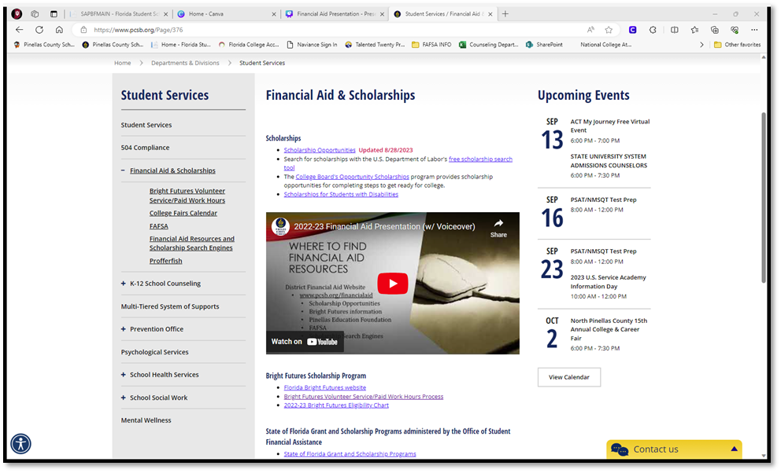

WWW.PCSB.ORG/FINANCIALAID

Slide 18






PINELLAS EDUCATION FOUNDATION TRADITIONAL SENIOR SCHOLARSHIP
www.pinellaseducation.org
Opens September 30th
Online Application
PEF Offers Additional Scholarships
Over 100 different scholarships to more than 250 high school seniors throughout Pinellas County
Scholarship criteria varies from music & drama to science & math and even sports
Pinellas Education also offers other scholarships such as Take Stock in Children and Walker’s Rising Stars

Slide 19

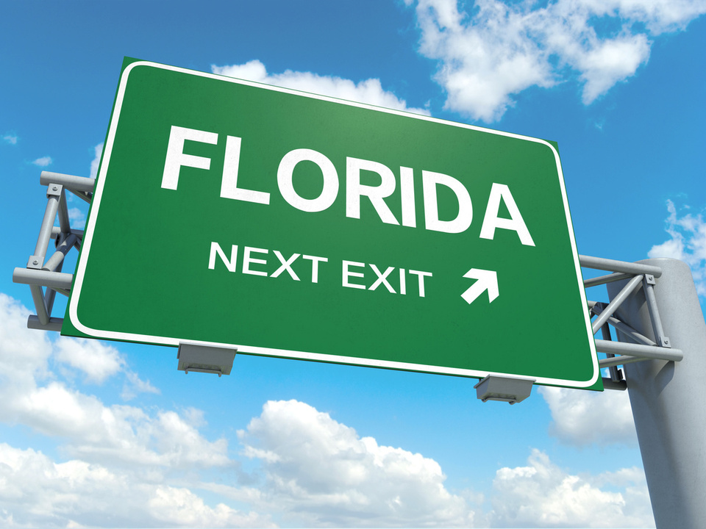
Florida State Scholarship and Grant Website
https://www.floridastudentfinancialaidsg.org
      Fact Sheets for each grant
      & scholarship
      Latest legislative information
      Bright Futures Handbook
      Florida Financial Aid Application

Slide 20




Florida Bright Futures Scholarship Program
Awarded to every student in the
state of Florida who meets all
requirements.
Requires that students complete
the Florida Financial Aid
Application (Opens Oct. 1)
Four levels of
Scholarships

Slide 21






General
Requirements for
Bright Futures
Be a Florida resident and U.S. citizen or eligible non-citizen as determine by the student’s postsecondary institution.
Complete the FFAA no later than August 31 after
high school graduation.
Earn a standard Florida high school diploma, or its equivalent.
Not have been found guilty of, or pled nolo contendre to a felony charge.
Be accepted by, and enroll in a degree or certificate program at, an eligible Florida public or independent postsecondary institution.
Be enrolled for at least six non-remedial semester credit hours(or the equivalent in quarter or clock hour) per term.
If not funded in the academic year immediately following high school graduation, apply within five years of high school graduation to have your award reinstated.

Slide 22







Florida Academic Scholarship (FAS) &
Florida Medallion Scholarship (FMS) Overview
Coursework
Weighted GPA
Test Scores (SAT, ACT, or CLT)
Volunteer or Work Hours

Slide 23



Florida Academic & Medallion- Coursework
Complete the required high school course work:
16 High School Course Credits
    4- English (three must include substantial writing)
    4- Mathematics (at or above the Algebra 1 level)
    3- Natural Sciences (two must have substantial laboratory)
    3- Social Studies
    2- World Languages (sequential, same language)
Coursework aligns with the State University System (SUS)
admissions requirements.

Slide 24



Florida Academic & Medallion- Grade Point Average (GPA)
Achieve the required minimum GPA:
High School Weighted GPA
FAS- 3.50
FMS- 3.00
Unrounded weighted GPA in the 16 college-prep courses listed on the previous slide
AP, Pre-IB, IB, Honors, Pre-AICE, AICE and academic Dual Enrollment are weighted .25 per semester course or .50 per year course

Slide 25

Florida Academic & Medallion-
College Entrance Exams
Florida Academic Scholarship (FAS)
Florida Medallion Scholarship (FMS)
2026 Graduates:
2027 Graduates:
29
24
ACT
OR
OR
2026 Graduates:
2027 Graduates:
95
82
CLT
OR
OR
2026 Graduates:
2027 Graduates:
1330
1190
SAT

Slide 26





Florida Academic and Florida Medallion- College Entrance Exams
The ACT®, CLT®, or SAT® exams may be taken an unlimited number of times through August 31 of the high school graduation year (or through January 31 for mid-year graduates*).
Students will be evaluated based on official test scores from the FDOE repository. To ensure OSFA obtains official test scores:
Ensure demographics on your test registration and high school transcript match; and
*Mid-Year graduates are those students who:
•Graduate midyear and plan to enroll and receive funding at a postsecondary institution in spring.
Must complete FFAA by December 31 of senior year
Request your official single sitting test scores be sent to one of Florida’s public colleges or state universities. CLT & ACT can be sent directly to Bright Futures.

Slide 27





Florida Academic & Medallion-
Volunteer Service and
Paid Work Hours
Combination
of Service
and
Paid Work Hours
FAS 100 Hours
FMS 100 Hours
Service Hours
FAS 100 Hours
FMS 75 Hours
Paid Work Hours
FAS 100 Hours
FMS 100 Hours

Slide 28

Florida Gold Seal CAPE Scholarship (GSC)
Initial Eligibility Requirements
1. Earn a minimum of 5 postsecondary credit hours through eligible CAPE industry certifications that articulate for
college credit.
2. Complete at least 30 volunteer service hours, 100 paid work hours, or a combination that equals a
minimum of 100 total hours.
**75 volunteer hours for Class of 2028 & after

Slide 29
Scholarship Restrictions for Florida Gold Seal CAPE
•Until a student has earned an eligible associate degree, Gold Seal CAPE (GSC) scholarships may only be used at postsecondary institutions that offer an applied technology diploma, technical degree education program (associate in applied science or associate in science), or a career certificate program.
•Upon completion of an eligible associate degree program, a GSC Scholar may also receive an award for a maximum of 60 credit hours toward an eligible baccalaureate degree.

Slide 30







Florida Gold Seal Vocational Scholarship (GSV) Initial Eligibility Requirements
Achieve the required weighted 3.0 GPA
in the non-elective high school courses,
01
Completes at least 3 full credits in
Career and Technical Education,
02
03
Achieve the required minimum 3.5
unweighted GPA in the career education courses,
Complete 30 service hours, 100 work hours,
or a combination of 100 hours (75 volunteer
hours for class of 2028 & after) and
04
05
Achieve the required minimum scores on one of the college entrance exams outlined on next slide

Slide 31



ACT
Reading 19
English 17
Math 19
Florida Gold Seal Vocational Scholarship-
College Entrance Exams
OR
SAT (March 1, 2024 & After)
Critical Reading: 490
Mathematics: 480
OR
PERT
Reading 106
Writing 103
Math 114

Slide 32


Scholarship Restrictions for Florida Gold Seal Vocational Scholarship
GSV may only be used at postsecondary institutions that offer an applied technology diploma, technical degree education program (associate in applied science or associate in science), or a career certificate program.

Slide 33




Bright Futures
Award Amounts
Florida Academic
Florida Medallion
Gold Seal Vocational & CAPE
100 % Tuition and Fee
75% Tuition and Fees at
75% Tuition and Fees at a public institution; 100% Tuition & Fees for student working on Associate Degree at a Florida Public College
100 % Tuition and Fees at a public institution
Fixed cost per hour based on award level, institution type & credit type
Example: Semester Hour $39-48
Non-public Florida institutions will receive a comparable amount.

Slide 34

What is the FAFSA?
    Free Application for Federal Student Aid (FAFSA)
    Snapshot of your family’s financial picture
    Helps determine your eligibility for federal and state aid as well as some college-base grants and scholarships
    That FAFSA is free!
    Opens October 1st each year
    When you are ready, go to www.studentaid.gov to get started.

Slide 35













What is an FSA ID?
Federal Student Aid Identification
Use to provide your electronic signature
Getting ready- Creating an FSA ID
Create both a Username and Password
Once created, it will be used each year.

Slide 36




Who Needs an FSA ID?
  The student who is applying
  If the student is dependent, one or both parents will need an FSA ID
  When ready to create your ID, go to studentaid.gov and choose Create Account.
      Will need personal email account (cannot use same email as parent)
      Parents who already have FSA ID will use the same one and cannot create a new one.

Slide 37
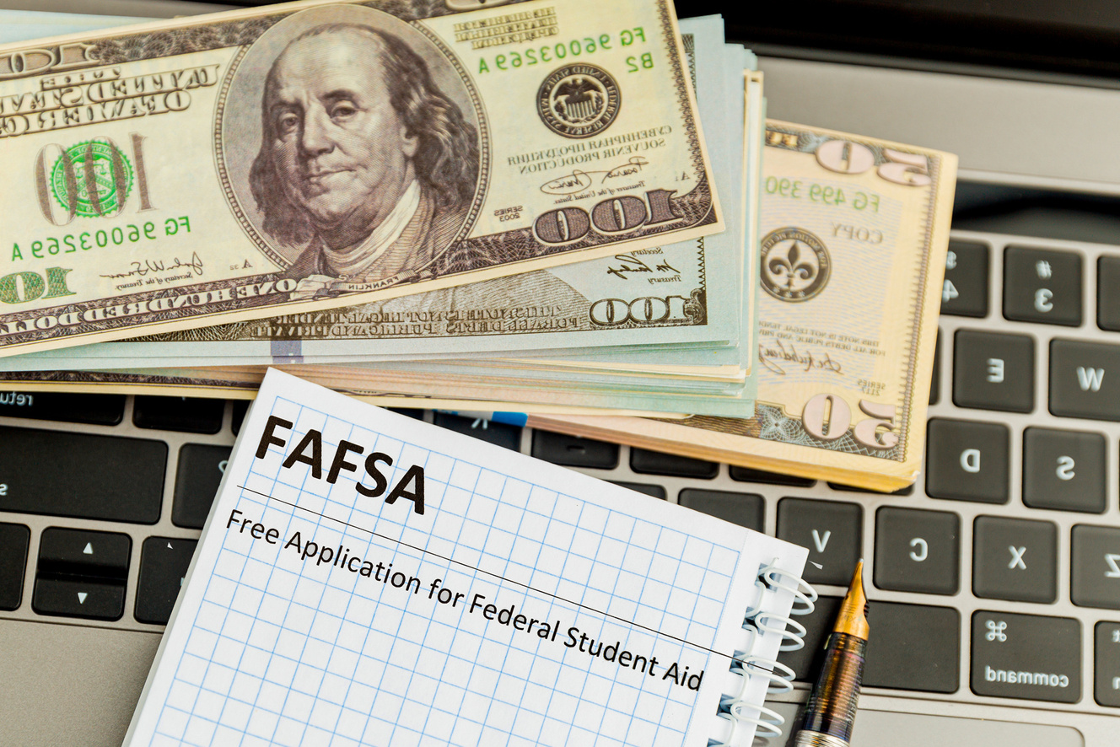
Need Help with Completing the FAFSA?
FAFSA Completion Event
Pinellas Park High School
Media Center
Tuesday, October 21
5:30pm-7:30pm

Slide 38

Questions?
Contact your School Counselor
Mrs. Sprout…..Traditional A - G sproutm@pcsb.org Ms. Pair…..Traditional H - Q pairm@pcsb.org Ms. Wassermann…..First Responders, Traditional R-T wassermannj@pcsb.org Mr. Bishoff…..Criminal Justice, Traditional U - Z bishoffc@pcsb.org Paul Peppers.....Assistant Principal of Curriculum peppersp@pcsb.org

