Slide 1

Tarpon Springs Middle School
Title l Annual Meeting
2024-25
Laura Burge
Title 1 Coordinator
Amber Schmittdiel
Title 1 Administrator

Slide 2

2024-25
Title l Annual Parent Meeting
Tarpon Springs Middle School
September 19th, 2024
5:15 pm
TSMS Cafeteria
Mr. Mason – Principal
Mrs. Schmittdiel – Asst Principal
Ms. Burge – Title 1 Coordinator
Notes:
Evidence: Upload completed presentation and recorded feedback as part of the evidence to support the Annual Meeting Materials. Do not forget the sign-in sheets, and survey/feedback that you receive throughout the meeting.

Slide 3


Data Resources/Consider
Comprehensive Needs Assessment
School Improvement Plan
District Climate Survey (Title l Items)
PM3 Data/Connection to Phase lll
Notes:
Calling out some data sources to get them started…

Slide 4


All About Title l
Title I is the largest federal assistance program for our nation’s schools.
The program serves 99 schools in Pinellas County including eligible students in 39 non-public schools.
The Title l goal is that every student achieves high levels of academic proficiency.
Notes:
Highlight the Title l Program here in Pinellas County.

Slide 5

Title I Funding Process
1. Federal Government
2. Florida Department of Education
Tarpon Springs Middle School
3. Pinellas County Schools
Notes:
The Florida Department of Education receives funds from the federal government. Districts receive Title I funds from Department of Education, and the school district distributes these funds to schools based on the percentage of children eligible for free/reduced price lunch; however, students do not have to be from low-income families to receive help.

Slide 6

Title l Supplemental Resources
Definition: provided in addition to what is already present or available to compete or enhance it
Notes:
Definition: provided in addition to what is already present or available to complete or enhance it extra academic support and learning opportunities for economically disadvantaged students.

Slide 7
Title I Schoolwide Planning and Input
First
Second
Last
Seek Input from school, family, and community members determine how Title I funds are used based on a needs assessment.
Please attend online or in-person meetings/trainings and complete surveys to provide input on Title I funding.
All Title I schools must document that parents are involved in the schoolwide planning process.
Notes:
Evidence for input – input from school can be a survey or notes, which include quotes related to what was shared as feedback AND how this input will be used to inform the PFEP and future engagement activities.
Evidence of Attendance – please include attendance of DIVERSE stakeholder group/s.

Slide 8

Title I Schoolwide Budget
Tarpon Springs Middle School is provided $90,160.00 to pay for supplemental resources and programs for increased student achievement.
Title 1 Support Assistant
Laptop refresh
Supplemental programs to support student learning (Penda, GimKit)
TDE Funds for Teacher Planning and Observation
Teacher supplements for tutoring

Slide 9

A+ School’s Title I Parent & Family Engagement 2023-24 Budget
Total Allocation - $9,697.00
Supplemental Hours for Parent Community Liaison - $3270.21 (34%)
Consultants for Parent Workshops - $500.00 (%5)
Teachers Stipends to Provide Parent Training - $232.24 (%2)
Family Engagement Resources - $5,694.55 (59%)
Notes:
SAMPLE ONLY - Delete Slide
Highlight your budget and resources and how they will be used to support family engagement.

Slide 10

Parent’s Right to Know
As a parent of a student attending a Pinellas County School Public School, you have the right to…
Be
Be provided information on your child’s level of achievement on assessments in Reading/Language Arts, Writing, Mathematics, and Science.
Request and receive information on the qualifications of your child’s teacher and supplemental personnel working with your child.
Be
Be notified of non-highly qualified or out-of-field teachers at the school.
Be
Be informed if your child is taught by a non-highly qualified teacher for four or more consecutive weeks.

Slide 11
Working Together for Student Success
School
School Improvement Plan (SIP)
Title
Title I Schoolwide Plan
Parent
Parent and Family Engagement Plan
School
School-Parent-Student Compact
Title l is now included as a part of the School Improvement Plan
Notes:
As a Title I parent you have the right to be involved in the development of the following plans and documents for our school which can be found on our website (insert website) to view as well as in the Parent Station located (insert location here).
Our school’s Title I Parent Station is located (insert location or photo of Title I Parent Station (front office and on the webpage). Please include photo as part of the evidence monitoring.
You will find a copy of our School Improvement Plan, Title I Schoolwide Plan, School’s PFEP, the School District’s PFEP, Parent’s Right to Know Memo, Upcoming Events, Compact, (insert other documents at your station)
School Improvement Plan (SIP)
Parent and Family Engagement Plan
Title I Schoolwide Plan
School-Parent-Student Compact

Slide 12

Parent-School-Student Compact
The purpose of the compact is to foster student achievement. By signing the Parent-School-Student Compact, (Insert name of school here), teachers, staff, parents and students agree to work together to share the responsibility of helping students meet or exceed state, district and school academic goals.
The Parent-School-Student Compact is updated every year to include parent, student, teacher, and staff input. Parent, student, teacher and staff comments are welcome at any time during the year.
Please review and sign your child’s Compact.
Our goal is to receive 100% signed compacts!
Notes:
At the elementary level, school compacts are used as a progress monitoring tool through the year during parent teacher conferences.

Slide 13
Sample School Compact
Insert school compact
Notes:
Please insert the an example of your updated school compact. Highlight any things that unique to your school’s compact.

Slide 14

Parent and Family Engagement Plan (PFEP)
The PFEP Sections include information about the following:
Parent trainings to increase student achievement
Staff trainings for engaging parents
Communication methods between home and school
Flexible meeting times
Accessibility for parents
Coordinating with other Federal Programs
To access the full LEA PFEP, please visit
www.pcsb.org/titleone
Notes:
Provide information on the specific committees that parents can be involved. Include the purpose, date and time of meetings.
Explain the PFEP and its purpose.
Consider the evidence related Title I Crate, Sample of Evidence,

Slide 15


Florida Benchmark For Excellent Student Thinking Standards (B.E.S.T). You may read more information by visiting, www.fldoe.org.
Notes:
All curriculum, instruction and assessments are based on student-centered expectations.

Slide 16

School’s Curriculum
Florida Benchmark For Excellent Student Thinking Standards (B.E.S.T). form the framework of everything taught at school.
Core Curriculum
Reading
Mathematics
Writing
Science
Civics
Notes:
This slide is optional if this will be discussed with classroom teacher
School’s Curriculum
Describe and explain the curriculum (Specific names of texts)

Slide 17
Florida End of Course (EOC) Assessments
Algebra 1 Honors
Geometry Honors
Civics
To learn more about state assessments visit the Florida Department of Education’s website, fldoe.org/accountability/assessments.
Notes:
This slide is only required, if it applies.

Slide 18

School Report Cards
School Grade and Overview
Population and Enrollment
Assessments – Academic Achievement, Growth, and Population
Assessments – English Language Learners
Graduation and Beyond
Educator Qualifications and Equity
Long-Term Goals and Interim Progress
Accelerated Course Enrollment
Per-Pupil Expenditures
National Data
Available online at https://edudata.fldoe.org/ or Front Office

Slide 19
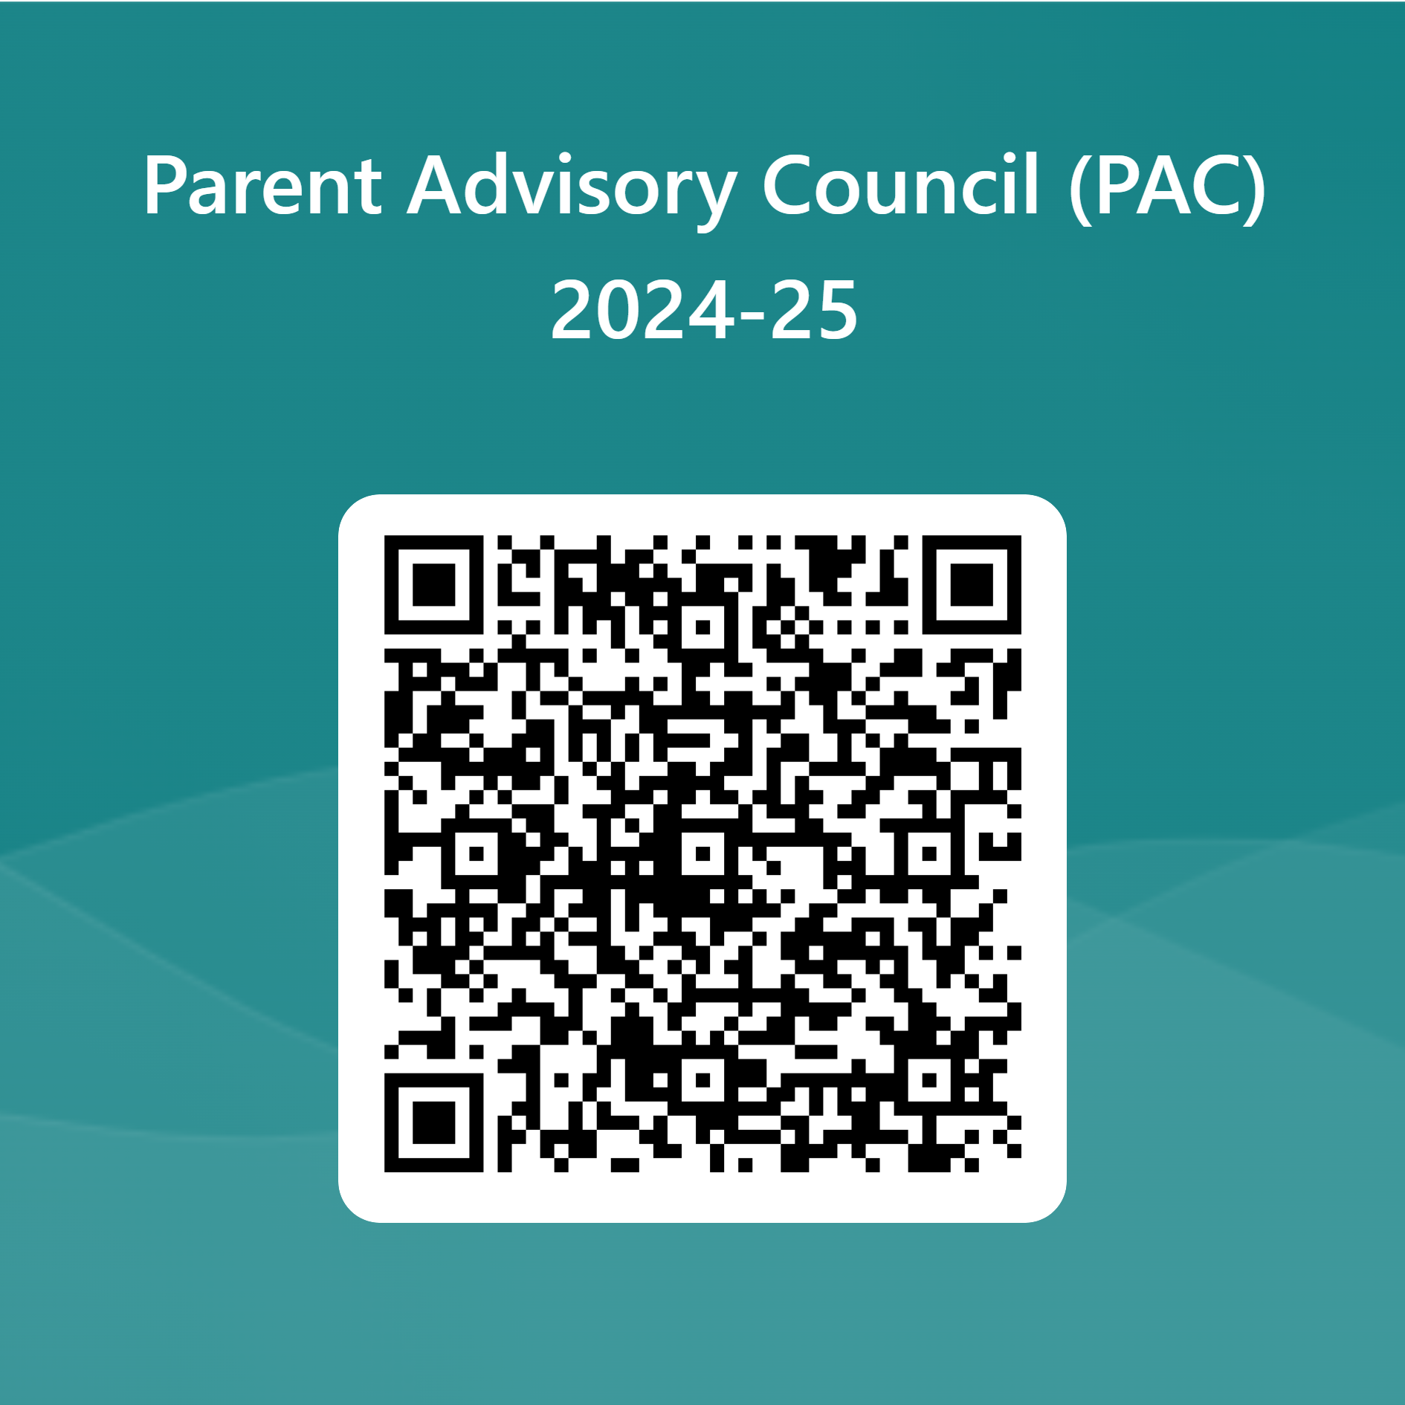

Parent Advisory Council (PAC)
The District has a Parent and Family Engagement Plan. The summary of the plan is in the Title I School & Family Partnership Overview.
You may access the full plan at www.pcsb.org/titleone
The Parent Advisory Council (PAC) is responsible for reviewing and revising the District PFEP.
PAC will meet virtually or in person with the district’s Title I staff.
Each school is committed to having at least one member representative in PAC.
PAC meets twice a year, if you are interested in representing our school please notify, Insert contact person
Notes:
Please add your PAC representative in slide and share with your Title I Specialist.
https://forms.office.com/r/r5daaMTENE\

Slide 20
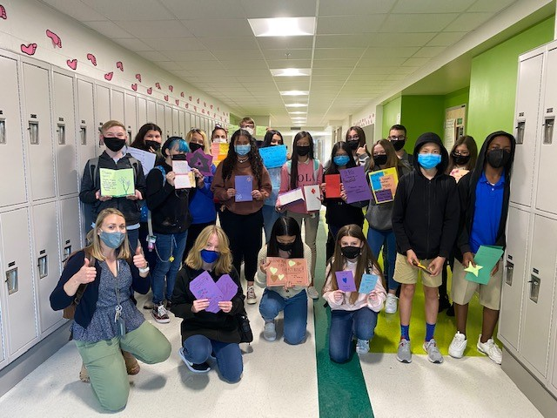

Additional Resources
Learning at Home Family Resources - https://www.pcsb.org/Page/32836
Volunteer in a Pinellas County School - https://www.pcsb.org/Page/459
Parent Academy POWER HOURS Webinars - https://www.pcsb.org/Page/26534
Partnerships - https://www.pcsb.org/Page/418

Slide 21
Thank you for your time! take e in L
Please reach out to your Title 1 Team with any questions.
Laura Burge - Title 1 Coordinator / Amber Schmittdiel - Title 1 Administrator
Your feedback is greatly appreciated!
Notes:
Please duplicate Microsoft Forms provided or create school survey. To generate a QR code hover over your school’s survey and and right click. Create QR code for this page will be an option.
https://forms.office.com/Pages/ShareFormPage.aspx?id=BZM8c9c5GkaGb_3ye_PH_x-1YNVO6C1FkgA88U6PR2tUNEQzTU0wNkZXVUxVTlpEMU81NkJFMlJNTi4u&sharetoken=FXXhmgwFjSnl0sNz61ki

