Slide 1


Slide 2
PHUHS CWMP Medical Staff
Administration
Teresa L. Patterson
Diamante Sadlowski
Erika Picard
Jayne Marino
Medical Sciences
Dr. Amanda Daniels
Dr. Kimberly Pate
Rachel Taylor
Sharon Ungs
Kelly Webb
Bobbie Zuelke
Lissa Bartle
English
Joseph Bedard
Valeria McAuliffe
Suzanne Santarelli
Andrea Weaver

Slide 3
PHUHS CWMP Medical Staff
Math
Kristi Engels
Steven Murphy
Maria Smith
Social Studies
Shaun Falcon
Michael Mullaney
Laura Tahajdi
Jason Tsardoulias
Michael Zollo
Science
Lori Bauck
Gregory Pozun
Elizabeth Stavropoulos
Sharon Ungs

Slide 4


Slide 5
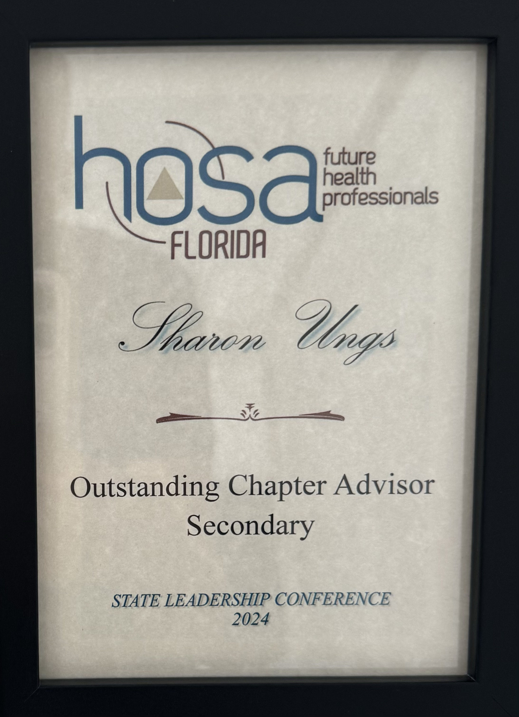
Advisor of the Year
Sharon Ungs

Slide 7
Teresa L. Patterson
Principal

Slide 9
Senior Class Gift
Amelia Kuehn

Slide 11
Jessica Krause
Medical Booster VP

Slide 13
Dr. Amanda Daniels

Slide 15
Erika Picard
Medical Program
Counselor

Slide 16


Slide 18
Abagail Haber
Salutatorian

Slide 20
Diamante Sadlowski
Assitant Principal
Program Coodinator

Slide 21

THE CENTER FOR WELLNESS
AND
MEDICAL PROFESSIONS
Presents
Bio-Medical (BACE)

Slide 22
THE CENTER FOR WELLNESS
AND
MEDICAL PROFESSIONS
Presents
Pharmacy (CPhT)

Slide 23
THE CENTER FOR WELLNESS
AND
MEDICAL PROFESSIONS
Presents
Medical (CNA, CCMA, EKG, CPT)

Slide 24
Medical Advisory Board

Slide 25
Ena Ibrahimovic
Amelia Kuehn
Paola Prada
Trevor Stinson

Slide 26
Congratulations
Palm Harbor University High School
Class of 2024

