Slide 1
















LMIBWS
Clubs & Activities

Slide 2

Canvas Page
If you have not already, join the LMIBWS Clubs & Activities Canvas page.
Go to Canvas
Click “accept” on your invitation
This page will be used by various club sponsors to relay important information like club events, dates, and reminders.
Notes:
Teachers, if you run a club/activity and want info posted on this Canvas Page, please send the information to Ms. Crawford or Ms. Cornelius. You can also be added as a teacher yourself to make your own announcements/posts.

Slide 3

Why join a club?
Being part of a club or organization provides a platform for personal growth. You can develop essential skills such as leadership, teamwork, and communication. Take on leadership roles within the club, organize events, and collaborate with fellow members to enhance your abilities. These experiences will not only enrich your academic life but also boost your confidence and prepare you for future challenges. You may also explore new or current interests!
https://www.iavalley.edu/the-benefits-of-joining-clubs-and-organizations-in-college/

Slide 4
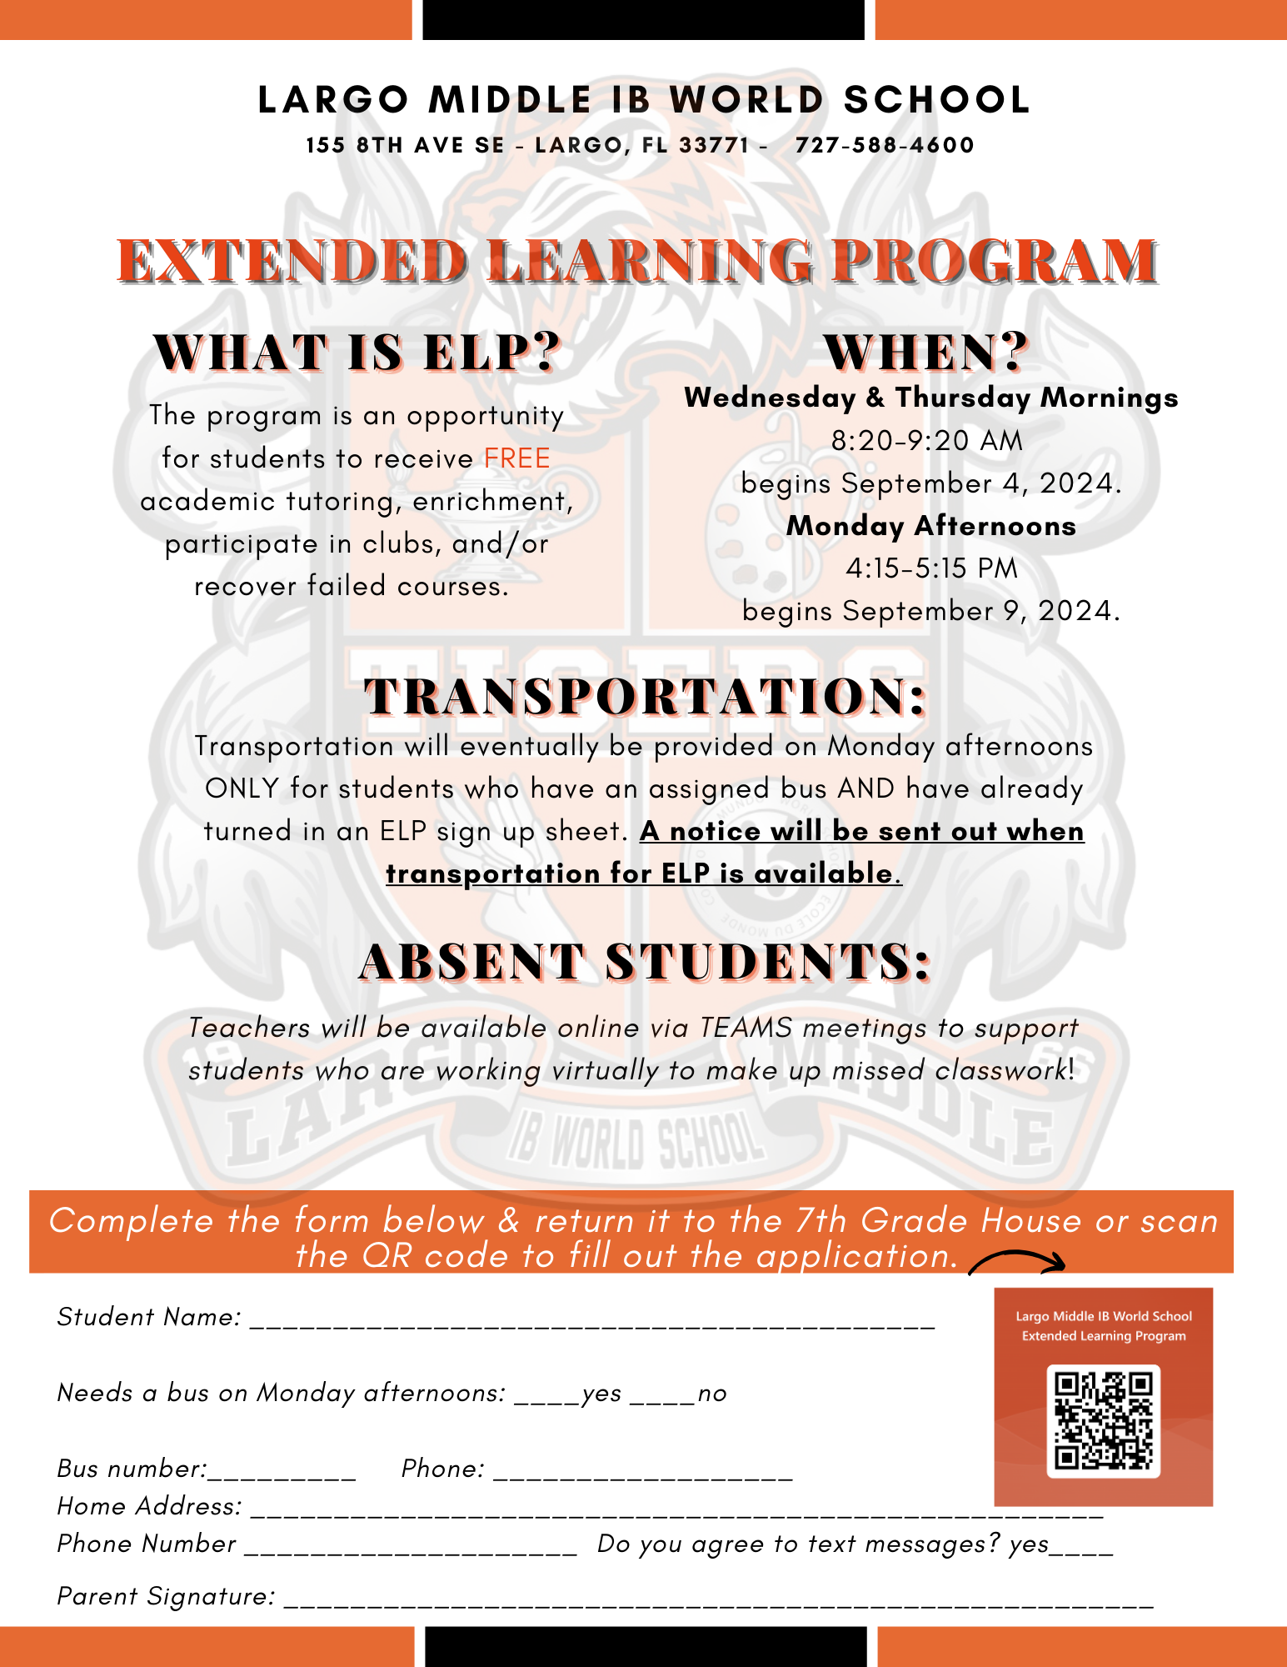
ELP

Slide 5
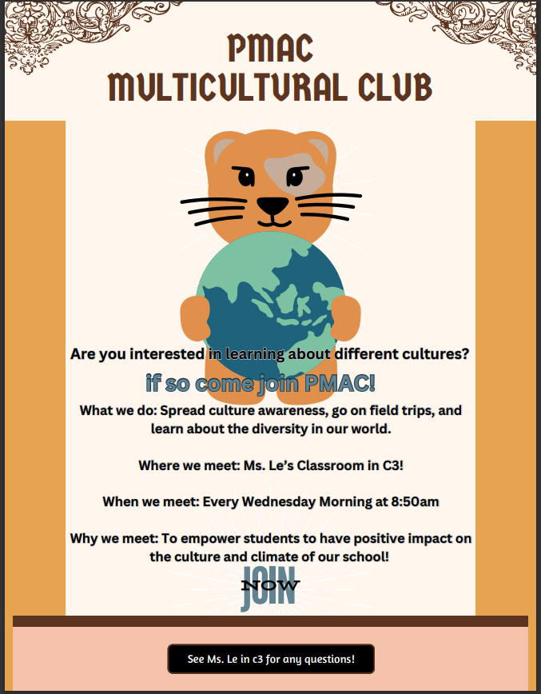
PMAC

Slide 6
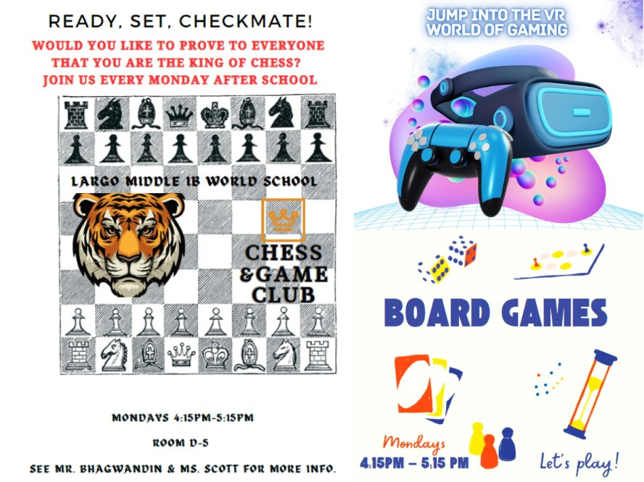
Chess &
Games
Club

Slide 7
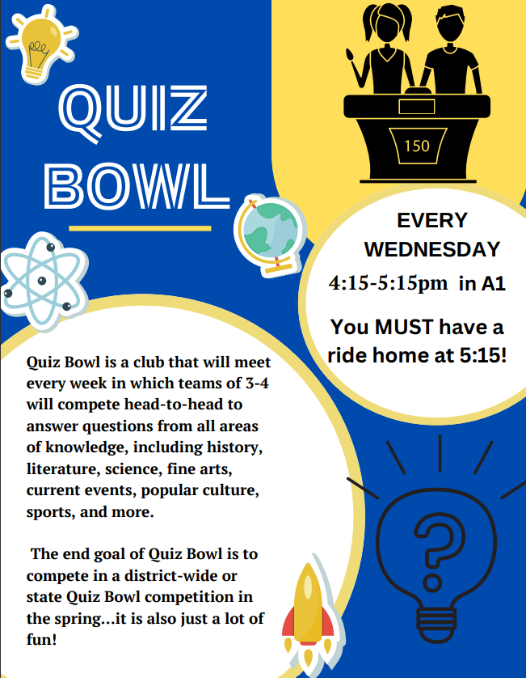
Quiz
Bowl
D8/B4
Club Sponsors: Ms. Martin & Mr. Smith

Slide 8

STEM
Club
Tuesdays – 4:15pm-5:15pm in Pod 6
Starts next month

Slide 9

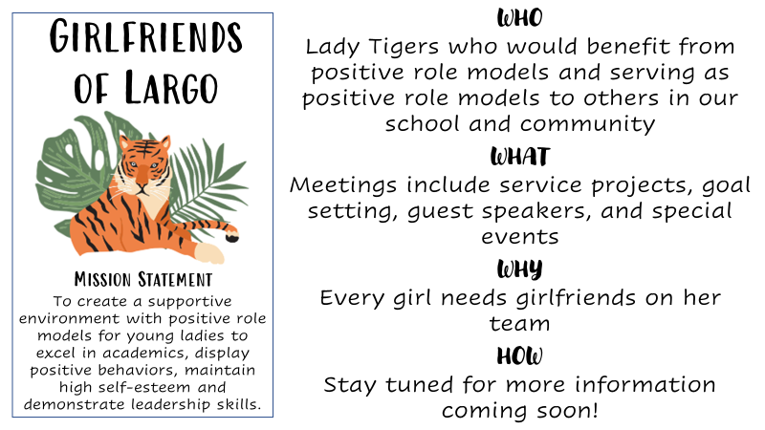
Girlfriends
Club
Club Sponsors:
Ms. Legions, Ms. Jay, Ms. Ash

Slide 10

5000
Role Models

Slide 11
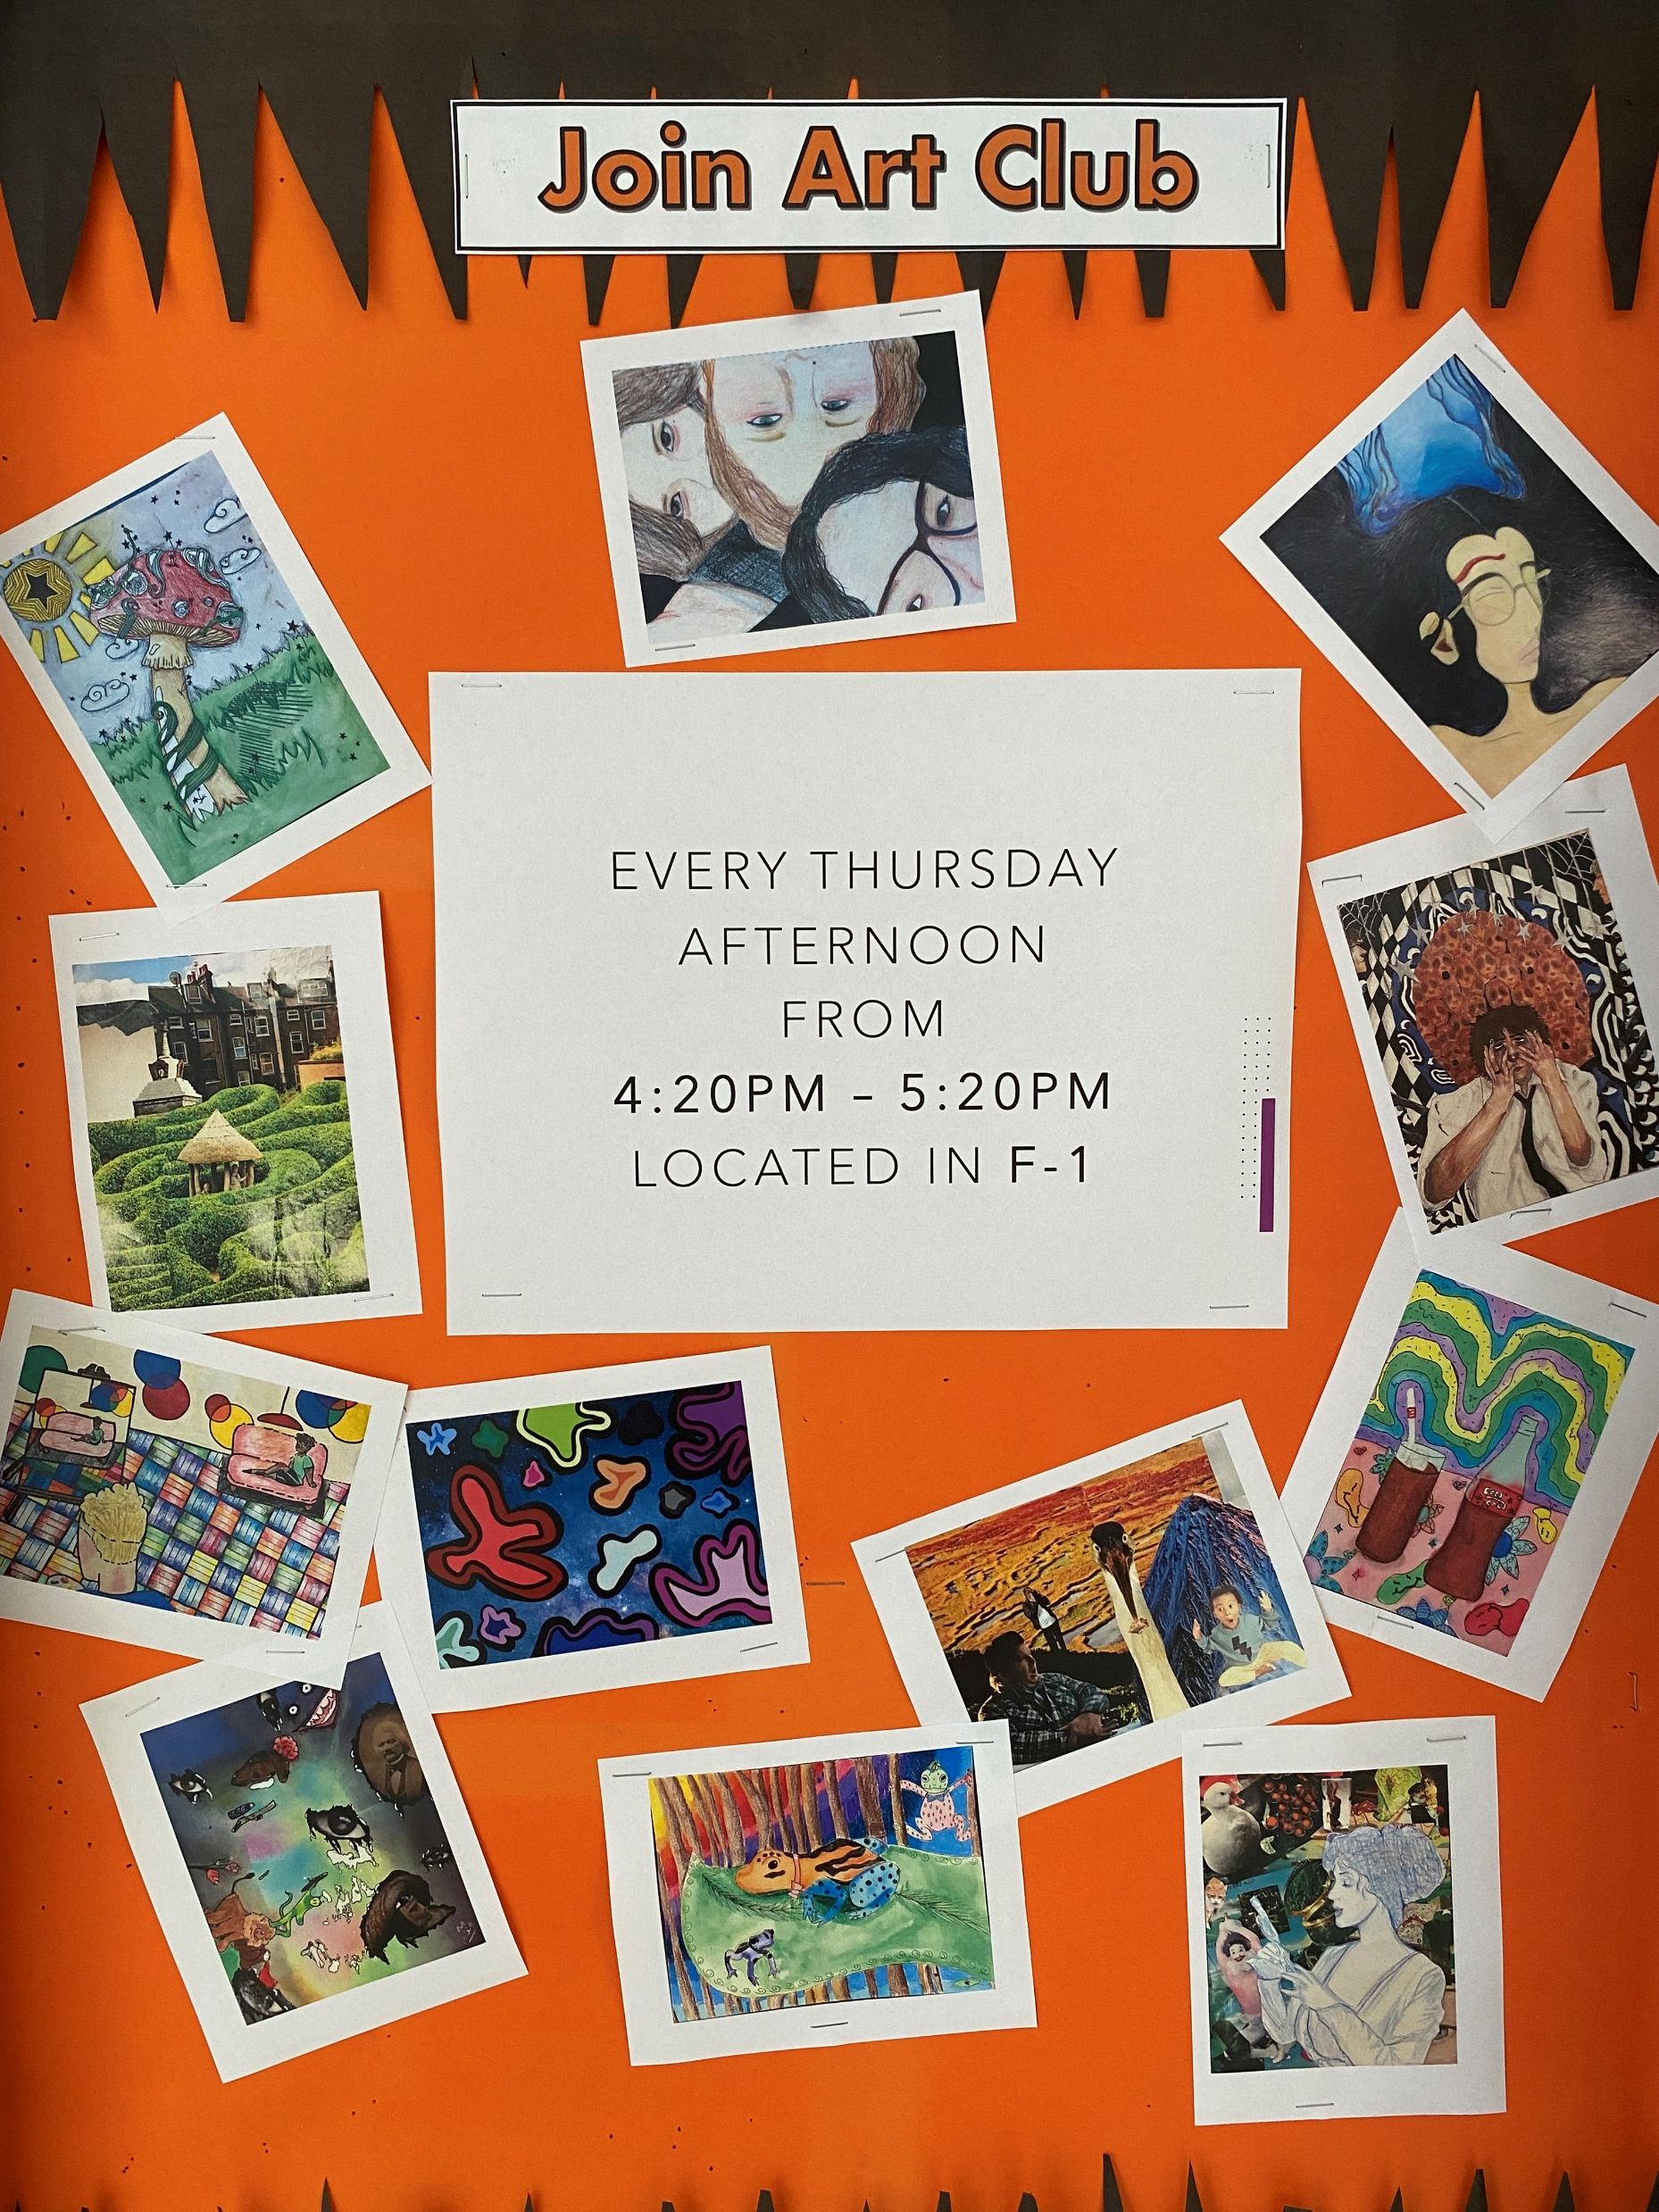
Art
Club
Club Sponsors: Mr. Powell

Slide 12

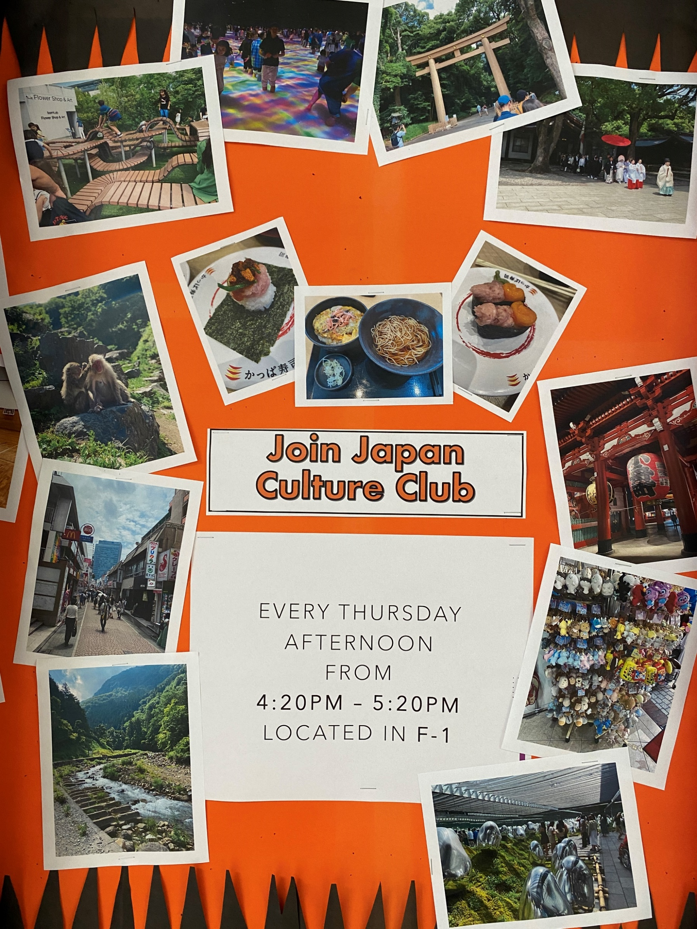
Japan
Culture
Club

Slide 13


SAVE
Club

Slide 14


Live Free
Club

Slide 15
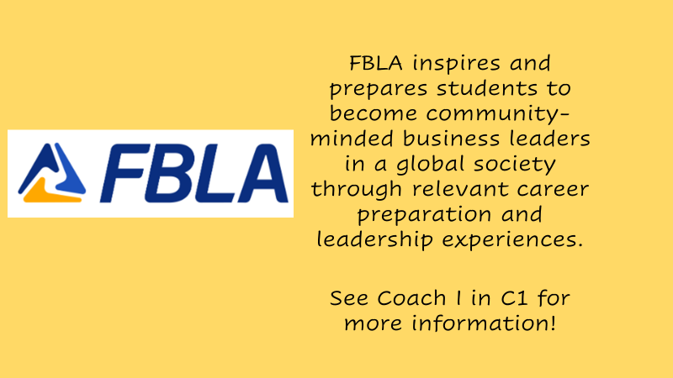
FBLA
Learn how to become a successful business leader.
Compete in district, state, and national competitions!
Go on field trips!
The last day to join is at the meeting on September 13th at 9:00am!

Slide 16
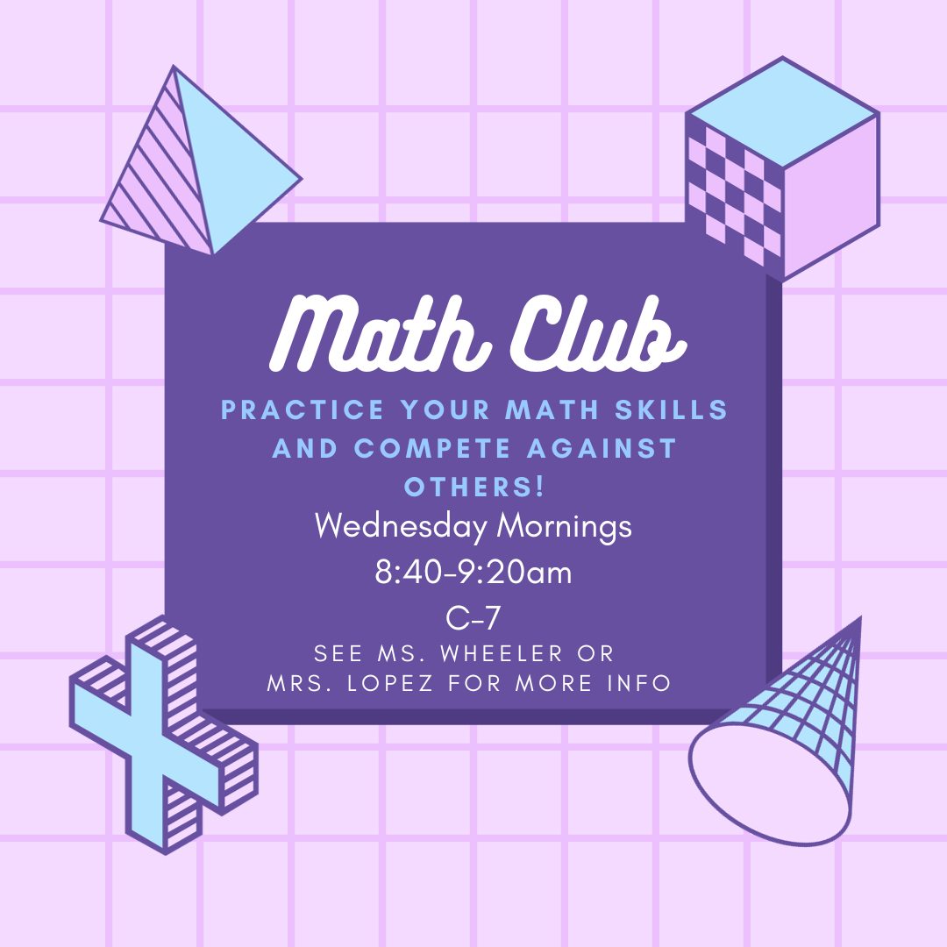
Math
Club
LMIBWS Math Club is a club for students interested in mathematics that can get together and further explore mathematics outside of a classroom with various activities.
See Ms. Mount or Ms. Lopez for more info!

Slide 17
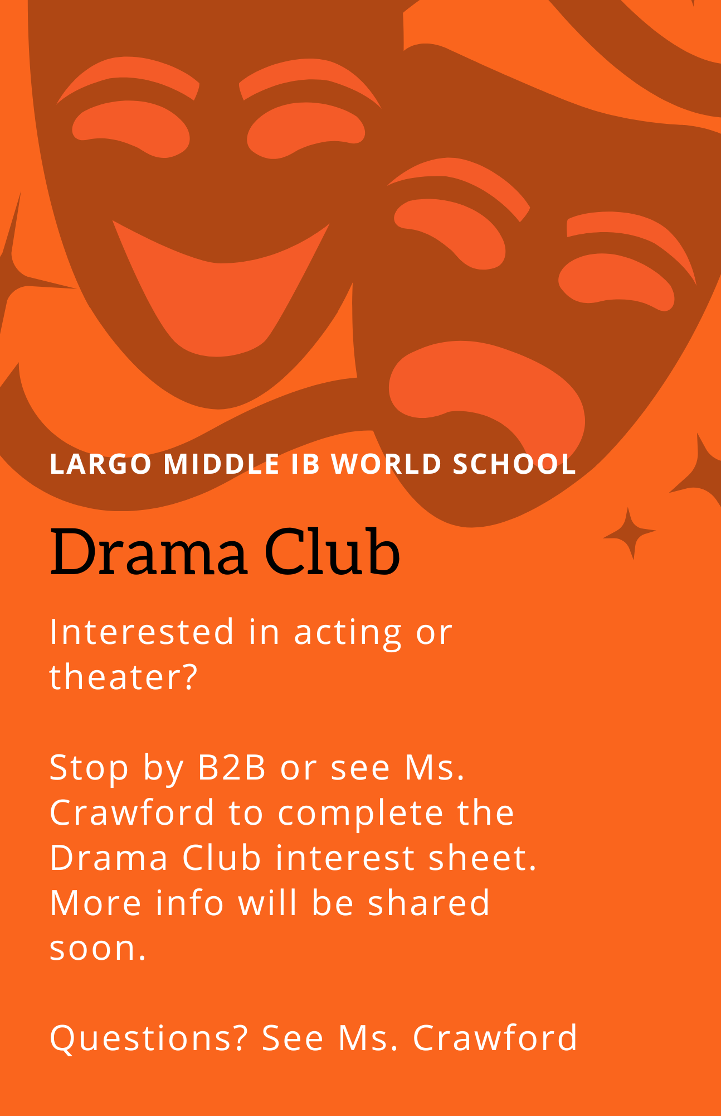
Drama
Club

Slide 18

Student
Council
What is Student Council?
Student Council is a group of elected and volunteer students that work together to help make improvements to the school. These students also help put on school events like dances and spirit weeks!
More info about Student Council will be shared soon!

Slide 19


Tri-M
Music
Honor
Society
The Tri-M Music Honor Society is a program of the National Association for Music Education (NAfME), which focuses on creating future leaders in music education and music advocacy. Tri-M seeks to make an impact in our community through public performances and music service projects.
Previously inducted 8th grade students will continue to be members.
New candidates will be invited at the end of quarter 1 based on participation in their music class and grades.
Club Sponsors: Ms. San Antonino, Mr. Ruffin, Ms. Ash, Ms. Crawford

Slide 20

National Junior
Honor
Society
The National Junior Honor Society (NJHS) elevates a school’s commitment to the values of scholarship, service, leadership, character, and citizenship and helps middle-level students develop the knowledge and skills to become well-rounded student leaders in their school, community, and beyond
Students are invited to be in NJHS based on academic performance. This group is for 8th grade students only and has already started.
See Mr. Berkman for more information.

Slide 21

AR Study World
Club Sponsors: Mr. Wells
Study Sessions are every Tuesday from 4:15-5:15pm in Pod 3.

Slide 22
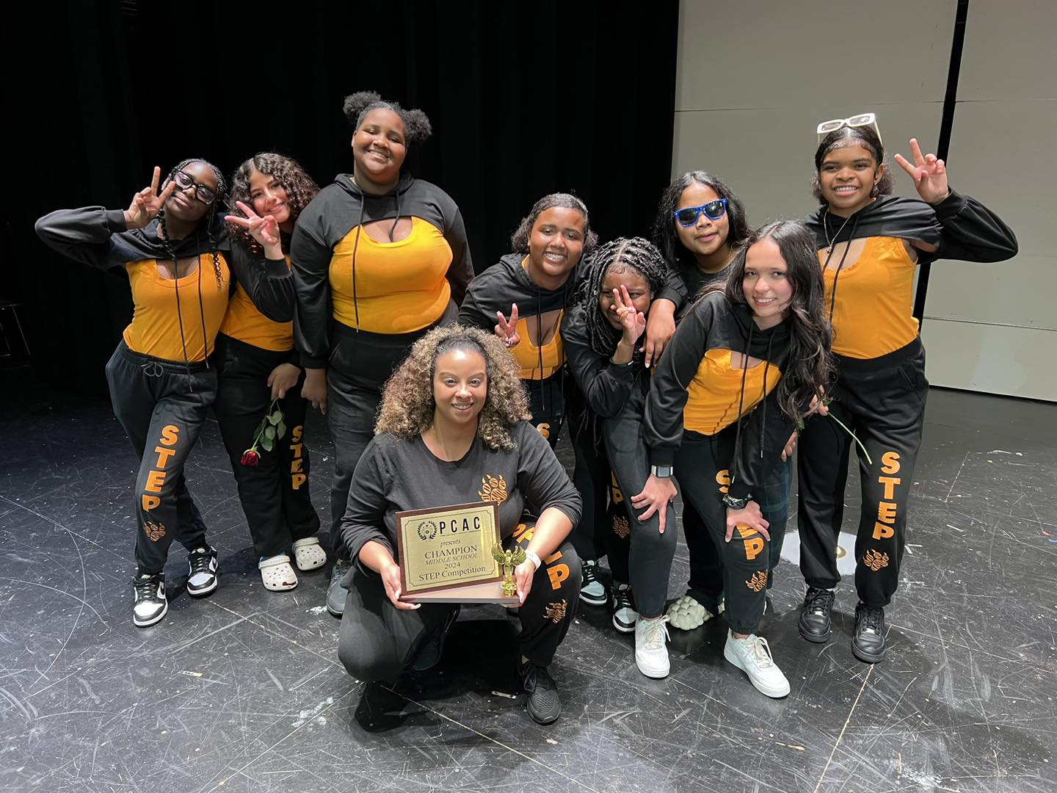
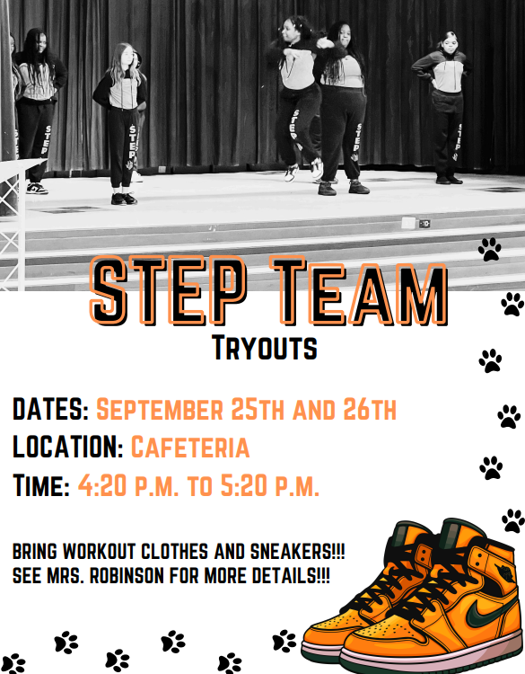
Step
Team
Join our award-winning Step Team!
Stepping is a historical form of communication and storytelling using the body to make sounds through clapping, stomping and spoken word. Modern day stepping also uses elements of tap dancing, break dancing, gymnastics, and afro-Caribbean dancing. Stepping is now a worldwide phenomenon practiced by multiple cultures and people of all ages. Stepping can be seen in churches, schools, competitions, and Greek step shows. Stepping is judged on sportsmanship, originality, stage presence, and uniformity. Stepping is more than dance, it’s an art form.
Tryouts will begin the last week of September 25th and 26th
Wednesdays afterschool from 4:20 p.m. to 5:20 p.m.
See Mrs. Robinson for more info!

Slide 23

Lady
Tigers
Flag
Football

Slide 24
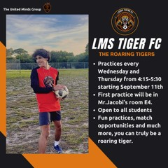
LMS
Tiger FC
Club Sponsors: Mr. Jacobi
Practices are on Wednesdays and Thursdays from 4:15-5:30pm.

Slide 25

Boys
Basketball
Boys Basketball tryouts will begin in late fall. Practices will be before school on Monday, Wednesday, and Thursday mornings at 8:00am.
Students must have good grades and behavior. ALL sports paperwork must be turned in BEFORE trying out.
See Coach I in C-1 with questions.

Slide 26
Current Activities
The following clubs and activities are already in progress and may not be accepting new members. Reach out to sponsors for more info for next year!
Volleyball –Coach Ondos & Coach Huff
Cross Country –Coach I

Slide 27
Coming Soon!
The following clubs and activities will be starting later in the year.
Basketball
Flag Football
Track
Cheer
and more!
To be on sports team you must maintain good grades & behavior!

Slide 28


Sports Paperwork
If you would like to participate in a sport, you need to have a completed 24-25 school physical/participation form and student activity insurance turned in PRIOR to participating. Forms can be found on the PCSB website and in your grade level office.

Slide 29

Have an idea for a club?
Plan out your club purpose, mission, and activities
Get your club approved by admin
Find a club sponsor & meeting space
Start your club!

Slide 30
Club Reminders
Joining an extracurricular is a commitment
Communicate with club sponsors and officers if you are unable to attend meetings/events
Remember to keep track of dates for club meetings and events
It is important to listen to the announcements and monitor the Canvas page for meeting changes
Use your agenda to help you stay organized
Be sure to consider logistics like transportation and keep your guardians in the loop

Slide 31


Join a club today!

