Slide 1
Slide 1
Why Largo IB?
Largo IB Alumni
Notes:
These can be changed to reflect your school’s specific rules.

Slide 2

Adriana Ladera 2018 Graduate
Massachusetts Institute of Technology
Major: Computational Science and Engineering
Occupation: Research Scientist at MIT, NSF Graduate Research Fellow
Why IB?
The IB program helps students refine their technical and soft skills, as well as inspires them to continue their academic, athletic, and other extra-curricular interests beyond the scope of the program.
How did the IB Program at Largo help me?
Carried 41 credits into undergraduate studies
CAS and academic rigor of the IB program allowed for 100% of Bright Futures (covers tuition in Florida) and additional university freshman scholarships (covers most personal expenses, i.e. off-campus housing, groceries, etc.)
Sparked a newfound interest in the physical sciences— this became the foundation of my undergraduate involvement in physics—when writing IAs: specifically conducting a thermodyamic investigation of the sun as it expands into a red giant (Chemistry HL) and using calculus to investigate projectile motion (Math SL)
Gained and refined technical and soft skills: the ability to think critically and philosophically (TOK), presentation skills (all classes, especially IB English IOC), construction of stronger essays (all classes), and effective communication
Current hobbies: a renewed interest in classical piano (IB Music HL), rock climbing, and self-defense (inspired by CAS Activity but not directly related)
Continued service involvements: social justice and climate action volunteering (inspired by CAS Service but not directly related)

Slide 3

Hailey Winder 2020 Graduate
University of Central Florida
Major: Advertising and Public Relations
Why IB?
Upcoming high schoolers should choose Largo IB because it is a community that inspires growth of all avenues -- personal, academic, social, and financial.
How Largo's IB Program helped me:
The community and family you become apart of is invaluable and hard to come by again in the real world.
The accolades and achievements that IB helped me attain are now the reason why I have paid $0 out-of-pocket to pursue two degrees and I get PAID to attend UCF.
My IB credits put me a year ahead and I came into college as a sophomore.
Doing IB coursework in high school set me up so that now the college workload is a piece of cake.
There is something for everybody. The Largo IB staff provided me with countless opportunities that aided me in my personal growth and academic and career goals. IB program components such as CAS, Extended Essay, Theory of Knowledge and my High Level courses have shaped me into a well-rounded, open-minded person and thinker.
Overall, it's an experience I wouldn't trade for the world :)

Slide 4

Emma Witham 2018 Graduate
Baylor University / Law School - UNT
Major: Public Health
Occupation: Paralegal – Berry Appleman & Leiden LLP – Corporate Immigration
Why IB?
The program provides a level of academic rigor that most people don’t even experience in college.
Students master skills much needed for life well before most are expected to in college.
I was surprised when I went to college and realized how poorly prepared most of my peers were despite going to accredited schools.
How the IB program at Largo supported me:
21 hours of class credits transferred
Due to flexible and understanding teachers I was able to pursue athletics and academics throughout the 4-year program and was granted an Athletic scholarship to Baylor
Presentation skills
Writing skills
Spanish fluency that allowed me to take on a leadership role in an Athletics sponsored service trip to Guatemala

Slide 5

Connor Panish 2021 Graduate
University of Florida
Major: Math and Statistics
Why IB?
Personal bonds, diverse knowledge base, writing skills and credits
How did IB help me?
• 45 credits, tested out of vast majority of general education requirements
• Coming in with this many credits will allow me to get a double major in only three years
• $10,000 in additional scholarships after I got accepted to UF, yes you can still apply to scholarships
after you get into college
• I was able to study abroad in London this past summer because of the credits and scholarships
• Writing skills are far above my peers, I have written multiple high caliber papers in considerably less
time
• IB made me significantly more socially aware, I have been elected to the UF Student Senate twice
• Part time job writing trivia questions, thanks to IB’s diverse education
• Bonding with my IB teachers has made me much better at bonding with professors, which has led to rec
letters and even a research opportunity in biostatistics

Slide 6
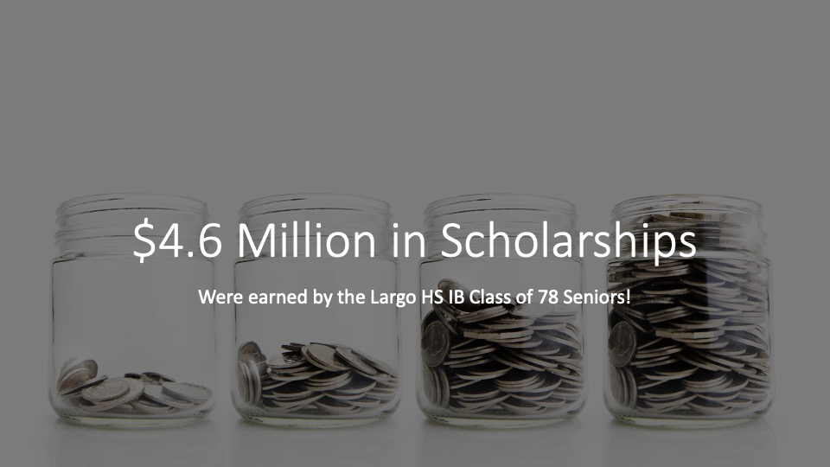

Slide 7

Amruta Karkare 2019 Graduate
Virginia Wesleyan University
Major: Biology Student Athlete: Soccer
Why IB?
Personally, I chose IB because I was looking for a challenge in course load on top of the added benefits seen from previous students when transitioning to college. Beyond the classroom, IB would allow for full immersion with the community around me and provide new outlooks to they way we naturally think about simple concepts. Not to mention, the community that surrounds the program is very welcoming and encouraging. The teachers are always fully invested each individual student and want the very best for everyone.
How did the IB Program at Largo help you?
Received an immense number of credits within the first year of college
Adjustment to course load in college was seamless
Time management and studying skills learned in IB made it easier to study for exams and keep track of assignments
Received full scholarship to Honors College
CAS Project and service activities paved way for internship opportunities when applying for Early Admission Program at some medical schools

Slide 8
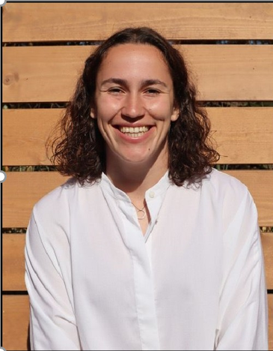
Emma Schechter 2018 Graduate
University of Rochester
Majored in Data Science
Occupation: Financial Analyst at Google
Why IB?
You will develop the critical thinking and study skills to be successful in a college and work environment, and have a community around you that can support you in every way.
How did the IB program help me?
The close knit community of IB teachers and students across grade levels provides an overwhelming sense of support, guidance and understanding
IB allows you to develop skills in a very well-rounded way (speaking, writing, studying, time management and test-taking are all required to be successful)
Prepping for IB exams helped me tremendously for studying in college, which for me was less assignment-focused and more content-focused to prepare for exams
I am roommates in Chicago with three IB friends and keep in close contact with my whole friend group
I have found fellow IB'ers from across the world and bonded over our shared experiences
Received a merit scholarship due to my extracurricular leadership experiences

Slide 9
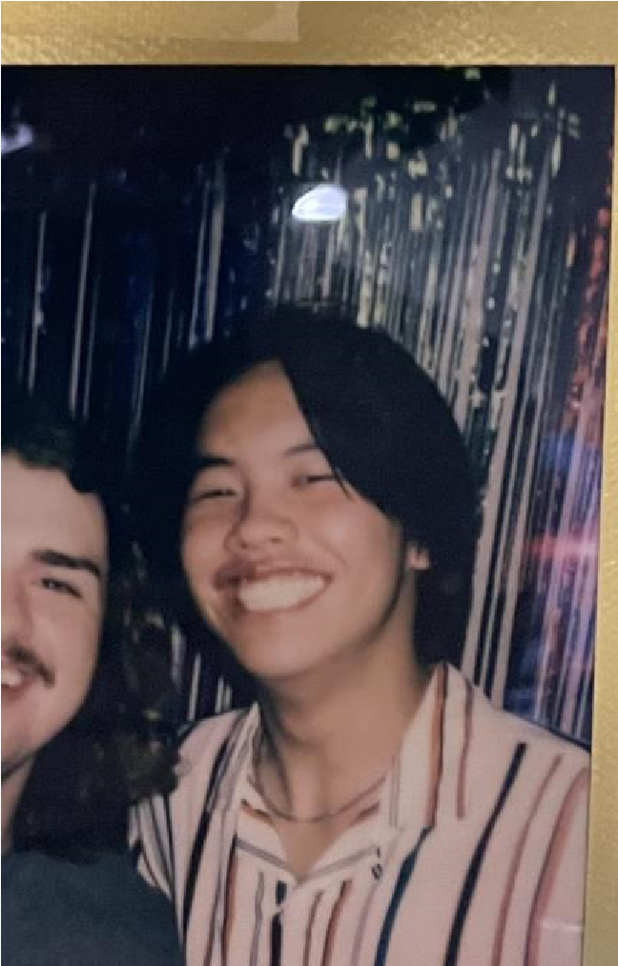
Jay Hu 2022 Graduate
University of Florida
Major: Biotechnology
Why IB?
IB credit covered all but one of my Gen-Ed classes which allowed me to do pretty much whatever I wanted freshmen year (and CAS also helps with completing Bright Futures so you get to do whatever you want for free). The essays are tedious but make college writing feel like absolutely nothing.
How did Largo Help Me?
I met friends who care about their future and it motivated me to not waste my life
Teachers are really cool and make difficult stuff less difficult
The block schedule gave me time to do extracurriculars
There is dedicated time to college applications so it isn’t stressful
My teachers and friends supported me in what I wanted to do throughout high school.

Slide 10

Alyssa Auderer – 2020 Graduate
University of Florida
Major: Communication Sciences and Disorders with a minor in Business Administration
Why IB?
IB is a great opportunity to prepare for college and get a wonderful education while forming bonds with other students and teachers in a close-knit group.
How did the IB Program at Largo help me?
I came into college with 30 credits, meaning I could have graduated a whole year early! The only reason I am not able to is because of my major, which requires a lot of specific classes and a certain timeline.
The block schedule and study hall periods in IB helped me tremendously with time management. I really enjoyed having only a few classes a day that were longer, and that helped to prepare me for the format of most classes in college as well. Study hall helped me learn how to use my time wisely to avoid having extra work outside of school, and I still use that skill when I’m stuck on campus between classes.
The best part of Largo IB was definitely the teachers. I felt like all my teachers truly cared about my well-being and my success, and they genuinely were great at teaching. I especially realize this when talking to others about their teachers and they have much less of a bond with them. I loved getting to know the teachers over the years, and still enjoy

Slide 11
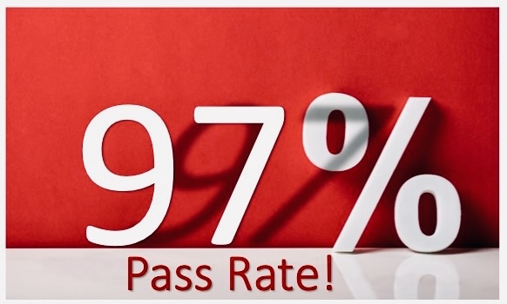

Slide 12
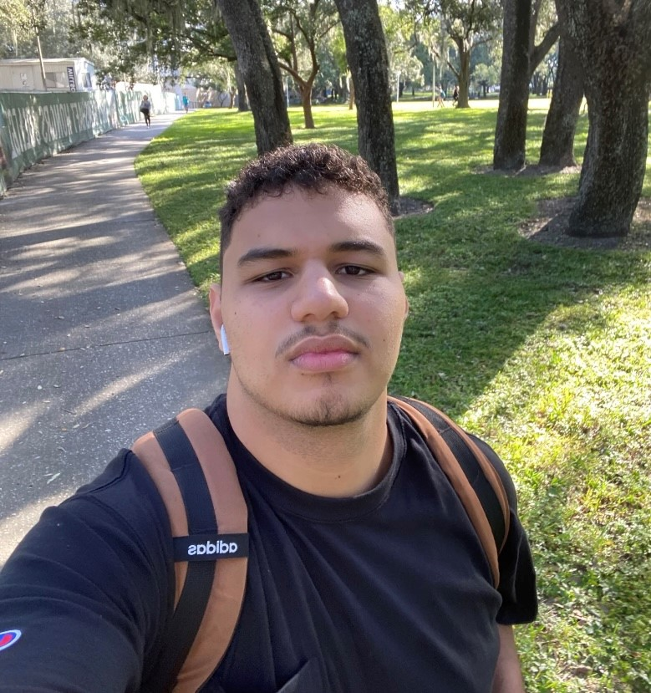
Hatem Elmougy 2021 Graduate
University of South Florida
Major: Computer Science
Why IB?
• Extremely helpful for college readiness (Workload, expectations, and habits built).
• Great and supportive teacher and staff team that prioritizes success and account for students' experience in and out of school.
• Family like social structure that encourages inquisition, critical thinking, and provides academic competitiveness.
• Encourages extracurricular achievements and activities that will build a great resume right out of high school.
How did the IB Program at Largo help me?
Made me accustomed to all types of workloads and expectations that make college assignments seamless.
Provided me with a structured approach towards different tasks in college.
Helped Identify my weaknesses and find a way to approach them or work around them.
Current Picture

Slide 13
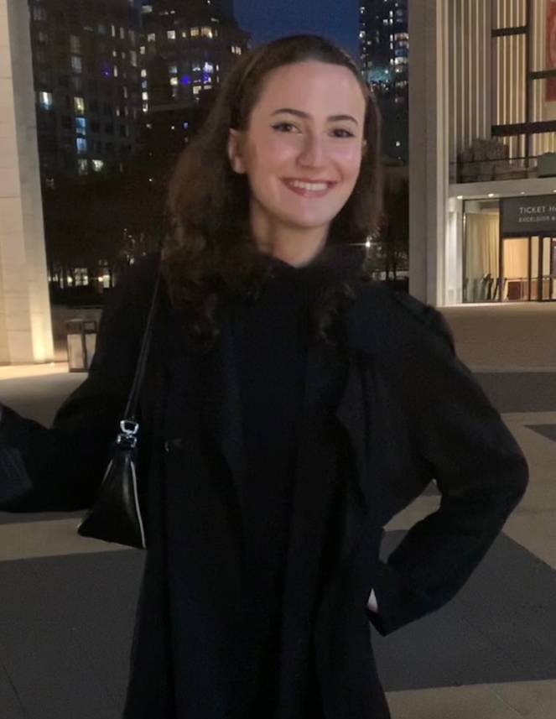
Grace Schechter 2020 Graduate
Fashion Institute of Technology
Major: Fashion Marketing
Why IB?
The teachers I had the pleasure of getting to know during my time in Largo IB made my high school experience far more elevated than it would’ve been had I not been in the program.
How did the IB Program at Largo help me?
My time management skills, as well as my ability to produce quality work with limited time, improved significantly
I received 15 transfer credits from my IB and AP exams
I am able to connect with IB students from all around the world who flock to New York and share mutual experiences.
Compared to my friends I made in college, I place a higher emphasis on grades, school, and gaining new knowledge

Slide 14
Slide 1
Why Largo IB?
Largo IB Alumni
Notes:
These can be changed to reflect your school’s specific rules.

Slide 15

Brook Brown – 2020 Graduate
McGill University
Major: Biology
Why IB?
The teachers are amazing and truly care about your success! A heavy, yet multi-faceted workload is beneficial especially when going to rigorous university.
How did the IB Program at Largo help me?
Received 20 Credits from my IB diploma (I need 120 Credits to earn a Bachelors)
I am still very close with some of my classmates, I am predicting lifelong friendships with them
Small program is incredible, take advantage of it now if you are going to a larger school. Get to know your teachers as they are great people that will leave a lasting impact on you
IB introduced me to time management under stress, a skill necessary for everyone’s future
As a student athlete, I was also prepped for the management of sports and studies, as well as a positive mindset for keeping up with both.

Slide 16
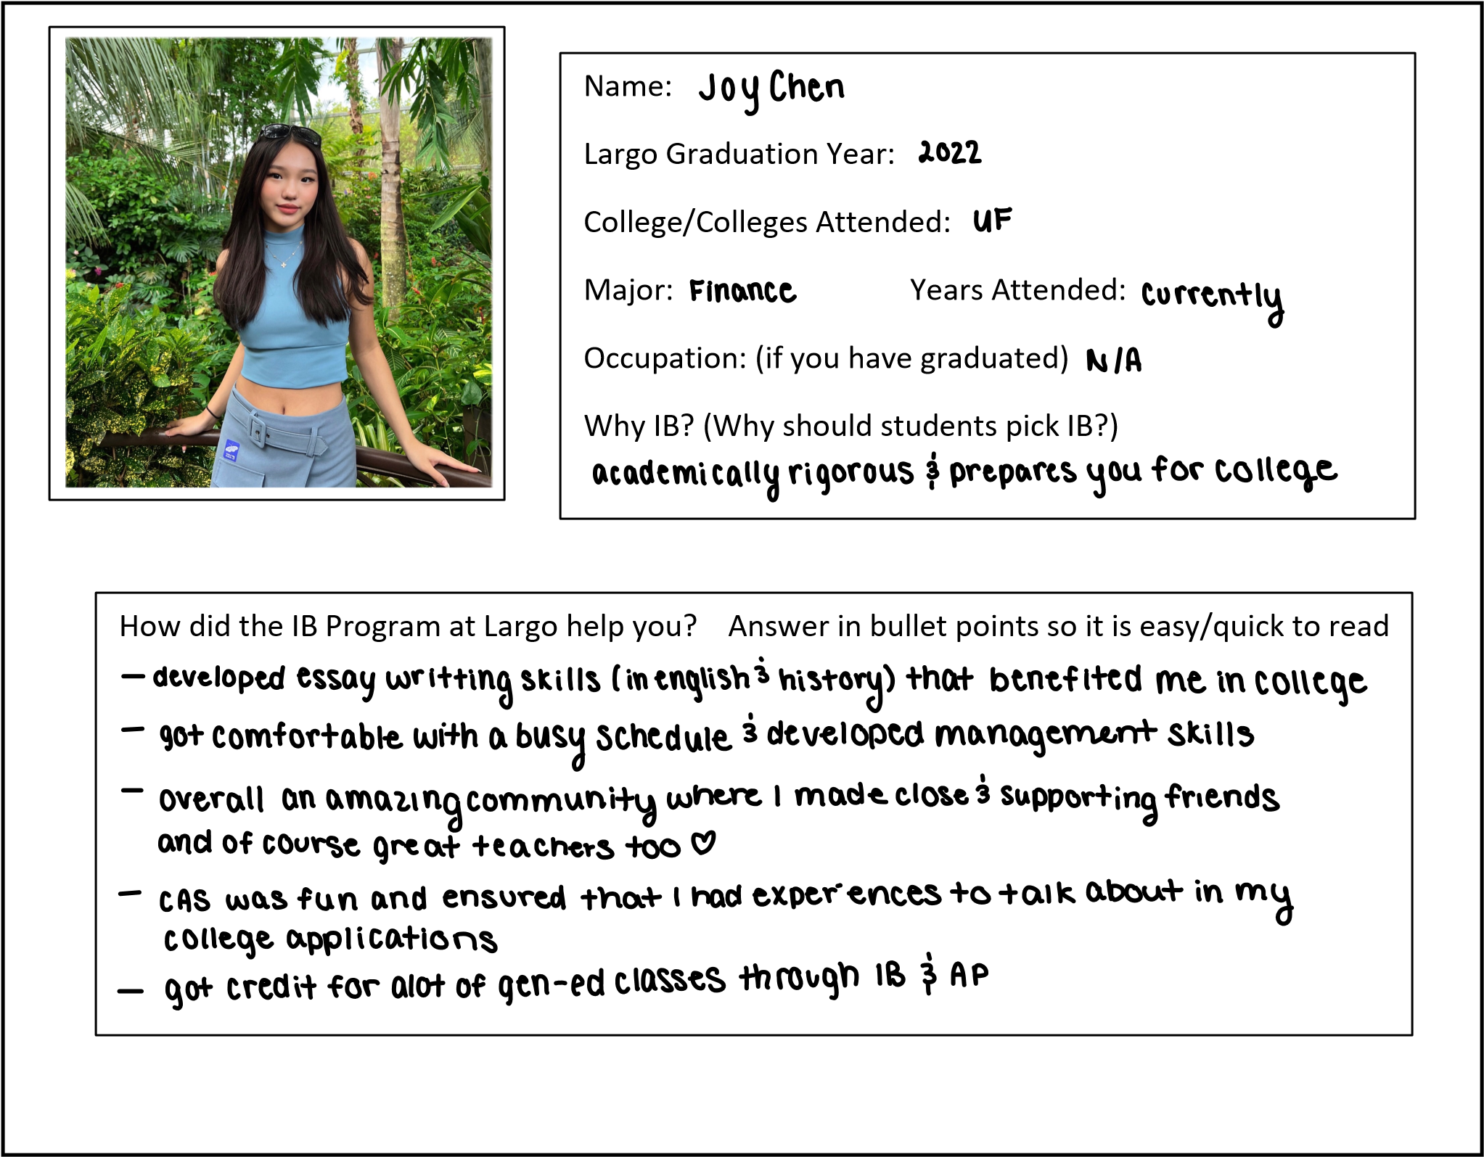
Joy Chen class of 2022
University of Florida
Major: Finance

Slide 17

Connor Mann 2019 Graduate
Yale University
Major: Electrical Engineering and Computer Science
Why IB?
The people you surround yourself with have a huge impact on how you learn and grow. In IB, you’ll be surrounded by excellent teachers and peers that really care about learning. It sounds simple, but it makes a big difference.
How did the IB Program at Largo help you?
Gave me the opportunity to push myself with advanced classes in my areas of interest
Prepared me for college-level coursework
Provided a tight-knit community of friends dealing with the same academic challenges
Helped me get the National Merit Scholarship

Slide 19

Bryn Muller – 2021 Graduate
Washington University in St. Louis
Major – Undecided Major, taking classes in environmental Analysis, Physics and Mathematics
Why IB?
I have felt incredibly prepared for college largely because of the rigor of IB. Not only due to the high level content of IB, but also due to the time management skills, essay writing, and ability to think critically and carefully. Beyond college preparation, IB gave me lifelong friends and memories.
How did the IB program help me?
• IB has truly shaped me into the person I am today. IB taught me how to work hard and allowed me to develop my passions of applied mathematics and physics which I have been able to pursue in college. Lastly, IB gave me several of my best friends and we keep in touch even when we are hundreds of miles apart at school.
• Having strong student/teacher relationships in IB taught me how to build these same relationships in college which has led to many of my academic successes. I have found myself able to ask for help and attend office hours more frequently and effectively than my peers. I have also been able to find the same community as I found in IB through building tight academic bonds with my peers.

Slide 20
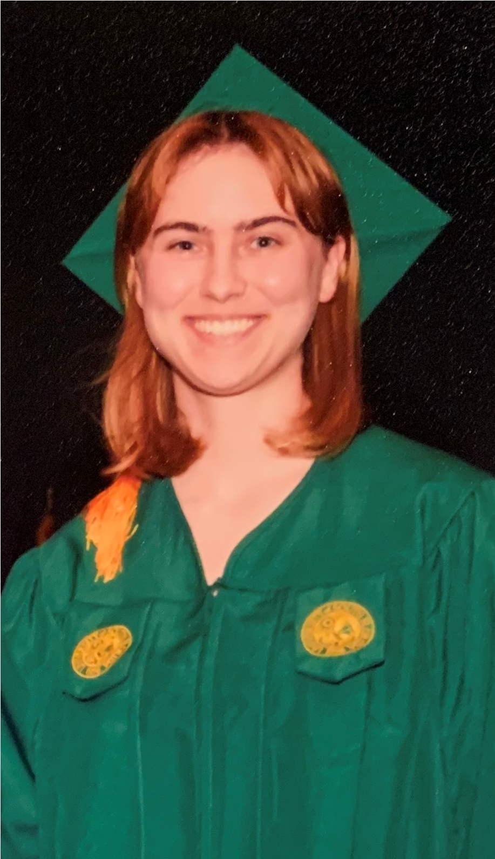
Darby Oleksak 2019 Graduate
University of South Florida
Majored in Biology (Medical Biology Concentration)
Lab technician at Johns Hopkins Medicine and applying to medical school
Why IB?
To be successful in IB, you should be prepared to gain a better understanding of yourself as a student and individual. There are always opportunities to learn beyond the curriculum. Some classes may be difficult, but those lessons ultimately teach you the most.
How did the IB program at Largo help me?
•Developed crucial time management skills that allowed me to succeed in college
•Gained a better understanding of how to study effectively for tests, and presentations
•Graduated college in three years, allowing me to take a year off to prepare for grad school
•Learned a second language in French class with Mme Samson
•Made friends that still let me send them annoying texts after many years of annoying texts

Slide 21

Amber Anderson 2021 Graduate
University of Florida
Major: Economics and English
Why IB?:
IB has made college so much easier for me, especially with course load.
How has Largo IB helped me?
I came into college with 45 credits!!!!! For reference, for most bachelor's degrees, you need 120 credits and will be able to graduate early with two degrees because of the credits I came in with.
I received full Bright Futures because I got my IB diploma, so I do not pay tuition.
I was very prepared for classes because of IB, especially with my course load.
I met many people during my time in IB that I will be friends with forever.
Learning different citation methods and using them constantly (MLA, APA, etc.)
The MOST important thing I learned in IB is how to write a thesis statement. This is useful for EVERY class. I write excellent essays because of what through effect. I am complimented on my essays because of this. I will never be able to properly thank IB teachers enough for giving me the essay skills that I have.
The teachers are the best part of IB. I feel so grateful that I had teachers who I had a relationship with individually. They care about their students' success genuinely, and I love every teacher I had.

Slide 22

Neil Shah 2021 Graduate
YALE University
Major: Computer Science
Why IB?
Share academic experiences with generally motivated students.
How did the IB program at Largo help me?
Found it easier to pursue academic success when I was surrounded by similar people.
Made me generally well-rounded.
Found the extended essay enriching; was useful for future mathematical write-ups.
Teacher/student relationship forms because of small size of program.

Slide 23
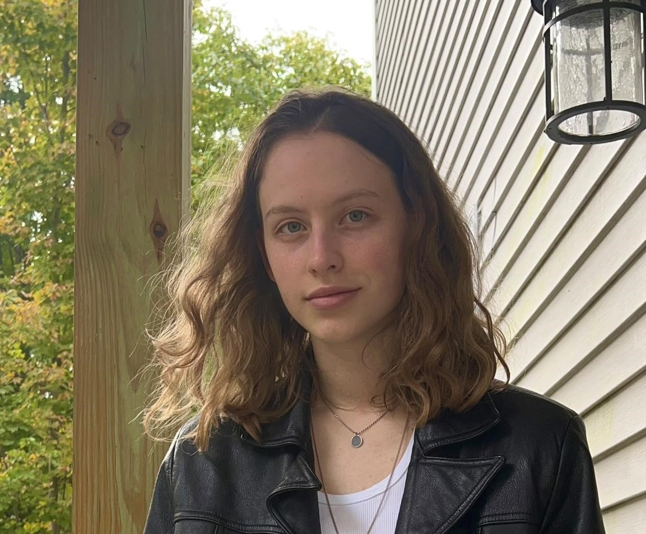
Frances Pool-Crane 2019 Graduate
Dartmouth College
Major: English and German
Why IB?
Smaller classes, great teachers, and a great support system that has stuck with me past high school
How did the IB Program at Largo help you?
The volunteering I did for my long term CAS service ended up turning into an internship in 2021 with the Dalí museum, which definitely helped me get my Summer 2022 internship with the National Portrait Gallery
My EE topic continued to interest me into college, and has ended up being a part of my Senior Honors Thesis
I’ve stayed close with a lot of my friends from the program despite moving away for college, and am so grateful to have met them all through IB :)

Slide 24

Boshko Stanisic 2020 Graduate
Florida State University
Major: Political Science/International Affairs
Why IB?
IB is hard but it really does prepare you for college.
How did the IB program at Largo help you?
IB gave me a bunch of extra credits so I can skip some general education classes and do some more fun ones in my major. Also I can graduate early, if that’s something that interests you.
College writing assignments have been relatively easy because of the experience I’ve had through IB.
IB classes prepare you to think critically about the topics. Whether it’s in Theory of Knowledge or History or Physics, there’s always an extra layer of knowledge and nuance that IB touches on.
IB helped socially, as spending four years with the same people really helped me learn how to communicate and interact with them .
IB has a sense of community that’s hard to get these days. It really does feel that everyone in IB (including the teachers) are working together to graduate and have fun.

Slide 25

Helena Visic 2018 Graduate
The University of Florida
Majored in Accounting
Occupation: Credit Analyst at Byline Bank in Chicago
Why IB?
IB’s curriculum challenged me and taught me how to think critically when presented with new information (ex: evaluate sources and organize an argument).
How IB helped me:
IB taught me how to manage my time well, something that many of my friends in college didn’t know until they were thrown into the deep end and had to figure it out freshman year.
IB History taught me more about US & World history than I would have learned otherwise. The focus on international history made me much more observant and knowledgeable than my peers (Ex: I was shocked the other day when a friend had no idea who Emmett Till was).
IB gave me great connections that range from my teachers (who I still keep in touch with) to friends. I met all three of my roommates at Largo IB.
IB prepared me to be a competitive candidate for college. It forced me to participate in extra curriculars and definitely helped me get into UF.

Slide 26

Logan Finney 2021 Graduate
University of Florida
Major: Political Science
Why IB?
IB created experiences, knowledge, and friendships that have helped me succeed and prosper in my personal and professional life!
How did the IB program at Largo help me?
I earned 40 credits from IB that helped me knock out most of my prerequisite courses.
Having 40 credits from IB has allowed me to get to the courses I’m interested in while allowing time to further my professional career with a job and an internship.
IB set me up for success in my classes and provided me with skills that allow me to excel in my college classes.
IB created lifelong friendships that I cherish. It also exposed me to so many different ideas and thoughts and helped affirm my future career aspirations.
Teachers in the IB program are above and beyond rock stars that will not only support your education but you as a person as well. They are simply the best!

Slide 28

Melani Stoyanova 2022 Graduate
University of Florida
Major: Political Science
Why IB?
IB is great because it sets you on the right track for college. You develop valuable critical thinking skills, better time management, and will notice that you are more prepared than most of your peers in college!
How did the IB program at Largo help me?
I feel more prepared for my classes, as they are very similar in structure to IB classes
IB helped me develop a foundation to build my professional resume; a lot of community service I did for CAS is still on my resume
The teachers at Largo IB are great, I would say they are very similar to professors in college; it’s a good idea to keep in mind that they are human beings too, and if necessary, they will cut you some slack
Passing your exams & completing CAS automatically gets you the full Bright Futures Scholarship, which is extremely helpful; ideally, you can graduate debt-free ☺

Slide 29

Thomas Mocellin 2022 Graduate
HEC Montreal
Major: Business
Why IB?
Helps to learn how to study well, and is a good preparation for college.
How did the IB Program at Largo help me?
Got accepted to my dream school thanks to IB
Was well prepared for college (I am able to study better than my friends)
Developed friendships that still last, even though I am in another country
It was nice to be with a small group of students, because it is easier to build bonds between people
Allowed me to study in Canada, which could not be possible just with an American high school diploma

Slide 30
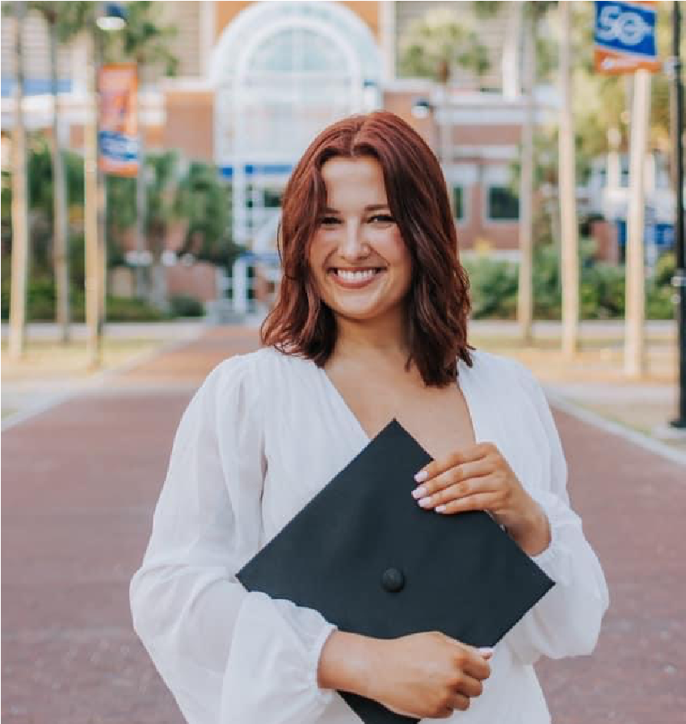
Naomi Simon 2018 Graduate
University of Florida (undergrad/graduate School)
Major: Marketing
Occupation: Recruiter for McKinsey & Company
Why IB?
You will make lifelong friends and be better prepared for college!
How did the IB Program at Largo help me?
Taught me effective studying habits
Prepared me for the heavy workload that I would be experiencing in college
Made me a great essay writer – I was much more skilled at writing than my peers when I came to university thanks to IB
Provided me a great group of friends that I still talk with to this day <3
Instilled in me a good sense of time management
Taught me the importance of being well-rounded, rather than just focusing on academics
Included me in a close-knit community! IB is an experience you will remember for life.

Slide 31
Slide 1
Why Largo IB?
Largo IB Alumni
Notes:
These can be changed to reflect your school’s specific rules.

Slide 32
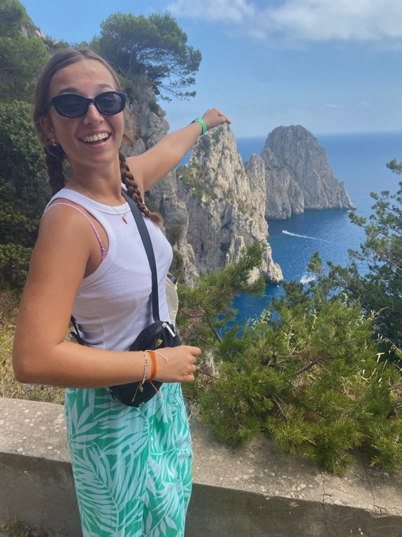
Annaliese Rexroad 2022 Graduate
University of South Florida
Major: Health Sciences
Why IB:
IB helped me become the student and person I am today, the academic and personal growth I endured is something I could have never replicated anywhere else. While the program is not for the weak, it truly shapes you for the best!
How did the IB Program at Largo help you?
I received 44 credits prior to entering college
I built a support system of teachers and my peers that I can turn to for guidance (ex: rec letters)
Received Bright Futures Scholarship
Allowed me to participate in extensive volunteer work that has aided me to take on executive positions in extracurriculars at my university
Being in IB has allowed balancing it all, from maintaining a social life to taking a rigorous academic course load, IB taught me the importance of time management.
The Teachers within this program truly make the program, they deeply value and care for every student and want nothing but the best for them.

Slide 33
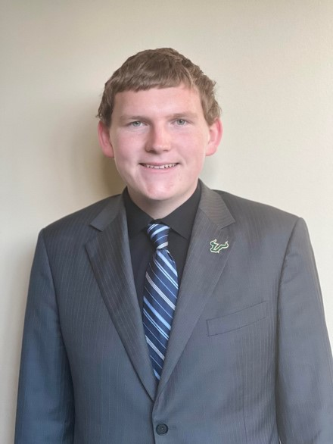
Sean Schrader 2019 Graduate
University of South Florida major: Business Management and Master’s in Business Administration
Occupation: Office Manager, Office of the 13th Congressional District of Florida
Why IB?
I picked the IB program because I thought it would provide a unique opportunity to think outside of the box in different core subject areas, while applying classroom concepts to current issues.
How did the IB Program at Largo help me?
The IB program was an incredible opportunity to examine real-world issues from a global perspective and realizing the role we can all play in solving current, relevant issues of our time.
The time management experience I gained from IB has been invaluable. The only way I’ve been able to be involved in many activities both at USF and in the community is because of the skills I learned in high school.

Slide 34

Briana Reed 2021 Graduate
University of Central Florida
Entertainment Management
Why IB?
IB is a rigorous program and can be very intimidating, but trust me in the end you become accustomed to the workload. However, it goes beyond preparing you for college and makes you a more well-educated individual. Being educated is extremely valuable and the rigorous style of IB helps keep you on track to becoming a well-rounded individual.
How did the IB program help me?
I was almost entirely done with general classes when I started college.
Having so many credits completed gave me more time for having a job, participating in extracurriculars, and having a social life.
I received two scholarships that covered more than all of my tuition for my freshman year due to my success in the IB Program.
IB helped me become more educated on political issues in the world.
The IB program at Largo High gave me incredible teachers to look up to, who all inspired me to be the best version of myself.
IB helped me learn to balance school with my normal life and made the transition to college much easier than it was for many of my non-IB peers.

Slide 35

Sophie Rosengarten 2020 Graduate
Florida State University
Major: Environmental Science & Geography
Why IB?
It’s a way to challenge yourself by thinking creatively and with a worldview. Plus, it helps prepare you for college courses!
How did the IB Program at Largo help me?
Largo IB has the BEST high school teachers you’ll find. Not only did I feel extra prepared for my college courses because of them, but their classes were incredibly educational and enjoyable to attend. I miss seeing them every day!
I came into college with about 40 credits completed, giving me the option to either graduate early or double-major (I went with the latter!).
I chose to volunteer in the Clearwater Marine Aquarium’s education department for my long-term CAS service. This experience kick-started my passion for ocean research and conservation, and helped me land a summer internship in CMA’s resident sea turtle department after I finished my freshman year of college!

Slide 36

Chelsea Downes 2018 Graduate
Flagler College
Major: Deaf Education/Elementary Education
Occupation: Teacher of the Deaf 2nd-5th grade
Why IB?:
It will prepare you with strong skills and knowledge, which will make college much easier. In the long run, the critical thinking skills that you learn through the IB program set you up for success in your professional life.
How did the IB program helped me?
Collegiate-level academic skills that set me apart from my peers.
The ability to discuss difficult topics with respect and consideration of multiple perspectives.
Enough writing stamina to make it through the seemingly endless number of college essays
College credits that later helped me graduate a semester early
Tons of leadership experience!

Slide 37

Kevin Stein 2021 Graduate
Florida State University
Major: Political Science
Why IB?
I choose IB since I thought it would be the best high school education I could get within the state of Florida.
Plus, the aspect of Bright Futures made me want to join more and is in part way many students join IB. It helps prepare you for college because in college I don’t struggle as hard compared to non-IB students. IB prepares you to study hard and effectively so by college you can have fun with your fun time there as by then you learned how to effectively study.
How did the IB program help me?
Conditioned me to learn how to deal with lots of homework and time management.
Helped me mentality as before IB I was pretty sit in stone on my beliefs and the program at Largo helped me to expend my horizons plus, learn how others view the world.

Slide 39

Zoe Leousis 2022 Graduate
McGill University
Major: Political Science
Why IB?
A rigorous academic experience that is amazing prep for college.
How did the IB Program at Largo help Me?
Having to communicate with teachers about developing papers such as the EE and IAs gave me the confidence to now communicate with professors.
The credits I received from my IB diploma put me on track to complete my bachelor’s degree in 3 years
The IB diploma is internationally recognized, which gives you the ability to apply to schools around the world!

Slide 40

Gwynne English 2020 Graduate
Florida State University
Major: International Affairs and Spanish
Why IB?
Going into college I already had 44 credit hours completed and was able to double major, along with starting my masters early.
I received multiple merit-based scholarships from the Largo Rotary club and the Pinellas Seminoles Club based on the grades I received in the program.
College classes, especially the general education requirements, were really easy.
Coming out of IB, I find it easy to manage my schedule and utilize time management strategies to make sure all my work gets done and I still have time for extracurriculars.
I enjoyed having the teachers for multiple years in a row and being in a small program because it allows the teachers to focus on what students need most.
Even though we all went to different colleges, I am still close with my closest friends from the program and we make time to spend time when we can.
Overall, the IB program helped me to be an independent person both in my academic and personal life.

Slide 41
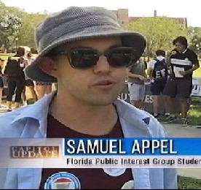
Samuel Appel 2021 Graduate
Florida State University
Major: Political Science
Why IB?
IB is a holistic program that will not only prepare you for college, but also challenge you critically and creatively.
How did the IB program at Largo help me?
Taught and promoted skills necessary to institutions of higher learning.
Provided ample credits within my institution, meaning I will graduate with a Master's degree only four years after HS.
Allowed me to grow as an individual, reforming ideas and beliefs on a personal level.

Slide 42

Madison Sheppard 2022 Graduate
Florida State University
Major: International Affairs and Political Science
Why IB?
IB prepared me for college more than I can describe and it allowed me to go into college with less nerves and a ton of credits.
How did the IB program help me?
I am so ahead of the games in terms of credit that I am almost done with all of my general education requirements and my international relations major. Now I am able to double major in political science as well.
Being in the IB program is what gave me my Bright Futures scholarship, which completely pays for my tuition. Because I already have tuition covered, I have more opportunity to look into studying abroad.
I am completely prepared to handle the workload I have experienced so far.
Compared to my peers who were not in IB, my stress over classes, assignments, and tests is much lower.
IB helped me develop my critical thinking skills, and has led me to be an analytical thinker.
The Largo IB program specifically helped develop me into the person I am today because of the amazing relationships I was able to make not only with my peers, but with my outstanding teachers as well.

Slide 43

Cheyanne Thompson 2021 Graduate
Flagler College
Major: Elementary Education with Music Minor
Why IB?
IB students develop strong academic, social, and organizational skills. Additionally, IB students learn from experiences and take action in the service of others. If you are looking to be a more well-rounded student, IB is the perfect match.
How did the IB program at Largo help me?
• Improved my public speaking skills
• Improved my organizational skills and study habits
• Became a critical and independent thinker
• Excelled in managing my time
• Became a well-rounded student

Slide 44
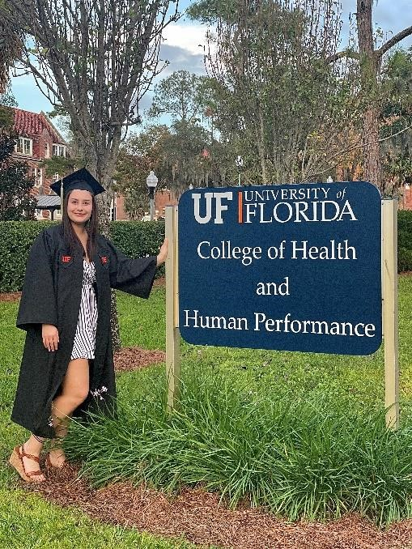
Samantha Askey 2019 Graduate
University of Florida
Graduate school: Doctor of Physical Therapy
How did the IB program help me?
Received 45+ credits from IB and AP but UF caps at 45
IB prepared me for the workload in college, undergraduate was easier than IB for me
Bright futures scholarship (FAS), able to apply to first year of grad school since I graduated early
CAS requirements automatically address the service hour requirement
Multiple components to the IB program taught me time management and made me a well-rounded student on my college applications
Learned how to consider and respect different perspectives because of TOK
Forces one to think critically from all facets

