Slide 1


Title I Annual Parent Meeting
Cross Bayou Elementary
August 24, 2022
5:00 pm
Cafeteria
Kathy Wickett
Notes:
Welcome Families to our title 1 annual meeting. We are glad you are here.

Slide 2

Education, then, beyond all other divides of human origin, is a great equalizer of conditions of men.”
– Horace Mann
Notes:
“Education, then, beyond all other divides of human origin, is a great equalizer of conditions of men.” – Horace Mann

Slide 3

All About Title I
Title I is the largest federal assistance program for our nation’s schools.
The program serves 75 schools in Pinellas County including eligible students in 36 non-public schools.
Notes:
Read slide

Slide 4
Title I Funding Process
Pinellas County Schools
Increased Student Achievement
Federal Government
1
3
2
4
Florida Department of Education
Cross Bayou Elementary
Notes:
The Florida Department of Education receives funds from the federal government. Districts receive Title I funds from Department of Education, and the school district distributes these funds to schools based on the percentage of children eligible for free/reduced price lunch; however, students do not have to be from low-income families to receive help.

Slide 5

Supplemental Resources
Definition: provided in addition to what is already present or available to complete or enhance it.
https://languages.oup.com/
Notes:
Title I is supplemental federal funding that provides e
Definition: provided in addition to what is already present or available to complete or enhance it extra academic support and learning opportunities for economically disadvantaged students.

Slide 6
Title I Programs Provide Supplemental Support
Supplemental Resource | Positive Impact
Additional supplemental personnel: MTSS Coach Hourly Teachers | Provide support for teachers for data analysis and targeting instruction to meet individual student needs. Provide small group support in Reading
Professional Development Book Study Collaborative Planning | Provides teachers with additional training and resources for instruction
Extended Learning Opportunities (before and/or after school programs) | Provides additional time for students on instruction after school
Parent and Family Engagement Resources and Training Workshops | Provides resources for families to extend learning at home and information/support on the curriculum their child is learning.
Supplemental teaching materials, equipment, and technology | Additional materials/resources for classrooms
Notes:
These are the supplemental resources we use title 1 funds for

Slide 7
Title I Schoolwide Planning and Input
First
Second
Last
Seek Input from school, family, and community members determine how Title I funds are used based on a needs assessment.
Please attend online or in-person meetings/trainings and complete surveys to provide input on Title I funding.
All Title I schools must document that parents are involved in the schoolwide planning process.
Notes:
We start planning for the following year in the Spring. We utilize parent surveys and information from PTA/SAC meetings

Slide 8

Title I Schoolwide Budget
Cross Bayou Elementary is provided $171,275.00 to pay for supplemental resources and programs for increased student achievement.
Personnel - $136,893.35 (80%)
Instructional Materials and Resources - $7110.42 (4%)
Professional Development - $27271.23 (16%)
4%
80%
Examples of what these funds provide:
Hourly Teachers/MTSS Coach
Classroom materials
Resource materials for classrooms
Additional Planning Time for Teachers
Teacher Training
Notes:
We have 2 Title 1 Budgets. The first is the Schoolwide Budget to help the school and the second is the Family Engagement Budget. This is the breakdown of the Schoolwide budget.

Slide 9
Title I Family Engagement Budget
Cross Bayou Elementary is provided $6,500.00 to Support Family Engagement
Supplemental Hours for Family/Community Liaison - $3,374.66 (52%)
Family Engagement Resources - $3125.34 (48%)
4%
Examples of what these funds provide:
Agenda Books
Family Workshop Materials/Refreshments
Curriculum resources for families
80%
52%
To meet family needs we schedule some events in the mornings and some in the evenings. We also will be holding our PTA/SAC meetings in-person and on-line so families can participate even if they can not attend in person.
Notes:
This is the Family Engagement Budget

Slide 10

Parent’s Right to Know
As a parent of a student attending a Pinellas County School Public School, you have the right to…
Be
Be provided information on your child’s level of achievement on assessments in Reading/Language Arts, Writing, Mathematics, and Science.
Request and Receive
Request and receive information on the qualifications of your child’s teacher and supplemental personnel working with your child.
Be
Be notified of non-highly qualified or out-of-field teachers at the school.
Be
Be informed if your child is taught by a non-highly qualified teacher for four or more consecutive weeks.
Notes:
Parents have the right to know specific information – read the slide

Slide 11
Working Together for Student Success
As a Title I parent you have the right to be involved in the development of the following plans and documents for our school which can be found on our website www.pcsb.org/crossbayou-es to view as well as in the Parent Station located in the Front Office.
School Improvement Plan (SIP)
Title I Schoolwide Plan
Parent and Family Engagement Plan (PFEP)
School-Parent-Student Compact
Notes:
Our school’s Title I Parent Station is located in the front office and on the website in the Title 1 section.
You will find a copy of our School Improvement Plan, Title I Schoolwide Plan, School’s PFEP, the School District’s PFEP, Parent’s Right to Know Memo, Upcoming Events, Compact,

Slide 12

Parent-School-Student Compact
The purpose of the compact is to foster student achievement. By signing the Parent-School-Student Compact, Cross Bayou teachers, staff, parents and students agree to work together to share the responsibility of helping students meet or exceed state, district and school academic goals.
The Parent-School-Student Compact is updated every year to include parent, student, teacher, and staff input. Parent, student, teacher and staff comments are welcome at any time during the year.
Please review and sign your child’s Compact.
Our goal is to receive 100% signed compacts!
Notes:
At the elementary level, school compacts are used as a progress monitoring tool through the year during parent teacher conferences.
At each conference this year you will review the compact.

Slide 13
Compact Commitments
Parent Commitment
Make sure my child arrives at school on time.
Support the School Wide Expectations.
Sign my child’s agenda each night.
Collaborate with my child’s teacher.
Attend conferences.
Support school activities.
Ensure homework is completed.
Student Commitment
Arrive at school on time.
Follow School Wide Expectations.
Take responsibility for my actions and my learning.
Follow directions the first time.
Come to class prepared.
Respect myself and others.
Complete and turn in homework on time.
Teacher Commitment
Provide a positive, safe and caring environment.
Apply School Wide Expectations fairly.
Communicate with parents in the agenda daily.
Provide focused, planned and purposeful instruction.
Provide information about your child’s progress.
Seek ways to involve parents in school/class.
Monitor homework completion/accuracy.
Notes:
Read slide

Slide 14

Parent and Family Engagement Plan (PFEP)
The PFEP Sections include information about the following:
Parent trainings to increase student achievement
Staff trainings for engaging parents
Communication methods between home and school
Flexible meeting times
Accessibility for parents
Coordinating with other Federal Programs
Notes:
WE have planned monthly family events and encourage parents to participate in PTA/SAC

Slide 15
Parent Advisory Council (PAC)
The District has a Parent and Family Engagement Plan. The summary of the plan is in the Title I School & Family Partnership Overview.
You may access the full plan at www.pcsb.org/titleone
The Parent Advisory Council (PAC) is responsible for reviewing and revising the District PFEP.
PAC will meet virtually or in-person with the district’s Title I staff.
Each school is committed to having at least one member representative on PAC.
PAC meets twice a year, if you are interested in representing our school please notify Kathy Wickett at 547-7834 or wickettk@pcsb.org.
Notes:
Read slide

Slide 16
Recruitment Video: We Want you !
Parent Advisory Council (PAC) Video
Notes:
Please play the 1-minute video to share with families about the PAC and the interest form (which is on the next slide).

Slide 17
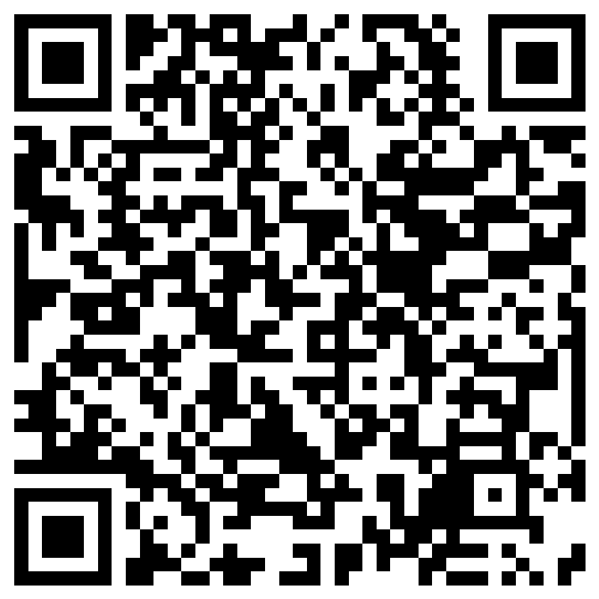
Parent Advisory Council (PAC) Interest Form
Notes:
Please complete the form if you are interested in representing your school/community.
Please allow a minute for interested families to complete the form during the meeting.
Here is the link for you to share also: https://forms.office.com/r/XYv54tECMy

Slide 18

Accountability
School Report Cards
School Grade and Overview
Population and Enrollment
Assessments – Academic Achievement, Growth, and Population
Assessments – English Language Learners
Graduation and Beyond
Educator Qualifications and Equity
Long-Term Goals and Interim Progress
Accelerated Course Enrollment
Per-Pupil Expenditures
National Data
Available online at https://edudata.fldoe.org/ or Front Office
Notes:
Our school did increase our School Grade percentage points by 57 points. Last year we were held harmless (kept the grade we had from the year before which was a C, even though technically we would have been a D based on student scores). This year we are a strong C and will be working toward achieving a grade of B or higher.

Slide 19


Shift to New B.E.S.T. Standards
Notes:
All curriculum, instruction and assessments are based on student-centered expectations.
FSA → Transition to BEST!
https://www.flgov.com/2021/09/14/governor-desantis-announces-end-of-the-high-stakes-fsa-testing-to-become-the-first-state-in-the-nation-to-fully-transition-to-progress-monitoring/

Slide 20


Florida Benchmark For Excellent Student Thinking Standards (B.E.S.T). You may read more information by visiting, http://www.fldoe.org/standardsreview/
Notes:
All curriculum, instruction and assessments are based on student-centered expectations.

Slide 21

New Assessment: FAST
More information can be found about the FSA Transition to FAST:
https://feaweb.org/fsa-transition-to-fast/
Source: https://www.flgov.com/2021/09/14/governor-desantis-announces-end-of-the-high-stakes-fsa-testing-to-become-the-first-state-in-the-nation-to-fully-transition-to-progress-monitoring/

Slide 22

School’s Curriculum
Florida Benchmark For Excellent Student Thinking Standards (B.E.S.T). form the framework of everything taught at school.
Core Curriculum
Reading
Mathematics
Writing
Science
Social Studies
Notes:
This slide is optional if this will be discussed with classroom teacher
School’s Curriculum
Describe and explain the curriculum (Specific names of texts)

Slide 23

Working Together for Student Success
Please join us…
Bobcat Assembly – 9/30 7:45 am
Walk and Roll to School – 10/12 – 7:00 am
Patriotic Concert – 11/10 – 6:00 pm
Notes:
Listed are some upcoming events. All families received an orange flyer with a list of additional upcoming events.

Slide 24
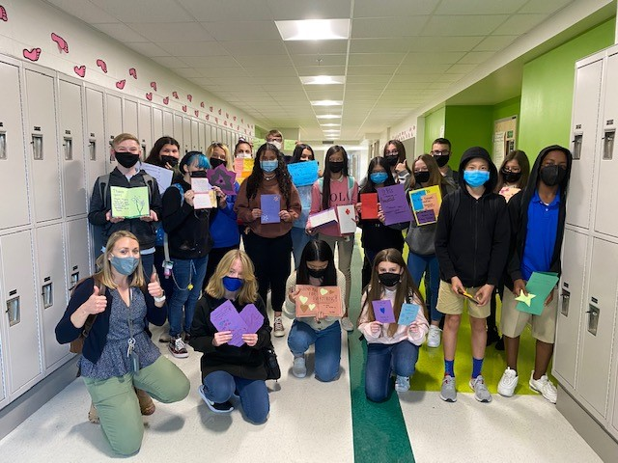

Additional Resources
Learning at Home Family Resources - https://www.pcsb.org/Page/32836
Volunteer in a Pinellas County School - https://www.pcsb.org/Page/459
Parent Academy POWER HOURS Webinars - https://www.pcsb.org/Page/26534
Partnerships - https://www.pcsb.org/Page/418

Slide 25
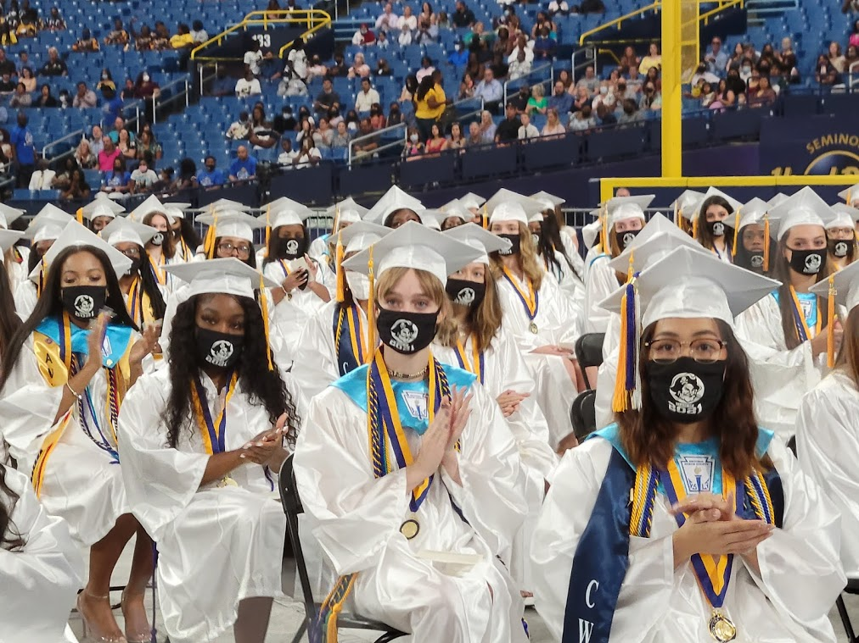
We appreciate your time!
Please feel free to ask any questions and provide feedback on our Title I Program.

Slide 26
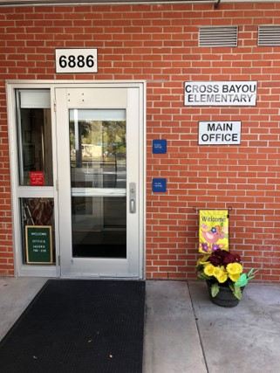
Contact Us
Cross Bayou Elementary
6886 102nd Ave N
Pinellas Park, FL 33782
727-547-7834
Kathy Wickett – Principal
Eileen Stull Assistant Principal

Slide 27
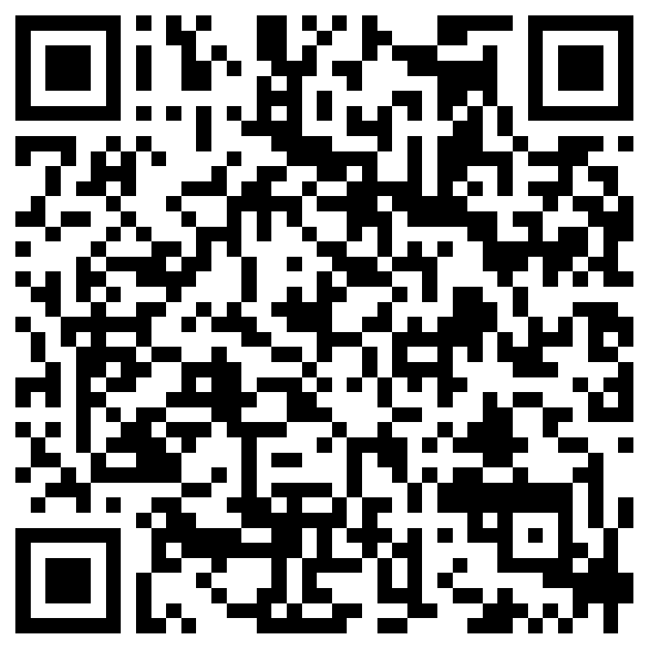
Please take the time to participate in our survey.
Please complete your survey before you leave tonight and place it in the bins at the back of the cafeteria or on the patio or scan the QR code to complete the survey online
Your feedback is greatly appreciated!
Notes:
I will put back up the slide of supplemental resources for you to reference for your survey, since we have covered a lot of information this evening.

Slide 28
Title I Programs Provide Supplemental Support
Supplemental Resource | Positive Impact
Additional supplemental personnel: MTSS Coach Hourly Teachers | Provide support for teachers for data analysis and targeting instruction to meet individual student needs. Provide small group support in Reading
Professional Development Book Study Collaborative Planning | Provides teachers with additional training and resources for instruction
Extended Learning Opportunities (before and/or after school programs) | Provides additional time for students on instruction after school
Parent and Family Engagement Resources and Training Workshops | Provides resources for families to extend learning at home and information/support on the curriculum their child is learning.
Supplemental teaching materials, equipment, and technology | Additional materials/resources for classrooms

