Slide 1








Middle School

Slide 2
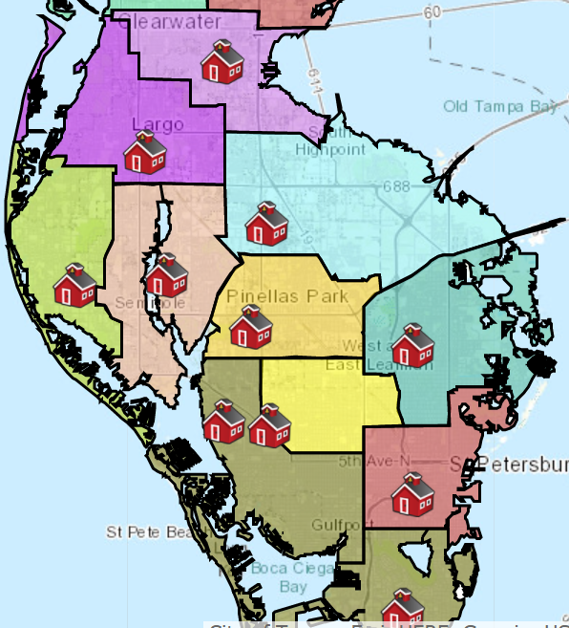
Where will you go to middle school?
Most students are zoned for Morgan Fitzgerald and Pinellas Park Middle.
Some students are zoned for Largo, Osceola, and Meadowlawn.
If your parents applied, you may be attending a magnet school, fundamental school, or other special application program (i.e. Thurgood Marshall, Madeira Beach Fundamental, etc.)

Slide 3

What will your day look like?
You will have a minimum of 7 periods (classes) a day
4 Required courses: Math, Language Arts, Science, Social Studies
2-3 Electives which includes Physical Education (P.E.)- at least one semester per school year.
30 minutes for lunch
4 minutes of passing time between classes
School hours:
9:40am-4:10pm

Slide 4

General Middle School Curriculum Overview
Students must pass all 12 of the following courses or higher level courses in order to go on to high school:
Language Arts: 6th, 7th, 8th
Mathematics: 6th, 7th, 8th
Science: 6th, 7th, 8th
Social Studies: 6th, 7th, 8th

Slide 5

A little insider information
Your FSA and MAP scores are used to put you into classes.
If you score a level 2 on FSA Math, you will be offered an Intensive Math course which you will take instead of an elective.
Students who score a level 1 or level 2 on FSA Reading in 5th grade, will be enrolled in and complete an Intensive Reading course in middle school. This intensive reading course will take the place of one elective.
How you score on the FSA Reading test will determine whether you are on a traditional or accelerated scheduling track for Social Studies.

Slide 6





Electives
AVID
Visual Arts
Band/Orchestra
Chorus Basic Theater/Exploring Music
Physical Education STEM
Gymnastics/Dance Family & Consumer Science
Computers/Technology Journalism
World Language (Spanish, French, ASL)
Gifted*

Slide 7
Extracurricular Activities
Options are different at every school
Science Olympiad
Chorus
National Junior Honor Society
STEM
Principal’s Multicultural Advisory Committee (PMAC)
Student Council
Athletics

Slide 8
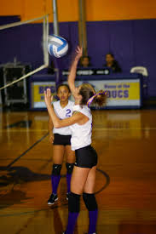

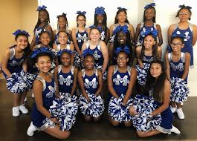
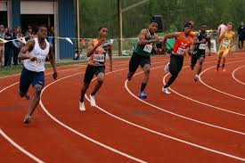
Middle School Athletics
Volleyball
Basketball
Cheerleading
Track

Slide 9

6th Grade Expo Nights
This is your opportunity to take a tour of the school, meet administrators and teachers, and learn about programs and activities.
School | Date | Time
Dunedin Highland MS | March 3, 2022 | 6:00 PM
John Hopkins MS | March 10, 2022 | 6:00 – 8:00 PM
Largo MS | March 8, 2022 | 5:30 - 6:30 PM
Meadowlawn MS | March 8, 2022 | 5:00 PM
Madeira Beach Fundamental MS | March 10, 2022 | 5:30 PM *Accepted student only
Morgan Fitzgerald MS | March 9, 2022 | 6:00 – 7:15 PM
Osceola MS | March 7, 2022 | 5:30 - 7:00 PM
Pinellas Park MS | March 8, 2022 | 6:00 - 7:30 PM
Thurgood Marshall Fundamental | March 9, 2022 | 6:00 PM *Accepted students only

Slide 10

Summer Bridge
The Summer Bridge Middle School Program helps students develop and strengthen skills in math, reading, science or social studies, with a blend of technology, small group instruction, manipulatives, hands-on labs and project-based learning. Students will have the opportunity to take an elective during summer bridge, too! Course recovery courses will also be offered to eligible students in math, science, social studies and language arts.
Dates: June 6th - 30th Breakfast and lunch available
Monday-Thursday Student Hours: 8:30am - 1:30pm
Locations: Azalea, Bay Point, Carwise, Clearwater Intermediate, Dunedin Highlands, James B. Sanderlin, John Hopkins, Largo, Meadowlawn, Morgan Fitzgerald, Oak Grove, Osceola, Palm Harbor, Pinellas Park, Safety Harbor, Seminole, Tarpon Springs, Thurgood Marshall and Tyrone

Slide 11

School | Grade Level Administrators | School Counselors | Phone Number
Dunedin Highland MS | Dianna Dolan | Courtney Northcutt | 727-469-4112 x2060
John Hopkins MS | Kimberly Vongsyprasom | Cheryl Wright | 727-893-2400 x2036
Largo MS | Salima Lakhani | Maisha Alexander | 727-588-4600
Madeira Beach Fundamental MS | Carolyn Altenore | Kristen Vermillion Dave Rosenberger | 727-547-7697
Meadowlawn MS | Alfredo Blanco | Megan Stifnell | 727-570-3097 x 2061
Morgan Fitzgerald MS | Christine Douglass Leah Donnelly | Jessica Read | 727-547-4526 x2015
Osceola MS | Dr. Dustin Adams | Allison McLellan | 727-547-7689 x2036
Pinellas Park MS | Dr. Julius Wynn | Kiara Kill | 727-669-1146 x2051
Thurgood Marshall Fundamental MS | Katie Slifkin | Heather Nemeth | 727-552-1731

Slide 12


Mrs. Odrzywolski
We will meet to discuss your electives and make course selections together.
I’m here to help you make a smooth transition into Middle School!

