Slide 1
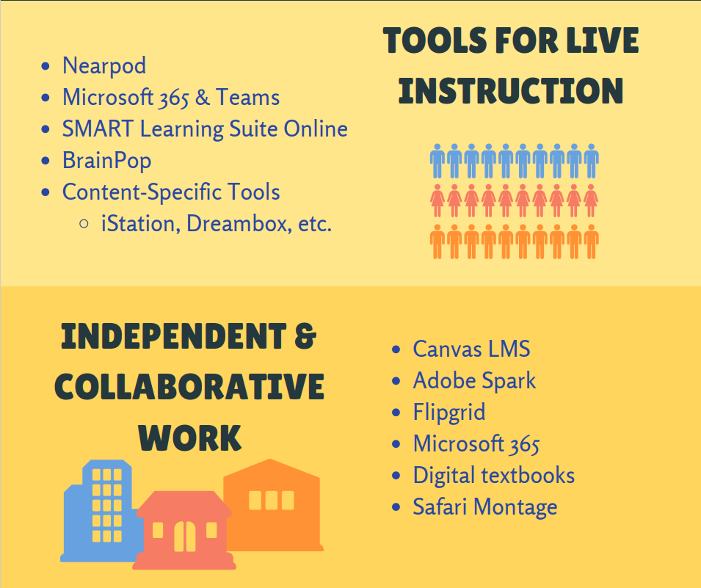
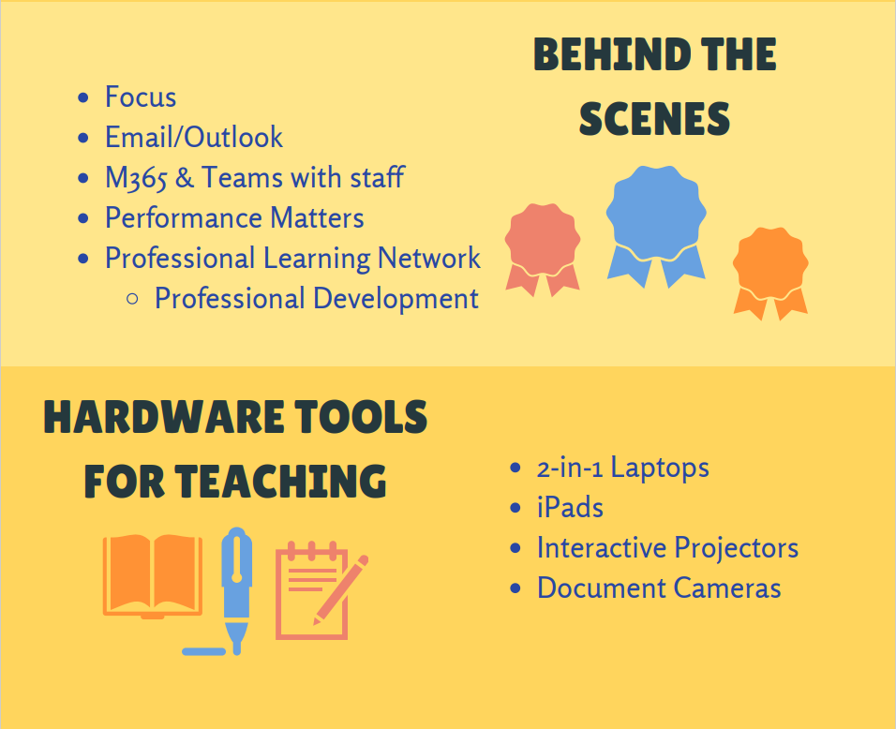
The right tool for the right job
PCS DIGITAL ECOSYSTEM
Single sign on powered by Clever

