Slide 1



Welcome to AVID

Slide 2


What IS AVID?
AVID (also known as Advanced Via Individual Determination) is a nonprofit organization that changes lives by helping schools shift to an equitable, more student-centered approach. It provides college/career exposure to students.

Slide 3
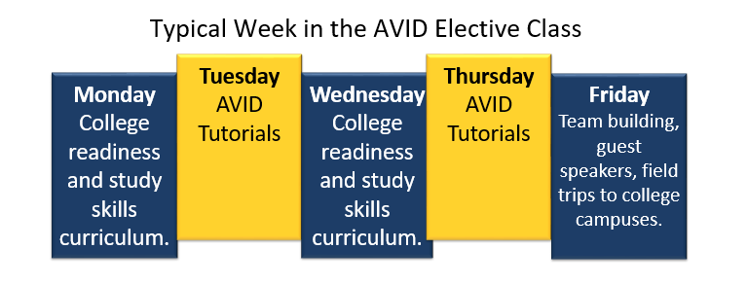
Course Description
AVID is a full year elective class, designed for students to accomplish the following:
Succeed in rigorous curriculum
Prepare students for college readiness.
Increase enrollment in 4-year colleges.
Become educated and responsible participants and leaders.

Slide 4


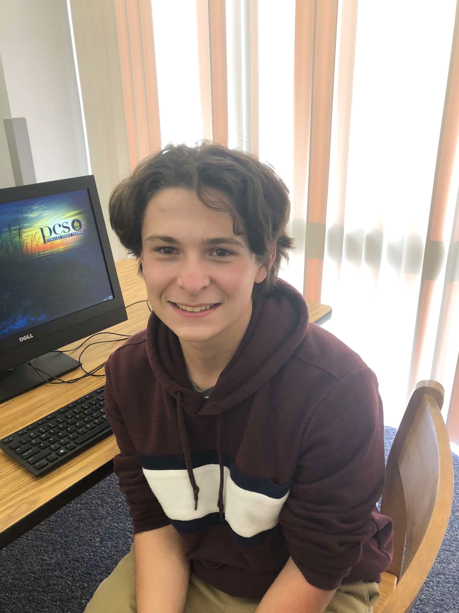
Senior students who have gotten into college
Sabira Mahmuti
Accepted into: University of South Florida, Loyola University of Chicago, and DePaul University.
Emma Mustafaraj
Andrew Smithers
Accepted into: University of South Florida and Nova Southeastern University.
Accepted into: University of South Florida.

Slide 5
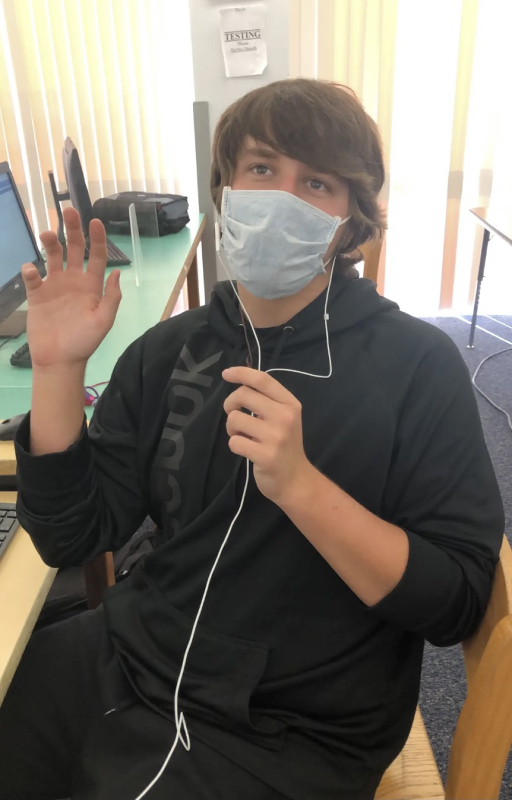

Quotes from avid students what was your favorite part about avid?
"Mrs. Wisemans teaching for college prep"
–Jack Hummell
"AVID has given me some wise words and wisdom, I am grateful for the advice"
-Aidan Griesgrieber

Slide 6
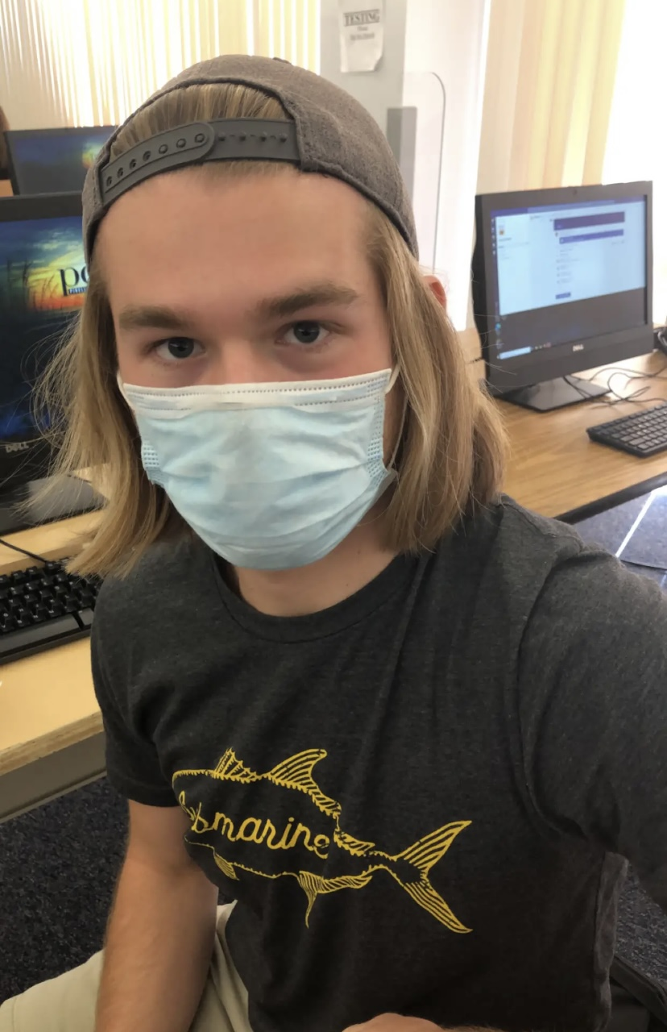

Quotes from avid students what was your favorite part about avid?
"AVID really helped me open up socially and meet a lot of new people, as well as keeping me organized and maintaining decent grades."
-Vasili Vassilakos
"Doing TRF's with friends"
-Zach Kelley

Slide 7

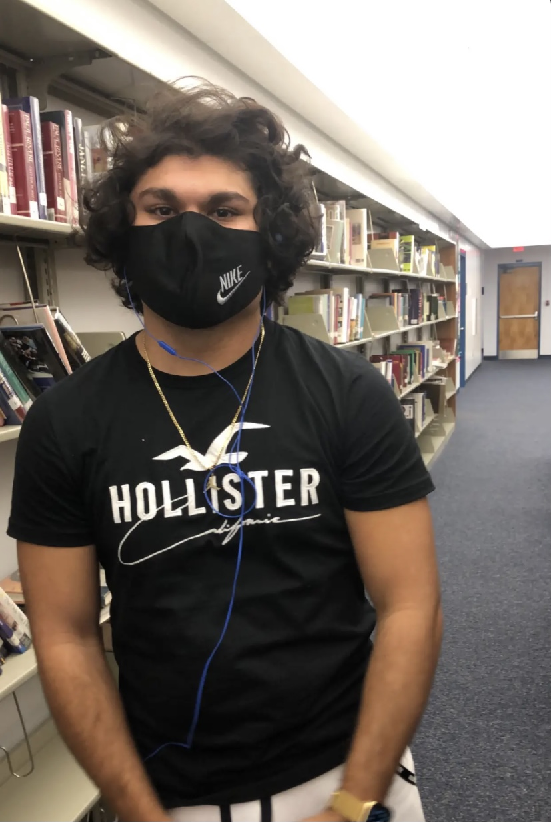
Quotes from avid students what was your favorite part about avid?
"Learning with friends and fixing my grades"
-Maksym Dimarov
"Doing projects"
-Antonio Mustafic

Slide 8


Quotes from avid students what was your favorite part about avid?
"AVID was an important part of my adolescence and I am thankful for foundation. My favorite part was teaching me organization and being around likeminded people" -Gianna Villani
"My favorite part about avid is that everyone is so nice and friendly and always willing to help each other out and it really helps my grades get higher."
-Alaina Rivera

Slide 9

Thank you! Please consider joining avid. ANy questions?

