Slide 1
Course Opportunities for Green Devil Students
St. Petersburg High School
2023/24
Notes:
Why am I here???

Slide 2
Minimum Requirements
4 English
4 Math including Algebra and Geometry
3 Science including Biology
3 Social Studies
  World History
  US History
  Economics (semester)
  US Government (semester)
HOPE
1 Fine Art
Pass Reading and Math Tests
2.0 Cumulative GPA
24 Credit

Slide 3
Weighted Courses
Honors
Dual Enrollment / Advanced Placement
Weighted at +.5
  A = 4.5
  B = 3.5
  C = 2.5
A step above “regular” but still HS level.
Weighted at +1
  A = 5
  B = 4
  C = 3
College Level course work

Slide 4
Comparing Apples to Oranges
DUAL ENROLLMENT
ADVANCED PLACEMENT
HS GPA only
College credit earned through test or task
Standardized curriculum
Open access to motivated students (AP Potential)
Only at HS
No cost to student
HS & College GPA
College credit from grade
Locally defined curriculum
Minimum testing and GPA requirements determine access
At HS or SPC Campus
No cost to student

Slide 5
Dual Enrollment on Campus
English Composition I and II
American History I and II (can meet US History requirement if both completed)
Greek Mythology (1 Semester)
College Experience (1 Semester)
Elementary Spanish I and II (1 semester each)

Slide 6
AP Courses Offerings
2D Art and Design
3D Art and Design
Biology
Calculus AB
Calculus BC
Chemistry
Computer Science Principles
Drawing
Economics (Macro/Micro)
English Language and Composition
English Literature and Composition
Environmental Science
European History
Human Geography
Music Theory
Physics 1
Psychology
Research (CAPSTONE)
Seminar (CAPSTONE)
Spanish Language and Culture
Spanish Literature and Culture
Statistics
US Government and Politics
US History
World History: Modern

Slide 7

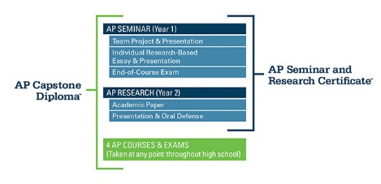

Slide 8
AP Capstone
Curriculum written at the request of and in partnership with major colleges/universities to strengthen pool of candidates with strong skills in:
Argumentation | Critical Thinking
Collaboration | Public Speaking
Research | Technical Writing

Slide 9
Arts Opportunities
Visual Arts
  Creative Photography
  2D Art
  3D Art
  Drawing
Performing Arts
  Eurythmics
  Band
  Orchestra
  Music of the World
  Keyboarding
  Music Theory
  Chorus
  Theatre
  Cinema and Film Production
  Musical Theatre
  Theatre Tech, Design and Production
  Digital Information Tech
  Journalism – Devil Vision or Yearbook
  Debate

Slide 10
In AVID Students...
All take advanced courses
Support and Challenge Each
Tutorials with College Students
Engage in rigorous academic discussion
Research and Identify College Options
Visit Colleges
Hear from Guest Speakers
Complete College Applications
Complete Scholarship and Financial Aid Applications

Slide 11
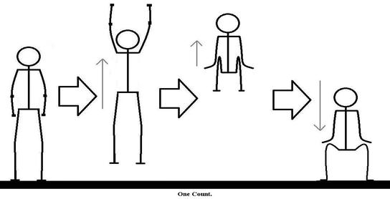
Where Should I Stretch?
What does your AP Potential say?
What classes have you done well in?
What do you ENJOY!!!
What are your goals?
What else do you have going on?
This Photo by Unknown Author is licensed under CC BY-SA

Slide 12
ELP Options
In the Media Center
After School Mondays, Wednesdays and Thursdays
Saturdays from 9:00-12:00

Slide 13
Credit Recovery Options
Summer Bridge – This option allows students to make up courses quickly over the summer. They begin the next year on track and do not lose classes during the day.
APEX – This puts students in an online credit recovery course during the school day. They do not begin the year on track and lose an elective during the day.

Slide 14
https://forms.office.com/r/Dn3dQzhkyN

