Slide 1


LARGO HIGH SCHOOL
International Baccalaureate Diploma Programme
School Profile 2023-2024
ADMINISTRATION
Jennifer Staten, Principal
vragovicj@pcsb.org
Michael Vasallo, IB Coordinator
vasallom@pcsb.org
Takeiah Perry, IB Counselor
perryta@pcsb.org
Marlee Piittmann, IB Clerk
piittmannm@pcsb.org
CONTACT
410 Missouri Avenue
Largo, Florida 33770
Phone: 727-588-3758
Fax: 727-588-4037
www.pcsb.org/largo-hs
CODES
CEEB: 100925
IB: 049031
ACCREDITATIONS &
AFFILIATIONS
Cognia Accreditation
Florida Association of IB
World Schools
Southern League of
Colleges and Schools
MISSION
Positive rigorous instruction
designed to empower students’
learning and success in
post-secondary endeavors
promoting civic engagement,
global understanding, and a
respect for individuals and
societies.
OUR SCHOOL
Established in 1914, Largo High School (LHS) serves the 4th largest urban city of Largo in the Tampa Bay area enrolling 2,112 scholars in the Pinellas School District. This public school offers two magnet programs, the International Baccalaureate (IB) and Exploring Careers & Education in Leadership, plus the traditional program with course options in remedial, regular, honors/pre-IB, Advanced Placement (AP), and IB Diploma. Instituted in 2013, the fast growing 4-year IB program attracts highly motivated scholars in the economically diversified central section of Pinellas County. Admission for the IB program in Pinellas County is by application only; criteria for admission includes: an academic GPA (A’s and B’s only), completion of Algebra 1 Honors, and above average standardized test scores.
INTERNATIONAL BACCALAUREATE DIPLOMA PROGRAMME
The IB Diploma Programme, one of the most rigorous curricula offered in the world, is a highly demanding pre-university course of study, and the most demanding program at Largo High School.
The IB Diploma Programme is structured to provide scholars with a rigorous and balanced education, to facilitate geographic and cultural mobility, and to promote international mindedness and awareness.
The IB Diploma Programme consists of 6 Core IB Subjects, 150 hours CAS (Creativity, Activity, Service), 4000 Word Extended Essay, 1 Theory of Knowledge course which includes a 1,600 Word Essay and Oral Presentation
Courses are examined externally in May of Grade 12, but all have at least a 20% internally assessed component. Each subject is graded on a 1 (minimum) through 7 (maximum) scale. The IB Diploma is awarded by the International Baccalaureate Organization in July after the scholar's high school graduation.
Largo High School enjoys a culturally and economically
diverse ethnic distribution.
25% Hispanic 16% Black 8% Asian 5% Multi/Other 47% White
60% of scholars qualify for free and reduced lunch.
Class of 2022 Highlights
National Merit Finalists: 2 IB Scholars
National Merit Commended: 6 IB Scholars
SAT Average: 1308 Composite
ACT Average: 26 Composite

Slide 2

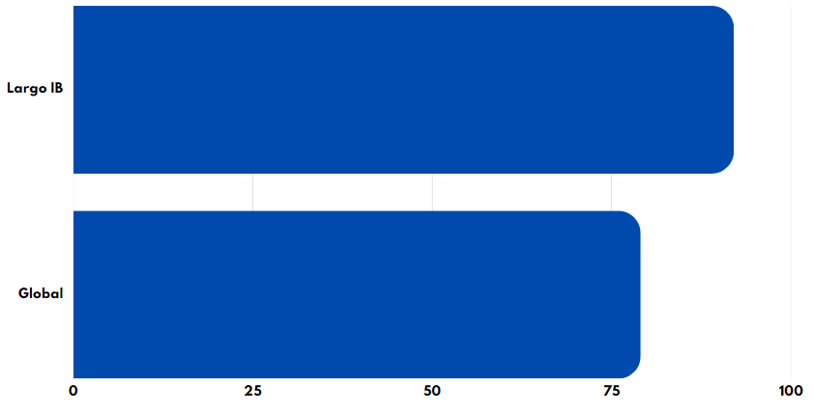
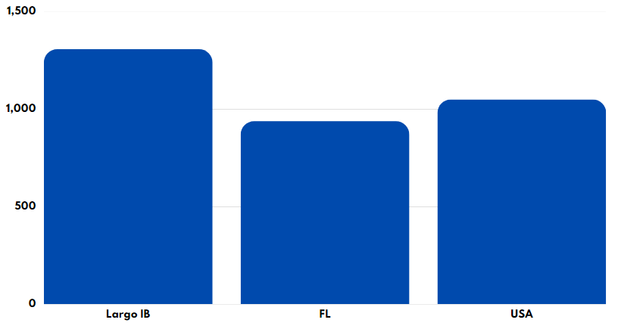
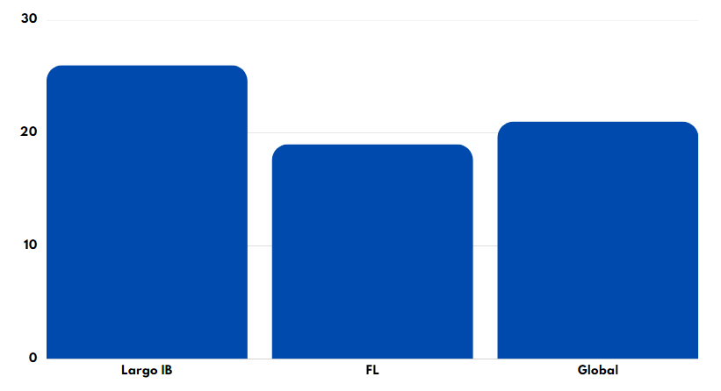
LARGO HIGH SCHOOL
International Baccalaureate Diploma Programme
School Profile 2023-2024
STANDARDIZED TESTS AND RECOGNITIONS
IB EXAM AND DIPLOMAS PASS RATE (2023)
LHS IB Class:
SAT AVERAGE COMPARISON (2023)
LHS IB Class:
Florida:
USA:
ACT AVERAGE COMPARISON (2023)
LHS IB Class:
Florida:
USA:
AP EXAM (2023)
Students taking APs: 162
Exams administered: 323
Number of Scores 3: 98
Number of Scores 4: 85
Number of Scores 5: 64
NATIONAL MERIT (2023)
National Merit African: 1
National Merit Hispanic: 1
National Merit Commended: 6
National Merit Finalists: 2
92%
79%
IB ENROLLMENT
50 Class of 2024
276 Total IB Scholars 2023-2024
IB GRADUATION RATE
100% Classes of 2015 – 2023
SCHOLARSHIPS
$3.1 Million (47 graduates; Class of 2023)
AWARDS
Academic Team: 20 Wins – 1 Loss
History Bowl: Qualified for Nationals
Model UN: Best Delegation
Secretary General’s Award
Science Olympiad: West Region Champion
Football: Regional Finals
Soccer - Boys: District Champion
Track & Field - Girls: 4th in State
1308 Composite
983 Composite
1050 Composite
26 Composite
19 Composite
21 Composite
CREATIVITY, ACTIVITY, SERVICE
Creativity, activity, service (CAS) is one of the three essential elements in every student's IB experience. It involves students in a range of activities outside the classroom providing a counterbalance to their studies. The three levels of CAS enhance a student's personal development through purposeful activities, personal challenges, and reflections on outcomes and learning.
Creativity: Encourages students to participate in the arts and creative thinking.
Activity: Encourages students to develop a healthy lifestyle through physical activity.
Service: Encourages students to volunteer within their communities for personal growth and learning.
In order to demonstrate these concepts, students are required to undertake a CAS project that challenges students to: show initiative, demonstrate perseverance, and develop skills such as collaboration, problem solving and decision making.

Slide 3
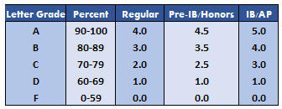
LARGO HIGH SCHOOL
International Baccalaureate Diploma Programme
School Profile 2023-2024
LHS COURSES AND ACTIVITIES
LHS PRE-INTERNATIONAL BACCALAUREATE
IB MYP Algebra 2
Pre-Calculus Honors
Pre-IB Art
Pre-IB Biology
Pre-IB Chemistry
Pre-IB English
Pre-IB French
Pre-IB Inquiry Skills
Pre-IB Music
Pre-IB Spanish
Pre-IB Theatre
Pre-IB World History
Spanish 5 Honors
US History Honors
*Non-Academic Electives
not listed
AICE / ADVANCED
PLACEMENT
AP Calculus AB
AP Calculus BC
AP Chemistry
AP Computer Science Principles
AP Environmental Science
AP European History
AP Human Geography
AP Music Theory
AP Physics 1, 2
AP Spanish Language and Culture
AP Statistics
AP Studio Art 2-D
AP World History: Modern
AICE Psychology
* IB scholars have little room for AP coursework in their schedule due to IB Diploma Programme requirements
INTERNATIONAL
BACCALAUREATE
IB Biology HL/SL
IB Chemistry HL/SL
IB Contemporary History HL/SL
IB Dance HL/SL
IB English Language & Literature HL/SL
IB Film SL/HL
IB French SL
IB Global Politics HL/SL
IB History of the Americas HL/SL
IB Math Analysis & Approaches SL
IB Math Applications & Interpretation HL/SL
IB Physics HL/SL
IB Spanish HL/SL
IB Music HL/SL
IB Theatre HL/SL
IB Theory of Knowledge
IB Visual Arts HL/SL
* During the junior and senior years, IB scholars
take three IB classes at the standard level (SL), three at the higher level (HL), and Theory of Knowledge
CLASS RANK AND GPA
The school year is divided into two semesters and students take 8 courses each semester. All high school courses taken in middle and high school are included in the grade point average (exact), and class rank. Quality points (weighted coursework) are designated with a "Q" on official transcripts. IB Diploma Programme Scholars do not have access to Dual Enrollment coursework with our local state college due to program limitations.
STUDENT ORGANIZATIONS
5000 Role Models, Academic Team, Asian American Student Association, Automotive/Skills USA, Badminton,, Chess & Board Games Club,, Color Guard, Crocheting and Knitting Club, Cultural Dance Club, DECA, Drama Club, Dungeons and Dragons Club, Environmental Club, E-sports & Gaming, ExCEL Board of Student Advisors, Fellowship of Christian Athletes, Family Career and Community Leaders of America, Freshman Council, Girlfriends, Gay-Sexuality Alliance, Future Health Occupations Students of America, History Bowl Team, International Cooking Club, Japanese Friendship Club, Junior Council, Junior Statesmen of America, Key Club, LHS Rocketeers, Model UN, Mu Alpha Theta, Muslim Student Association, National Art Honor Society, National English Honor Society, National Honor Society, Octagon, Packer Pen, Pickleball Club, Robotics, Science National Honor Society/Science Olympiad, Senior Council, Student Government Association, Sophomore Council, Spanish Club, Spanish Honor Society, Students Against Tobacco, Senior Council, Super Hero Club, Thespians, Ultimate Frisbee, Women's Empowerment
ATHLETICS
Baseball, Basketball, Cheerleading, Cross Country, Flag Football, Football, Golf, Lacrosse, Soccer, Softball, Swimming, Tennis, Track, Volleyball, Wrestling
Unweighted GPA (Class of 2023)
3.74 Average GPA (78 Graduates)
4.00 GPA earned by 7 scholars
Weighted GPA (Class of 2023)
4.5+ GPA earned by 21 scholars
4.0+ GPA earned by 40 scholars
3.8+ GPA earned by 48 scholars

Slide 4
LARGO HIGH SCHOOL
International Baccalaureate Diploma Programme
School Profile 2023-2024
COLLEGE AND UNIVERSITY ACCEPTANCES: CLASSES OF 2015-2023
Adelphi University
American University
Amherst College
Andrews University
Appalachian State University
Arcadia University
Arizona State University
Assumption College
Auburn University
Baylor University
Bentley University
Binghamton University
Boston University
Brandeis University
Brown University
Bryn Mawr College
Bucknell University
California State Polytechnical University
California State
Carnegie Mellon University
Champlain College
Chapman University
College of Charleston
College of William and Mary
Colorado School of Mines
Columbia University
Cornell University
Dartmouth College
DePaul University
Drexel University
Duke University
Eckerd College
Elon University
Embry Riddle Aeronautical University
Emerson College
Emory University
Flagler College
Florida Atlantic University
Florida Gulf Coast University
Florida Institute of Technology
Florida International University
Florida Polytechnic University
Florida Southern College
Florida State University
Fordham University
George Mason University
George Washington University
Georgetown University
Georgia Institute of Technology
Georgia State University
Harvard University
Harvey Mudd College
Haverford College
Hawaii Pacific University
HEC Montreal
Hollins University
Howard University
Illinois College
Illinois Institute of Technology
Iowa State University
Jacksonville University
John Hopkins University
Johnson and Wales University
Kansas State University
Lehigh University
Louisiana State University
Loyola Marymount
Loyola University
Manhattan College
Marymount University
McGill University, Canada
Mercer University
Michigan State University
Middlebury College
Mississippi State University
Molloy College
New College of Florida
New Mexico State
New York Institute of Technology
New York University
North Carolina State University
Northeastern University
Northwestern University
Nova Southeastern University
Oberlin College and Conservatory
Ohio State University
Oklahoma City University
Pace University
Pennsylvania State University
Piedmont International University
Purchase College
Purdue University
Quinnipiac University
Rensselaer Polytechnic Institute
Rhodes College
Rice University
Rollins College
Santa Fe College
Savannah College of Art & Design
Silliman University, Philippines
Southern Adventist University
Southern Methodist University
St. John’s University
St. Petersburg College
Stanford University
Stetson University
Stony Brook University
Syracuse University
Temple University
Texas A&M
The Citadel
Trinity College
Tuskegee University
United States Airforce Academy
United States Military Academy
United States Naval Academy
University of Alabama
University of Alaska
University of Arizona
University of Arkansas
University of Bonn, Germany
University of California
University of Central Florida
University of Chicago
University of Cincinnati
University of Colorado
University of Connecticut
University of Florida
University of Georgia
University of Illinois
University of Jamestown
University of Maryland
University of Massachusetts
University of Miami, Florida
University of Miami, Ohio
University of Michigan
University of Minnesota
University of Mississippi
University of North Carolina
University of North Dakota
University of North Florida
University of Oklahoma
University of Pennsylvania
University of Rochester
University of San Francisco
University of Southern California
University of South Carolina
University of South Florida
University of Southern California
University of Tampa
University of Tennessee
University of Texas
University of Toledo
University of Utah
University of Virginia
University of Washington
University of Wyoming
Vanderbilt University
Vassar College
Villanova University
Virginia Tech
Virginia Wesleyan University
Wake Forest University
Washington University in St. Louis
Wesleyan University
Yale University
CLASS of 2023
BY THE NUMBERS
47 Graduates
3.74 Average GPA
$3.1 Million in scholarships
213 College acceptances
25% Attending out of state
16 Different colleges enrolled

