Slide 1


Lakewood High School
AVID Recruitment Night
Thursday, February 7, 2019
6 pm
Erin Savage, Principal
Chantella Moore, AVID Coordinator

Slide 2












#WEARECOLLEGEBOUND

Slide 3
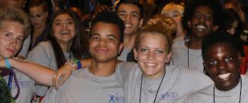


What is AVID?
AVID, which stands for Advancement Via Individual Determination, is a college readiness program designed to help students develop the skills they need to be successful in college. The program places special emphasis on growing writing, critical thinking, teamwork, organization and reading skills.

Slide 4
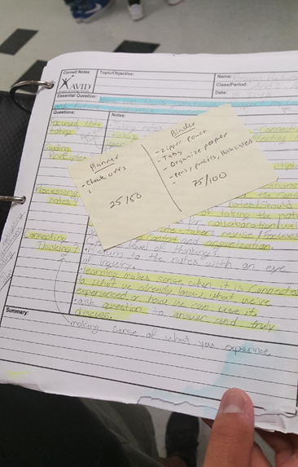

The AVID Elective
The core component of the AVID program is the AVID Elective, which supports students as they tackle the most rigorous classes.
For one period every other day, AVID students learn
organizational and study skills,
work on critical thinking and asking probing questions,
get academic help from peers and college tutors, and
participate in enrichment and motivational activities that make college seem attainable.
Furthermore, AVID students become academically successful leaders and role models for other students on campus.

Slide 5

The AVID Elective
The AVID Elective is driven by the WICOR method, which stands for
Writing
Inquiry
Collaboration
Organization
Reading

Slide 6
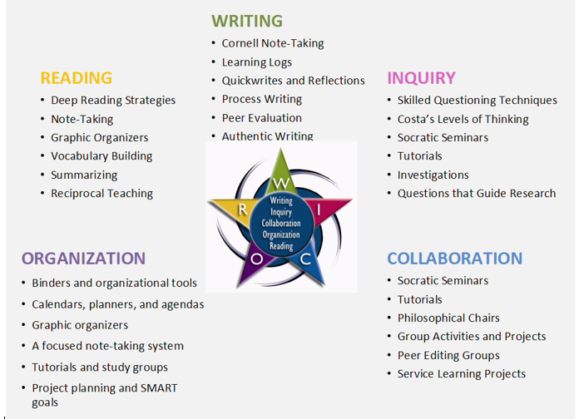
WICOR

Slide 7
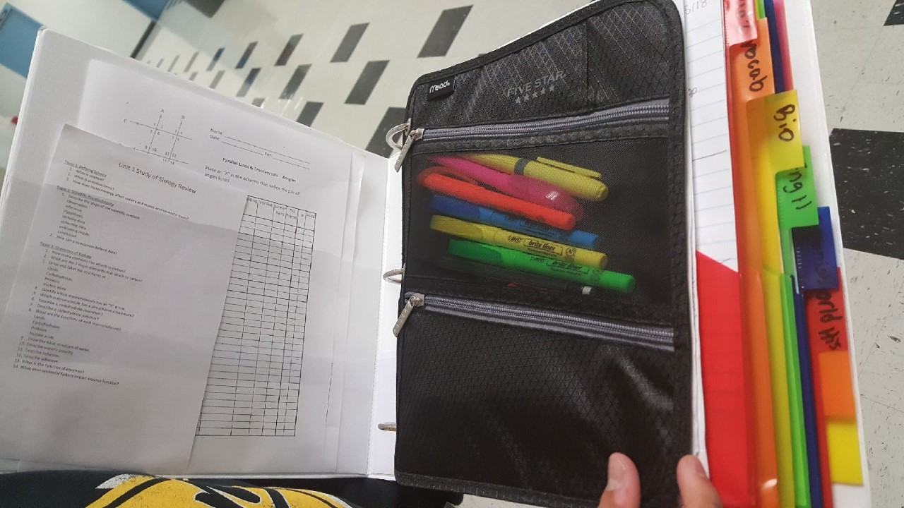
Who is the AVID student?
Does average or above average in class work and on standardized tests.
Has a desire to go to college, and are willing to work hard.
Could be the first in their families to attend college.
Willing to be placed in challenging courses. AVID puts its students on a college track.
Capable of completing rigorous curriculum but could possibly be falling short on their potential.
Works hard to maintain a 80% in all courses.
Willing to complete homework and study nightly

Slide 8
Lakewood AVID Candidates
Have been identified according to the following criteria:
Ability—academic potential to succeed in college preparatory courses (GPA of 2.5-3.5).
Desire and determination—desire to attend college
Have good attendance and behavior records
A willingness to undertake demanding preparation for college.

Slide 9
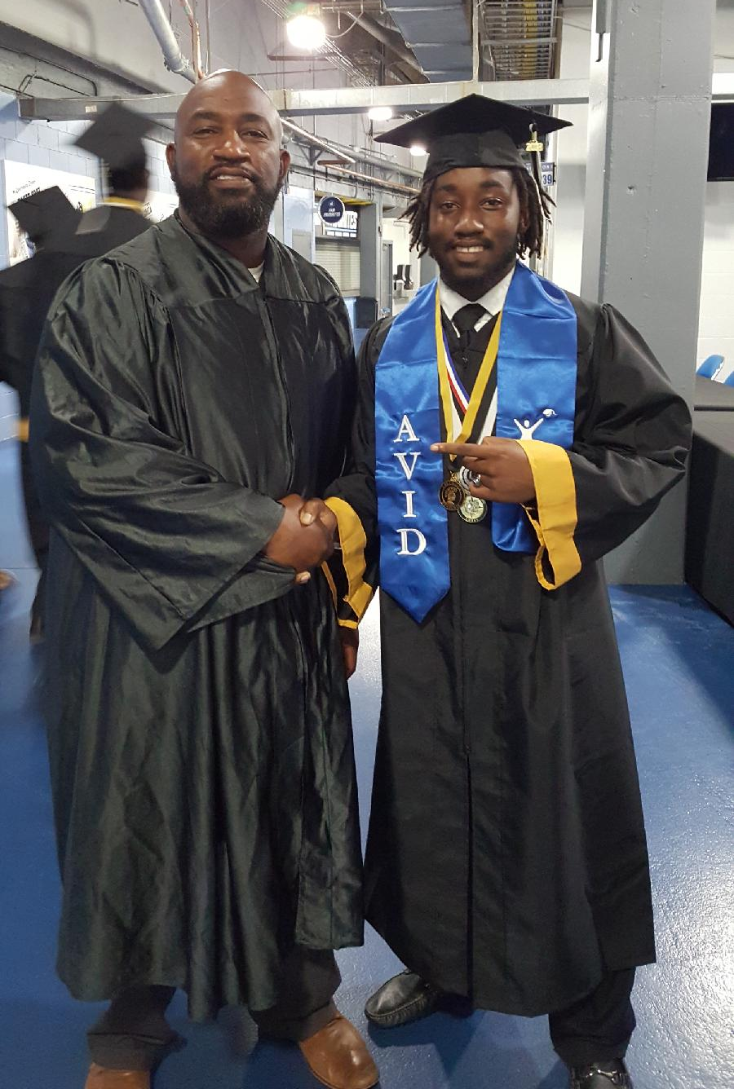

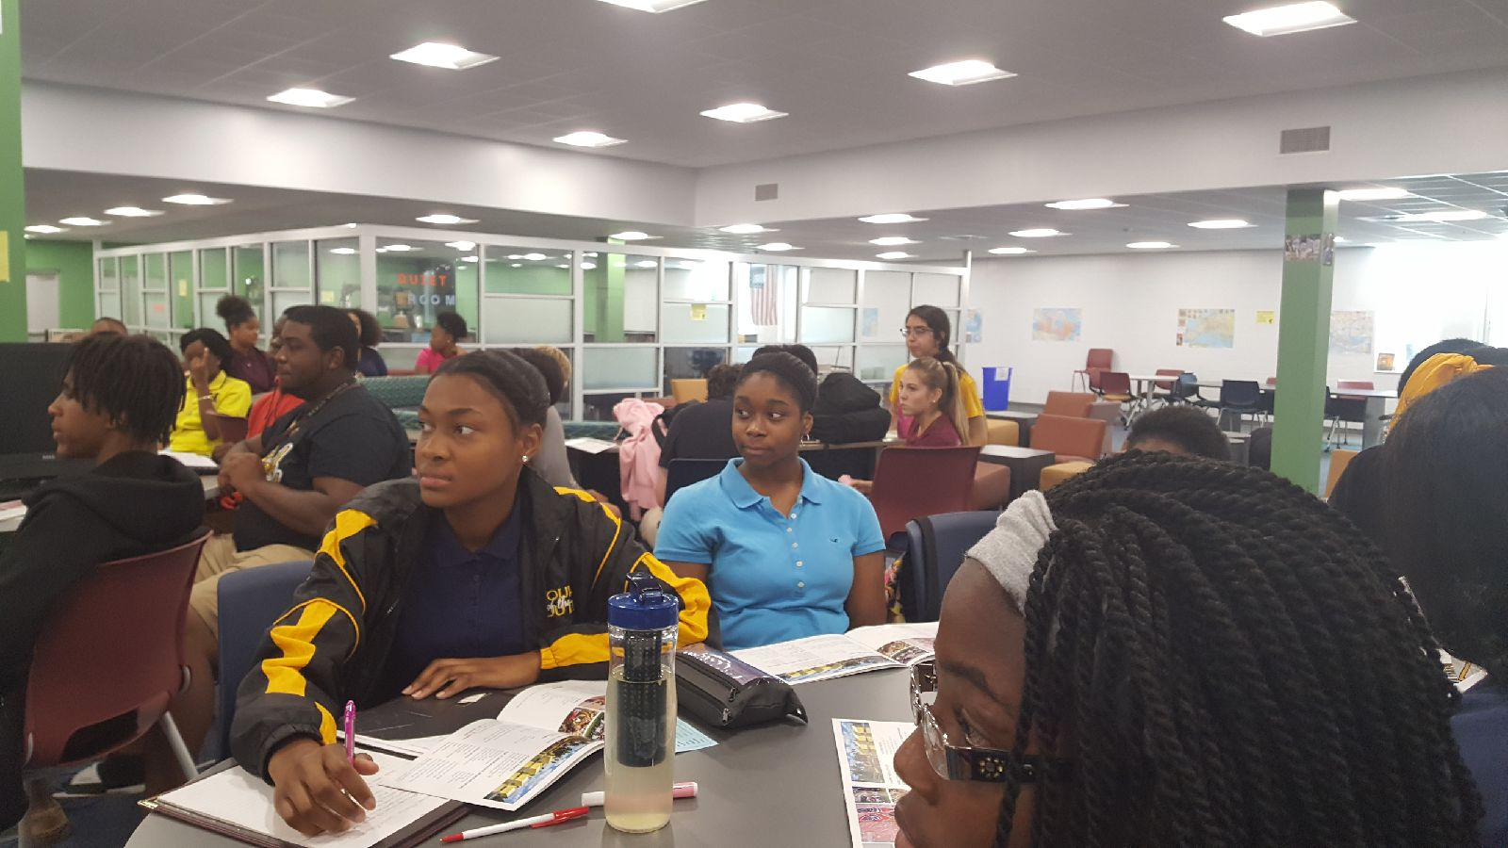
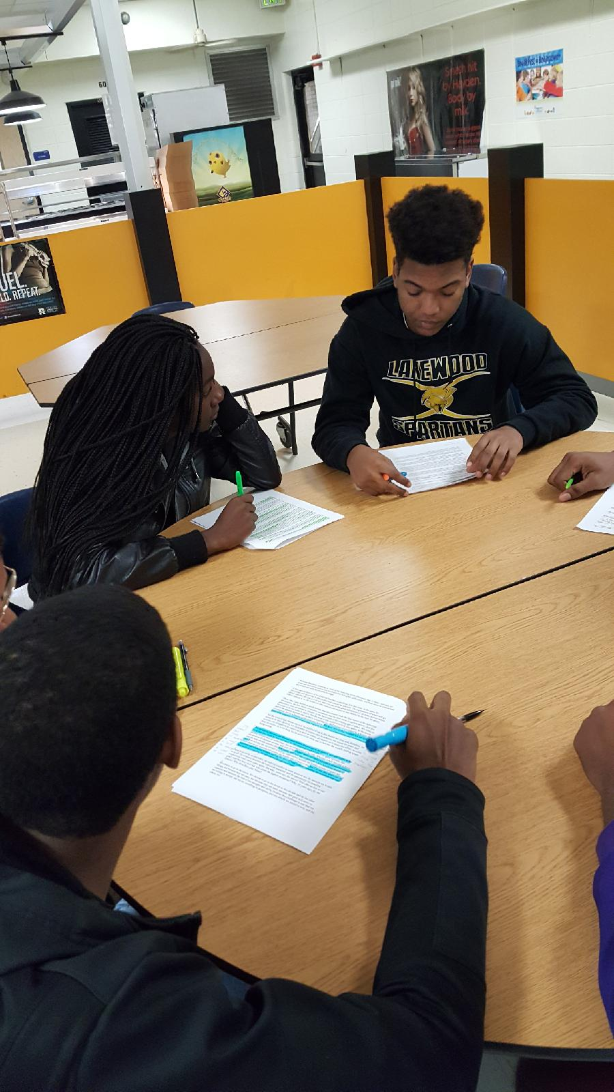
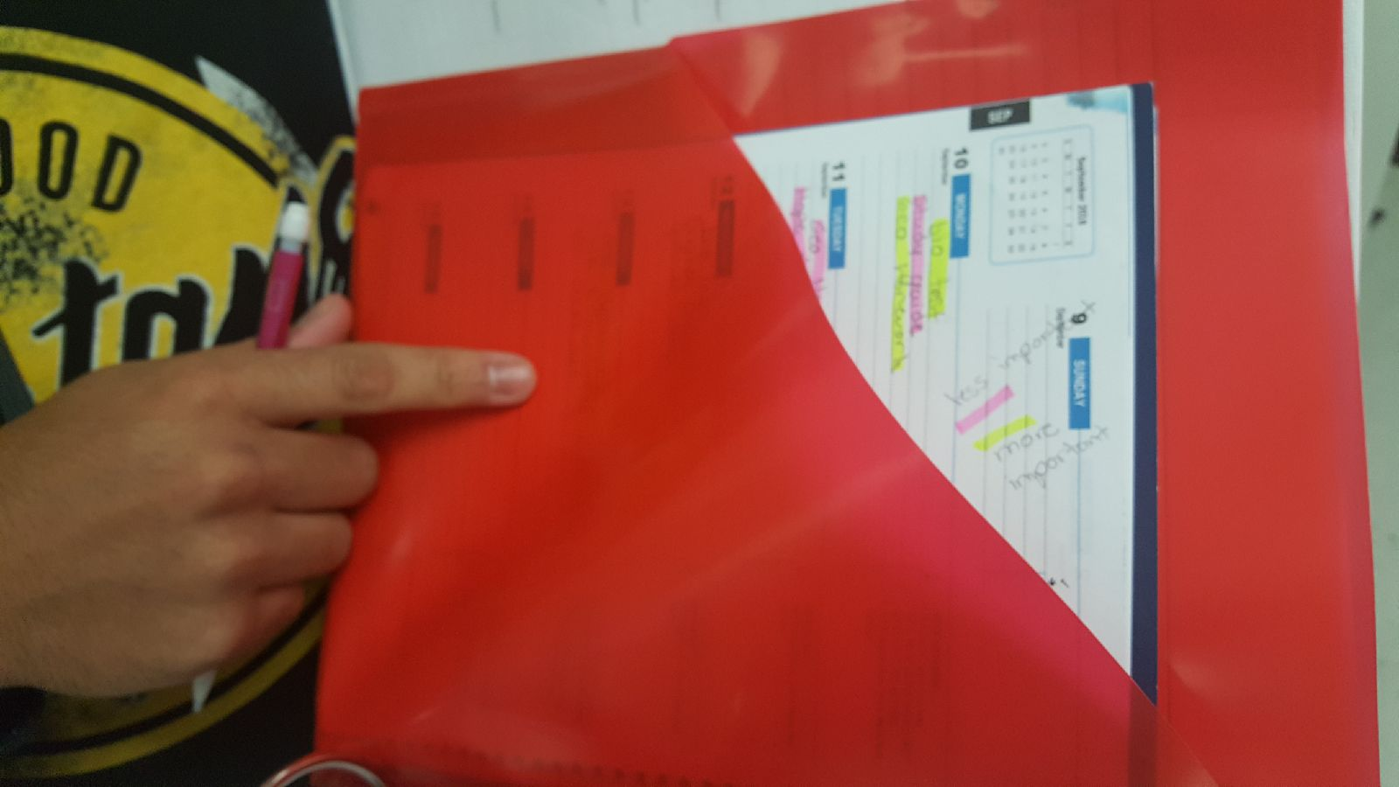
Lakewood Spartan

Slide 10
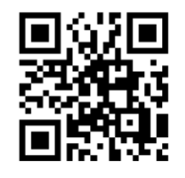
2019.2020 High School AVID Application QR Code

