Slide 1



High Point Elementary
Title l Annual Meeting
2025-2026

Slide 2


Slide 3

2025-26 Title l Annual Parent Meeting
High Point Elementary
September 25, 2025
5:30 PM
Mrs. Mavres, Principal
Ms. Paolillo, Assistant Principal
Ms. DelDuca, SAC Chair
Notes:
Evidence: Upload completed presentation and recorded feedback as part of the evidence to support the Annual Meeting Materials. Do not forget the sign-in sheets, and survey/feedback that you receive throughout the meeting.

Slide 4
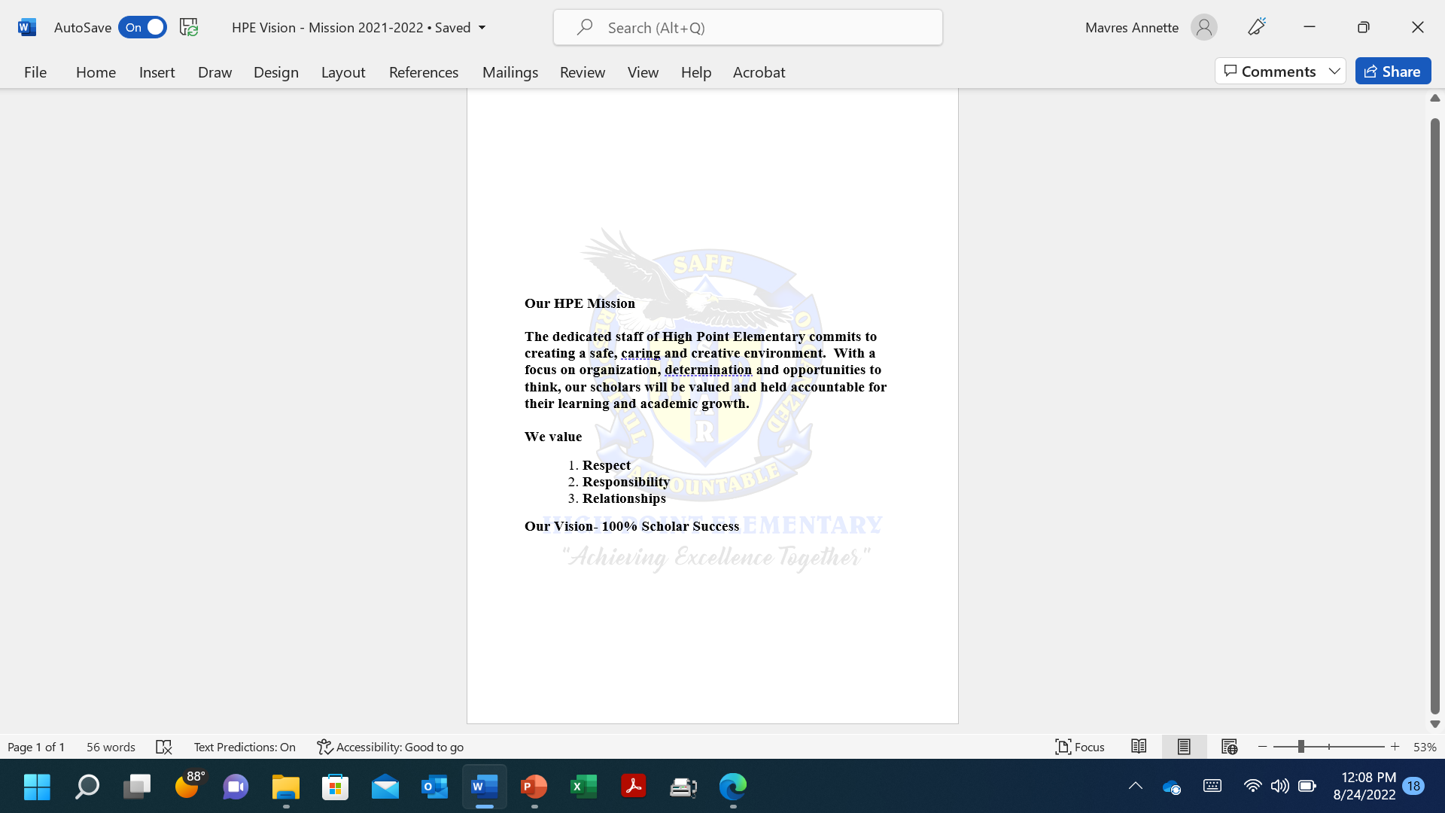

Slide 5



All About Title l
Title I is the largest federal assistance program for our nation’s schools.
The program serves 99 schools in Pinellas County including eligible students in 39 non-public schools.
The Title l goal is that every student achieves high levels of academic proficiency.
Notes:
Highlight the Title l Program here in Pinellas County.

Slide 6

Title I Funding Process
2. Florida Department of Education
1. Federal Government
High Point Elementary
3. Pinellas County Schools
Notes:
The Florida Department of Education receives funds from the federal government. Districts receive Title I funds from Department of Education, and the school district distributes these funds to schools based on the percentage of children eligible for free/reduced price lunch; however, students do not have to be from low-income families to receive help.

Slide 7

HIGH POINT ELEMENTARY
RISING SCHOLARS & AMAZING STAFF

Slide 9
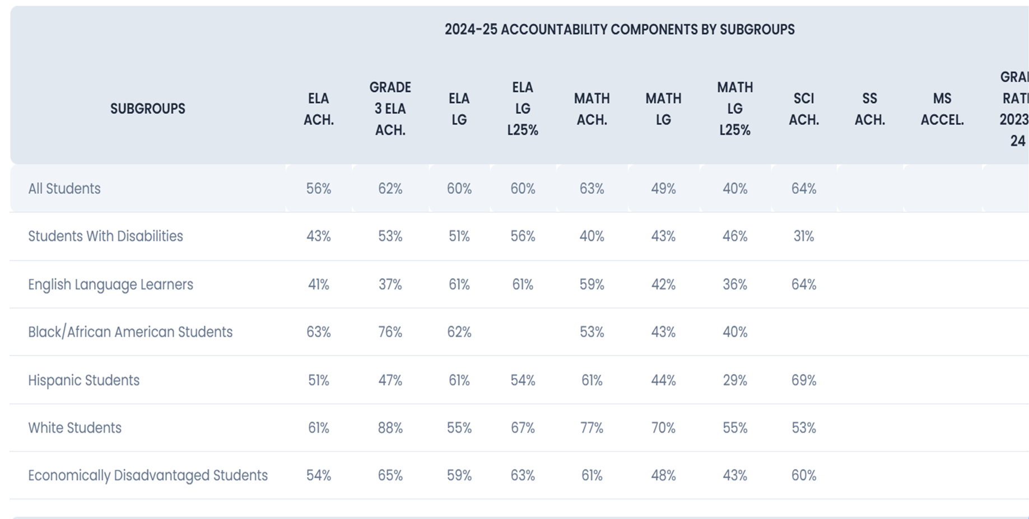

Slide 10
Title I Programs Provide Supplemental Support
Supplemental Resource | Positive Impact
! | Coaching Support to enhance planning and scholar performance: 1 SPROUT Reading Interventionist Grade K-2 MTSS Coach Math Coach Supports that connect the school and community: Parent Community Liaison
Extended Learning Opportunities (before and/or after school programs) | Programs to enhance scholar performance: Daily After and Before School Tutoring: Math, Science, Reading, Writing and Enrichment
Parent and Family Engagement Resources and Training Workshops | Quarterly Reading Recovery Training Daily Agenda Books 2 Family Events per semester to connect families to scholar academics
Supplemental teaching materials, equipment, and technology. | Curriculum Supports: Reading and Writing Materials, Computer Program Supplements Grade 4-5 Study Island for Science
Notes:
Use additional slides if necessary. This is where you want to really highlight Title I funding and how it positively impacts your scholars! Additional supplemental personnel (add specific positions)
If there are connections that they can make, they call it out!

Slide 11
Title I Schoolwide Planning and Input
First
Second
Last
All Title I schools must document that parents are involved in the schoolwide planning process.
Today we begin the new year together.
Parent and Staff Survey Information is collected and discussed to create a school wide plan.
Please attend online or in-person meetings/trainings and complete surveys to provide input on Title I funding.
Notes:
Evidence for input – input from school can be a survey or notes, which include quotes related to what was shared as feedback AND how this input will be used to inform the PFEP and future engagement activities.
Evidence of Attendance – please include attendance of DIVERSE stakeholder group/s.

Slide 12

Title I Schoolwide Budget
High Point Elementary is provided $270,500.00 to pay for supplemental resources and programs for increased student achievement.
Personnel - Instructional Coaches 85%
Curriculum Development and Coordination ( Reading Intervention) 10%
Technology Support 1%
Supplemental Instructional Materials and Resources 4%
Family Engagement $6,200
Agenda
Food

Slide 13

Parent’s Right to Know
As a parent of a student attending a Pinellas County School Public School, you have the right to…
Be
Be provided information on your child’s level of achievement on assessments in Reading/Language Arts, Writing, Mathematics, and Science.
Request and receive information on the qualifications of your child’s teacher and supplemental personnel working with your child.
Be
Be notified of non-highly qualified or out-of-field teachers at the school.
Be
Be informed if your child is taught by a non-highly qualified teacher for four or more consecutive weeks.

Slide 14
Working Together for Student Success
School
School Improvement Plan (SIP)
Title
Title I Schoolwide Plan
Parent
Parent and Family Engagement Plan
School
School-Parent-Student Compact
Title l is now included as a part of the School Improvement Plan
Notes:
As a Title I parent you have the right to be involved in the development of the following plans and documents for our school which can be found on our website (insert website) to view as well as in the Parent Station located (insert location here).
Our school’s Title I Parent Station is located (insert location or photo of Title I Parent Station (front office and on the webpage). Please include photo as part of the evidence monitoring.
You will find a copy of our School Improvement Plan, Title I Schoolwide Plan, School’s PFEP, the School District’s PFEP, Parent’s Right to Know Memo, Upcoming Events, Compact, (insert other documents at your station)
School Improvement Plan (SIP)
Parent and Family Engagement Plan
Title I Schoolwide Plan
School-Parent-Student Compact

Slide 15

Parent-School-Student Compact
The purpose of the compact is to foster student achievement. By signing the Parent-School-Student Compact, (Insert name of school here), teachers, staff, parents and students agree to work together to share the responsibility of helping students meet or exceed state, district and school academic goals.
The Parent-School-Student Compact is updated every year to include parent, student, teacher, and staff input. Parent, student, teacher and staff comments are welcome at any time during the year.
Please review and sign your child’s Compact.
Our goal is to receive 100% signed compacts!
Notes:
At the elementary level, school compacts are used as a progress monitoring tool through the year during parent teacher conferences.

Slide 16
Notes:
Please insert the an example of your updated school compact. Highlight any things that unique to your school’s compact.

Slide 17
Notes:
Please insert the an example of your updated school compact. Highlight any things that unique to your school’s compact.

Slide 18

Parent and Family Engagement Plan (PFEP)
The PFEP Sections include information about the following:
Parent trainings to increase student achievement
Staff trainings for engaging parents
Communication methods between home and school
Flexible meeting times
Accessibility for parents
Coordinating with other Federal Programs
To access the full LEA PFEP, please visit
www.pcsb.org/titleone
Notes:
Provide information on the specific committees that parents can be involved. Include the purpose, date and time of meetings.
Explain the PFEP and its purpose.
Consider the evidence related Title I Crate, Sample of Evidence,

Slide 19

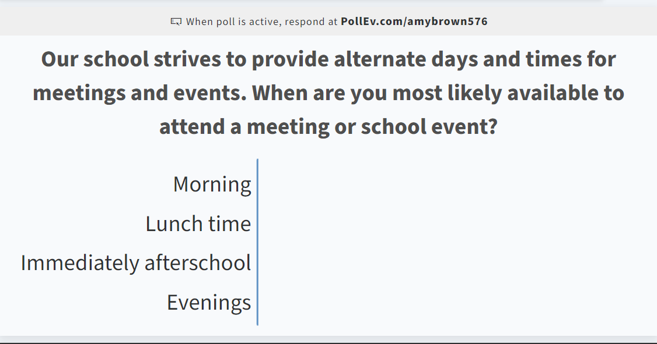
Opportunity for Two Way Communication
As mentioned in the previous slide, the PFEP ensures to provide families with flexible meeting times.
Notes:
Evidence – please keep this as evidence to support using feedback to inform flexible meetings.

Slide 20


Florida Benchmark For Excellent Student Thinking Standards (B.E.S.T). You may read more information by visiting, www.fldoe.org.
Notes:
All curriculum, instruction and assessments are based on student-centered expectations.

Slide 21

School Report Cards
School Grade and Overview
Population and Enrollment
Assessments – Academic Achievement, Growth, and Population
Assessments – English Language Learners
Graduation and Beyond
Educator Qualifications and Equity
Long-Term Goals and Interim Progress
Accelerated Course Enrollment
Per-Pupil Expenditures
National Data
Available online at https://edudata.fldoe.org/ or Front Office

Slide 22

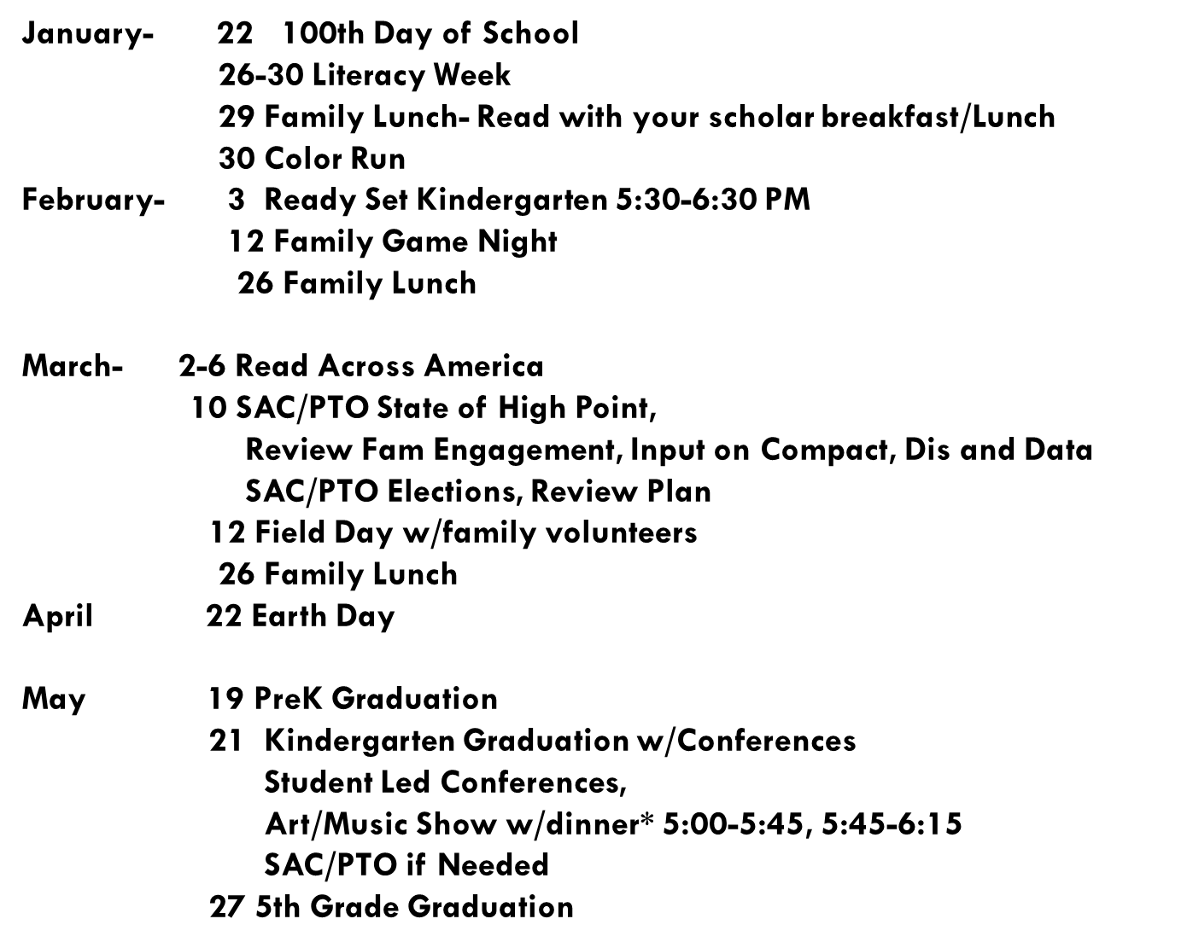
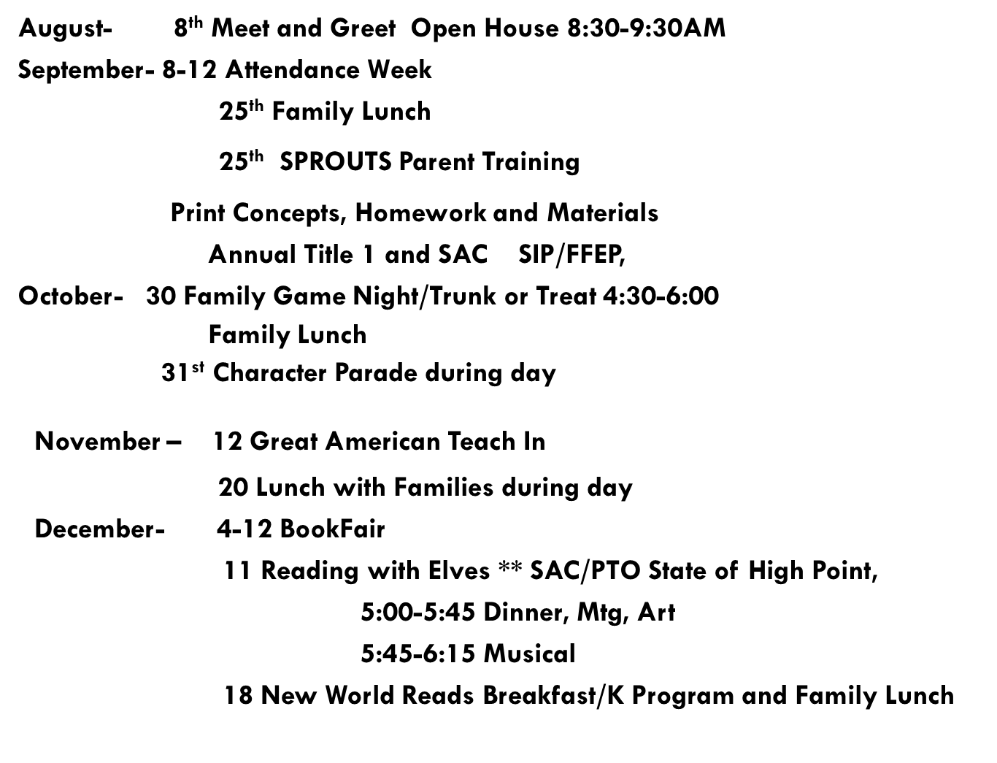
Working Together Creates Success
Notes:
Do you have a calendar of key events that are included in your PFEP.
Evidence – Consider this as evidence to include to support Family Engagement.

Slide 23
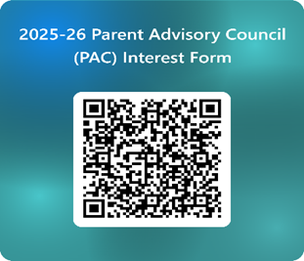

Parent Advisory Council (PAC)
The District has a Parent and Family Engagement Plan. The summary of the plan is in the Title I School & Family Partnership Overview.
You may access the full plan at www.pcsb.org/titleone
The Parent Advisory Council (PAC) is responsible for reviewing and revising the District PFEP.
PAC will meet virtually or in person with the district’s Title I staff.
Each school is committed to having at least one member representative in PAC.
PAC meets twice a year, if you are interested in representing our school please notify, Insert contact person
Notes:
Please add your PAC representative in slide and share with your Title I Specialist.
https://forms.office.com/r/r5daaMTENE\

Slide 24
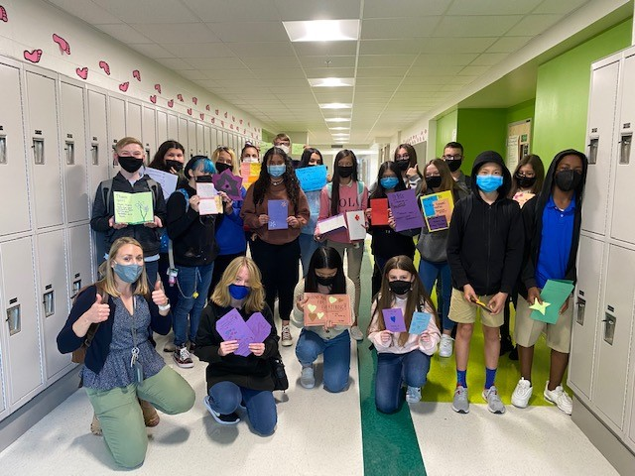

Additional Resources
Learning at Home Family Resources - https://www.pcsb.org/Page/32836
Volunteer in a Pinellas County School - https://www.pcsb.org/Page/459
Parent Academy POWER HOURS Webinars - https://www.pcsb.org/Page/26534
Partnerships - https://www.pcsb.org/Page/418

Slide 25

Thank you for your time!
Contact Us
High Point Elementary
5921 150th Avenue North
Clearwater, FL 33760
727 538-7440

Slide 26
Please take the time to participate in our survey.
Please remember to complete the parent survey if you are on campus.
Your feedback is greatly appreciated!
Notes:
Please duplicate Microsoft Forms provided or create school survey. To generate a QR code hover over your school’s survey and and right click. Create QR code for this page will be an option.
https://forms.office.com/Pages/ShareFormPage.aspx?id=BZM8c9c5GkaGb_3ye_PH_x-1YNVO6C1FkgA88U6PR2tUNEQzTU0wNkZXVUxVTlpEMU81NkJFMlJNTi4u&sharetoken=FXXhmgwFjSnl0sNz61ki

