Slide 1









St. Petersburg HS, Principal Darlene Lebo
Title I Annual
Parent Meeting
August 26, 2025 6:00 pm
Notes:
Evidence: Upload completed presentation and recorded feedback as part of the evidence to support the Annual Meeting Materials. Do not forget the sign-in sheets, and survey/feedback that you receive throughout the meeting. ​

Slide 2

ALL ABOUT TITLE I
  Title I is the LARGEST federal assistance program for our nation’s schools
  The Program serves 95 schools in Pinellas County including students in 38 non-public schools
Notes:
Highlight the Title I Program here in Pinellas County.

Slide 3




Title I Funding
Process
  Federal Government
3. Pinellas County Schools
2. Florida Department of Education
4. SPHS
Notes:
The Florida Department of Education receives funds from the federal government. Districts receive Title I funds from Department of Education, and the school district distributes these funds to schools based on the percentage of children eligible for free/reduced price lunch; however, students do not have to be from low-income families to receive help. ​

Slide 4

TITLE I
SUPPLEMENTAL RESOURCES
Definition: provided in addition to what is already present or available to complete or enhance it. Title 1 funds are provided above the state and federal requirement.
Notes:
Title I is supplemental federal funding that provides e​
​
Definition: provided in addition to what is already present or available to complete or enhance it extra academic support and learning opportunities for economically disadvantaged students.

Slide 5




Title I
Schoolwide Planning and Input
FIRST
Seek input from school, family, and community members determine how Title I funds are used based on a needs assessment
SECOND
Please attend online or in-person meetings/trainings and complete surveys to provide input on Title I funding
LAST
All Title I schools must document that parents are involved in the schoolwide planning process
Notes:
Evidence for input – input from school can be a survey or notes, which include quotes related to what was shared as feedback AND how this input will be used to inform the PFEP and future engagement activities. ​
​
Evidence of Attendance – please include attendance of DIVERSE stakeholder group/s.

Slide 6
Title I Schoolwide Budget
SPHS is provided $92,160 to pay for supplemental resources and programs for increased student achievement. Federal funds can pay for:
  Personnel
  Professional Development
  Curriculum Development and Coordination
  Technology Support
  Supplemental Instructional Materials and Resources
  At SPHS, these funds are used to pay for two Title 1 associates, along with instructional materials and funds for professional development and parent nights.
Notes:
change ALL in red to reflect your school

Slide 7
SPHS Title I Parent & Family Engagement 2025-26 Budget
Total Allocation- $92,160.00
  Title 1 Support Assistants (2) - $87,762.67
  Classroom materials $2452
  Teachers Stipends to Provide Parent Training - $2450
  Family Engagement Resources - $1210
  Substitutues- $1420
Notes:
SAMPLE ONLY - Delete Slide ​
Highlight your budget and resources and how they will be used to support family engagement.

Slide 8


PARENT’S
RIGHT TO KNOW
Be provided information on your child’s level of achievement on assessments in Reading/Language Arts, Writing, Mathematics and Science
Be notified of non-highly qualified or out-of-field teachers at the school
Request and receive information on the qualifications of your child’s teacher and supplemental personnel working with your child.
Be informed if your child is taught by a non-highly qualified teacher for four or more consecutive weeks.

Slide 9

Working Together for Student Success
SCHOOL
TITLE I
PARENT
SCHOOL
School Improvement Plan (SIP)
Title I Schoolwide Plan
Parent and Family Engagement Plan (PFEP)
School - Parent - Student - Compact
Notes:
As a Title I parent you have the right to be involved in the development of the following plans and documents for our school which can be found on our website (insert website) to view as well as in the Parent Station located (insert location here). ​
​
Our school’s Title I Parent Station is located (insert location or photo of Title I Parent Station- front office and on the webpage). Please include photo as part of the evidence monitoring. ​
​
You will find a copy of our School Improvement Plan, Title I Schoolwide Plan, School’s PFEP, the School District’s PFEP, Parent’s Right to Know Memo, Upcoming Events, Compact, (insert other documents at your station)​
​
School Improvement Plan (SIP)​
​
Parent and Family Engagement Plan ​
​
Title I Schoolwide Plan ​
​
School-Parent-Student Compact​
​

Slide 10


Parent - School - Student Compact
The purpose of the compact is to foster student achievement. By signing the Parent - School - Student Compact, SPHS, teachers, staff, parents and students agree to work together to share the responsibility of helping students meet or exceed state, district and school academic goals.
The Parent - School - Student Compact is updated every year to include parent, student, teacher and staff input. Parent, Student, Teacher and Staff comments are welcome at any time during the year.
Please review and sign your child’s Compact, if you did not already do so in their homeroom packet
Our GOAL is to receive 100% signed compacts!
Notes:
At the elementary level, school compacts are used as a progress monitoring tool through the year during parent teacher conferences.

Slide 11
SAMPLE SCHOOL COMPACT
Notes:
Please insert the an example of your updated school compact. Highlight any things that unique to your school’s compact.

Slide 12





Parent and Family
Engagement Plan (PFEP)
The PFEP Sections include information about the following:
  Parent trainings to increase student achievement
  Staff trainings for engaging parents
  Communication methods between home and school
  Flexible meeting times
  Accessibility for parents
  Coordinating with other Federal Programs
Notes:
Provide information on the specific committees that parents can be involved. Include the purpose, date and time of meetings. ​
Explain the PFEP and its purpose. ​
Consider the evidence related Title I Crate, Sample of Evidence,

Slide 13






Florida Benchmark for Excellent Student Thinking Standards (B.E.S.T). You may read more information by visiting, www.fldoe.org
Notes:
All curriculum, instruction and assessments are based on student-centered expectations.

Slide 14

School’s
Curriculum
Florida Benchmark for Excellent Student Thinking Standards (B.E.S.T) form the framework of everything taught at school.
Core Curriculum:
  Reading and Writing
  EOC courses
Notes:
This slide is optional if this will be discussed with classroom teacher ​
School’s Curriculum​
Describe and explain the curriculum (Specific names of texts)​
​

Slide 15

Florida End of Course (EOC) Assessments
(Algebra 1, Biology, U.S. History, Geometry)
Add EOC information, if applicable​
To learn more about state assessments visit the Florida Department of Education’s website, fldoe.org/accountability/assessments.
Notes:
This slide is only required, if it applies.

Slide 16


School Report Cards:
  School Grade and Overview
  Population and Enrollment
  Assessments- Academic Achievement, Growth, and Population
  Assessments -English Language Learners
  Graduation and Beyond
  Educator Qualifications and Equity
  Long-Term Goals and Interim Progress
  Accelerated Course Enrollment
  Per-Pupil Expenditures
  National Data
Available online at School Report Cards:
Available online at https://edudata.fldoe.org OR Front Office
  School Grade and Overview
  Population and Enrollment
  Assessments- Academic Achievement, Growth, and Population
  Assessments -English Language Learners
  Graduation and Beyond
  Educator Qualifications and Equity
  Long-Term Goals and Interim Progress
  Accelerated Course Enrollment
  Per-Pupil Expenditures
  National Data

Slide 17
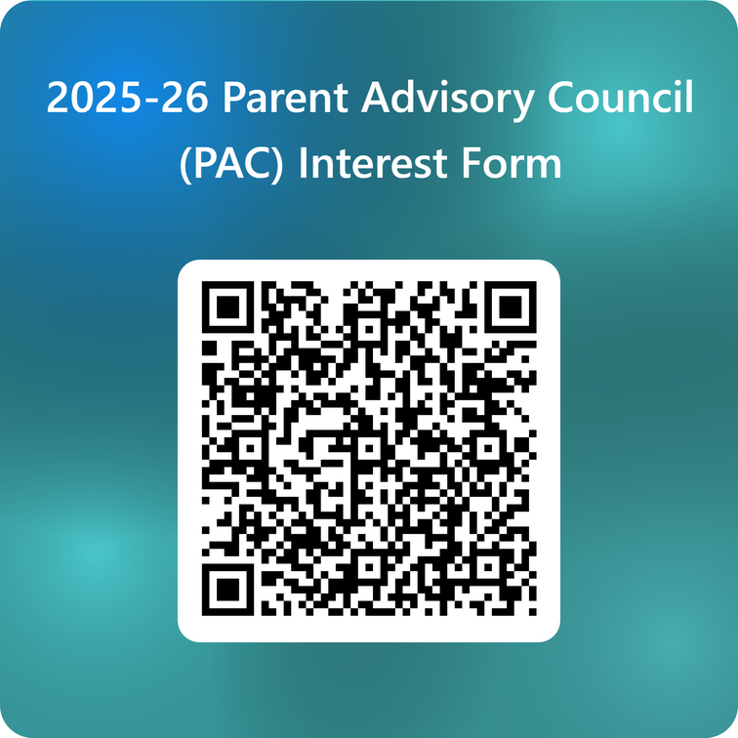
Parent Advisory
Council (PAC)
  The district has a Parent and Family Engagement Plan. The summary of the plan is in the Title I School & Family Partnership Overview.
  You may access the full plan at www.pcsb.org/titleone
  The Parent Advisory Council (PAC) is responsible for reviewing and revising the District PFEP.
  PAC will meet virtually or in-person with the district’s Title I Staff.
  Each school is committed to having at least one member representing our school please notify, Lonnette Frazier
Notes:
Please add your PAC representative in slide and share with your Title I Specialist. ​
​https://forms.office.com/Pages/ResponsePage.aspx?id=BZM8c9c5GkaGb_3ye_PH_ywWjljlMQdDv9wc58mKxfhUMlBCTlJTQkVCUkNDTjNIUTBaQTZSSDI1My4u

Slide 18



Thank You!
For your time!

