Slide 1

Madeira Beach Fundamental PTSA
General Meeting – August 25, 2025
Order of Events:
  Introductions
  Treasurer’s Report – Erin Swift
  Givebacks – Angie Hay
  President’s Report – Erin Osburn
  Q& A

Slide 2
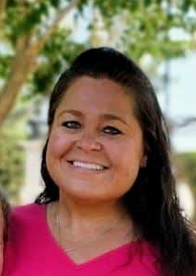
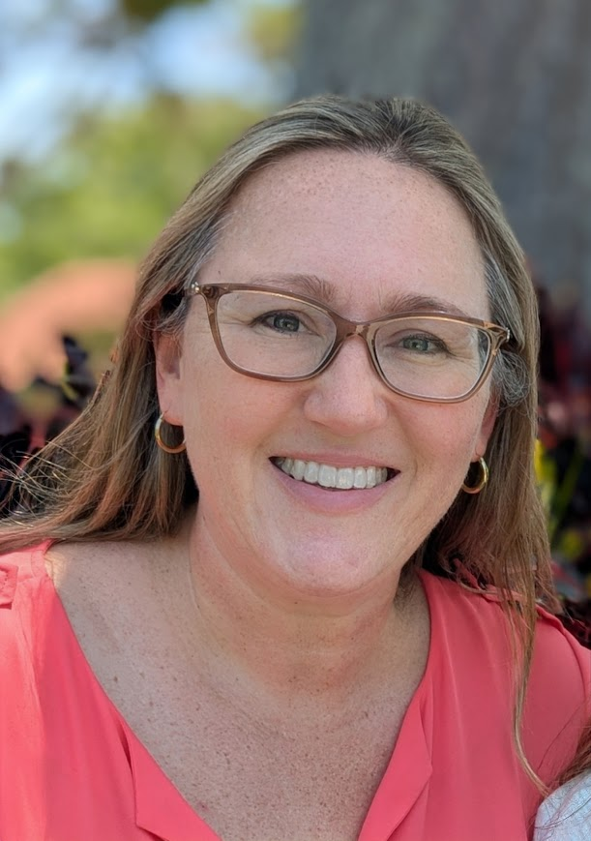
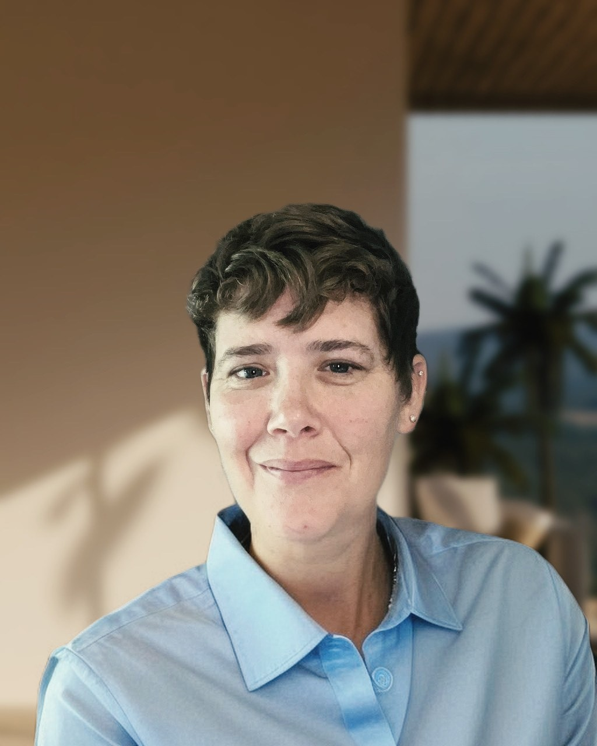
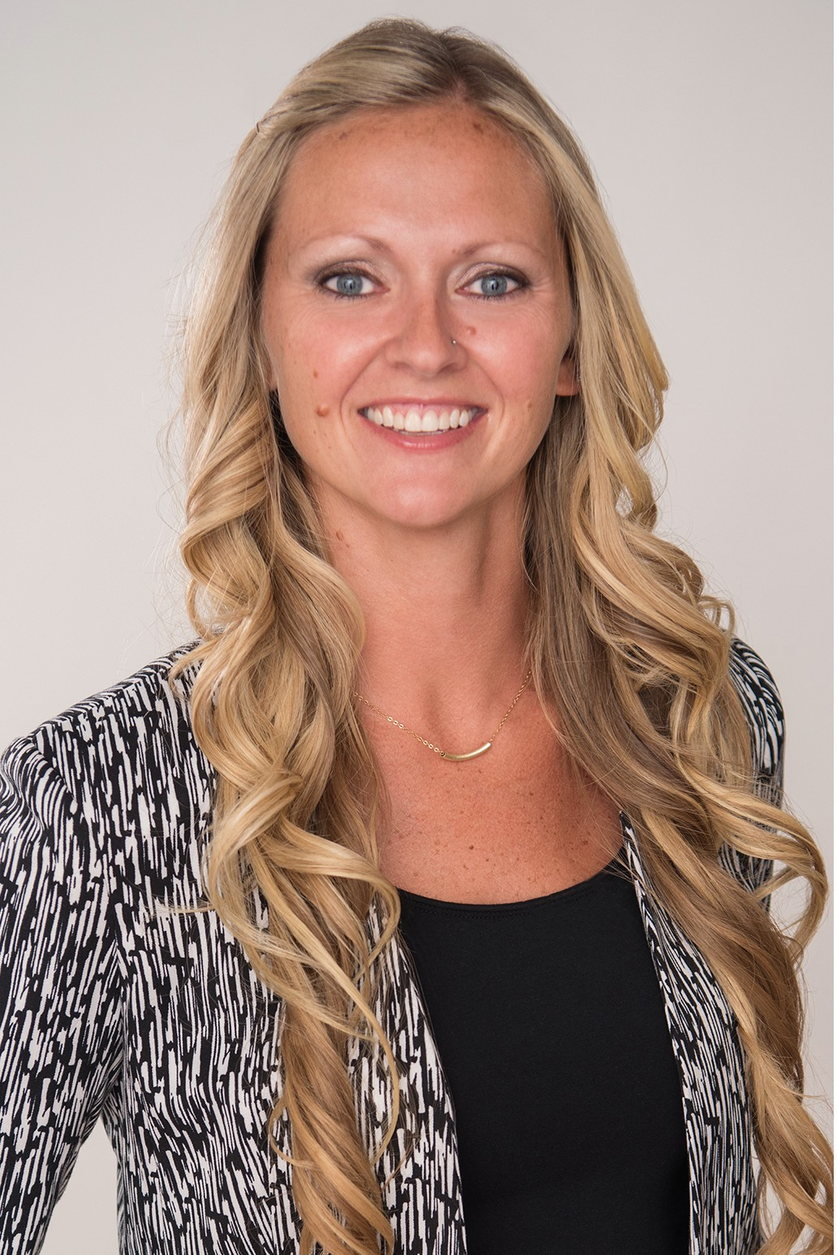
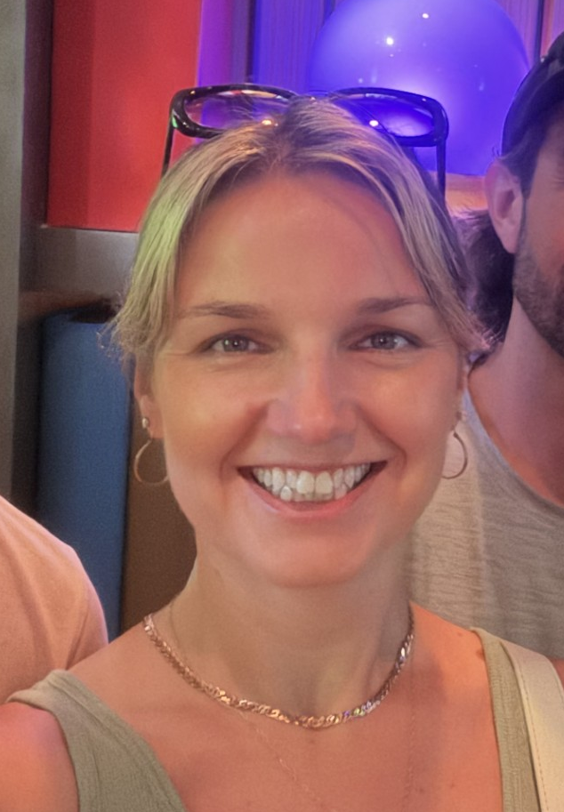
Meet This Year’s PTSA Board!
President
Erin Osburn
Secretary
Kristy Lake
Treasurer
Erin Swift
Vice President 1
Sarah Myers
Vice President 2
Angie Hay

Slide 3
Treasurer’s Report
2024-2025 PTSA Annual Financial Audit

Slide 4
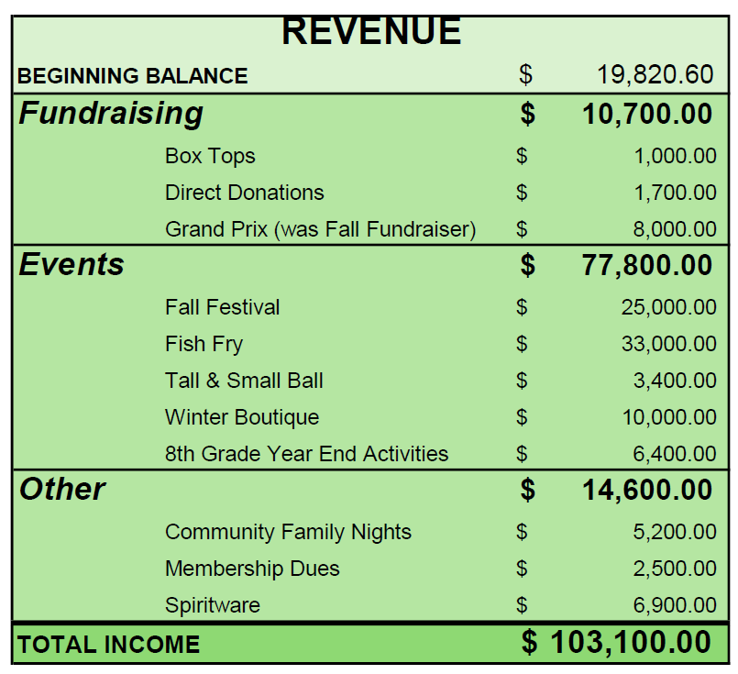
2025-2026 Proposed Budget

Slide 5
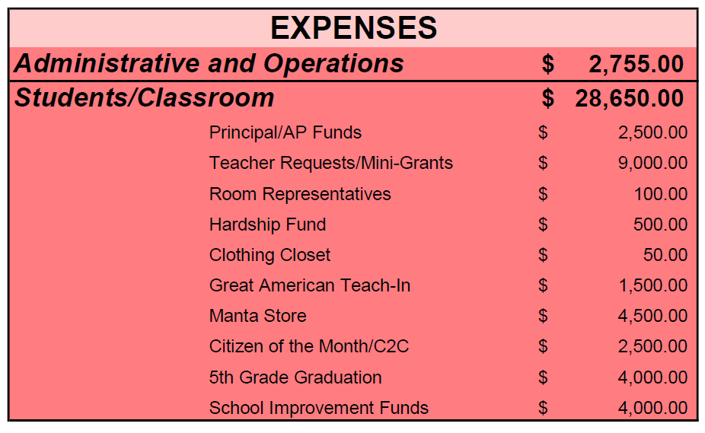
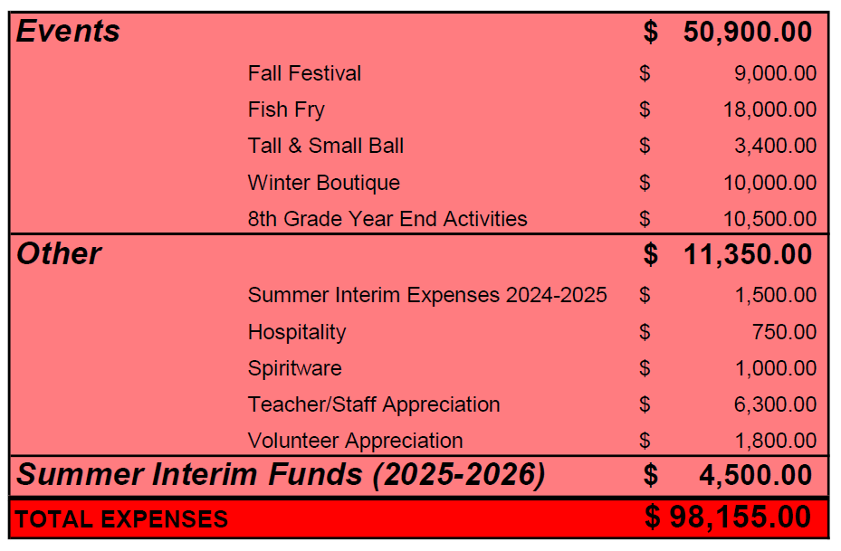
2025-2026 Proposed Budget

Slide 6

2025-2026 Proposed Budget
Let’s bring it to a vote!

Slide 7
May 5th
General Meeting Minutes
Let’s bring them to a vote!

Slide 8


























Givebacks
A Cashback app funded by 25,000 local and national businesses

Slide 9

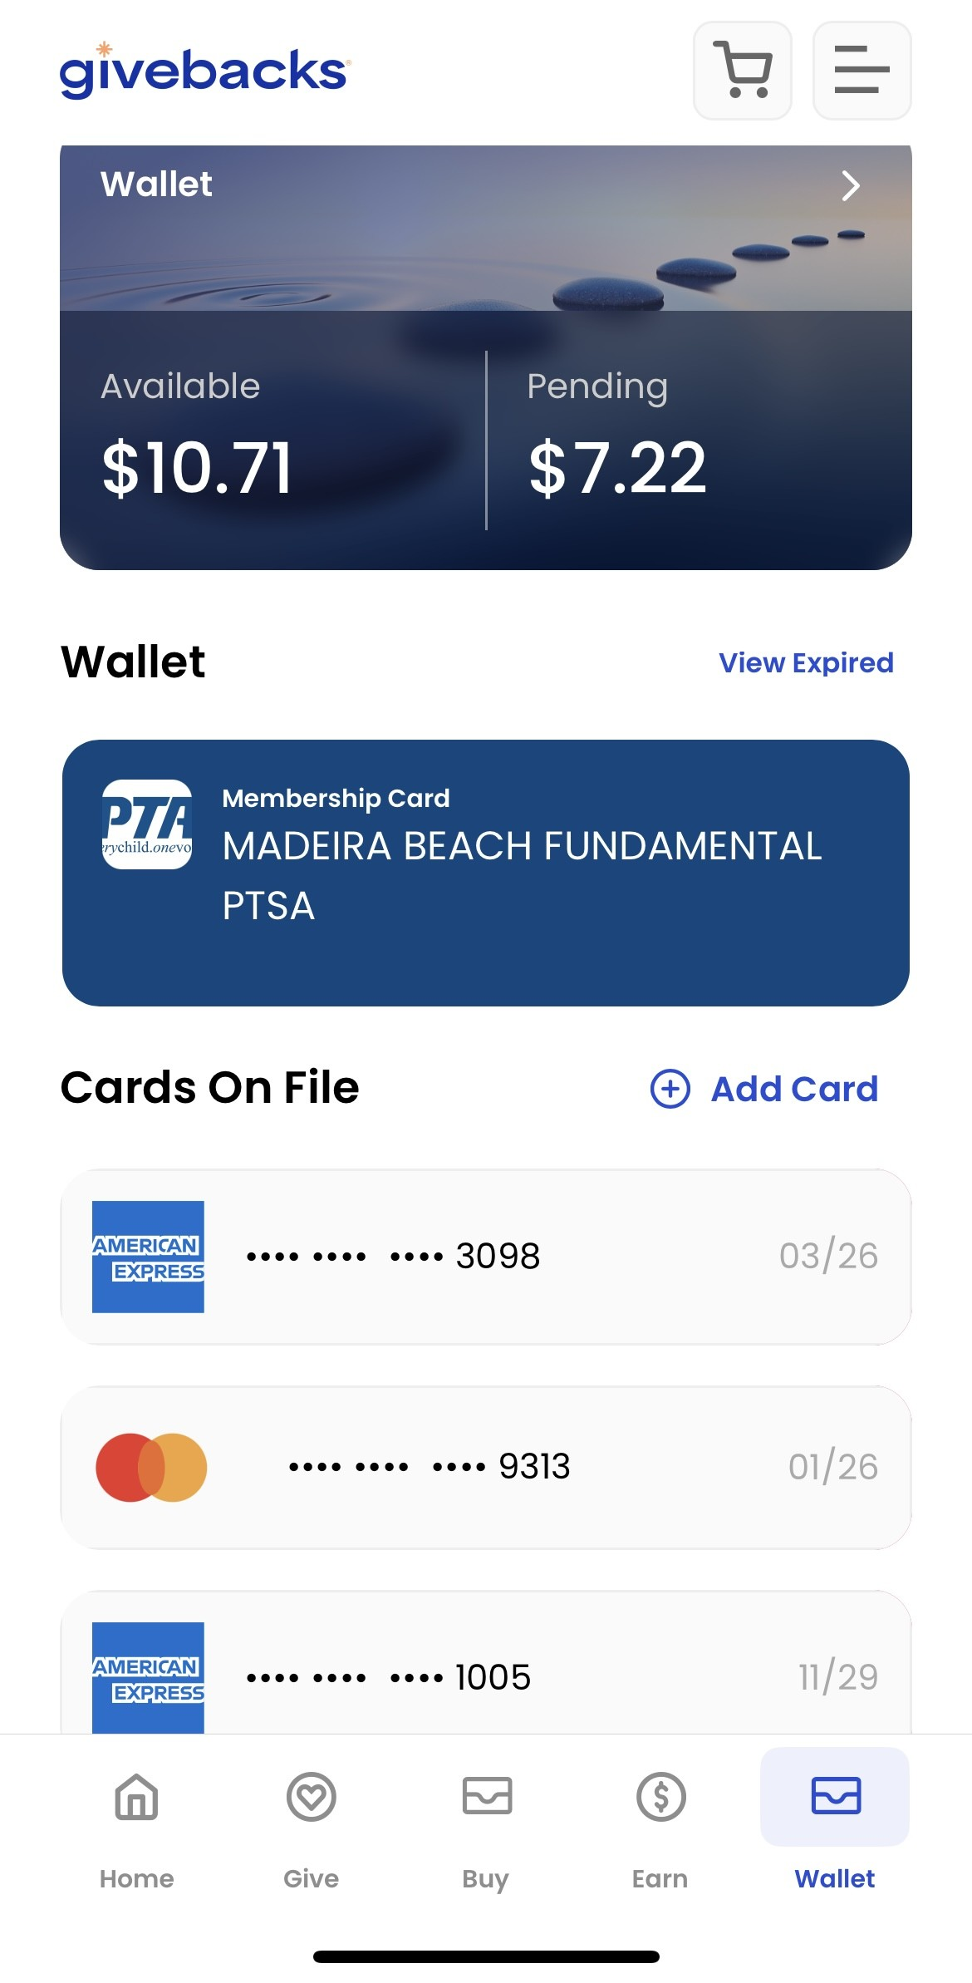
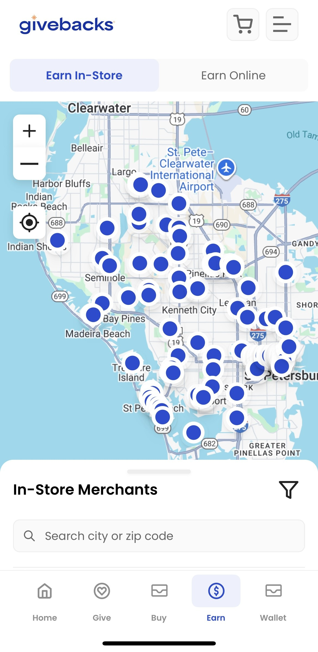
Step 1: Create an Account

Slide 10
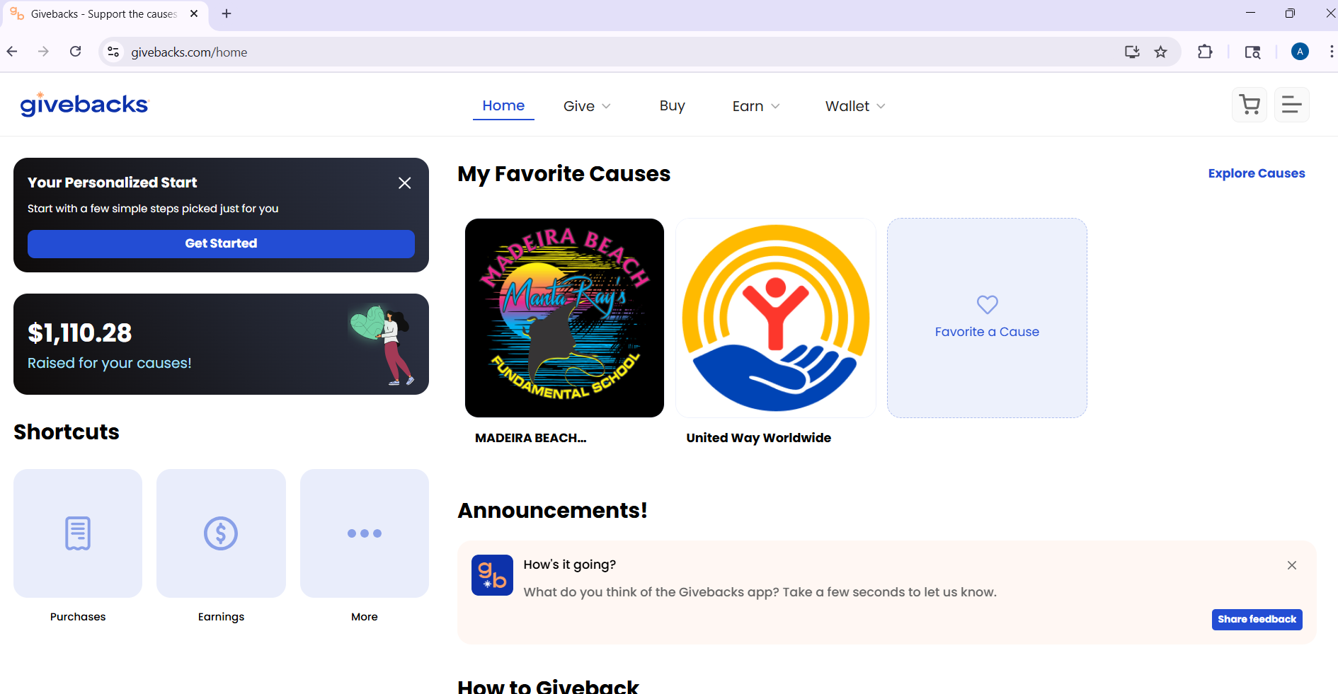

Step 2: Install the Givebacks Extension

Slide 11
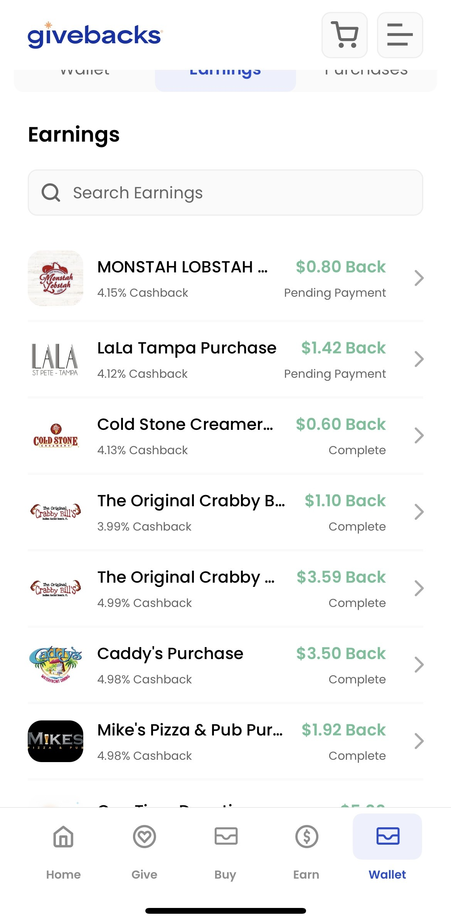
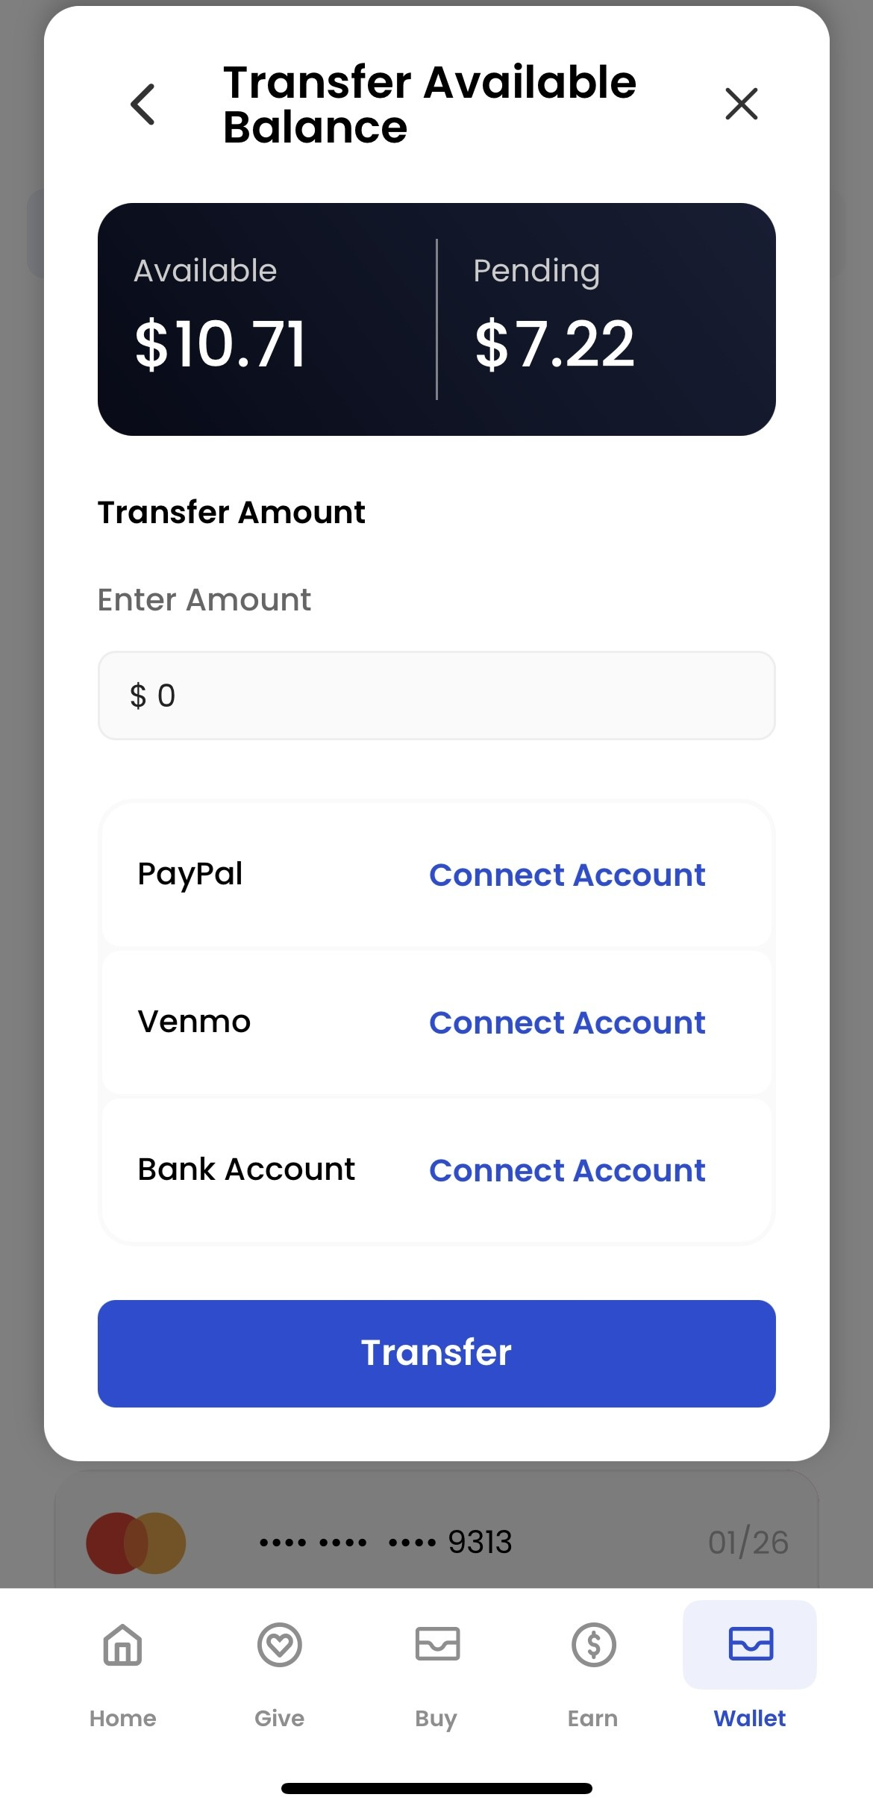
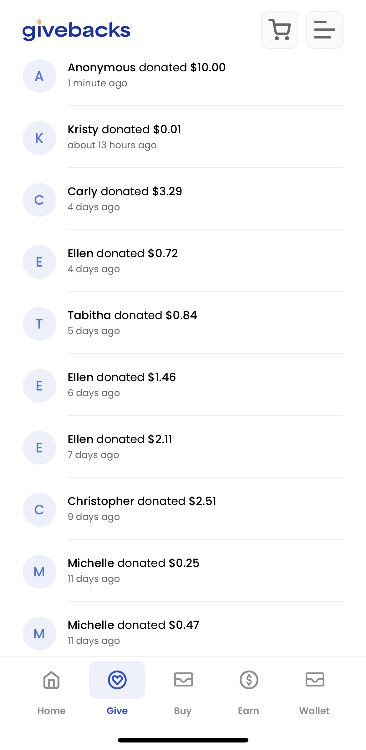
Step 3: Start Earning!

Slide 12

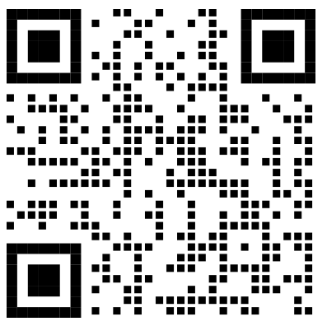
President’s Report
  Membership Drive ends September 26th
  Hello Week
  Fall Festival – October 24th
  How to Get Involved in Your School

Slide 13

Q&A

