Slide 1

Title I Annual Parent Meeting
Anona Elementary School
Thursday, August 25th 2021
5:00 pm
Virtual via MS Teams
Ann Welsh & Holly Huey
Notes:
Welcome!

Slide 2

About Title I
Title I is the largest federal assistance program for our nation’s schools.
The goal of Title I is a higher quality of education for every child. Its purpose is to address the academic needs of students and to assist them in meeting their state’s academic standards.
The program serves millions of children in public elementary and secondary schools each year including eligible students in non-public schools.

Slide 3

Title I Funding
The federal government provides funding to states each year for the Title I program.
The Florida Department of Education sends the funding to our Pinellas County School district.
The school district identifies eligible schools and distributes the Title I funds to the school.
Anona Elementary implements a Title I Schoolwide Plan. All students and staff benefit from the supplemental services.
Notes:
The Florida Department of Education receives funds from the federal government. Districts receive Title I funds from Department of Education, and the school district distributes these funds to schools based on the percentage of children eligible for free/reduced price lunch; however, students do not have to be from low-income families to receive help.
For Title I School-wide Programs: Our students are in a Title I School-wide program. This means that our Title I money can be used to upgrade the educational program in ways that may impact every student in the school . This also means that every parent/guardian of a student in our school is a Title I parent! The schools set goals for improvement, measure student progress, using standards set forth in the state’s Title I plan, develop programs that add to regular classroom instruction, and involve parents in all aspects of the program.

Slide 4

Title I Programs Provide Supplemental Support
Additional supplemental personnel (Hourly Reading/Writing Teacher & additional hours for Family Community Liaison)
Extended Learning Opportunities (before and/or after school programs)
Parent and Family Engagement Resources and Training Workshops
Supplemental teaching materials, equipment, and technology
Notes:
Title I funds are used to supplement the program at the school by providing funds which support the following types of activities:
Additional teachers and paraprofessionals to create smaller classes
Additional training for school staff
Extra time for instruction (Before and/or after school programs)
Parent and Family Engagement Activities
A variety of supplemental teaching methods and materials

Slide 5

Title I Schoolwide Planning
Input from school, family, and community members determine how Title I funds are used based on a needs assessment.
Please attend online or in-person meetings/trainings and complete surveys to provide input on Title I funding.
All Title I schools must document that parents are involved in the schoolwide planning process.
Notes:
Decisions and Planning on How to Use Title I funds based on needs assessment.

Slide 6
Title I Schoolwide Budget
Anona Elementary is provided $83,776 to pay for supplemental resources and programs for increased student achievement.
Personnel
Professional Development
Curriculum Development and Coordination
Technology Support
Supplemental Instructional Materials and Resources

Slide 7
Title I Parent & Family Engagement Budget
Anona Elementary is provided $4,510 to pay for supplemental resources and programs for increased student achievement.
  Supplemental Hours for Parent Community Liaison
  Consultants for Parent Workshops
  Teachers Stipends to Provide Parent Training
  Family Engagement Resources

Slide 8
A+ ES Title I Parent & Family Engagement 20-21 Budget
Total Allocation - $4,510.00
Supplemental Hours for Parent Community Liaison - $3325.63
Parent Compacts $200.00
Agenda Books $984.37
Notes:
SAMPLE ONLY - Delete Slide

Slide 9

Parent’s Right to Know
As a parent of a student attending a Pinellas County School Public School, you have the right to…
Be provided information on your child’s level of achievement on assessments in Reading/Language Arts, Writing, Mathematics, and Science.
Request and receive information on the qualifications of your child’s teacher and supplemental personnel working with your child.
Be notified of non-highly qualified or out-of-field teachers at the school.
Be informed if your child is taught by a non-highly qualified teacher for four or more consecutive weeks.
Notes:
Principal’s Attestation provides the number of teachers that are non highly qualified or teaching out of field
Parents Rights under ESEA
Request the qualifications of your child’s teacher
Be notified if your child is taught for more than 4 consecutive weeks by a teacher who is not highly qualified
Request opportunities for regular meetings with staff in order to make suggestions
Participate in decisions relating to the education of your child
Submit a written comment on the school-wide program plan when the school makes the plan available to the district (if you are not satisfied with the plan)

Slide 10

Parent’s Right to Know
Title I law requires that all Title I schools and families work together.
As a Title I parent you have the right to be involved in the development of the following plans and documents for our school:
School Improvement Plan (SIP)
Title I Schoolwide Plan
Parent and Family Engagement Plan (PFEP) for the school and district
School-Parent-Student Compact
You may request and attend virtual or in-person meetings to express your opinions and to formulate suggestions and to participate, as appropriate, in decisions relating to the education of your children.
Notes:
Discuss timeline and how does your school gather input. (Surveys, suggestion box, links to school personnel
Title I Schoolwide Plan should only include Comprehensive Needs Assessment, Areas of Focus, Program Implementation, Professional Development (No names or salaries)

Slide 11
Working Together for Student Success
Where are these documents located?
Please review these documents at the Parent Station and the school and district websites. We invite you to attend meetings or complete surveys to share your input…we need and want you to be involved.
Check out our website https://www.pcsb.org/Page/9 to view:
School Improvement Plan (SIP) https://www.pcsb.org/Page/34033
Title I Schoolwide Plan
School Level Parent and Family Engagement Plan (PFEP)
Parent-School-Student Compact
Pinellas County School’s Parent and Family Engagement Plan at www.pcsb.org/titleone and a summary is written in, “Title I Family & School Partnership Overview”, which is given to all Title I families.
Notes:
Section 1112 of ESEA requires meaningful involvement of parents in the decisions made at the school. Specifically, parents are required to be involved in the development, implementation, review and revisions of the Parent and Family Engagement Plan, School-wide Plan (School Improvement Plan) and the Parent-School Compact. Parents are also required to be involved in the development of district wide policies.
Title I District Parent and Family Engagement Plan– how the district involves parents and families and build schools’ and parents’ capacity for strong parent and family engagement and to help their children succeed. Must be reviewed and revised annually with parents.
Explain that Title I parents can be involved in reviewing and updating the policy each year (provide the dates/times for the virtual meeting if available)

Slide 12
Title I Parent Station
Our school’s Title I Parent Station is located in the front office.
You will find a copy of our School Improvement Plan, Title I Schoolwide Plan, School’s PFEP, the School District’s PFEP, Parent’s Right to Know Memo, Upcoming Events, Compact,
Notes:
Title I Schoolwide Plan should only include Comprehensive Needs Assessment, Areas of Focus, Program Implementation, Professional Development (No names or salaries)
Inform parents about information that can found at the station…School’s PFEP, Distict PFEP, Parents Right to Know, SIP, Portal information, etc

Slide 13

Parent-School-Student Compact
Every Title I school has a Compact or Agreement.
The purpose of the compact is to foster student achievement. By signing the Parent-School-Student Compact. Anona teachers, staff, parents and students agree to work together to share the responsibility of helping students meet or exceed state, district and school academic goals.
The Parent-School-Student Compact is updated every year to include parent, student, teacher, and staff input. Parent, student, teacher and staff comments are welcome at any time during the year.
Please review and sign your child’s Compact.
Our goal is to receive 100% participation!
Notes:
Title I School-Parent-Student Compact – outlines how parents, the entire school staff, and students will share the responsibility for improved student academic achievement. Must be reviewed and revised annually with parents.
Explain that Title I parents can be involved in reviewing and updating the school/parent policy each year (provide the dates/times for the meeting if available)

Slide 14
Parent and Family Engagement Plan (PFEP)
The PFEP Sections include information about the following:
  Parent trainings to increase student achievement
  Staff trainings for engaging parents
  Communication methods between home and school
  Flexible meeting times
  Accessibility for parents
  Coordinating with other Federal Programs
Notes:
Provide information on the specific committees that parents can be involved. Include the purpose, date and time of meetings.
Explain the PFEP and its purpose.

Slide 15
Parent Advisory Council (PAC)
The District has a Parent and Family Engagement Plan. The summary of the this plan is in the Title I School & Family Partnership Overview.
You may access the full plan at www.pcsb.org/titleone
The Parent Advisory Council (PAC) is responsible for reviewing and revising the District PFEP.
PAC will meet virtually or in-person with the district’s Title I Family Education Coordinator.
PAC meets twice a year, if you are interested in representing our school please notify, Stacia Cancillere
Notes:
Please add your PAC representative in slide and email Amy Brown the contact at dodgeam@pcsb.org

Slide 16

Accountability
  School Report Cards
  School Grade and Overview
  Population and Enrollment
  Assessments – Academic Achievement, Growth, and Population
  Assessments – English Language Learners
  Graduation and Beyond
  Educator Qualifications and Equity
  Long-Term Goals and Interim Progress
  Accelerated Course Enrollment
  Per-Pupil Expenditures
  National Data
  Available online at https://edudata.fldoe.org/ or Front Office

Slide 17
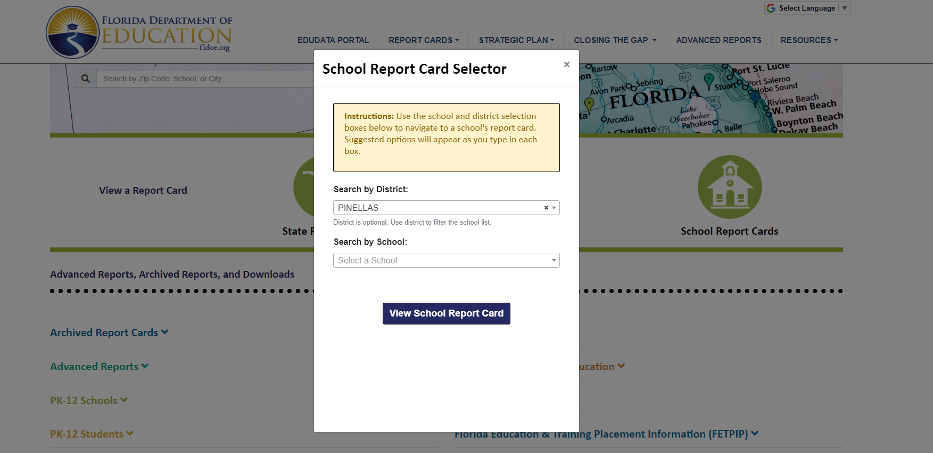
Visit to find district and school grades, EduData Portal
Notes:
When you follow the link EduDataPortal select Pinellas County and search by school.

Slide 18

School Classification
School Grade A
Strategies to focus on during 2021-22 school year:
Collegial Coaching
Focus on early foundational reading skills K-2 and vocabulary instruction in grades 3-5
Culturally Responsive Teaching Strategies
Infusing technology into all content areas
Notes:
You may use this slide to explain your school’s grade

Slide 19

Florida Standards
  Florida’s academic content standards establish high expectations for all students.
  Florida Standards identify what your child needs to know and be able to do in all content areas. You may read more information by visiting fldoe.org/academic/standards/.
  Also, your child’s teacher will be able to explain the standards for your child’s grade level.
Notes:
All curriculum, instruction and assessments are based on student-centered expectations.

Slide 20

School’s Curriculum
Florida’s Standards form the framework of everything taught at school.
Curriculum
  Reading
  Mathematics
  Writing
  Science
Notes:
This slide is optional if this will be discussed with classroom teacher
School’s Curriculum
Describe and explain the curriculum (Specific names of texts)

Slide 21
Florida Standards Assessment
(FSA)
Fall Assessment-
FLKRS (Florida Kindergarten Readiness Assessment)
Spring Assessments-
ELA Gr 3-10
Math Gr 3-8
Science Grs 5 and 8

Slide 22

K-2 in ELA during 2021-22 schoolyear
Florida Benchmark For Excellent Student Thinking Standards (B.E.S.T). You may read more information by visiting, http://www.fldoe.org/standardsreview/
Notes:
All curriculum, instruction and assessments are based on student-centered expectations.

Slide 23
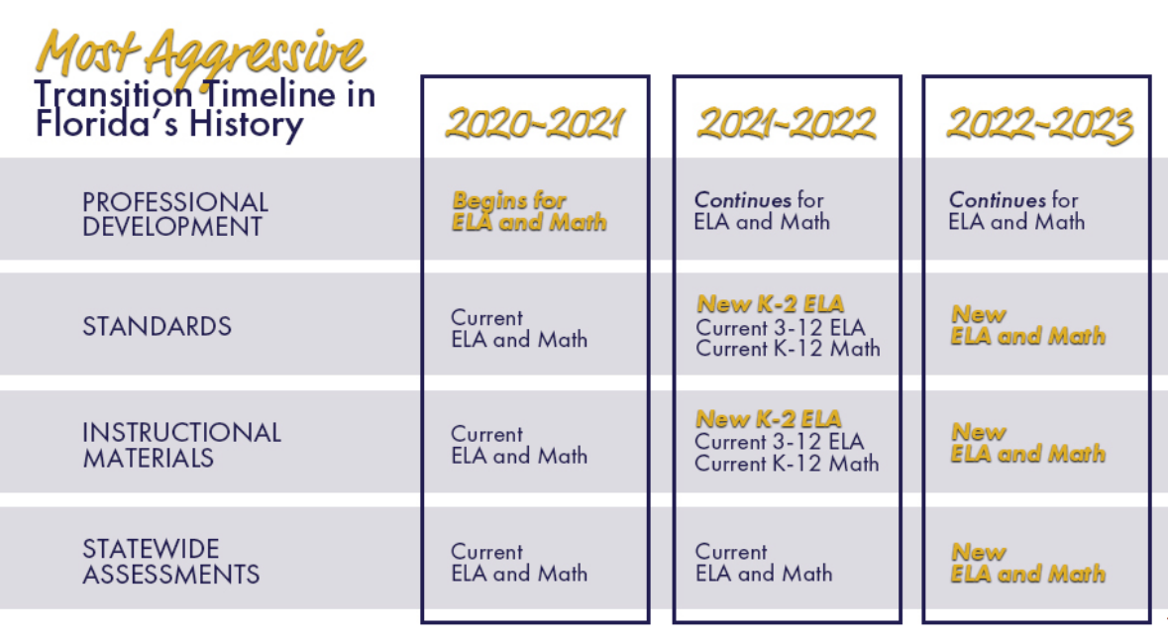
Notes:
Here is the timeline for the implementation for Florida’s BEST Standards.

Slide 24

We need your help!
Active Parent Involvement
Share a love of learning
Read to and with your child
Review the Compact throughout the year
Keep Portal info up to date
Volunteer
Participate in giving your input for our SIP, PFEP, and budget
Show interest in your child’s school day
Ask her/him questions
Check homework
Praise their efforts
Encourage good study habits
Communicate with the teachers and other staff
Virtually or in-person attend events

Slide 25

Working Together for Student Success
Please join us virtually or in-person…
PTA – Last Tuesday of each month at 3:15 pm
SAC – Monthly TBD

Slide 26

Additional Resources
Title I Parent & Family Coordinator – Amy Brown
dodgeam@pcsb.org
Learning at Home Family Resources - https://www.pcsb.org/Page/32836
Volunteer in a Pinellas County School - https://www.pcsb.org/Page/459
Mentoring & Tutoring - This Year it's Virtual -https://www.pcsb.org/Page/461
Parent Advocacy – Keosha Simmons simmonskeo@pcsb.org
Parent Academy POWER HOURS Webinars - https://www.pcsb.org/Page/26534
Partnerships - https://www.pcsb.org/Page/418

Slide 27
We appreciate your time!
Please feel free to ask any questions and provide feedback on our Title I Program.

