Slide 1

Community Schools
Advisory Council
Ronda Evans, Director of Community Schools
September 12, 2025
8:30 am-11:30 am

Slide 2
Spanish Translation
Available

Slide 3

Welcome!
Eureka City Schools Community Schools
Advisory Council #14
Centering our Work
8:30 - 8:40 am

Slide 4

We begin by acknowledging that Eureka City School District and its schools are on the unceded territory and ancestral homeland of the Wiyot people, who are still here and who continue to remain in relationship to these lands through ceremony, culture, and who are the past, present and future stewards of this land.
To recognize the land is an expression of gratitude and appreciation to those whose homelands we reside on and is a recognition of the original people and nations who have been living and working on the land since time immemorial.
Call to action: Supporting local Native American Communities through honor tax is a step I am committed to taking as an individual.
In my role as an educator I commit to centering Native Youth and Families by continuing to amplify and support culturally responsive teaching practices in our schools.
https://www.honortax.org/

Slide 5


Group Norms:
Share the Air
Practice and model what we are wanting to create
Recognize you positional power
Welcome personal reflection in this process
Practice Listening
Provide space FIRST to people and families most impacted by the necessity of the work of Community Schools

Slide 6
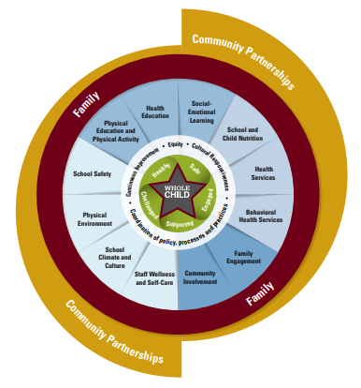
Whole Child
Goal: Working together with families & Community Partners to improve
the lives
of all
of our students.
Safe
Engaged
Healthy
Challenged
Supported
Coordination of:
-Policies
-Processes
-Practices
Commitment to:
-Equity
-Cultural Responsiveness
-Continuous Improvement

Slide 7
A community school strategy transforms a school into a place where educators, local community members, families, and students work together to strengthen conditions for student learning and healthy development.
As partners, they organize in-and-out of school resources, supports, and opportunities so that young people thrive.
-Community Schools Forward, 2023

Slide 8
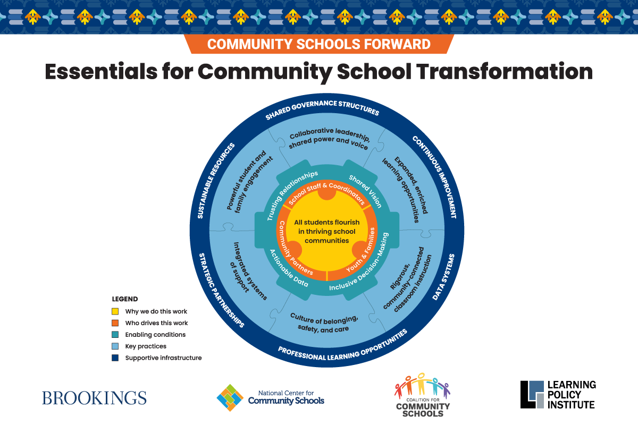

Slide 9


Slide 10

Introductions
8:40 - 9:00
Your Name…
Organization…
A goal for your attendance here today…

Slide 11



Learner Agency
Garett Montana & Jeff Bird
🚪Secret Doorway
Notes:
Intro and first 15 slides: 10 minutes

Slide 12

Lunch33 @ EHS, Zane, and Winship
Transforming Lunch into Belonging, Joy, and Student Leadership

Slide 13

High Performance Requires Extraordinary Efforts
One can be:
5. Elite
4. Excellent
____________
3. Good
2. Average
1. Bad
It is extraordinary to be EXCELLENT or ELITE. It requires extraordinary efforts to reach that level.
Notes:
Different people might say that we are in different spots, but I can promise you that we are not Excellent nor Elite.

Slide 14

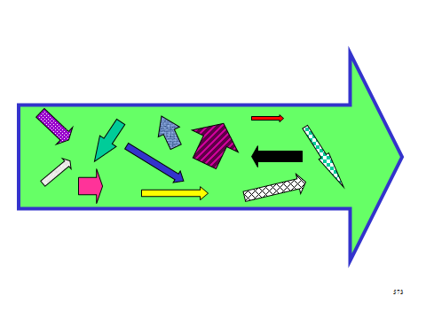
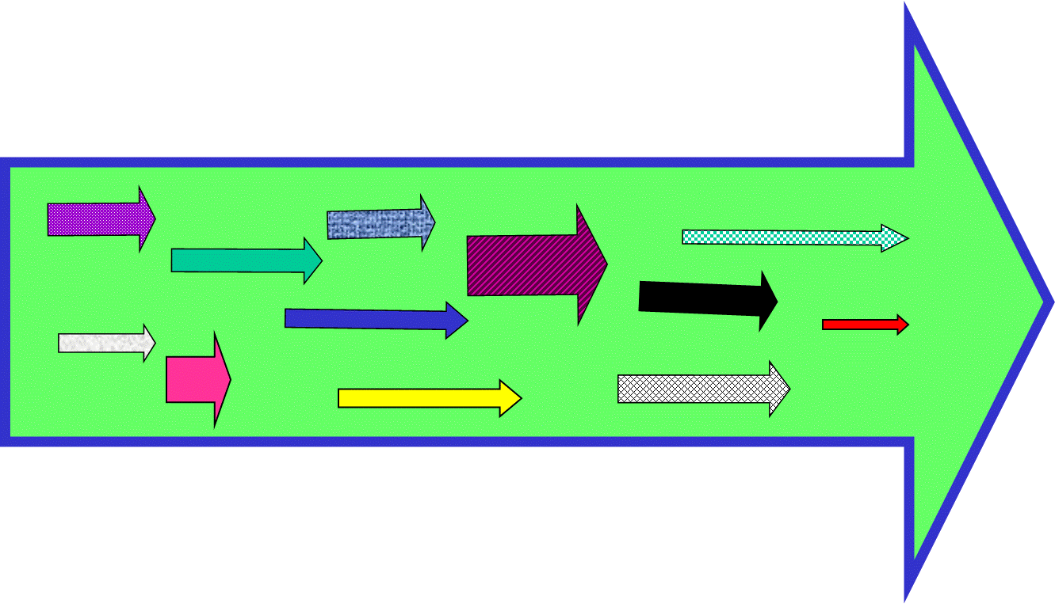
Code of Cooperation
ECS is in the process of getting all of its arrows heading in the same direction!
VS
Notes:
Coherence Member in Charge:

Slide 15
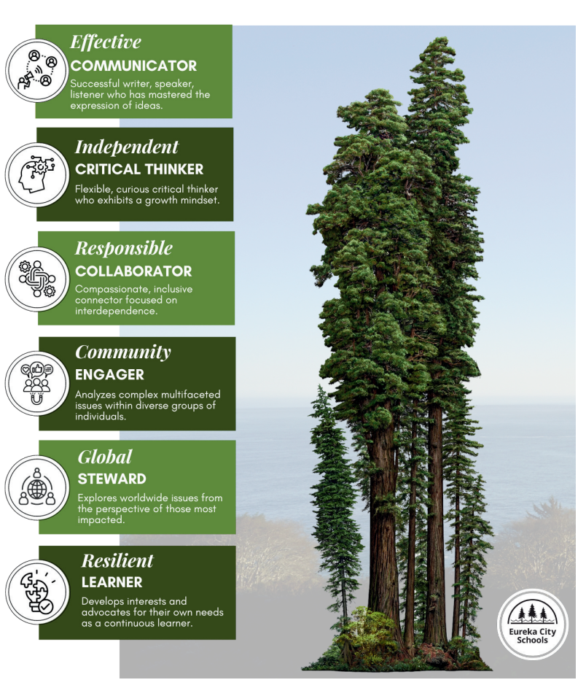
ECS Portrait of a Graduate and Values
…
Effective Communicator
Independent Critical Thinker
Responsible Collaborator
Community Engager
Global Steward
Resilient Learner
Notes:
Coherence Member in Charge:

Slide 16


The Problem - Traditional School

Slide 17
Why The Traditional (time-based) School Is Not Working
One-size-fits-all model
Seat time over mastery
Grades mask true learning
Lack of relevance
Little student ownership
Failure is punished, not used for growth
Rigid schedules and structures
Disengagement and inequity
Soft skills and lifelong learning ignored
Everyone moves at the same pace, regardless of readiness or need.
Students pass based on time spent in class, not demonstrated understanding.
A single grade averages everything, hiding what students actually know or don’t.
Students don’t see the connection between school and real life or future goals.
Learning is done to students, not with them — limited voice, choice, or agency.
Mistakes hurt your GPA. There’s little room for revision or trying again.
Students can’t accelerate or get more time based on need — the calendar drives learning.
Marginalized students often feel unseen, unheard, and underserved by systems not designed for them.
The system prioritizes content over collaboration, self-direction, and resilience.

Slide 18

Traditional School Is Not Working!
The traditional school model does not naturally create learner agency.
Some pockets have either intentionally or inadvertently created agency, but there has not been a collective effort to create it.
Notes:
Need evidence here! Student statements, etc.

Slide 19
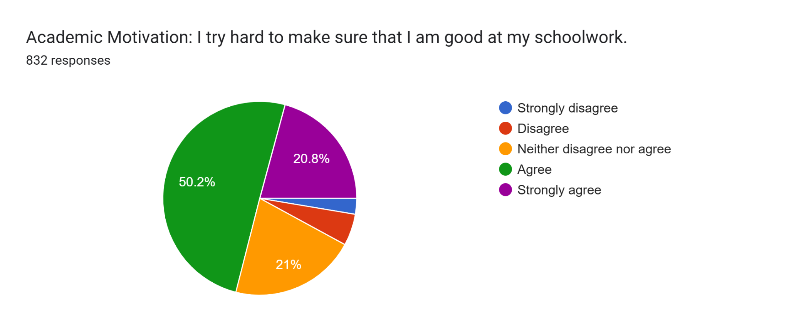
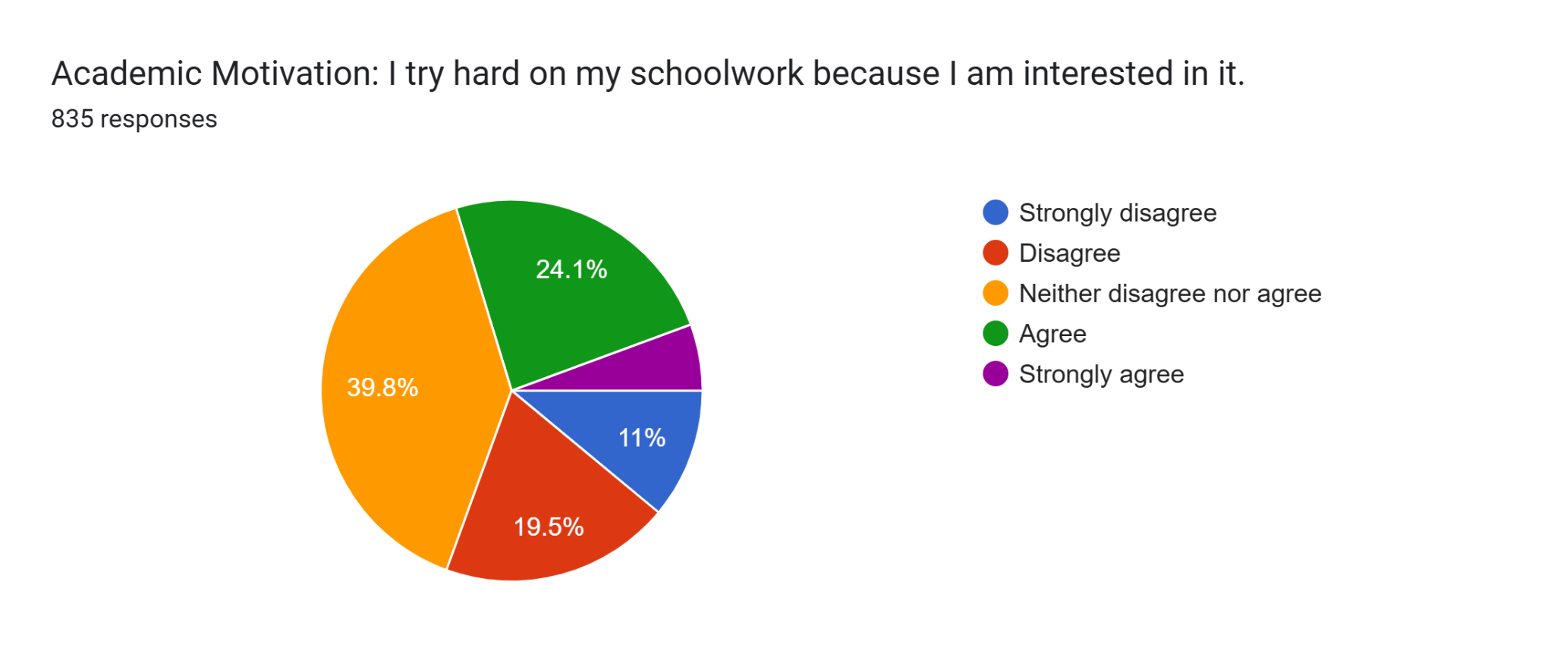

Noteworthy Metric: ENGAGEMENT improves Belonging and Success
whole school
71%
Strongly agree
24.4 % P1
down to 20.8% P2
-4.8%
from P1
whole school
29.7%
Competency Based Learning
5.6
Strongly agree
P1 7.4%
down to 5.6% P2
P2
24-25

Slide 20

One Big Problem
By the time students get to the high school, even the highest achieving students, it is all too often about chasing grades, not learning.
They have been asked to master the “game” of school.
They are missing out on the critical learning about themselves and how they motivate, work, attack obstacles, and LEARN.
Notes:
Need evidence here! Student statements, etc.

Slide 21

Where do we start?
To put it simply, we want to create a school environment where you would want to put your own children, grandchildren, or any young ones you care deeply about.
Notes:
I am guilty of not team playing. No collective responsibilty

Slide 22
EHS - Intentionally Creating a High-Performance Environment!
Safe
Students feel protected, supported, and ready to learn
Orderly
Clear routines and structures that maximize learning time
Welcoming
Every student belongs and is valued as part of our community
Inspirational (Ignition)
We spark curiosity, motivation, and the drive to achieve
Shared Vocabulary
A common language for success and accountability
Collective Responsibility
Every student is our student — we all share the mission

Slide 23
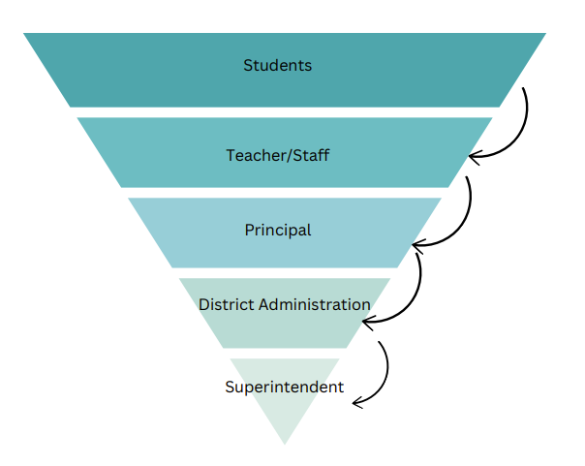
The Upside Down Pyramid
Competency Based Education starts with the question: “What do our students need to be successful?”

Slide 24
The Upside Down Pyramid
The lower you are in this pyramid the more people you serve.

Slide 25
How Competency-Based Education Addresses The Problem
Personalized pacing
Mastery-based progression
Transparent, specific feedback
Real-world relevance
Student ownership and agency
Failure is part of learning
Flexible structures
Equity at the core
Whole learner development
Students move forward when they demonstrate mastery, not when the calendar says so.
Learning is measured by what students know and can do — not time spent in a seat.
Assessments are tied to clear competencies and learning targets, not vague letter grades.
Learning is grounded in purpose, application, and student interest.
Students set goals, reflect, and make choices in how they learn and show understanding.
Students are expected to revise, retry, and grow — learning is a continuous journey.
Time, support, and pathways adapt to meet learner needs — not the other way around.
The system is built to ensure every student reaches high outcomes, not just some.
Habits of success, social-emotional skills, and learner agency are intentional parts of the model.

Slide 26
Traditional School
Competency Based
One-size-fits-all model
Seat time over mastery
Grades mask true learning
Lack of relevance
Little student ownership
Failure is punished, not used for growth
Rigid schedules and structures
Disengagement and inequity
Soft skills and lifelong learning ignored
Personalized pacing
Mastery-based progression
Transparent, specific feedback
Real-world relevance
Student ownership and agency
Failure is part of learning
Flexible structures
Equity at the core
Whole learner development

Slide 27
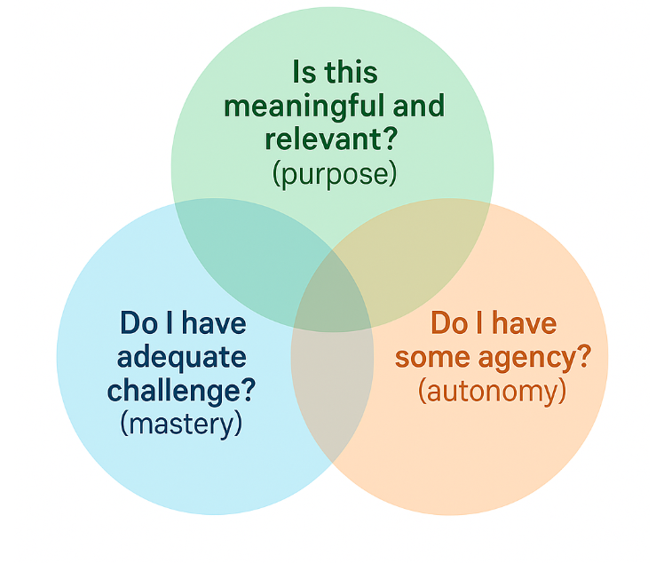
WE WANT MOTIVATED STUDENTS!
We want to create environments where IGNITION is more likely to happen.
CBE places students at the center, and builds in intentional ownership (Agency) for the learners.
Notes:
With my teams, we did not focus on the outcomes. We focused on the process. We created an environment where great things happened.

Slide 28
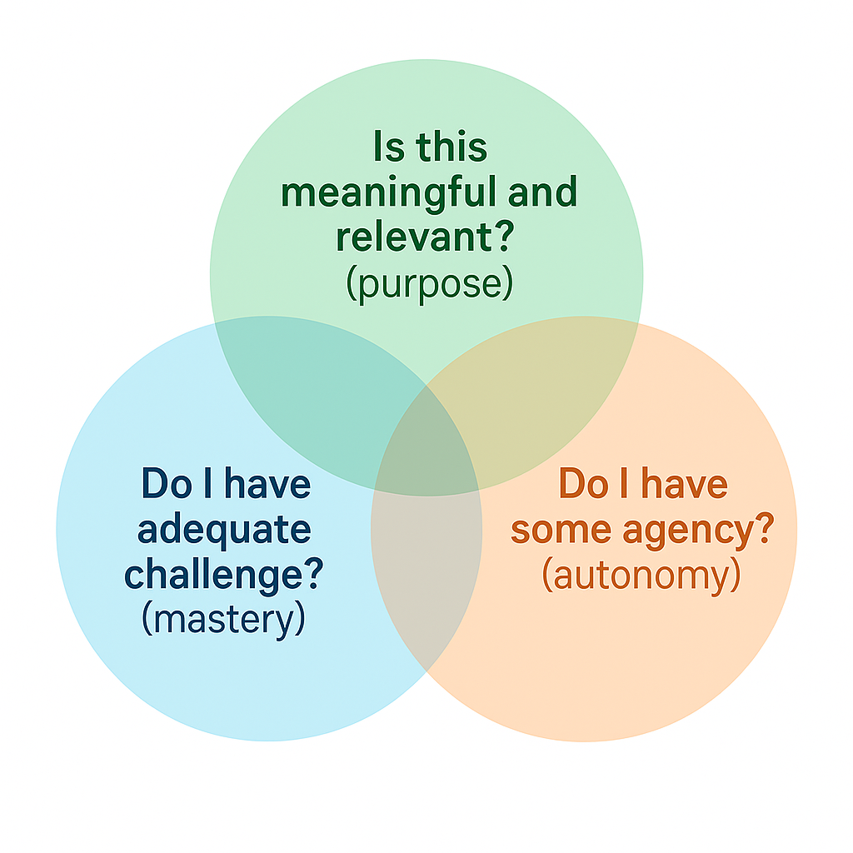
CBE & Motivational Theory
Does the student understand the “why” of the learning? Do they see how it connects to the real world, their lives, other content they’ve learned?
Does the student have authentic voice and choice in different areas of their learning?
Is the content at the student’s zone of proximal development…not too easy, not too hard?

Slide 29

A School is a System!
First and foremost, it is a human system.
Relationships, belonging, and care create the foundation.
Second, it is an educational system.
Learning thrives only when the human system is strong.
High-performance environments are human systems first.
The strength of the educational system depends on the strength of the human system.
Notes:
With my teams, we did not focus on the outcomes. We focused on the process. We created an environment where great things happened.

Slide 30

WE WANT MOTIVATED STUDENTS!
Successful people strive to be the best version of themselves.
We want our students to do the same.
When we get intentional, ignition happens.
The question: How do we create that spark?

Slide 31

Gardener and Flower Parable
The gardener’s role is not to shape the flower into what they want, but to nurture the flower so it can become what it was meant to be.

Slide 32


Learner Agency - What is it?
______________________________________________________________
Learner agency in the context of competency-based education (CBE) refers to a student’s capacity and opportunity to:
"Act with purpose, make choices, and take ownership over their learning."

Slide 33

What is LEARNER AGENCY?
As “agents,” we know we can make things happen (or stop them from happening), and we take responsibility for moving toward our goals. Over time, we develop our ability to motivate ourselves; we build our capacity for persistence and long-term effort. Agency makes us the authors of our lives. Lopez (2013)

Slide 34

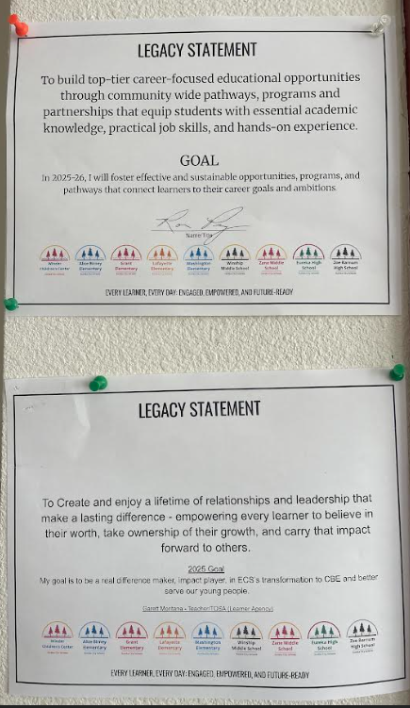
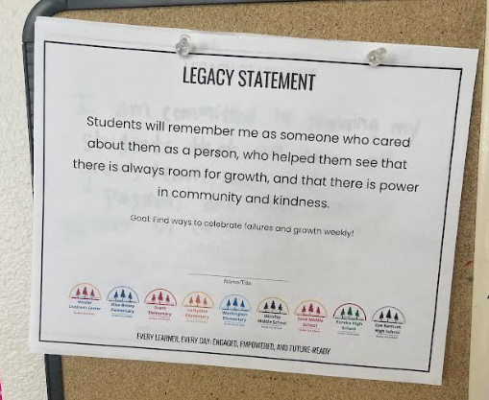
LEGACY STATEMENT
A Legacy Statement is a personal declaration of the long-term impact each staff member wants to leave on learners, colleagues, and the community. It reflects core passions and values, while connecting daily actions to lasting influence. Legacy Statements inspire purpose in the present and define the mark we hope to leave behind.
Key Features:
Personal & Authentic: Written in each person’s own voice, rooted in passions and values.
Long-term Impact: Describes how staff want to be remembered for their influence on learners and community.
Action-Oriented Goal: Paired with a specific, measurable step for the current year.
Visible & Shared: Posted in every workspace to strengthen culture and collective purpose.

Slide 35
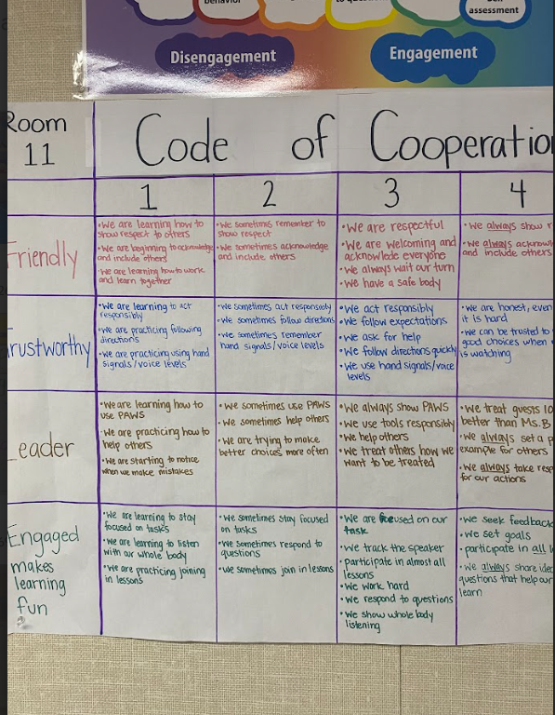
Codes of Cooperation
A Code of Cooperation is a co-created, living agreement that defines the expected behaviors and mindsets for learning environments. It is built with learners, not for them, and emphasizes mutual respect, responsibility, and a commitment to growth.
Key Features:
Co-created: Developed with learners’ voices at the center.
Living document: Reviewed and revised throughout the year.
Behavioral norms: Outlines how students will treat one another, the teacher, and the learning process.
Alignment with values: Supports Lindsay's focus on lifelong learning, ownership, and growth mindset.

Slide 36
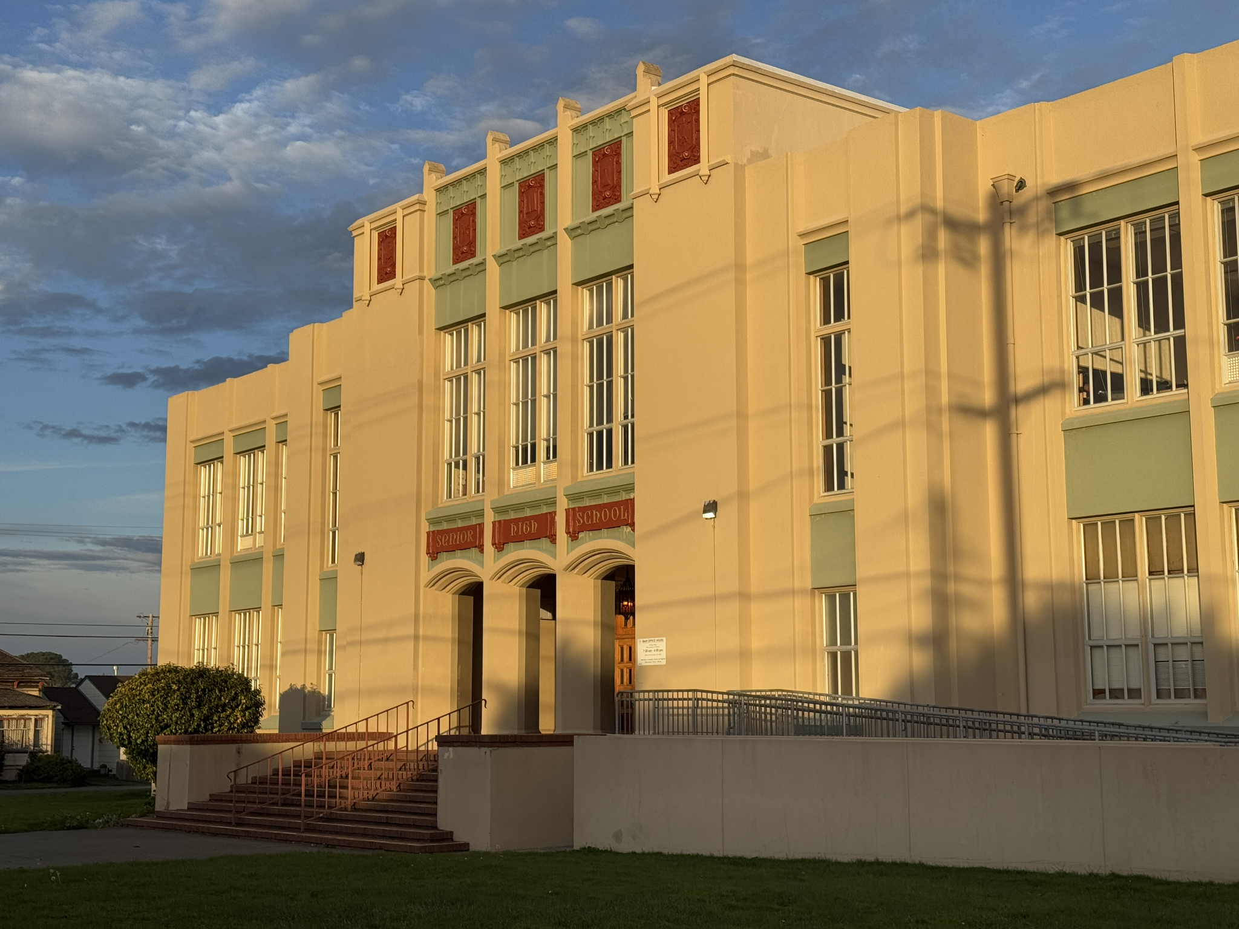
Learner Agency Team – Current ROCs
PBIS Tier 2 & 3 Progressions – Clear, consistent responses for 48900(k) disruptions to strengthen discipline and support student growth.
Learner Ambassador Team – Student leaders elevating learner voice, feedback, and partnership in district transformation.
Focus 3 – Relentless Leadership & E+R=O – Common leadership blueprint and accountability framework for staff and learners.
Personalized Learning Plans (PLPs) – District-wide system of goal setting and reflection to build ownership of learning.
3 Dimensional Framework – Coaching and teaching model that develops lifelong learning skills, social-emotional growth, and purpose.
Classroom SOPs – Co-created systems of routines and expectations that give students voice and ownership in their learning environments.

Slide 37
Lunch33 @ EHS, Zane, and Winship
Transforming Lunch into Belonging, Joy, and Student Leadership

Slide 38

What is Lunch33?
It started as a solution to the problem of students being bored at lunch, aimless, and not feeling engaged in school
It is a structured, student-led lunchtime activity system in contrast to opening the gym and allowing kids free play
Our values as determined by Lunch33Crew: Purpose | Passion | Positivity
Provides weekly opportunities for competition, learning, and growth
Prepares for a closed-campus EHS future

Slide 39
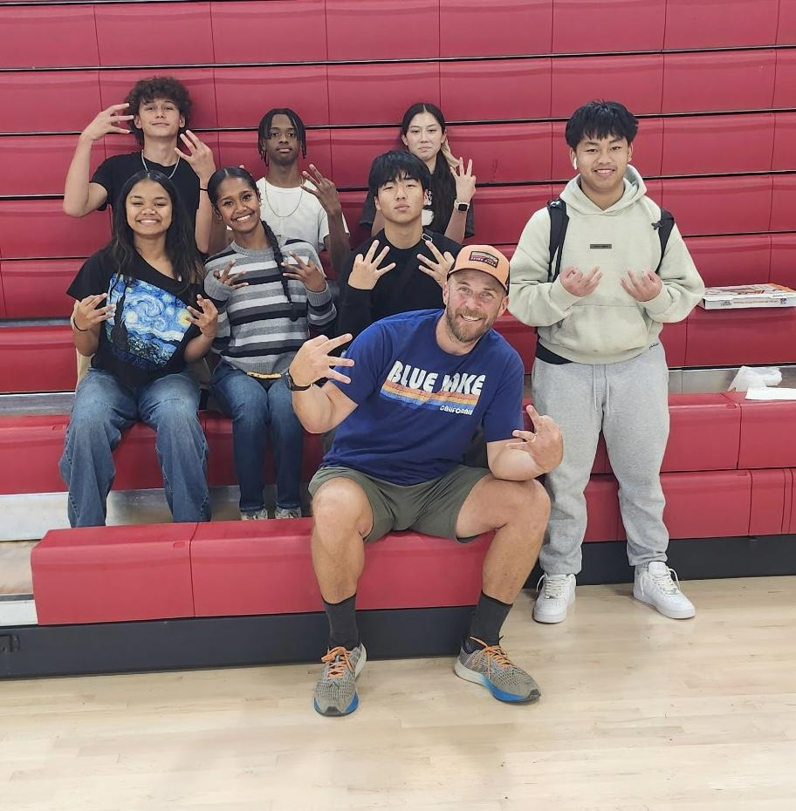
Vision & Purpose
Lunch33 builds:
Belonging – a place students want to be and gets more students feeling connected
Engagement – purposeful, fun weekly activities
Agency – students lead by choosing activities & modeling school values
Culture – joy, pride, and positive momentum

Slide 40

Goals for Lunch33
Lunch33 builds:
Builds relationships student-to-student and student-to-staff through fun, non-academic interactions
Strengthens student leadership by providing the opportunity to design & implement activities of their choosing along with the responsibility of running the activities
Reinforces the culture we want to build by emphasizing our Lunch33 values- 3P’s (Geno Cotter/HoopJones saying)
Low-cost, high-impact, scalable

Slide 41
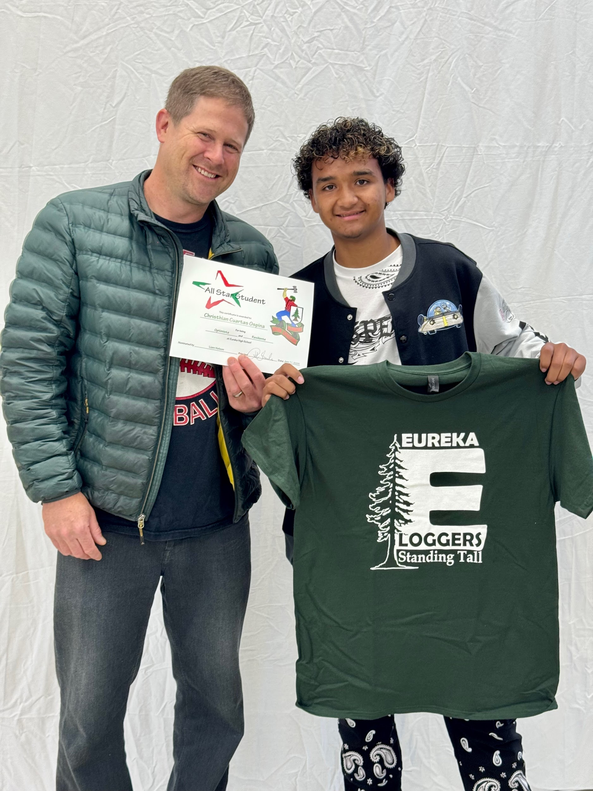
Where we’re starting
September 29th, we’ll have a mandatory lunchtime meeting with volleyball participants where we’ll discuss our values and expectations along with speech from guest speaker Steamer Nelson talking about the power of positivity
Beginning October 1, we’ll begin running 2 volleyball games simultaneously in our main gym. Games will be 10 minutes long and we’ll run 4 games per lunch period (8 teams will play). Scorekeeping, reffing and other game duties will be done by Lunch33Crew along with playing music and mcing of the event. Bird will be lone staff expected to supervise activities
Volleyball will run 4-6 weeks depending on number of participants
Non-participating students will be invited in to watch in the bleachers.

Slide 42
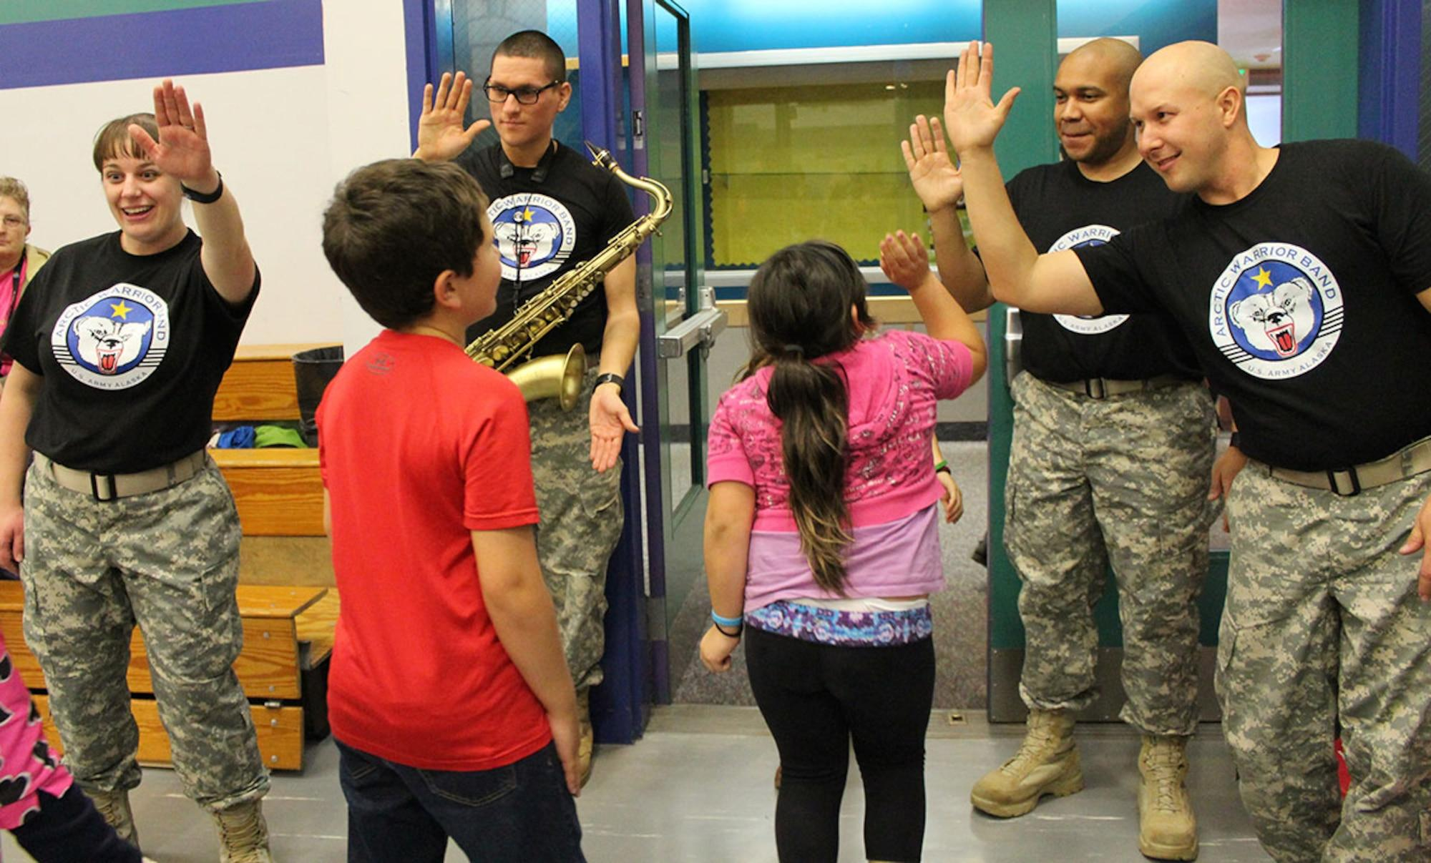
Where we’re going
After volleyball activity, we’ll start running multiple activities in main gym and around campus
We will have a second activity in main gym, basketball, along with dance in the small gym, and a Makers Space in the library.
The goal is to keep expanding more diverse areas of interest in order to get students engaged in school and excited about being on campus.
Teachers and staff need to be paid for their time. Clubs in the past have had minimal compensation

Slide 43
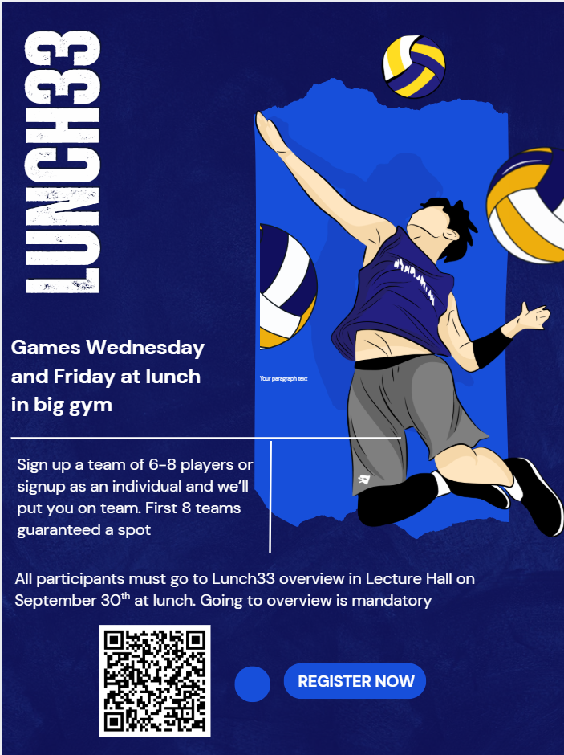
Community Schools Alignment (4 Pillars)
Pillar 1 – Student Supports → Safe, structured, positive spaces
Pillar 2 – Family/Community Engagement → Guest speakers, events, showcases
Pillar 3 – Collaborative Leadership → Student-led, staff-supported, partner-integrated
Pillar 4 – Extended Learning → Arts, athletics, wellness, service — during lunch

Slide 44
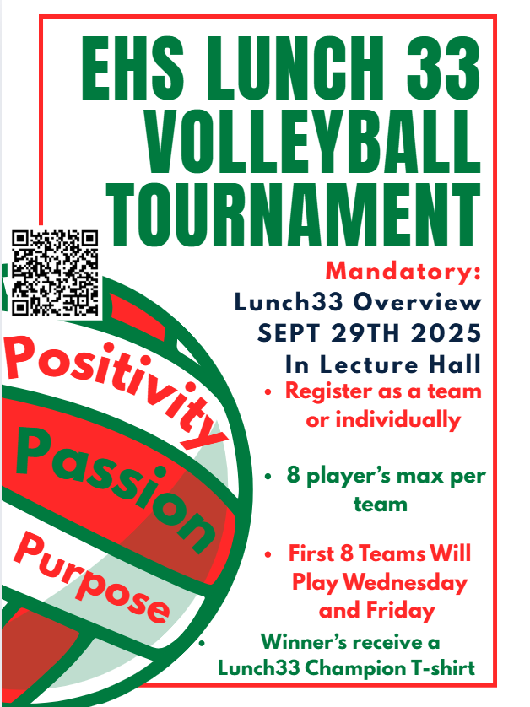
Goals & Outcomes
Increase belonging, engagement, and joy
Reduce idle/unstructured time & behavior issues
Boost attendance and student outcomes
Create a district-wide culture shift one lunch break at a time

Slide 45
The Ask: How Partners Can Help
Help provide the following:
Trainers – fitness, wellness, leadership in movement
Dance Instructors – cultural dance, K-Pop, performances
Creatives/Artists/Makers – art, crafts, media, design, estheticians
Athletics/Clubs/Orgs – tournaments, clinics, mentorship
👉 Commit to 1–2 lunch sessions/quarter • Sponsor shirts/rewards • Provide guest speakers

Slide 46
Notes:
Different people might say that we are in different spots, but I can promise you that we are not Excellent nor Elite.

Slide 47

~Break~ 9:50 -10:10
Bathrooms located in the in back Kitchen
& behind Projector Screen

Slide 48

CCSPP ECS Implementation Plan
10:10- 10:30
Goal 1: Improve Student Attendance
Goal 2: Increase student and family Belonging
Goal 3: Improve academic outcomes for student sub-groups:
African American | English Learners | Hispanic | Socio-Economically Disadvantaged
American Indian | Filipino | Homeless | Students with Disabilities
Asian | Foster Youth | Pacific Islanders | Two or more races
Notes:
2 min

Slide 49
Goal 1: Improve Student Attendance
Data: District Wide 22/23 C(39.71%) 23/24 C(35.61%) 24/25 C(35.59%) EOY
Grant Elem. 22/23 C(33.62%) 23/24 C(31.50%) 24/25 C(26.20%)
Actions:
Hired a district-wide Chronic Absenteeism Social Worker & Transporter
Purchased a van for transportation
Coordination of School Attendance Review Teams (SART) at all school sites
Developed a Attendance Protocol Toolkit
Family Outreach: Attendance Education Tabling
District-wide Attendance Campaign
Empathy Interviews - questions expanded to Middle/High School in 25/26
Quarterly Attendance Data reviews with each School Site
Piloted at Grant Elementary:
Attendance Campaign
Held SART (School Attendance Review Team) Conferences
Monthly follow-up after initial SART 1 Conferences *Allowed School to review data, communicate with families, offer resources and implement interventions
Notes:
4 min. 10:11

Slide 50

Jenny Martinez - District Chronic Absenteeism Social Worker
Back to School Night Site-level Presentation
Notes:
10:11 - 10:30

Slide 51
Jenny Martinez - District Chronic Absenteeism Social Worker
Q & A
Notes:
10:11 - 10:30

Slide 52

Community Schools Updates
10:30-10:55

Slide 53
Community Schools MOUs & Partnerships
Black Student Union
Support and Development of BSUs at both middle & high schools
True North
Development of ELAC & School Site Councils, currently at EHS, expanding to Lafayette and Zane
Grow Together
Social Emotional learning through a garden stewardship program at both Grant and Lafayette Elementary
English Express
English Classes, Citizenship Classes and Field trips for multi-language learning families and students
Community Engagement Initiative (CEI)
District Level Initiative to improve Family & Community Engagement. The focus for the 25/26 school year is on increased family engagement at English Language Advisory Councils, School Site Councils and Parent Teacher Associations at each school site
Faith Based Partnership Initiative
April 24th In partnership with Big Brothers, Big Sisters
Optical Academy
Glasses to Classes

Slide 54
Data Points:
Student Transportation: How many student transports that have been provided since the beginning of the school year, supported by Community Schools Staff - Total transports so far this year: 150+
Well Space Access: How many students at each school site that have accessed the Well Space at a particular school, resulting in a re-set or mental health services.
MTSS Referrals: Multi-Tiered Systems of Support Teams consisting of a site administrator, Education Specialist, Social Worker, CARE Specialist and Community Schools Liaison to staff individual students for tiered services, created and supported by Community Schools
Check & Connect: Students at each school site who are identified as housing insecure. Their attendance is checked weekly to support any issues related to attendance, completed by site Community Schools Liaisons.
Student Success Center: An Alternative to Suspension space at each Middle School to reduce suspensions and increase student engagement, staffed by Community Schools Restorative Practices Support Specialists.

Slide 55
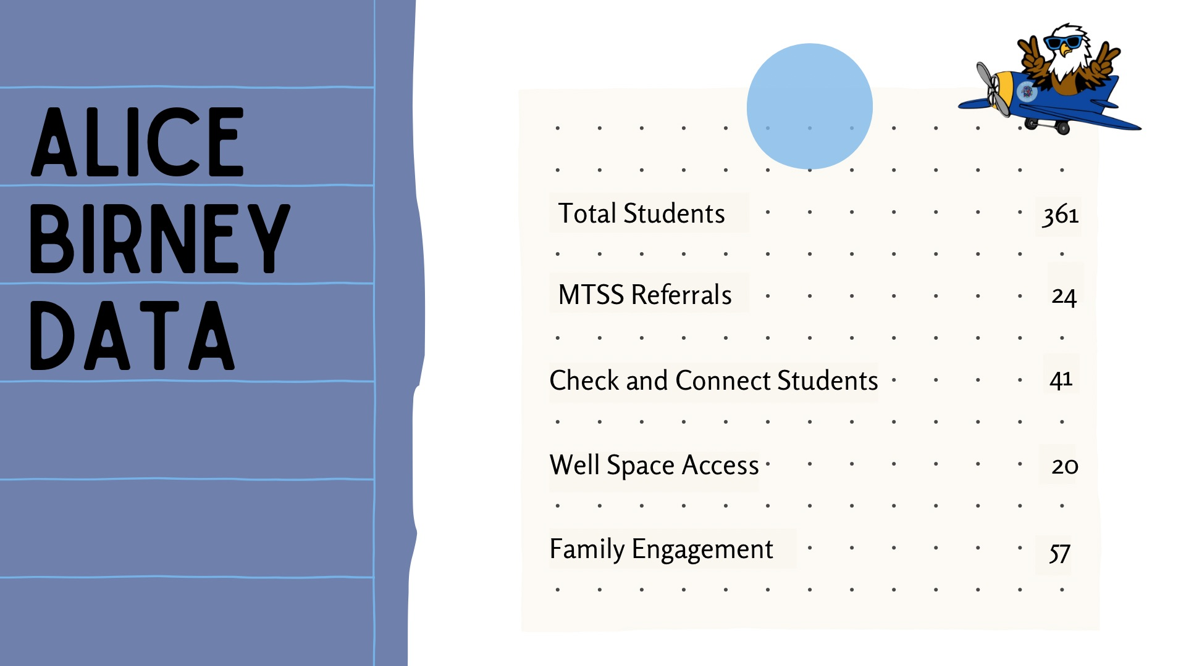
Site: Alice Birney Elementary 363 Students
Quarterly Data Review
MTSS Referrals
Check & Connect Students
WellSpace Access
Family Engagement -how are we measuring? Attendance at Events, BTSN? Raffle Tickets!!!

Slide 56
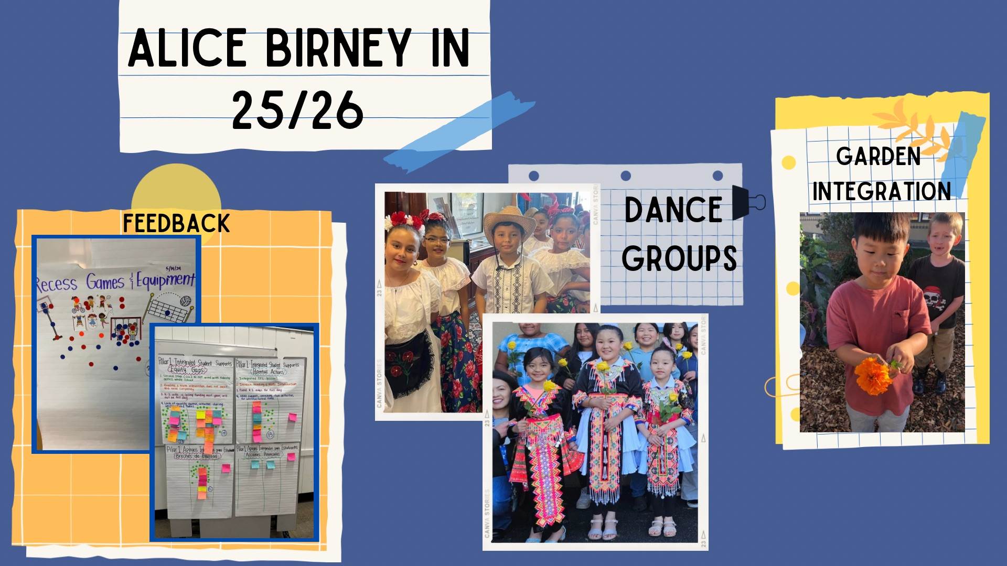
Alice Birney
Student Feedback/Input/voice
What is coming in 25/26
Garden Teacher 20 hours a week
Recess Remix
Lunch Clubs

Slide 57
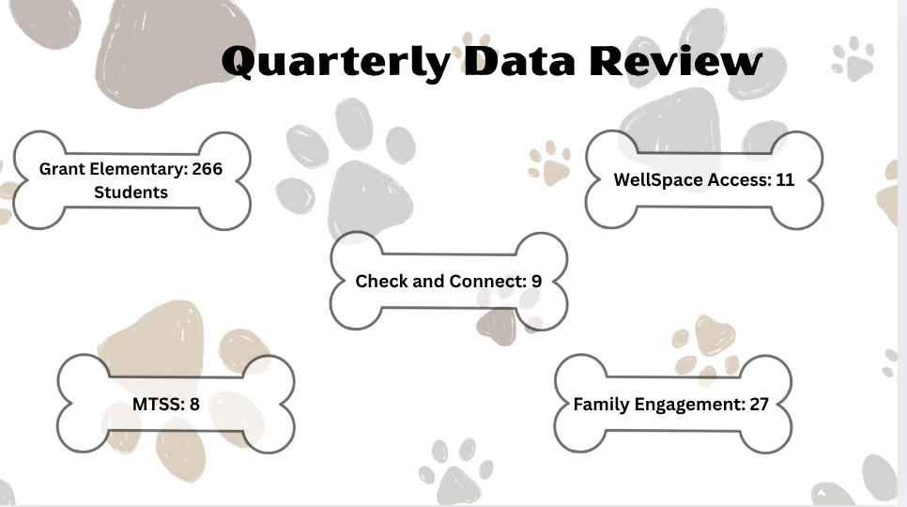

Slide 58
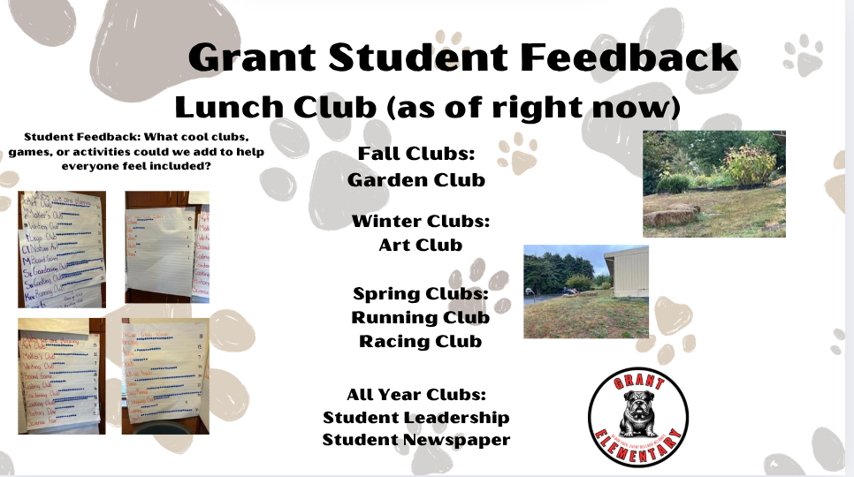

Slide 59
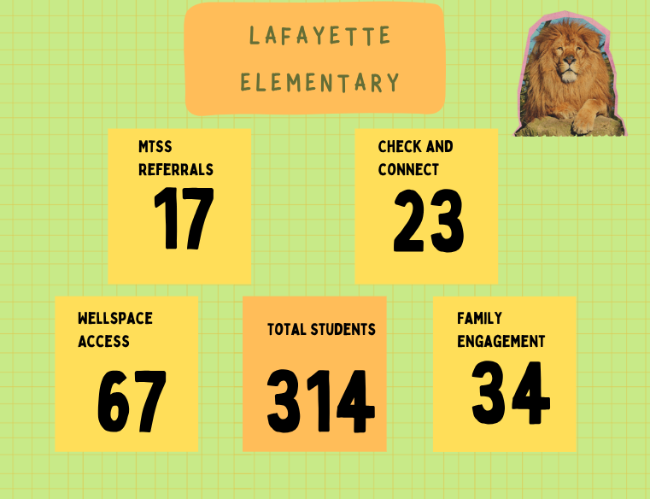
Site: Lafayette Elementary 312 Students
Quarterly Data Review
MTSS Referrals
Check & Connect Students
WellSpace Access
Family Engagement

Slide 60
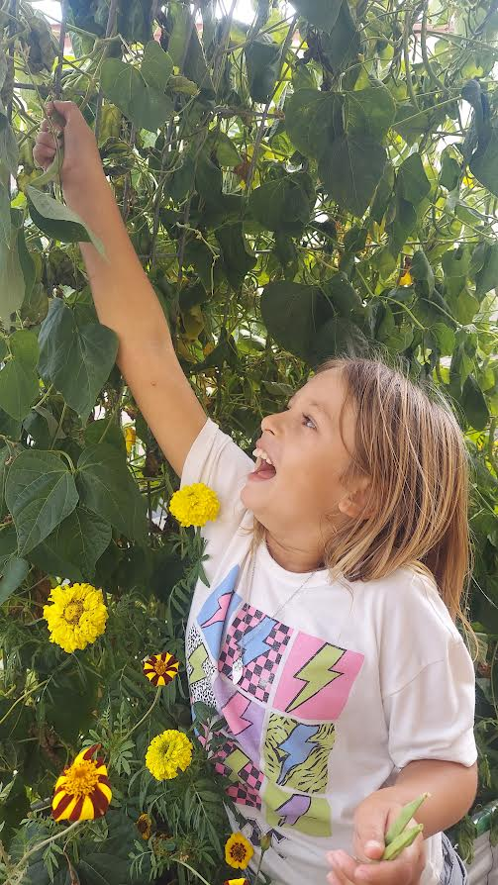
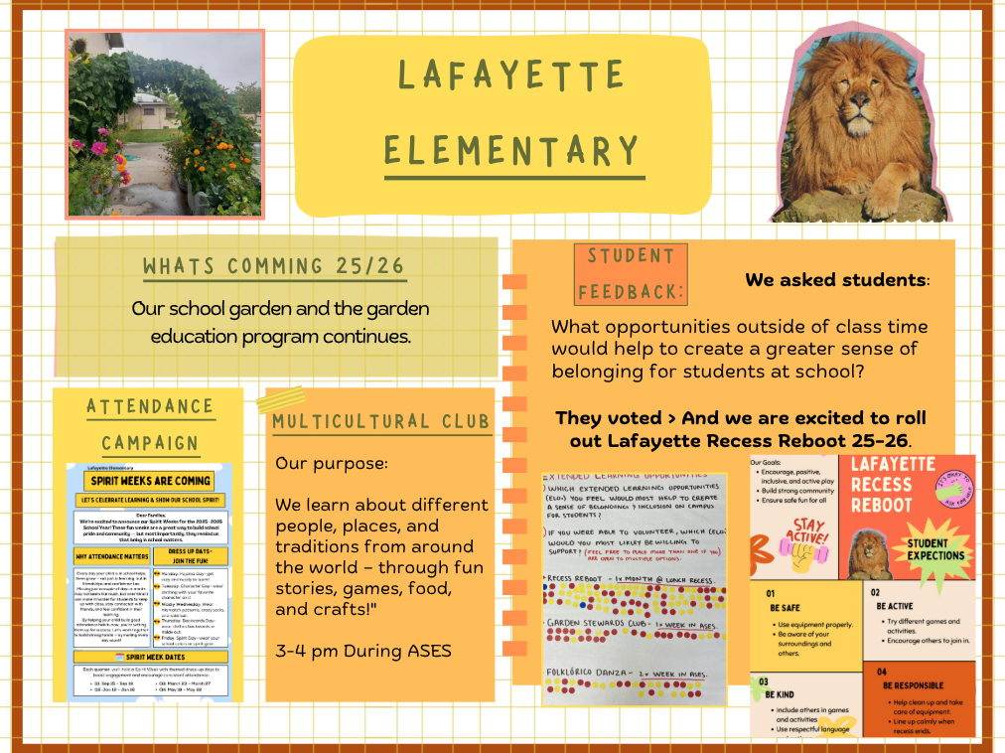
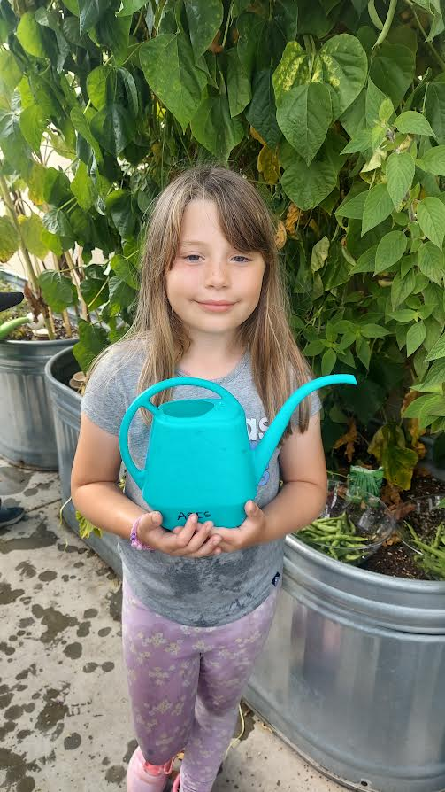
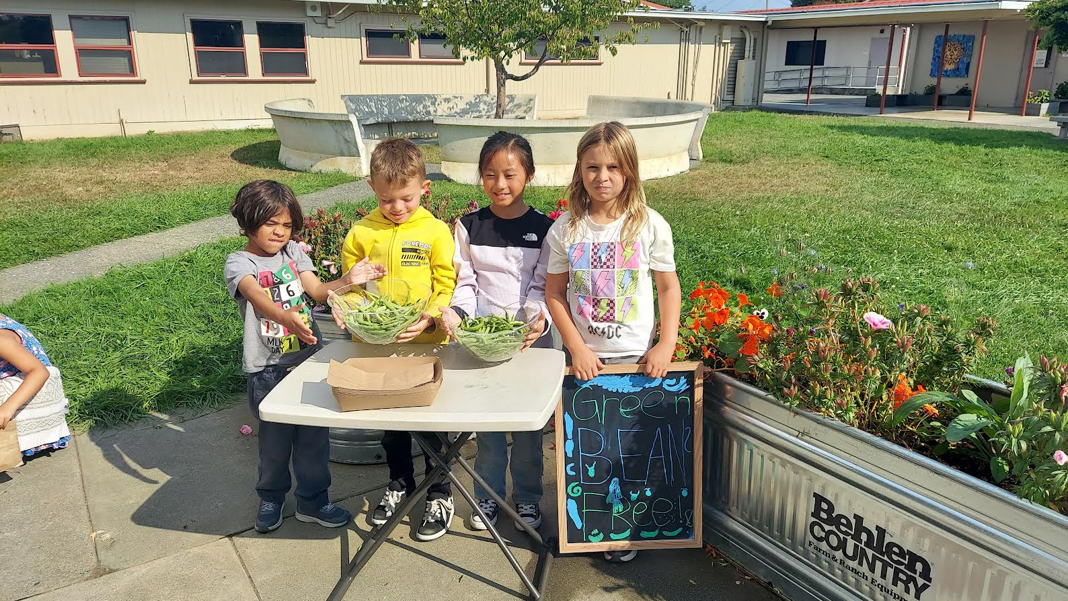

Slide 61
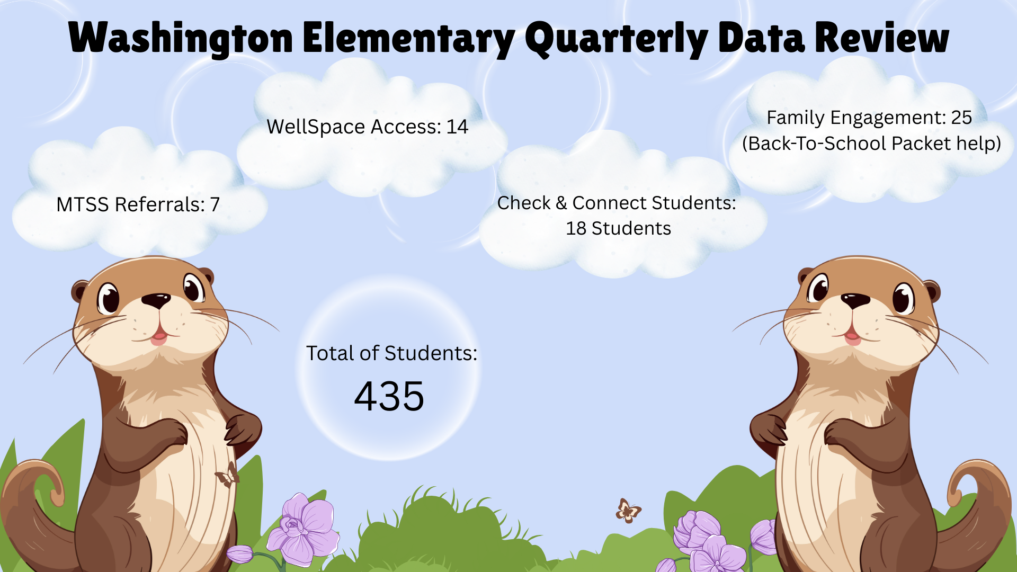
Site: Washington Elementary 435 Students
Quarterly Data Review
MTSS Referrals- 7
Check & Connect Students- 18 Students
WellSpace Access- 14
Family Engagement- 25 (Back-To-School Packet help)

Slide 62
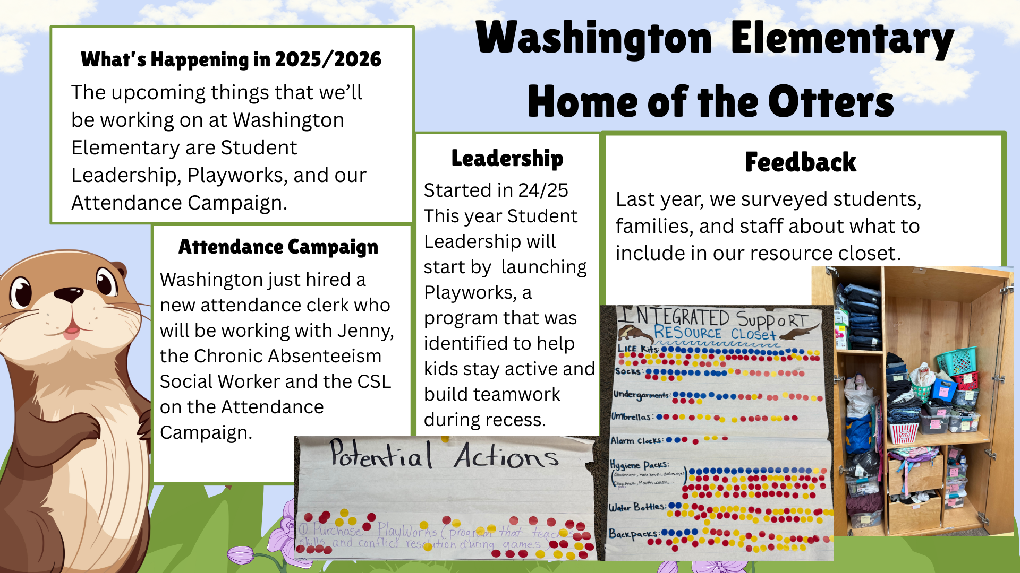
Site Washington
Student Feedback/Input/voice
What is coming in 25/26

Slide 63

Winship Middle School - 429 Students
Quarterly Data Review
MTSS Referrals - 39
Check & Connect Students - 21
WellSpace Access - 44
Family Engagement -220
Student Success Center - 30

Slide 64
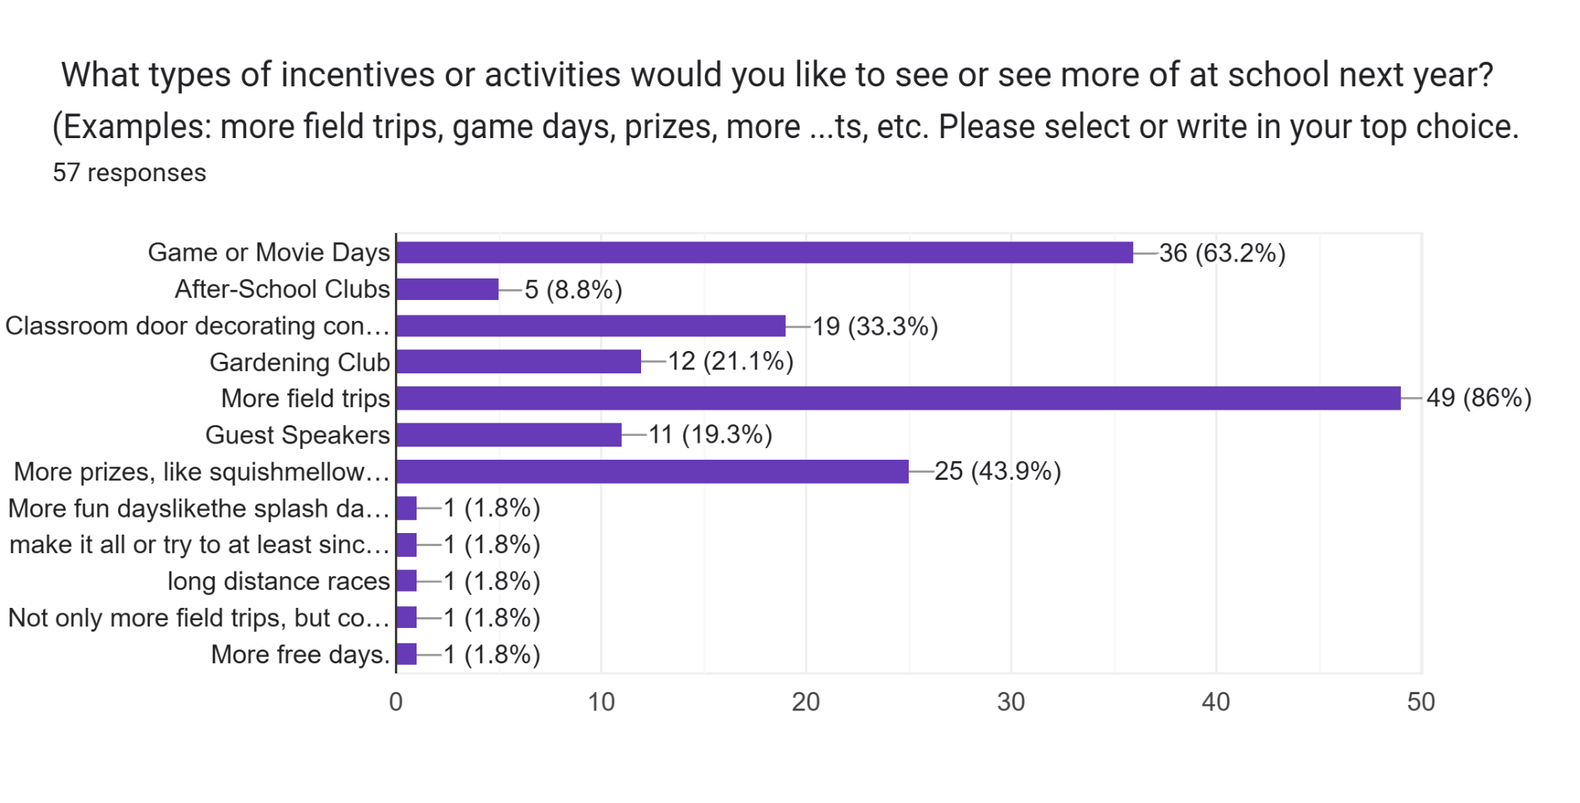

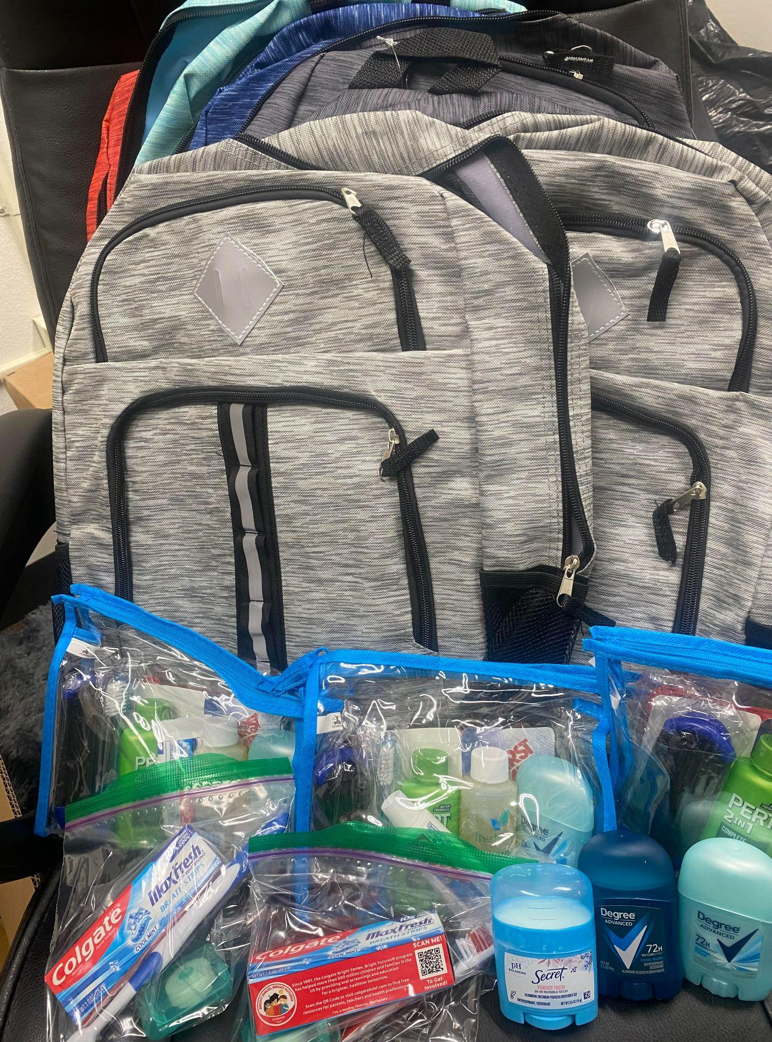


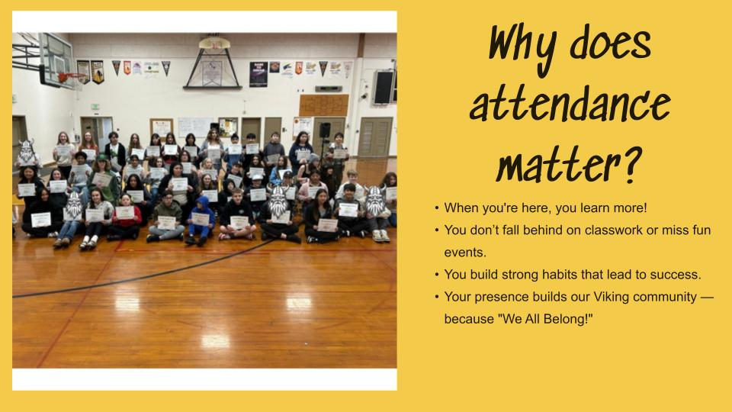
Winship Middle School
Student Voice
Attendance Campaign
Resource closet is almost complete!
We have hygiene kits, undergarments, clothes, shoes, and backpacks.

Slide 65


Slide 66
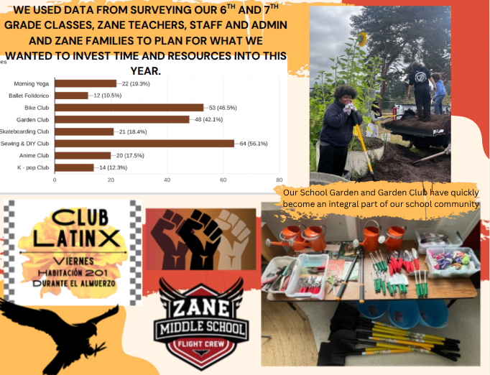
Site Zane
Student Feedback/Input/voice
What is coming in 25/26

Slide 67
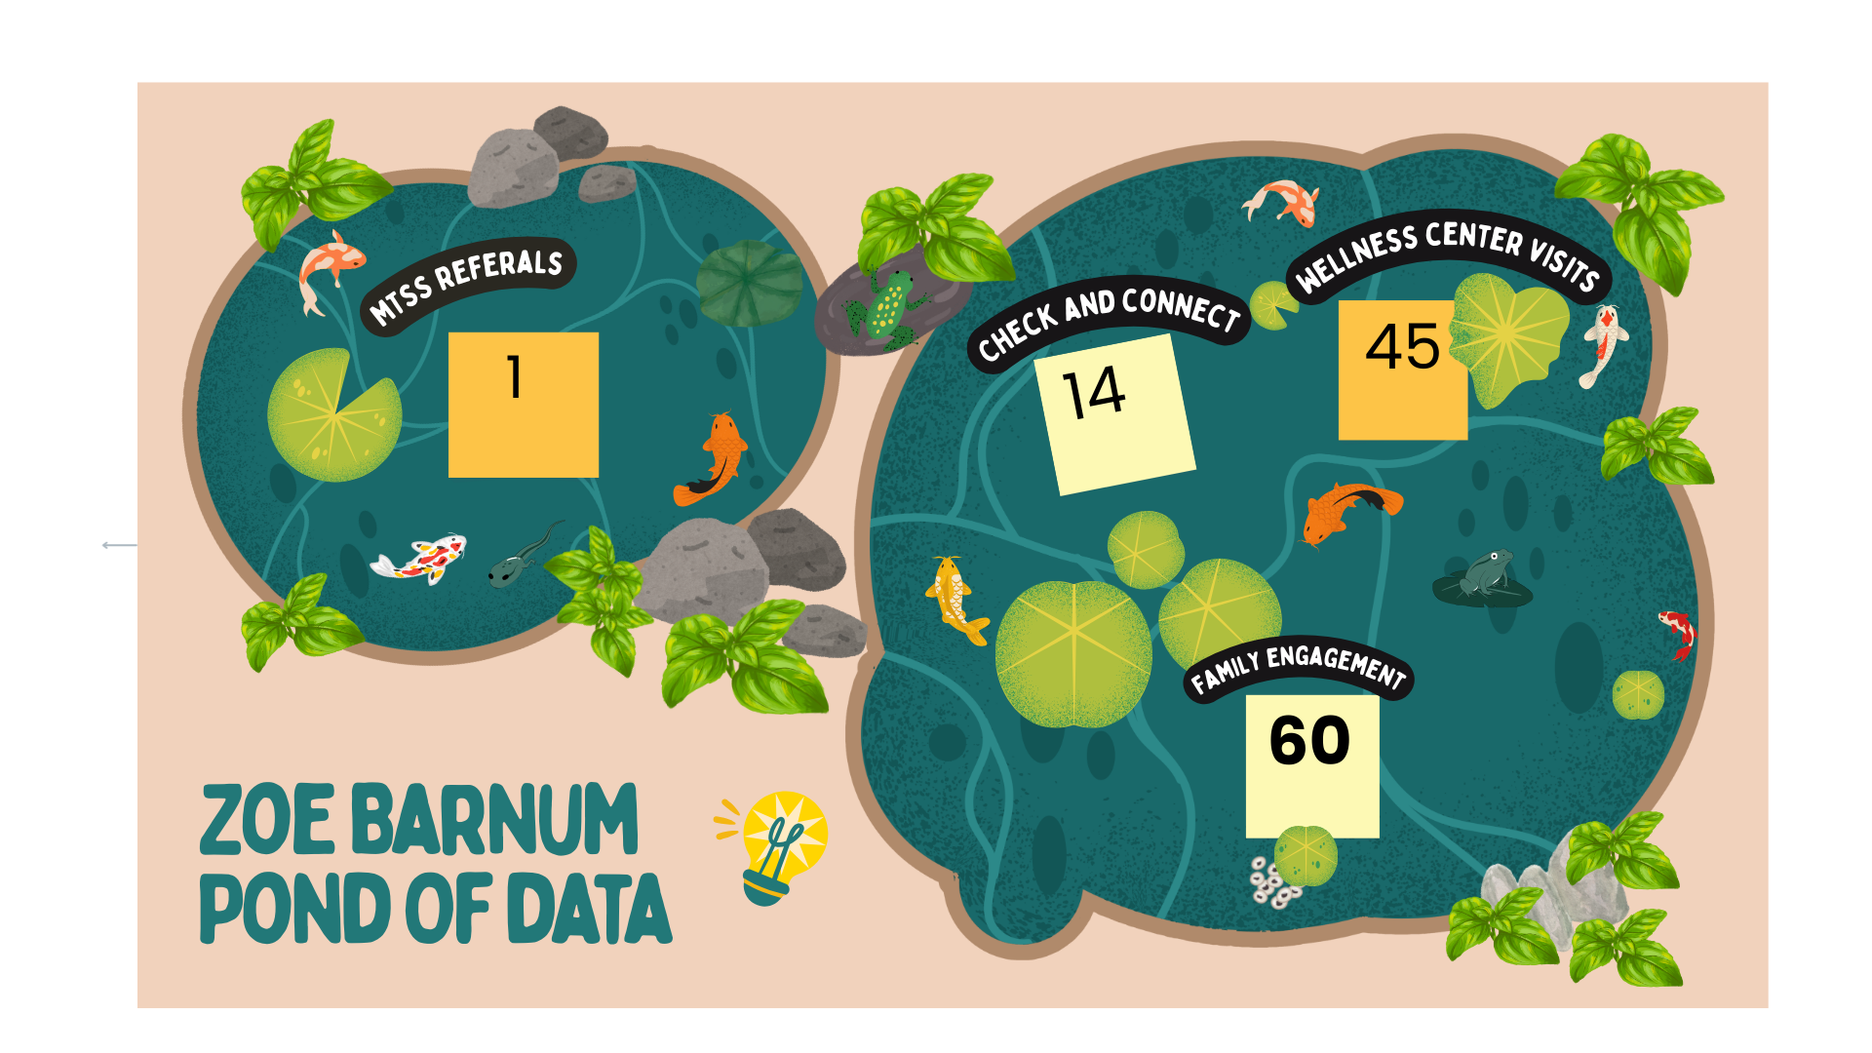
Site: Zoe Barnum High
Quarterly Data Review
MTSS Referrals
Check & Connect Students
WellSpace Access
Family Engagement

Slide 68


Zoe Barnum High School - 50 Students
Talia Ciarabellini
Student Feedback/Input/voice
What is coming in 25/26
Big Picture Learning
Drivers Ed Online
Culinary

Slide 69

Site: Eureka High -1,159 Students
Stats…
MTSS Referrals - 27
Check & Connect Students - just launching
WellSpace Access - 77 students
Family Engagement - ELAC
Career-Centered Education with Transcend, a non-profit that partners with schools to design, build and spread equitable, innovative and student-centered learning environments
Ron Perry is looking for 4-7 parents/guardians Sept. 17th at 11am in IT202 - 45 min. meeting

Slide 70
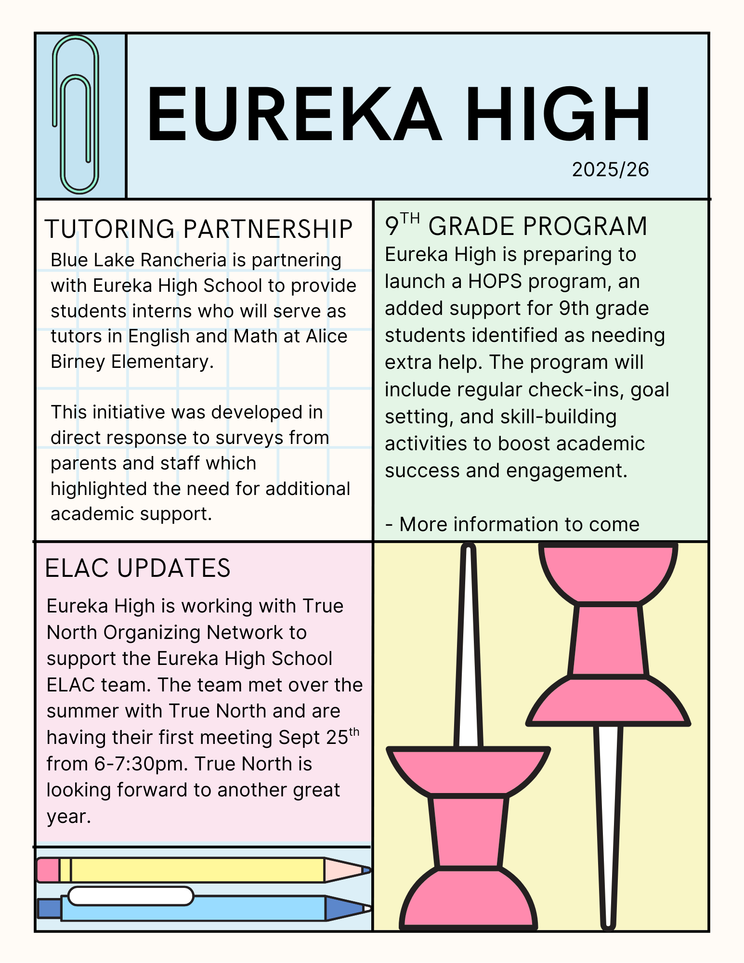
Eureka High
LUNCH 33 and…..

Slide 71
District Leadership Data Walk 8/14 Outcomes:
Next Steps:
Recommendation from ECS Cabinet: Collect data at the end of each trimester/semester, Utilize HCOE to create posters with this data and have principals and CS staff present to School Site Councils. Presentations will be placed on School Site Agendas and the public will be invited to attend.
Information gathered from these events will provide an opportunity for principals to engage with site leadership teams to collaborate on School Scorecard reviews
Do:
Use simple, clear language.
Make data relatable with visuals & voices
Ensure access (translations, childcare, timing).
Show demographics, services, trends.
Clarify purpose, outcomes, next steps.
Keep metrics consistent year-to-year.
Provide:
Trends & summaries with context.
Guiding questions.
Student/family quotes.
District vs. school-level views.
Clear ways families can help at home.
Avoid:
Too much text or jargon.
Data without action/next steps.
Overwhelming charts.
Singling out staff or skipping equity.

Slide 72
10:55-11:15
Whole Group Q & A
Notes:
Q & A,

Slide 73
Closing & Next Steps
11:15 - 11:30 am
Faith-based Partnership Initiative with Big Brothers, Big Sisters
Parking lot- Missed Partnership Opportunities? Warm Handoff…
Focus Group Sign Ups
Mental Health Sub-Committee meets Bi-Monthly and is ISO new members! If you are interested, please reach out to Taffy Stockton @tmstockton@gmail.com

Slide 74
Future Meeting Dates
Next Advisory Board
  Friday, Dec. 5th, 2025 8:30 -11:30am
Data Focus Group 1-2:15 pm
  4th Thursday of each month
2S/LGBTQIA+ & BIPOC Focus Group 1-2:15 pm
  1st Thursday of each month

Slide 75


