Slide 1


Indian Trail Elementary
Title I Annual Meeting
September 22, 2025

Slide 2

Federal Requirements
The Every Student Succeeds Act (ESSA) requires that each Title I school hold an Annual Meeting for the purpose of…
  Informing you of your school’s participation in Title I.
  Explaining the requirements of Title I.
  Explaining your rights as parents to be engaged in the school community.

Slide 3
Meeting Overview
What is Title I?
What does it mean to be a Title I school?
Our School’s Proud Points from 2024-2025
Our School’s Goals for 2025-2026
How Title I funds are Used at Our School
Your Rights as Parents and Families
    School Improvement Planning
    Parent and Family Engagement Policy
    School-Parent Compact
    Your “Right to Know”

Slide 4
What is Title I?
Title I is the nation’s oldest and largest federally funded educational program.
Title I provides supplemental funds to schools to help students meet their educational goals.

Slide 5
What does it mean to be a Title I school?
Being a Title I school means receiving federal funding to supplement the school’s existing programs. This funding is used for…
  Identifying students experiencing academic difficulties and providing timely assistance to help them meet the State’s challenging content standards.
  Purchasing supplemental programs, materials, and/or supplies.
  Conducting parent and family engagement meetings, trainings, and activities.
Being a Title I school also means encouraging parental engagement and advocating for parents’ rights.

Slide 6
Our School’s Proud Points from 2024-2025
Accountability Results
  Overall Exceeded Growth → Highest Growth Since 2014 - 91% of our 3rd-5th grade students demonstrated growth
  K-2 Literacy → 75%, +7% from year prior
  ELL Progress → 77% of students met their WIDA goals (+13%)
Teacher Working Conditions Survey
  Good Place To Work & Learn → Above 95% for the last 3 years
Year 12 - LeaderInMe Lighthouse School

Slide 7
Our School’s Goals for 2025-2026
Academics - Increase overall school literacy proficiency
  Strengthen core literacy instruction, differentiation across the grade-level, master teachers supporting interventions
Safety - Increase percentage of students who follow the school rules
  Recognize and celebrate positive behavior (Admin. Breakfast, Garden of Greatness bulletin, book vending machine) daily morning meeting, SOLE procedures, class/individual PAWS
Culture - Increase parent and community support
  Feedback from families, Growing Partnerships bulletin board, informational sessions for parents, more opportunities for involvement

Slide 8
How Title I Funds are Used at Our School
Staffing
  2 Tutors
  2 Master Teacher's
Instructional Support
  iReady - All students
    Online math program, personalized lessons
  Lexia Core5 - All students
    Online reading program, helps students build reading skills through structured and adaptive practices
PD/Extended Planning Opportunities

Slide 9
Your Rights as Parents and Families at a Title I School
You have a right to be involved in the following:
  Development of the…
    School Improvement Plan/NCStar Plan
    Parent and Family Engagement Policy
    School-Parent Compact
  Title I funding allocations for parent and family engagement.

Slide 10
School Improvement/NCStar Plan
The School Improvement Plan/NCStar Plan includes:
    A Comprehensive Needs Assessment
    Goals and Strategies to Address Academic Needs of Students
    Professional Development for School Staff
    Coordination of Resources and a Comprehensive Budget
    The School’s Parent and Family Engagement Goals
Parents and families at Title I schools have the right to be engaged in the development of this plan.

Slide 11
Parent and Family Engagement Policy
Every Title I School must have a School Parent and Family Engagement Policy that is jointly developed with parents and families.
The school Parent and Family Engagement Policy outlines how the school will implement the parental engagement requirements of the Every Student Succeeds Act (ESSA). Components include:
    How parents can be involved in decision-making activities.
    How information on instruction and assessment will be provided to parents.
    How the school will build parents’ and families’ capacities for supporting their children’s learning at home.
    How parental involvement funds are being used.
Parents and families at Title I schools have the right to be involved in the annual review and improvement of the Parent and Family Engagement Policy.

Slide 12
How Our School Engages Parents and Families
Teachers and staff will inform parents of their students’ academic progress through progress reports and other means of communication throughout the year.
Parent-teacher conferences will be held for all students in the fall of the year and as needed thereafter. Interpreters will be provided as needed.
Parent workshops focused on reading and mathematics curricula, assessments, and ways to support students’ reading and mathematics learning at home will be held throughout the year.
The school’s website, Facebook and Twitter pages will be updated regularly to keep parents and families informed on school and district related events.
Parents are welcome to volunteer at the school and attend regularly scheduled PTO and Site-based Team meetings.

Slide 13
School-Parent Compact
Every Title I School must have a School-Parent Compact that is jointly developed with parents and families.
The compact is a commitment or contract between the school, teacher, parent, and student to share in the responsibility for academic achievement.
The compacts must be distributed to all parents and families.
Parents and families at Title I schools have the right to be engaged in the annual review and improvement of the School-Parent Compact.

Slide 14
Your “Right to Know”
You, as a Title I parent/family, have the right to request…
  the qualifications of your child’s teachers.
  information about any state or local policy regarding student participation in any assessments mandated by the state or local district.
The Right to Know notification is distributed to all students at the beginning of the school year and is posted on our school’s website.
You, as a Title I parent/family, will be notified if your child is instructed for four or more consecutive weeks by a teacher who does not meet the North Carolina state licensure requirements for the grade level or subject area that he/she is teaching.

Slide 15
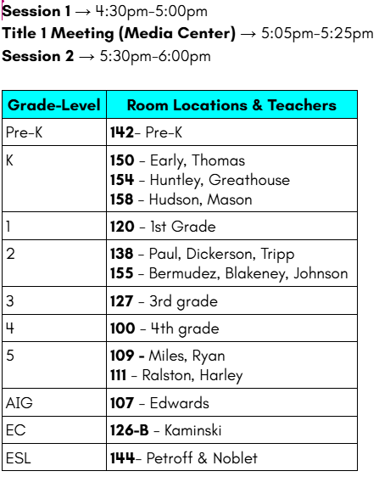
Raffle and Session 2

Slide 16
Title I Department Contact Information
Director of Federal Programs
Dr. Hema Lalwani
hema.lalwani@ucps.k12.nc.us
Title I Specialist
Paulette Pipkin
paulette.richardson pipkin@ucps.k12.nc.us
Title I Specialist
Lori Spruiell
lori.spruiell@ucps.k12.nc.us

Slide 17


Slide 18


