Slide 1


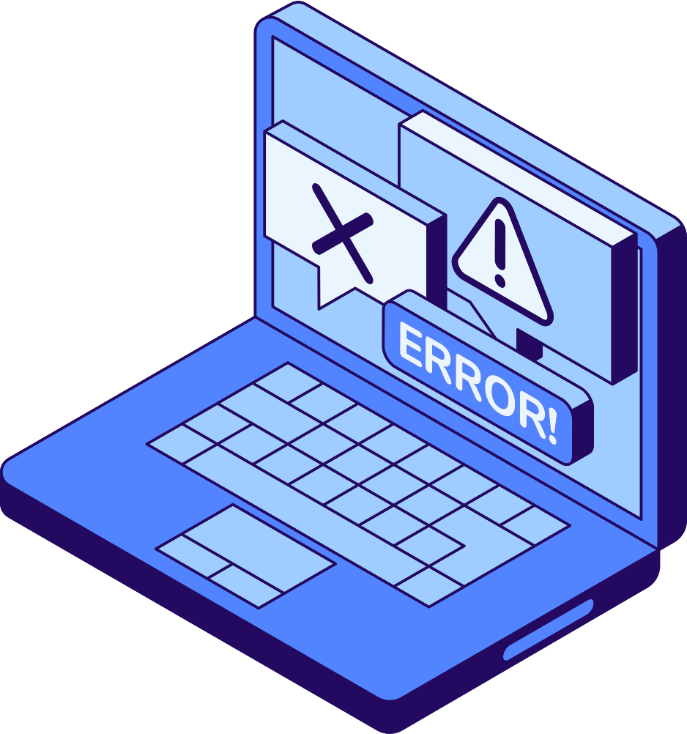
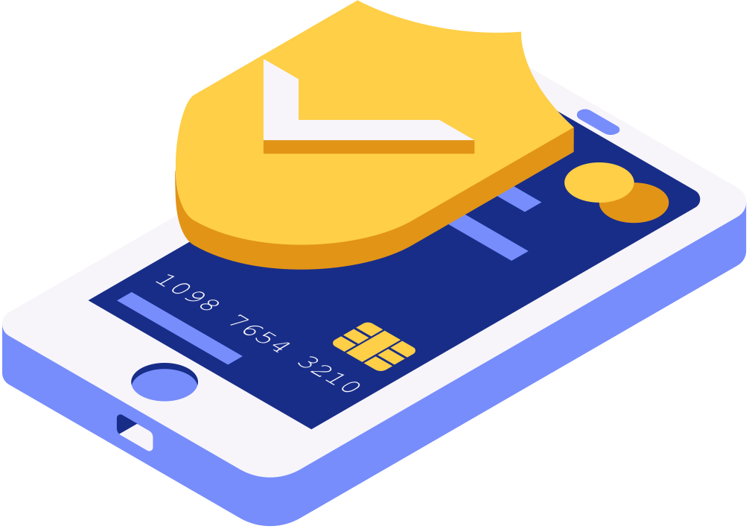

2025-2026
Hempstead Public Schools
RESPONSIBLE
USE POLICY AND DIGITAL CITIZENSHIP
MIDDLE SCHOOL EDITION
www.hempsteadschools.org

Slide 2
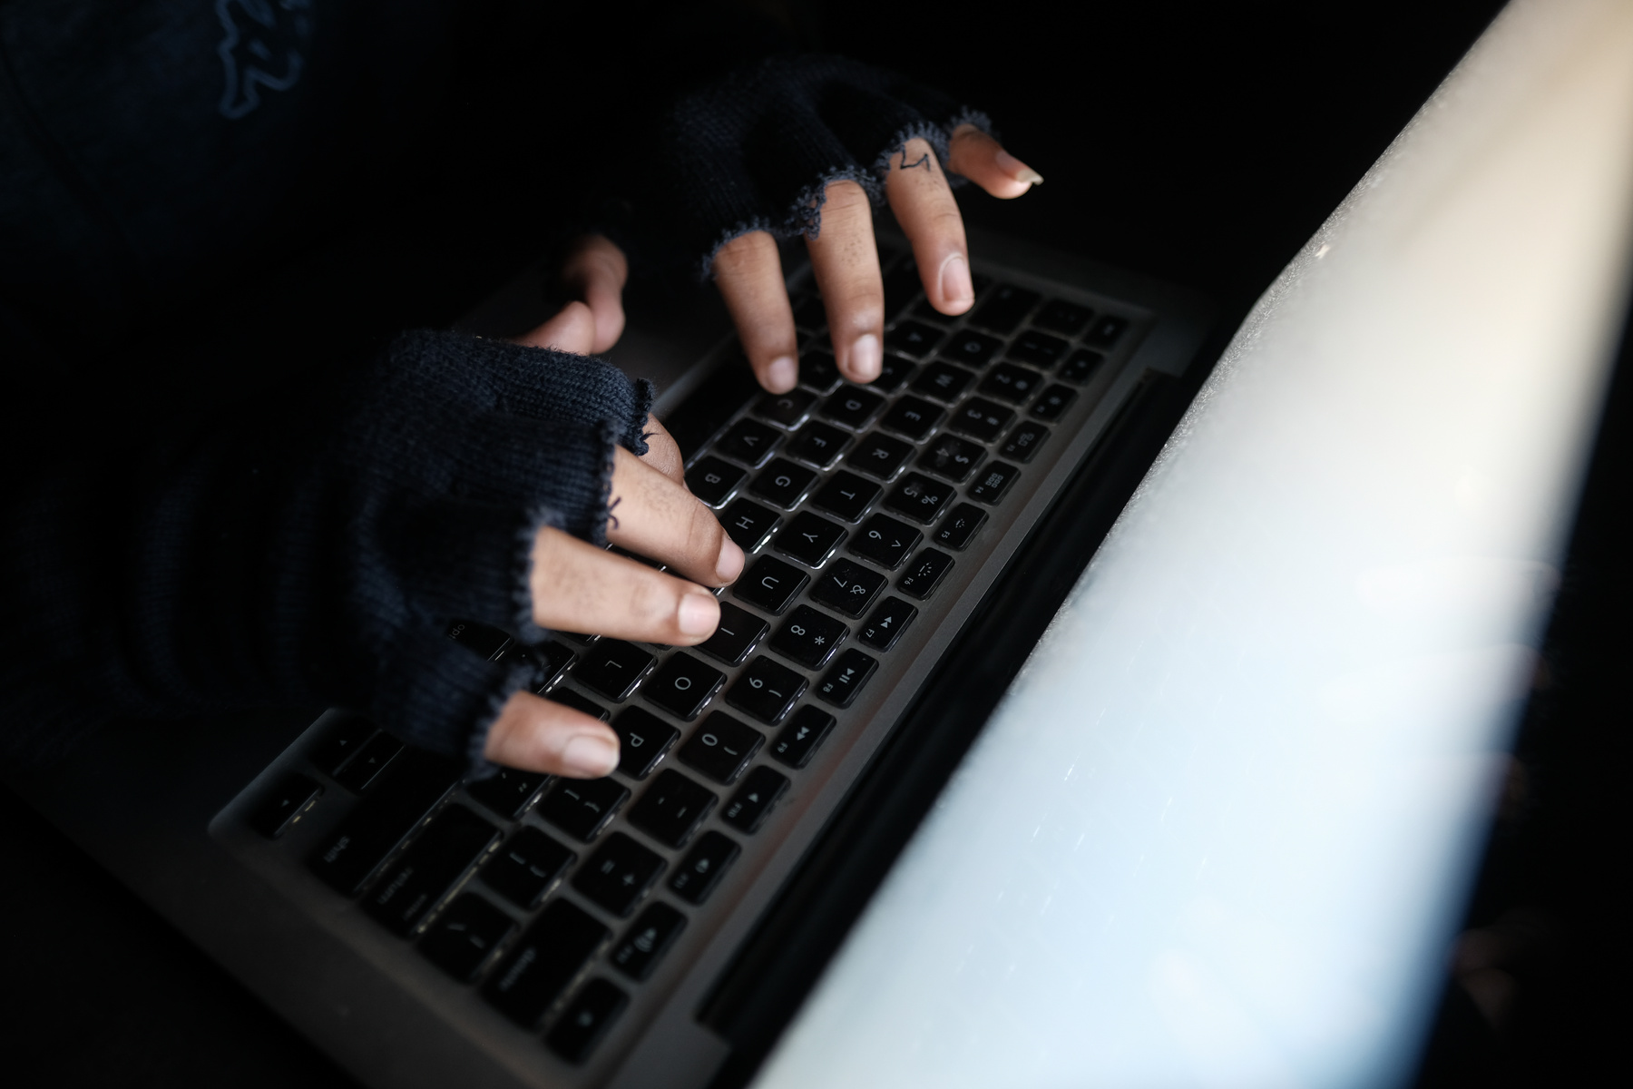
2025-2026
Hempstead Public Schools
It is the District’s philosophy that students learn to use technology tools to communicate globally and advance their educational goals.
It is a privilege to have access to these resources and therefore, all users must agree that they will comply with these guidelines.
RUP
GUIDELINES
www.hempsteadschools.org

Slide 3

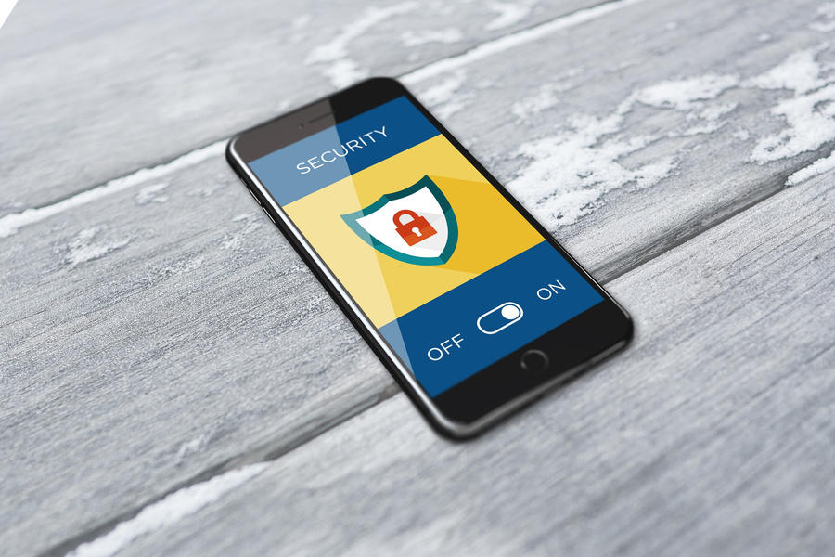
2025-2026
Hempstead Public Schools
To use computers, iPads, or any other technology at school, you and your parents have to sign an agreement stating that you will use them properly and responsibly. This is called a Responsible Use Policy (RUP) – rules for using school tech safely
→ Responsible Use Policy (RUP) – rules for using school tech safely – a set of rules for using school technology safely.
RUP POLICY
& INTERNET SAFETY
This presentation reviews the main rules that are outlined in our RUP, as well as guidelines for Internet safety and digital citizenship.
www.hempsteadschools.org

Slide 4

2025-2026
Hempstead Public Schools
I will not install programs or games
→ Example: Don’t download Fortnite or random apps on school laptops – it could cause problems. on a school computer or change it in any way.
BECOME A
I will only access programs or websites allowed by my teacher
→ Example: Stick to learning sites your teacher allows for music (unless your teacher says it’s okay)..
RESPONSIBLE USER
I know that my computer activity and files can be monitored
→ Remember: Teachers can check what you do on school devices what you do on school devices, so always stay appropriate. at any time.
www.hempsteadschools.org

Slide 5
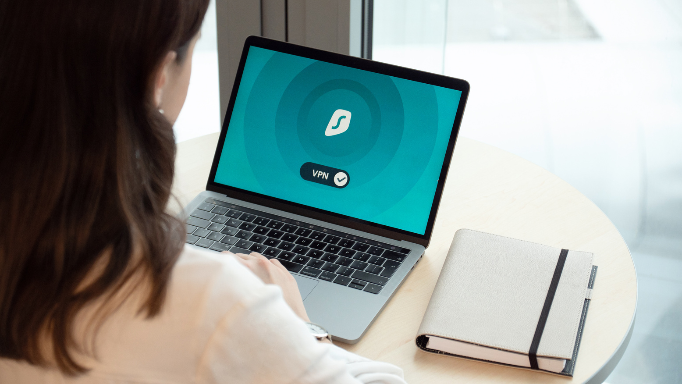
2025-2026
Hempstead Public Schools
All students are responsible for seeing that our labs, equipment and network are used in an effective, efficient, ethical and lawful manner.
A RESPONSIBLE
I will treat all computers and other equipment with care
→ Example: Be careful with laptops – treat them like your own phone – handle devices like they’re your own. If any equipment does become damaged, I will notify my teacher immediately.
USER HELPS…
www.hempsteadschools.org

Slide 6
2025-2026
Hempstead Public Schools
A RESPONSIBLE
USER ACTS…
I will only use social media as part of educational activities
Example: Only use apps for school projects if your teacher says so, use it for the project only – not for personal scrolling., as directed by my teacher. I will always treat others with respect and kindness when interacting with them online.
I will tell my teacher immediately if I see anything inappropriate on my computer or know of something inappropriate on someone else’s device.
www.hempsteadschools.org

Slide 7

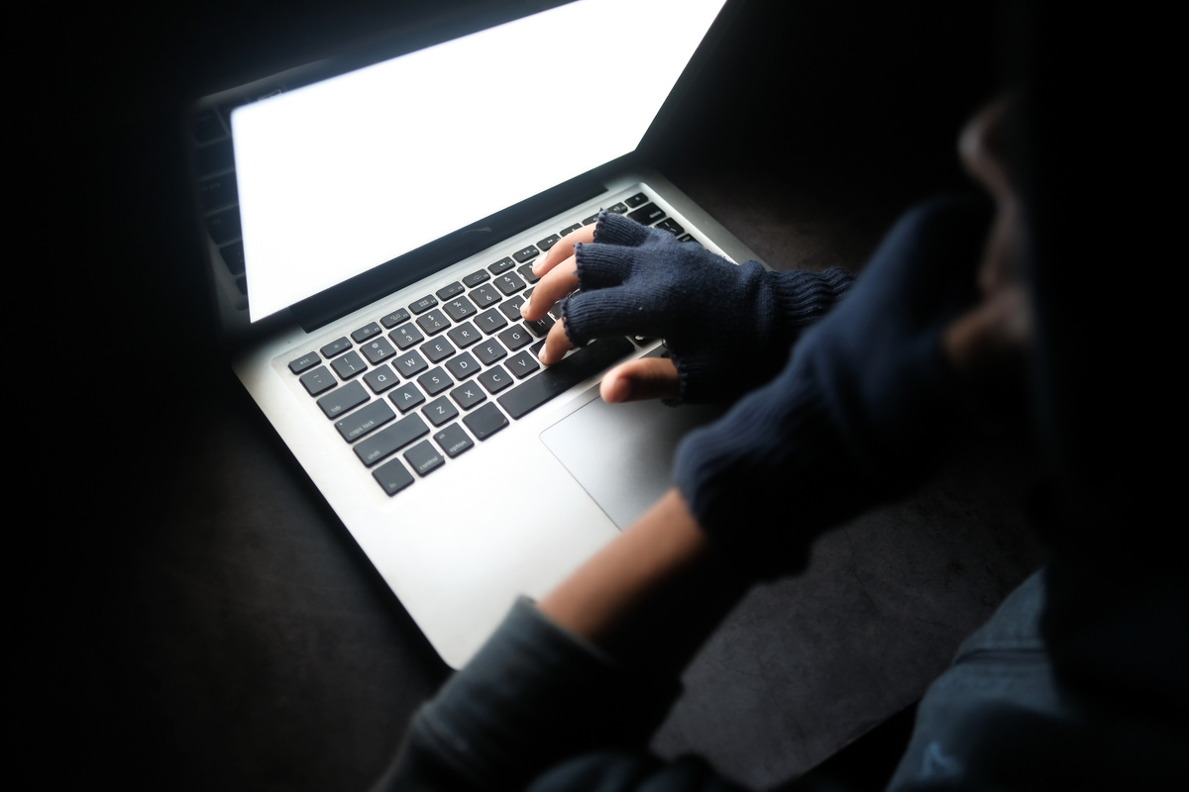

2025-2026
Hempstead Public Schools
ACTING
RESPONSIBILITY MEANS…
Keep your school network username and password private
Respect the rights of copyright owners
Example: Keep your password secret – it’s like your house key – it’s like giving them your house keys. They are yours alone and should NEVER be shared with other users
Example: If you’re making a slideshow, use royalty-free images or cite where you got them.
Refrain from installing any software or games on any District computer
NEVER engage in personal attacks or harass other persons
Example: Be kind online – no mean messages online.
www.hempsteadschools.org

Slide 8


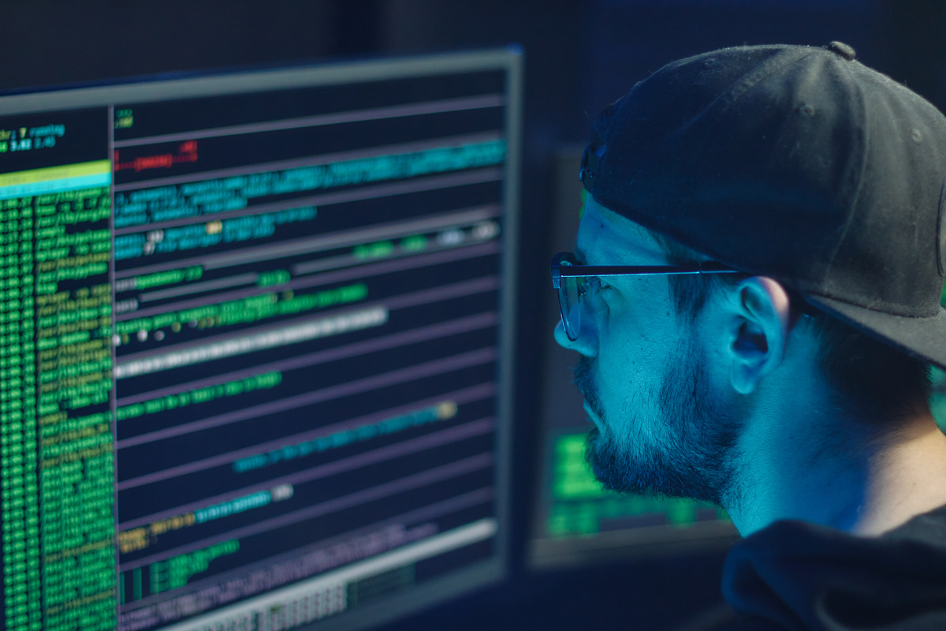
2025-2026
Hempstead Public Schools
ACTING
RESPONSIBILITY
NEVER access material that is profane or obscene, that advocates illegal or dangerous acts, or that advocates violence or discrimination toward other people.
www.hempsteadschools.org

Slide 9

2025-2026
Hempstead Public Schools
THE
CONSEQUENCES
If you break any of the rules for responsible technology use, you may lose your computer privileges and have other consequences as appropriate.
Remember:
Be Kind, Be Safe, Be Responsible!
www.hempsteadschools.org

Slide 10


2025-2026
Hempstead Public Schools
What is Digital Citizenship?
The societal guidelines that dictate what is considered appropriate and responsible use of technology.
DIGITAL
CITIZENSHIP
Your Reputation
Create a positive online presence!
www.hempsteadschools.org

Slide 11
2025-2026
Hempstead Public Schools
DIGITAL
CITIZENSHIP
01
02
03
What you do now in a moment of fun may impact you in the future.
Social networking should only be used for positive and productive purposes.
Always act and treat others with respect, both in person and online.
www.hempsteadschools.org

Slide 12


2025-2026
Hempstead Public Schools
If it’s private, don’t post it online
PROTECT
YOUR PRIVACY
Once it’s posted you can’t take it back
Video
www.hempsteadschools.org

Slide 13
Video
2025-2026
Hempstead Public Schools
WHAT IS
Spreading rumors and gossip
CYBERBULLYING?
Posting pictures without consent
Harassing or threatening language
www.hempsteadschools.org

Slide 14
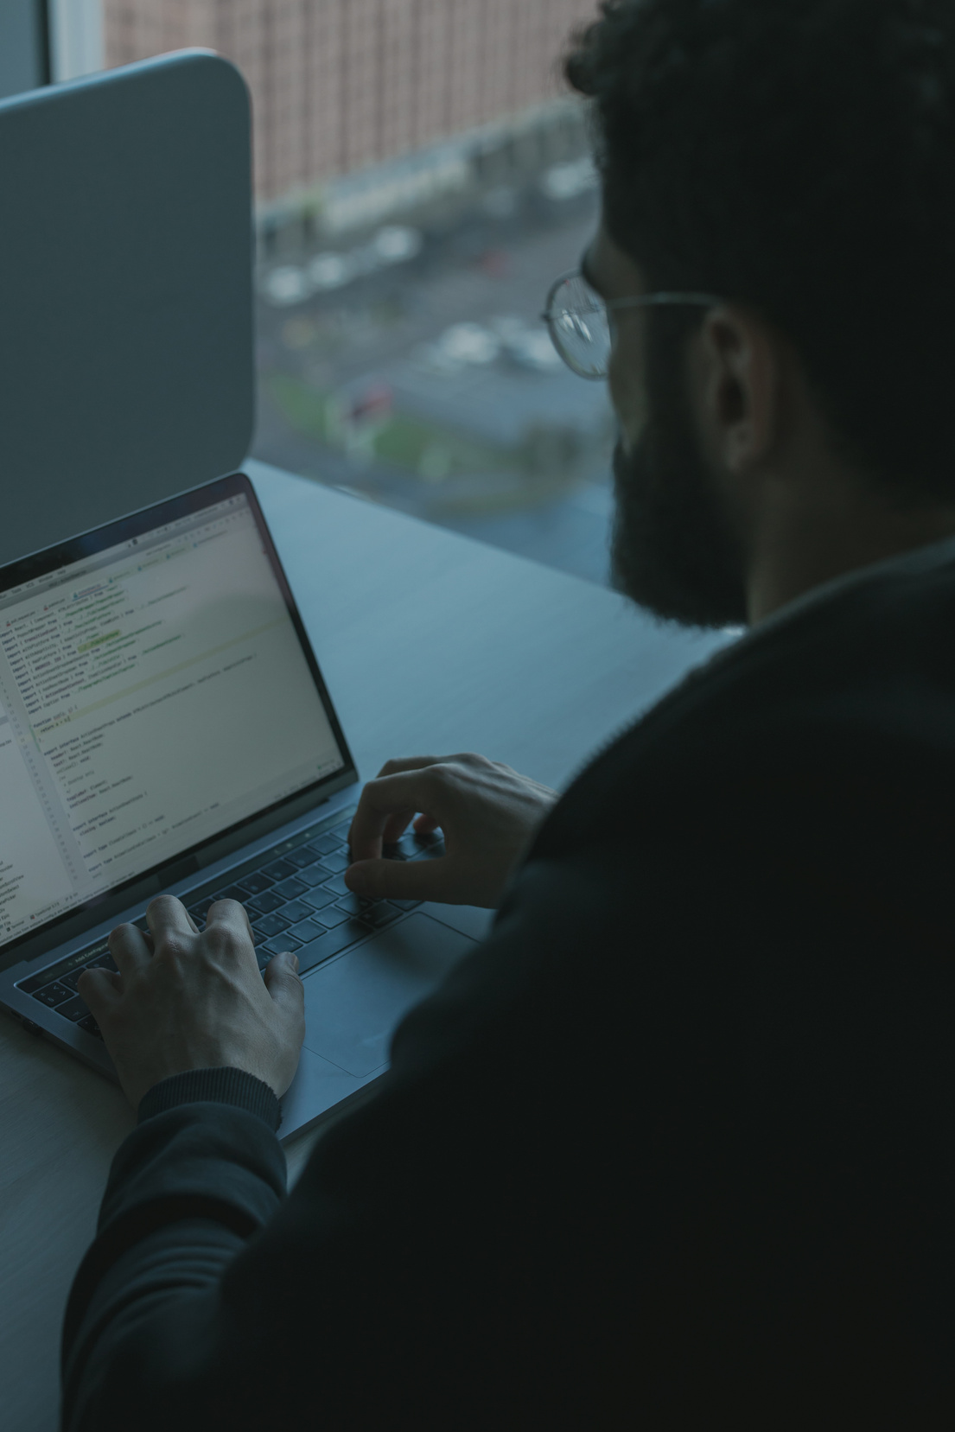
2025-2026
Hempstead Public Schools
If you feel bullied…..
→ If bullied: Don’t respond, take screenshots, and tell a trusted adult.
Do not respond, save the evidence and talk to an adult you trust.
If you see something….
Do not participate
Don’t be an audience
Tell an adult
SEEK
SUPPORT
www.hempsteadschools.org

Slide 15
2025-2026
Acknowledge your sources of ideas and information when you write a research paper, create a poster, post a web site or do a presentation.
Don’t…
use an essay from another course/source
ACADEMIC
HONESTY
copy a friend’s homework or project
copy and paste from an electronic encyclopedia, online database, or the Internet
Example: Use your own words and give credit to where you found info. Instead, rewrite in your own words and give credit.
www.hempsteadschools.org

Slide 16
2025-2026
Hempstead Public Schools
BE
Use the internet as a powerful tool for learning, like researching for projects or practicing math online.
Use the internet as a powerful tool!
SMART!
www.hempsteadschools.org

Slide 17
POLICY 5695
2025-2026
Hempstead Public Schools
PERSONAL
ELECTRONIC DEVICES
01
02
03
Devices Off & Stored:
Phones, earbuds, and smartwatches must be silenced and kept in your locker (or other designated place) during the school day.
Exceptions Only: Devices may only be used if your teacher gives permission for classwork, or if needed for health, translation, or family care (with approval).
Consequences – If you break the rules, your device will be taken to the office; repeated issues mean parent pickup and possible school consequences.
www.hempsteadschools.org

Slide 18
2025-2026
Hempstead Public Schools
A.I.
Artificial Intelligence
01
02
03
Use AI Responsibly
Only use AI tools for helping with learning, not to cheat or copy someone else’s work.
AI should support your ideas, not replace your thinking.
Protect Your Data and Privacy
Don’t share personal information (like full name, address, or passwords) with AI tools. AI tools may collect what you type, so be careful about what you enter.
Follow School Rules and Guidelines
Use AI only for school-approved projects or assignments. Respect the rules about what is allowed and not allowed when using AI in the classroom.
www.hempsteadschools.org

Slide 19
POLICY 4526
2025-2026
Hempstead Public Schools
Responsible
Use
01
02
03
Use Technology Responsibly
Only visit websites and apps approved by your teacher.
Follow school rules and behave respectfully online.
Take Care of Devices
Handle school computers and equipment carefully.
Report any problems or damage to a teacher right away.
Stay Accountable
Don’t install software or change settings without permission.
Use social media only for class activities and always be respectful.
Remember: anything you do on school devices can be seen by staff.
www.hempsteadschools.org

Slide 20
2025-2026
Hempstead Public Schools
QUICK
HUFSD One to One Device Agreement
HUFSD Technology Use Policies
Information Technology Department
Instructional Technology Department
LINKS:
www.hempsteadschools.org

