Slide 1
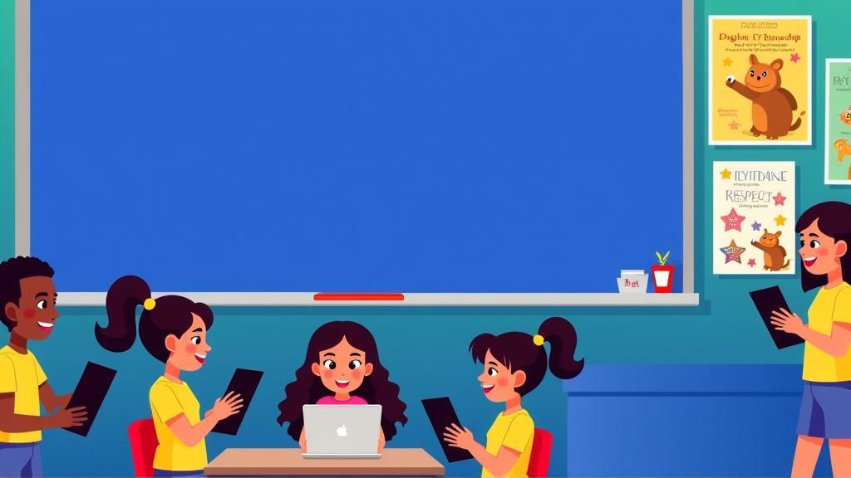

Hempstead
Public Schools
Responsible Use and Digital Citizenship
2025-2026
Elementary Edition

Slide 2


Our Promise
  We use iPads, laptops and computers to learn.
  Using them is a privilege.
  We must follow the rules.

Slide 3


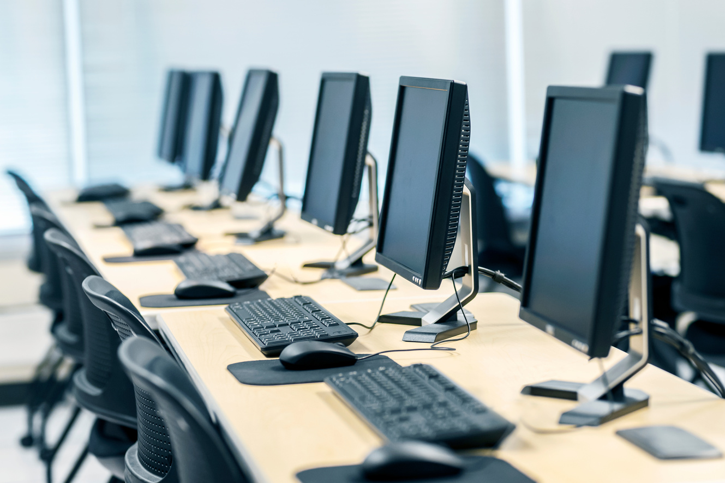
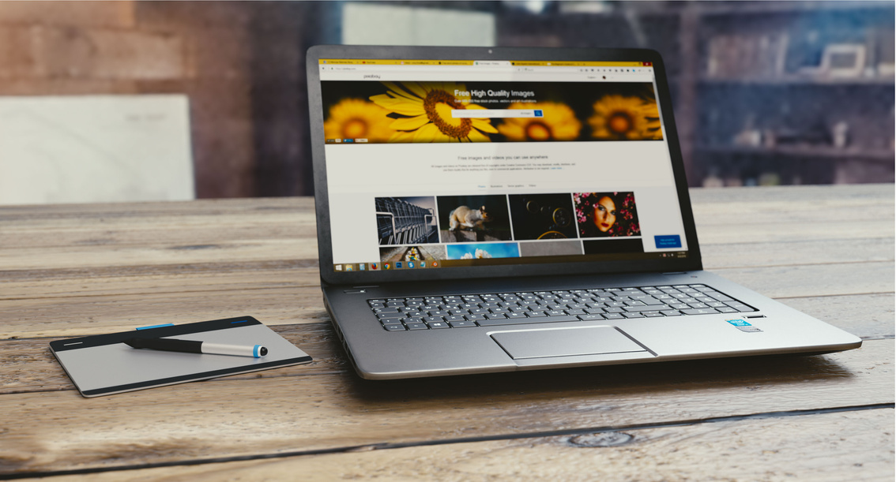
Be a Responsible User
No downloading games.
Only visit sites your teacher says.
Teachers can see what you do.

Slide 4


Help Our School
Take care of iPads, laptops and computers.
Tell your teacher if something is broken.

Slide 5



Be Kind Online
  Only use apps when teacher says.
  Be kind online.
  Tell teacher if you see something wrong.

Slide 6

Act Responsibly
  Keep your password secret.
  No mean words online.
  Do not copy others’ work.

Slide 7

Stay Safe
  Never go to bad or unsafe sites.

Slide 8

Consequences
  If you break rules, you may lose tech time.
  Remember: Be Kind, Be Safe, Be Responsible!

Slide 9

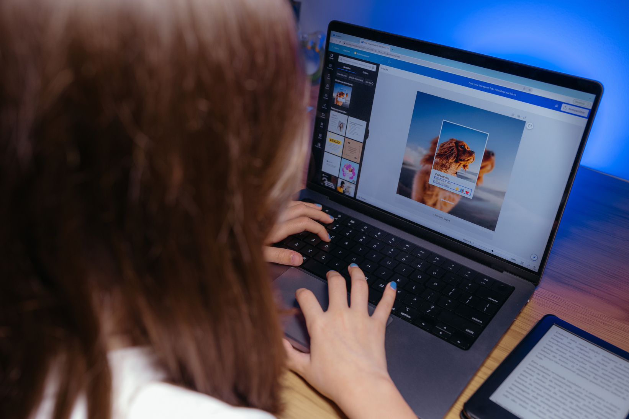

Digital Citizenship
Be good online.
Create a positive reputation.

Slide 10
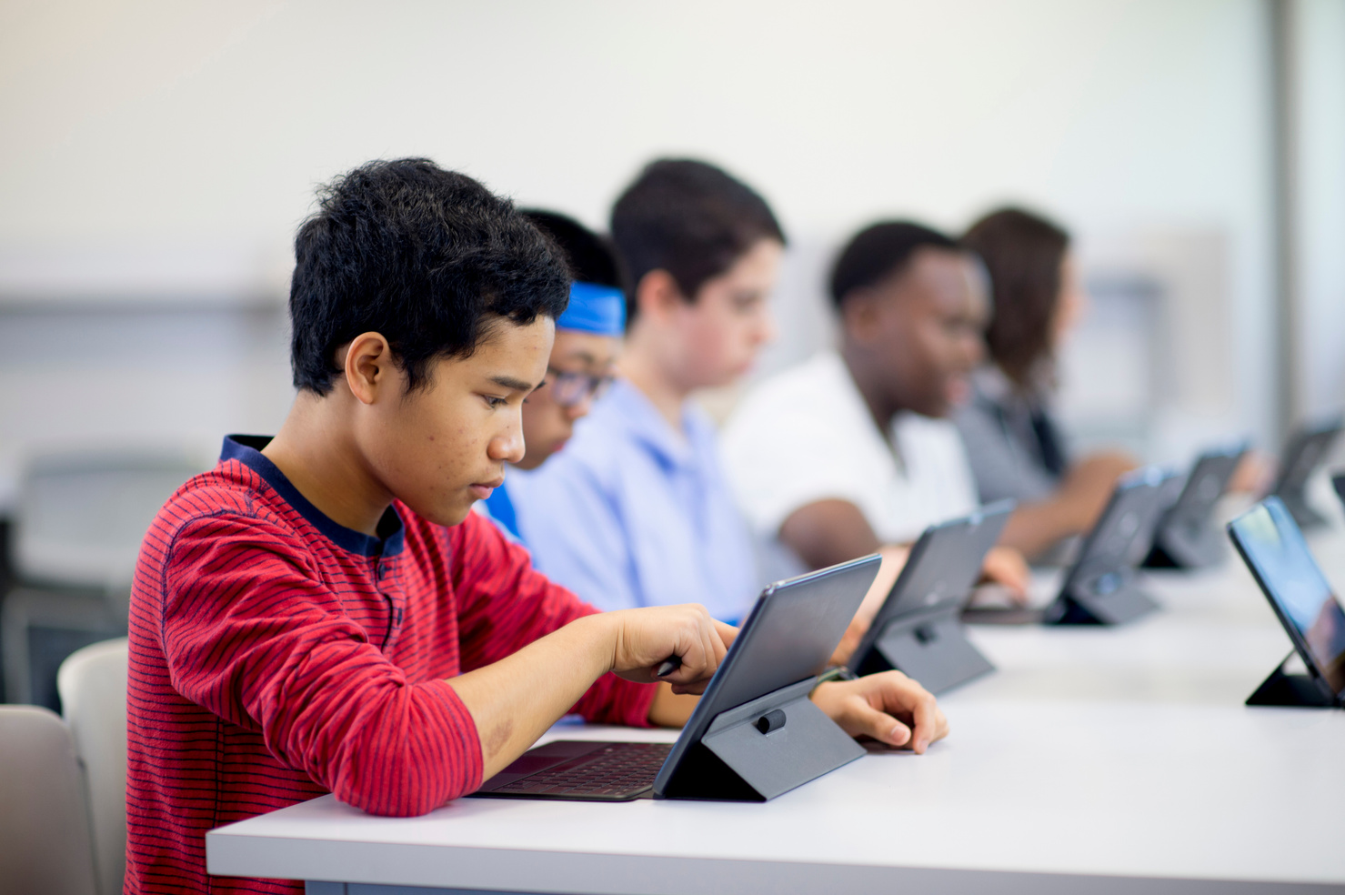


Digital Citizenship
Think before you post.
Use social media only for good.
Be respectful in person and online.

Slide 11

Protect Your Privacy
  Don’t share private info.
  Once it’s online, it stays there.

Slide 12
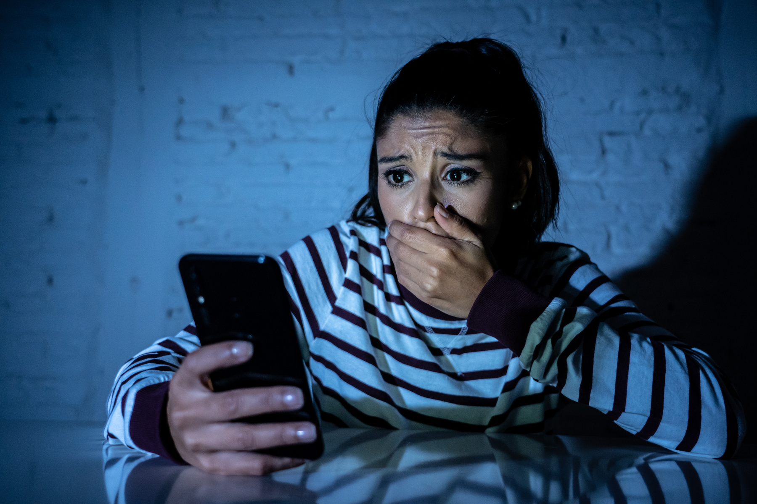
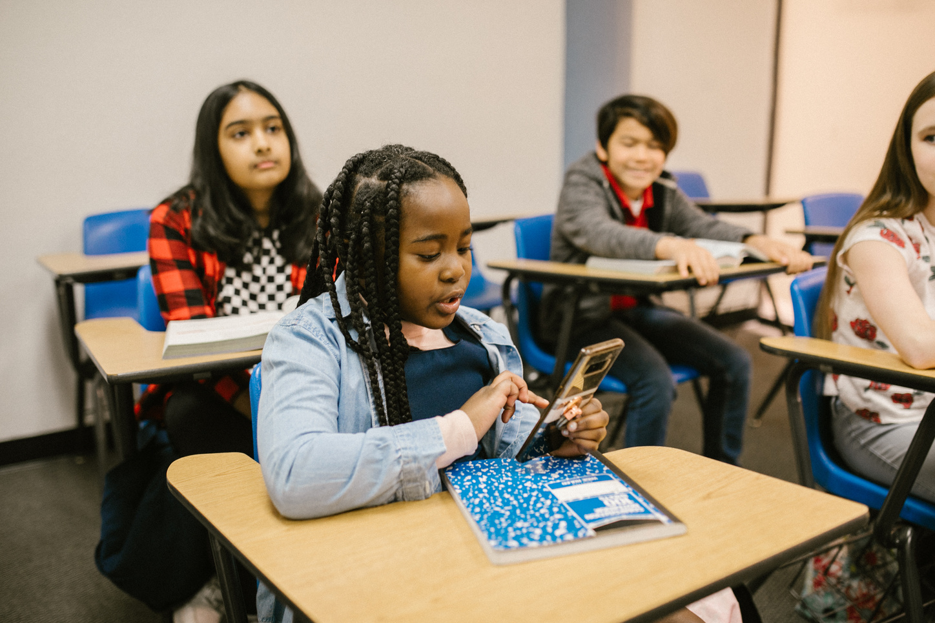

Cyberbullying
  No gossip or rumors.
  Don’t post pics without permission.
  No mean or scary words.

Slide 13

If Someone is mean…
  Don’t answer.
  Tell a teacher or trusted adult.
  Don’t join in.

Slide 14

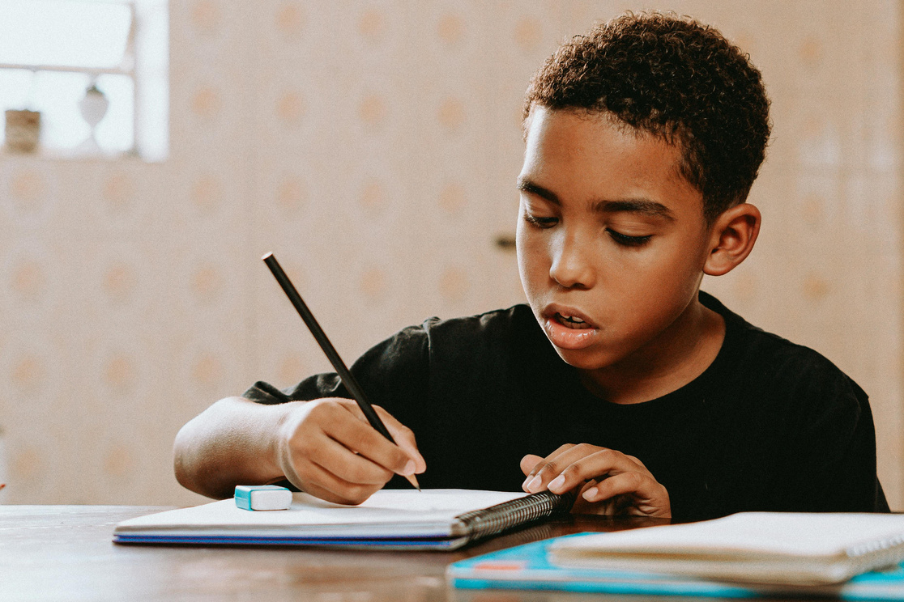
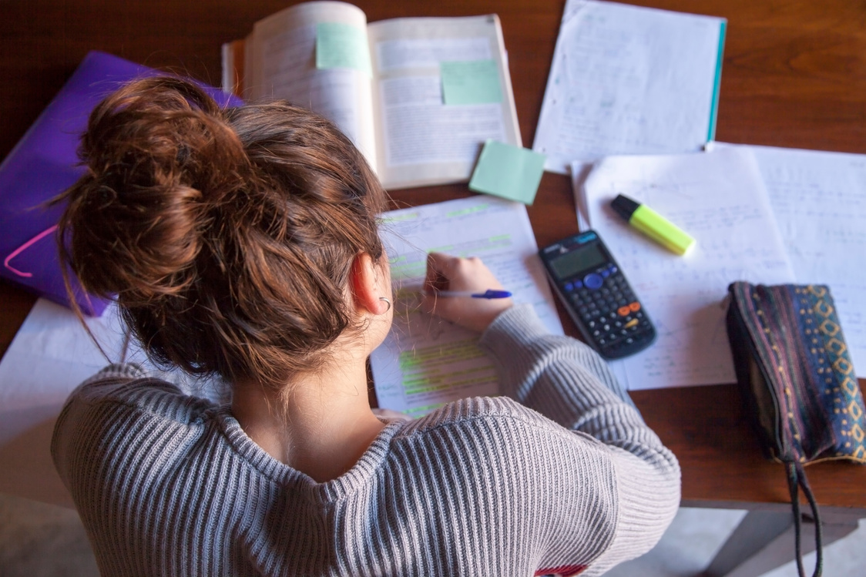
Be Honest
Don’t copy homework.
Don’t copy-paste from the internet.
Use your own words.

Slide 15

Be Smart!
  Use the internet to learn.
  Research, practice, explore.

Slide 16
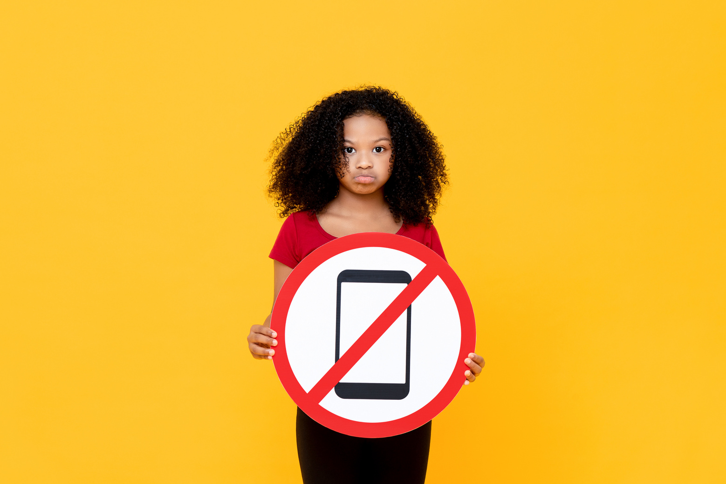
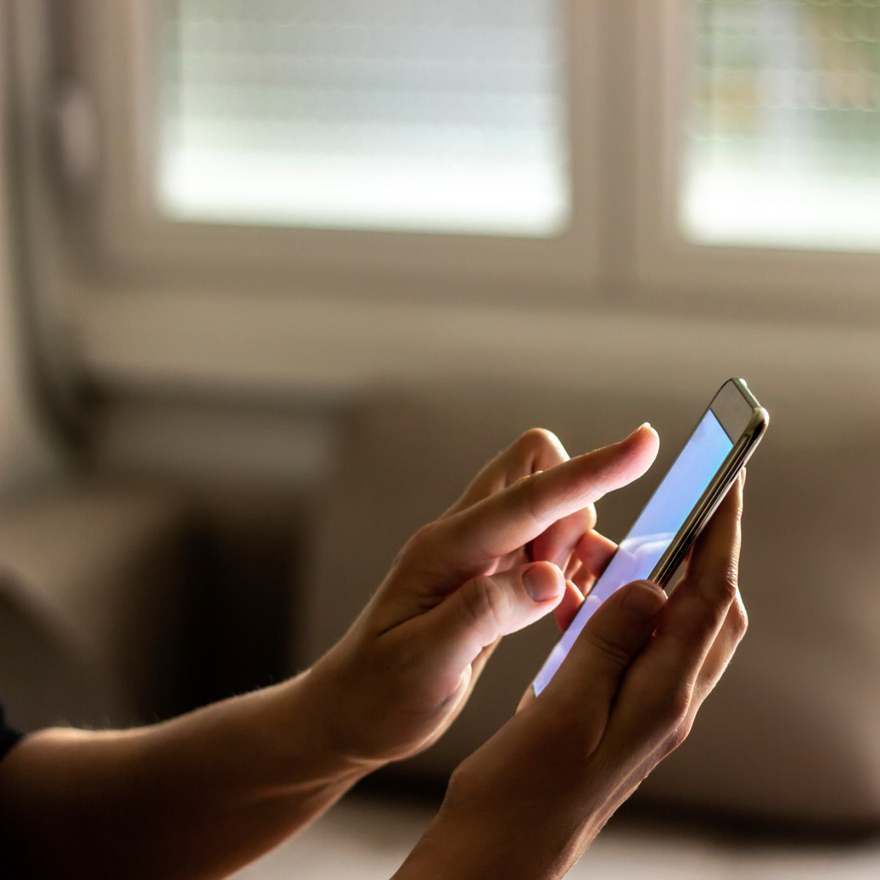

Phones & Devices
  Give your phone to your teacher everyday.
  You may only use it with your teacher’s permission.
  If rules are broken, device goes to the office.

Slide 17



Artificial Intelligence (A.I.)
What is AI?
“AI is when computers and machines learn to think and make decisions like people.”
What AI Can Do
Recognize pictures and voices.
Help us find information fast.
Translate languages.
Be Smart & Safe
Remember: Not everything online is true.
Don’t share personal info with apps or websites.
Always ask a parent/teacher if unsure.

Slide 18



Responsible Use
Use Computers and Internet Safely
Only go to websites your teacher allows.
Follow rules and be respectful online.
Take Care of Technology
Treat computers and devices gently.
Tell a teacher if something breaks or doesn’t work.
Personal Responsibility
Don’t install apps, games, or change settings.
Remember: anything you do on school devices can be seen by teachers.

Slide 19
Quick Links
HUFSD One to One Device Agreement
HUFSD Technology Use Policies
Information Technology Department
Instructional Technology Department

