Slide 1

24-25 Integrated Programs
Annual Report Presentation
Jefferson School District

Slide 2
Annual Reporting Requirements
ODE’s annual report consists of two narrative questions
Throughout the year, grant recipients have been asked to report expenditures, three overall reflection narrative questions, and report on progress markers which will help inform overall progress and annual report.

Slide 3
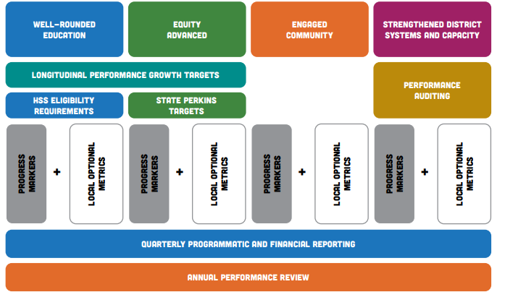
Summary of Integrated Programs Performance Measures
Notes:
There are seven distinct performance measures and processes used in the monitoring and evaluation process for implementation under this integrated guidance:
1. Longitudinal Performance Growth Targets (LPGTs)
2. High School Success Eligibility Requirements
3. State CTE Perkins Performance Targets
4. Progress Markers
5. Local Optional Metrics
6. Quarterly and Financial Reporting
7. Annual Reporting 8. Auditing (SIA funds only)
9. Performance Reviews
Here’s one way to visualize how these evaluation components fit together:

Slide 4
SIA Annual Report Requirements
SIA recipients are required by statute to:
review their own progress on an annual basis through an annual progress report and financial audit
present their annual report to their governing board at an open meeting with opportunity for public comment (cannot be consent agenda item),
and post the report to the district or charter school website.
If grantee set LPGTs and LOM:
In Year 1 of biennium: Affirm progress has been reviewed towards meeting the LPGTs in the grant agreement (Assurance)
In Year 2 of biennium: Review actual metric rates compared to previously created LPGT and LOM and share reflection on progress. (Narrative Question)

Slide 5
Annual Report Narrative #1
As you review your progress markers/overall reflection responses and reflect on plan implementation, how do you see your progress contributing to the Outcomes and Strategies in your plan and your Longitudinal Performance Growth Targets (LPGT)/Local Optional Metrics (LOM)?
Discuss at least one Outcome where you have seen progress in implementation.
In our Integrated Guidance Program, Jefferson School District identified three outcomes for our students:
Outcome A - Engage and inspire students by increasing their sense of belonging, safety, and well-being.
Outcome B - Implement a rigorous and engaging array of academic opportunities for all students that include CTE courses, fine arts courses, accelerated and dual credit courses, and college credit courses at the secondary level.
Outcome C - Increase 4-year graduation, 5-year completion, and 9th grade on-track rates, and improving third grade ELA scores.

Slide 6
Annual Report Narrative #1 (con’t)
Outcome A
Strategy A-1: Develop and implement a 6-12 alternative school where students can choose an alternative method of receiving their education.
Alt Pathways Program at the high school: 2 options
All classes online
Hybrid model
Second year of implementation
Added additional support
Google Meets and Parent meetings
Graduated students
5th year students
Others completed in four years
40 students during 24-25
9 finished graduation requirements
2025-26
21 enrolled
Middle School
Currently continue to support students in grades 6-8 with an online program
Notes:
The Alternative Pathways Program provides two options for student to experience high school in a different way:
All Classes online:
We have students who take all classes online through Graduation Alliance. This program has licensed teachers for each course and our staff at JHS provide support and guidance as they monitor student progress.
We also have students who elect the hybrid model. This model allows students to take some courses in person with JHS teachers, utilize our Alternative Pathways classroom while also completing classes online.
In our second year of implementation we added additional support through Google Meets and parent conferences.
We have had students complete their fifth year and graduate and others complete their high school education in four years.
We had 40 students in our program during the 24-25 school year and 9 of those students finished their graduation requirements.
For the 2025-26 school year, we currently have 21 students enrolled in the Alt Pathways Program

Slide 7
Annual Report Narrative #1 (con’t)
Outcome A
Strategy A-2: Develop and implement an elementary and secondary Emotional Growth Center.
Middle School EGC
Elementary School EGC
RULER and Second Step
Notes:
We were able to continue to provide support at the middle school with an EGC classroom, and for the 2024-25 school year, we were able to provide support at the elementary school with the implementation of an EGC classroom beginning in January 2025 as well. This has been valuable for our students who have been identified as needing this additional support.
We have also been able to continue to implement RULER and Second Step which are research based SEL curriculums at the elementary and middle school levels.

Slide 8
Annual Report Narrative #1 (con’t)
Outcome B
Strategy B-2: Continue to partner with The Willamette Career Academy (WCA) as a way to support and broaden our CTE offerings
Juniors and seniors continue to participate in WCA
Freshmen tour the WCA during Career Day
Notes:
Our juniors and seniors continue to participate in the additional CTE opportunities that have been made available because of our partnership with the WCA.
In the 24-25 school year, we had our freshman tour WCA during our Career Day. We are expecting that sharing about WCA earlier with a tour will show students their options earlier.

Slide 9
Annual Report Narrative #1 (con’t)
Outcome C
Strategy C2: Continue to engage the community in authentic and meaningful ways
Variety of options at JHS
Seniors
Attended a City Council meeting
Mock Interviews
Information nights for 11th and 12th graders and their families
Booster Club
Surveys and Informal discussions
Elementary
Parent Club
LatinX Group
Multiple Other Events
Surveys and informal discussions
Notes:
At the high school our students have had a variety of options to engage with the community.
Our seniors attended a City Council Meeting and were able to ask questions, give input and learn about their community
In addition, our seniors participated in mock interviews. We had local business members support this event and volunteer their time to interview and provide feedback.
To engage our families, we held 11th and 12th grade information nights, partnered with parents in our Booster Club and sought input through surveys and informal discussions.
We have a parent club at the elementary school that is very active and a district wide LatinX group. These groups meet on a regular basis and provide opportunities for the district to meet with parents to discuss concerns, build relationships, and to help families navigate the educational system.
All of our schools host multiple events throughout the school year where families, students and the community are invited. At these events, the district provided opportunities for attendees to provide input about the district through the use of surveys and informal discussions.

Slide 10
Annual Report Narrative #2
Where have you experienced barriers, challenges, or impediments to progress toward your Outcomes and Strategies in your plan that you could use support with?
Discuss at least one Outcome where you have seen challenges or barriers to implementation.
Although JSD does have some successes toward progress of our identified outcomes, there are a couple of areas in which we have experienced challenges.
Outcome A - Engage and inspire students by increasing their sense of belonging, safety, and well-being.
Strategy A4: Support social and emotional dysregulation and attendance.
Continues to be an area of concern at all levels
Continued focus on SEL
Continued focus on attendance at high school
9GOT and WESD partnership
Notes:
This continues to be an area of concern for our district given the wide variety of student needs. We were able to continue to focus on SEL and attendance at the high school level with the implementation of the 9GOT team and partnership with the WESD.
However, we continue to struggle with chronic absenteeism at all schools and with emotional dysregulation at the elementary school.

Slide 11
Annual Report Narrative #2 (con’t)
Where have you experienced barriers, challenges, or impediments to progress toward your Outcomes and Strategies in your plan that you could use support with?
Discuss at least one Outcome where you have seen challenges or barriers to implementation.
Another challenge toward implementation:
Outcome C: Increase 4-year graduation, 5-year completion, and 9th grade on-track rates, and improving third grade ELA scores.
Strategy C1 - Continue to utilize AVID strategies to help students focus on important academic tasks
AVID discontinued due to lack of funding
Notes:
Due to the lack of funding available, we had to discontinue AVID although staff still continue to implement strategies to help support our students with engagement in learning.

Slide 12
Annual Report Narrative #3
2024-25 Only: Review actual metric rates compared to previously created LPGT and LOM and share reflection on progress. Describe how activities are supporting progress towards targets and if any shifts in strategy implementation are planned for the future based upon that current progress. Include specific metrics and target types in your reflection.
3rd Grade ELA proficiency Baseline Target for All Students: 24% 2024-25 All Students: 7% (Decreased 25% from 2023-24) | Regular Attenders Baseline target for All students: 60% 2024-25 All Students 58%
Four Year Cohort Graduation Baseline Target for All Students: 77% 2024-25 All Students: 78% (Increased 12% from 2023-24) | Five Year Cohort Completion Baseline Target for All Students: >95% 2024-25 All Students: 69% (Decreased 12% from 2023-24)
 | 9th Grade On Track Baseline Target for All Students: 90.9% 2024-25 All Students: 88% (Increased 12% from 2023-24)

Slide 13
Annual Report Narrative #3 (con’t)
2024-25 Only: Review actual metric rates compared to previously created LPGT and LOM and share reflection on progress. Describe how activities are supporting progress towards targets and if any shifts in strategy implementation are planned for the future based upon that current progress. Include specific metrics and target types in your reflection.
Areas of Concern Identified:
Third-grade ELA proficiency is a major concern, with only 7% of students meeting the standard, far below the 24% baseline target.
Five-year cohort completion rate is also a major red flag, with a sharp 12% decrease to 69%, falling well short of the >95% baseline target.
Areas of Strength Idenfified:
The four-year cohort graduation rate not only met its 77% baseline target but exceeded it, reaching 78%.
9th-grade on-track rate is performing well at 88%, which is a 12% increase from the prior year and very close to the 90.9% baseline target.
The regular attenders metric is also stable, with 58% of students meeting the attendance target, which is just slightly below the 60% baseline.
Notes:
The data reveals a critical need for intervention in two key areas.
Third-grade ELA proficiency is a major concern, with only 7% of students meeting the standard, far below the 24% baseline target. The 25% decrease from the previous year is particularly alarming and signals a significant decline in early literacy skills.
Similarly, the five-year cohort completion rate is also a major red flag, with a sharp 12% decrease to 69%, falling well short of the >95% baseline target. This suggests a significant number of students are not completing their education within five years.
The data also shows encouraging progress in high school student outcomes. The four-year cohort graduation rate not only met its 77% baseline target but exceeded it, reaching 78%. This 12% increase from the previous year demonstrates a positive trend in students graduating on time.
Additionally, the 9th-grade on-track rate is performing well at 88%, which is a 12% increase from the prior year and very close to the 90.9% baseline target. This indicates that a large majority of incoming high school students are successfully meeting the early requirements for graduation.

Slide 14
Annual Report Narrative #3 (con’t)
2024-25 Only: Review actual metric rates compared to previously created LPGT and LOM and share reflection on progress. Describe how activities are supporting progress towards targets and if any shifts in strategy implementation are planned for the future based upon that current progress. Include specific metrics and target types in your reflection.
Initiatives and Focused Work:
LETRS training for K-5 teachers 2023-2025 school years
K-12 Curriculum Alignment to state standards 2025-27 school years
Improving Student Attendance 2025-27 school years
Notes:
The Jefferson School District invested heavily in our K-5 teachers during the past two years by certifying them in LETRS (Language Essentials for Teachers of Reading and Spelling) which provided teachers with a deep understanding of how students learn to read, covering foundational skills like phonics, phonemic awareness, fluency, and comprehension. By providing this training, the District is directly targeting the root cause of low ELA scores: the need for explicit and systematic literacy instruction.
During the 2025-26 school year, the Jefferson School District will focus on aligning our K-12 curriculum to state standards which is critical.
Since the third-grade ELA proficiency rate is so low, this effort ensures that the knowledge teachers gained from LETRS is translated into classroom practice. It creates a cohesive instructional framework across all grade levels. This alignment helps ensure that students' literacy skills build upon one another from one grade to the next. While the full impact may not be seen immediately, a strong commitment to the science of reading and curriculum alignment should lead to improved teacher effectiveness and, over time, a positive trend in student literacy outcomes. This is a vital investment in reversing the current negative trend and ensuring students have the foundational skills needed for future academic success.
Additionally, the District will implement a focused effort on improving student attendance, which is crucial for academic success across all grade levels. While the “Regular Attenders” metric is slightly below its baseline, this initiative is a proactive step to prevent a decline and is directly linked to other key metrics.

Slide 15
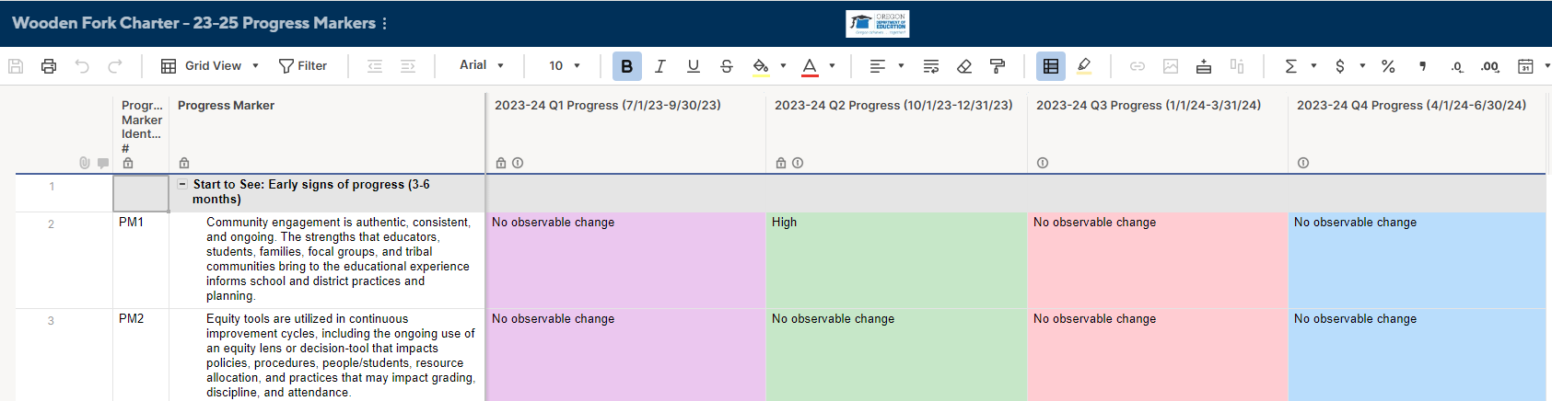
Progress Markers (Optional to Share)
If you would like to share your progress markers with your Board then we suggest you add slides with screenshots that show progress/tracking from all four quarters of reporting.
Example:

Slide 16
Questions?

