Slide 1

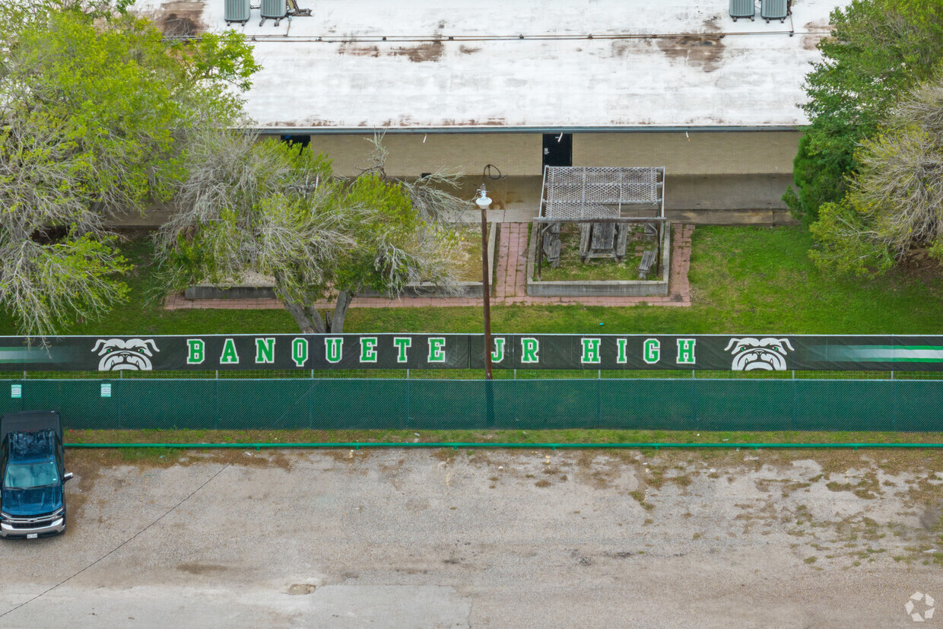
Banquete Independent School District
Bond 2024: The Process
December 11, 2024
PRESENTED BY: AG|CM

Slide 2
Introduction
Christopher Shull
Construction Project Manager
As a construction manager, Chris represents the Owner in overseeing the project’s execution and ensuring the project adheres to the contract documents. This all starts by coordinating the process through design to seamlessly bring it through to construction and closeout. Chris has been with AG|CM for 9 years and has had the opportunity to serve on projects including waterparks, mass transit rail, K-12 facilities, higher education facilities and municipal facilities.

Slide 3
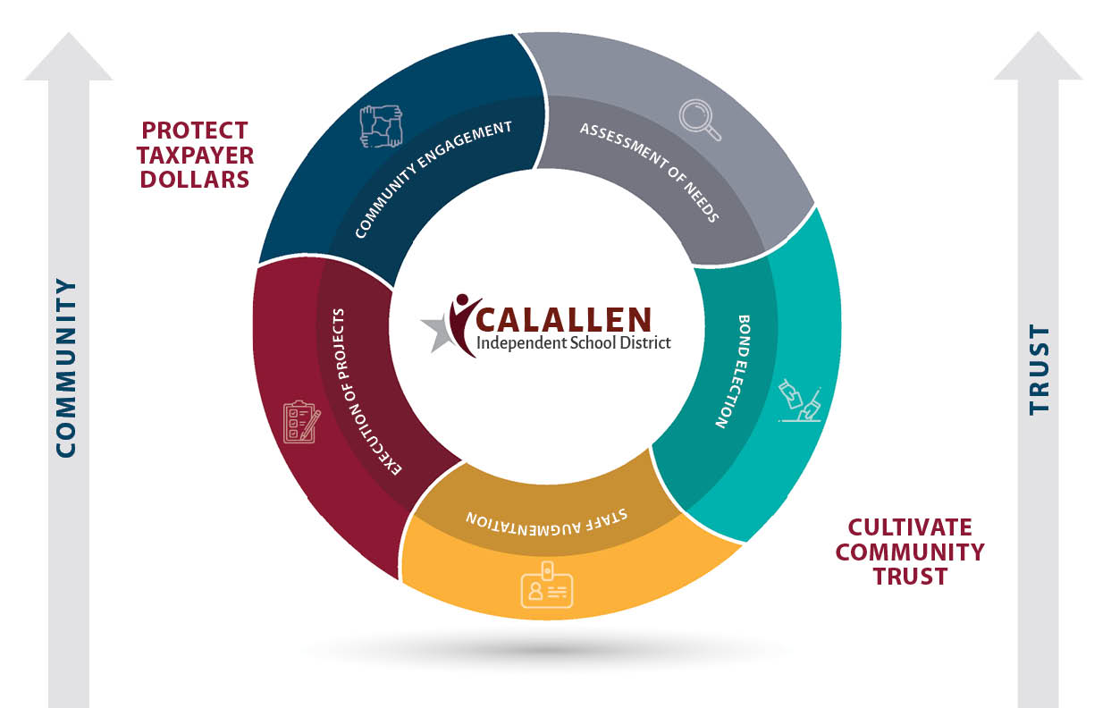

Bond 2024: Revisiting Fall 2023 through May 2024
Determining Projects and Call Bond
Board Engagement
Staff Engagement
Community Engagement
Transparency
Notes:
AGCM’s contract approved August of 2024
AGCM has since been working on:
-a preliminary master budget
-a preliminary program schedule, including thoughts and options on procurement methods, timelines, etc
-RFQ and process for bringing on board AE services
facilitating the negotiation of contracts for top ranked firm
-Starting procurement discussions on site condition geotech (general soils report), civil utilities and topo

Slide 4
Bond 2024: The Project Process
Engage the Community
START
Assess the Program
Plan the Process
Operation and Warranty
Determine Delivery Strategy
Procure AE and Contractor
Define the Vision (Design Phase)
Build the Vision (Construction Phase)
Engage the Community
Risk
Communication & Trust
Notes:
AGCM’s contract approved August of 2024
AGCM has since been working on:
-a preliminary master budget
-a preliminary program schedule, including thoughts and options on procurement methods, timelines, etc
-RFQ and process for bringing on board AE services
facilitating the negotiation of contracts for top ranked firm
-Starting procurement discussions on site condition geotech (general soils report), civil utilities and topo

Slide 5

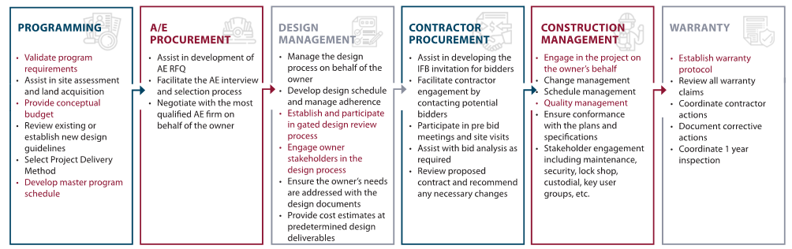
Bond 2024: AE Procurement and Programming
Plan the Process
Operation and Warranty
Determine Delivery Strategy
Procure AE and Contractor
Define the Vision (Design Phase)
Build the Vision (Construction Phase)
Assess the Program
START
Engage the Community
Engage the Community
Notes:
We are in AE procurement and programming stages. We have preliminary programming for the projects identified in Bond 2024 and the AE will be critical in taking that and working on a full-scale programming effort with stakeholders
Negotiation of the AE contract(s) anticipated at the January 2024 School Board Meeting, request for approval of contracts and execution by District
If a contract for getechncial and civil utilities survey needs to be brought back to the board, it will be done so anticipated at the January 2024 School Board Meeting
Playground equipment and shade structures

Slide 6
Bond 2024: 2 Month Look Ahead
Assess the Program
Plan the Process
Operation and Warranty
Determine Delivery Strategy
Procure AE and Contractor
Define the Vision (Design Phase)
Build the Vision (Construction Phase)
Ongoing:
  Ongoing: Negotiations with highest ranked firms
  Procurement strategy discussions for preliminary geotechnical services and preliminary civil/utilities studies
  Procurement strategy for playground equipment and shade structures at elementary
  Continued coordination of baseline master schedule
  Reaching out to industry partners to drum-up interest in projects
  January 2025:
  AE contract(s) brought to School Board for review and authorization to execute
  Master Program Schedule/Budget (Baseline) to be reviewed in January 2025
  Presentation of construction delivery methods (CSP, CMAR, JOC, purchasing co-op) to the School Board
  Design phase begins
  Possible procurement of geotechnical, civil survey
  February 2025:
  Recommendation of construction delivery methods presented to the School Board for JHS, HS CTE, Athletic Fields, Mechanical, Roofing and Drainage
  Recommendation of wage rate adoption to the School Board
  Prepare for construction procurement
Engage the Community
Engage the Community
Notes:
We are in AE procurement and programming stages. We have preliminary programming for the projects identified in Bond 2024 and the AE will be critical in taking that and working on a full-scale programming effort with stakeholders
Negotiation of the AE contract(s) anticipated at the January 2024 School Board Meeting, request for approval of contracts and execution by District
If a contract for getechncial and civil utilities survey needs to be brought back to the board, it will be done so anticipated at the January 2024 School Board Meeting
Playground equipment and shade structures

Slide 7
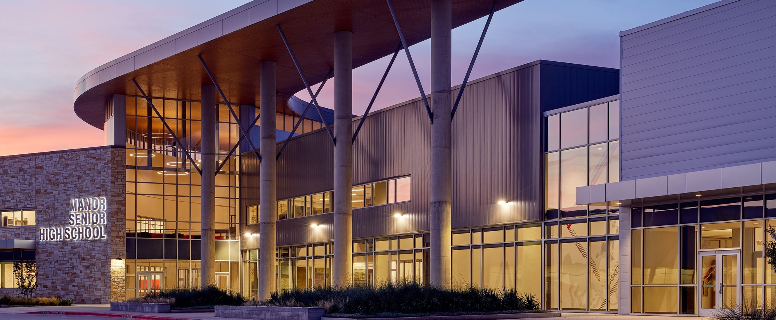
Thank you!
Questions?
Chris Shull; AG|CM Construction Project Manager
cshull@agcm.com
www.agcm.com
Notes:
Institutional knowledge

