Slide 1

Hephzibah High School
Class of 2025 Graduation Info
April 21, 2025 6:00 pm

Slide 2
Graduation Date and Time
Date: May 28, 2025
Time: 2:30 PM ( keep train in mind at 2:00pm)
*Wednesday, May 28th 2025
ARC – 8:00 A.M.
Davidson – 11:00 A.M.
Hephzibah – 2:30 P.M.
A.R. Johnson – 5:30 P.M.
Graduates Report at 1:30 PM.

Slide 3
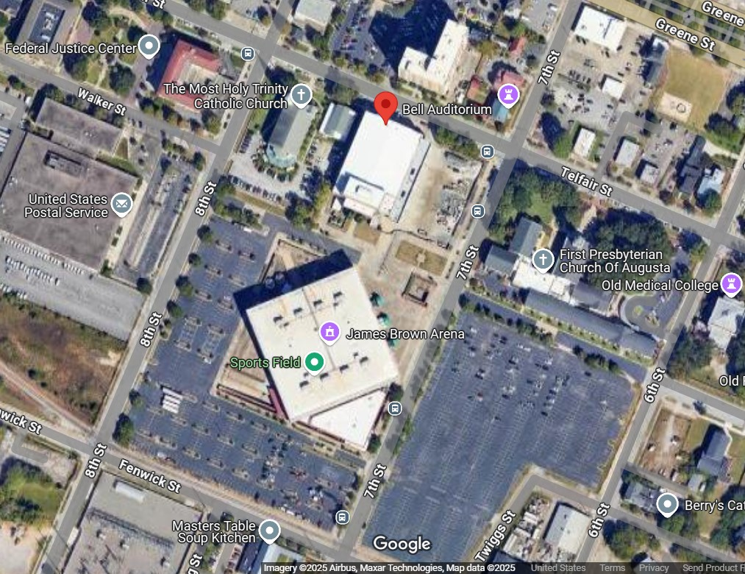
Venue
Location: Bell Auditorium
Address: 712 Telfair Street, Augusta, ga 30904

Slide 4
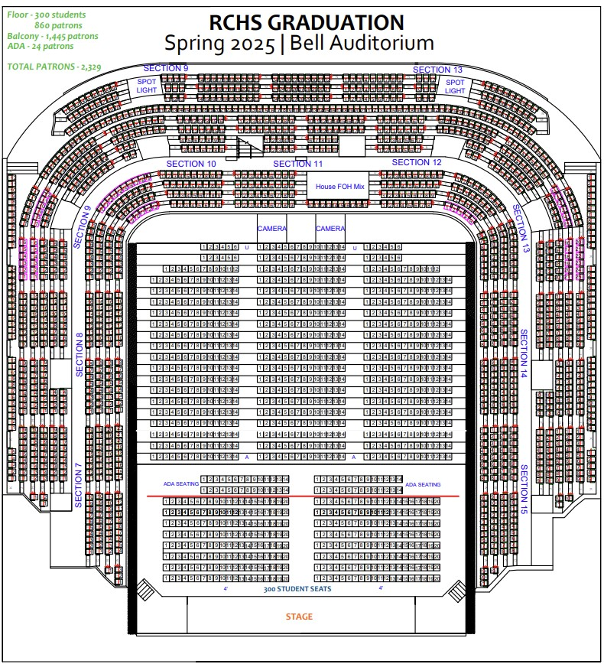
Venue

Slide 5
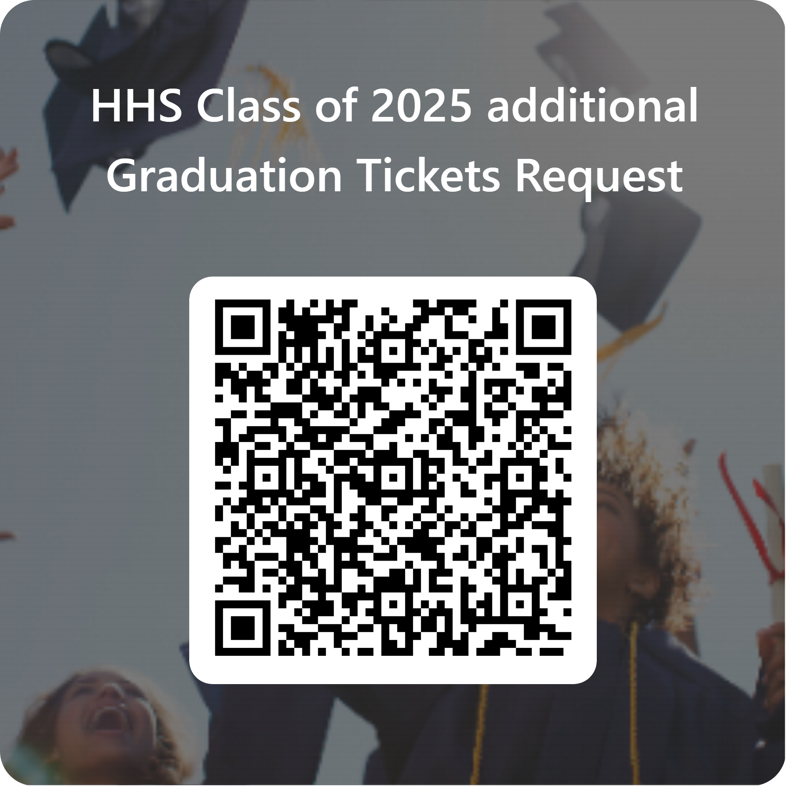
Tickets
Each graduate will receive 8 tickets for family members and friends: (The ticket count does NOT include the student) The graduate does not need a ticket to enter.
Click here to request additional Tickets or scan qr code--→
This is an official ticketed event. If tickets are lost…sorry.
Tickets given out at mandatory rehearsal on may 27th.

Slide 6
Dress Code
Students should follow the RCSS dress code when planning to dress for graduation. Each student will be expected to be dressed in the school designated cap and gown (there should be no additions or embellishments to the cap or gown).
We recommend that dresses not been seen hanging longer than the gown.
Other recommended dress attire: white collared dress shirt, black/dark tie, black pants, and black shoes.
Balloons will not be allowed in the bleachers as they may block the view of other guests.

Slide 7
Senior grades
All graduates must meet rcss graduation expectations.
Meetings with parents of seniors that are in jeopardy of not graduating will be held by April 23rd and may 16th.
Submit all missing work and complete assignments. Do not wait until the last minute.
Last day to be at 100% complete with Edgenuity courses is may 23rd.

Slide 8
Senior Exam expectations
students to complete all missing work by Wednesday, May 7, 2025.
All grade books should be updated by Monday, May 12, 2025.
print out exemption letters on Tuesday, May 13 2025 (exemption earned with a grade of 90 or better and/or NWEA Map Growth from Winter to Spring + Passing Grade).
Exemption letters will be sent home Wednesday May 14, 2025.

Slide 9
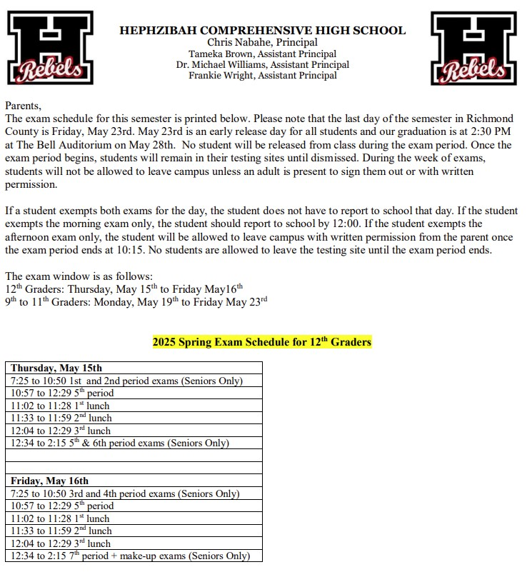
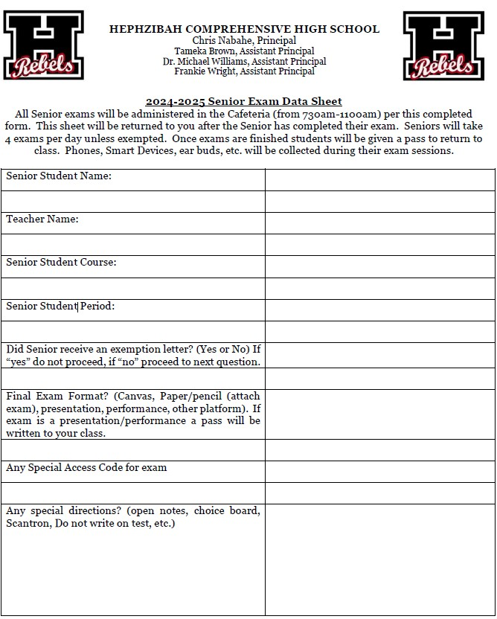
Senior Exam Schedule

Slide 10
Important Reminders
Scholarship info: HHS Counseling Dept (Scholarship Info)
Jostens Cap and Gown distribution will be April 30th at 8:00 am in Black Box Theater. Jostens balance must be paid in full.
Honors Day: May 6th at 8:30 am in the New Gym.
Senior Walkthrough (new tradition): immediately follow honors day.
Class of 2025 to cheer out HES during dismissal on May 23rd
Graduation rehearsals: may 23rd 2:00 pm-4:00 PM & May 27th 1:00 Pm-3:00 PM. Monday May 26th is memorial day holiday.

Slide 11
Questions & concerns
Please raise your hand or place question in chat box.
This meeting is being recorded to be shared or replayed.

