Slide 1
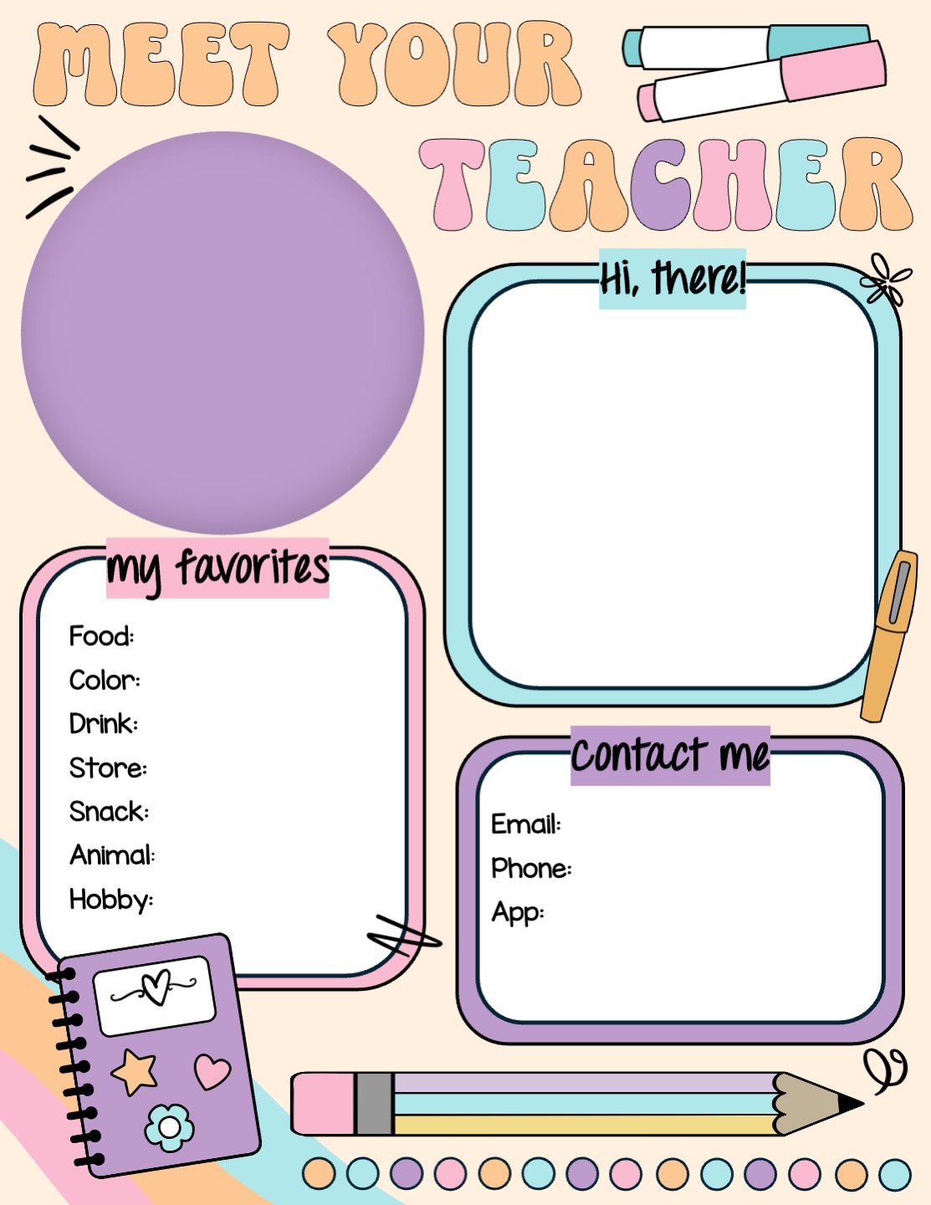
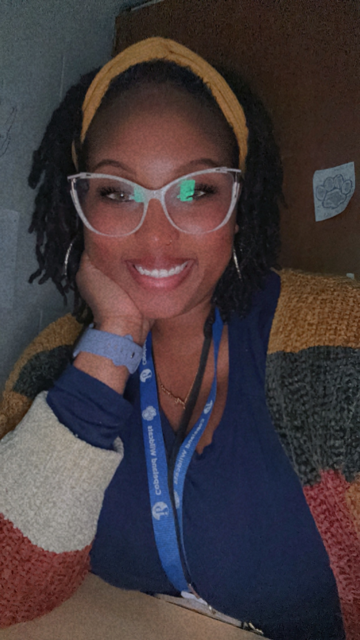
Welcome to Pre-K! My name is Ms. Williams. I have been teaching Pre-K for a total of nine years, and this will be my fourth year at Copeland Elementary School. I am so excited to have you in my class this year! I look forward to meeting you during Open House. See you soon!
Stuffed Salmon
Turquoise
Olipop
Ross / TJ Maxx
Salt & Vinegar Chips
WilliAk@BOE.Richmond.k12.ga.us
Elephants
Cooking
(229) – 305 – 1987
Class Dojo
***you can also write me in your child’s folder.

