Slide 1
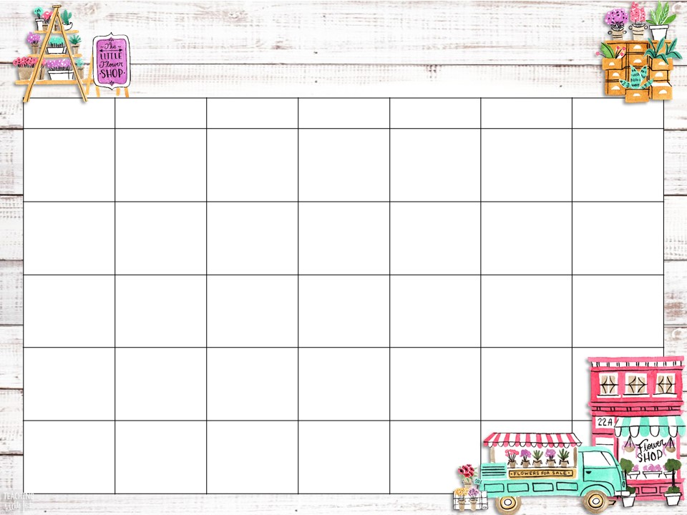





February 2022
Sunday | Monday | Tuesday | Wednesday | Thursday | Friday | Saturday
 |  | 1It’s Black History Month. In 1926, it was first celebrated as a week organized by Carter G. Woodson. It became a month long celebration in 1976. | 2 | 3Start a chain of hearts. Cut out small hearts. Each day, write a reason you love your child on one and attach it to the chain. | 4It’s International Friendship Month. Have your child plan to do a good deed for a friend. | 5Tell your child people learn when they try new things. Today, try a new food or take a new route home together.
6Read a news article with your child today | 7 | 8On Feb. 8, 1986, Oprah Winfrey becomes the first African American woman to host a nationally syndicated talk show. | 9On Feb. 9, 1995, Bernard Harris, African American astronaut, takes space walk. | 10Play board game as a family this evening. | 11Make a special effort to reinforce manners today. Remind your child to say please and thank you. | 12Have a 20-minute DEAR time (Drop Everything and Read)
13After our child goes to bed, leave a Valentine where he or she will see it first thing tomorrow morning. | 14On Feb. 14, 1867, Morehouse College was organized in Augusta, GA. The institution was later moved to Atlanta. Happy Valentine’s D Day | 15Set aside time today to work on a hobby with your child. | 16Have your child practice counting by 5’s. | 17Encourage your child to write a thank you note to a favorite teacher this month. | 18 Student Holiday | 19Talk to your child about people they admire. Ask why they admire them.
20Turn chores into a game. Assign each chore a number and have your child roll a die to see which one she or he gets. | 21 Holiday | 22On Feb. 22, 1979, Frank E. Peterson Jr. was named the first black general in the Marine Corps. Learn at Home | 23Teach your child how to sew on a button today. | 24At bedtime tonight, tell your child a story about yourself when you were their age. | 25On Feb. 25, 1948 Dr. Martin L. King Jr. became an ordained Baptist minister. | 26Have your child write a poem or story from the point of view of a family pet.
27Have your child read to you as you’re cleaning up after dinner. Or read to your child as he or she cleans up! | 28Talk about three ways you used math today. Ask everyone in the family to say how they used math.

